Slide 1
Thesis
Nazmul Arefin
Tapon Hassan

Slide 2
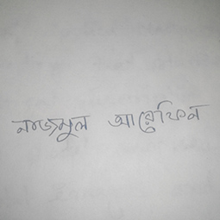
Original Image

Slide 3
Resized (255x255)

Slide 4
RGB to GRAYSCAL
im = imread('name.jpg');
IM = rgb2gray(im);

Slide 5
Adaptive thresholding & Binarizing
im = imread('name.jpg');
IM = rgb2gray(im);
T = adaptthresh(IM, 0.7);
%used adaptthresh to determine threshold to use in binarization operation.
BW = imbinarize(IM,T);
%Convert image to binary image, specifying the threshold value.
imshowpair(IM, BW, 'montage');

Slide 6
Adaptive threshold & Binarized
T = adaptthresh(I) computes a locally adaptive threshold that can be used with the imbinarize function to convert an intensity image to a binary image. The result, T, is a matrix the same size as I containing normalized intensity values in the range [0, 1]. adaptthresh chooses the threshold based on the local mean intensity (first-order statistics) in the neighborhood of each pixel.
T= adaptthresh(I,sensitivity) computes a locally adaptive threshold with sensitivity factor specified by sensitivity. Sensitivity is a scalar in the rang [0 1] that indicates sensitivity toward thresholding more pixels as foreground

Slide 7
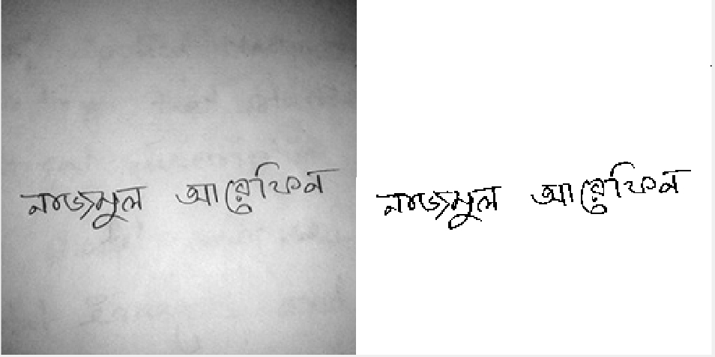
Adaptive threshold & Binarized

Slide 8
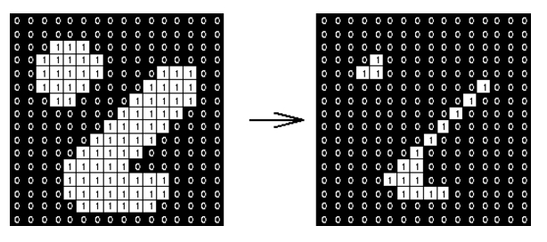
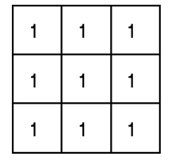
Morphological operation
Erosion: The erosion operator takes two pieces of data as inputs. The first is the image which is to be eroded. The second is a (usually small) set of coordinate points known as a structuring element(also known as a kernel). As an example of binary erosion, suppose that the structuring element is a 3×3 square, with the origin at its center as shown in Figure 1 The structuring element may have to be supplied as a small binary image. In this latter case, a 3×3 square structuring element is normally assumed which gives the shrinking effect. The effect of an erosion using this structuring element on a binary image is shown in Figure 2.

Slide 9
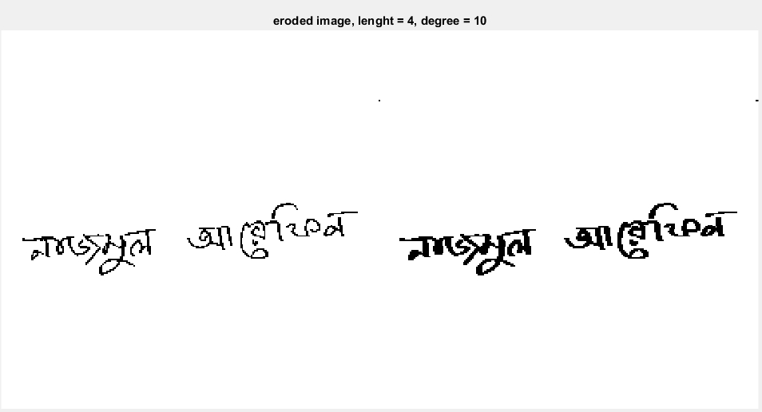
Morphological operation
Erosion:
se = strel('line',4,10);
erodedI = imerode(BW,se);

Slide 10
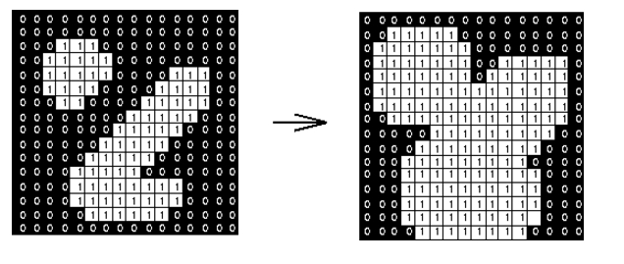
Morphological operation
Dilation: The basic effect of the operator on a binary image is to gradually enlarge the boundaries of regions of foreground pixels (i.e. white pixels, typically). Thus areas of foreground pixels grow in size while holes within those regions become smaller.
As an example of binary dilation, suppose that the structuring element is a 3×3 square, with the origin at its center, as shown in Figure 1. Note that in this and subsequent diagrams, foreground pixels are represented by 1's and background pixels by 0's.
The structuring element may have to be supplied as a small binary image. In this latter case, a 3×3 square structuring element is normally assumed which gives the expansion effect. The effect of a dilation using this structuring element on a binary image is shown in Figure 2.

Slide 11
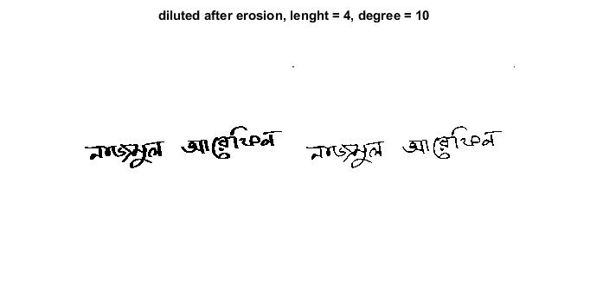
Morphological operation
Dilation:
se1 = strel('line',4,10);
BW2 = imdilate(erodedI,se1);

Slide 12
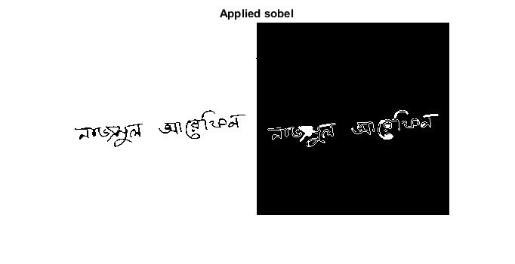
Edge detected by sobel
p_edge = edge(IM, 'Sobel');
bw = bwareaopen(imfill(p_edge, 'holes'),5);

Slide 13

Edge detected by Canny
BW3 = edge(BW2,'Canny');

