Slide 1
Thesis-7

Slide 2
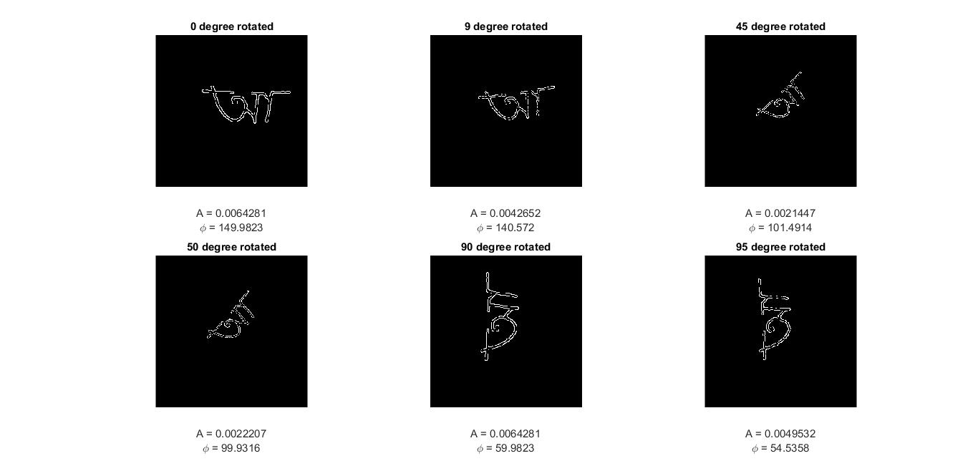
Image - 1

Slide 3
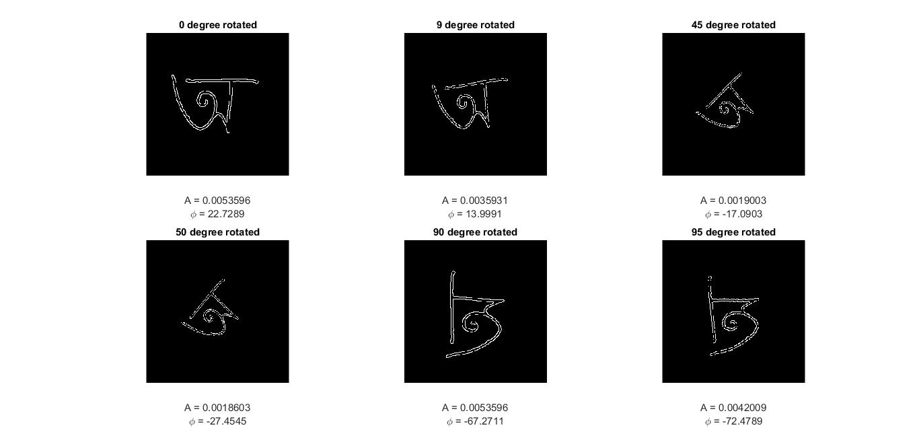
Image - 1

Slide 4
Result of Zernike moment for image-1
 | Original | 9 degree | 45 degree | 50 degree | 90 degree | 95 degree
A | 0.0064281 | 0.0042652 | 0.0021447 | 0.0022207 | 0.0064281 | 0.0049532
ɸ | 149.9823 | 140.572 | 101.4914 | 99.9316 | 59.9823 | 54.5358
Here we can observe that, Amplitude of the moment for image 1 in different angel is close.

Slide 5
Result of Zernike moment for image-1
 | Original | 9 degree | 45 degree | 50 degree | 90 degree | 95 degree
A | 0.0053596 | 0.0035931 | 0.0019003 | 0.0018603 | 0.0053596 | 0.0042009
ɸ | 22.7289 | 13.9991 | -17.0903 | -27.4545 | -67.2711 | -72.4789
Here we can observe that, Amplitude of the moment for image 2 in different angel is close.

Slide 6
Conclusion
From the results of 2 different images we can observe that the Amplitude of the moment are different for “O” and “A”
But for different the Amplitude of the moment of a particular image is close enough.

