Slide 1
Thesis-8
Zernike moment analysis

Slide 2
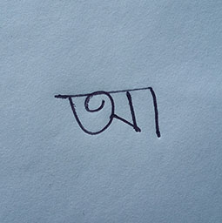
a_1.jpg

Slide 3
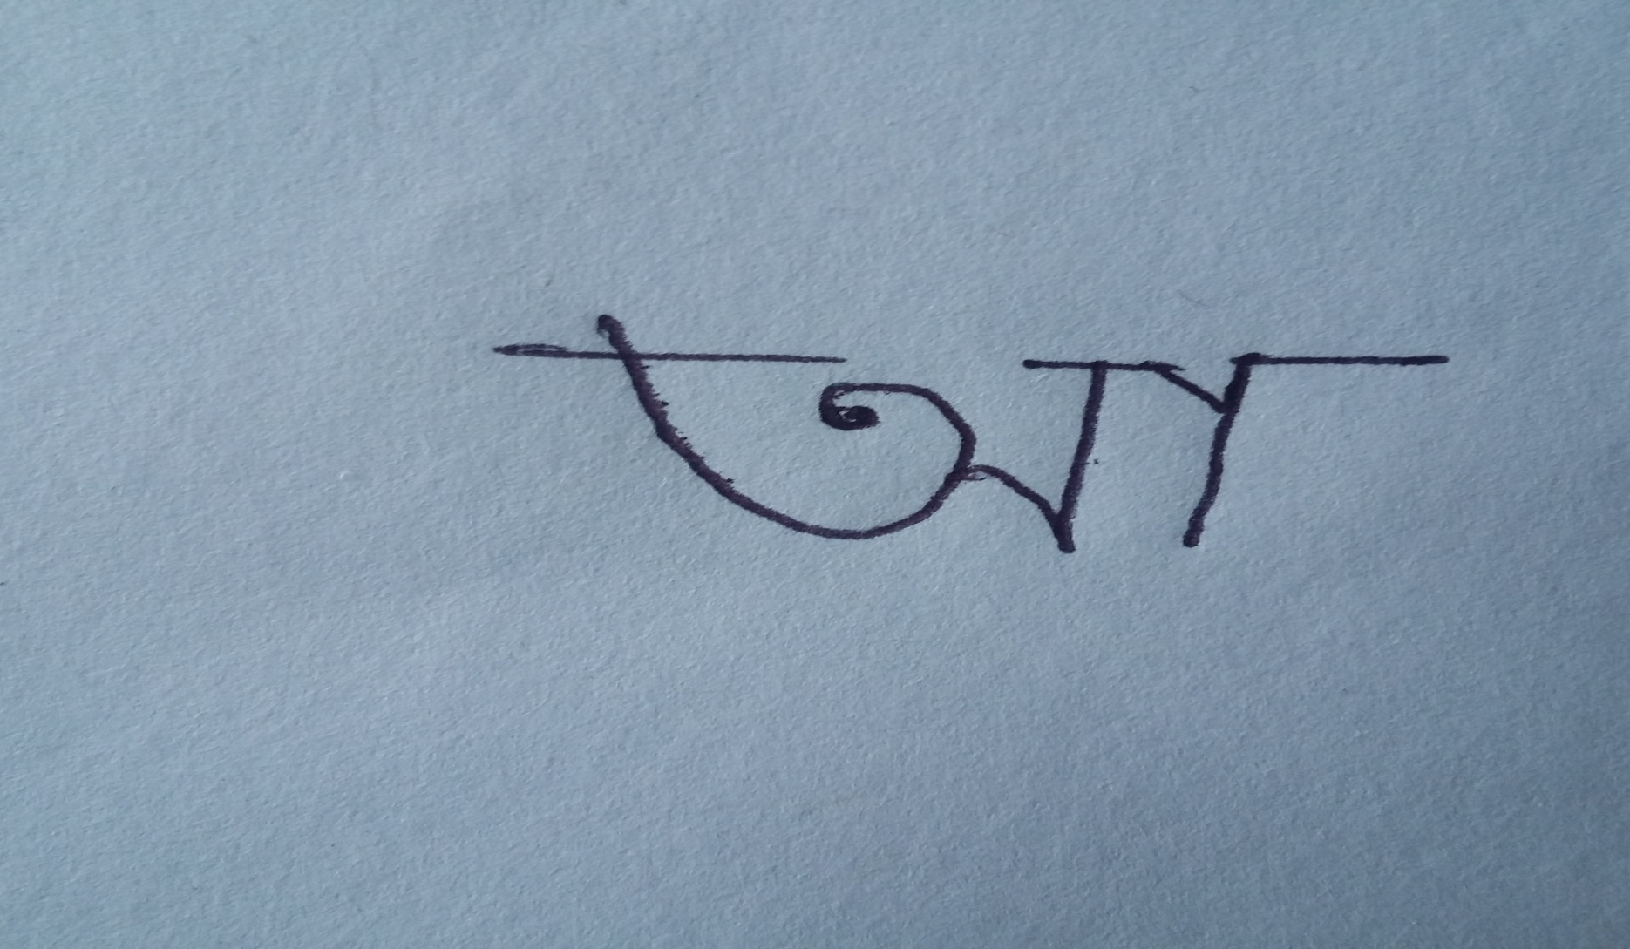
a_2.jpg

Slide 4
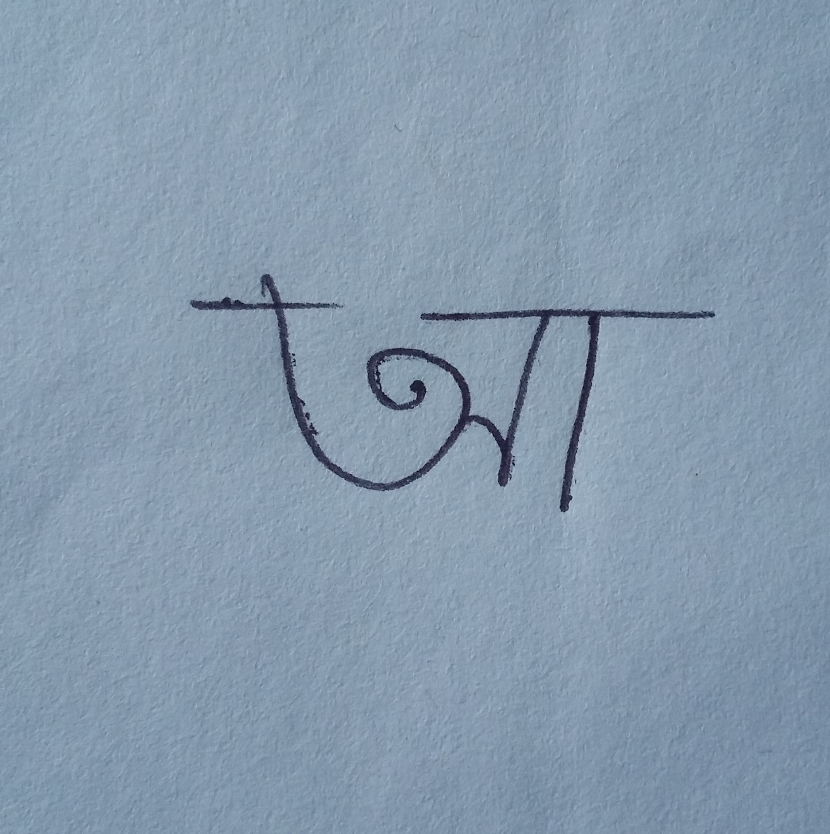
a_3.jpg

Slide 5
a_1.jpg:
Z_1 | Z_2 | original_1 | original_2 | nine_1 | nine_2 | fortyfive_1 | fortyfive_2 | fifty_1 | fifty_2 | ninety_1 | ninety_2 | ninetyfive_1 | ninetyfive_2
0 | 0 | 0.00072114 | 114.3067003 | 0.000451944 | 107.8034578 | 0.000248684 | 63.14501548 | 0.000278857 | 77.4626772 | 0.00072114 | 24.3067003 | 0.000547404 | 15.02190624
1 | 1 | 0.002324392 | -175.5959692 | 0.001355406 | 166.3882889 | 0.000540985 | 90.81807176 | 0.000598106 | 83.59791266 | 0.002324392 | 4.404030787 | 0.001663988 | -5.727739095
2 | 0 | 0.002276243 | -76.33850797 | 0.001496279 | -80.46978385 | 0.000890869 | -121.6192334 | 0.000974204 | -106.9564375 | 0.002276243 | -166.338508 | 0.001812148 | -173.8083884
2 | 2 | 0.000274665 | 99.63477223 | 0.000128689 | 75.49615517 | 5.20385E-05 | -41.80104197 | 4.5705E-05 | -47.11044487 | 0.000274665 | -170.3652278 | 0.000183642 | 172.5550586
3 | 1 | 0.009123102 | 2.887950727 | 0.005660862 | -14.75074856 | 0.002421572 | -89.77821197 | 0.002665607 | -97.14674399 | 0.009123102 | -177.1120493 | 0.006805693 | 173.0332023
3 | 3 | 0.000266205 | -66.49591393 | 0.000731427 | -3.640728494 | 0.000293308 | 4.135345194 | 0.000141104 | 9.187253675 | 0.000266205 | -66.49591393 | 0.001006641 | -6.079940546
4 | 0 | 0.003740214 | 81.93699698 | 0.002565964 | 82.71199129 | 0.001689358 | 49.51097217 | 0.001757163 | 64.22792644 | 0.003740214 | -8.063003016 | 0.0031361 | -11.05313739
4 | 2 | 0.001301692 | -81.38989393 | 0.000646407 | -105.2861715 | 0.000278544 | 137.708049 | 0.000246184 | 132.2196629 | 0.001301692 | 8.610106066 | 0.000904361 | -8.290872839
4 | 4 | 8.36242E-05 | 63.62641578 | 3.09122E-05 | 18.01582403 | 8.33465E-06 | -162.8733162 | 7.59576E-06 | 164.8693408 | 8.36242E-05 | -26.37358422 | 4.73343E-05 | -50.84570256
5 | 1 | 0.017415922 | -179.6523983 | 0.011970922 | 163.3843277 | 0.005721935 | 89.29857248 | 0.00625449 | 81.67331252 | 0.017415922 | 0.347601696 | 0.013909699 | -9.000949021
5 | 3 | 0.001710367 | 46.99066125 | 0.00189117 | 7.754355233 | 0.000302123 | -24.91571836 | 0.000137871 | -100.2374957 | 0.001710367 | 46.99066125 | 0.002426022 | 13.7039176
5 | 5 | 9.12354E-05 | -61.97858585 | 3.1021E-05 | -116.5815499 | 4.59232E-06 | 30.86671287 | 5.97303E-06 | 1.678646093 | 9.12354E-05 | 118.0214142 | 4.70965E-05 | 87.520372
6 | 0 | 0.005350719 | -126.7746778 | 0.003635391 | -122.7718748 | 0.002460658 | -144.263939 | 0.002368548 | -131.2599337 | 0.005350719 | 143.2253222 | 0.00447947 | 144.7729734
6 | 2 | 0.003058888 | 96.17221969 | 0.00166073 | 73.08310743 | 0.000788168 | -43.173029 | 0.000702552 | -48.91364839 | 0.003058888 | -173.8277803 | 0.002256885 | 169.879919
6 | 4 | 0.000511374 | -116.0621629 | 0.000202792 | -161.7594801 | 5.88898E-05 | 17.148531 | 5.37119E-05 | -14.87784399 | 0.000511374 | 153.9378371 | 0.000303344 | 129.2657249
6 | 6 | 2.18226E-05 | 68.38510093 | 6.43887E-06 | 3.828964078 | 1.02891E-06 | 111.6947745 | 1.11348E-06 | 67.09956328 | 2.18226E-05 | 158.3851009 | 1.0151E-05 | 124.9835202
7 | 1 | 0.021329796 | -3.715055283 | 0.017219793 | -19.46977426 | 0.009702095 | -91.99063435 | 0.0104955 | -100.0350891 | 0.021329796 | 176.2849447 | 0.018989454 | 167.8707589
7 | 3 | 0.003518656 | -117.8091056 | 0.000835617 | -122.172297 | 0.000895217 | 26.50765217 | 0.000855344 | 29.89984532 | 0.003518656 | -117.8091056 | 0.001546381 | -91.82633564
7 | 5 | 0.000617059 | 118.6819871 | 0.000226132 | 63.88076567 | 3.60867E-05 | -148.6261046 | 4.70229E-05 | -177.9830046 | 0.000617059 | -61.31801289 | 0.000334914 | -91.97070976
7 | 7 | 0.001796152 | -0.427580648 | 0.003754289 | -0.09995177 | 0.001191534 | -0.017938621 | 0.002078672 | -0.021877638 | 0.001796152 | -0.427580648 | 0.001096919 | -0.556526601
8 | 0 | 0.006985316 | 32.78722627 | 0.005074314 | 33.37344393 | 0.003227474 | 18.16786138 | 0.00290759 | 25.84142702 | 0.006985316 | -57.21277373 | 0.005998797 | -56.29410831
8 | 2 | 0.004686033 | -89.3726156 | 0.002901983 | -110.1939046 | 0.001584131 | 135.3082969 | 0.001426858 | 129.2471713 | 0.004686033 | 0.6273844 | 0.003788493 | -13.92349931
8 | 4 | 0.001572258 | 64.17225881 | 0.000684712 | 18.44597165 | 0.000219251 | -162.8513308 | 0.000200245 | 165.4290711 | 0.001572258 | -25.82774119 | 0.000992582 | -50.72364574
8 | 6 | 0.000158979 | -112.7002408 | 5.11754E-05 | -176.9743714 | 8.92396E-06 | -68.86007603 | 9.65284E-06 | -113.3973382 | 0.000158979 | -22.70024082 | 7.82035E-05 | -55.8763048
8 | 8 | 6.38038E-06 | 115.1288221 | 1.42088E-06 | 30.92293691 | 1.41481E-07 | 69.1286955 | 1.56023E-07 | 12.32581167 | 6.38038E-06 | 25.12882211 | 2.51631E-06 | -18.1829172

Slide 6
a_2.jpg
Z_1 | Z_2 | original_1 | original_2 | nine_1 | nine_2 | fortyfive_1 | fortyfive_2 | fifty_1 | fifty_2 | ninety_1 | ninety_2 | ninetyfive_1 | ninetyfive_2
0 | 0 | 0.006428108 | 149.9822643 | 0.004265156 | 140.571962 | 0.00214475 | 101.4913768 | 0.00222071 | 99.93162094 | 0.006428108 | 59.98226433 | 0.004953174 | 54.53580061
1 | 1 | 0.004244655 | 160.4368564 | 0.002476229 | 142.1315334 | 0.000965281 | 73.0683035 | 0.001035812 | 60.05566234 | 0.004244655 | -19.56314359 | 0.003016357 | -29.27792723
2 | 0 | 0.015028611 | -35.24101457 | 0.011590818 | -43.01184113 | 0.006829591 | -80.97938686 | 0.007035747 | -82.02710852 | 0.015028611 | -125.2410146 | 0.012804871 | -129.6148503
2 | 2 | 0.003552064 | 130.3275031 | 0.001822622 | 103.0481996 | 0.000595222 | -3.739564751 | 0.000611674 | -19.60683523 | 0.003552064 | -139.6724969 | 0.002340728 | -154.728603
3 | 1 | 0.011258617 | -10.36960438 | 0.007891123 | -32.05371737 | 0.003668194 | -103.1544773 | 0.003945289 | -116.856409 | 0.011258617 | 169.6303956 | 0.009037485 | 157.779531
3 | 3 | 0.002140188 | 96.64829713 | 0.001533305 | 36.37842698 | 0.000415214 | -36.54409413 | 0.000279803 | -72.7343733 | 0.002140188 | 96.64829713 | 0.001846457 | 45.44593235
4 | 0 | 0.014649201 | 132.0303036 | 0.013776479 | 128.6222412 | 0.010544126 | 94.04844399 | 0.010723848 | 93.95698806 | 0.014649201 | 42.03030364 | 0.014209509 | 40.57860048
4 | 2 | 0.011124343 | -46.17228146 | 0.00693426 | -74.80449479 | 0.002718309 | 177.6267111 | 0.002781865 | 161.5474922 | 0.011124343 | 43.82771854 | 0.008340886 | 27.87938169
4 | 4 | 0.001686039 | 88.01574267 | 0.00066454 | 42.7165351 | 0.000138975 | -136.3453262 | 0.000147608 | -161.2044801 | 0.001686039 | -1.984257333 | 0.000943341 | -26.93024441
5 | 1 | 0.013376102 | -170.396139 | 0.011408406 | 160.2047043 | 0.006817299 | 83.88043576 | 0.007341838 | 68.8655781 | 0.013376102 | 9.603861041 | 0.012175886 | -7.119312301
5 | 3 | 0.006591475 | -74.82196692 | 0.003576486 | -95.9044184 | 0.001231143 | 85.27498253 | 0.0013583 | 77.41385361 | 0.006591475 | -74.82196692 | 0.004793773 | -78.53562938
5 | 5 | 0.001419343 | 65.11254079 | 0.000488497 | 10.93687763 | 8.42584E-05 | 155.4067909 | 8.81842E-05 | 126.1619346 | 0.001419343 | -114.8874592 | 0.000733206 | -144.835451
6 | 0 | 0.010389434 | -68.40786175 | 0.010863602 | -68.03836841 | 0.011304345 | -94.73274514 | 0.011150829 | -93.46622594 | 0.010389434 | -158.4078617 | 0.010771321 | -157.5389741
6 | 2 | 0.016092057 | 140.6854161 | 0.012398188 | 109.245187 | 0.006205336 | -0.086233584 | 0.006301926 | -16.49393302 | 0.016092057 | -129.3145839 | 0.013813391 | -147.0770551
6 | 4 | 0.005339321 | -89.87285109 | 0.00287093 | -136.1844108 | 0.000767986 | 44.44861764 | 0.000819718 | 19.40558154 | 0.005339321 | -179.8728511 | 0.003672798 | 154.5178259
6 | 6 | 0.001119826 | 45.09954463 | 0.000336715 | -18.06618821 | 4.73148E-05 | 90.15862529 | 4.95451E-05 | 56.40055518 | 0.001119826 | 135.0995446 | 0.000532397 | 100.2240735
7 | 1 | 0.012385841 | 36.37105873 | 0.011352553 | 2.084435116 | 0.008646289 | -83.9605991 | 0.009245375 | -101.2369257 | 0.012385841 | -143.6289413 | 0.011835016 | -162.5361432
7 | 3 | 0.007249501 | 95.23964195 | 0.007375403 | 54.00379157 | 0.003132283 | -69.81898616 | 0.003179952 | -93.65127291 | 0.007249501 | 95.23964195 | 0.007614157 | 64.50514899
7 | 5 | 0.005127 | -116.8759137 | 0.002393583 | -170.172543 | 0.000527467 | -25.08344642 | 0.00055244 | -54.38037283 | 0.005127 | 63.12408626 | 0.003247593 | 33.75821461
7 | 7 | 0.002625802 | 9.461812014 | 0.003932621 | -2.46510238 | 0.001215619 | 0.615952855 | 0.00210695 | -0.147901278 | 0.002625802 | 9.461812014 | 0.001491406 | -3.209310564
8 | 0 | 0.005837912 | 91.59733633 | 0.00747084 | 90.09219163 | 0.009903168 | 71.98883918 | 0.009184101 | 74.12965313 | 0.005837912 | 1.597336334 | 0.00714058 | 3.087901367
8 | 2 | 0.017190186 | -30.86502607 | 0.014856882 | -64.19532158 | 0.009669559 | -176.5203395 | 0.009686579 | 166.6308903 | 0.017190186 | 59.13497393 | 0.015721464 | 40.64550717
8 | 4 | 0.006093422 | 100.0486685 | 0.005317586 | 47.09786994 | 0.002038501 | -133.9529922 | 0.002195094 | -159.3515957 | 0.006093422 | 10.04866854 | 0.005791789 | -20.46332554
8 | 6 | 0.004271478 | -139.0588376 | 0.001782673 | 159.6833617 | 0.000324051 | -90.97970767 | 0.000339611 | -124.682215 | 0.004271478 | -49.05883757 | 0.002527665 | -82.62130176
8 | 8 | 0.000762626 | 9.650380804 | 0.000174379 | -71.55822502 | 1.64271E-05 | -35.38258543 | 1.71323E-05 | -78.95920277 | 0.000762626 | -80.3496192 | 0.000307704 | -125.1379478

Slide 7
a_3.jpg
Z_1 | Z_2 | original_1 | original_2 | nine_1 | nine_2 | fortyfive_1 | fortyfive_2 | fifty_1 | fifty_2 | ninety_1 | ninety_2 | ninetyfive_1 | ninetyfive_2
0 | 0 | 0.004400854 | 134.8954406 | 0.002985478 | 127.1274368 | 0.001755255 | 95.84628157 | 0.00160019 | 85.3042012 | 0.004400854 | 44.89544062 | 0.003408157 | 39.63894508
1 | 1 | 0.003564653 | 167.4869198 | 0.002097187 | 148.5141562 | 0.000977433 | 69.6244798 | 0.00089995 | 67.88275431 | 0.003564653 | -12.51308021 | 0.002552907 | -22.29746847
2 | 0 | 0.011125697 | -47.33602823 | 0.008569944 | -54.32657321 | 0.005661565 | -84.99579512 | 0.005229546 | -95.5564681 | 0.011125697 | -137.3360282 | 0.009372335 | -142.1362265
2 | 2 | 0.002902772 | 110.4499762 | 0.001486156 | 83.54537853 | 0.000548382 | -24.92721496 | 0.000518915 | -39.24412628 | 0.002902772 | -159.5500238 | 0.001913365 | -174.8015153
3 | 1 | 0.011163322 | -7.91317339 | 0.007463077 | -28.42793655 | 0.003925978 | -108.6882338 | 0.003646533 | -110.2875915 | 0.011163322 | 172.0868266 | 0.008705981 | 161.3111293
3 | 3 | 0.001142847 | 60.32276574 | 0.001261289 | 13.57763042 | 0.000293021 | -34.84185746 | 0.000110871 | -73.05848745 | 0.001142847 | 60.32276574 | 0.001601679 | 18.18102005
4 | 0 | 0.011714178 | 131.4829946 | 0.011028744 | 124.1107583 | 0.00883313 | 93.72182818 | 0.008378464 | 83.26190493 | 0.011714178 | 41.48299459 | 0.01125942 | 36.22867652
4 | 2 | 0.009981255 | -70.33252532 | 0.005994587 | -97.01300249 | 0.002564607 | 154.5858206 | 0.002440153 | 140.4310876 | 0.009981255 | 19.66747468 | 0.007305287 | 4.577517272
4 | 4 | 0.001112489 | 85.40377217 | 0.000442122 | 39.8719203 | 0.00011434 | -145.6853858 | 0.000100945 | -164.0742128 | 0.001112489 | -4.596227832 | 0.00062634 | -29.77397523
5 | 1 | 0.01612302 | 177.3203512 | 0.012700353 | 155.7443833 | 0.007928842 | 73.93173646 | 0.007467777 | 72.37161197 | 0.01612302 | -2.679648828 | 0.014001816 | -14.05029584
5 | 3 | 0.003207962 | -116.3207873 | 0.00109782 | -117.2764131 | 0.001038714 | 54.23948238 | 0.000773846 | 40.32896543 | 0.003207962 | -116.3207873 | 0.001599984 | -96.41206245
5 | 5 | 0.000955526 | 42.25540493 | 0.000329058 | -11.22805804 | 6.80426E-05 | 133.6267316 | 6.15591E-05 | 103.2041406 | 0.000955526 | -137.7445951 | 0.00049512 | -168.114275
6 | 0 | 0.007702055 | -38.57163378 | 0.008978132 | -54.16145901 | 0.009261182 | -87.4769198 | 0.009224088 | -97.49224858 | 0.007702055 | -128.5716338 | 0.008457762 | -139.9817968
6 | 2 | 0.014885523 | 109.2408896 | 0.011261011 | 82.40936081 | 0.00598179 | -26.10198646 | 0.00574086 | -39.96716437 | 0.014885523 | -160.7591104 | 0.012658935 | -175.9551828
6 | 4 | 0.004264684 | -92.0491742 | 0.002129981 | -138.7655494 | 0.000673823 | 34.40948658 | 0.000594071 | 16.72749372 | 0.004264684 | 177.9508258 | 0.002793813 | 152.0205454
6 | 6 | 0.00051454 | 30.29280887 | 0.000157743 | -32.13163915 | 2.91319E-05 | 74.0628146 | 2.37293E-05 | 41.60463722 | 0.00051454 | 120.2928089 | 0.00024521 | 85.23587153
7 | 1 | 0.015689626 | -4.169719806 | 0.014488501 | -21.32927658 | 0.011076471 | -102.6773436 | 0.01062141 | -104.5919948 | 0.015689626 | 175.8302802 | 0.015047208 | 167.8421995
7 | 3 | 0.005539519 | 22.94051146 | 0.005111927 | 8.876464261 | 0.002056908 | -98.70606658 | 0.001512577 | -135.1952507 | 0.005539519 | 22.94051146 | 0.006077565 | 12.54195354
7 | 5 | 0.004427391 | -143.0152429 | 0.001859123 | 165.4920572 | 0.000459719 | -48.13216685 | 0.000417349 | -78.65338608 | 0.004427391 | 36.9847571 | 0.002618092 | 7.945083493
7 | 7 | 0.002265607 | 3.85111848 | 0.003835439 | -1.63993468 | 0.001208847 | 0.219747075 | 0.002093859 | -0.1663529 | 0.002265607 | 3.85111848 | 0.001303512 | -3.847734326
8 | 0 | 0.004525558 | 174.7759001 | 0.005513704 | 140.4101898 | 0.007156412 | 93.41512065 | 0.00778714 | 84.21702722 | 0.004525558 | 84.77590007 | 0.005065995 | 61.14875379
8 | 2 | 0.012639463 | -68.75678961 | 0.013026112 | -97.63578355 | 0.009305536 | 153.0315447 | 0.009046871 | 139.6750028 | 0.012639463 | 21.24321039 | 0.013085266 | 4.556057791
8 | 4 | 0.006543832 | 94.50158119 | 0.004632124 | 43.98629341 | 0.001958044 | -145.3864171 | 0.001723291 | -161.9461697 | 0.006543832 | 4.501581186 | 0.005417131 | -24.1199953
8 | 6 | 0.00222948 | -156.07699 | 0.00089652 | 144.3438991 | 0.000210307 | -107.7489075 | 0.000168953 | -140.32343 | 0.00222948 | -66.07699 | 0.001269615 | -99.22442048
8 | 8 | 0.000356256 | -12.17268683 | 8.22062E-05 | -92.49792749 | 9.44682E-06 | -56.40481527 | 8.2718E-06 | -100.5282481 | 0.000356256 | -102.1726868 | 0.000144327 | -147.548833

Slide 8
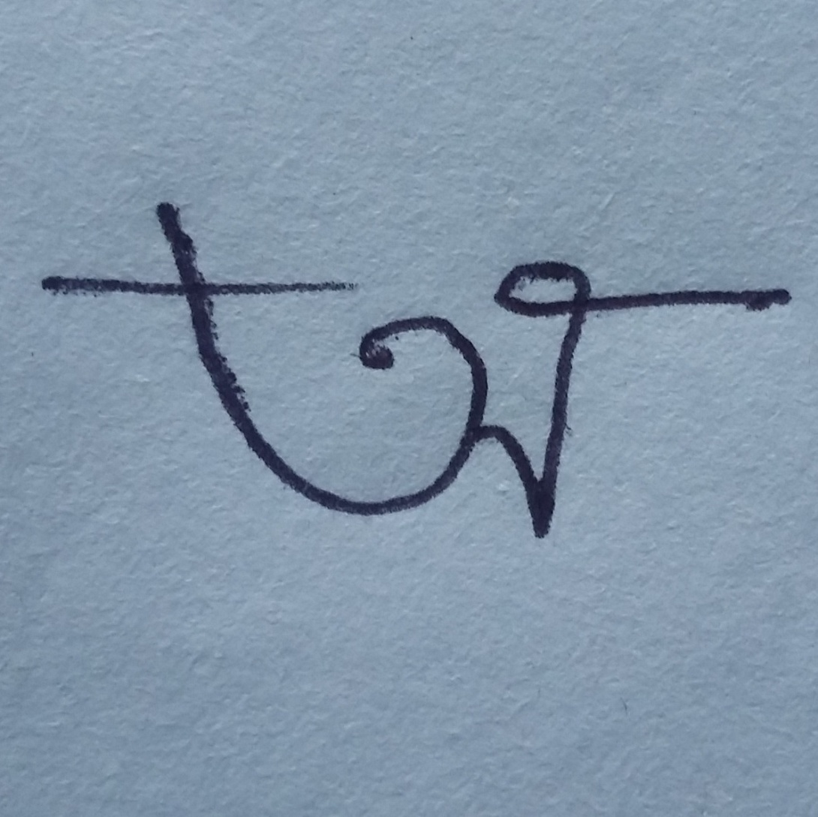
o_1.jpg

Slide 9
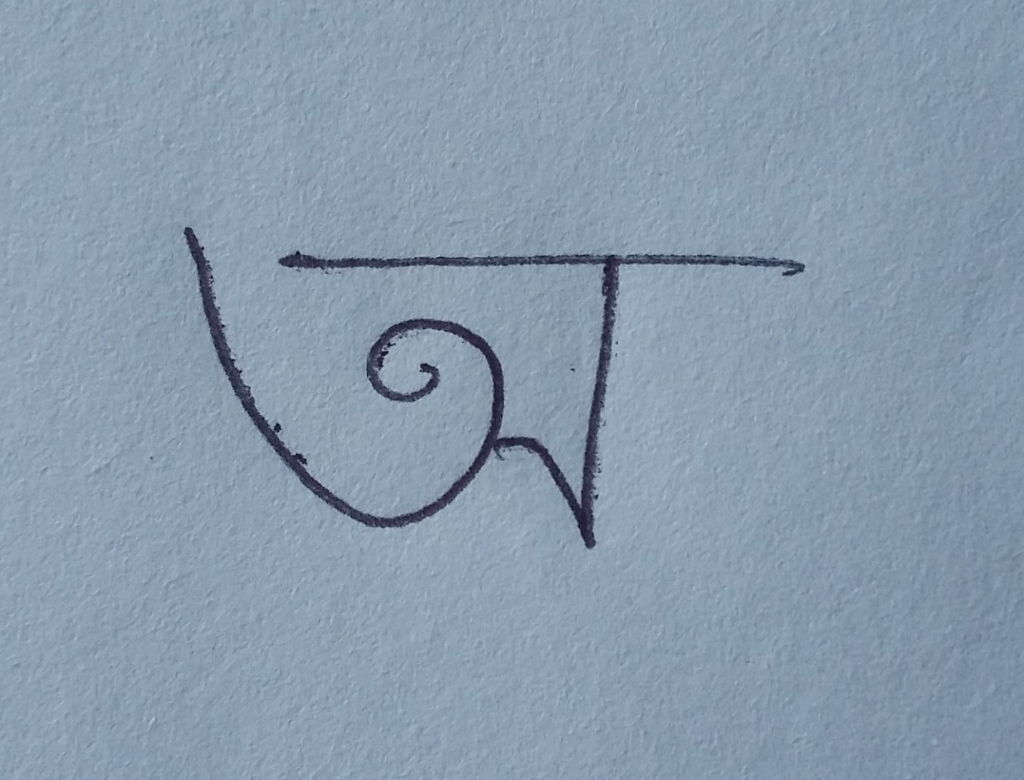
o_2.jpg

Slide 10
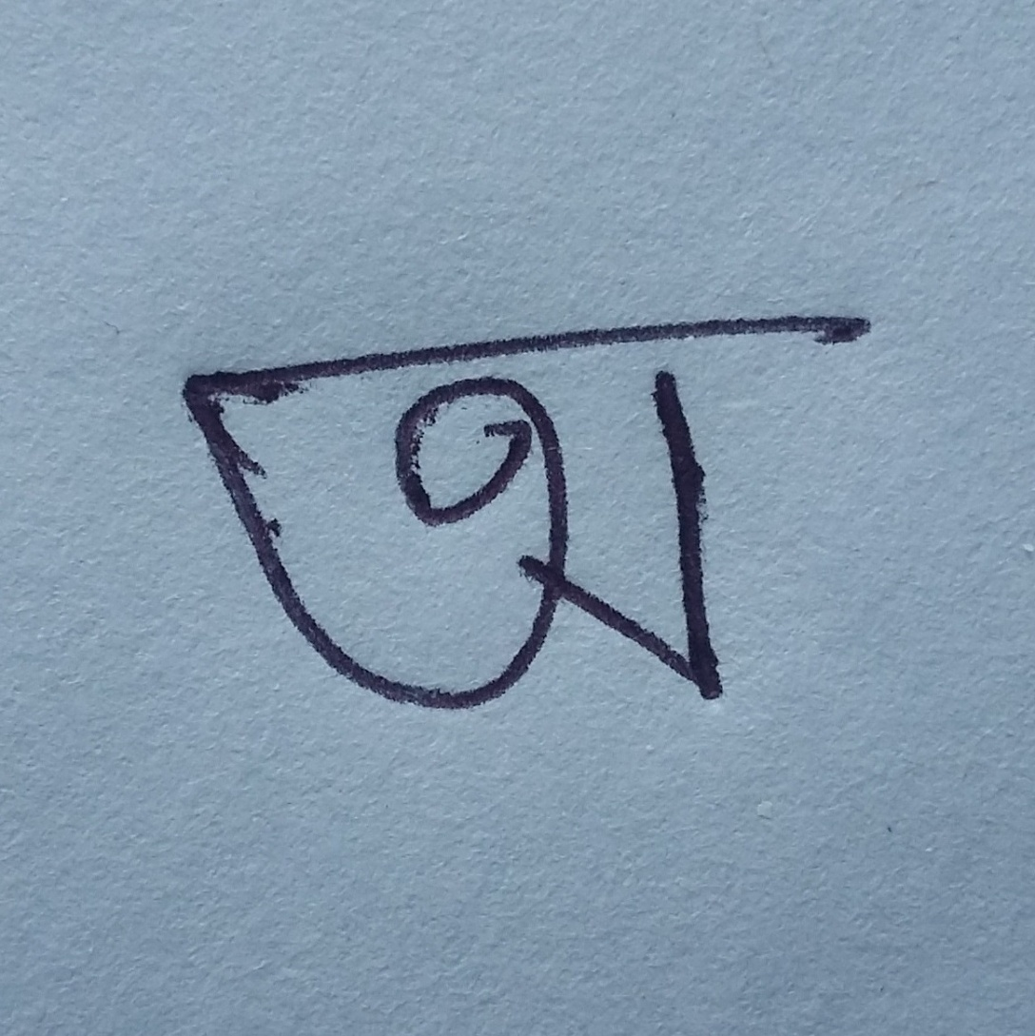
o_3.jpg

Slide 11
o_1.jpg
Z_1 | Z_2 | original_1 | original_2 | nine_1 | nine_2 | fortyfive_1 | fortyfive_2 | fifty_1 | fifty_2 | ninety_1 | ninety_2 | ninetyfive_1 | ninetyfive_2
0 | 0 | 0.005266987 | 89.7195007 | 0.00355743 | 82.60097817 | 0.001872476 | 39.5168198 | 0.001862759 | 39.02007517 | 0.005266987 | -0.280499302 | 0.00413886 | -5.769355987
1 | 1 | 0.008949547 | -171.3669981 | 0.005178406 | 170.1131901 | 0.00219636 | 101.4440235 | 0.002217854 | 87.0321474 | 0.008949547 | 8.633001915 | 0.006427038 | -1.085170629
2 | 0 | 0.006515288 | -74.19891354 | 0.006833311 | -88.39027926 | 0.004862428 | -137.1362738 | 0.004810208 | -139.9589307 | 0.006515288 | -164.1989135 | 0.006821738 | -175.4399294
2 | 2 | 0.010331945 | 95.07372401 | 0.005243786 | 67.81408194 | 0.001788904 | -40.1996029 | 0.001849274 | -53.66560004 | 0.010331945 | -174.926276 | 0.006839316 | 170.0070709
3 | 1 | 0.012806775 | 8.814350665 | 0.011744955 | -10.04171668 | 0.007146139 | -78.25040708 | 0.007066925 | -92.39450157 | 0.012806775 | -171.1856493 | 0.012685675 | 178.9407753
3 | 3 | 0.000765729 | -20.54507766 | 0.000950116 | -12.93280218 | 0.000193151 | 19.17404509 | 4.80674E-05 | -17.88597586 | 0.000765729 | -20.54507766 | 0.001377099 | -11.63487274
4 | 0 | 0.009261962 | -178.799335 | 0.006061419 | 143.3135128 | 0.004900551 | 59.05986258 | 0.004706491 | 50.64607755 | 0.009261962 | 91.20066501 | 0.006516633 | 72.25111963
4 | 2 | 0.015640559 | -92.29266704 | 0.013552904 | -115.3163202 | 0.006774211 | 138.439425 | 0.006898444 | 124.376804 | 0.015640559 | -2.292667037 | 0.015019348 | -14.33469323
4 | 4 | 0.00851803 | 102.5580043 | 0.003302753 | 57.11785861 | 0.00070651 | -121.5960655 | 0.000767392 | -147.9490286 | 0.00851803 | 12.55800429 | 0.004760728 | -12.23177656
5 | 1 | 0.011892852 | 163.262284 | 0.010486237 | 160.2756404 | 0.010325785 | 100.4520314 | 0.009840607 | 86.63159487 | 0.011892852 | -16.73771597 | 0.010441789 | -16.04276949
5 | 3 | 0.007019292 | 154.9311009 | 0.00248457 | 94.67696486 | 0.001236048 | -21.26318821 | 0.000776456 | -21.58015747 | 0.007019292 | 154.9311009 | 0.003277707 | 114.8907477
5 | 5 | 0.005190769 | 22.65462815 | 0.001732836 | -32.38194924 | 0.000316057 | 111.7054391 | 0.000346008 | 88.77201755 | 0.005190769 | -157.3453719 | 0.002666746 | 172.6190534
6 | 0 | 0.012303131 | 21.89175013 | 0.010451848 | 3.515300493 | 0.004524159 | -59.65812434 | 0.003634068 | -67.15235825 | 0.012303131 | -68.10824987 | 0.01173071 | -78.41226313
6 | 2 | 0.009303985 | 73.44660081 | 0.012708172 | 57.04349207 | 0.011424506 | -44.013461 | 0.01137274 | -59.39491716 | 0.009303985 | 163.4466008 | 0.011280991 | 154.1840176
6 | 4 | 0.010024882 | -70.70042473 | 0.009239855 | -120.8300857 | 0.003259268 | 59.48519268 | 0.003491372 | 33.05497065 | 0.010024882 | -160.7004247 | 0.010531433 | 170.92721
6 | 6 | 0.004720831 | 93.78375235 | 0.001407912 | 31.16454289 | 0.000185067 | 138.6971163 | 0.00021775 | 97.7447388 | 0.004720831 | -176.2162476 | 0.002235354 | 149.0000934
7 | 1 | 0.011615928 | -29.5596108 | 0.009428548 | -45.91837314 | 0.00928684 | -87.62672686 | 0.008380966 | -102.3225661 | 0.011615928 | 150.4403892 | 0.011072866 | 140.1539506
7 | 3 | 0.01102412 | -8.413417241 | 0.008975203 | -46.03455383 | 0.002682367 | 149.4889383 | 0.002544262 | 139.9673931 | 0.01102412 | -8.413417241 | 0.011349811 | -30.75573139
7 | 5 | 0.01178091 | -169.3191575 | 0.006711795 | 142.4066602 | 0.001786704 | -70.86964183 | 0.001912218 | -94.48966425 | 0.01178091 | 10.6808425 | 0.008766381 | -14.28076046
7 | 7 | 0.008655158 | 15.98165192 | 0.005046453 | -16.39571132 | 0.00138242 | 2.860052221 | 0.002296769 | -1.731746178 | 0.008655158 | 15.98165192 | 0.004071132 | -14.6944547
8 | 0 | 0.010420826 | -146.4891372 | 0.010953722 | -166.4095464 | 0.00816205 | 154.4108799 | 0.007340084 | 150.1092041 | 0.010420826 | 123.5108628 | 0.010761198 | 112.4505921
8 | 2 | 0.002512926 | -162.8586308 | 0.005580882 | -144.2997536 | 0.010967719 | 131.3351059 | 0.010627908 | 112.6429146 | 0.002512926 | -72.85863082 | 0.004259488 | -56.8077756
8 | 4 | 0.002751506 | 80.73833013 | 0.008138633 | 60.94074753 | 0.006649555 | -119.0555474 | 0.006969847 | -145.5328573 | 0.002751506 | -9.261669872 | 0.00592422 | -7.433736682
8 | 6 | 0.002018251 | -38.77913676 | 0.003701349 | -143.4945762 | 0.000943392 | -38.9369408 | 0.001105309 | -80.81617972 | 0.002018251 | 51.22086324 | 0.003975299 | -22.36499266
8 | 8 | 0.001775188 | 36.20654296 | 0.000386076 | -42.29401235 | 3.68103E-05 | -14.84237783 | 5.56053E-05 | -61.58894651 | 0.001775188 | -53.79345704 | 0.000713469 | -97.52841147

Slide 12
o_2.jpg
Z_1 | Z_2 | original_1 | original_2 | nine_1 | nine_2 | fortyfive_1 | fortyfive_2 | fifty_1 | fifty_2 | ninety_1 | ninety_2 | ninetyfive_1 | ninetyfive_2
0 | 0 | 0.005359591 | 22.72891405 | 0.003593101 | 13.99905948 | 0.001900275 | -17.09025349 | 0.001860276 | -27.45450461 | 0.005359591 | -67.27108595 | 0.004200867 | -72.47886112
1 | 1 | 0.00259957 | 179.9839216 | 0.001527704 | 162.6828497 | 0.000641639 | 90.72483294 | 0.000657576 | 77.55124443 | 0.00259957 | -0.016078445 | 0.001904683 | -11.14366523
2 | 0 | 0.011556318 | -162.1456331 | 0.009301202 | -168.896131 | 0.005805285 | 161.8976938 | 0.005694815 | 150.8188629 | 0.011556318 | 107.8543669 | 0.010246908 | 103.6981599
2 | 2 | 0.002986524 | 62.92639785 | 0.001521272 | 35.46915966 | 0.000574915 | -73.21797977 | 0.000534392 | -88.00818105 | 0.002986524 | 152.9263978 | 0.001995025 | 138.0383994
3 | 1 | 0.005955712 | -19.55624681 | 0.004406901 | -28.71027484 | 0.002283233 | -96.09295622 | 0.002372958 | -108.8564069 | 0.005955712 | 160.4437532 | 0.005142671 | 154.8525952
3 | 3 | 0.001563293 | -36.25520491 | 0.001126639 | -31.67304642 | 0.000199652 | 43.40408263 | 0.000155038 | 75.62449887 | 0.001563293 | -36.25520491 | 0.001695564 | -25.55606979
4 | 0 | 0.007348317 | -2.8657982 | 0.009042867 | 2.41835875 | 0.008001153 | -20.54496539 | 0.007866073 | -33.23668453 | 0.007348317 | -92.8657982 | 0.008752415 | -89.04791305
4 | 2 | 0.008756127 | -124.5475674 | 0.005549033 | -149.2466022 | 0.002582675 | 104.1515603 | 0.002387196 | 89.63005259 | 0.008756127 | -34.54756742 | 0.006771235 | -47.35924789
4 | 4 | 0.000904425 | 111.7615192 | 0.000357335 | 66.69456765 | 8.59319E-05 | -111.1997427 | 8.19984E-05 | -142.3056178 | 0.000904425 | 21.76151921 | 0.000509036 | -4.357128921
5 | 1 | 0.00591277 | 92.11387572 | 0.004877934 | 118.5752899 | 0.00365803 | 69.03161581 | 0.003899747 | 57.46086681 | 0.00591277 | -87.88612428 | 0.005364242 | -67.87153357
5 | 3 | 0.004179032 | 148.3254378 | 0.002383036 | 80.14150067 | 0.001272246 | -31.15967384 | 0.000939545 | -52.13563756 | 0.004179032 | 148.3254378 | 0.002544436 | 98.24642479
5 | 5 | 0.001074754 | -20.23141488 | 0.00036675 | -74.46519737 | 7.07606E-05 | 68.99755829 | 6.66779E-05 | 36.9652491 | 0.001074754 | 159.7685851 | 0.000560921 | 129.7241004
6 | 0 | 0.00529166 | 73.81672924 | 0.003612817 | 133.7896585 | 0.006281685 | 152.49981 | 0.006187611 | 135.5786978 | 0.00529166 | -16.18327076 | 0.003934154 | 16.20629377
6 | 2 | 0.009156937 | 35.25614205 | 0.008557618 | 20.74014759 | 0.00562016 | -80.39218693 | 0.005131294 | -94.481998 | 0.009156937 | 125.256142 | 0.009179556 | 120.347922
6 | 4 | 0.00295447 | -80.59853199 | 0.001559741 | -120.1435039 | 0.000481333 | 65.29122396 | 0.000465456 | 34.22794658 | 0.00295447 | -170.598532 | 0.002034038 | 166.8129917
6 | 6 | 0.000555365 | -143.4834438 | 0.00016568 | 152.5019904 | 2.70706E-05 | -101.314442 | 2.26778E-05 | -136.4358993 | 0.000555365 | -53.48344382 | 0.000262051 | -87.81433152
7 | 1 | 0.012833766 | -161.1665914 | 0.006260052 | -143.5701793 | 0.003691616 | -148.6647948 | 0.004009883 | -156.1252964 | 0.012833766 | 18.83340857 | 0.008513659 | 30.37051461
7 | 3 | 0.007852274 | 1.537456162 | 0.005813484 | -42.06504096 | 0.002083022 | 136.0732215 | 0.00207191 | 123.3596185 | 0.007852274 | 1.537456162 | 0.007688841 | -22.98663702
7 | 5 | 0.004450603 | 153.3517436 | 0.0019349 | 101.7999036 | 0.000464938 | -113.1817891 | 0.000440263 | -145.0988615 | 0.004450603 | -26.64825644 | 0.002744893 | -54.86664847
7 | 7 | 0.002085052 | 6.010188646 | 0.003835601 | -0.874524373 | 0.001201037 | 0.372744039 | 0.002089239 | -0.054071591 | 0.002085052 | 6.010188646 | 0.001252697 | -0.610736976
8 | 0 | 0.007840721 | -135.1497256 | 0.005924688 | -133.7305932 | 0.002325896 | -67.93381153 | 0.00283994 | -99.38802754 | 0.007840721 | 134.8502744 | 0.00723291 | 135.995789
8 | 2 | 0.005925611 | 145.9434077 | 0.006935557 | 174.003438 | 0.007786733 | 91.52681793 | 0.006908313 | 78.00647178 | 0.005925611 | -124.0565923 | 0.006151558 | -98.20066051
8 | 4 | 0.003176748 | 64.0870531 | 0.002793309 | 46.48001751 | 0.001286596 | -120.2847635 | 0.001271146 | -151.0962029 | 0.003176748 | -25.9129469 | 0.003145761 | -32.09978588
8 | 6 | 0.002287041 | 41.10674088 | 0.000910464 | -24.78391356 | 0.000192048 | 79.60633981 | 0.000160103 | 44.78484527 | 0.002287041 | 131.1067409 | 0.001312222 | 95.44674613
8 | 8 | 0.000419591 | -99.77834995 | 9.64486E-05 | 178.5201385 | 9.70329E-06 | -145.272636 | 8.73677E-06 | 167.3099853 | 0.000419591 | 170.22165 | 0.000168946 | 125.2860081

Slide 13
o_3.jpg
Z_1 | Z_2 | original_1 | original_2 | nine_1 | nine_2 | fortyfive_1 | fortyfive_2 | fifty_1 | fifty_2 | ninety_1 | ninety_2 | ninetyfive_1 | ninetyfive_2
0 | 0 | 0.003158241 | 65.0315522 | 0.002038992 | 59.02441364 | 0.001190794 | 12.03401927 | 0.001059197 | 13.87368542 | 0.003158241 | -24.9684478 | 0.002480643 | -30.7425604
1 | 1 | 0.003156823 | 166.7067786 | 0.001791756 | 148.1880732 | 0.000769152 | 75.37529553 | 0.00080262 | 69.77242244 | 0.003156823 | -13.29322142 | 0.002286858 | -23.07701913
2 | 0 | 0.007049536 | -119.3257434 | 0.005369788 | -123.9118374 | 0.003757412 | -169.806858 | 0.003252899 | -167.7711148 | 0.007049536 | 150.6742566 | 0.006186001 | 146.1334489
2 | 2 | 0.003241022 | 60.36203074 | 0.001640441 | 33.67597737 | 0.000557865 | -75.54211708 | 0.00058248 | -90.74083866 | 0.003241022 | 150.3620307 | 0.002153002 | 135.3727236
3 | 1 | 0.007095242 | -4.422067884 | 0.005134874 | -26.131411 | 0.002778586 | -102.4748569 | 0.002900173 | -106.9412863 | 0.007095242 | 175.5779321 | 0.006096149 | 162.9726811
3 | 3 | 0.001566786 | -3.942483604 | 0.001346907 | -15.7943095 | 0.000123005 | 9.02023892 | 7.56668E-05 | 116.9842644 | 0.001566786 | -3.942483604 | 0.00188251 | -10.4438201
4 | 0 | 0.004841012 | 76.75978806 | 0.00544716 | 58.74533222 | 0.005513583 | 8.596594966 | 0.004513574 | 11.61659831 | 0.004841012 | -13.24021194 | 0.005484522 | -27.88627194
4 | 2 | 0.00875097 | -127.0852967 | 0.005696195 | -150.6745977 | 0.002437378 | 102.0639375 | 0.002522502 | 86.63985996 | 0.00875097 | -37.08529672 | 0.006878896 | -49.92742397
4 | 4 | 0.001562903 | 40.59820458 | 0.000612588 | -5.645653176 | 0.000128516 | 176.112168 | 0.00014399 | 150.8468628 | 0.001562903 | -49.40179542 | 0.000871691 | -73.59333214
5 | 1 | 0.003702673 | -129.4942555 | 0.004934763 | 172.2896373 | 0.004447704 | 82.06157953 | 0.0046921 | 80.07094361 | 0.003702673 | 50.50574449 | 0.004802401 | 6.315826277
5 | 3 | 0.004969308 | 160.1158359 | 0.002127581 | 105.6722598 | 0.00123033 | -8.334431843 | 0.001004901 | -25.99901399 | 0.004969308 | 160.1158359 | 0.002440447 | 121.6448801
5 | 5 | 0.001416467 | -27.30654322 | 0.000476494 | -80.97577925 | 8.40683E-05 | 62.41318264 | 9.15642E-05 | 32.90714748 | 0.001416467 | 152.6934568 | 0.000733525 | 122.5047916
6 | 0 | 0.007682041 | -27.58157451 | 0.003736418 | -68.24248005 | 0.004883244 | -167.217455 | 0.003593941 | -158.3246494 | 0.007682041 | -117.5815745 | 0.004768791 | -137.2784732
6 | 2 | 0.006666215 | 26.69437826 | 0.007688961 | 19.53853012 | 0.005014558 | -82.17396141 | 0.00511934 | -98.08647516 | 0.006666215 | 116.6943783 | 0.007767185 | 116.3494924
6 | 4 | 0.005575275 | -141.3791615 | 0.00282966 | 173.1172707 | 0.000746146 | -4.614810556 | 0.000831294 | -29.72025594 | 0.005575275 | 128.6208385 | 0.003695851 | 104.8191194
6 | 6 | 0.000404336 | -49.38304536 | 0.000128135 | -110.9279905 | 1.6282E-05 | -6.904144619 | 1.85262E-05 | -38.41066289 | 0.000404336 | 40.61695464 | 0.000181987 | 4.719382866
7 | 1 | 0.012668668 | 147.0012049 | 0.004740828 | 99.45210753 | 0.003474154 | -83.42404207 | 0.0040433 | -79.38153062 | 0.012668668 | -32.99879506 | 0.00693528 | -56.5879906
7 | 3 | 0.010908303 | -29.67458687 | 0.007217068 | -50.03989889 | 0.001996128 | 157.8348081 | 0.002297374 | 140.1485376 | 0.010908303 | -29.67458687 | 0.009385311 | -37.46908219
7 | 5 | 0.005939657 | 147.9665256 | 0.002527064 | 96.08139104 | 0.000557328 | -119.1203617 | 0.000601085 | -148.5684232 | 0.005939657 | -32.0334744 | 0.003617777 | -60.88728868
7 | 7 | 0.002238338 | -15.90536782 | 0.003635149 | -2.220656921 | 0.001202168 | -0.828493666 | 0.002074988 | -0.649507635 | 0.002238338 | -15.90536782 | 0.001099871 | -16.45586108
8 | 0 | 0.012176176 | 145.0312243 | 0.007928348 | 146.3278273 | 0.003029038 | 52.53581349 | 0.002926151 | 81.36930161 | 0.012176176 | 55.03122434 | 0.010178386 | 58.45932241
8 | 2 | 0.008509088 | 82.5872109 | 0.003712855 | 153.0366158 | 0.006108066 | 89.43968404 | 0.006117224 | 72.28185169 | 0.008509088 | 172.5872109 | 0.00393251 | -155.5574311
8 | 4 | 0.007423411 | 29.64270465 | 0.005748775 | -10.42597119 | 0.002121467 | 173.9260543 | 0.002345293 | 149.0661077 | 0.007423411 | -60.35729535 | 0.006531918 | -80.31839492
8 | 6 | 0.001341187 | 113.9926631 | 0.000624505 | 61.63237191 | 0.000108307 | 168.4485894 | 0.000120916 | 137.6092106 | 0.001341187 | -156.0073369 | 0.000784585 | 172.8586617
8 | 8 | 0.000536467 | -117.1772193 | 0.000122202 | 162.7551919 | 1.09672E-05 | -161.3665481 | 1.25295E-05 | 152.7456897 | 0.000536467 | 152.8227807 | 0.000214743 | 107.4695934

Slide 14
Comparison of different hand written Zernike moment values.
Order |  | Original |  |  |  | Nine |  |  |  | Fortyfive |  |  |  | Fifty
Z_1 | Z_2 | a_1 - a_2 | a_1- a_3 | a_2 - a_3 | Avg | a_1- a_2 | a_1- a_3 | a_2 - a_3 | Avg | a_1- a_2 | a_1- a_3 | a_2 - a_3 | Avg | a_1- a_2 | a_1- a_3 | a_2 - a_3 | Avg
0 | 0 | 0.005706968 | 0.003679715 | 0.002027253 | 0.003804645 | 0.003813212 | 0.002533535 | 0.001279677 | 0.002542141 | 0.001896066 | 0.001506571 | 0.000389495 | 0.001264044 | 0.001941853 | 0.001321333 | 0.000621 | 0.001295
1 | 1 | 0.001920263 | 0.001240261 | 0.000680001 | 0.001280175 | 0.001120824 | 0.000741781 | 0.000379042 | 0.000747216 | 0.000424296 | 0.000436448 | 1.2152E-05 | 0.000290965 | 0.000437706 | 0.000301844 | 0.000136 | 0.000292
2 | 0 | 0.012752367 | 0.008849454 | 0.003902914 | 0.008501578 | 0.010094539 | 0.007073665 | 0.003020874 | 0.006729693 | 0.005938722 | 0.004770696 | 0.001168026 | 0.003959148 | 0.006061543 | 0.004255343 | 0.001806 | 0.004041
2 | 2 | 0.003277399 | 0.002628107 | 0.000649291 | 0.002184932 | 0.001693933 | 0.001357467 | 0.000336466 | 0.001129289 | 0.000543184 | 0.000496344 | 4.68398E-05 | 0.000362122 | 0.000565969 | 0.00047321 | 9.28E-05 | 0.000377
3 | 1 | 0.002135515 | 0.002040219 | 9.52959E-05 | 0.001423677 | 0.002230261 | 0.001802215 | 0.000428046 | 0.001486841 | 0.001246622 | 0.001504407 | 0.000257785 | 0.001002938 | 0.001279682 | 0.000980927 | 0.000299 | 0.000853
3 | 3 | 0.001873983 | 0.000876642 | 0.000997341 | 0.001249322 | 0.000801878 | 0.000529863 | 0.000272015 | 0.000534585 | 0.000121906 | 2.87688E-07 | 0.000122194 | 8.14624E-05 | 0.000138699 | 3.02326E-05 | 0.000169 | 0.000113
4 | 0 | 0.010908987 | 0.007973965 | 0.002935022 | 0.007272658 | 0.011210515 | 0.00846278 | 0.002747735 | 0.007473677 | 0.008854768 | 0.007143772 | 0.001710996 | 0.005903178 | 0.008966685 | 0.006621301 | 0.002345 | 0.005978
4 | 2 | 0.00982265 | 0.008679562 | 0.001143088 | 0.006548433 | 0.006287853 | 0.005348179 | 0.000939673 | 0.004191902 | 0.002439765 | 0.002286063 | 0.000153702 | 0.00162651 | 0.002535681 | 0.002193968 | 0.000342 | 0.00169
4 | 4 | 0.001602415 | 0.001028865 | 0.00057355 | 0.001068277 | 0.000633628 | 0.000411209 | 0.000222418 | 0.000422419 | 0.00013064 | 0.000106006 | 2.46344E-05 | 8.70934E-05 | 0.000140012 | 9.33489E-05 | 4.67E-05 | 9.33E-05
5 | 1 | 0.00403982 | 0.001292902 | 0.002746919 | 0.002693214 | 0.000562515 | 0.000729431 | 0.001291947 | 0.000861298 | 0.001095364 | 0.002206907 | 0.001111542 | 0.001471271 | 0.001087347 | 0.001213287 | 0.000126 | 0.000809
5 | 3 | 0.004881109 | 0.001497595 | 0.003383514 | 0.003254072 | 0.001685316 | 0.00079335 | 0.002478666 | 0.001652444 | 0.000929021 | 0.000736591 | 0.00019243 | 0.000619347 | 0.001220429 | 0.000635975 | 0.000584 | 0.000814
5 | 5 | 0.001328107 | 0.00086429 | 0.000463817 | 0.000885405 | 0.000457476 | 0.000298037 | 0.000159439 | 0.000304984 | 7.96661E-05 | 6.34503E-05 | 1.62158E-05 | 5.31107E-05 | 8.22112E-05 | 5.5586E-05 | 2.66E-05 | 5.48E-05
6 | 0 | 0.005038715 | 0.002351335 | 0.00268738 | 0.003359143 | 0.007228212 | 0.005342741 | 0.00188547 | 0.004818808 | 0.008843687 | 0.006800524 | 0.002043163 | 0.005895791 | 0.008782281 | 0.00685554 | 0.001927 | 0.005855
6 | 2 | 0.013033169 | 0.011826636 | 0.001206533 | 0.008688779 | 0.010737458 | 0.009600281 | 0.001137177 | 0.007158305 | 0.005417167 | 0.005193622 | 0.000223545 | 0.003611445 | 0.005599374 | 0.005038308 | 0.000561 | 0.003733
6 | 4 | 0.004827947 | 0.00375331 | 0.001074636 | 0.003218631 | 0.002668138 | 0.001927189 | 0.000740949 | 0.001778759 | 0.000709096 | 0.000614933 | 9.41632E-05 | 0.000472731 | 0.000766006 | 0.000540359 | 0.000226 | 0.000511
6 | 6 | 0.001098003 | 0.000492718 | 0.000605285 | 0.000732002 | 0.000330276 | 0.000151304 | 0.000178972 | 0.000220184 | 4.62859E-05 | 2.8103E-05 | 1.81829E-05 | 3.08573E-05 | 4.84317E-05 | 2.26158E-05 | 2.58E-05 | 3.23E-05
7 | 1 | 0.008943956 | 0.005640171 | 0.003303785 | 0.005962637 | 0.005867239 | 0.002731292 | 0.003135947 | 0.003911493 | 0.001055806 | 0.001374375 | 0.002430181 | 0.001620121 | 0.001250124 | 0.000125911 | 0.001376 | 0.000917
7 | 3 | 0.003730845 | 0.002020864 | 0.001709982 | 0.00248723 | 0.006539787 | 0.004276311 | 0.002263476 | 0.004359858 | 0.002237066 | 0.001161691 | 0.001075375 | 0.001491377 | 0.002324608 | 0.000657233 | 0.001667 | 0.00155
7 | 5 | 0.00450994 | 0.003810332 | 0.000699608 | 0.003006627 | 0.002167451 | 0.001632991 | 0.000534461 | 0.001444967 | 0.000491381 | 0.000423632 | 6.77486E-05 | 0.000327587 | 0.000505417 | 0.000370326 | 0.000135 | 0.000337
7 | 7 | 0.00082965 | 0.000469455 | 0.000360195 | 0.0005531 | 0.000178331 | 8.11493E-05 | 9.71821E-05 | 0.000118888 | 2.40847E-05 | 1.73132E-05 | 6.77145E-06 | 1.60564E-05 | 2.82783E-05 | 1.51869E-05 | 1.31E-05 | 1.89E-05
8 | 0 | 0.001147404 | 0.002459758 | 0.001312354 | 0.001639838 | 0.002396526 | 0.00043939 | 0.001957136 | 0.001597684 | 0.006675694 | 0.003928937 | 0.002746757 | 0.004450462 | 0.006276511 | 0.00487955 | 0.001397 | 0.004184
8 | 2 | 0.012504153 | 0.00795343 | 0.004550723 | 0.008336102 | 0.011954899 | 0.01012413 | 0.001830769 | 0.007969933 | 0.008085428 | 0.007721405 | 0.000364024 | 0.005390286 | 0.008259721 | 0.007620013 | 0.00064 | 0.005506
8 | 4 | 0.004521164 | 0.004971574 | 0.00045041 | 0.003314383 | 0.004632874 | 0.003947412 | 0.000685462 | 0.003088582 | 0.00181925 | 0.001738793 | 8.0457E-05 | 0.001212833 | 0.001994849 | 0.001523047 | 0.000472 | 0.00133
8 | 6 | 0.004112499 | 0.002070502 | 0.002041998 | 0.002741666 | 0.001731497 | 0.000845345 | 0.000886153 | 0.001154332 | 0.000315127 | 0.000201383 | 0.000113743 | 0.000210085 | 0.000329958 | 0.000159301 | 0.000171 | 0.00022
8 | 8 | 0.000756246 | 0.000349876 | 0.00040637 | 0.000504164 | 0.000172958 | 8.07854E-05 | 9.21724E-05 | 0.000115305 | 1.62856E-05 | 9.30534E-06 | 6.98025E-06 | 1.08571E-05 | 1.69762E-05 | 8.11577E-06 | 8.86E-06 | 1.13E-05

Slide 15
Comparison of Zernike moment values of same character written by different person

Slide 16
Chart of comparison of different hand written Zernike moment values

Slide 17
Conclusion
We found almost similar values for same character written by same person.
But little close values for same character written by other person.
Again we found totally different values for different characters.

