Slide 1
Dynamic Programming
Week 11 Study Session - Yuji

Slide 2
What is dynamic programming?
A method for solving a complex problem by breaking it down into a collection of simpler subproblems, solving each of those subproblems just once, and storing their solutions using a memory-based data structure (array, map,etc)
Works really well for problems with a lot of repetitive computations
A way to optimize the performance of recursive problems
Recursion isn’t optimal for larger iterations, and also cause recursion errors.

Slide 3
Key Concepts
Typically 3 steps in dynamic programming process:
Recursion
Storing (Memoization)
Bottom-up

Slide 4
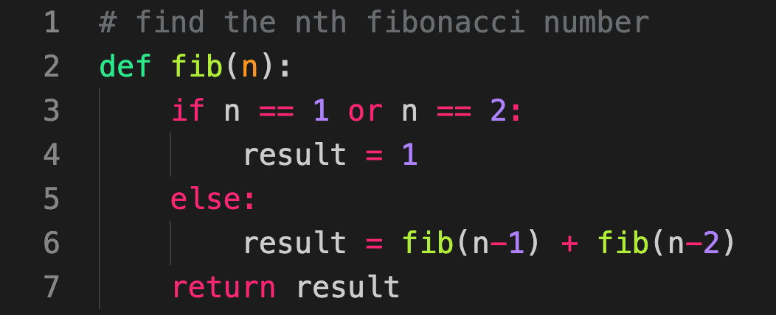
Ex: Fibonacci Sequence
1, 1, 2, 3, 5, 8

Slide 5
Ex: Fibonacci Sequence
fib(5)
fib(4)
fib(3)
fib(3)
fib(2)
fib(2)
fib(1)
fib(2)
fib(1)

Slide 6
Ex: Fibonacci Sequence
fib(5)
fib(4)
fib(3)
fib(3)
fib(2)
fib(2)
fib(1)
fib(2)
fib(1)
T(n) = O(2**n)

Slide 7
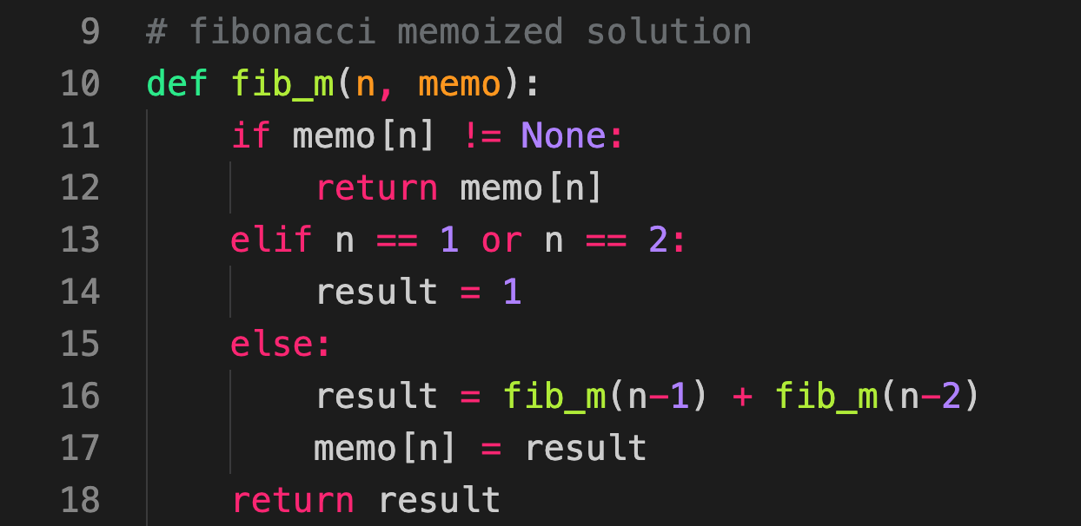
Fibonacci Memoized Solution
Store each fibonacci value into an array (memo) throughout the problem.
memo = [1, 1, 2, 3, 5, 8...]

Slide 8
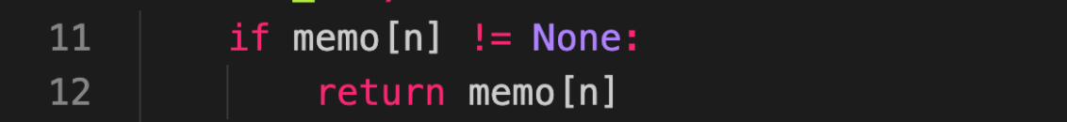
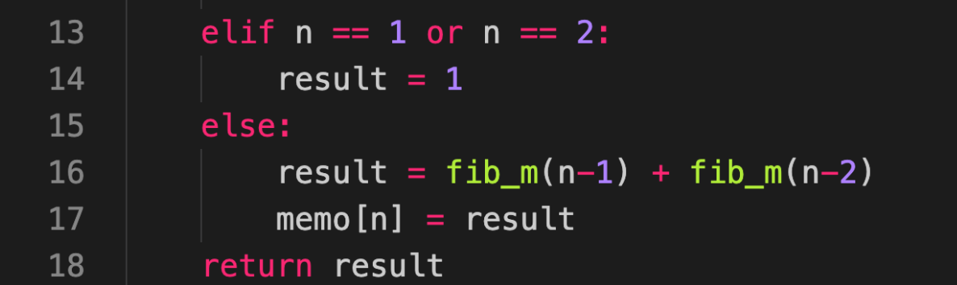
Fibonacci Memoized Solution Time Complexity
Original time complexity: T(n) = O(n**2)
Memoized: T(n) = number of calls * time for each call
O(1)
O(2n)
2n + 1 * O(1) = O(2n + 1) = O(n)

Slide 9
Fibonacci Memoized Solution
fib(5)
fib(4)
fib(3)
fib(3)
fib(2)
fib(2)
fib(1)
fib(2)
fib(1)
n
1
2
3
4
5

Slide 10
Fibonacci Memoized Solution
fib(5)
fib(4)
fib(3)
fib(3)
fib(2)
fib(2)
fib(1)
fib(2)
fib(1)
1 | 1 | 2 | 3 | 5
n
1
2
3
4
5

Slide 11
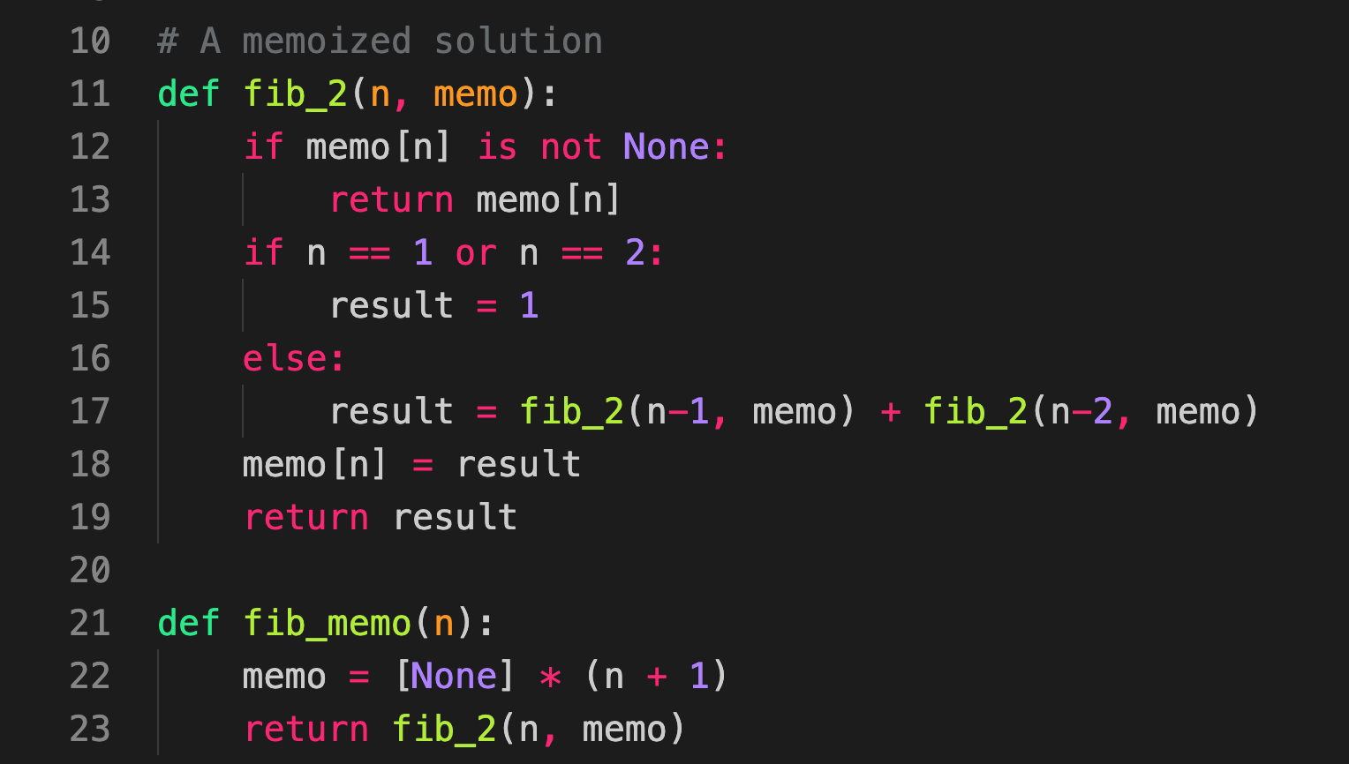
Python Code for Memoized Solution

Slide 12
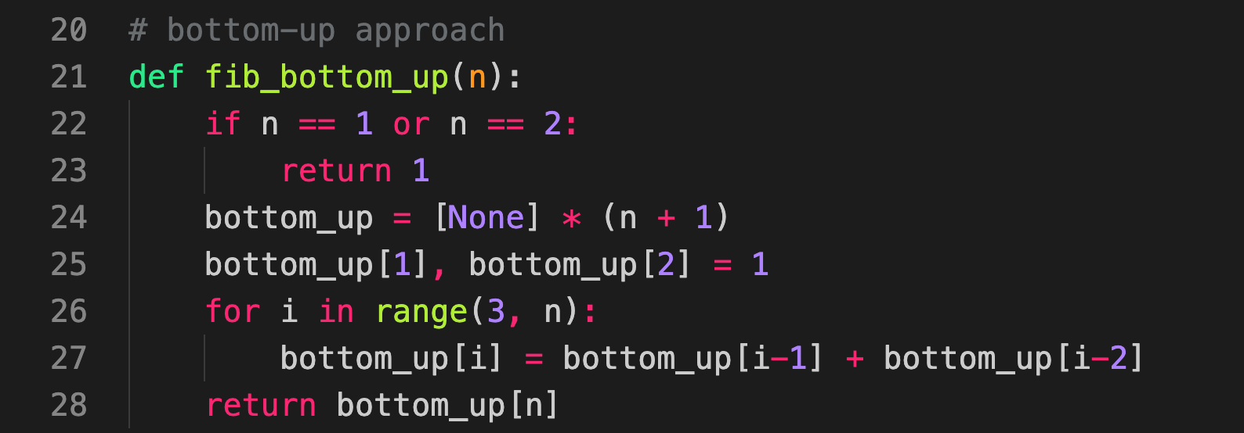
Bottom-Up Approach
If the memoized array is built from left to right recursively, why not just explicitly build it from left to right.

Slide 13
Practice Problem
Find subsets of numbers that add up to a number (no negative or duplicates in array).
Input: Array -> [2, 4, 6, 10], Int -> 16
Output: 2
{2, 4, 10} and {6, 10} are the 2 subsets

