Slide 1
A Tutorial on the conversion of the bathymetry data to the scatter data of the area of interest
Author
Md. Nazmus Sanib Chowdhury
Scientific Officer
Hydrography and Oceanography
Celestial Tech Limited

Slide 2
What we will learn in this tutorial?
In the previous tutorial, we made a rectified image (an image in which the vertices are defined with coordinates).
In this tutorial, we will use this rectified image to create the scatter data that would represent the bathymetry in geographic space.

Slide 3
First, open the MIKE Zero software

Slide 4
Press Ctrl+N when the windows of the MIKE Zero is open or navigate to the File> New > File…
The “New File” Dialog box will be opened.

Slide 5
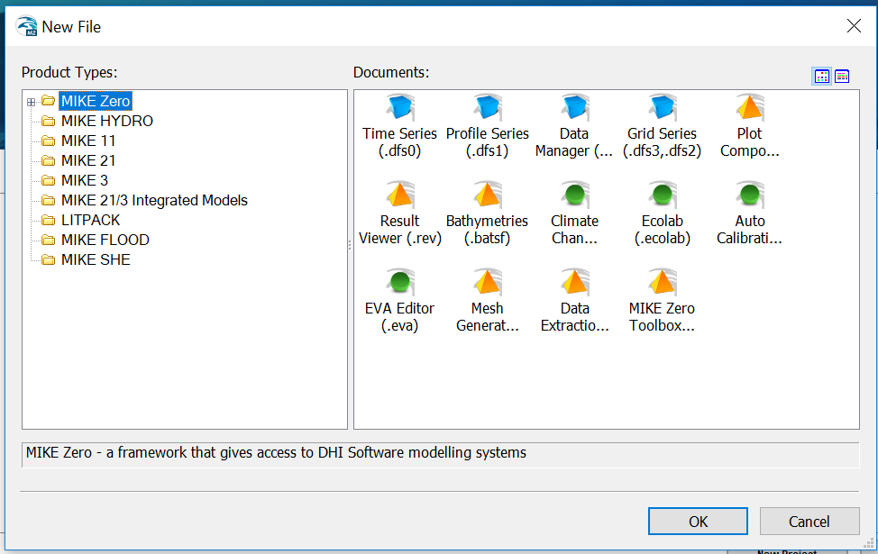
New File Dialog box

Slide 6
There are two sections in the “New File” dialog box:
One is “Product Types” and the another is “Documents”.
Below the “Product Types”, there is a tree view of different module available in the MIKE Zero software.
The first one in the tree view is the MIKE Zero module. We will do simulation pre-processing (data preparation including the creation of scatter data and scatter data production with this module) and post processing (presentation of the simulation result) with this module.

Slide 7
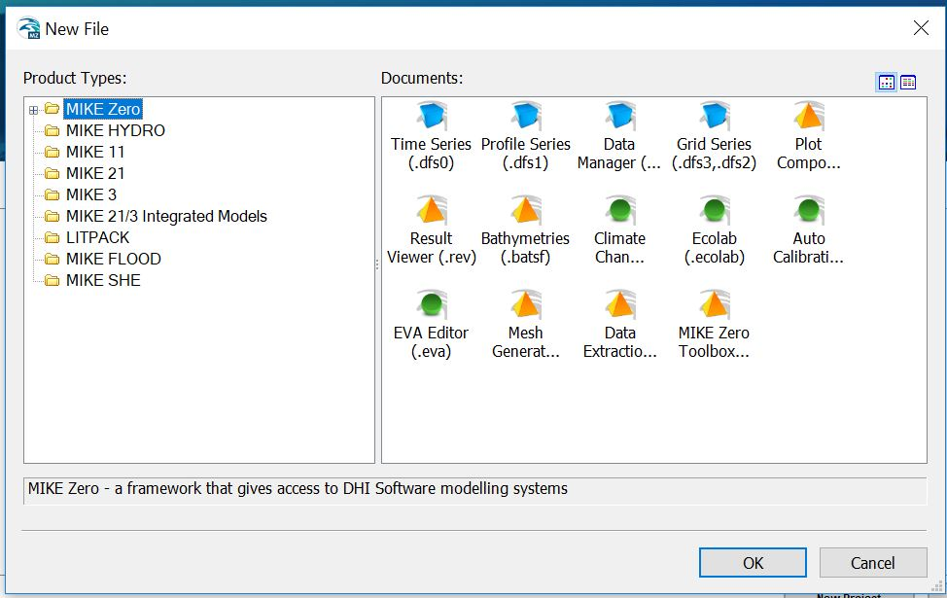
You can find the list of Module under the “Product Types” and submodules of the corresponded module under the “Documents”
List of Modules
List of Submodules of the selected module
Selected Module from the list of modules

Slide 8
“MIKE Zero” is a module of “MIKE Zero software” which can be found in the “New File” dialog box of “MIKE Zero software”.
The Module “MIKE Zero” has sub-modules. When you select the module “MIKE Zero” below the “Product Types:” then, the icon of the submodules “Mike Zero” would be appeared in the box below the “Documents”.
In the same way, if you select other module like “MIKE HYDRO” then, the submodule of “MIKE HYDRO” will be appeared in the box below the “Documents”.
As shown in the following figure, You can change of the looking of icon as either large icon or small icon by clicking on the “Large Icon” button and “Small Icon” button respectively.

Slide 9
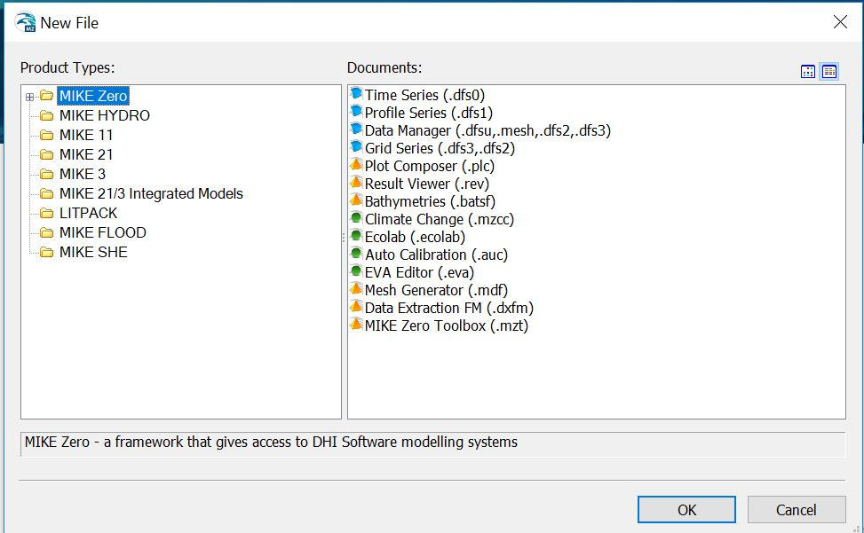
Large Icon Button
Small Icon Button
Large Icon
Small Icon

Slide 10
Open “Bathymetry (.batsf)” submodule by selecting the icon of this submodule under the box of the “Documents” from the “New File” dialog box.
After doing this press OK.
Make sure that, the “MIKE Zero” module is selected in the tree view of module list under the “Product Types:”.

Slide 11
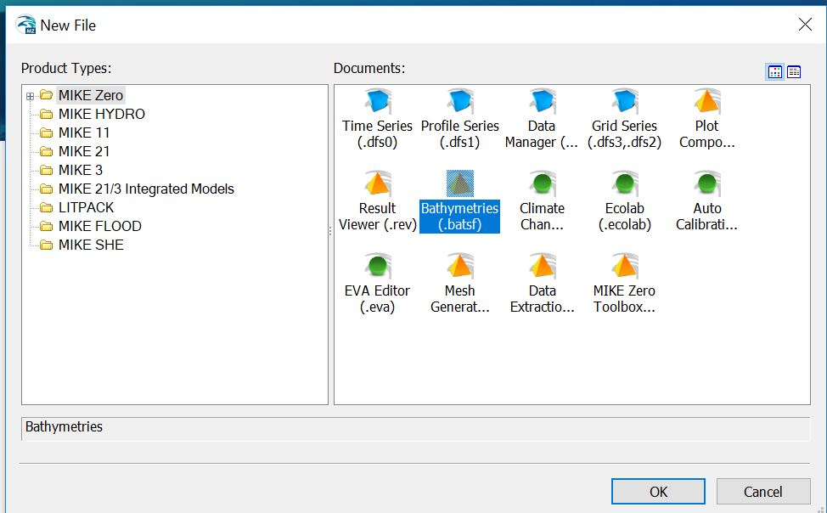

Slide 12
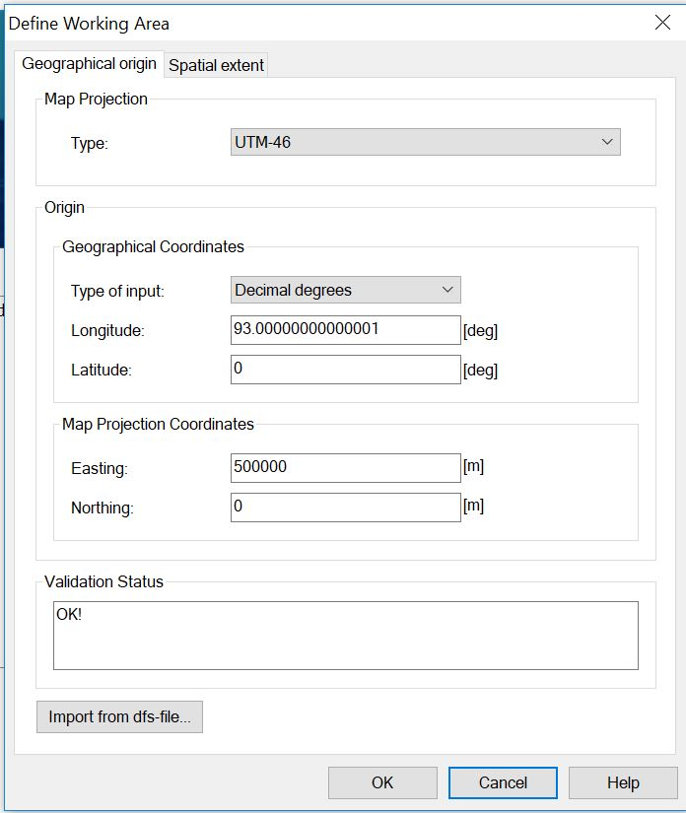
Then “Define Working Area” dialog box will be opened

Slide 13
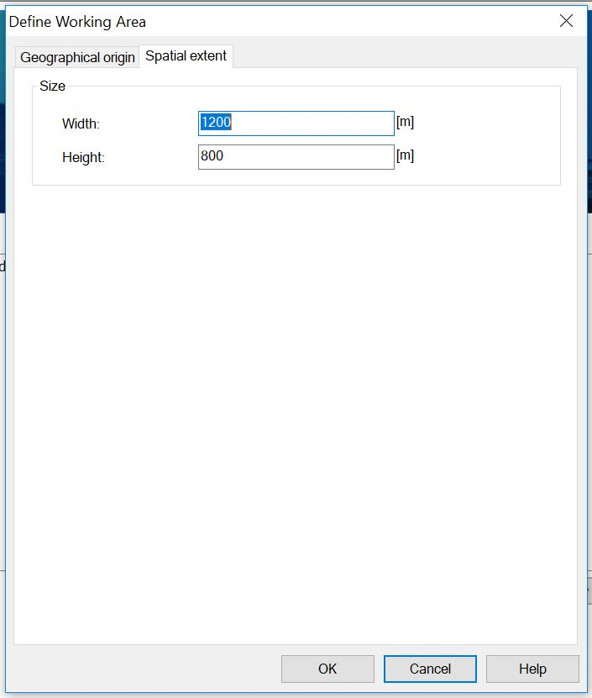
“Define Working Area” dialog box has two tabs: “Geographical origin” and “Spatial extent”

Slide 14
We will fill-up the information in these two tabs, then the options would be visible in the next step in order to open the rectified image we created in the previous tutorial. The information that we wooul provide in this step is related to the coordination system of the rectified image which we will open in the next step.
In the “Geographical origin” tab, we will provide the information of the type of map projection (the appropriate map projection system of the study area) and the coordinate of the origin of the rectified image.
In the “Spatial extent”, we will provide the width and height in meter unit covered by the real world projection of the rectified image.

Slide 15
The real world projection of the rectified image is situated around the Naf river of Bangladesh. Thus UTM 46 would be appropriate projection system for this area.
The origin is mentioned in the tutorial 2, slide no 30.
Origin → (Easting, Northing) : (428689.614308852, 2294630.88853734)
The width is mentioned in the tutorial 2, slide no 35.
Width = 8520
Height = 10515

Slide 16
In the “Geographic origin” tab,
Enter “UTM-46” right to the “Type:” option.
Enter the value of Easting and northing (428689.614308852, 2294630.88853734) below the “Map Projection Coordinates”.

Slide 17
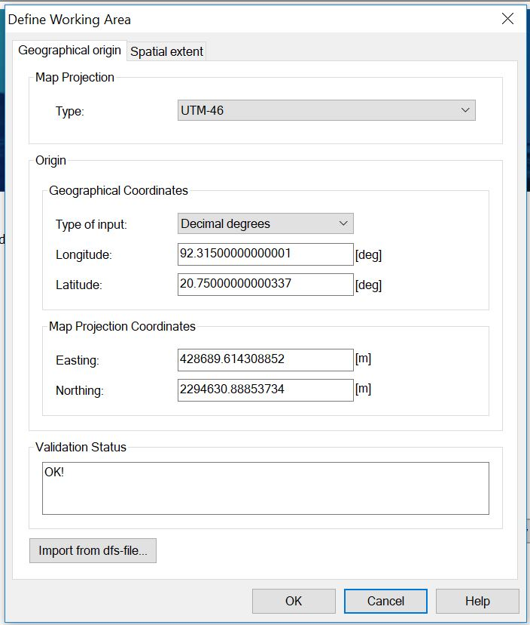

Slide 18
Move to the “Spatial extent” tab by clicking on the “Spatial extent” button.
Enter the value of the width and height (8520, 10515) right to the “Width” and “Height” options respectively.
Then press OK.

Slide 19
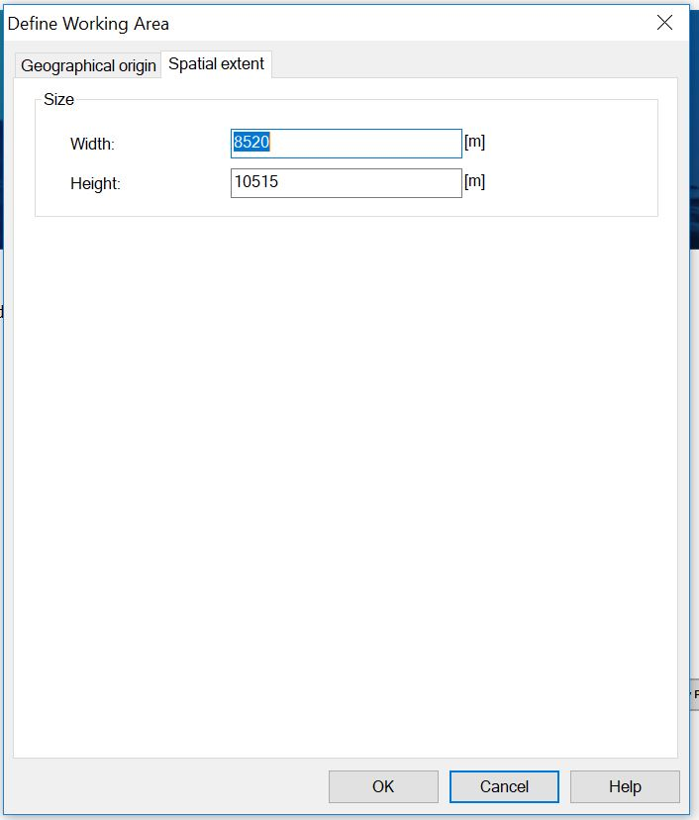

Slide 20
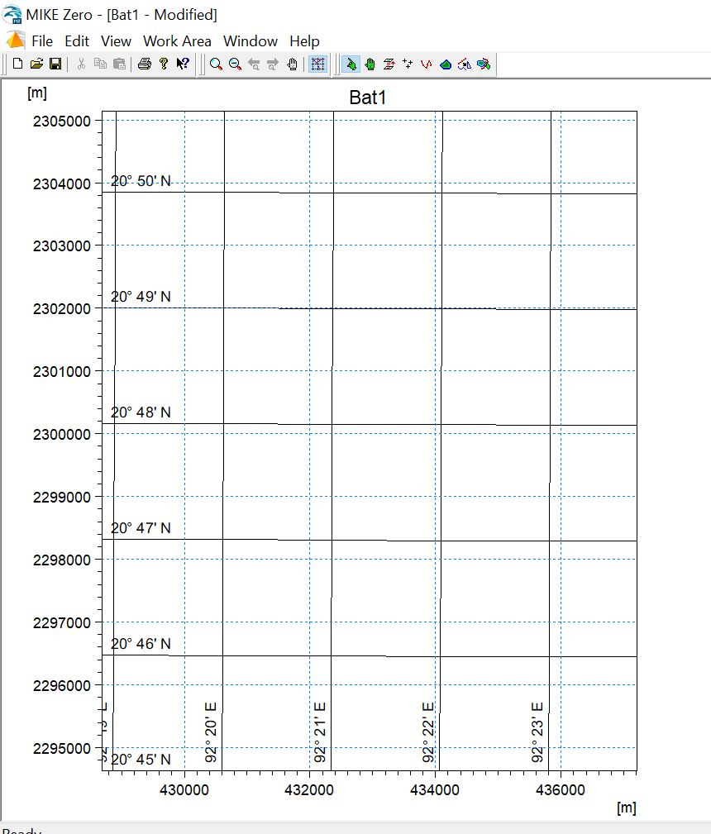
The following window (the will be appeared
We will now know the available Editor tool options of this window

Slide 21
Menu
Editing tools

Slide 22
Tool 1: Zoom In
Tool 5: Move Point
Tool 2: Zoom Out
Tool 6: Add Point
Tool 7: Add Contour-line
Tool 3: Move through the window
Tool 8: Add Land/Water Polygons
Tool 4: Select Point
Tool 9: Select Polygons or Contours

Slide 23
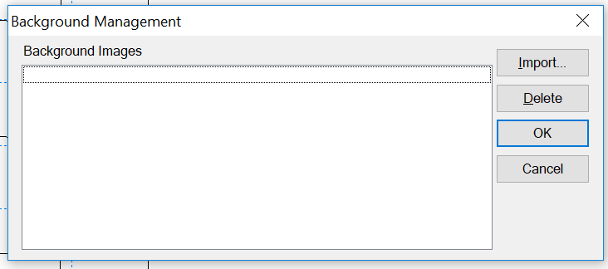
Press ctrl+B when the Bathymetry (.batsf) window is open or navigate to the Work Area> Background Management from the menu.
Then the “Background Management” dialog box will be opened.

Slide 24
Click on the “Import” button from right portion of the “Baclground Management” dialog box.

Slide 25
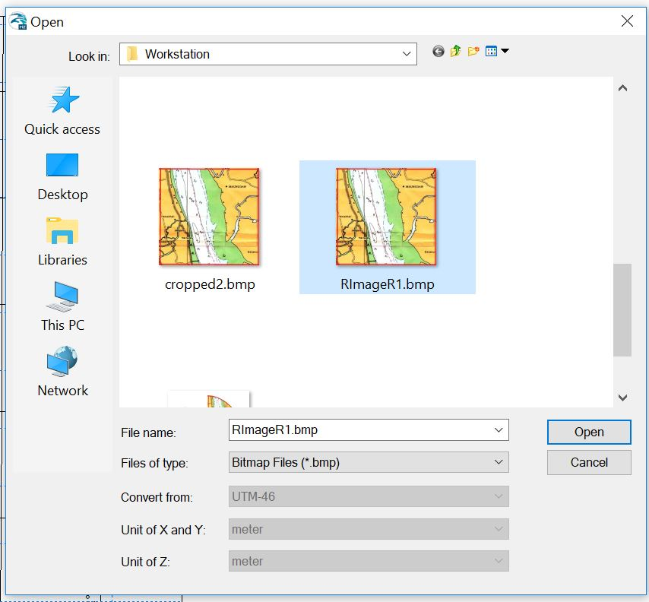
First, select the file type as “Bitmap Files (*bmp)” from the drop down list of the right to the “Files of type” option.
Then, select the rectified
image which was created
in the tutorial 2.
3. Then, Click on the button
“Open”.

Slide 26
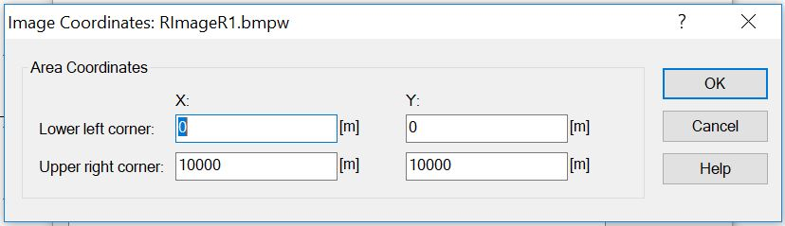
Then “Image Coordinates: %filename of the rectified image%.bmprw” dialog box will be opened
You need to fill in the blanks by taking the easting and northing values of the lower left vertex and upper right vertex and whose are mentioned in the Table 4 of Tutorial 2.

Slide 27
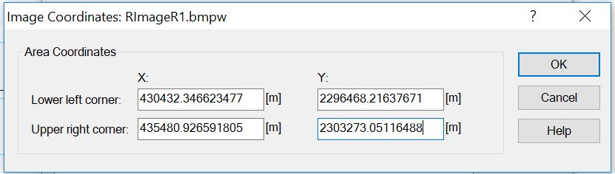
Fill in the blanks:
Lower left corner: (X: 430432.346623477, Y: 2296468.21637671)
Upper right corner: (X: 435480.926591805, Y: 2303273.05116488)

Slide 28
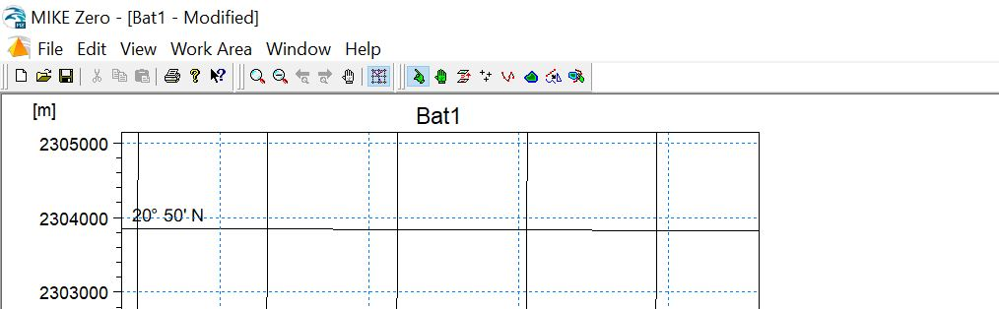
Then navigate to the:
Work Area > Show Background Images
from the menu bar option

Slide 29
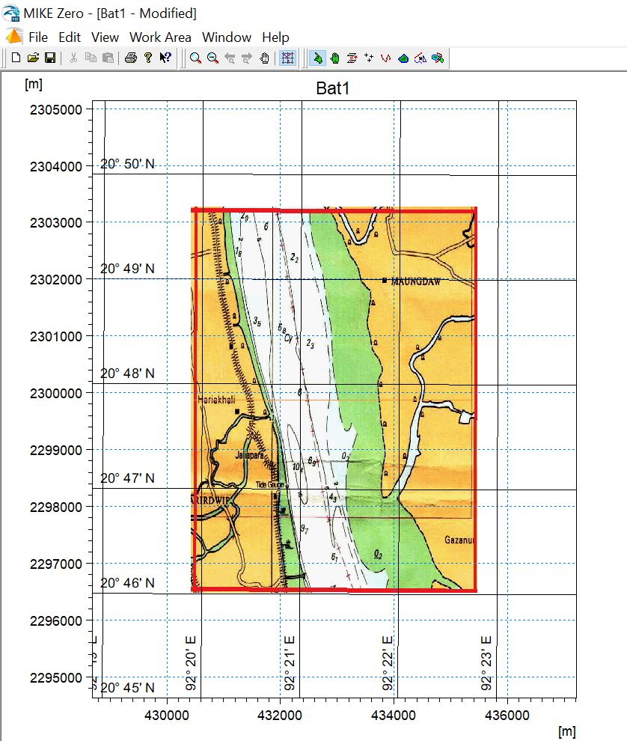
Then, the rectified image will be appeared in the window

Slide 30
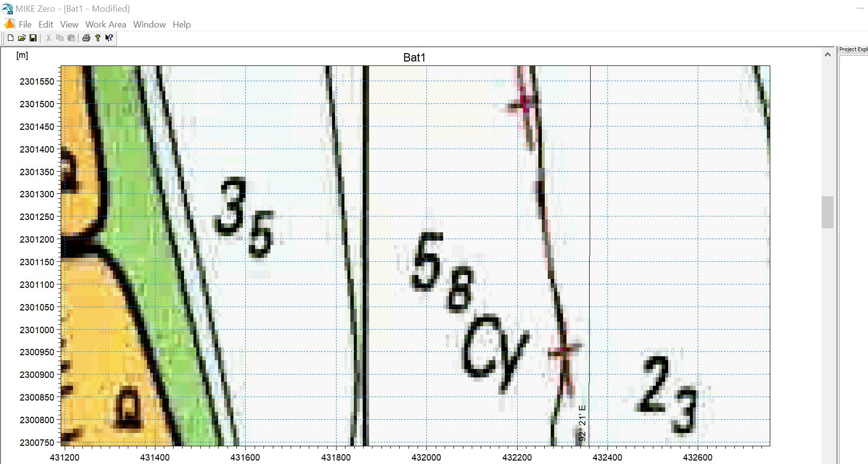
You can magnify the image in the window by using tool 1.
This number is not 35, it is actually 3.5, so the bathymetry of this point is 3.5 m
So the bathymetry of this point is 5.8 m
And this is 2.3 m

Slide 31
Add Land Polygons
Take a look on the image window, and find out on the land boundary.
Click on the tool 8 to activate the adding of land boundary.
A green color mouse cursor will be appeared.

Slide 32
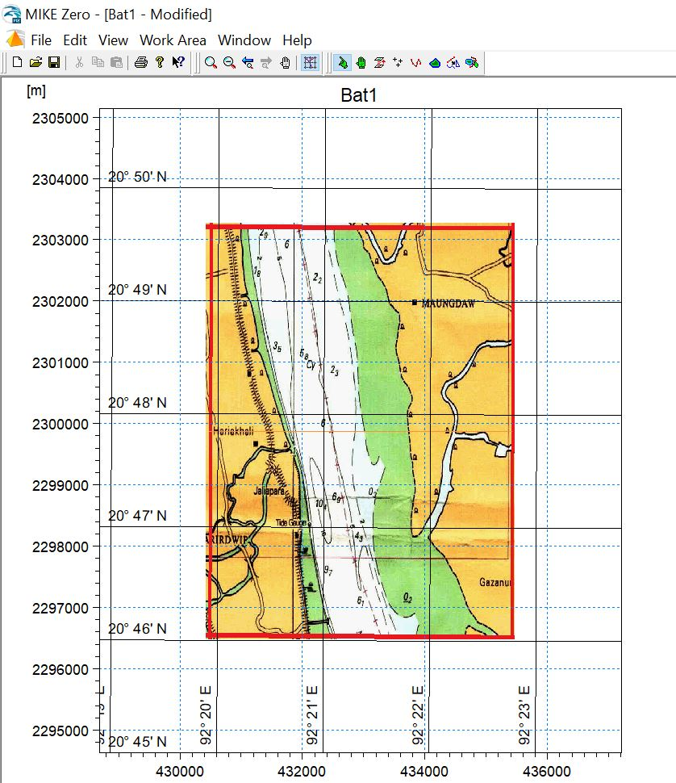

Slide 33
We will first define the land boundary from the left side.
Left click on the mouse and hold on a arbitrary point in the left side of the image and move the mouse cursor as you are supposed to draw a rough curve as roughly as the following figure.
Unhold the left click of the mouse.

Slide 34
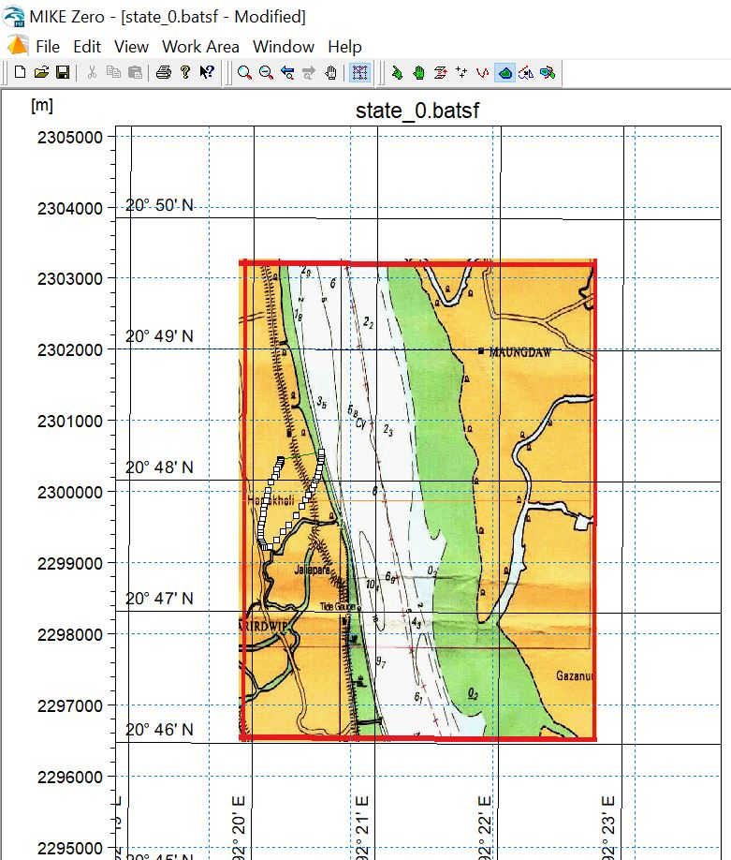

Slide 35
Now you can move a point by the tool no 5.

Slide 36
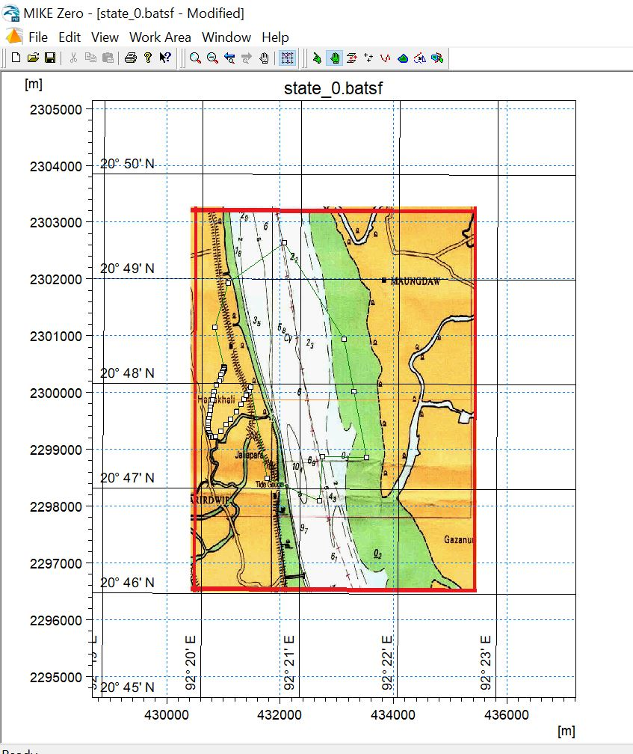

Slide 37
Move all the points of this polygon by the tool 5 in a way that, the points are located along the boundary line (the land boundary in the left side of the image) and the polygon coincided with the boundary line (the land boundary in the left side of the image) .
You can also use tool 1, tool 2 if necessary to do this task.

Slide 38
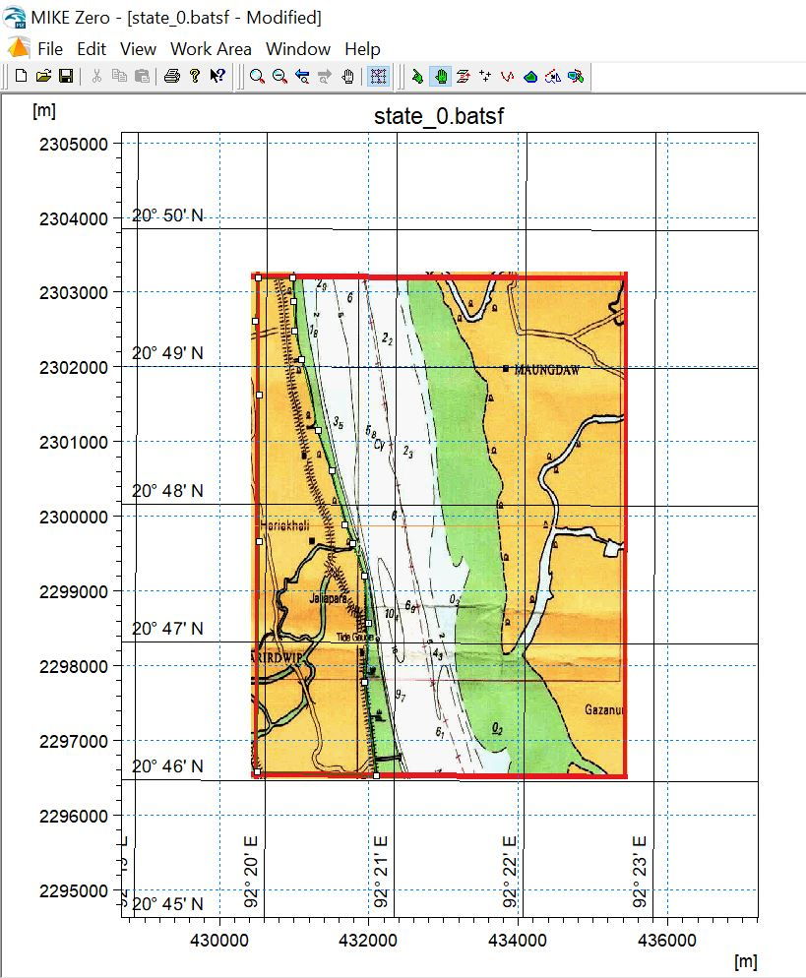

Slide 39
In the same way, draw land boundary polygon for the right side land boundary of the image.

Slide 40
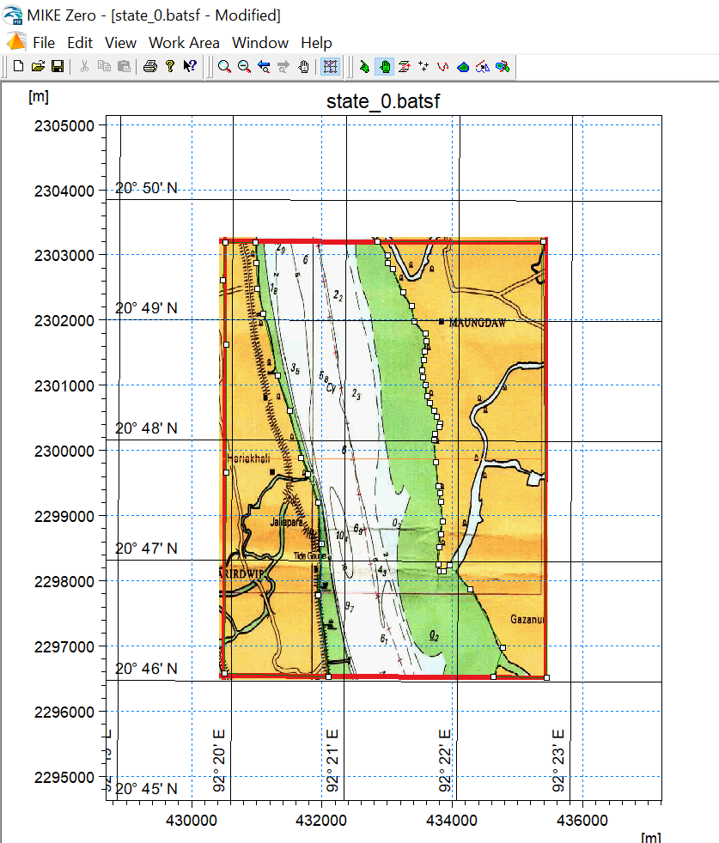

Slide 41
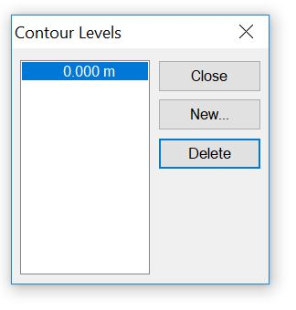
Set the current contour level
Press ctrl+L or navigate: Work Area > Set Current Contour Level …
A “Contour level” dialog box will be opened.
Click “New” button
Enter 0
Don’t close it now

Slide 42
Set the contour level of land boundary
Left click on the icon of the tool 9.
Left click on a outer point that is located above the image and left to the image.
Hold on this mouse left click and the move the green icon to the right and then down in a way that it covers the whole land boundary polygon of the left side of the image. Then the left land boundary polygon will be selected.

Slide 43
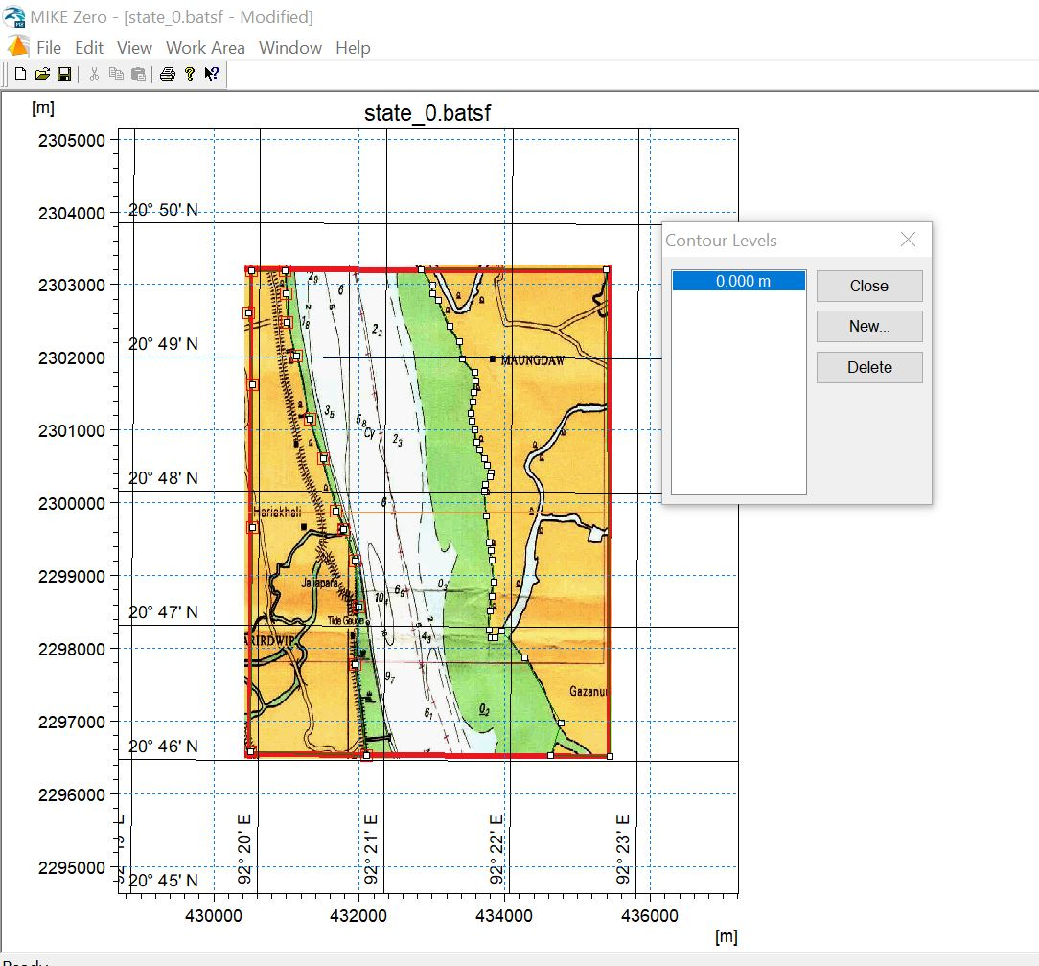

Slide 44
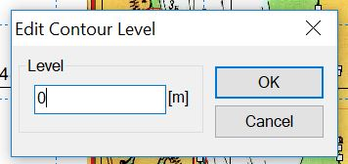
Right click on any point of the selected polygon.
A tool bar option will be appeared.
Select the option “Edit Contour Level”.
A “Edit Contour Level” dialog box will be opened.
Enter 0 and click the button “OK”.

Slide 45
In the same way, edit the Contour Level Entry of the right polygon boundary.

Slide 46
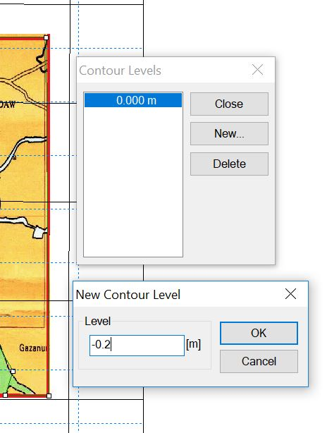
Add Points
In the “Contour Levels” dialog box, click “New” button.
Then the ‘New Cotour Level” dialog box will be appeared.
Enter 0.2, click on the ‘OK” button.

Slide 47
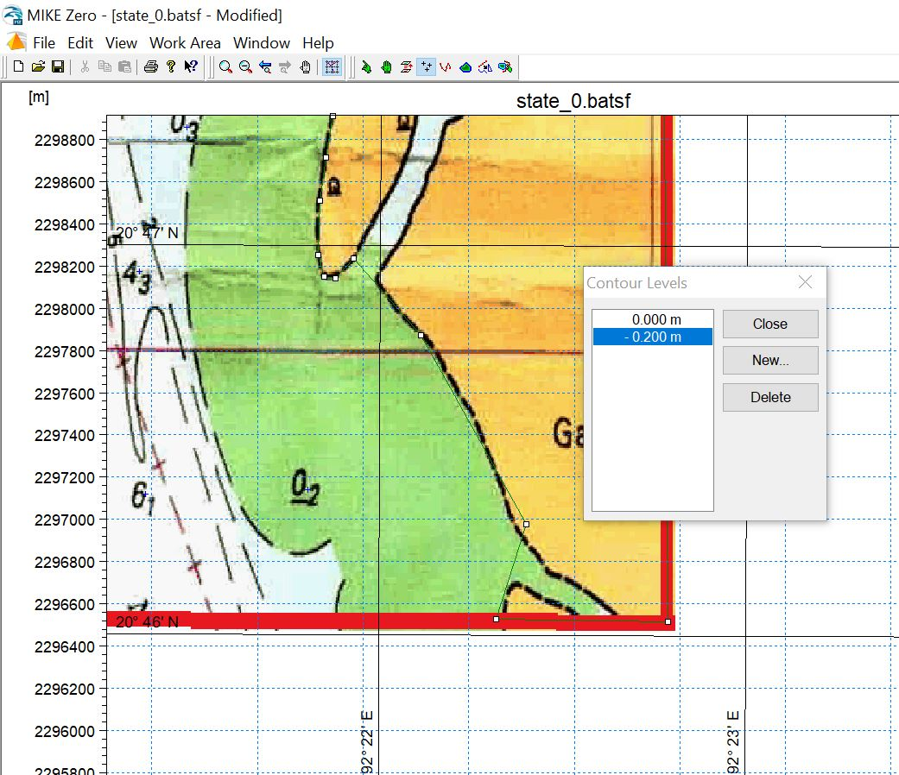
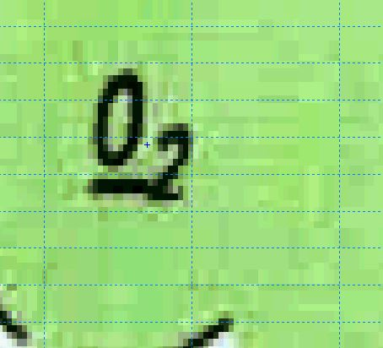
Click on the icon of the tool no 5 to activate the add points
Find all the points that are referenced to 0.2
Click on these points

Slide 48
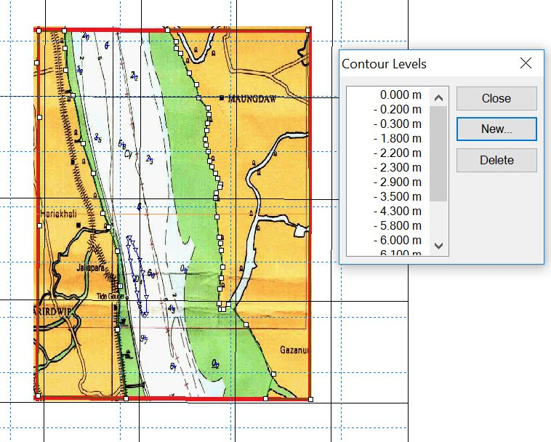
In the same way, add all other points whose are referred other values (e.g., 0.3, 1.8, 2.2, 2.3 etc.)

Slide 49
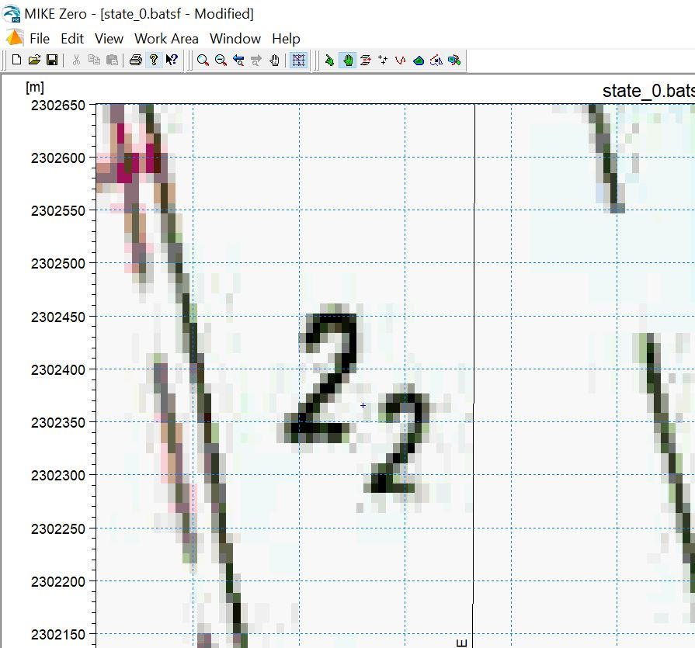
Adjust the position of the point by using tool 5 when necessary (if the location of the added point is seem to be in incorrect location)

Slide 50
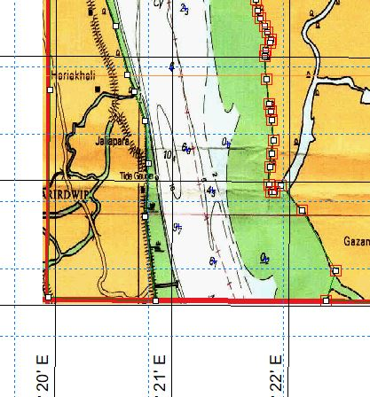
Add contour line (only applicable for water body)
We will now add the contour line for the water surface which is marked by the following:

Slide 51
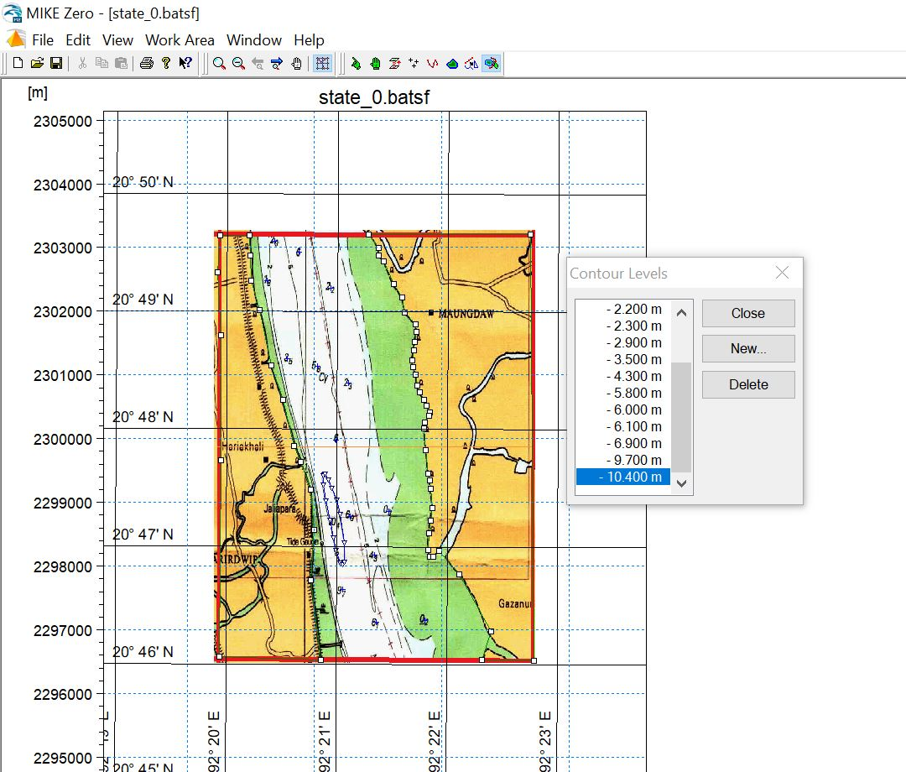
Add a new label -10.4 to the “Contour Levels”
Click on the icon of the tool 7 to activate the Add Contours.

Slide 52
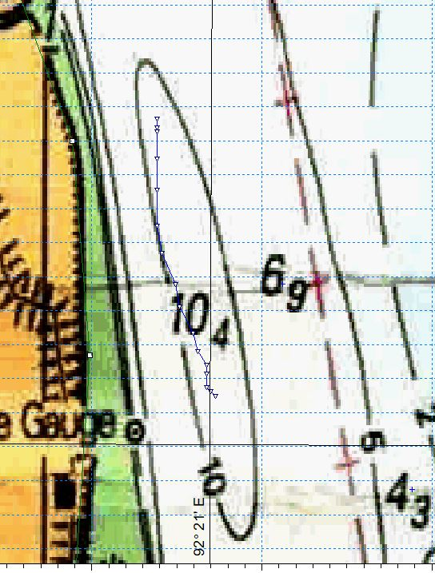
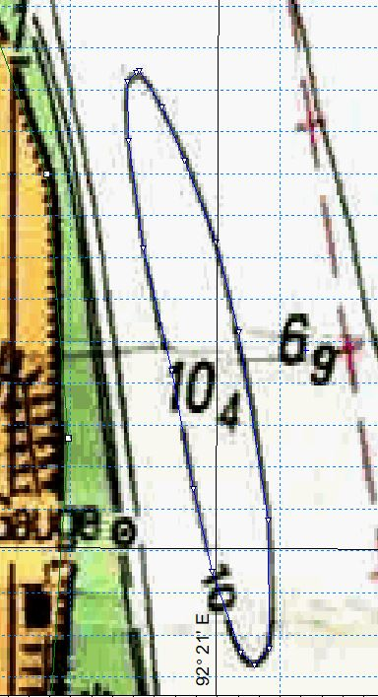
Add contour line for the water surface which is referred to the bathymetry value -10.4 m

Slide 53
Close the “Contour Levels” dialog box as we have not anything else to do with this dialog box.

Slide 54
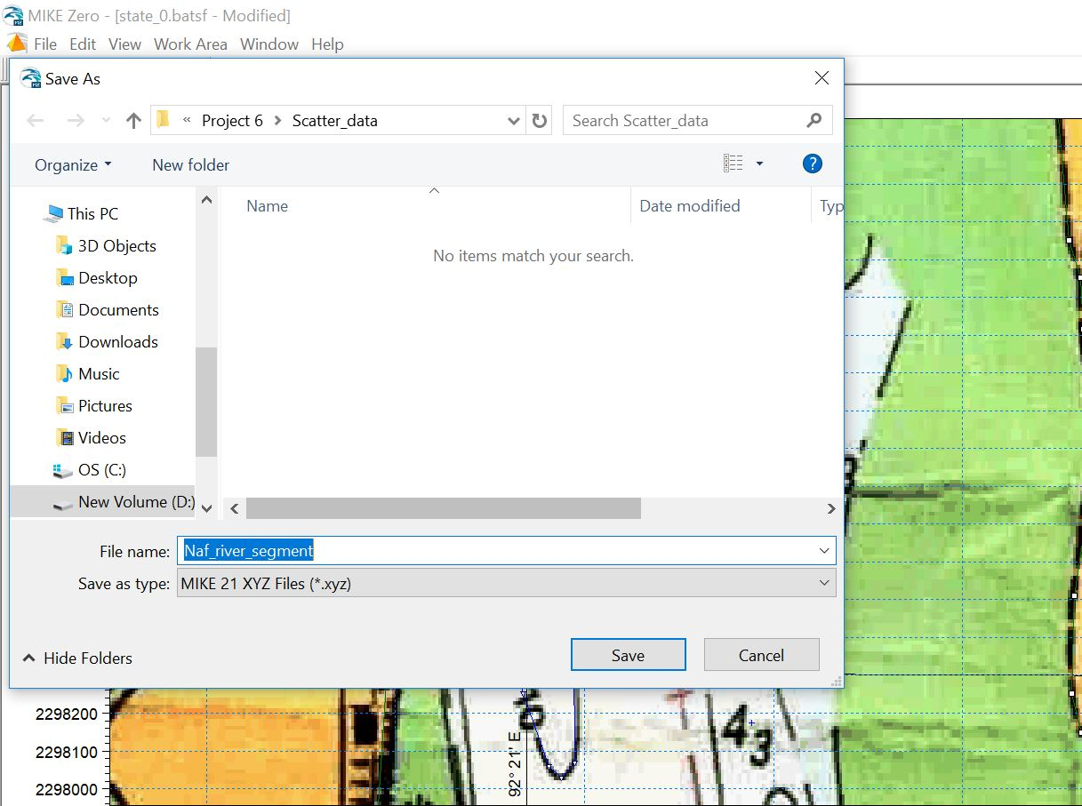
Export the as Scatter data
Navigate Workarea > Export .. from the menu bar option.
A “Save As” dialog box will be opened.
Save the file with a name.

Slide 55
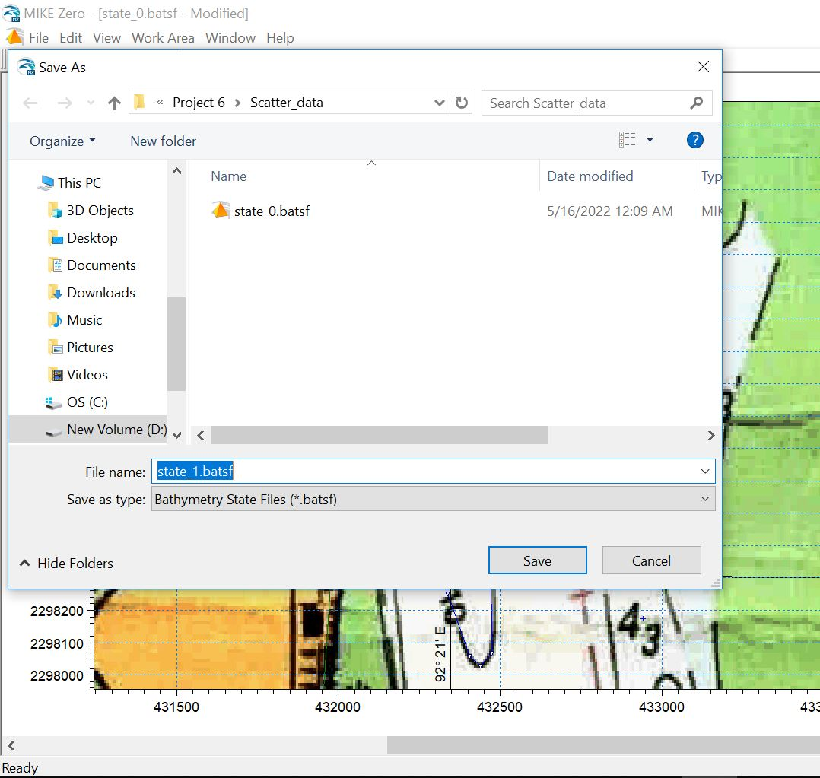
Now save the state file by at first navigate: File > Save As. Then give a name of the state file and click “Save” button on the “Save As” dialog box in a specified directory.
Close Mike Zero Window.

Slide 56
The End

