Slide 1
Tutorial 4: Mesh Generation
Author
Md. Nazmus Sanib Chowdhury
Scientific Officer
Hydrography and Oceanography
Celestial Tech Limited

Slide 2
First, open the MIKE Zero software

Slide 3
Press Ctrl+N when the windows of the MIKE Zero is open or navigate to the File> New > File…
The “New File” Dialog box will be opened.

Slide 4
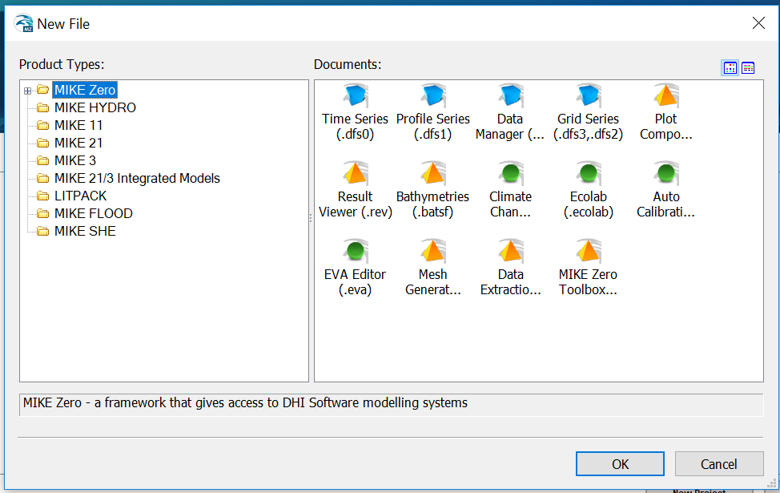
New File Dialog box

Slide 5
Open “Mesh Generator (.mdf)” submodule by selecting the icon of this submodule under the box of the “Documents” from the “New File” dialog box.
After doing this press OK.
Make sure that, the “MIKE Zero” module is selected in the tree view of module list under the “Product Types:”.

Slide 6
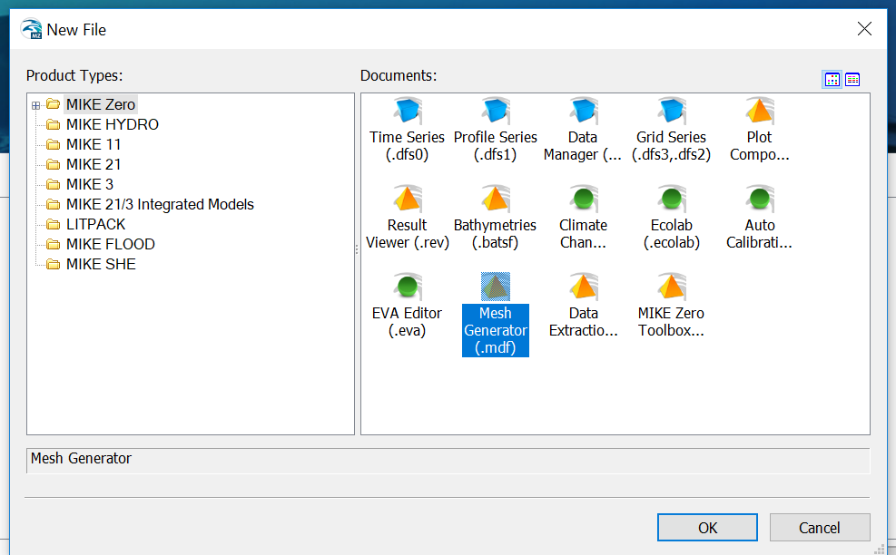

Slide 7
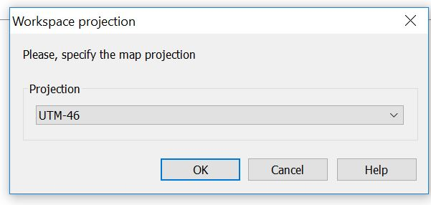
A “Workspace projection” dialog box will be opened.
Select the ‘UTM 46’ projection system below the “Projection”.
Click the “OK” button.

Slide 8
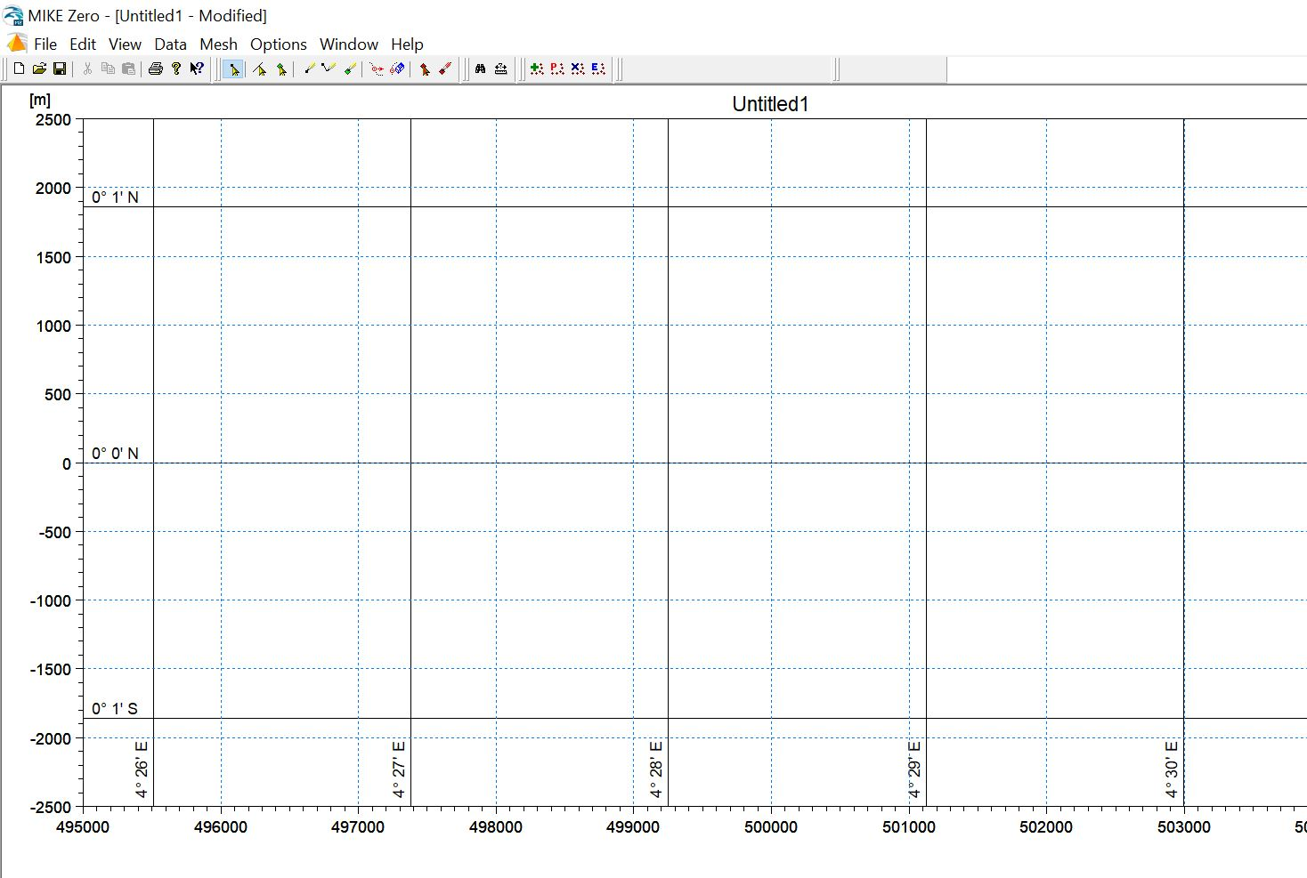
The following window will be opened:

Slide 9
Navigate: Data > Manage Scatter Data… from the menu bar option.

Slide 10
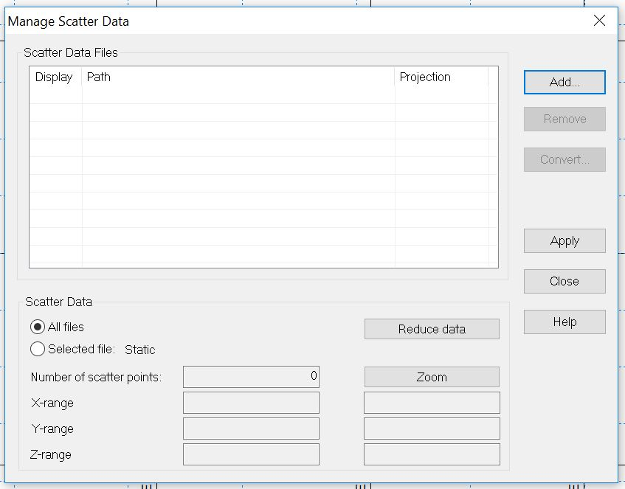
“Manage Scatter Data” dialog box will be opened
Click on “Add...” button

Slide 11
An “Open” dialog box will be appeared.
There are two files of scatter data whose were created in the previous tutorial (tutorial 3), one is Land boundary scatter data (the one which name is started with L) and the other is water boundary scatter data (the name is started with W).
Select the land boundary scatter data and click “Open” button.

Slide 12
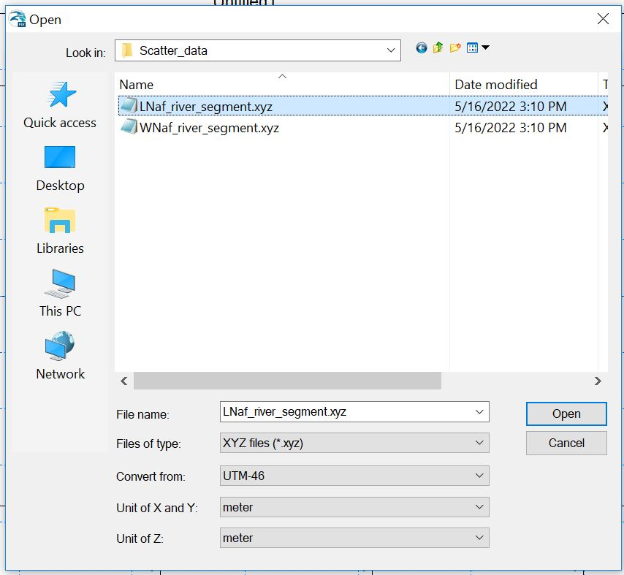

Slide 13
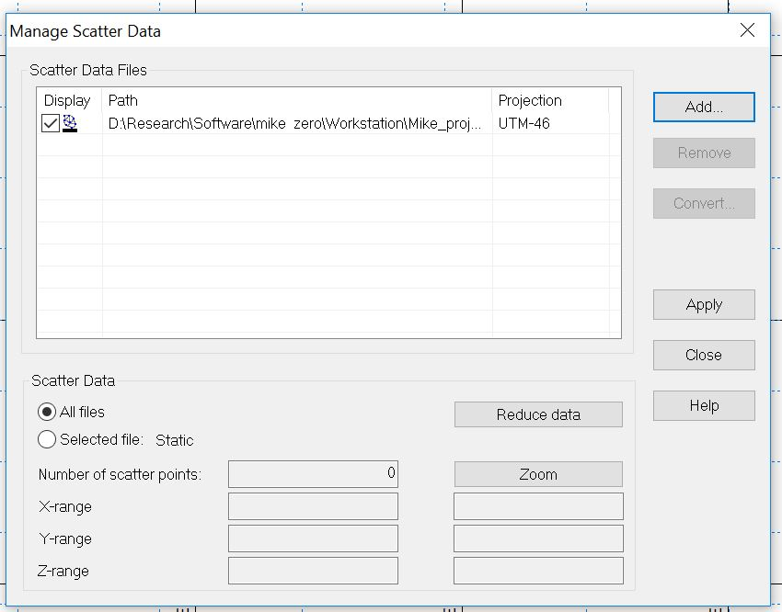
Again click ‘Add…” on the “Manage Scatter Data” dialog box.

Slide 14
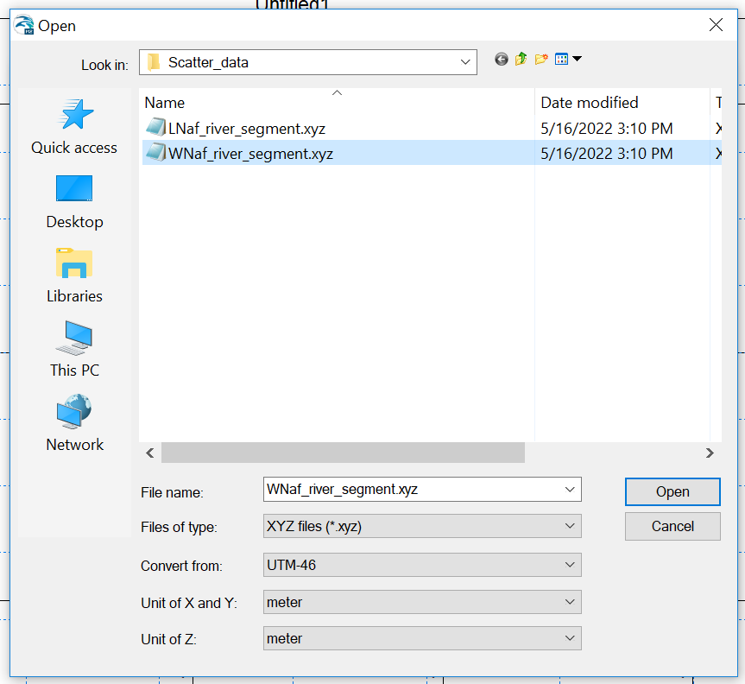
This time, select the water boundary scatter data and open it as the previous.

Slide 15
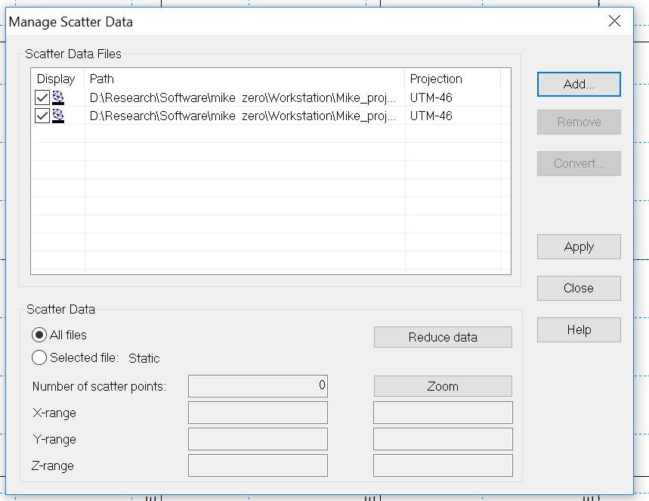
Click “Apply” on the “Manage Scatter Data” dialog box and then close it.

Slide 16
Navigate View> Zoom to Extend of Data

Slide 17
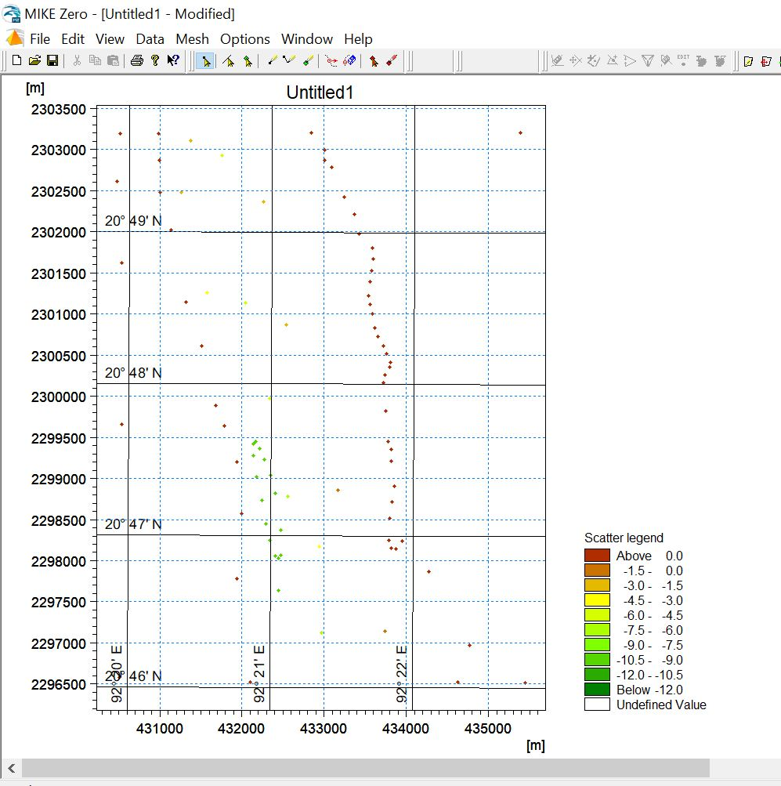
Now the scatter data is visible
As per the legend, the points above the land is shown with red-brick color

Slide 18
Before move to the next step let us be addressed with the edit options from the just below to the menu bar

Slide 19
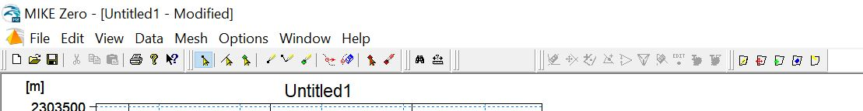
Tool 7: Move points
Tool 2:
Select Arcs
Tool 8: Delete points
Tool 1: Select Points
Tool 4:
Insert nodes
Tool 3: Select Polygons
Tool 5:
Draw arc
Tool 6:
Insert polygons
Moreover there are tools for Zoom in, Zoom out and move to previous zoom as like as other modules

Slide 20
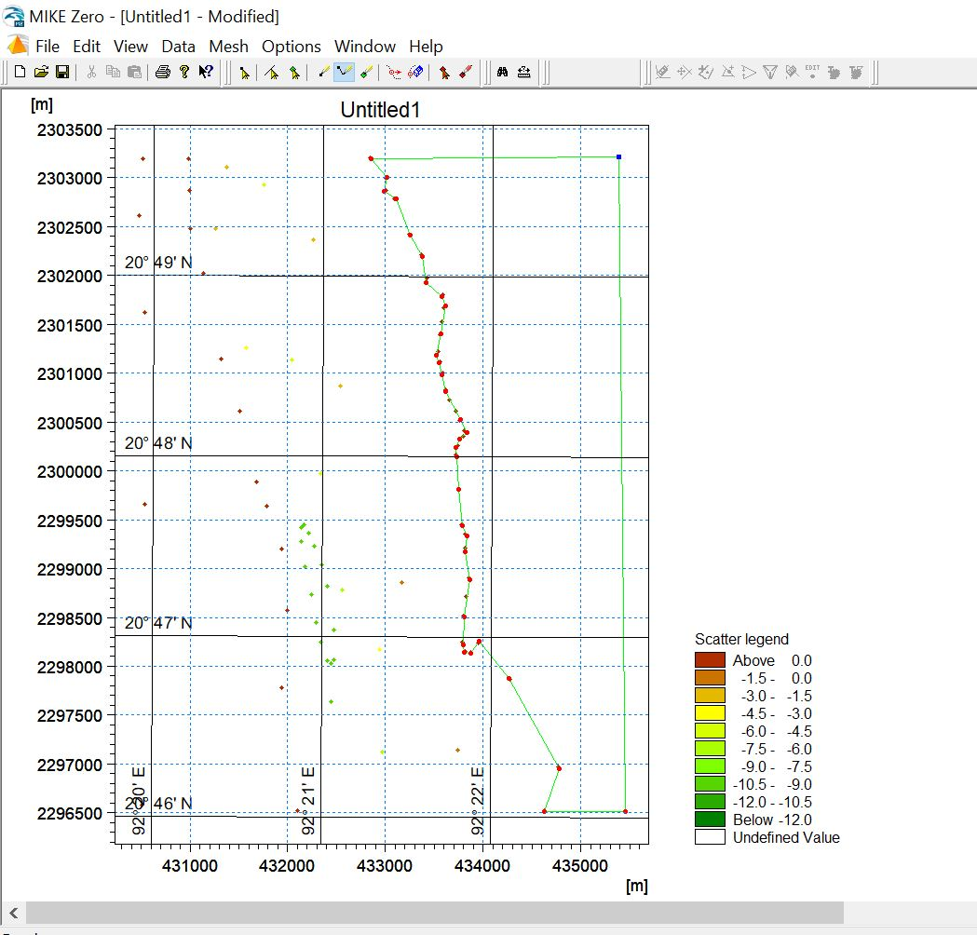

Slide 21
Connect the land scatter data point with tool 5, by clicking on the points. You start clicking on a point A, you finish to click all other point and then you have to finish to clicking the point by clicking on the point A.

Slide 23
In the same way, connect the land scatter data points of the left side.

Slide 24
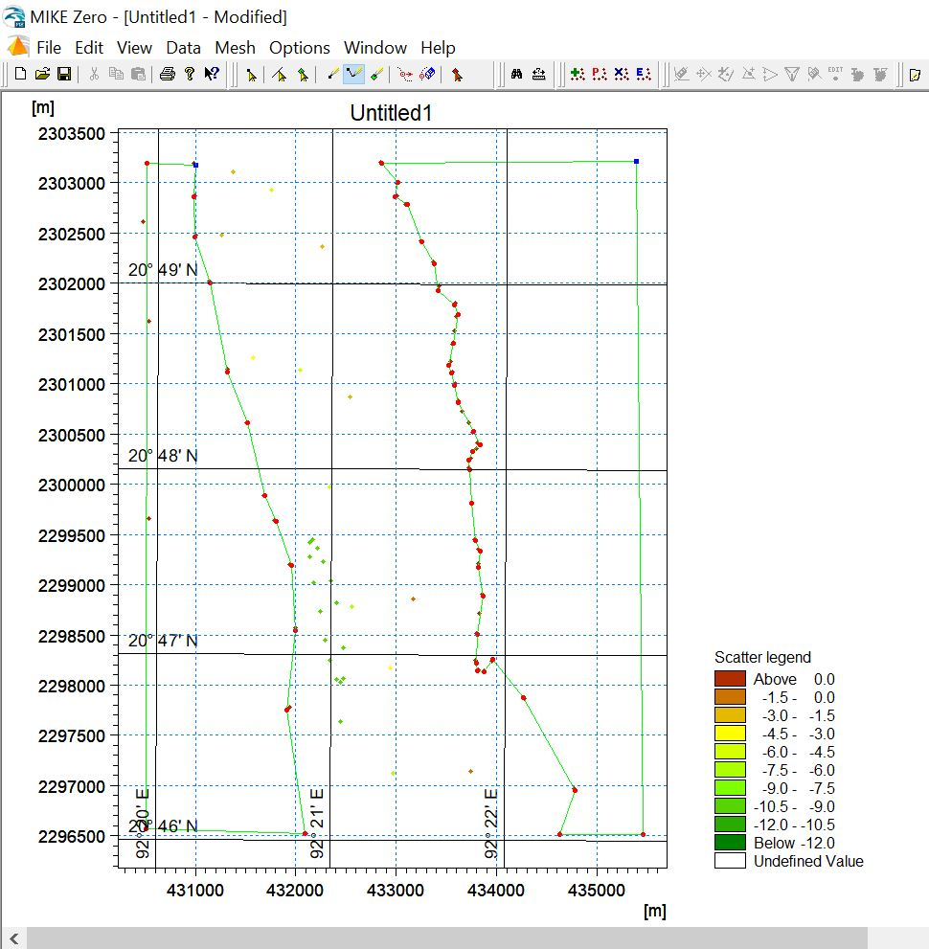

Slide 25
Click on Tool 1.
Then, select the point A, right click on
it and a tool bar option will be appeared.
Select the option:
“Vertices -> Nodes”
Do the same for the points B, C and D.
B
A
D
C

Slide 26
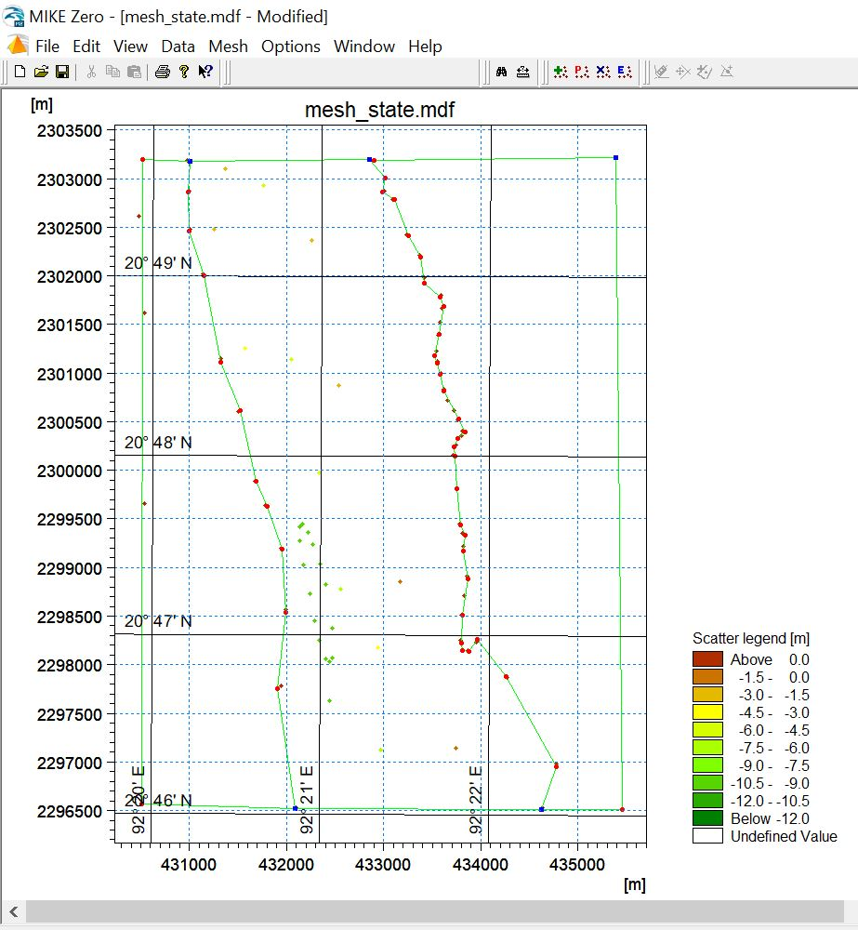
Connect A and B by using
the tool 5
Connect B and C by using
the tool 5
B
A
D
C

Slide 27
Set the arc attribute associated with the water boundary
Tide would have different constituent in the line CD and AB (Study about the Cotidal chart. The tide gauges are installed along the coast-line, but a ship which is located in the mid of the Bay of Bengal would know the height of tide for the corresponded location of the ship (suppose that, the ship don’t have tide gauge of there own to measure tide in the mid of ocean and the tide height is not measured by the satellite), how do the ship know the tide height without the direct measurement of height?).
So, MIKE Zero need different numerical addresses for the CD and AB to predict the tide height considering that tidal constituents are not the same for AB and CD.
AB and CD are two arcs.
Attributes of AB and CD indicated the numerical address.

Slide 28
Click on the icon of tool 2.
Select the arc AB with the mouse left click and right click on it.
A toolbar options will be appeared.
Click on the option “Properties”.
“Arc Property” dialog box will be appeared.

Slide 29
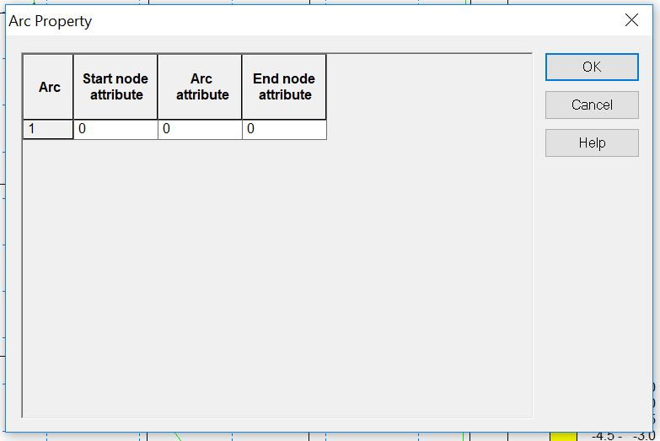

Slide 30
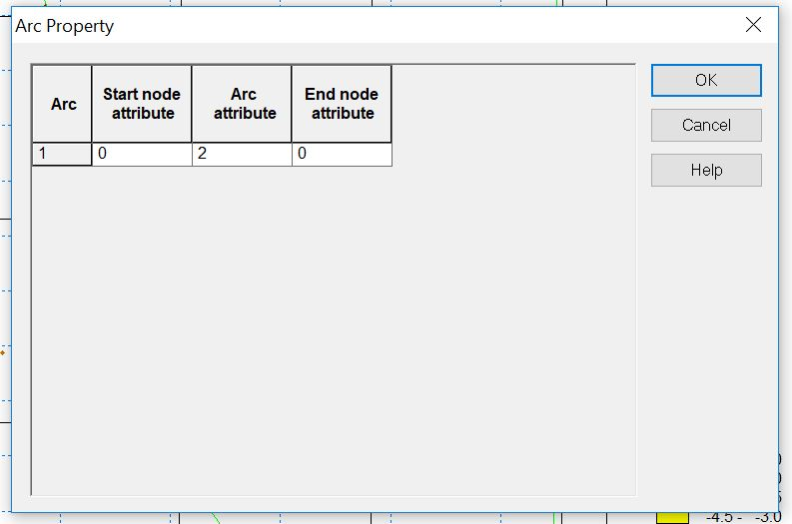
Set the value of ‘Arc attribute” = 0, while “Start node attribute” and “End node attribute” would be remained unchanged (=0). Then press the “OK” button.

Slide 31
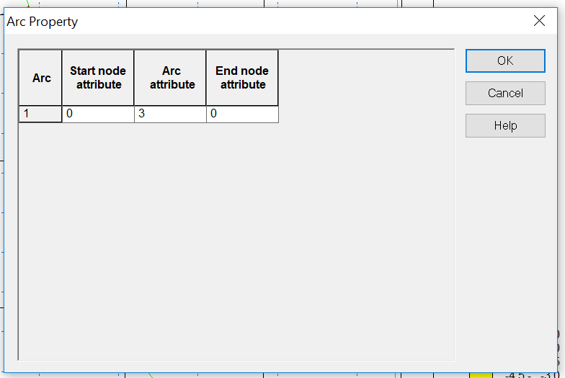
In the same way, set the value of “Arc attribute” of the arc CD as 3.

Slide 32
Why we set the “Arc attribute” for the arc AB = 2, and for the CD = 3.
Because, Condition 1: the attributes for water boundary arcs would be greater then 1 and different from each other.
Condition 2: Without conflicting condition 1, any number would be applicable as the “Arc attribute”
Arc attributes of the land boundaries were set (or keep unchanged to) 0.

Slide 33
Insert polygons
In MIKE, polygon is a simple conception, it simply defined by clicking on the icon of the ‘Insert polygons” and then click on a point either inside the land boundary or water boundary. The boundary of the polygon coincided the land or water boundary inside which you clicked.

Slide 34
Click on the icon of tool 6.
In our case we have two land boundary and one water boundary.
Click on the middle/center of the boundaries.
Polygons have created!
You can think of points where you clicked as the address of the polygons. Each green point is the address of each polygon.

Slide 35
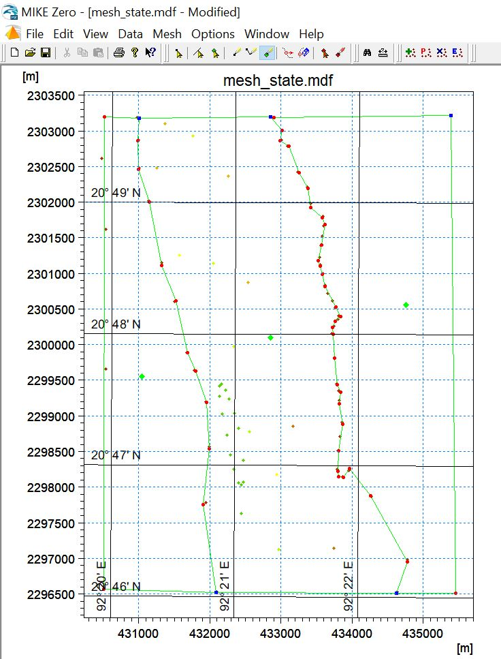

Slide 36
Make Polygon Visible: To make the polygons visible, click on the icon of tool 3 and click on the address of the polygon.
The polygon is visible as the following.

Slide 37
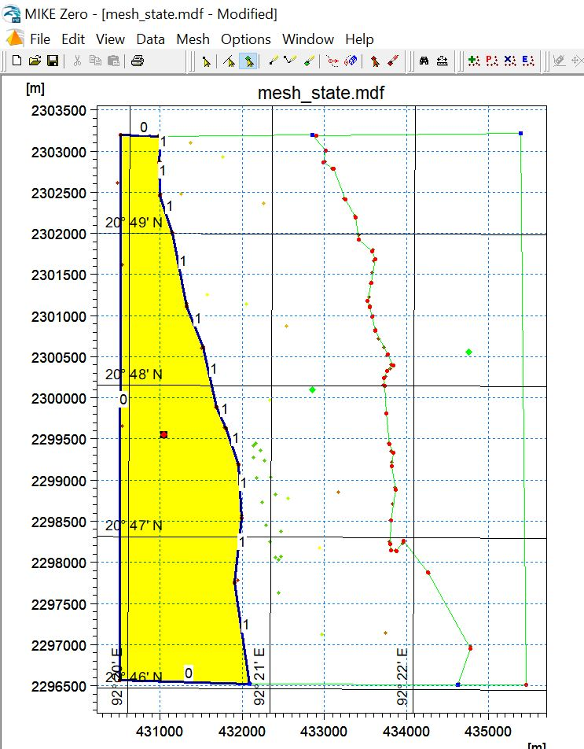
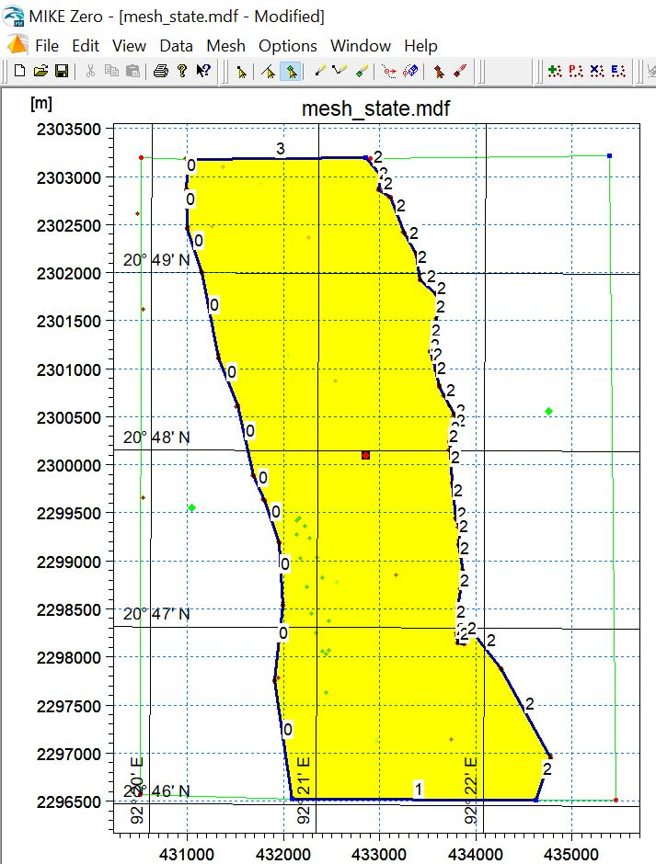
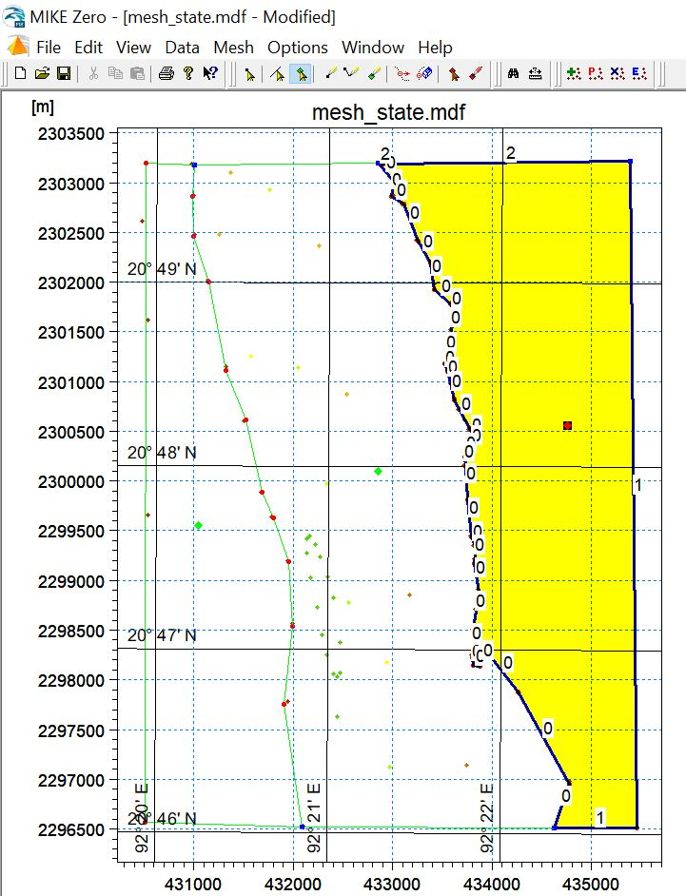
Left Land Boundary Polygon
Water Boundary Polygon
Right Land Boundary Polygon

Slide 38
Exclude Mesh
Apply Make Polygon Visible for the left polygon and right click on any point inside that polygon.
A tool-bar option will be appeared, click on the “Properties” option.
Then a Polygon properties dialog box will be opened.
Click on the radio button in the left of the “Exclude from mesh”.
Click OK button.

Slide 39
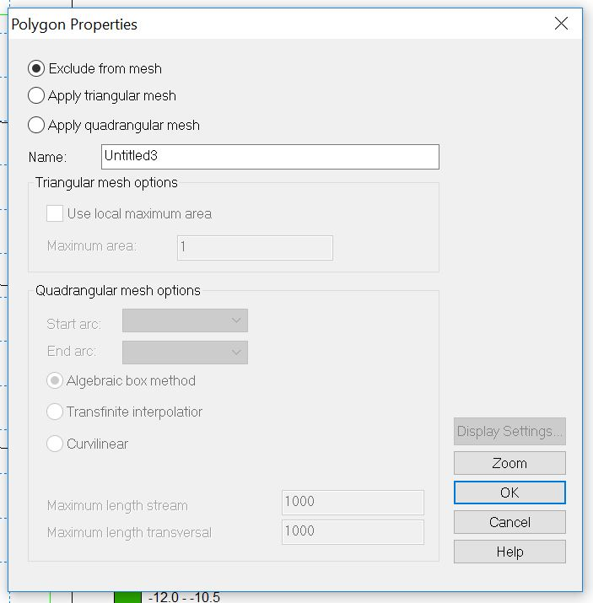

Slide 40
Do the same for the other land boundary too.

Slide 41
Apply Triangular Mesh
This step is not the creation of the mesh, but we are specifying the way creation of the mesh in this step.
Again apply Make Polygon Visible for the polygon of the water boundary.
Right click on the water boundary polygon and select the option “Properties” from the tool-bar options.

Slide 42
A “Polygon Properties” dialog box will be appeared.
Select the radio button left to the “Apply triangular mesh”
Not obligatory (optionally), you can set the name of the polygon.
Click “OK”.

Slide 43
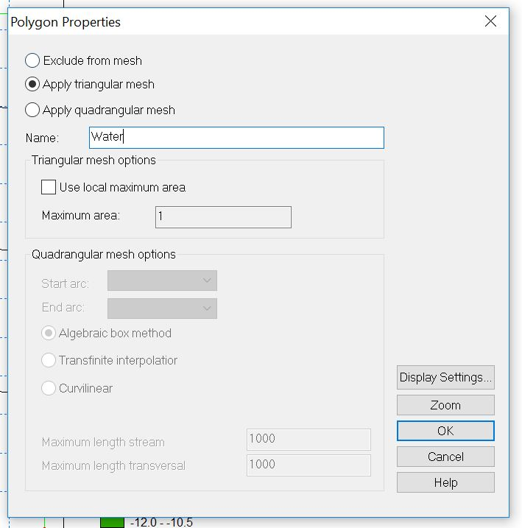

Slide 44

Creation of the mesh
Navigate to the smallest amount of Mesh> Generate Mesh… from the menu.

Slide 45
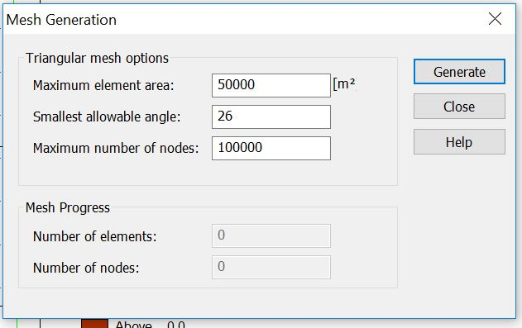
A “Mesh Generation” dialog box will be opened.
Make sure that “Smallest allowable angle:” is defined as 26 in this dialog box.
Click on the generate button.

Slide 46
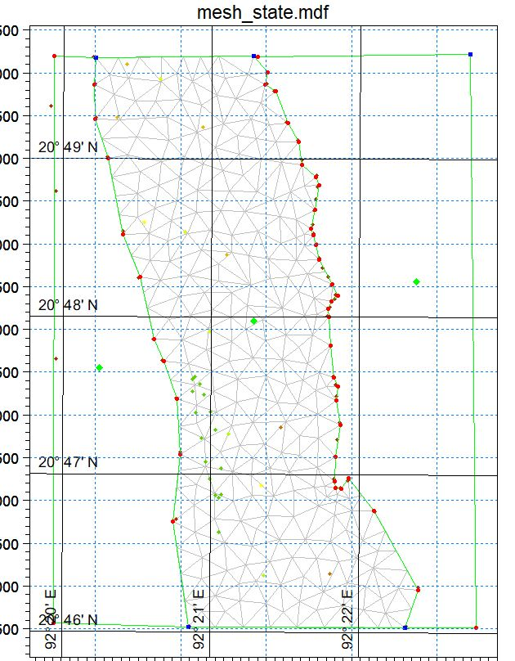
The following mesh would be created

Slide 47
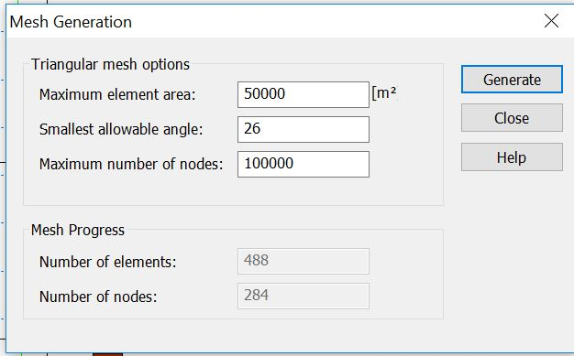
You could find the “Number of Elements” and the “Number of nodes” below the “Mesh Progress”.
In here, Number of elements: 488, Number of nodes: 284
If the number of elements is greater than 5000, simulation will not be run in the free version. To run the simulation, we will require MIKE license (the dongle which is a peripheral device. The license key code is restored inside this).

Slide 48
Smooth Mesh
Smoothing mesh is necessary for the curve fitting alongside boundary of the computational region.
Navigate to the Mesh> Smooth Mesh… from the Menu.
A “Smoothing” dialog box will be opened.

Slide 49
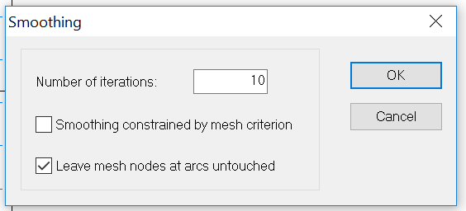
Set the “Number of iterations:” 10, then click on the “OK” button.

Slide 50
Interpolate Mesh
Navigate to the Mesh > Interpolate… from the main menu.
An “Interpolation” dialog box will be opened.
Click “Start” button.
Wait for some time until the mesh interpolation would be finished.
Check if the status is OK.
Click on the “Close” button.

Slide 51
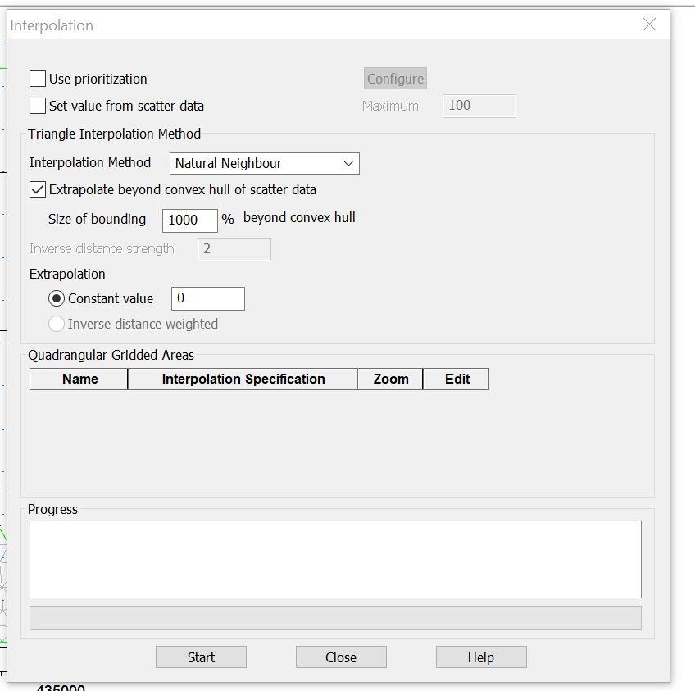
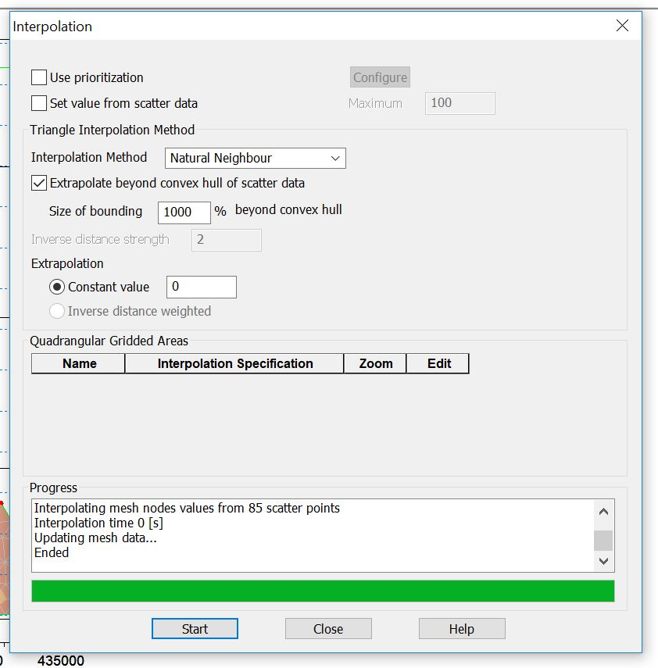

Slide 52
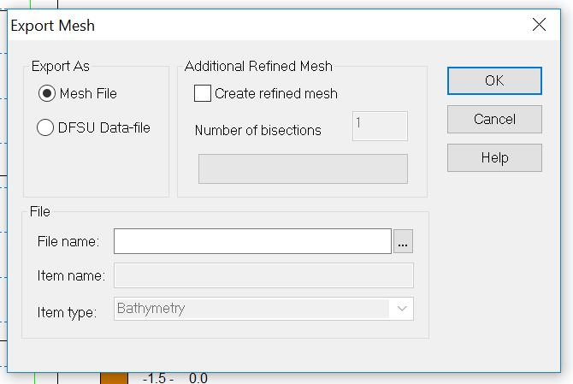
Export Mesh
Navigate Mesh > Export Mesh… from the menu bar.
An “Export Mesh” dialog box will be opened.
Browse the export file location
from the right of the File Name
and set a name for the exported
mesh file.

Slide 53
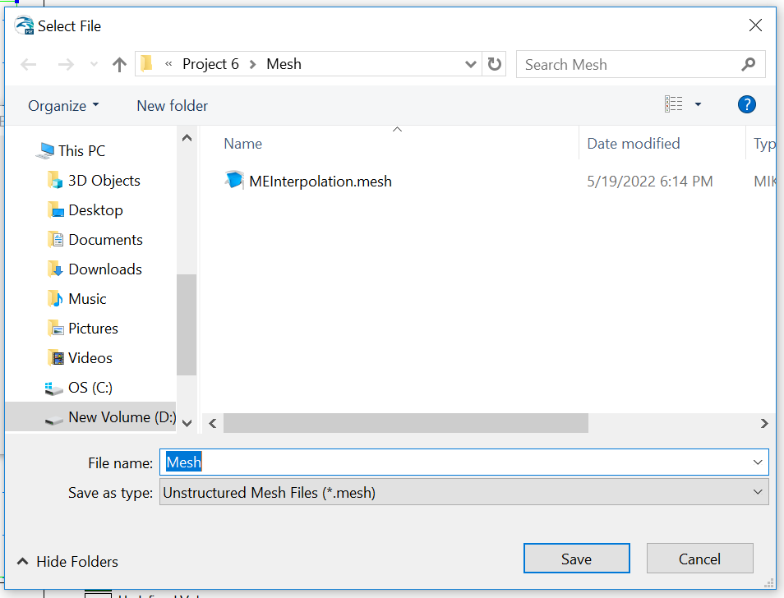
A “Select file” dialog box will be opened in the time of browse the export mesh directory. Set the mesh file name and click on the “Save” button.

Slide 54
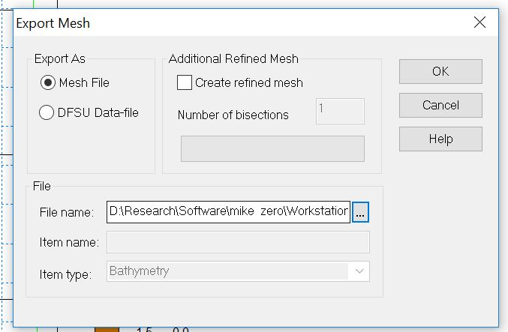
Then click on the “OK” button on the ‘Export Mesh” dialog box.

Slide 55
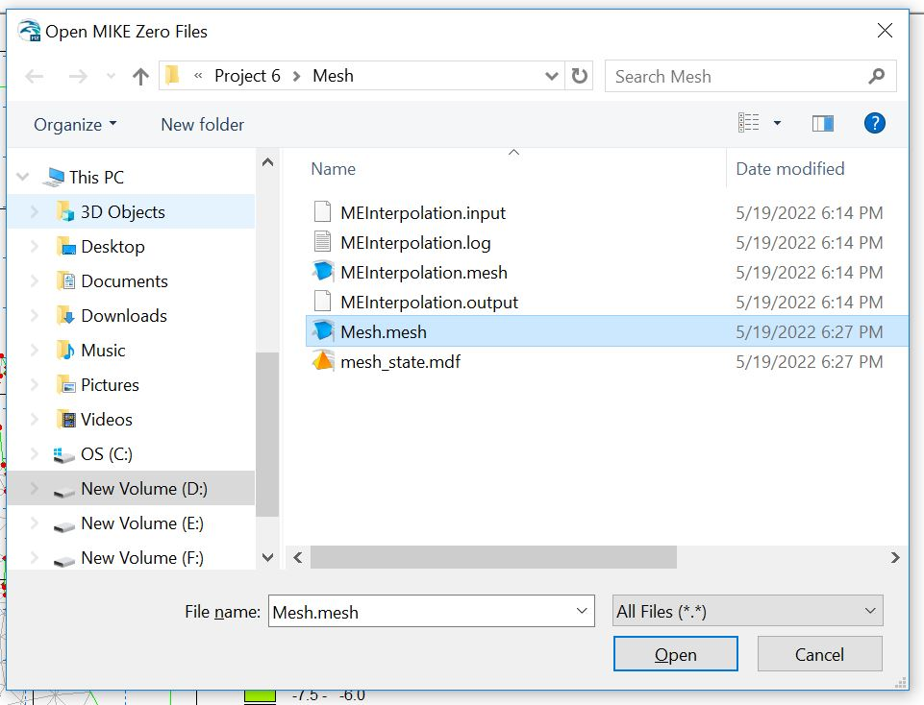
You can Have a look on the finally generated mesh. Press CTRL+O from the keyboard and select the just exported mesh, then click “Open” button.

Slide 56
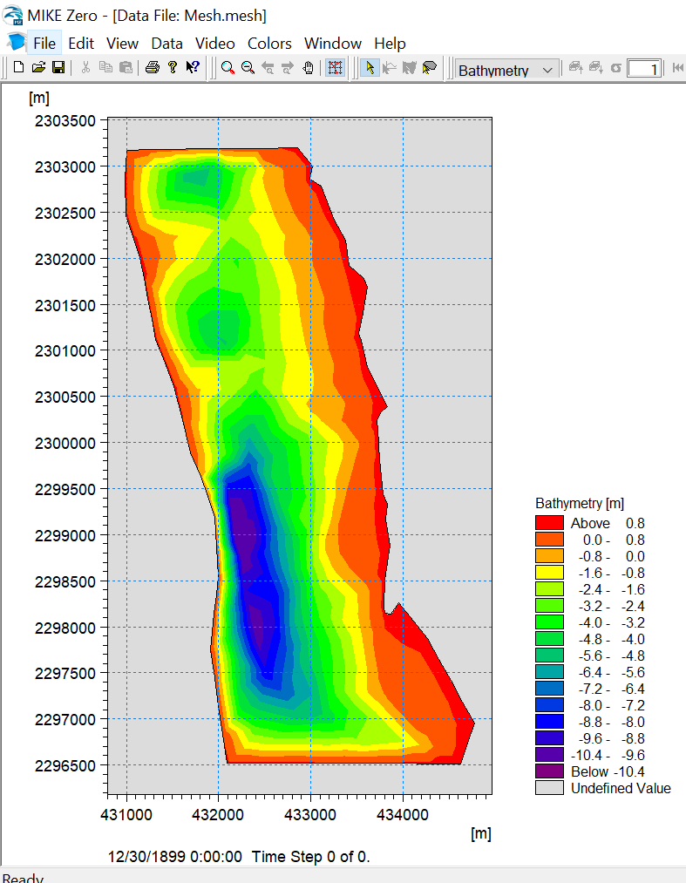
In the following, the generated mesh is shown as a contour plot

Slide 57
THE END

