Slide 1
Tutorial 5: A Presentation on the Tide Prediction with MIKE Zero Software
Author
Md. Nazmus Sanib Chowdhury
Scientific Officer
Hydrography and Oceanography
Celestial Tech Limited

Slide 2
The predicted tide will be used in Hydrodynamic simulation. It will be used as one of the initial data.

Slide 3
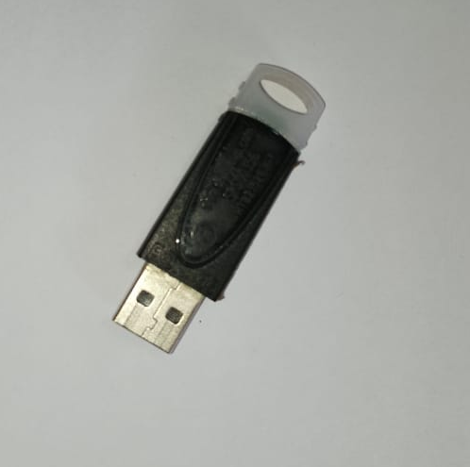
At first, connect your dongle through a USB port of your computer

Slide 4
Press CTRL+N from keyboard.
“New File” dialog box will be opened.
Select ‘MIKE 21” from the tree view of product types.
Select “MIKE 21 Toolbox (.21t) from the ‘Documents” section.
Click the “OK” button.

Slide 5
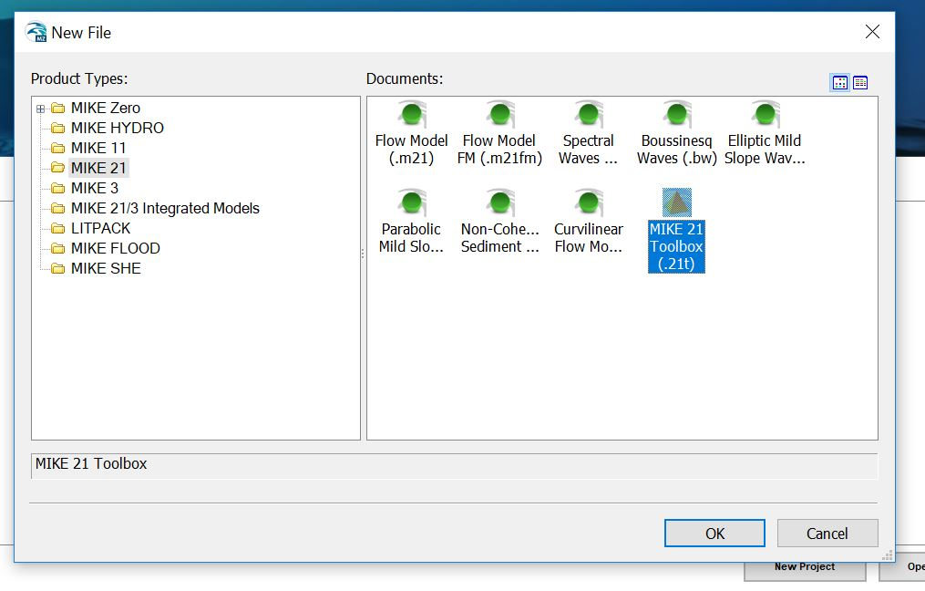

Slide 6
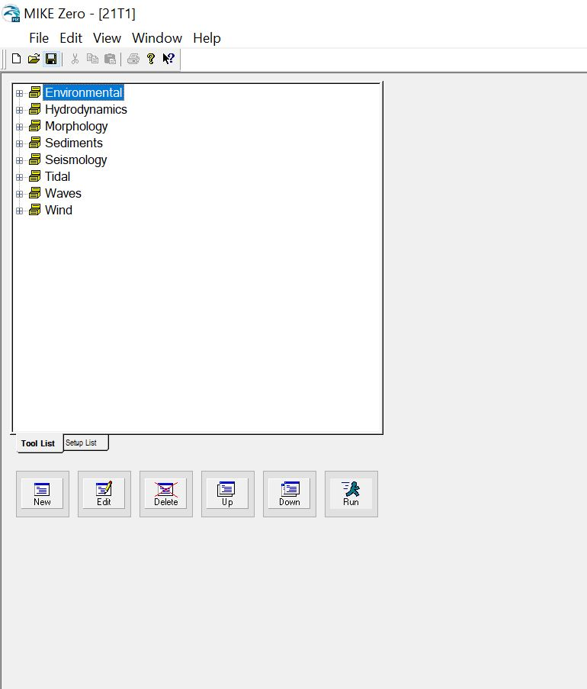
‘MIKE Zero – [21T1]” window will be opened

Slide 7
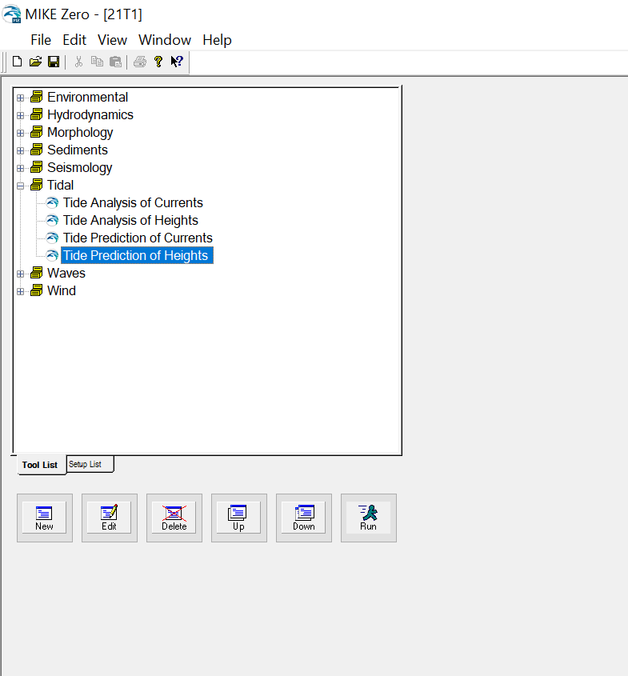
Click on the “+” left to the “Tidal” option from the tree view on the left side of the “MIKE Zero – [21T1] module.

Slide 8
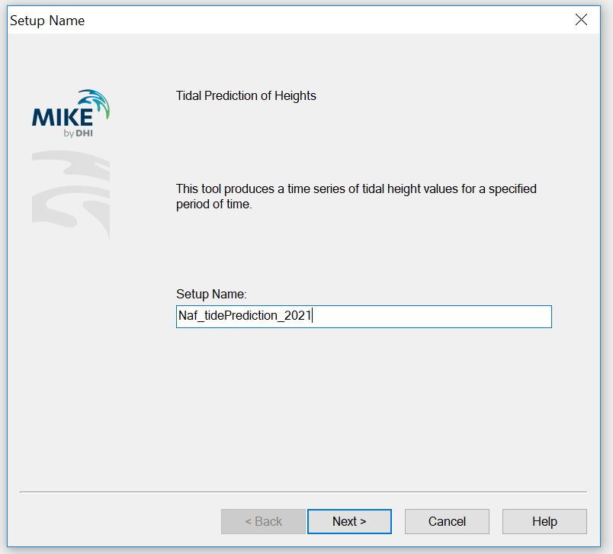
A “Setup Name” dialog box will be opened.
Type a name for the setup inside the box which is under the “Setup Name”
Click on the “Next” button.

Slide 9
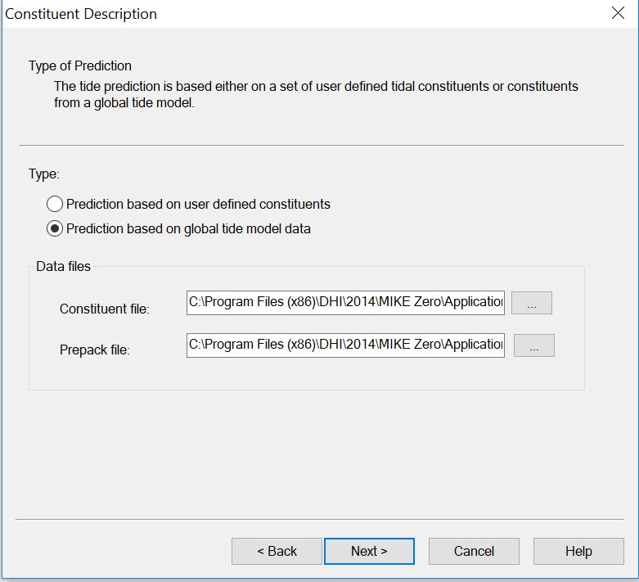
Then, “Constituent Description” dialog box will be opened.
Click on the radio button left to the “Prediction based on global tide model data”

Slide 10
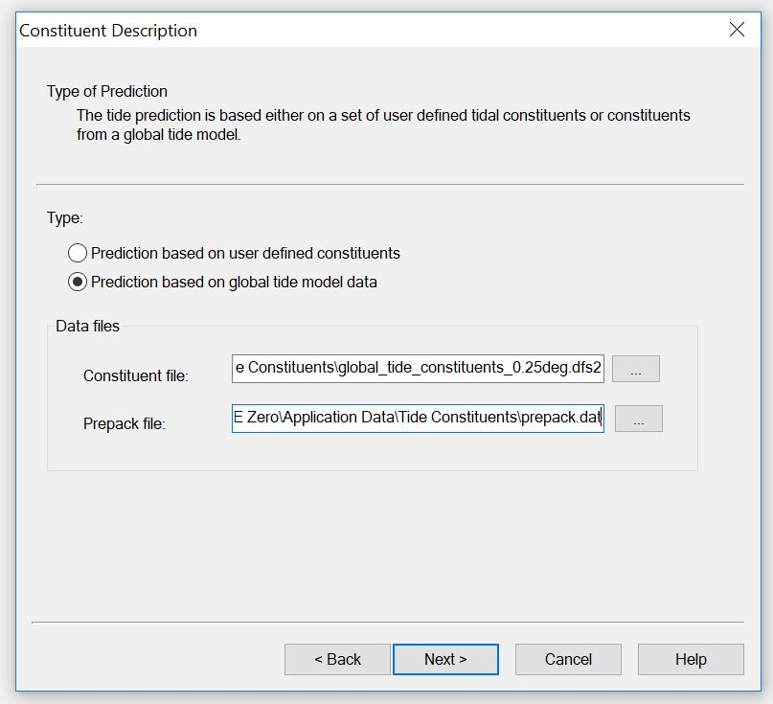
Check if the selected “Constituent file:” is “global_tide_constituents_0.25deg.dfs2”. Click on the “Next” button.

Slide 11
“General Parameters” dialog box will be appeared.
Select the “Type of output” as “Line series (dfs1)”.
Set the “Start Date:” as 1/1/2021 and enter the “Stop Date” as 12/31/2021 under the “Prediction Period”.
Set the “Interval” as 1 hour.
Then click on the “Next” button.

Slide 12
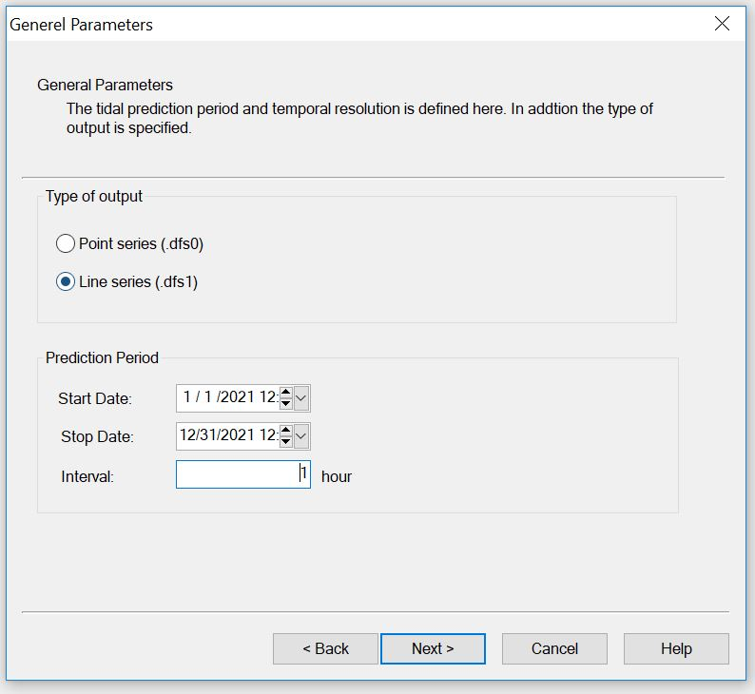

Slide 13
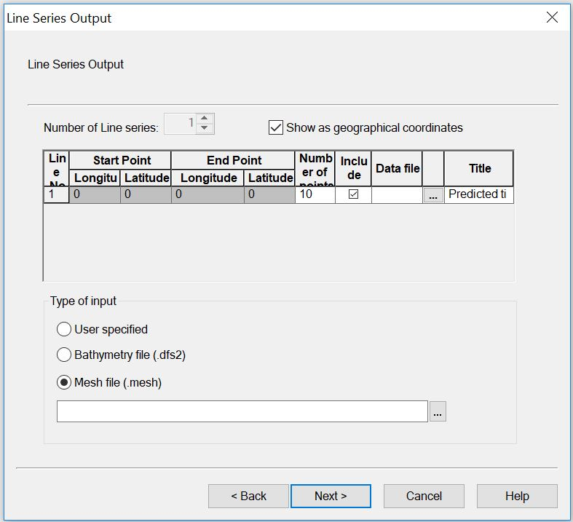
“Line Series Output” dialog box will be appeared.
Click on the radio button left to the “Mesh file (mesh)”.

Slide 14
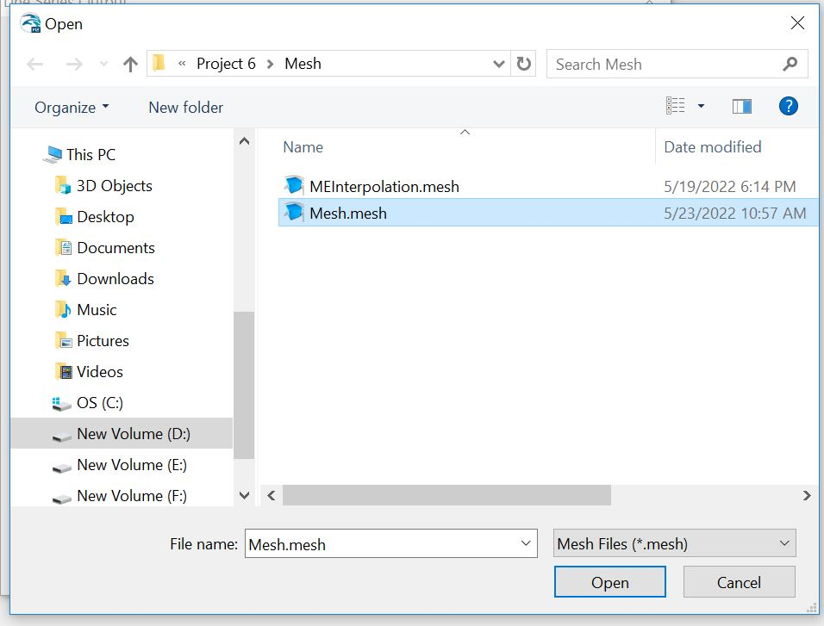
An “Open” dialog box will be appeared.
Select the Mesh file we created in the tutorial 4: mesh generation tutorial.
Click on the “Open” button.

Slide 15
Then, according to the following figure, number of line series is 2, as we defined 2 arcs (AB and CD) in the tutorial of mesh generation.
Check if the “Show as geographical coordinates” is selected.
Find out the northern line series and southern line series from the value of “Latitude” in the “Start Point” and “End Point” from the table of “Line Series Output”.
Line series no 1 is northern line as its latitude (“Start Point” = 20.8241, “End Point” = 20.8243) is greater than the latitude (“Start Point” = 20.7667, “End Point” = 20.7672) of the Line series no 2.

Slide 16
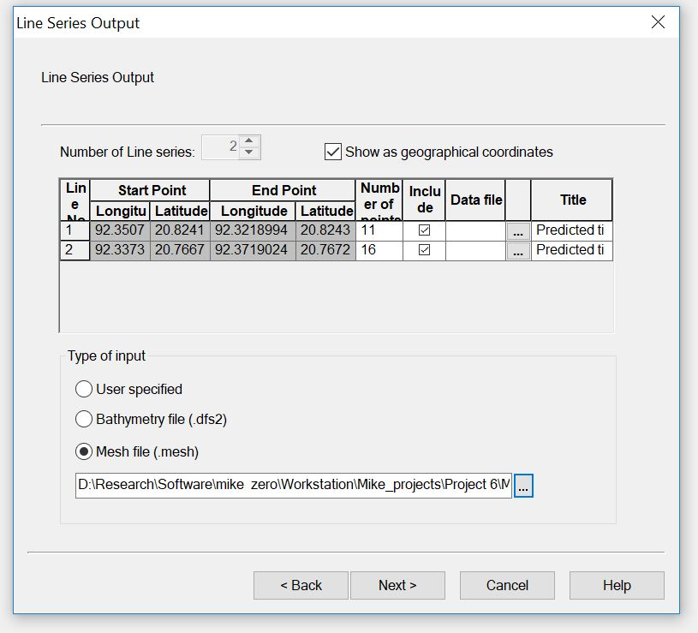
Then select this 3 dots

Slide 17
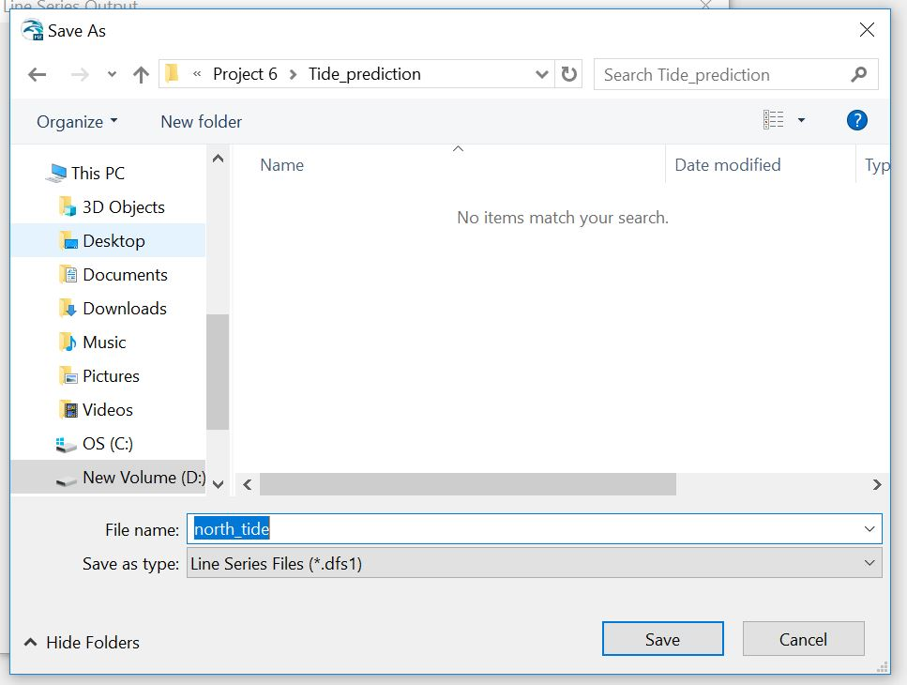
Then a “Save as” dialog box will be opened.
Set the file name and then click on the “Save” button.
The predicted tide for the line series 1 will be saved as this file name.

Slide 18
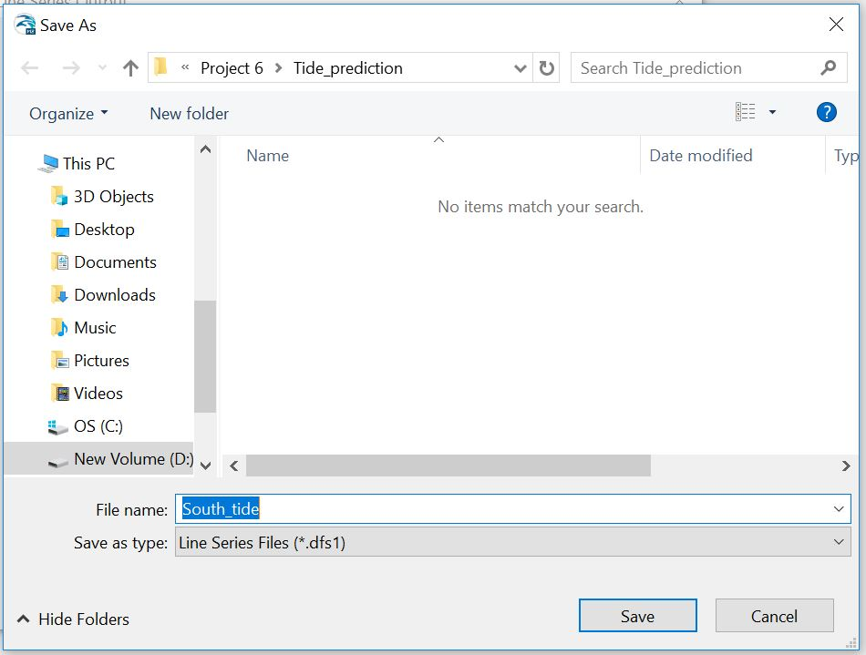
In the same way set the name of the southern line series.

Slide 19
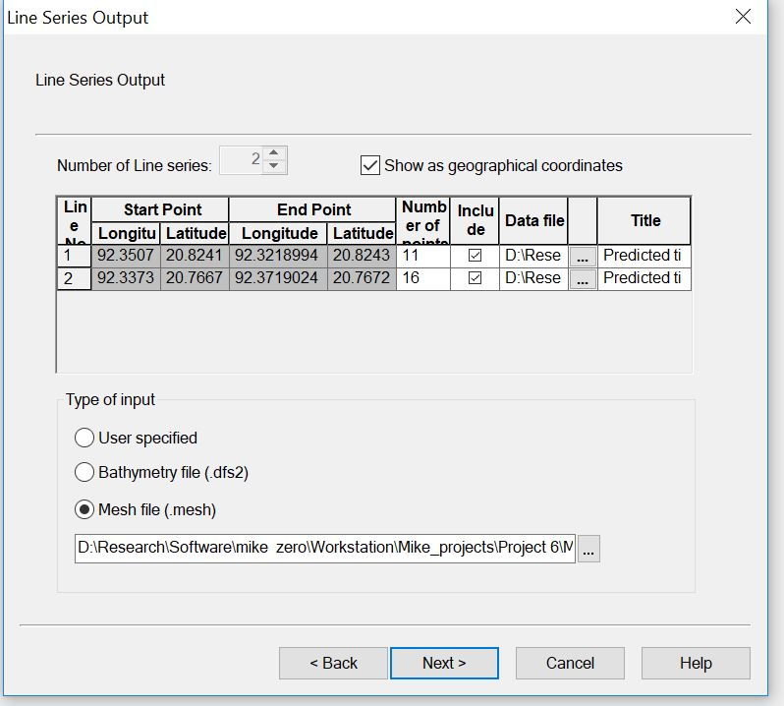
Click on the “Next” button.

Slide 20
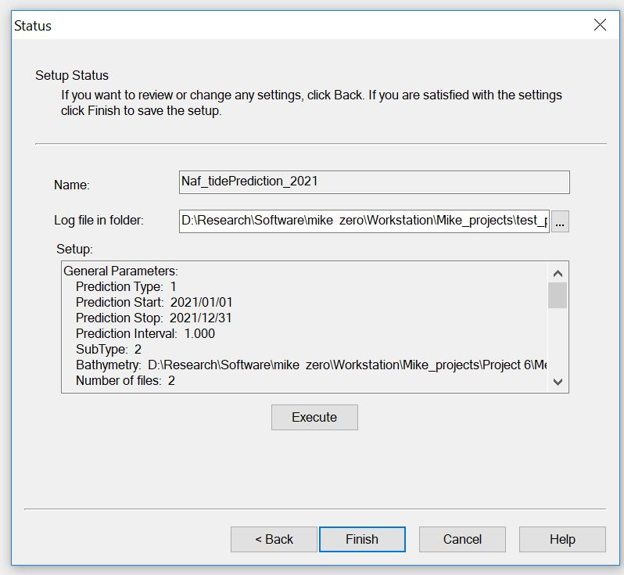
A “Status” dialog box will be appeared.
Click on the “Execute” button.

Slide 21
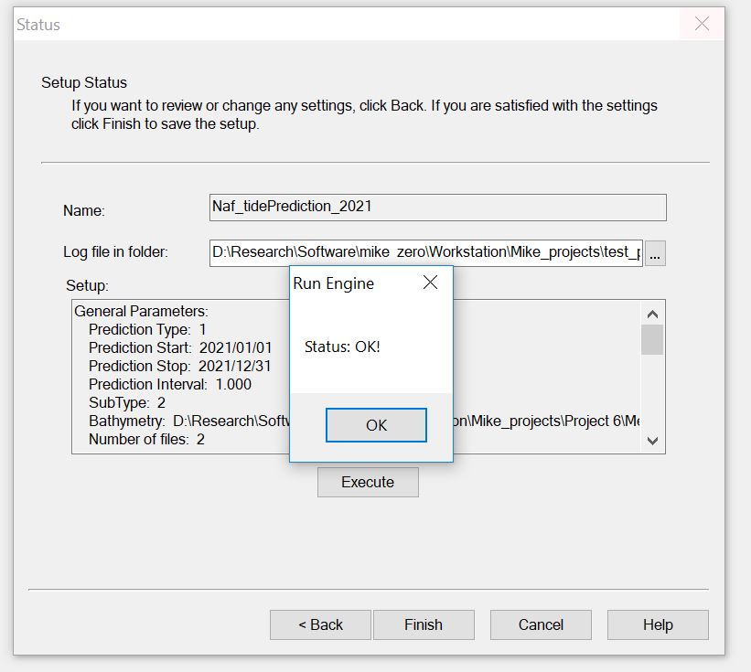
Then the tide prediction calculation will be started.
If everything is fine message “Status: OK!” will be appeared in the window after finishing the tide prediction. Click “OK” button on this message tab.

Slide 22
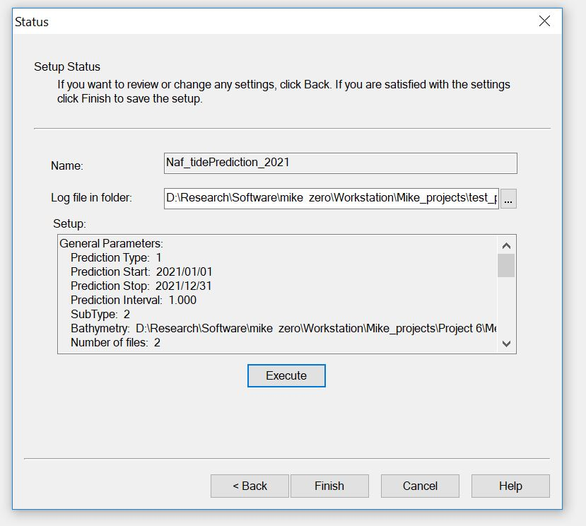
Click finish and terminate the program.

Slide 23
The End
Thank You

