Slide 1




University of Asia Pacific
Department of Computer Science and Engineering
Course : BUS 301 | Semester : 3.1 | Section : A
Navigating the Future of Urban Farming:
“A Smart Aquaponics Approach”
Submitted by :
23201009 MD. Momin Ali Rifat
23201023 MD. Nazmuz Saif 23201033 Kamrul Hasan Siam
23201050 MD. Tahsin Rahman Khan
Submitted to:
Towfiq Ahmed
Lecturer
Dept. of Business Administration
University of Asia Pacific

Slide 2



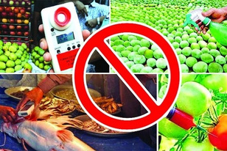


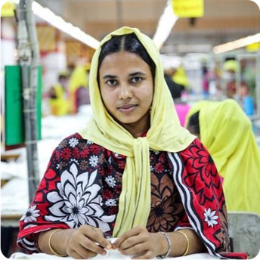


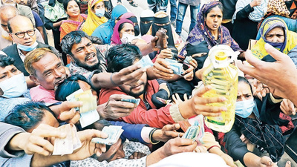

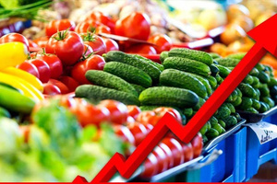

Problem
Food Adulteration
Declining Avg. Income
Salma, Consumer
(A garment’s worker)
Increased Price Hikes

Slide 3
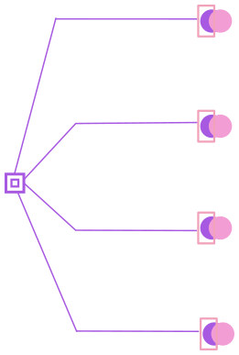




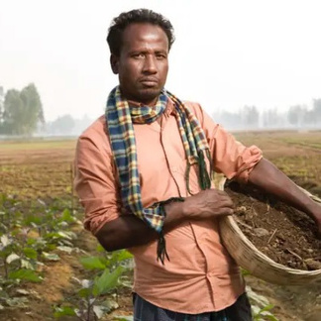






Problem
Loses 40%Revenue
Inadequate Yields
Technology Deficit
Mahin Farmer
Climate Disasters

Slide 4





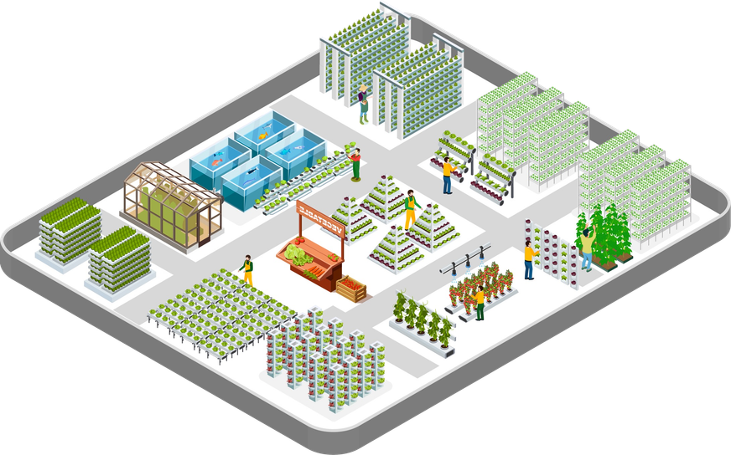








Solution
Excellent Yields
Producing Green
Foods
Data-Driven
Analytics
Eliminating Price
Hikes

Slide 5

















Opportunity & Target Market
Market Trends:
Rapidly increasing demand for organic and chemical-free food
Growing preference for traceable and locally produced products
Urban consumers are becoming more health-conscious
60%
Target Market for Setup Services
Revenue Sources
Hobbyist homeowners
Farmers
corporate offices
Forecast

Slide 6
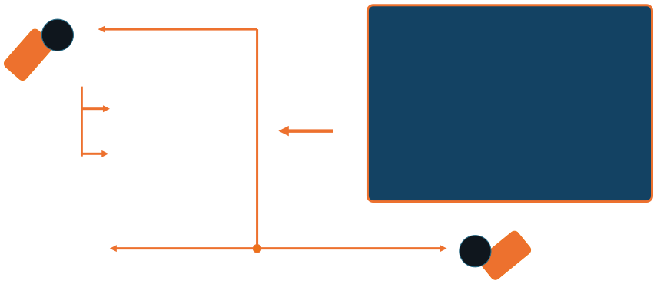
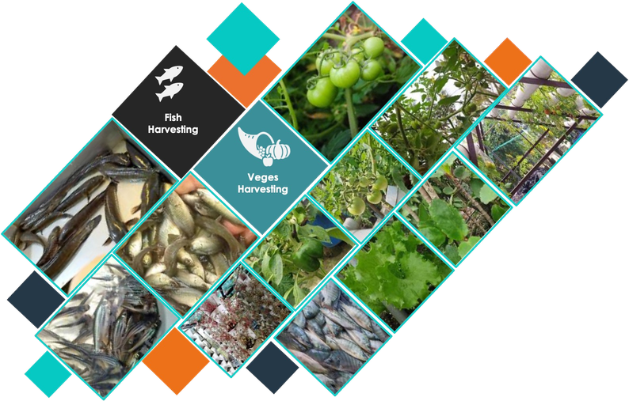







Opportunity & Target Market
Target Market for Products:
01
60%
Six Floor Building
Mid-to-high-income urban families
Offering 15%
savings
02
03
20%
20%
B2B with
Restaurants
premium super shops

Slide 7





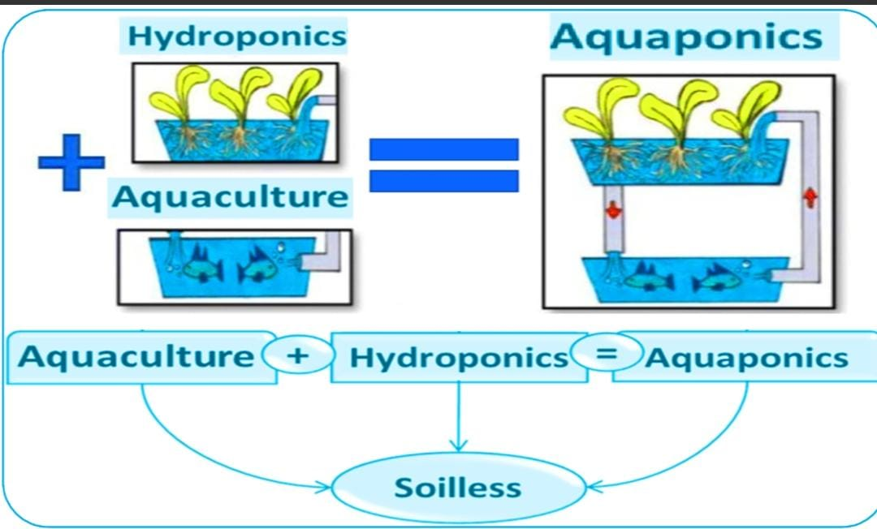






Technology
Aquaponics
Hyper Local Vertical Farming
RAS Technology
Vertical Farming
LED Grow Lights
Auto Monitoring
Our Implementation

Slide 8






Competition
Business Type
Smart Farming
Super Shop
Online Shop
Super Shop
Super Market
Category
Groceries
Groceries &
Groceries &
Groceries &
Groceries &
other items
other items
other items
other items
Freshness
High
Medium
Medium
Low
Low
Price
Low
Strong
Medium
Medium
Medium
Medium
Quality Control
Delivery
Very Strong
Strong
Strong
Strong
Within 45 mins
Within 2 hours
Within 1 hour
Within 2-3 hours Within 3 hours
Customer Target
Mass Customers
Online Buyers
Family Shoppers
Premium
Customers
Health-conscious

Slide 9
Marketing & Sales
Marketing Strategy
Target: Urban health-conscious consumers in Dhaka
Model: Direct-to-Consumer (D2C) for fresh delivery
Promotion: Social media marketing (Facebook, Instagram) with “Farm-to-Table Freshness” branding
Year | Revenue (৳) | Cost (৳) | Operating Profit (৳) | Previous Loss Adjusted | Net Cumulative Profit (৳) | Growth Rate
Year 1 | 4,00,000 | 6,00,000 | -2,00,000 | 0 | -2,00,000 | Base Year
Year 2 | 4,00,000 | 80,000 | 3,20,000 | -2,00,000 | 1,20,000 | +260%
Year 3 | 4,00,000 | 80,000 | 3,20,000 | 1,20,000 | 4,40,000 | +166%
Year 4 | 4,00,000 | 80,000 | 3,20,000 | 4,40,000 | 7,60,000 | +73%
Year 5 | 4,00,000 | 80,000 | 3,20,000 | 7,60,000 | 10,80,000 | +42%

Slide 10




























Management Team
CEO
Kamrul Hasan Siam
Leads overall strategy, business planning, and smart rooftop farming integration.
Momin Ali Rifat
CTO
Manages IoT systems, automation, and technical infrastructure
Operations Manager
Nazmuz Saif
Handles rooftop farming operations, logistics, supplier coordination, and product delivery.
Tahsin Rahman Khan
Marketing
Manager
Responsible for branding, customer acquisition, partnerships, and market expansion.

Slide 11
Financial Projections
Initial Investment & Cost Structure :
Rooftop Partnership Model
Full farming setup cost will be managed by FarmEX
Rooftop owners will provide rooftop space
Profit-sharing model:
Rooftop Owner: 15% – 20% profit share
FarmEX: Remaining operational profit
Initial Setup Cost
Smart Rooftop Farming Setup → ৳4,00,000
IoT system
Irrigation
Solar support
Aquaponics infrastructure
Seeds & Fish Cost (First 4 Months) → ৳60,000×3=৳1,80,000
Approx Total Cost → ৳6,00,000
Fish Production Revenue → 600 kg yearly ≈ ৳3,60,000 Vegetable Production Revenue → ≈ ৳40,000
Total Annual Revenue per Unit → ৳4,00,000
Annual Operational Cost (after setup) → ৳80,000
Annual Operating Profit per Unit → ৳3,20,000
Break-Even Time
BEP = Initial Investment / Annual Profit
BEP = 6,00,000 / 3,20,000= 1.875 years
Monthly Income per Setup → ≈ ৳30,000
Technology Service Revenue → 15% profit margin from setup sales
👉 FarmEX achieves break-even in Year 2 and generates stable recurring profit from Year 2 onward

Slide 12







Current Status
FarmEX is currently in the pre-launch / development stage
Core business model, rooftop farming system, and financial plan have been fully designed
Market research and competitor analysis have been completed
Prototype planning for smart rooftop farming + aquaponics system is in progress

Slide 13
Financing Sought
Total financing required: ৳6,00,000 (per rooftop unit setup)
Use of Funds:
Smart Rooftop Farming Setup (IoT, irrigation, aquaponics) → ৳4,00,000
Seeds & Fish Stock (1 Year) → ৳1,80,000
Installation, setup support & contingency → ৳20,000
Funding Purpose:
To build and deploy the first operational FarmEX rooftop farming unit
To establish a scalable model for multiple rooftop expansions
To support initial production until break-even is achieved in Year 2

Slide 14
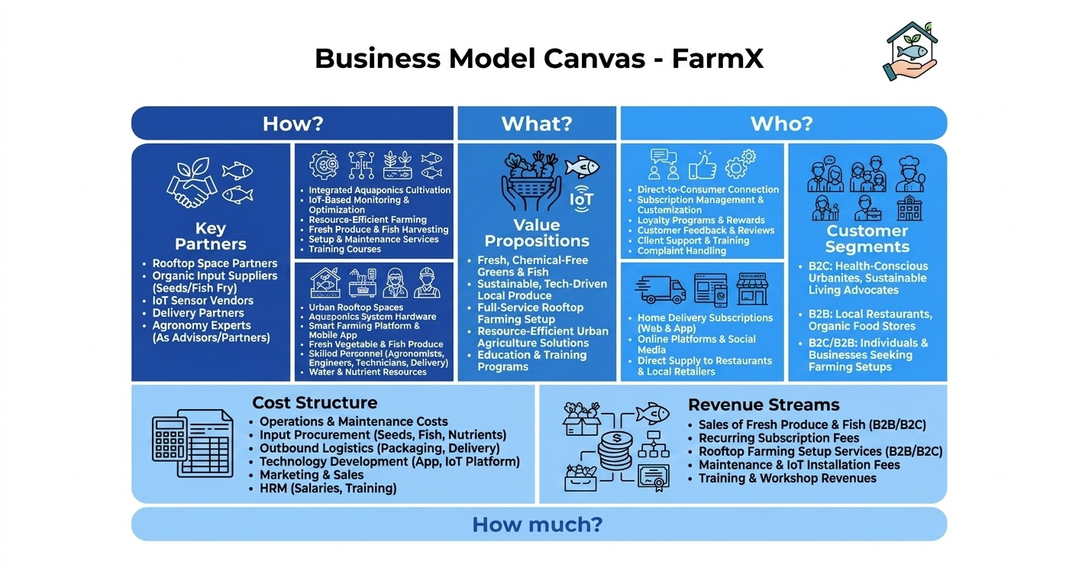
Financing Sought

Slide 15
Value Chain
Core Activities | Inbound Logistics | Operations | Outbound Logistics | Marketing and Sales | After Sales Services
 | Rooftop space partnerships organic vegetable procurement Fish supply (aquaponics system) Nutrients & bio-fertilizers IoT sensors & smart farming equipment procurement | Rooftop aquaponics farming setup IoT-based monitoring Automated water circulation system Vegetable cultivation & fish farming (integrated system) Growth tracking & data | Fresh vegetable & fish packaging Home delivery system (B2C) Supply to restaurants & local retailers (B2B) Minimal cold-chain logistics (fast delivery focus) | Social media marketing (Facebook, Instagram, TikTok) SEO & website-based awareness Referral & community farming campaigns Partnerships with restaurants & healthy food brands Educational content on sustainable farming | Customer feedback & review system Subscription management & customization Complaint handling & replacement support Loyalty programs & reward points Guidance/support for rooftop farming setup clients
Support Activities | Infrastructure | Legal & compliance framework (food safety, urban farming) Business administration & finance system
 | HRM | Agronomists & aquaponics specialists IoT engineers & software developers Farm technicians & maintenance staff
 | Technology Development | IoT-based smart farming system Mobile app for monitoring & subscription Data analytics for crop/fish optimization
 | Resource Procurement | Organic seeds & fish fry suppliers IoT hardware vendors (sensors, controllers) Farming equipment & materials Packaging materials (eco-friendly)

Slide 16

Thanks!
Any Questions ?

