Slide 1
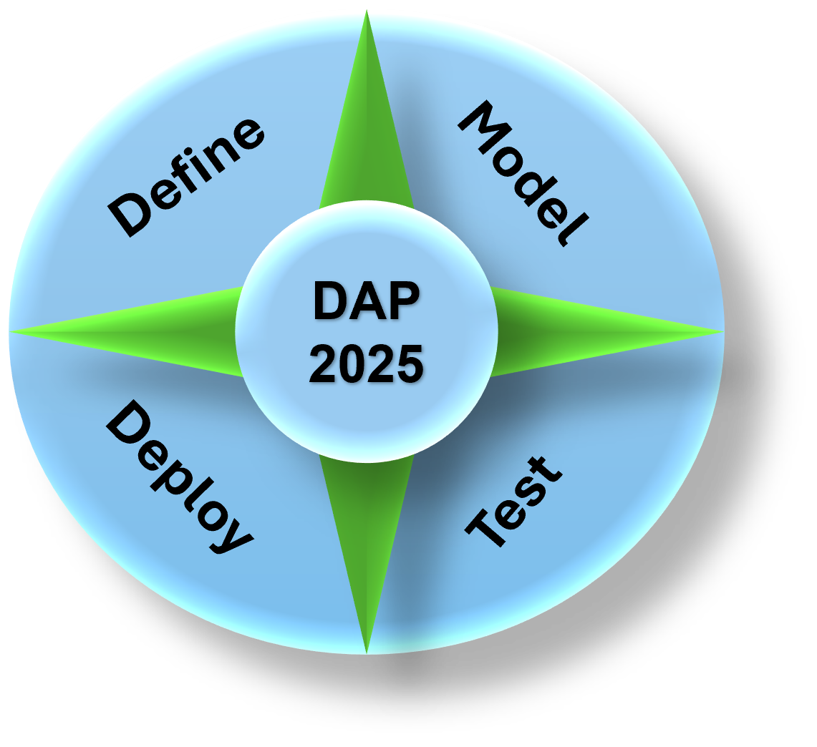
Data Analytics Program
(DAP - 2025)
By Mustapha Bouchaqour
Week #12 – Saturday, April 26

Slide 2

Agenda
Lecture:
What is Pandas?
Why Pandas?
Demo:
How Does Pandas Work With Python?
Q&A:

Slide 3

What’s Pandas?
Pandas is an open-source library in Python, designed specifically for:
Data manipulation
Analysis
Exploration
Pandas provides flexible and powerful tools to handle structured data efficiently. Think of it as a Swiss Army Knife for working with datasets!
Pandas is built on NumPy, so it can handle large datasets while offering features like labeled axes (rows and columns). It’s especially handy for tasks like:
Reading/writing data from various formats (CSV, Excel, SQL, etc.)
Cleaning and organizing messy data.
Performing statistical analysis
To give Python these enhanced features, Pandas introduces two new data types to Python:
Series: Is a single column of the DataFrame
DataFrame: Represent your entire spreadsheets or rectangular data. DataFrame can also be thought of as a dictionary or collection of series object.

Slide 4
Why Pandas?
Ease of Use: Intuitive syntax that simplifies working with large datasets.
Flexibility: Support data formats like CSV, JSON, Excel, SQL databases, and more
Powerful Functions: Offers filtering, grouping merging, and reshaping data effortlessly.
Efficiency: Optimized for fast computations, even with large data.

Slide 5
Demo
(Python)

Slide 6


