Slide 1

Note: The data and information in this document is reflective of a hypothetical situation and client. This document is to be used for KPMG Virtual Internship purposes only.
Sprocket Central Pty Ltd
Data analytics approach
Junior Analyst–Nazrin Jafarova

Slide 2
Note: The data and information in this document is reflective of a hypothetical situation and client. This document is to be used for KPMG Virtual Internship purposes only.
Agenda
Introduction
Data Exploration
Model Development
Interpretation

Slide 3
Note: The data and information in this document is reflective of a hypothetical situation and client. This document is to be used for KPMG Virtual Internship purposes only.
Introduction
Customers analysis
Age distributions
Number of bike purchases in 3 years / percentages purchases
Job industry category
RFM analysis
Number of cars own on each states

Slide 4
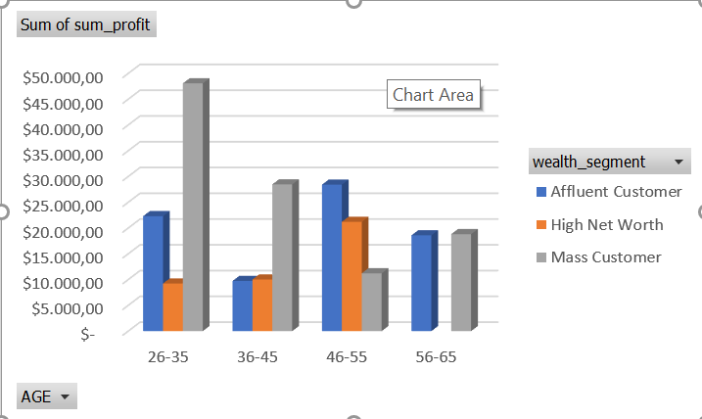
Note: The data and information in this document is reflective of a hypothetical situation and client. This document is to be used for KPMG Virtual Internship purposes only.
Data Exploration
Customers’ age distribution
As we can see, mostly our new customers are between 26 to 65 years old.
Number of customers from 26 to 35 years old is Mass Customer than others
There is a slightly increase in number of High Net customers between 46-55 years old in term of percentages
Affluent Customers are between 46-55 years old customers.

Slide 5
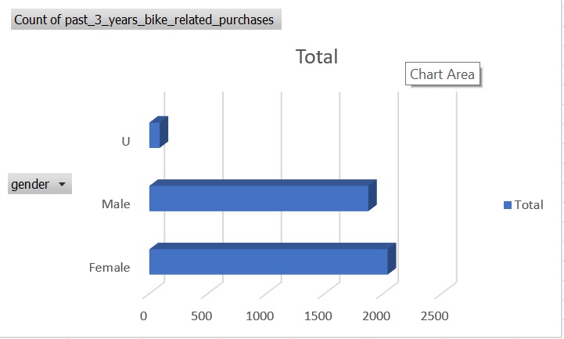
Note: The data and information in this document is reflective of a hypothetical situation and client. This document is to be used for KPMG Virtual Internship purposes only.
Model Development
Bike purchases last 3 years
As we can see, our new customers mostly Female with with total of 2039 bikes.
Male contributed with 1873 bikes.
U customers bought a total of 88 bicycles. This quantity is very low.

Slide 6
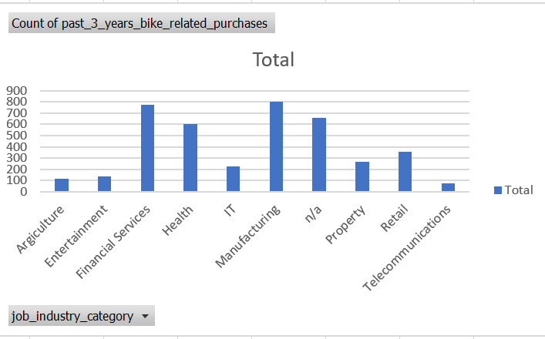
Note: The data and information in this document is reflective of a hypothetical situation and client. This document is to be used for KPMG Virtual Internship purposes only.
Interpretation
Job industry category
Mostly our new customers are on Manufacturing industry and our Financial Services customers are still on top 2.
The remaining industries are slightly diferent from each other. The least productive area is Telecommunication.

Slide 7
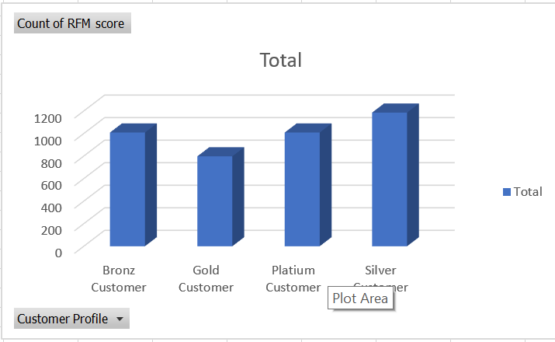
Note: The data and information in this document is reflective of a hypothetical situation and client. This document is to be used for KPMG Virtual Internship purposes only.
Interpretation
RFM analysis
We divide the customers into 4 groups by RFM analysis:
Platium Customer 1009
Gold Customer 798
Silver Customer 1186
Bronz Customer 1009

Slide 8
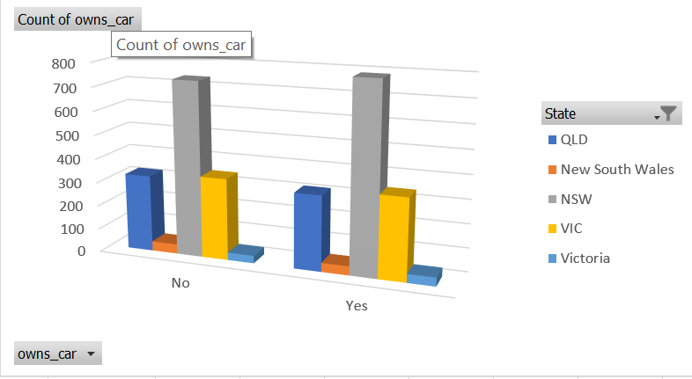
Note: The data and information in this document is reflective of a hypothetical situation and client. This document is to be used for KPMG Virtual Internship purposes only.
Interpretation
Numbers of cars owned
NSW should be considered the most, because the number of customers who have their own car is much higher than those who do not have their own car.
VIC and QLD has more customers that own car that who don’t but we can try to have something so that those owns car will buy bikes.

