Slide 1
Nazrin Muradova AI
Flowers Trained
PPTX

Slide 2
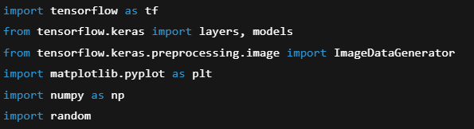
Framework , Library insertion

Slide 3
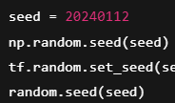
Seed configration

Slide 4
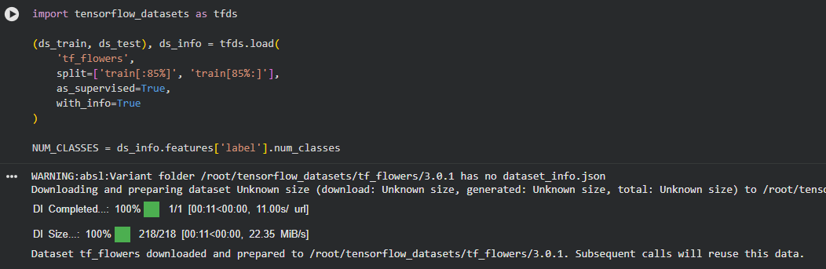
Downlaod Flowers Dataset

Slide 5
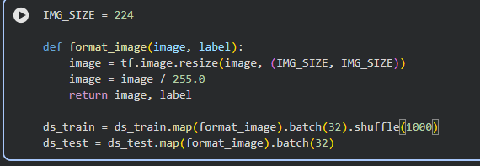
Preprocessing

Slide 6
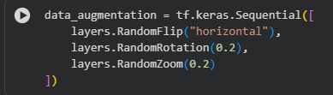
Data Augmentation

Slide 7
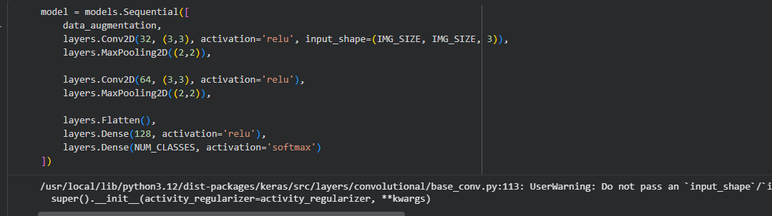
Create CNN Model

Slide 8
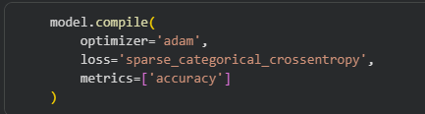
Compile

Slide 9
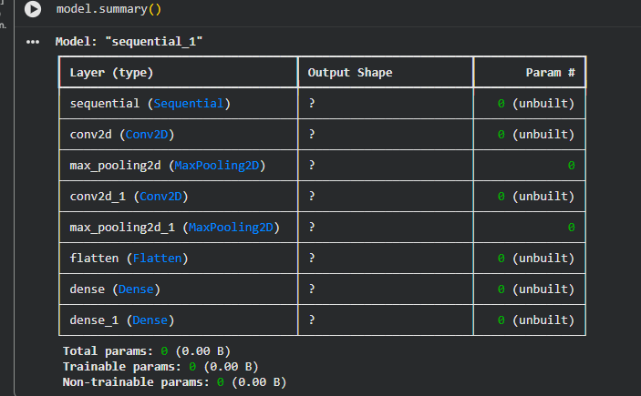
Model Summary

Slide 10
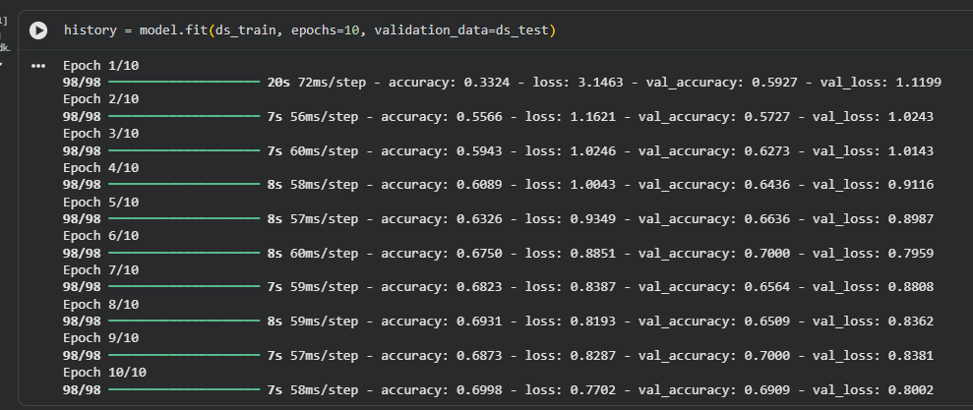
Train

Slide 11
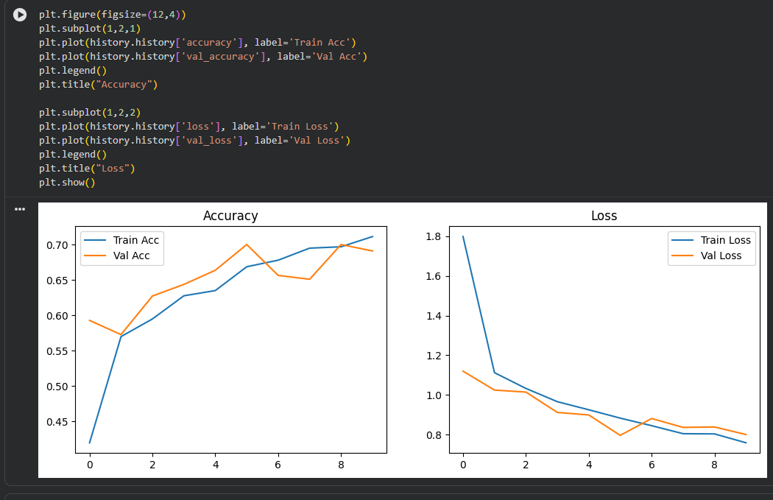
Plots with matplot

