Slide 1
Project #2
National foods of Kazakhstan
Tairova Nazymgul 200103520
Nurlanbek Karlygash 200103199

Slide 2


Bootstrap’s grid system

Slide 3


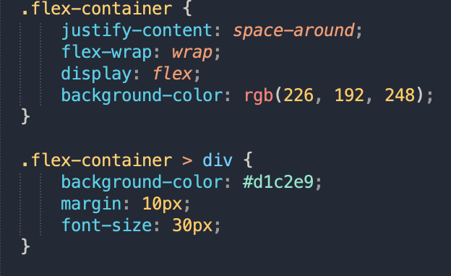
Flex-container

Slide 4

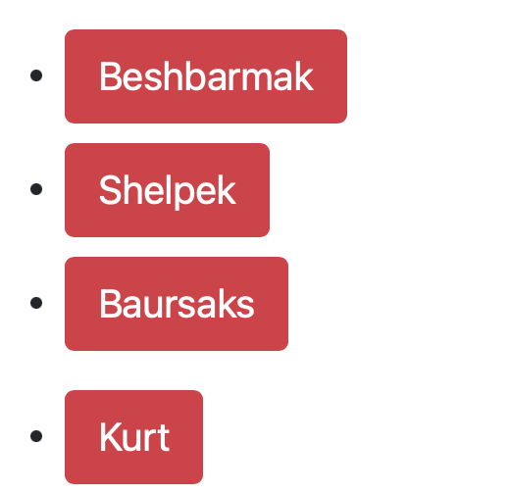


Bootstrap Button

Slide 5
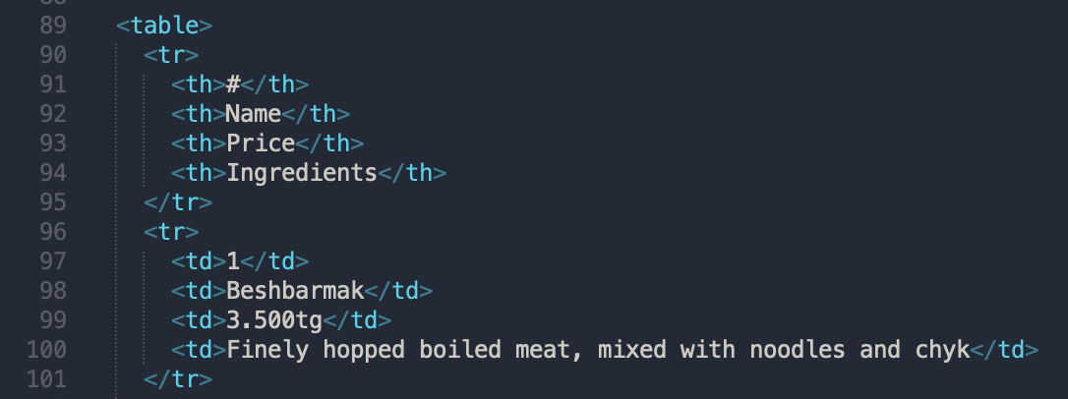
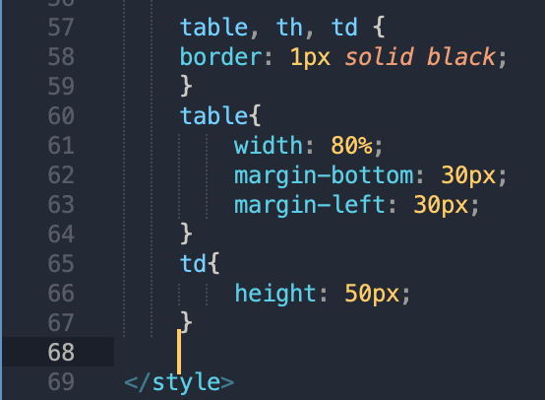

2 Tables

Slide 6
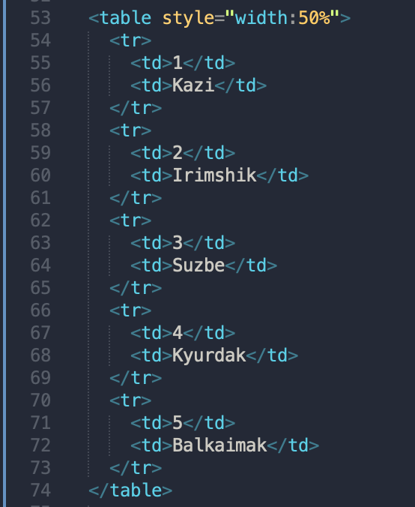
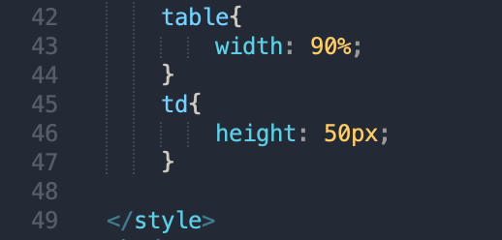
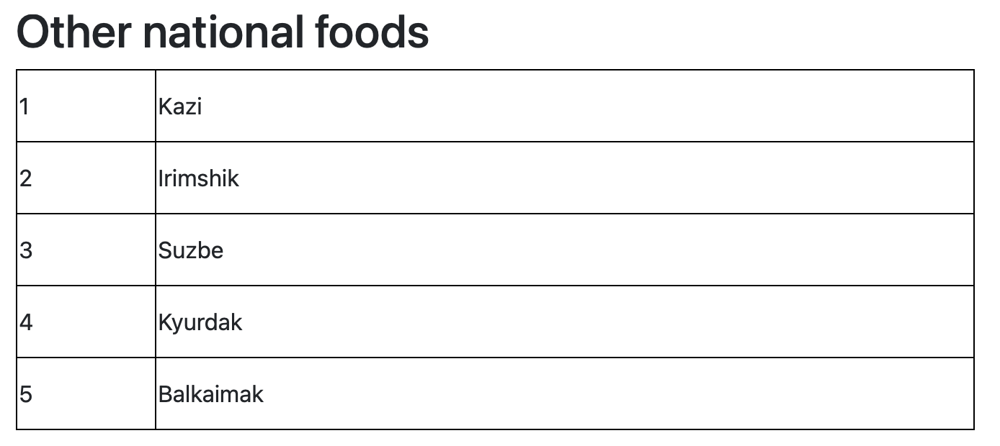

Slide 7


Color
Hex, rgb, rgba, hsl, hsla

