Slide 1





Colour Detection using OpenCV and pandas

Slide 2

Project work submitted to
Indian Institute of Information Technology Kalyani.
3rd-year (6th Semester) Project
By:
Nikita Barua(39/CSE/17053/251)
Ritu Chauhan(39/CSE/17070/268)
Sanny Kumar(39/CSE/17075/273)
Mentor: Dr. Bhaskar Biswas
(Assistant Professor)
<number>

Slide 3
Acknowledgement
First of all, we would like to take this opportunity to thank our supervisor Dr. Bhaskar Biswas without whose effort this project would not have been possible. We are most grateful to the Department of Computer Science and Engineering, Indian Institute of Information Technology Kalyani, Kalyani, West Bengal-741235, India, for providing us this wonderful opportunity to complete our 3rd-year(6th Semester) project. We would like to thank our friends for helping with various topics related to Image Visualisation.
<number>

Slide 4
Contents
1.Introduction
2.Requirements
3.Working & Result
4.Advantages & Disadvantages
5. Applications
6. Conclusion
7. Future Scope
<number>

Slide 5



1.Introduction
Colour detection is the process of detecting the name of any colour. For humans this is an extremely easy task but for computers, it is not straightforward. Human eyes and brains work together to translate light into colour. Light receptors that are present in our eyes transmit the signal to the brain. Our brain then recognizes the colour. Since childhood, we have mapped certain lights with their colour names. We will be using the somewhat same strategy to detect colour names. Colours are made up of 3 primary colours; red, green, and blue. In computers, we define each colour value within a range of 0 to 255. So in how many ways we can define a colour? The answer is 256*256*256 = 16,581,375. There are approximately 16.5 million different ways to represent a colour. In our dataset, we need to map each colour’s values with their corresponding names. But don’t worry, we don’t need to map all the values. We will be using a dataset that contains RGB values with their corresponding names.

Slide 6
What is OpenCV?
OpenCV is a Computer Vision library. It is a collection of C functions with a few C++ classes that implement popular Image Processing and Computer Vision algorithms. Computer vision is the science that means to give a comparative, if not better, capacity to a machine or PC. Computer vision is worried about the programmed extraction, investigation and comprehension of valuable data from a single picture or a grouping of pictures. Some of the basic image processing capabilities include filtering, edge detection, corner detection, sampling and interpolation, colour conversion, morphological operations, histograms and many more.
<number>

Slide 7
Why use OpenCV?
Colour detection using OpenCV has many advantages like, it allows the detection of a specific colour in a livestream video content. In this OpenCV colour detection system there are four major modules, activated webcam, scan object, match frame parts and system results. Users can open webcam by clicking the webcam button. Then the algorithm analysis the pattern of the framed part of webcam. Pattern is matched with defined colour pattern by RGB colour model. If the pattern matched with the potential pattern of RGB colour model then the system results with the correct output.
<number>

Slide 8
What is pandas in python?
Pandas is an open-source, BSD-licensed Python library providing high-performance, easy-to-use data structures and data analysis tools for the Python programming language. Python with Pandas is used in a wide range of fields including academic and commercial domains including finance, economics, statistics, analytics, etc. In this tutorial, we will learn the various features of Python Pandas and how to use them in practice.
<number>

Slide 9
Why use pandas?
Pandas is very efficient with small data (usually from 100MB up to 1GB) and performance is rarely a concern.
However, if you’re in data science or big data, chances are you’ll encounter a common problem sooner or later when using Pandas — low performance and long runtime that ultimately result in insufficient memory usage — when you’re dealing with large data sets.
Eventually, one of the ways to use Pandas with large data on local machines (with certain memory constraints) is to reduce memory usage of the data.
<number>

Slide 10
2.Requirements
Hardware:
I3 processor Based Computer or higher
Memory: 1GB RAM
Hard Drive: 50 GB
Monitor
Internet Connection
Software:
Windows 7 or higher
Python
Pandas
OpenCV

Slide 11
3. Working and Results
In this colour detection Python project, we are going to build an application
through which you can automatically get the name of the colour by clicking
on them. So for this, we will have a data file that contains the colour name
And its values. Then we will calculate the distance from each colour and find the shortest one.
Dataset:
Colours are made up of 3 primary colours; red, green, and blue. In computers, we define each colour value within a range of 0 to 255. So in how many ways we can define a colour? The answer is 256*256*256 = 16,581,375. There are approximately 16.5 million different ways to represent a colour. In our dataset, we need to map each colour’s values with their corresponding names. We will be using a dataset that contains RGB values with their corresponding names. The CSV file for our dataset has been taken from this link:
Colors Dataset
<number>
Notes:
cryptography requires sets of integers and specific operations that are defined for those sets:-
The combination of the set and the operations that are applied to the elements of the set is called an algebraic structure.

Slide 12
The colors.csv file includes 865 color names along with their RGB and hex values.
The project folder contains 3 files:
Color_detection.py​ – main source code of our project.
Colorpic.jpg​ – sample image for experimenting.
Colors.csv​ – a file that contains our dataset.
The system comprises of 4 major modules as follows:
Activated Webcam:
The user opened the webcam by clicking the button on the screen.
Scan object part within the camera frame:
Algorithm analysis the pattern of the framed part.
Matching framed part:
Pattern matched with a defined color pattern by RGB color model
System result:
If the pattern matched with a potential pattern of RGB color model then system output the correct result
<number>

Slide 13
Pseudo Code
1. Taking an image from the user.
2. We are using argparse library to create an argument parser. We can directly give an image path from the command prompt:
import argparse
ap = argparse.ArgumentParser()
ap.add_argument('-i', '--image', required=True, help="Image Path")
args = vars(ap.parse_args())
img_path = args['image']
#Reading image with opencv
img = cv2.imread(img_path)
<number>

Slide 14
3. Next, we read the CSV file with pandas.
The pandas library is very useful when we need to perform various operations on data files like CSV. pd.read_csv() reads the CSV file and loads it into the pandas DataFrame. We have assigned each column with a name for easy access.
index=["color","color_name","hex","R","G","B"]
csv = pd.read_csv('colors.csv', names=index, header=None)
4. Set a mouse callback event on a window.
First, we created a window in which the input image will display. Then, we set a callback function which will be called when a mouse event happens.
cv2.namedWindow('image')
cv2.setMouseCallback('image',draw_function)
With these lines, we named our window as ‘image’ and set a callback function which will call the draw_function() whenever a mouse event occurs.
<number>

Slide 15
5. Create draw_function.
It will calculate the RGB values of the pixel which we double click. The function parameters have the event name, (x,y) coordinates of the mouse position, etc. In the function, we check if the event is double-clicked then we calculate and set the r,g,b values along with x,y positions of the mouse.
def draw_function(event, x,y,flags,param):
if event == cv2.EVENT_LBUTTONDBLCLK:
global b,g,r,xpos,ypos, clicked
clicked = True
xpos = x
ypos = y
b,g,r = img[y,x]
b = int(b)
g = int(g)
r = int(r)
<number>

Slide 16
6. Calculate distance to get a color name.
We have the r,g, and b values. Now, we need another function which will return us the color name from RGB values. To get the color name, we calculate a distance(d) which tells us how close we are to color and choose the one having the minimum distance.
Our distance is calculated by this formula:
d = abs(Red – ithRedColor) + (Green – ithGreenColor) + (Blue – ithBlueColor)
def getColorName(R,G,B):
minimum = 10000
for i in range(len(csv)):
d = abs(R- int(csv.loc[i,"R"])) + abs(G- int(csv.loc[i,"G"]))+
abs(B- int(csv.loc[i,"B"]))
if(d<=minimum):
minimum = d
cname = csv.loc[i,"color_name"]
return cname
<number>

Slide 17
7. Display image on the window.
Whenever a double click event occurs, it will update the color name and RGB values on the window. Using the cv2.imshow() function, we draw the image on the window. When the user double clicks the window, we draw a rectangle and get the color name to draw text on the window using cv2.rectangle and cv2.putText() functions.
<number>

Slide 18
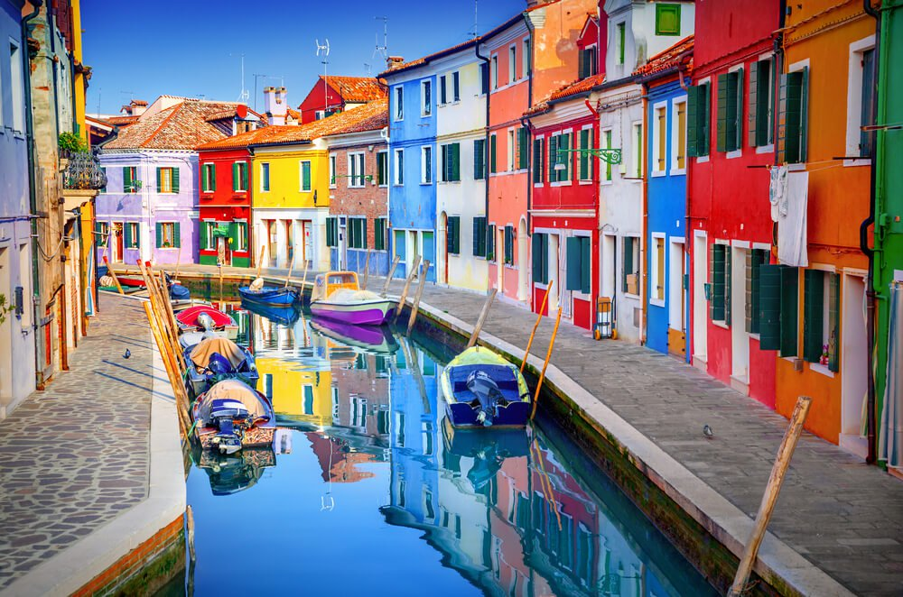
Result
Input:
<number>

Slide 19
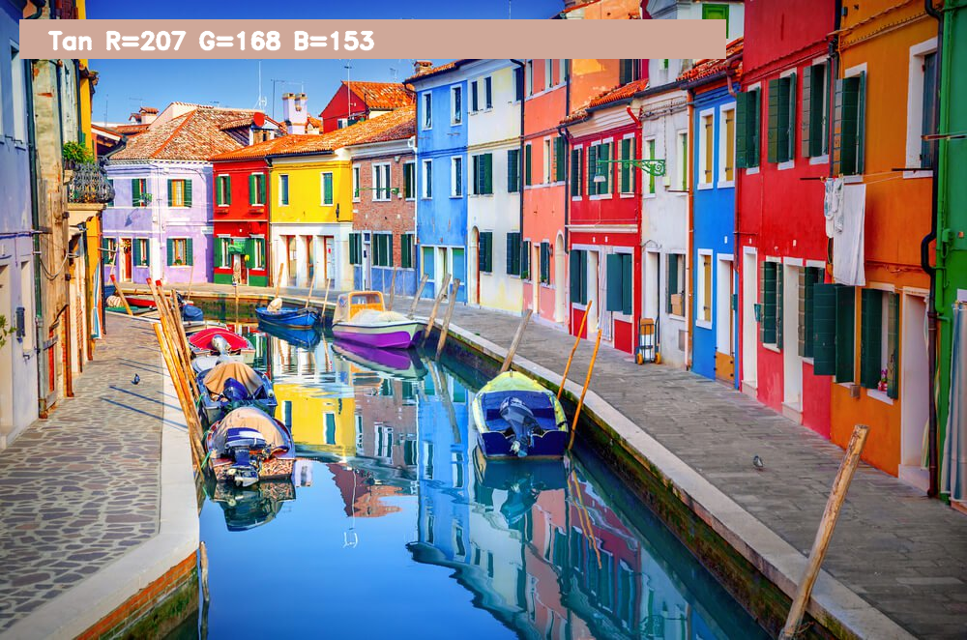
Outputs:
<number>

Slide 20
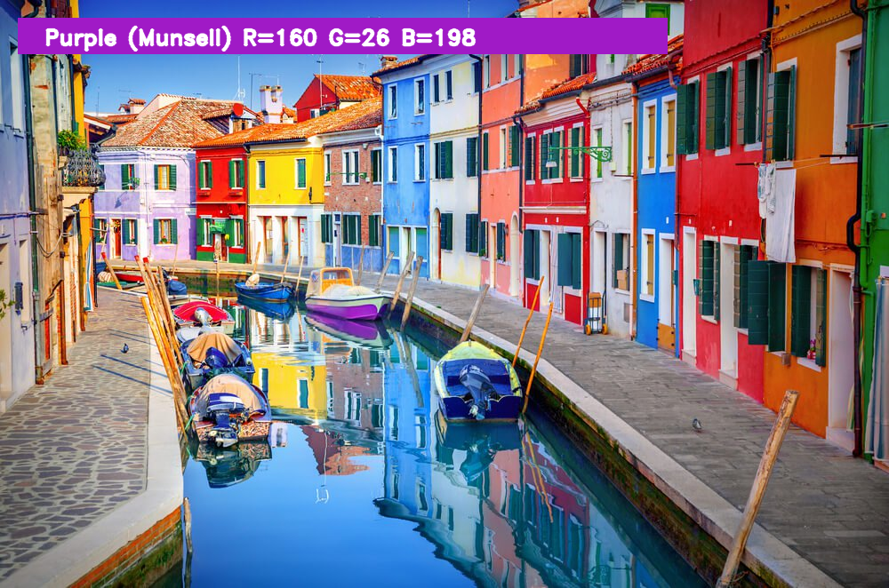
<number>

Slide 21
4. Advantages and Disadvantages
Advantages:
The system is user-friendly and has a simple interface.
Can be used in a manufacturing company
It helps in the sorting of objects based on a three-color approach. It also helps in counting objects.
Disadvantages:
Data needs to be entered properly otherwise, the outcome may won’t be accurate.
Problem with the lighting of the scene.
Time consumption increases with the dataset.
<number>

Slide 22
5. Applications
This system can be used by multiple peoples to get counseling sessions online.
Some of the applications are the light color temperature measurement, RGB LED consistency control, medical diagnosis systems, health fitness systems, industrial process control, etc…
Color sensors available in the market are AS73211, TCS3200, TCS3400, TCS34715, TCS34727, colorPAL from parallax, SEN-11195, Lego Mindstorms EV3, etc…
<number>

Slide 23
6. Conclusion
With the help of an image processing toolbox in the OpenCV and Pandas, the program has been made which can detect red, blue, green, magenta, yellow, cyan colors. Also, the colored object is being enclosed inside a bounded region along with the centroid of that region.
<number>
Notes:
Redundant bits: extra binary bits generated and added to the info to ensure that data is not lost.
2^r>=m+r+1
Parity bits:bit appended to ensure the data binary bits are even or odd
Odd parity and even parity

Slide 24
7. Future Scope
Computer vision- Color detection is the basic and important step for proceeding in computer vision. Some special types of spectacles can be made which will make use of computer vision (image processing) along with neural networks to provide an artificial vision to blind people.
Spy robots- The spy robots are made to identify objects in the place where they are launched. Object’s shape, size, color, orientation is of importance to robots.
Object Segregation- An object can be segregated(separated) on the basis of its color.
Object Tracking- A moving object can be tracked on the basis of its color.
<number>
Notes:
SIngleton: crude upper bound on the size of a block code with d n k

Slide 25
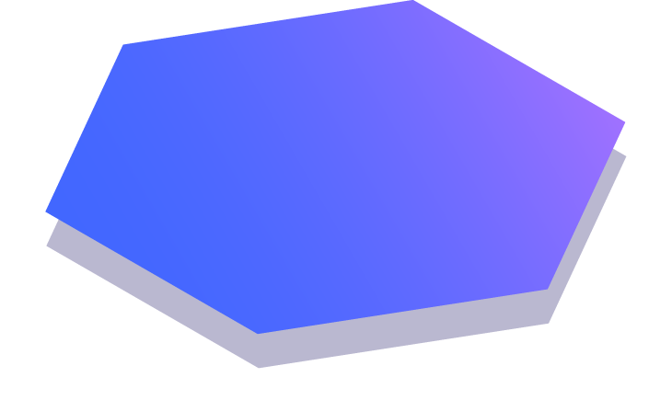
Thanks!
<number>

