Slide 1
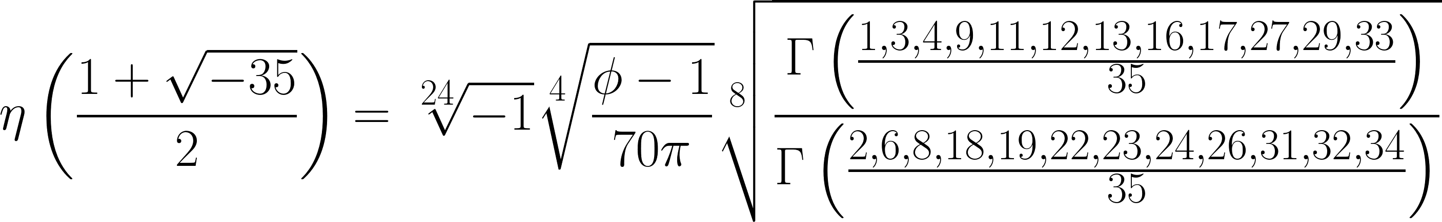
Special and Limiting Values of the Dedekind Eta Function
Neil Bickford and R. W. Gosper
or,
for Fun and Profit
AMS Special Session on Special Functions and Q-Series
January 9th, 2016

Slide 2
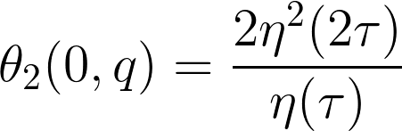
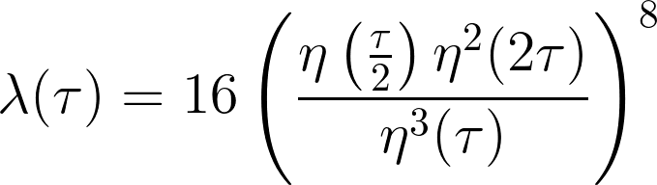
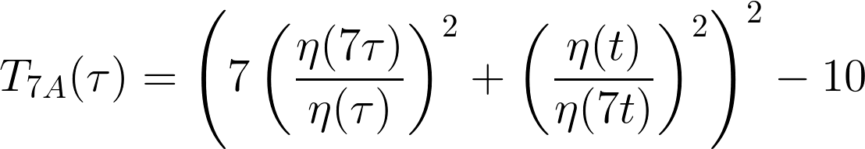
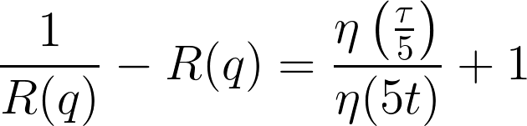
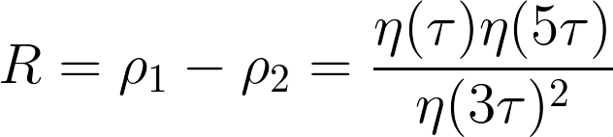
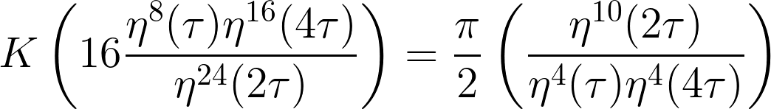
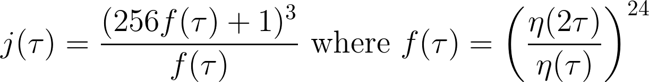

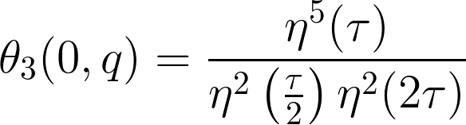
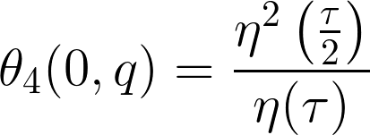
The Joy of η
for the Held group
for one part of the solution
So If we can compute η, we can compute special values of K!
So If we can compute η, we can compute special values of K!
surprisingly difficult!

Slide 3
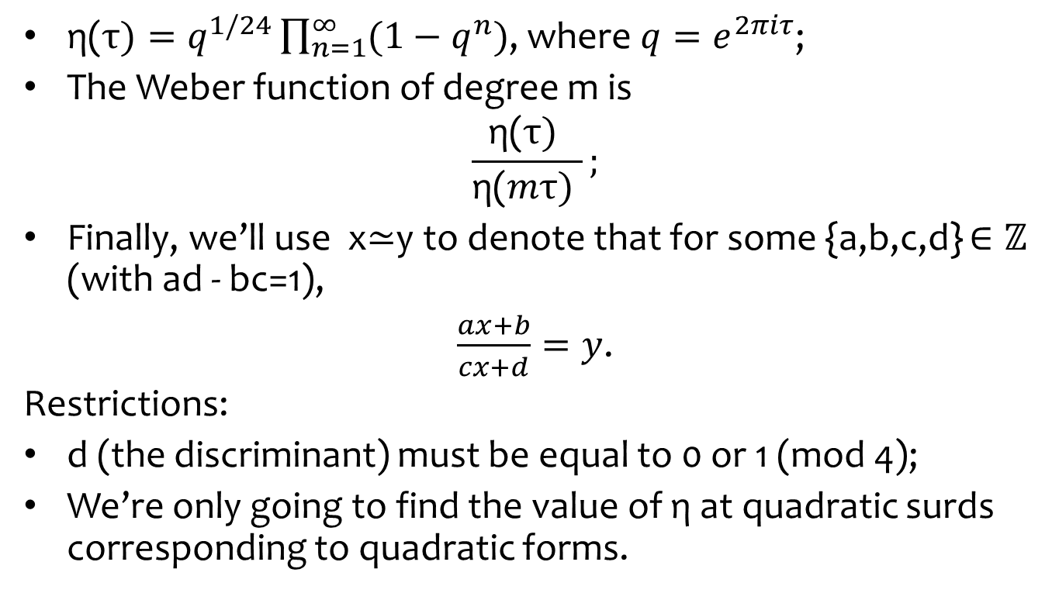
Notation
$\text{η}\text{(}τ)=q^{1/24}\prod_{n=1}^{∞}{(1−q^{n})}$, where $q=e^{2πiτ}$;
The Weber function of degree m is
$$\frac{\text{η}\text{(}τ) }{\text{η}\text{(}mτ) };$$
Finally, we’ll use x≃y to denote that for some {a,b,c,d} $∈ℤ$ (with ad - bc=1),
$\frac{ax+b}{cx+d}=y$.
Restrictions:
d (the discriminant) must be equal to 0 or 1 (mod 4);
We’re only going to find the value of $\text{η}$ at quadratic surds corresponding to quadratic forms.

Slide 4
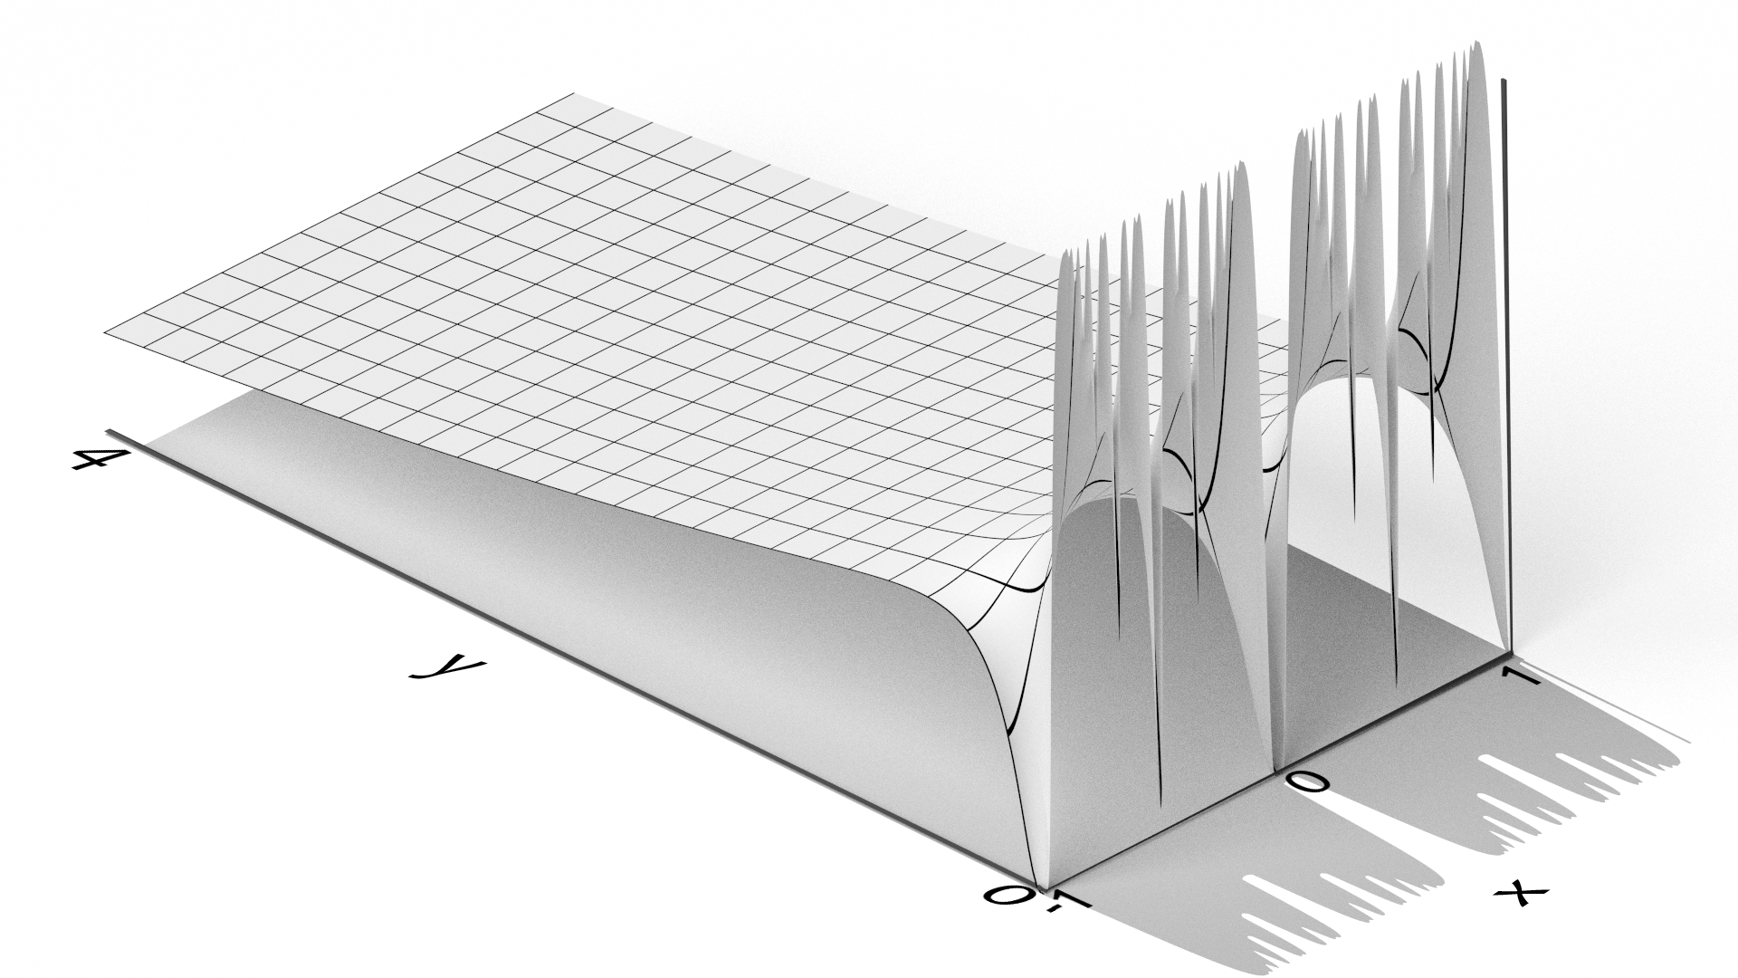
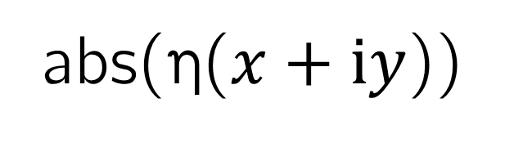
abs(η($x+\text{i}y$))

Slide 5
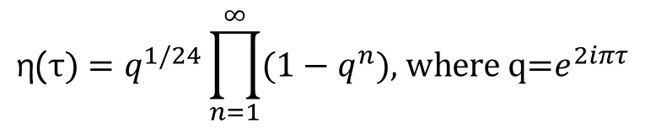
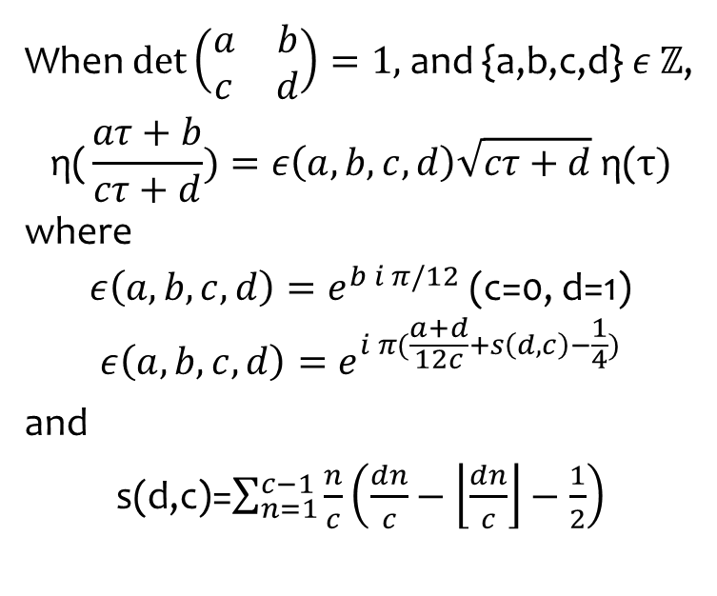


$$\text{η}\text{(}τ)=q^{1/24}\prod_{n=1}^{∞}{(1−q^{n}})\text{, }\text{where} \text{q}\text{=}e^{2iπτ}$$
$$\text{η}\text{(}τ+1)=e^{2iπ/24}\text{η}\text{(}τ)$$
$$\text{η}\text{(}−1/τ)=\sqrt{−iτ} \text{η}\text{(}τ)$$
When $\det\left(\begin{matrix}a & b \\ c & d\end{matrix}\right)=1,$and {a,b,c,d}$ε \text{ℤ}$,
$$\text{η}\text{(}\frac{aτ+b}{cτ+d})=ε\left(a,b,c,d\right)\sqrt{cτ+d} \text{η}\text{(}τ)$$
where
$ε\left(a,b,c,d\right)=e^{b i π/12}$ (c=0, d=1)
$$ε\left(a,b,c,d\right)=e^{i π(\frac{a+d}{12c}+s\left(d,c\right)−\frac{1}{4})}$$
and
s(d,c)=$\sum_{n=1}^{c−1}{\frac{n}{c}\left(\frac{dn}{c}−\left\lfloor \frac{dn}{c}\right\rfloor −\frac{1}{2}\right)}$

Slide 6
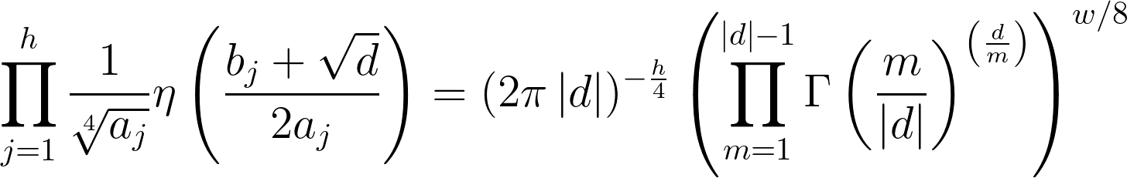
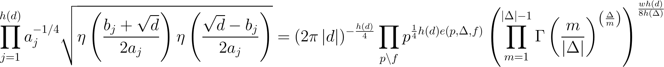
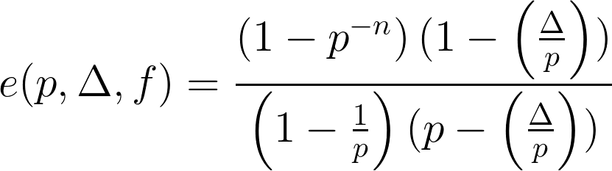
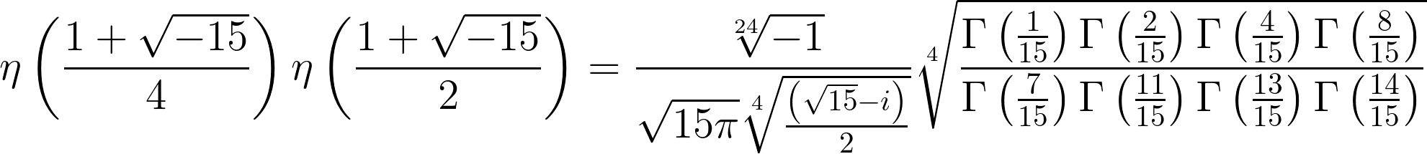

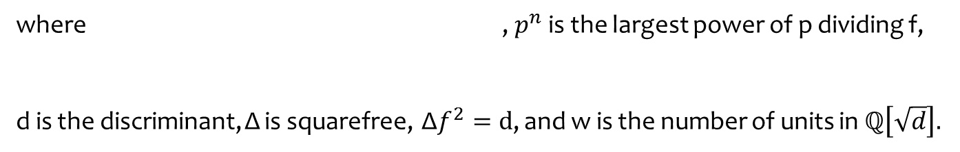
The mystery of $\text{η}$
The Chowla-Selberg formula (1949, 1967)
The Chowla-Selberg formula (Kaneko (1990), Nakkajima and Taguchi’s 1991 version)
where , $p^{n}$ is the largest power of p dividing f,
d is the discriminant, Δ is squarefree, Δ$f^{2}=d$, and w is the number of units in ℚ$\left[\sqrt{d}\right].$
For instance, the two reduced quadratic forms of discriminant -15 are
[1, 1, 4] and [2,1,2],
so Chowla-Selberg gives (after a bit of simplification)
But this doesn’t give individual values (Unless d is a Heegner number.)
Solution: Find quotients of special values!

Slide 7
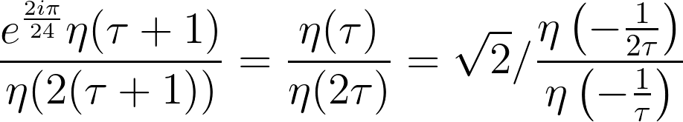
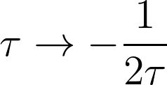

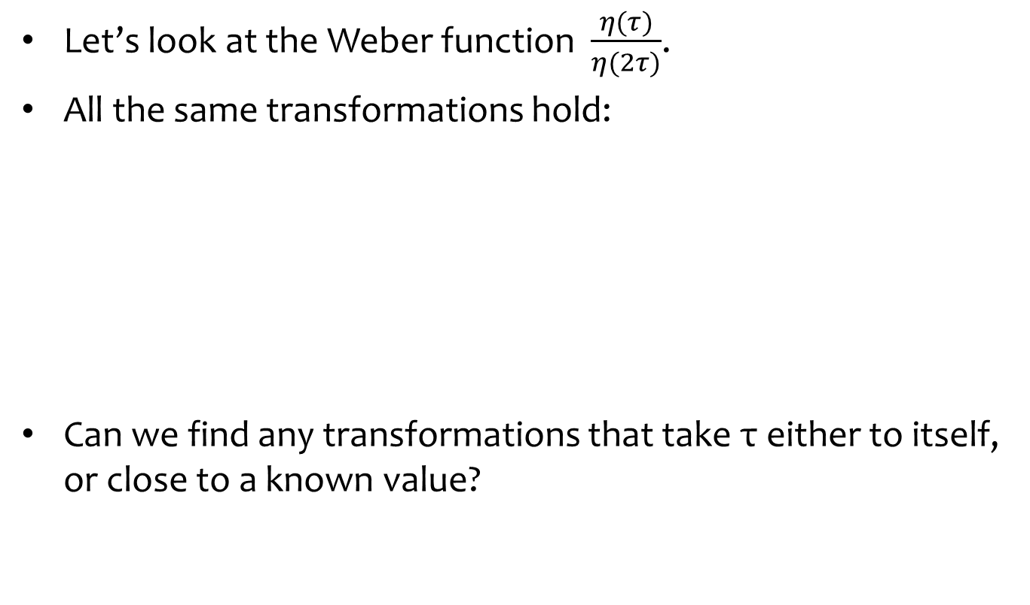
Weber by example
Let’s look at the Weber function $\frac{η(τ)}{η(2τ)}$.
All the same transformations hold:
Can we find any transformations that take τ either to itself, or close to a known value?

Slide 8
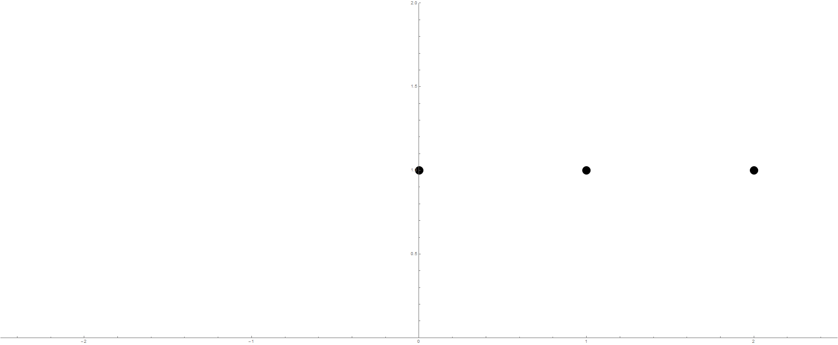
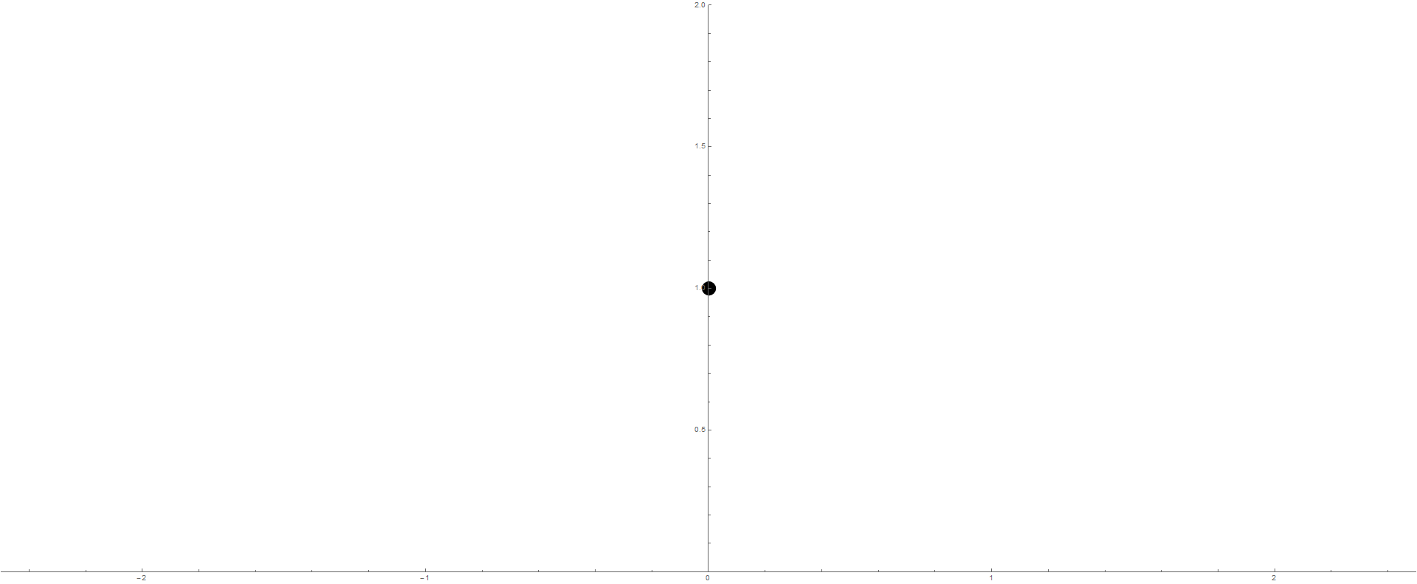
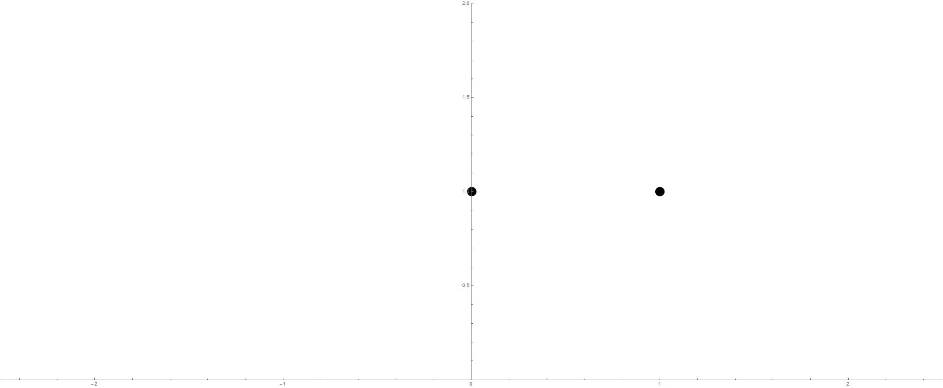
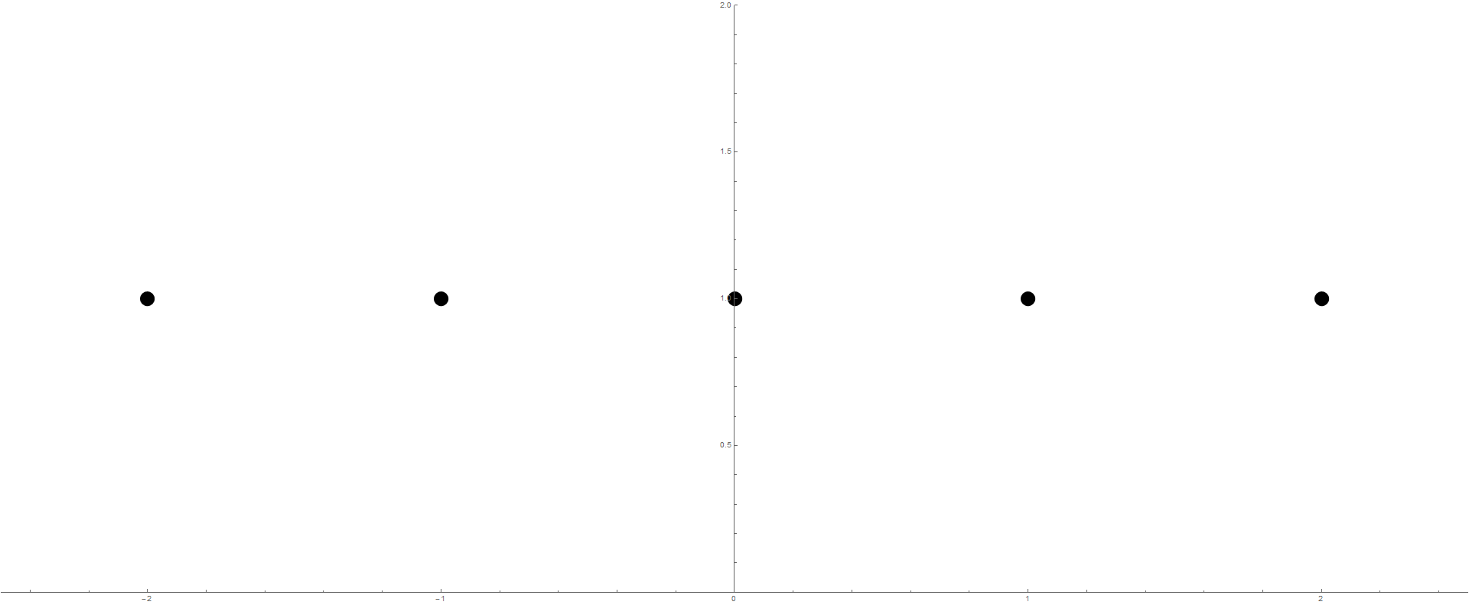
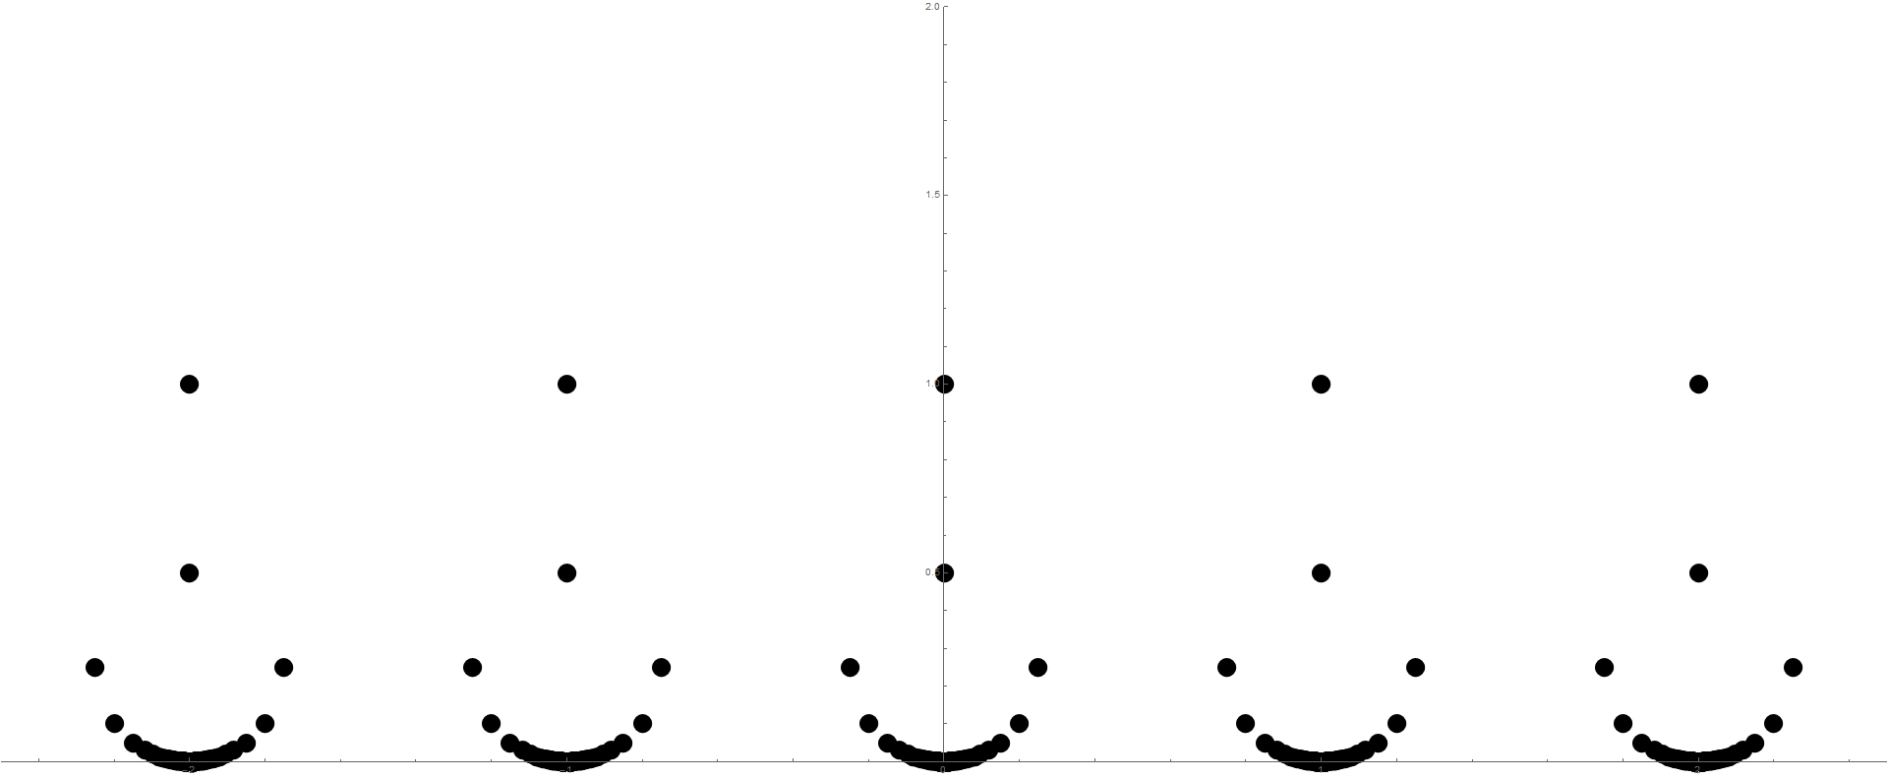
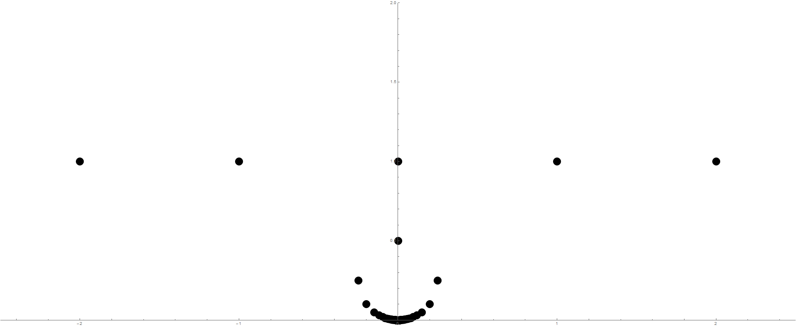
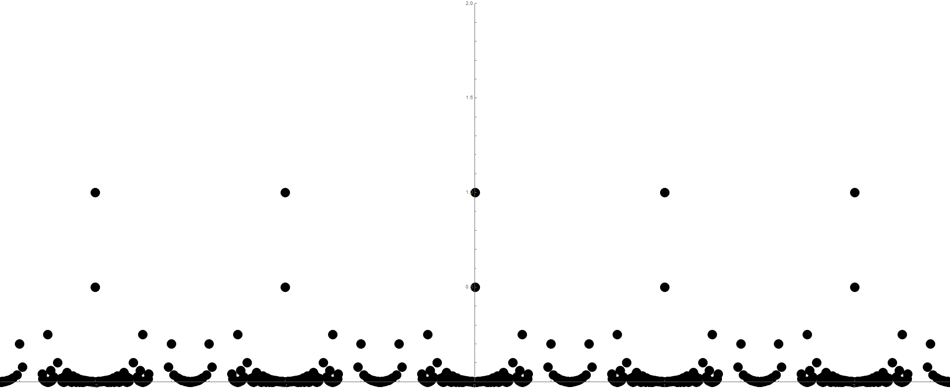
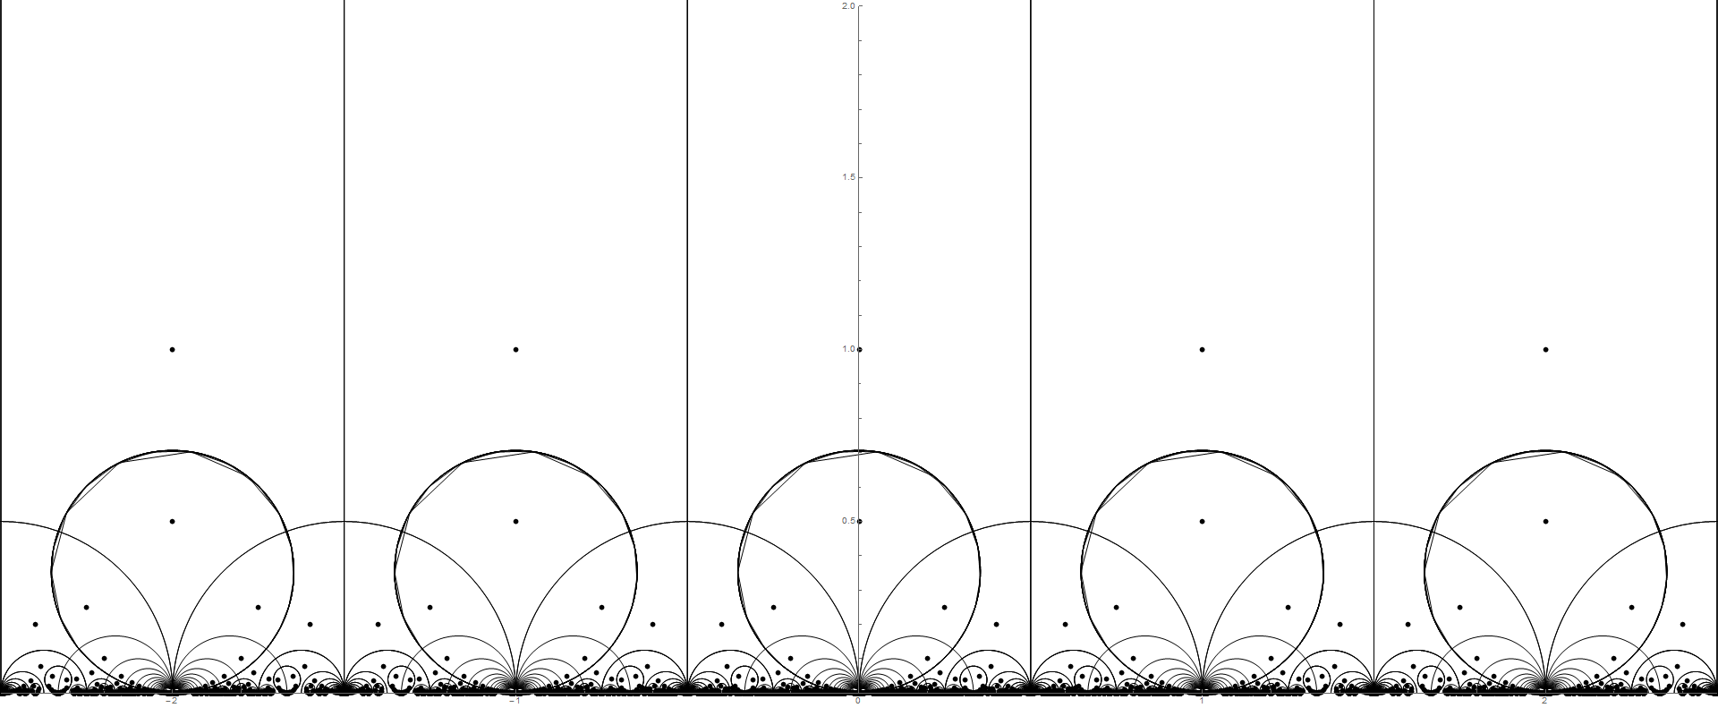
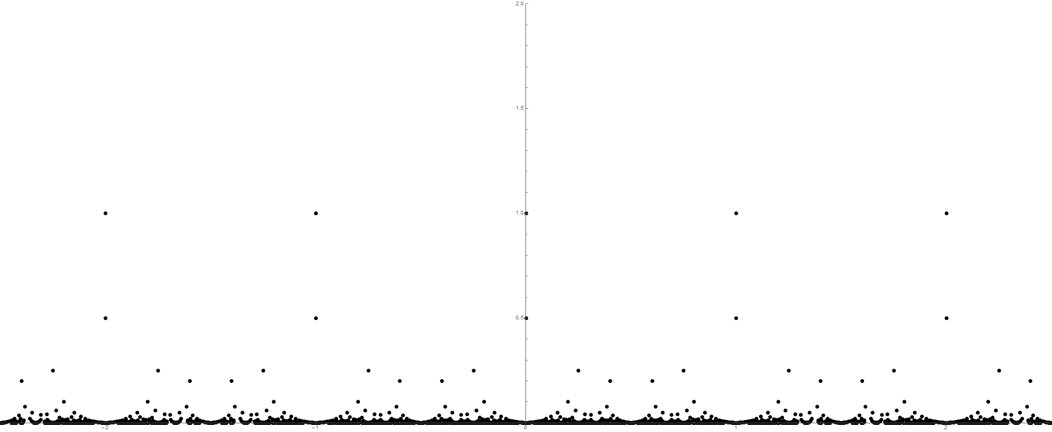
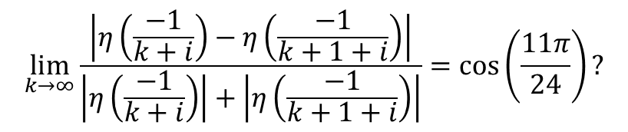
Weber by example
$$\lim_{k→∞}{\frac{\left|η\left(\frac{−1}{k+i}\right)−η\left(\frac{−1}{k+1+i}\right)\right|}{\left|η\left(\frac{−1}{k+i}\right)\right|+\left|η\left(\frac{−1}{k+1+i}\right)\right|}=\cos\left(\frac{11π}{24}\right)?}$$

Slide 9
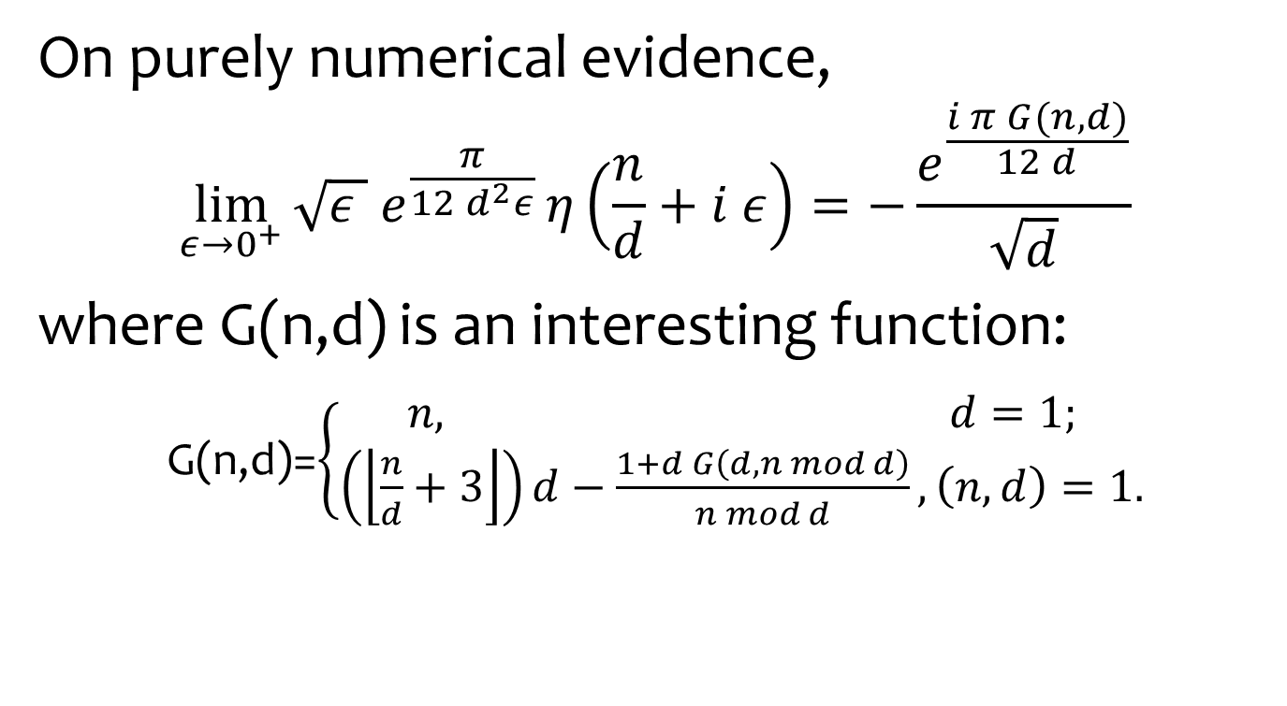
Limiting values of η
On purely numerical evidence,
$$\lim_{ε→0^{+}}{\sqrt{ε }{ e}^{\frac{π}{12 d^{2}ε}}}η\left(\frac{n}{d}+i ε\right)=−\frac{e^{\frac{i π G(n,d)}{12 d}}}{\sqrt{d}}$$
where G(n,d) is an interesting function:
G(n,d)=$\left\{\begin{aligned}n, d=1; \\ \left(\left\lfloor \frac{n}{d}+3\right\rfloor \right)d−\frac{1+d G\left(d,n mod d\right)}{n mod d}, \left(n,d\right)=1.\end{aligned}\right.$

Slide 10

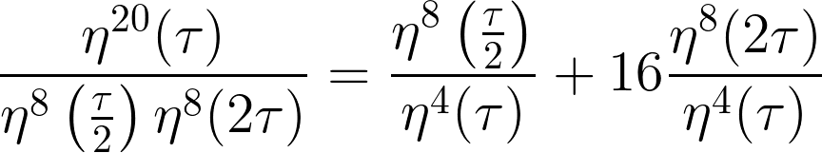

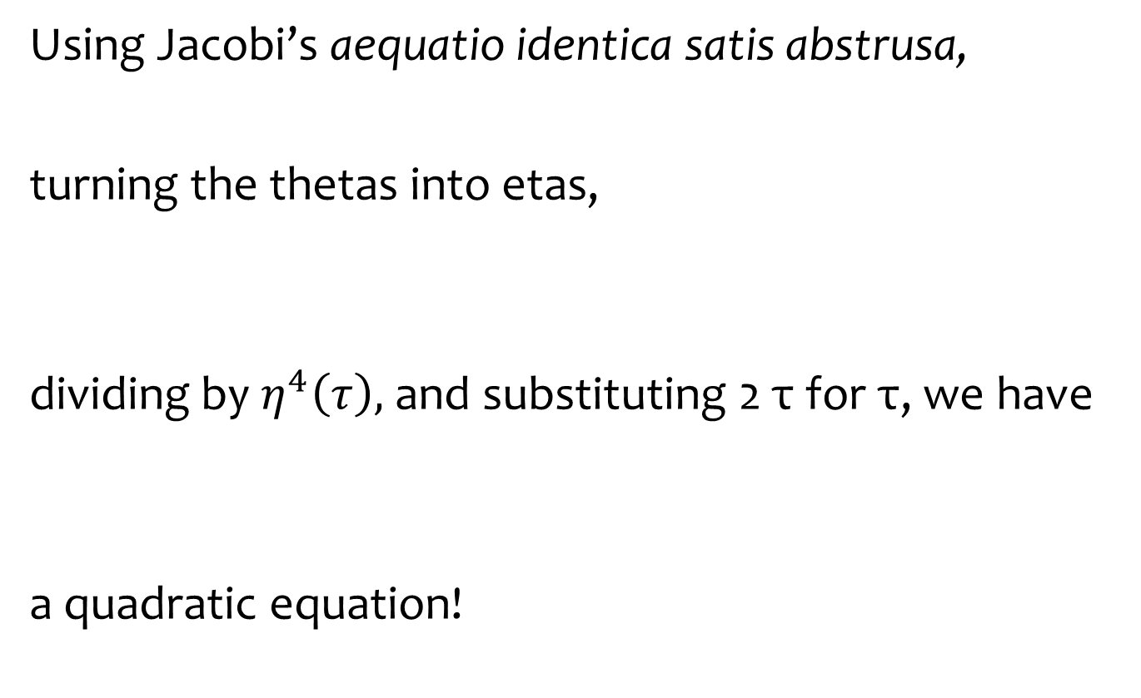
Double, double, boil and eta
Using Jacobi’s aequatio identica satis abstrusa,
turning the thetas into etas,
dividing by $η^{4}\left(τ\right),$ and substituting 2 τ for τ, we have
a quadratic equation!

Slide 11
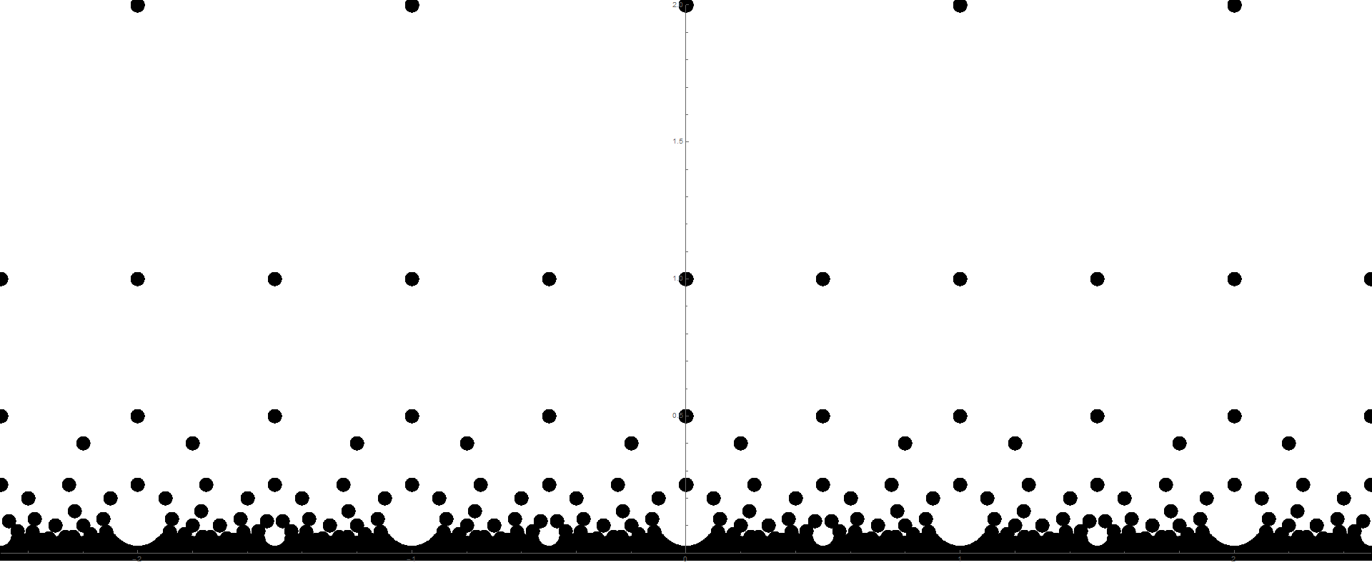


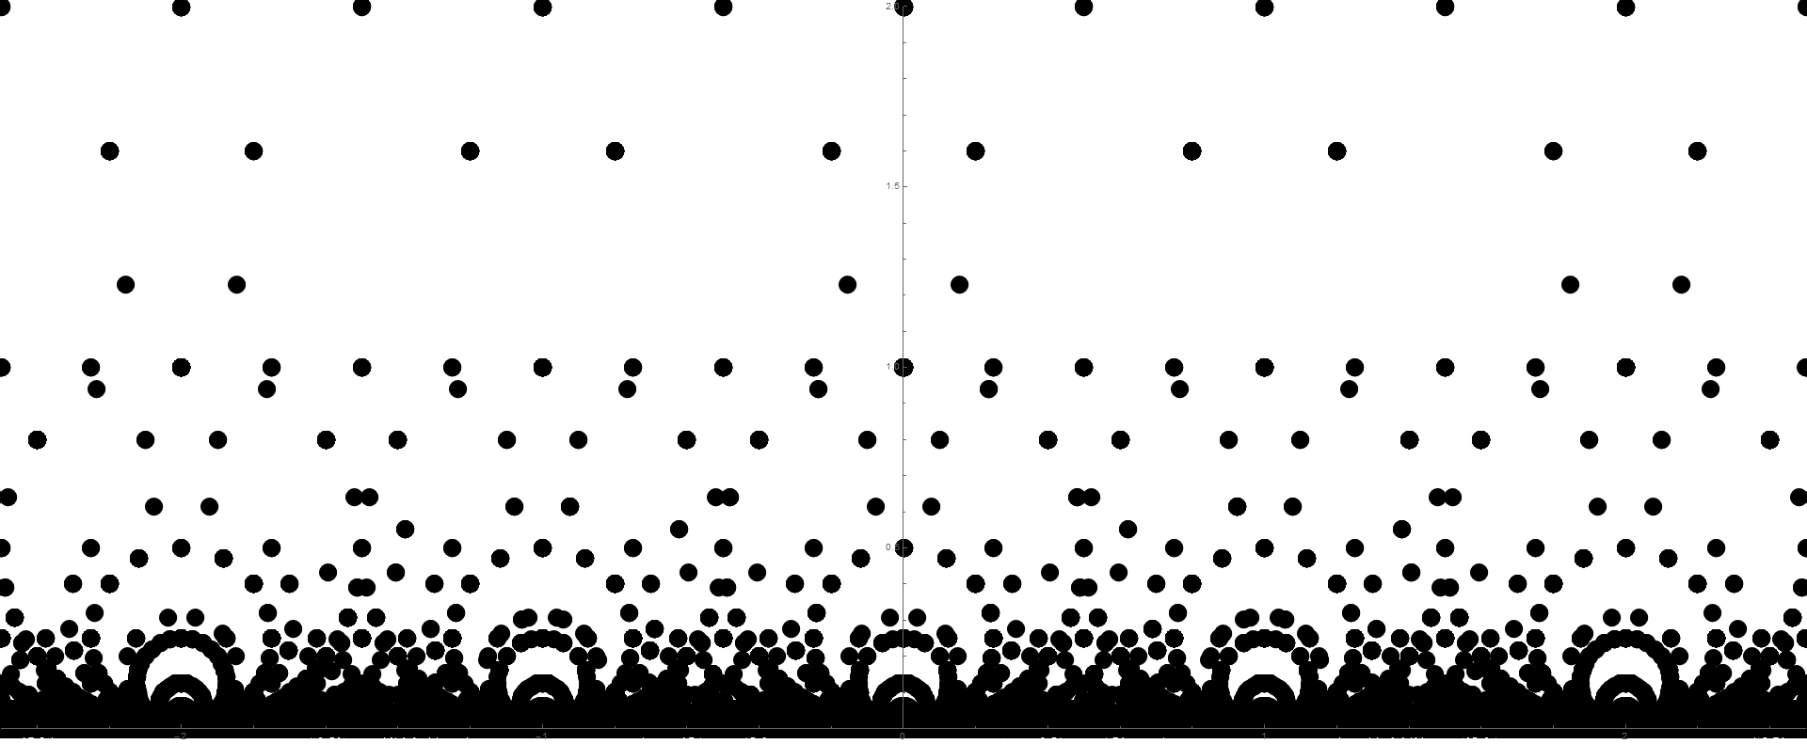
Weber by Jacobi
…and sometimes the points overlap.

Slide 12
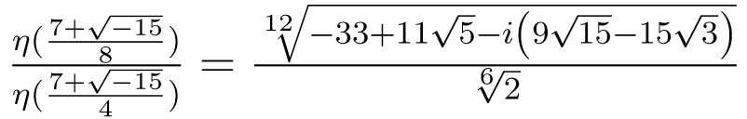
Weber by Jacobi

Slide 13
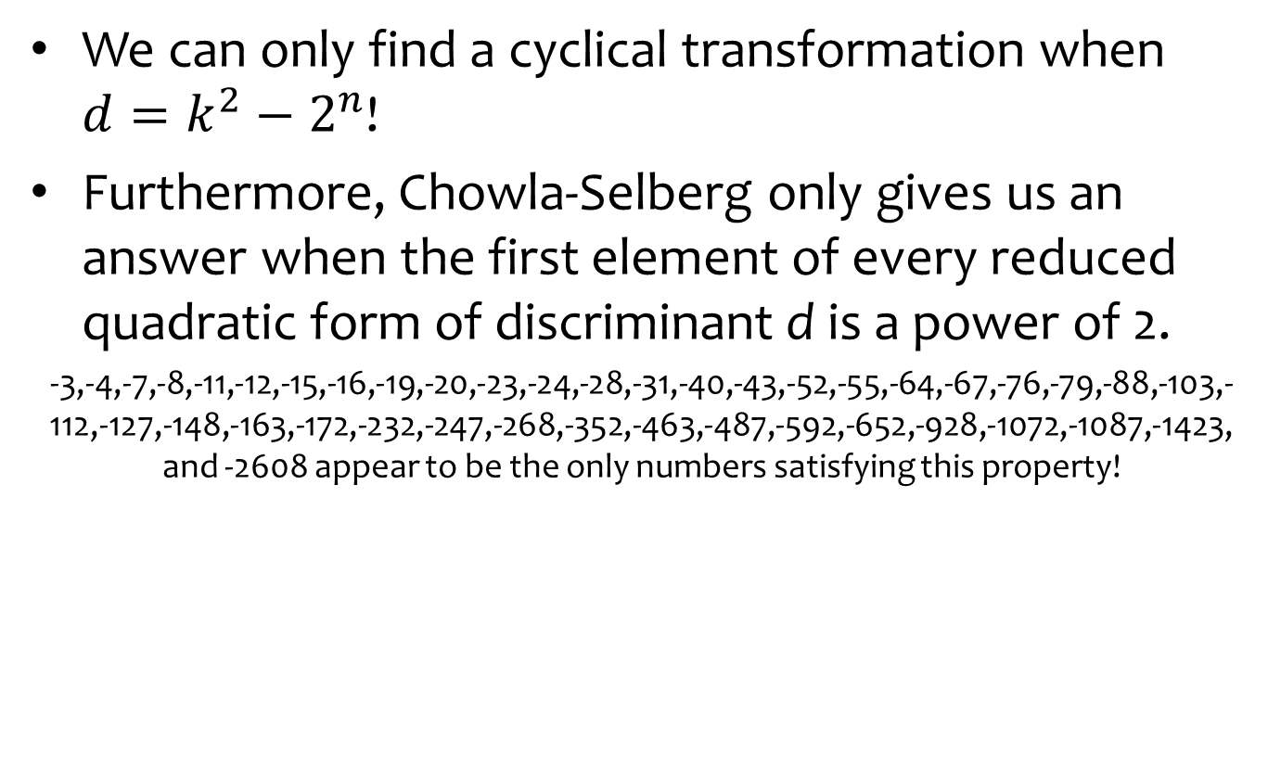
The bad news
We can only find a cyclical transformation when $d=k^{2}−2^{n}$!
Furthermore, Chowla-Selberg only gives us an answer when the first element of every reduced quadratic form of discriminant d is a power of 2.
-3,-4,-7,-8,-11,-12,-15,-16,-19,-20,-23,-24,-28,-31,-40,-43,-52,-55,-64,-67,-76,-79,-88,-103,-112,-127,-148,-163,-172,-232,-247,-268,-352,-463,-487,-592,-652,-928,-1072,-1087,-1423, and -2608 appear to be the only numbers satisfying this property!

Slide 14
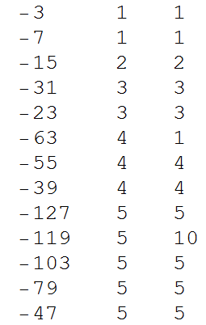
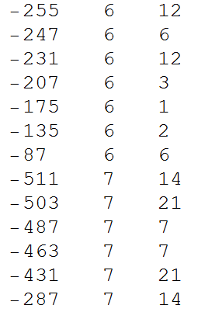
Spooky action in class field theory
d doublings h(d)
d doublings h(d)

Slide 15
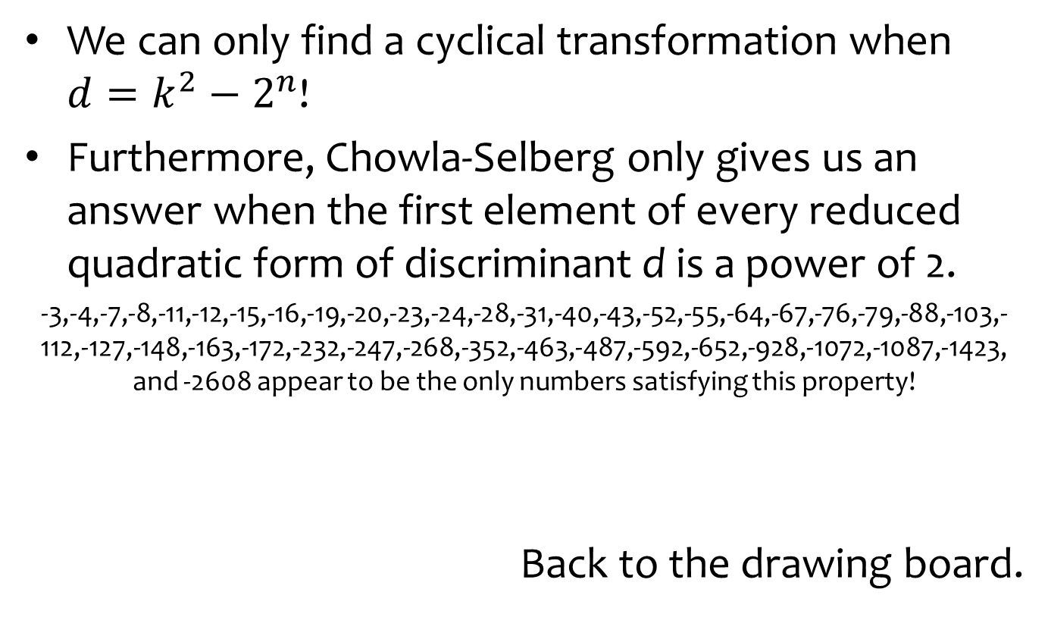
The bad news
We can only find a cyclical transformation when $d=k^{2}−2^{n}$!
Furthermore, Chowla-Selberg only gives us an answer when the first element of every reduced quadratic form of discriminant d is a power of 2.
-3,-4,-7,-8,-11,-12,-15,-16,-19,-20,-23,-24,-28,-31,-40,-43,-52,-55,-64,-67,-76,-79,-88,-103,-112,-127,-148,-163,-172,-232,-247,-268,-352,-463,-487,-592,-652,-928,-1072,-1087,-1423, and -2608 appear to be the only numbers satisfying this property!
Back to the drawing board.

Slide 16
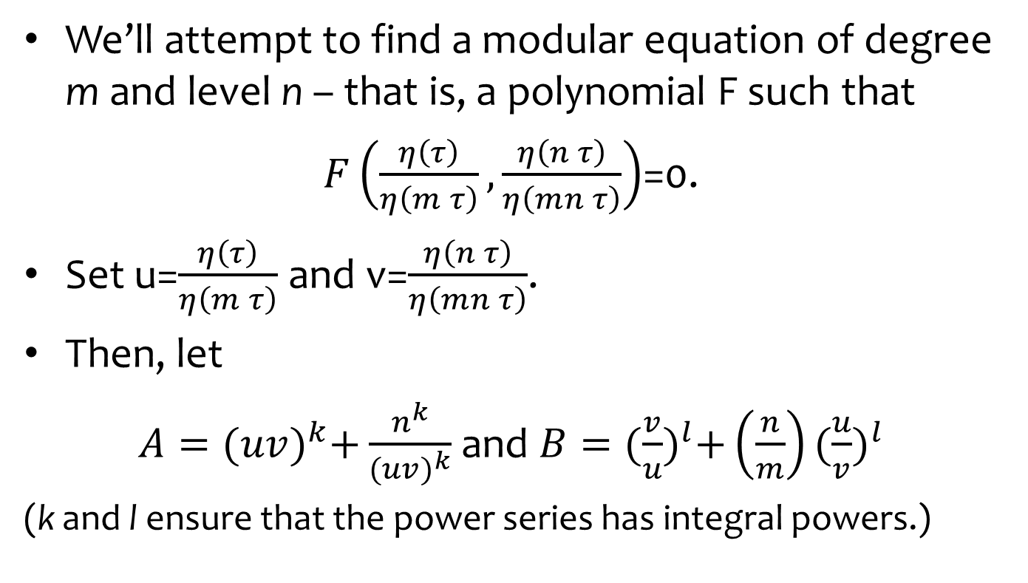
Generalizing modular equations (William B. Hart, 2008)
We’ll attempt to find a modular equation of degree m and level n – that is, a polynomial F such that
$F\left(\frac{η\left(τ\right)}{η\left(m τ\right)},\frac{η\left(n τ\right)}{η\left(mn τ\right)}\right)$=0.
Set u=$\frac{η\left(τ\right)}{η\left(m τ\right)}$ and v=$\frac{η\left(n τ\right)}{η\left(mn τ\right)}$.
Then, let
$A={(uv)}^{k}+\frac{n^{k}}{{(uv)}^{k}}$ and $B={(\frac{v}{u})}^{l}+\left(\frac{n}{m}\right){(\frac{u}{v})}^{l}$
(k and l ensure that the power series has integral powers.)

Slide 17
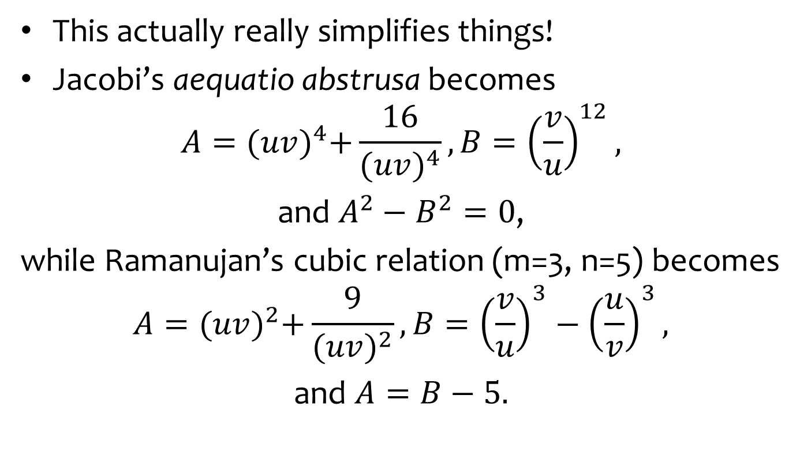
Generalizing modular equations (William B. Hart, 2008)
This actually really simplifies things!
Jacobi’s aequatio abstrusa becomes
$$A={(uv)}^{4}+\frac{16}{{(uv)}^{4}}, B={\left(\frac{v}{u}\right)}^{12},$$
and $A^{2}−B^{2}=0$,
while Ramanujan’s cubic relation (m=3, n=5) becomes
$$A={(uv)}^{2}+\frac{9}{{(uv)}^{2}}, B={\left(\frac{v}{u}\right)}^{3}−{\left(\frac{u}{v}\right)}^{3},$$
and $A=B−5.$

Slide 18
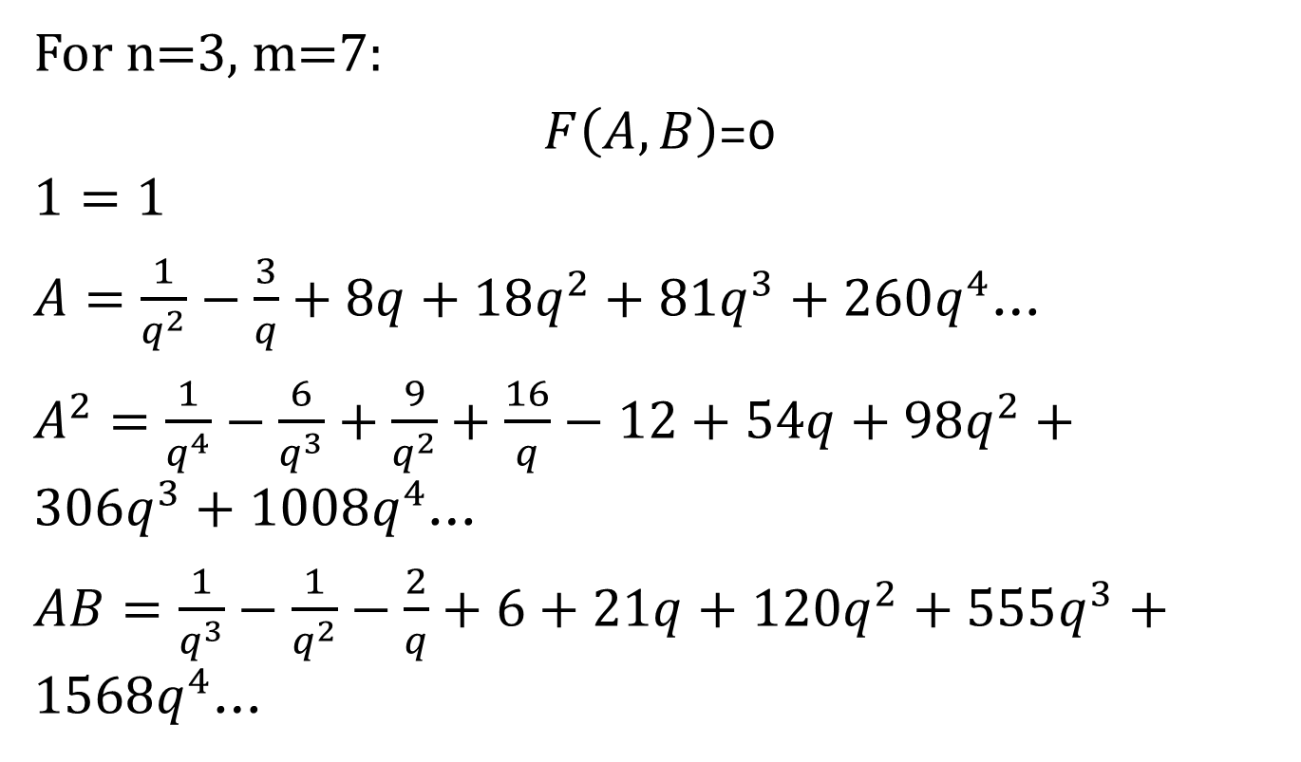
Generalizing modular equations (William B. Hart, 2008)
For n=3, m=7:
$F\left(A,B\right)$=0
$$1=1$$
$A=\frac{1}{q^{2}}−\frac{3}{q}+8q+18q^{2}+81q^{3}+260q^{4}$…
$A^{2}=\frac{1}{q^{4}}−\frac{6}{q^{3}}+\frac{9}{q^{2}}+\frac{16}{q}−12+54q+98q^{2}+306q^{3}+1008q^{4}$…
$AB=\frac{1}{q^{3}}−\frac{1}{q^{2}}−\frac{2}{q}+6+21q+120q^{2}+555q^{3}+1568q^{4}$…

Slide 19
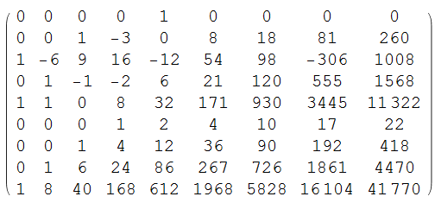

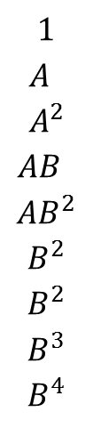
Generalizing modular equations (William B. Hart, 2008)
For n=3, m=7:
$F\left(A,B\right)$=0
-4 -3 -2 -1 0 1 2 3 4
$$1$$
$$A^{ }$$
$$A^{2}$$
$${AB}^{ }$$
$${AB}^{2}$$
$$B^{2}$$
$$B^{2}$$
$$B^{3}$$
$$B^{4}$$

Slide 20
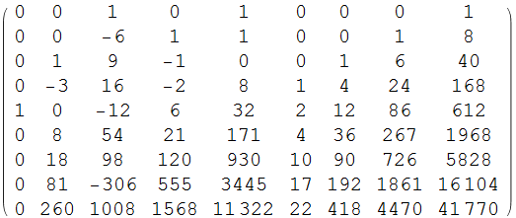
Generalizing modular equations (William B. Hart, 2008)
For n=3, m=7:
$F\left(A,B\right)$=0
$1 A A^{2} AB AB^{2} B B^{2} B^{3} B^{4}$
-4
-3
-2
-1
0
1
2
3
4

Slide 21



Generalizing modular equations (William B. Hart, 2008)
For n=3, m=7:
$F\left(A,B\right)$=0
$1 A A^{2} AB AB^{2} B B^{2} B^{3} B^{4}$
-4
-3
-2
-1
0
1
2
3
4
$$A^{2}+14AB+45B^{2}−B^{4}=0$$
which works!

Slide 22


Exploiting modular equations
Suppose we can find a z such that
$z \text{≃}$ nz ≃ $f_{1}$
mz ≃ mnz ≃ $f_{2}$
As it turns out, given only n, m, and the matrix that transforms z to nz, we can determine z – and all of the other matrices – very quickly.
Suppose we can find a z such that
$z \text{≃}$ nz .
mz ≃ mnz .

Slide 23

Exploiting modular equations
Suppose we can find a z such that
$z \text{≃}$ nz ≃ $f_{1}$
mz ≃ mnz ≃ $f_{2}$
Then if
$$F\left(\frac{η\left(z\right)}{η\left(mz\right)},\frac{η\left(nz\right)}{η\left(mnz\right)}\right)=0,$$
$$F\left(\frac{η\left(z\right)}{η\left(mz\right)},\frac{ε(M_{1})}{ε(M_{2})}\frac{η\left(z\right)}{η\left(mz\right)}\right)=0,$$
3
2 4

Slide 24

Exploiting modular equations
Suppose we can find a z such that
$z \text{≃}$ nz ≃ $f_{1}$
mz ≃ mnz ≃ $f_{2}$
Then if
$$F\left(\frac{η\left(z\right)}{η\left(mz\right)},\frac{η\left(nz\right)}{η\left(mnz\right)}\right)=0,$$
$$F\left(\frac{ε(M_{3})}{ε(M_{4})}\frac{η\left(f_{1}\right)}{η\left(f_{2}\right)},\frac{ε(M_{1})ε(M_{3})}{ε(M_{2})ε(M_{4})}\frac{η\left(f_{1}\right)}{η\left(f_{2}\right)}\right)=0,$$
and we can solve for $\frac{η(f_{1})}{η(f_{2})}!$
1 3
2 4

Slide 25
We now have all the pieces we need to compute the value of η.

Slide 26




Dedekind η for fun and profit
d=-51
Use Chowla-Selberg to get a product of η values.
Search through quadratic surds to find a way of linking the arguments of η:
Find a modular equation that allows you to compute the value of η(z)/η(mz);
Plug in values and solve the resulting polynomial equation…
And substitute back into the original equation to get…
$\frac{13z+48}{1}=\frac{3+\sqrt{−51}}{6}$ and $\frac{3∗13∗z+142}{1}=\frac{−1+\sqrt{−51}}{2}$
where $z=\frac{−285+\sqrt{−51}}{78}$
$$1404+A−1215 B−351B^{2}+493B^{3}$$
$$−52B^{4}−45B^{5}+13B^{6}−B^{7}=0$$
$$\frac{η\left(\frac{3+\sqrt{−51}}{6}\right)}{η\left(\frac{−1+\sqrt{−51}}{2}\right)}=\sqrt[4]{3}{\left(−33−8\sqrt{17}\right)}^{1/12}$$

Slide 27
Dedekind η for fun and profit
d=-51
Use Chowla-Selberg to get a product of η values.
Search through quadratic surds to find a way of linking the arguments of η:
Find a modular equation that allows you to compute the value of η(z)/η(mz);
Plug in values and solve the resulting polynomial equation…
And substitute back into the original equation to get…
$\frac{13z+48}{1}=\frac{3+\sqrt{−51}}{6}$ and $\frac{3∗13∗z+142}{1}=\frac{−1+\sqrt{−51}}{2}$
where $z=\frac{−285+\sqrt{−51}}{78}$
$$1404+A−1215 B−351B^{2}+493B^{3}$$
$$−52B^{4}−45B^{5}+13B^{6}−B^{7}=0$$
$$\frac{η\left(\frac{3+\sqrt{−51}}{6}\right)}{η\left(\frac{−1+\sqrt{−51}}{2}\right)}=\sqrt[4]{3}{\left(−33−8\sqrt{17}\right)}^{1/12}$$

Slide 28

Dedekind η for fun and profit
And it works!

Slide 29
Source code available online at
evaluate an eta today!
http://bit.ly/eta2016

Slide 30
Neil Bickford nbickford.wordpress.com nbickford@g.ucla.edu
Thank you!
Bill Gosper gosper.org billgosper@gmail.com

Slide 31
Template 2

Slide 32
template

