Slide 1
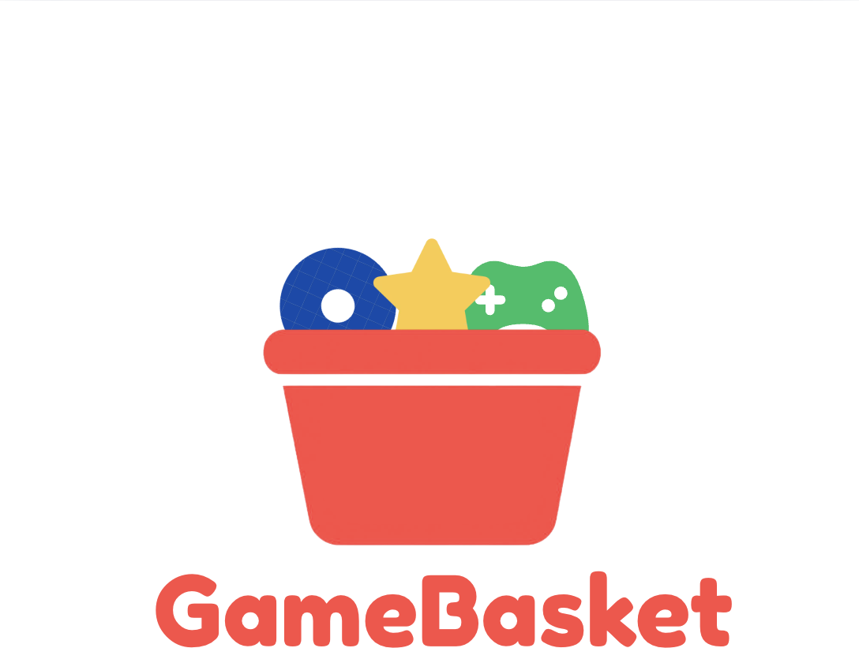
Your games. Your history. Your basket.
A social app for tracking, rating, and reliving the games you actually play — built the way Letterboxd built film, for the medium that actually deserves it.
A proof-of-concept pitch — built to explore this idea together

Slide 2
Gamers don't have a home for their game history
Letterboxd gave film a place to log, rate, and discover — built into a real community and a real business. Games have never had an equivalent winner. What exists today is fragmented, and the closest thing — Backloggd — still leaves real friction on the table:
Browser-only, for years
Still fundamentally a mobile-web experience — no real native app of its own.
No auto-sync from Steam, PSN, or Xbox
Every game gets hand-logged, one at a time. Huge drop-off risk for anyone with a real library.
Weak data portability
CSV export is locked behind paid “Backer” status — creates lock-in anxiety instead of trust.
Slow, single-maintainer development
Built and maintained by one person — feature velocity is naturally limited.
GameBasket — Concept Pitch

Slide 3
The gap is real — and the model already works
No dominant player in gaming yet
$3.62M
Backloggd, GG, SavePoint, Infinite Backlog — each nails a piece, none owns the category.
Tiny Capital's 2023 acquisition of a majority stake in Letterboxd
Games carry richer data than film
Playtime, platform, completion, co-op — signal a movie tracker never has to touch.
...after 12 years of running profitably on subscriptions and ads alone — no outside funding needed to get there.
A bootstrapped niche app can win
Letterboxd needed passion and time, not venture capital, to become a real business.
GameBasket — Concept Pitch

Slide 4
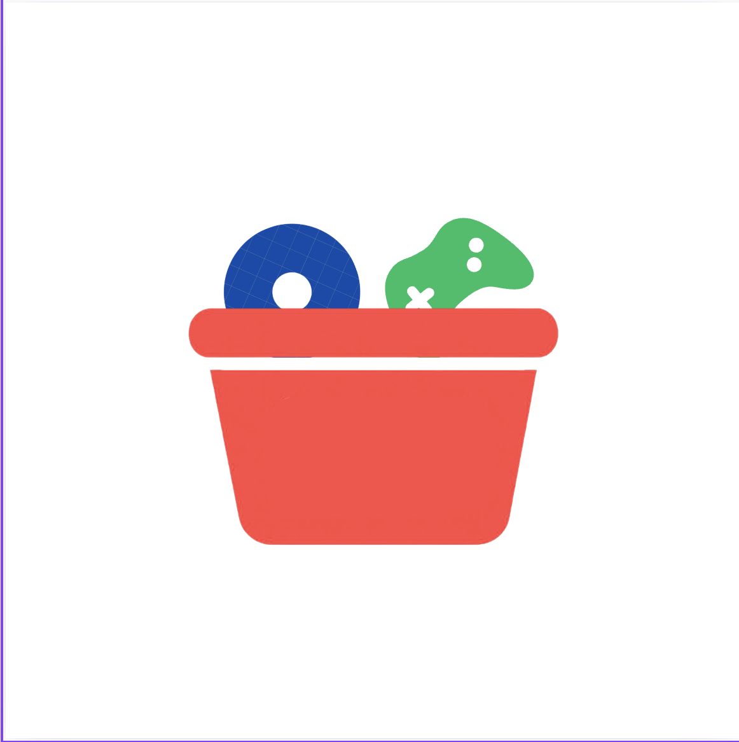
Introducing GameBasket
Letterboxd, but for the basket of games you actually grew up with.
Status-first home
Playtime as a first-class stat
Playing, Backlogged, Wishlist, Completed — the lens that actually matters for a game library, not a one-time diary entry.
Games range from 3 hours to 3,000. Hours played sits front and center, not buried in a stats tab.
Sessions, not single entries
“Played With” tagging
Log every sitting across weeks or months — games aren't watched once and done.
Tag real co-op partners on a game or a review — something film tracking has no reason to need.
GameBasket — Concept Pitch

Slide 5
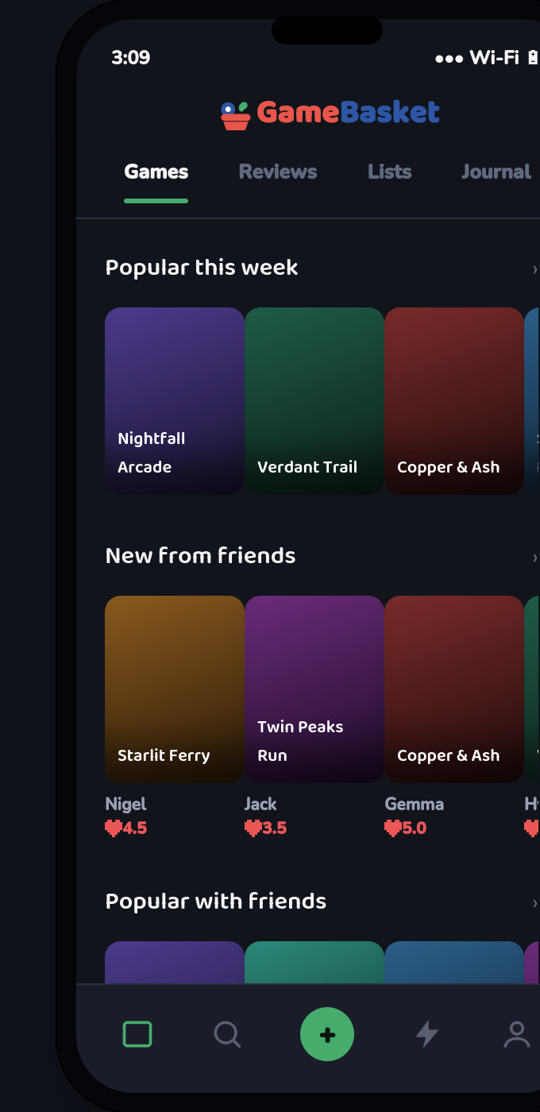
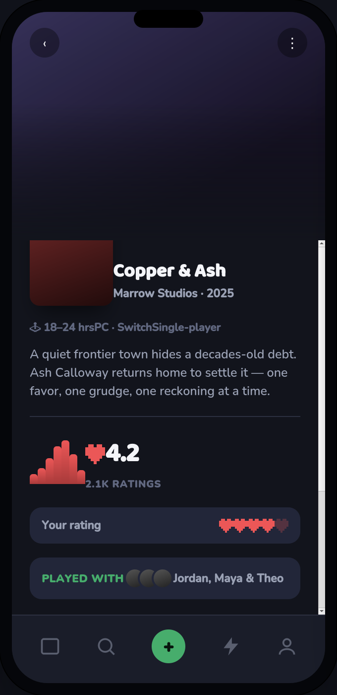
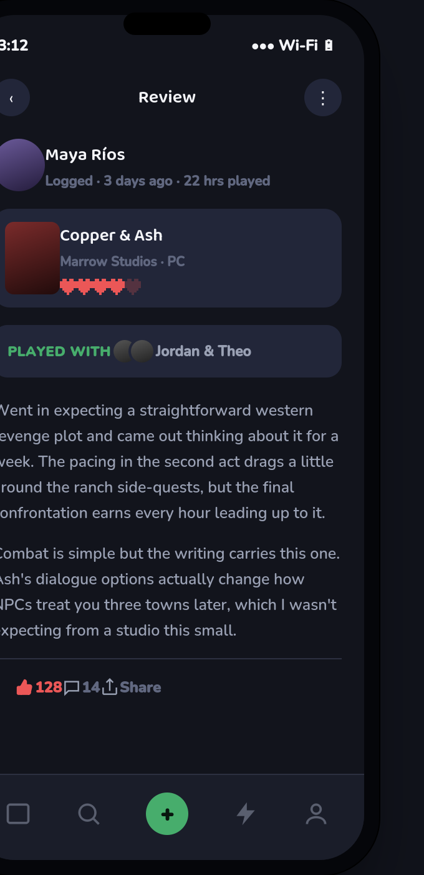
What it looks like today (working prototype)
Home Feed
Game Page
Review
GameBasket — Concept Pitch

Slide 6
Hearts, not stars. Played With, not just watched.
Pixel hearts replace stars
A classic 8-bit heart — health, lives — reads instantly as “gaming,” and never gets mistaken for a price tag the way coins did in an earlier pass.
“Played With” on every game & review
Tag the friends you actually played alongside — co-op partners, not just people who also left a review. Letterboxd has no equivalent, because films aren't played together.
Your rating vs. the community's
A personal heart rating sits right next to the community average and its distribution — at a glance, not a tap away.
GameBasket — Concept Pitch

Slide 7
Structurally different, not just re-skinned
Letterboxd
GameBasket
Core lens
A diary — what you watched, and when
Status first — Playing, Backlogged, Wishlist, Completed
Logging unit
One entry per watch
Multiple play sessions, with playtime tracked
Social tag
Reviewed by
Played With — real co-op partners
Rating unit
Stars
Pixel hearts
Content lifespan
Static — a film never changes
Live-service games keep evolving after logging
GameBasket — Concept Pitch

Slide 8
A proven model, borrowed on purpose
Letterboxd never took outside funding until 2023 — it ran on exactly this mix for over a decade.
Freemium subscriptions
Advertising
Brand & studio partnerships
Free core: logging, ratings, basic lists. Paid Pro tier: deep stats, playtime trends, Steam/PSN/Xbox auto-sync, backlog forecasting.
Letterboxd saw a 490% jump in ad revenue after professionalizing its ad stack — a lightweight path to revenue on the free tier.
Sponsored lists, launch placements, and curated content — the same playbook publishers already use with Letterboxd.
GameBasket — Concept Pitch

Slide 9
How we'd actually get this off the ground
1
Validate
Talk to 10–15 current Backloggd/GG users. Confirm the auto-sync + native-app wedge is the real pain point before writing code.
2
Scope a lean MVP
Log, rate, review, one platform auto-sync (Steam first). Skip social and stats dashboards until the core loop works.
3
Build & seed
Prototype the app, then seed a Discord and subreddit before public launch — solve the cold-start problem on purpose.
4
Formalize
Lock the brand (domain, socials, app store handles) and set up the right legal structure once real users are involved.
GameBasket — Concept Pitch

Slide 10
I don't want to build this alone.
I can bring the business side — finance, market research, brand. What this needs next is someone to help shape the product and build it with me. This deck is the proof of concept. The rest is up to us.
Let's basket this together.

