Slide 1

Applying DRQN to Stock Trading
Lixu Wang, Jing Jiang
Final Project: Implementation of paper
‘Financial Trading as a Game: A Deep Reinforcement Learning Approach’

Slide 2
Outline Project Background Main Idea & Implementation Experiment Results

Slide 3
Deep Recurrent Q-Network
Objective of Q-learning
an optimal policy that maximizes the reward
DQN: Use Deep Neural Networks as approximator.
DRQN: Deep Recurrent Network

Slide 4
Characteristics of Financial Trading
Discrete time steps
Trading actions are finite, every action needs paying for cost.
The future trend is unknown.
Bear transaction (-1), no-transaction (0), and bull transaction (1).

Slide 5
Outline Project Background Main Idea & Implementation Experiment Results

Slide 6
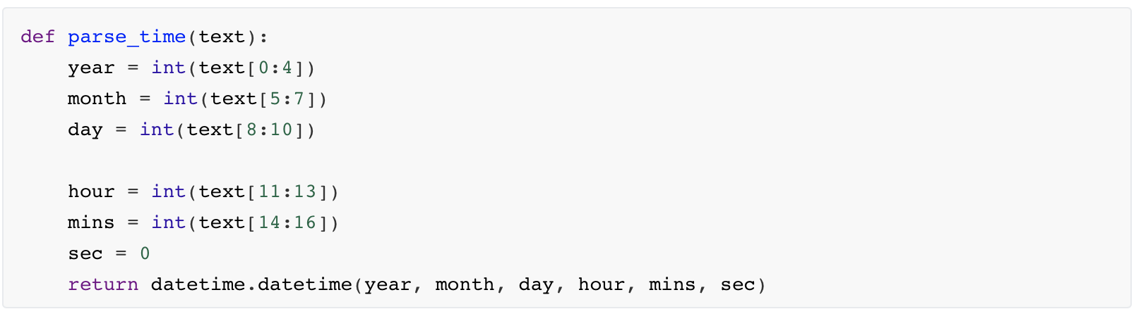
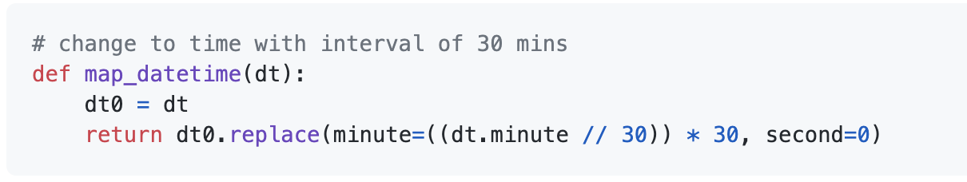
How to split the data set
The raw data is hard to acquire
2015~2020 – intervals of 30 mins
Change the form of time
Split and group the time

Slide 7
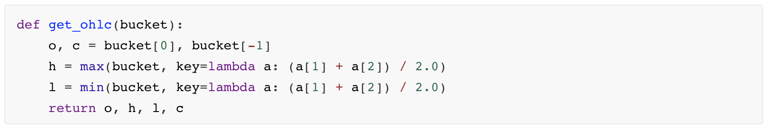
How to split the data set
The opening and closing price of each group.
The opening and closing price of different groups.
What need to be recorded?

Slide 8
How to prepare for the state feature
Currency Trading vs. Stock Trading
Log operation for closing prices of 8 most recent intervals.
Conduct Z-Score normalization on each feature with a period of 96 states.
Time is encoded via a sinusoidal function
The merge with the last action

Slide 9
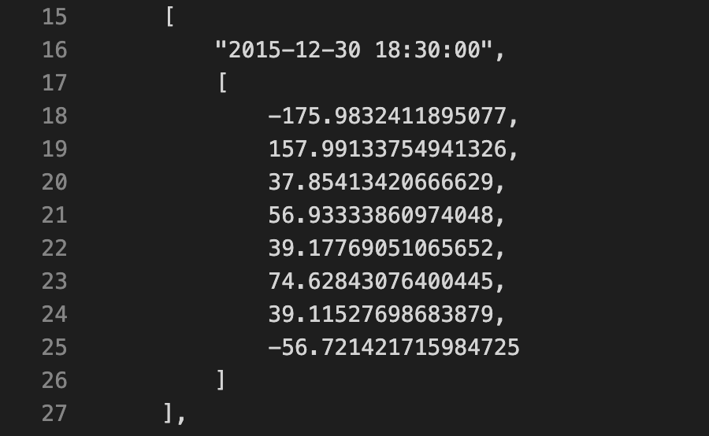
How to prepare for the state feature
x 96

Slide 10
The basic workflow of the trading agent
An initial state and an initial action 0.
After the action augmentation, results will be stored in a replay memory.
When the replay memory is larger than a set threshold (10 * batch_size), the agent will randomly sample training pairs from the replay memory and optimize the exploration and target policy network.

Slide 11
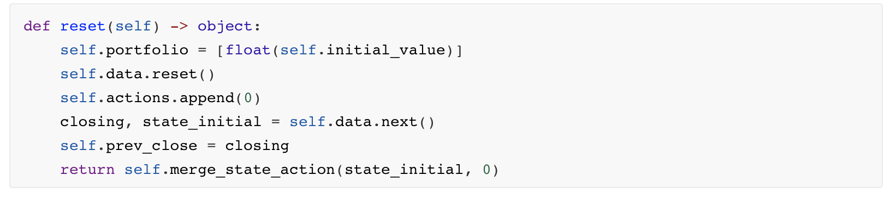
How to build the trading environment
Reset() initializes the beginning state 0 and action 0.

Slide 12
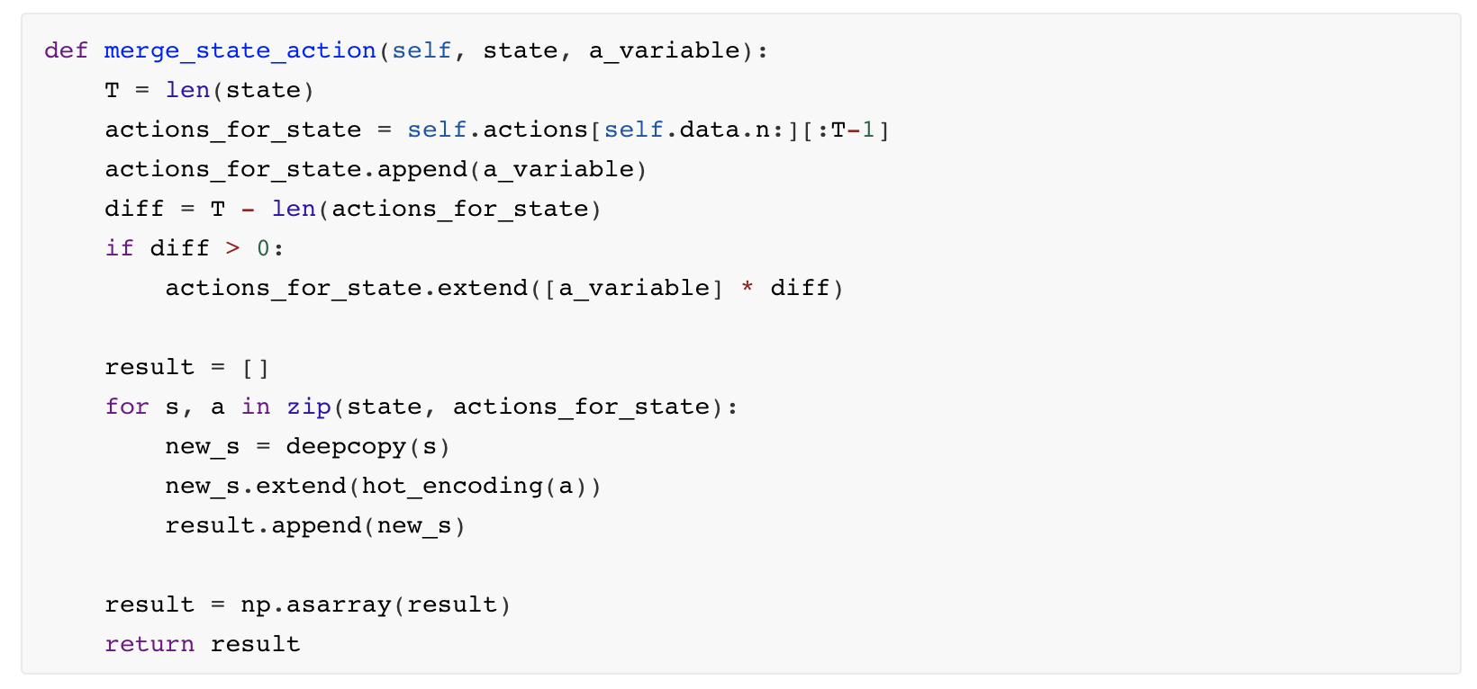
How to build the trading environment
Here, merge_state_action() is merging the aforementioned previous position (argument a_variable) with features of the current state (argument state).

Slide 13
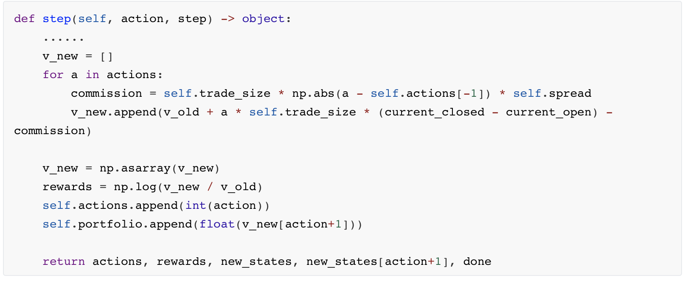
How to build the trading environment
Action augmentation
Here the variable 'commission' is the cost of each trading action which is decided by two arguments -- spread and trade size, and 'v_new' is the updated account balance. The rewards here are the log difference between the balance before and after taking the action.

Slide 14
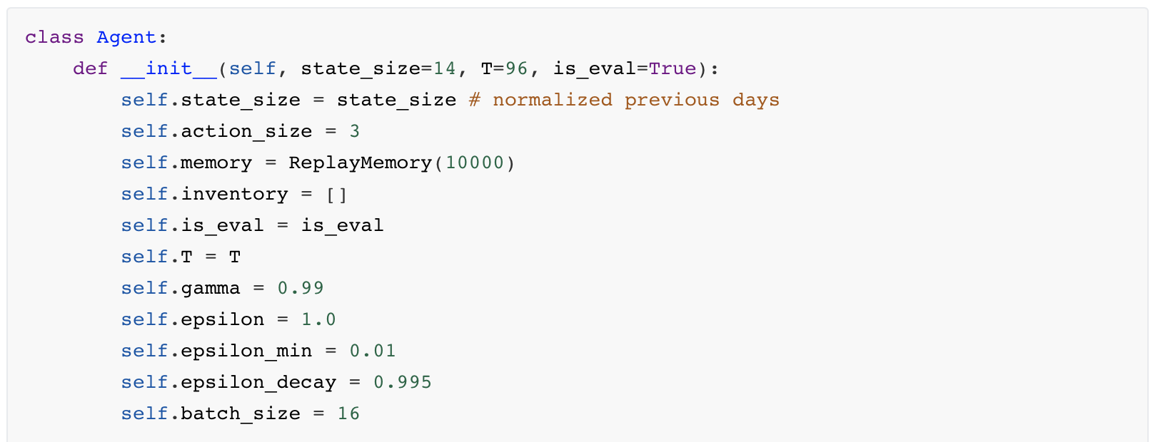
How to build the agent - Initialization
Hyperparameter Initialization

Slide 15
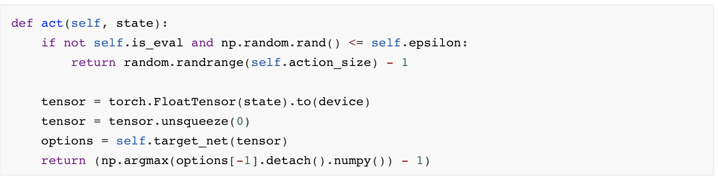
How to build the agent - Act
Action selecting based on our policy

Slide 16
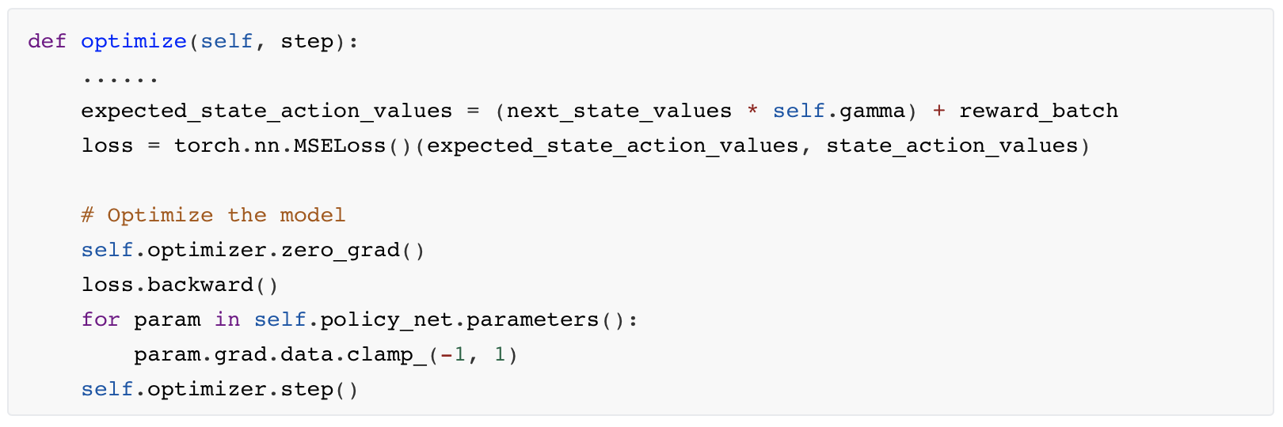
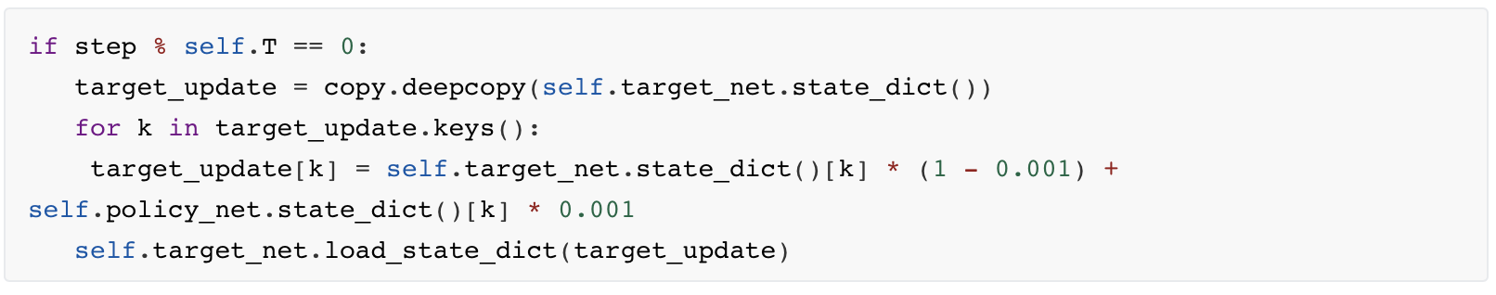
How to build the agent - Optimize
Single step optimization.
Samples a batch -> concatenate all the tensors into a single one→ compute the values -> combine them into our loss.
Soft Update

Slide 17
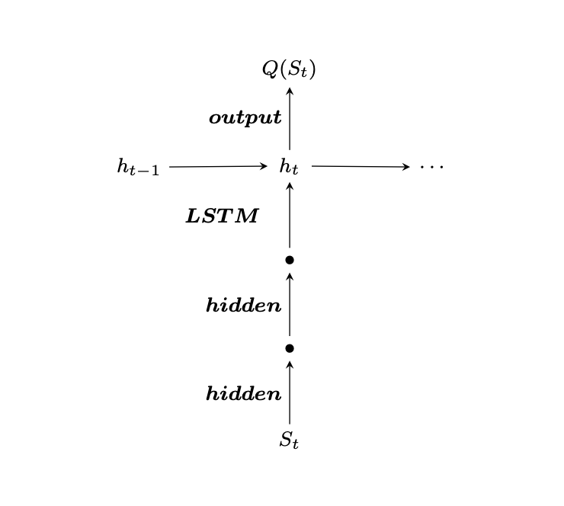
How to implement the Q network in Pytorch

Slide 18
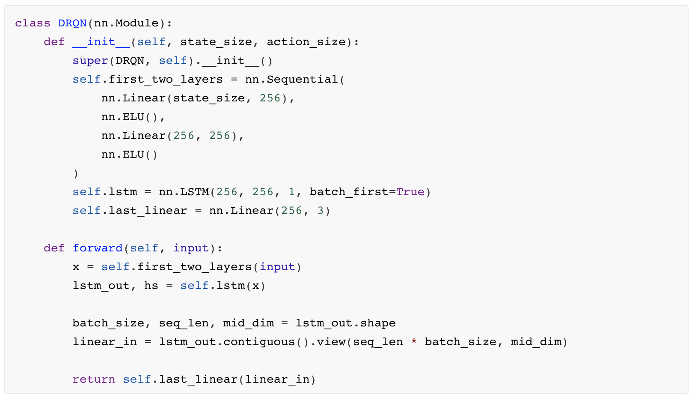
How to implement the Q network in Pytorch

Slide 19
Replay Memory
Transition tuple
A named tuple representing a single transition in our environment. It essentially maps state-action pairs to their next_state and reward result.
ReplayMemory class
A cyclic buffer of bounded size that holds the transitions observed recently.
a .sample() method for selecting a random batch of transitions for training.

Slide 20
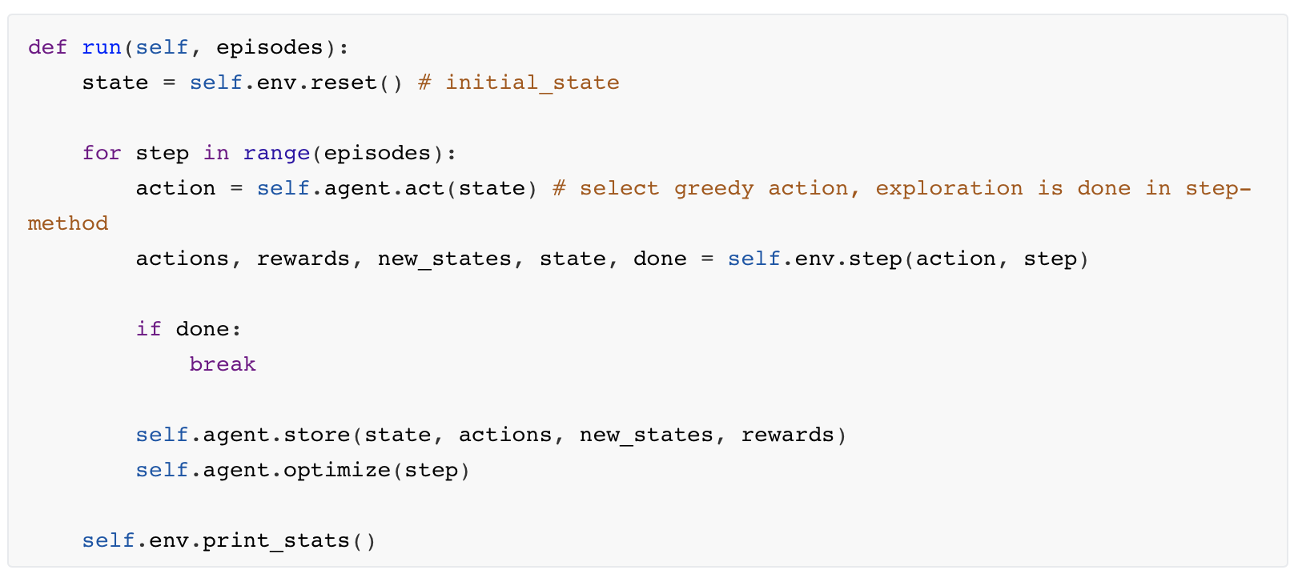
Training starts
initialize the state and the action - > storing training pairs of all possible actions to the replay memory -> the agent randomly samples training batch from the memory -> optimize the policy network.

Slide 21
Outline Project Background Main Idea & Implementation Experiment Results

Slide 22
Baseline methods setting
We compare our DRL-based trading approach with several baseline methods, and they are :
continuous buy / sell
The model assumes the agent always takes one action (buy or sell) all the time with a fixed interval. We select the baseline with better return.
interval trading
To implement the interval trading baseline, we divide the time period into 10 pieces and sell 10% stocks periodically at every interval.
e-greedy DRL.
This is the model without Action Augmentation defined in the paper.

Slide 23
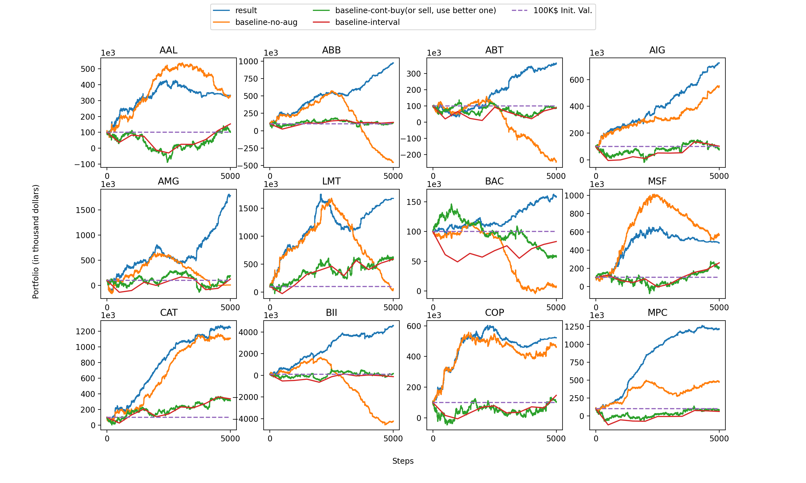
Performance Comparison

Slide 24
Performance Discussion
Good performance in term of return. For some stock, like BII, with 100K initial value, the final return can be as high as 4000K.
Significantly better than Baseline 1 (continuous buy/sell) and Baseline 2 (interval trading) .
Sometimes (AAL, MSF), Baseline 3 (e-greedy, no action augmentation) will perform better than our model.
Even in case of Baseline 3 outperforming our model, the results were not significantly better.
In many cases, the return of Baseline 3 model exhibited the pattern of going down continuously after reaching a top point (like for ABT). But our model does not show this pattern, showing that Action Augmentation is useful.

Slide 25
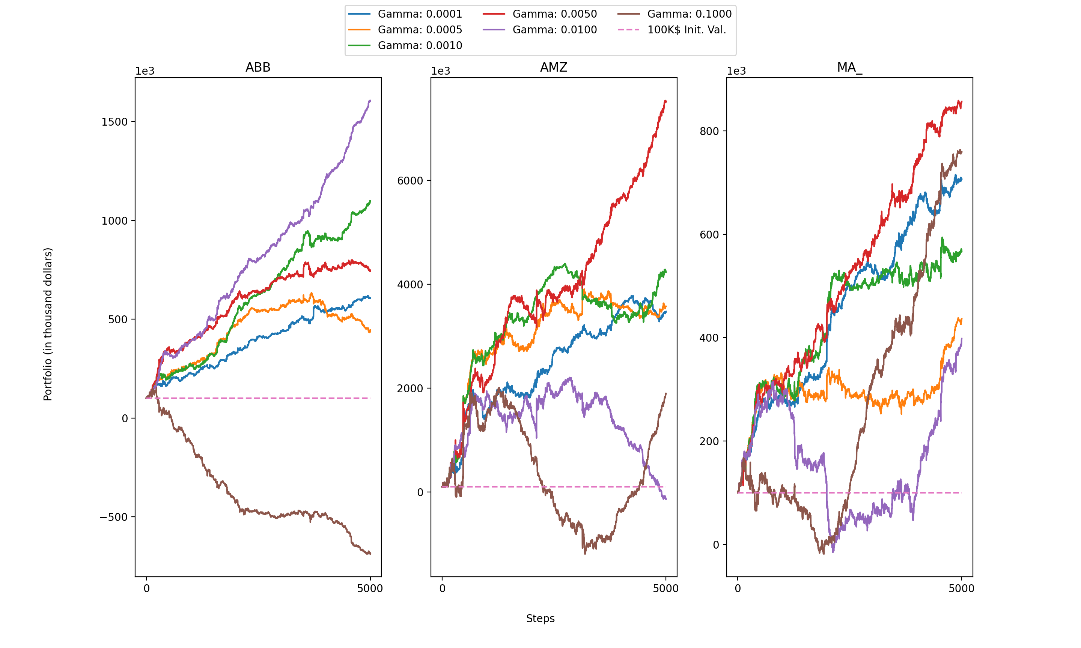
Ablation study – Soft Update Gamma
Good Gamma values: 0.0010, 0.0050

Slide 26
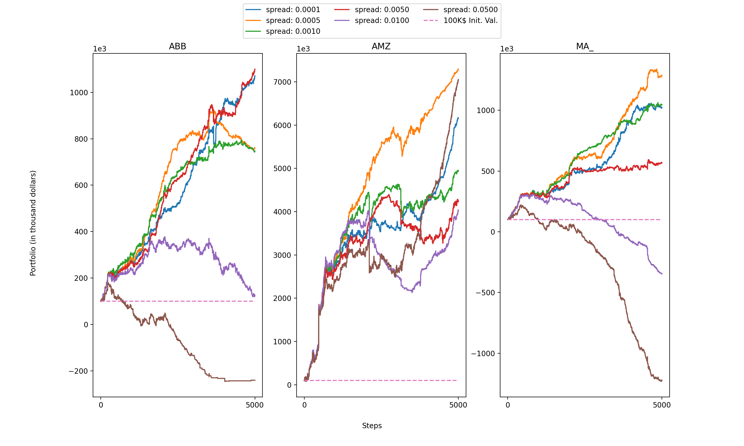
Ablation study – Spread
Difference is huge for 3 chosen stocks when testing with different spreads.
0.0005 is a good value to choose.

Slide 27
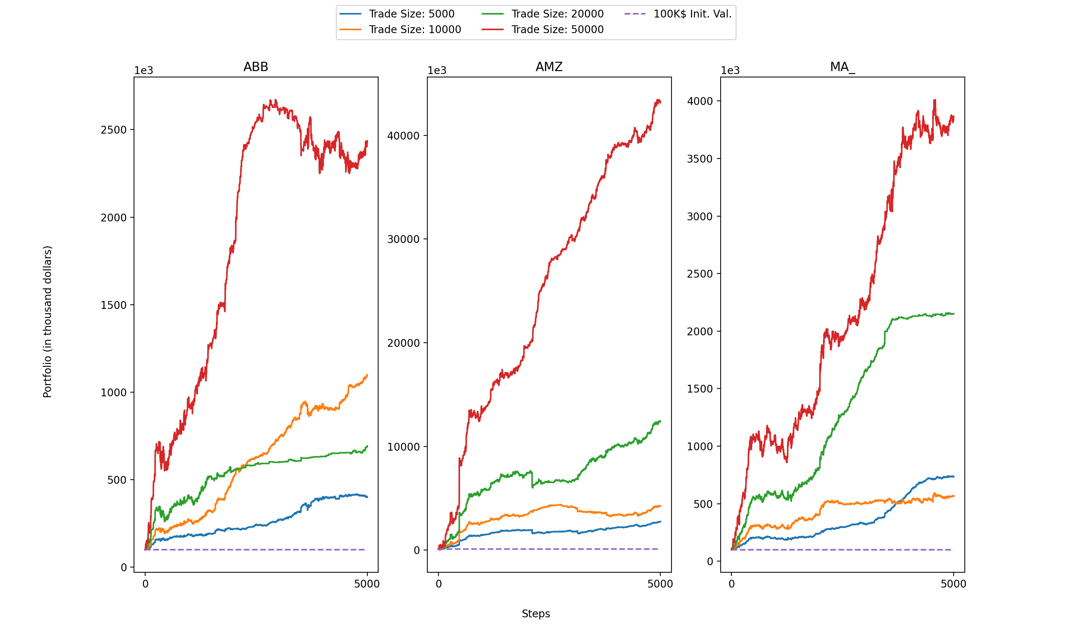
Ablation study – Trade Size
Trade size with best performance: 50000
Significantly better than other values.

