Slide 1
Mesh Generation
Structured vs Unstructured
Nick Earle
March 21st, 2019
MATH 521
Notes:
Mesh generation, this is one area of numerical analysis that is easy to overlook, but there’s actually quite a bit happening when you use the generate_mesh command in Fenics, and the parameters you set can have a large outcome on the results. One of the first decisions that you must make is whether to use a structured or unstructured grid.

Slide 2

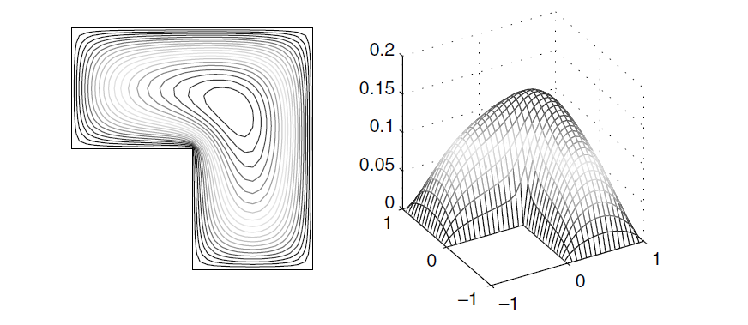
Poisson Problem
Notes:
If we solve on a simple poisson problem with zero boundary conditions, we get something like this. Using a standard rectangular grid, we get an even distribution everywhere, but as Timm alluded to on Tuesday, one method of mesh refinement is by giving better resolution to areas with large gradients. The best way to do this is by using an elliptic smoother.

Slide 3
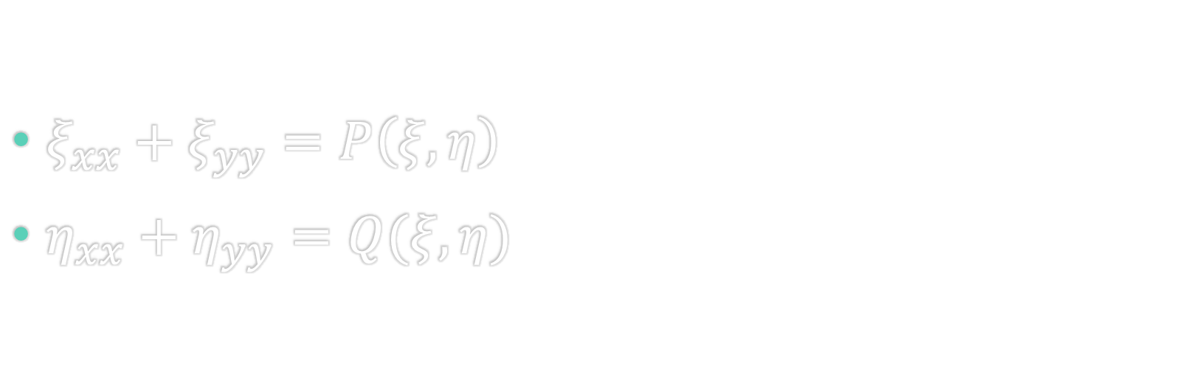
Elliptic System
$ξ_{xx}+ξ_{yy}=P\left(ξ, η\right)$
$η_{xx}+η_{yy}=Q(ξ,η)$
Notes:
Elliptic mesh generation (or smoothing) starts with this system of equations. A simple Poisson or Laplace problem.

Slide 4
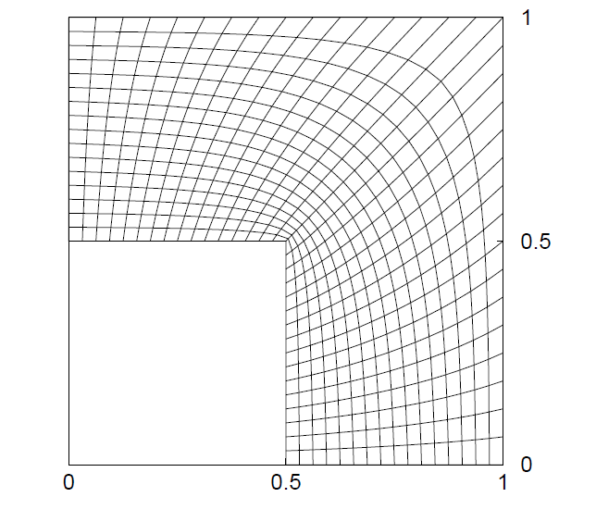
Elliptic Grid
Notes:
Solving this system, with zero source terms, we can alter or “smooth” the standard rectangular grid into something like this. As you can see here, there is much better resolution around the convex corner where there are large gradients, and coarser resolution elsewhere.

Slide 5
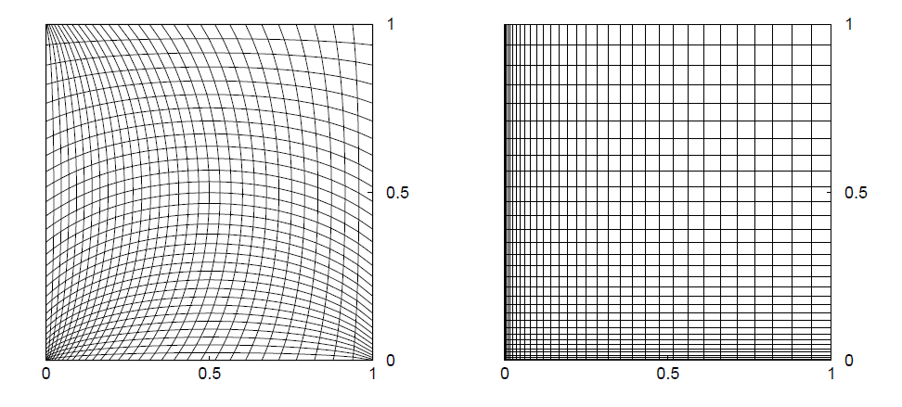
Effect of the source term
No Source Term
Source Term
Notes:
The source term is used to tune just how we want the mesh to look. Here we can tune it so the cells look just like a rectangular grid, but using Laplacian smoothing is more fun.

Slide 6
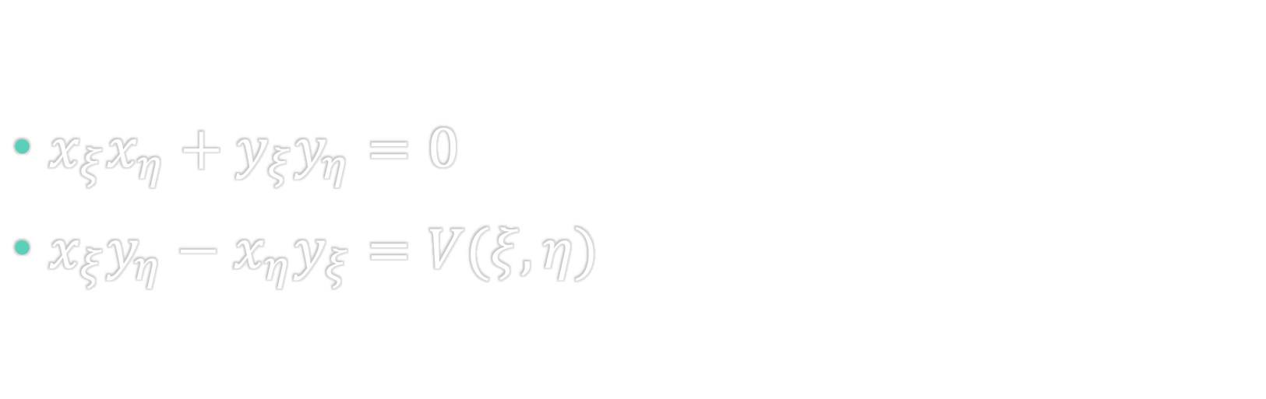
Hyperbolic System
$x_{ξ}x_{η}+y_{ξ}y_{η}=0$
$x_{ξ}y_{η}−x_{η}y_{ξ}=V(ξ,η)$
Notes:
Moving on to hyperbolic mesh generation. This works by extruding a mesh outward from an initial boundary. Think of it like stepping through time, for each time step the equations are solved again and a new layer of mesh is added. The first equation represents the orthogonality, while the second is a volume or area constraint.

Slide 7
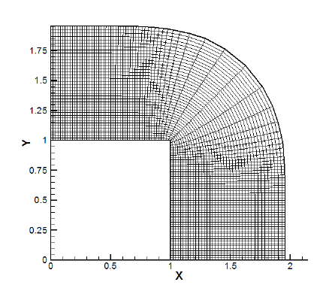
Hyperbolic Grid
Notes:
For a domain similar to before we can get a mesh like this, but hyperbolic meshing is much better for external objects.

Slide 8
Hyperbolic C-Grid & O-grid
Notes:
Like say an airfoil, here we see the famous C-grid and O-grid.

Slide 9
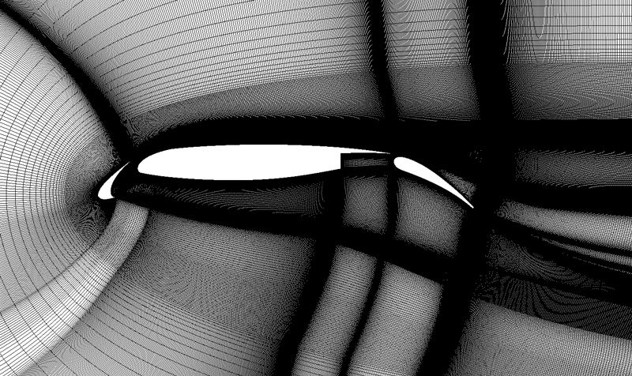
Structured mesh around a multi-element airfoil
Notes:
And here we see a fully structured mesh around a multi-element airfoil just to show that complex shapes don’t immediately need an unstructured grid.

Slide 10
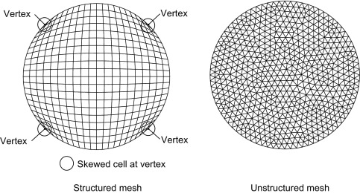
Unstructured Grid Generation
Delaunay Triangulation
Advancing Front
Notes:
Although, that mesh probably took days to produce (or weeks if expanded to 3D). We can instead of course use unstructured grids, generated using the two most popular methods of Delaunay triangulation and advancing fronts. While unstructured meshes do offer serious advantages in ease of application, it does have some downfalls too, in that, at it’s simplest it take about 5 times as many cells to achieve the same level of accuracy, which in turn leads to larger memory requirements, not to mention all of the other connectivity data structures needed.

Slide 11
Delaunay Triangulation
Notes:
First up we have Delaunay triangulation, which is a point insertion method, of which I do not yet understand the algorithm for the actual point selection. The key here is that there are no vertices inside the circumcircle of any given triangle. This is a very quick method and works for any geometry, but can produce some very skewed cells, especially nearer to boundaries.

Slide 12
Advancing Front
Notes:
Next up we have the advancing front method, also a point insertion method, except that each point is checked for collision and overlap, and adjusted accordingly. Shown here we have our first point, then the second one has a boundary point inside it’s prescribed circle, so it will take that point instead.

Slide 13
Advancing Front
Notes:
This continues around the domain until it is completely filled. It also works for external boundaries, similar to the hyperbolic methods.

Slide 14
Convergence Rate of Rectangular and Triangular Grids
Notes:
Finally on to some results, here we see the convergence rate of our standard rectangular compared with the triangulated grids, for an inviscid flow, with radially stretched cells, using a third order scheme. As you can see we seem to lose an order of convergence with any mesh irregularity.
So to summarize, structured grids offer much better accuracy with a fraction of the cells, and a fraction of the memory, but can be very difficult to implement when the geometry gets complex. Unstructured grids, offer easy adaption and refinement, but lack in accuracy and memory. So next time your discretizing your space, before just generating any mesh, think about whether there may be a benefit to using a structured or unstructured one.

Slide 15
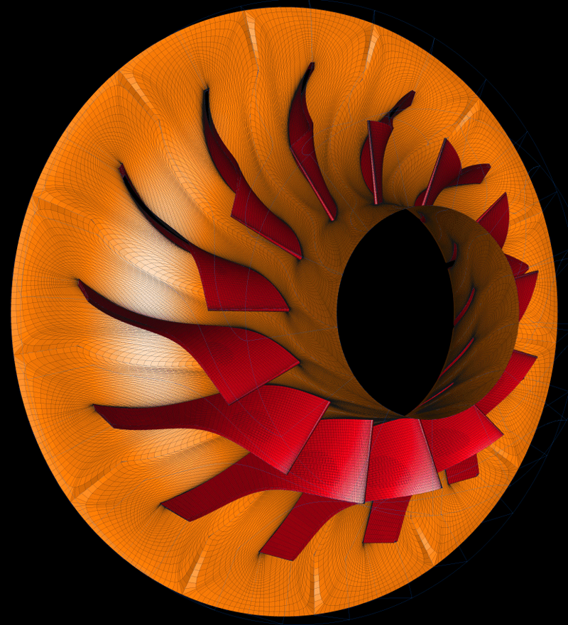
Questions?

