Slide 1
Structured PDE Mesh Generation
Elliptic and Hyperbolic Grids
Nick Earle
February 14th, 2019
MATH 521

Slide 2

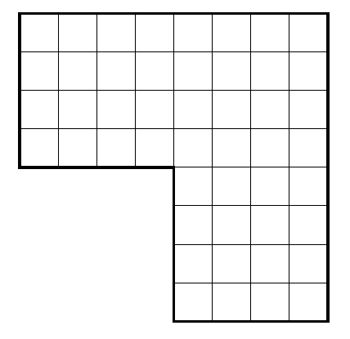
Standard Rectangular Grid
Notes:
Here is our standard rectangular grid that hopefully all of you are familiar with. I have chosen the L shape here to help show my point. But say we want to solve our basic Poisson problem, with homogeneous BCs, on this grid. While it will certainly work, the solution won’t be very well resolved. [Next]

Slide 3
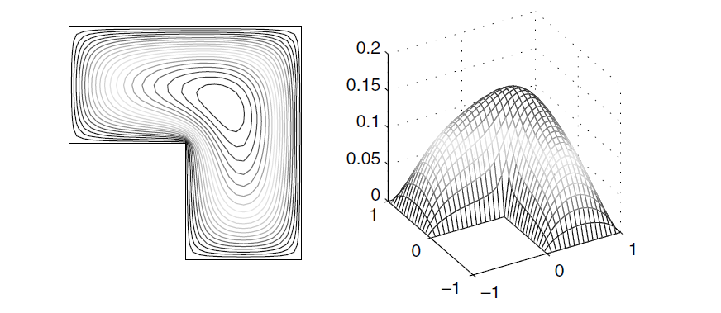
Poisson Solution with Zero BC
Notes:
The solution looks something like this. As you can see, the greatest variation in the solution happens right in the corner at the origin, while next to nothing is happening at the corner at point (1,1), but from our grid before, both have the same grid spacing. So let’s say we want to cluster some more points at the origin, you could use some sort of interpolation [next]

Slide 4
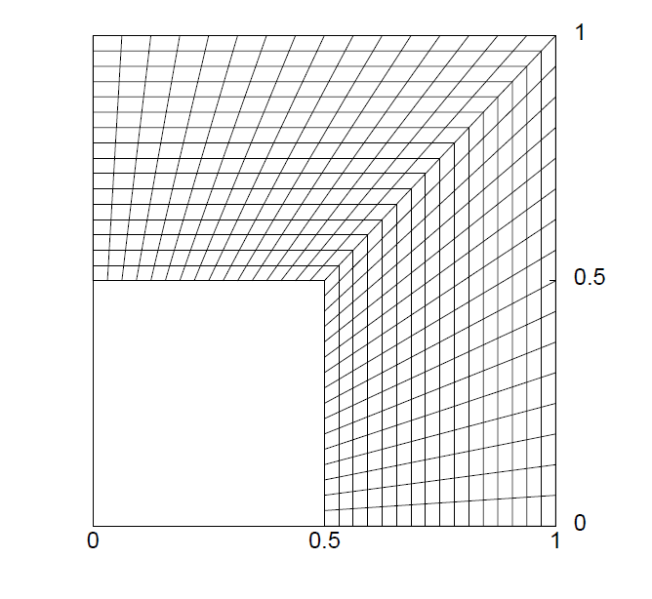
Algebraic Interpolation
Notes:
But that looks something like this. These discontinuities can certainly cause problems. [Next]

Slide 5
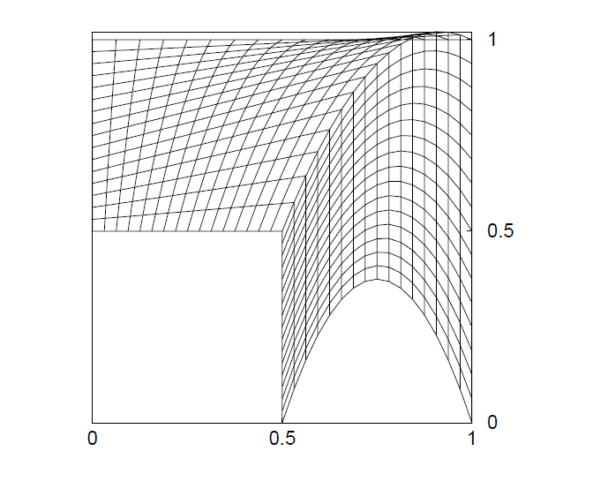
TransFinite interpolation
Notes:
Interpolation can also fail if there is some perturbations in the boundary. [Next]

Slide 6
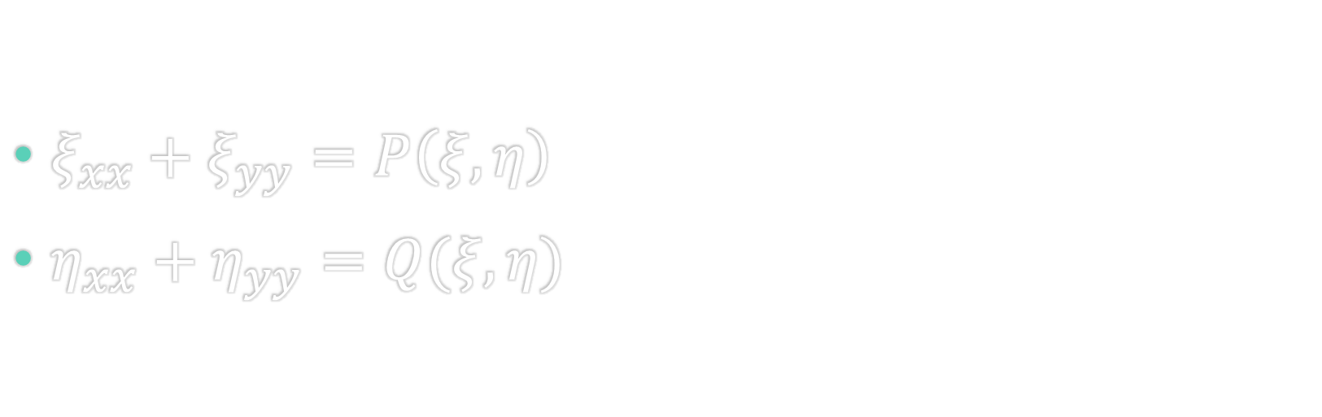
Elliptic System
$ξ_{xx}+ξ_{yy}=P\left(ξ, η\right)$
$η_{xx}+η_{yy}=Q(ξ,η)$
Notes:
So instead, let’s get smart and think about turning the mesh idea into a problem of its own. Using a transformation, like the famous sponge analogy, how about solving an elliptic system to generate grid lines. This becomes a boundary value problem, where we define boundary points and start with some sort of algebraic mesh (usually transfinite) and iterate until your new elliptic mesh is sufficiently smooth.

Slide 7
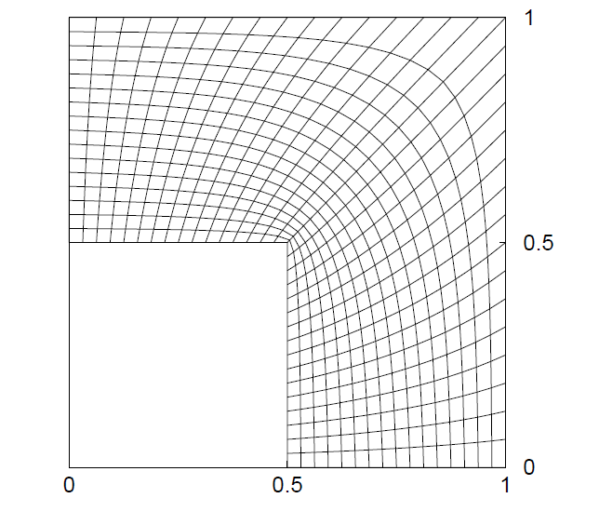
Elliptic Grid
Notes:
Which results in a much smoother grid. This was generated using zero source terms as has the exact desired result, finer resolution near the interior corner, coarsening as it moves away. (I apologize for the different axes, I “borrowed” them from different sources). This was made using a zero source term [next]

Slide 8
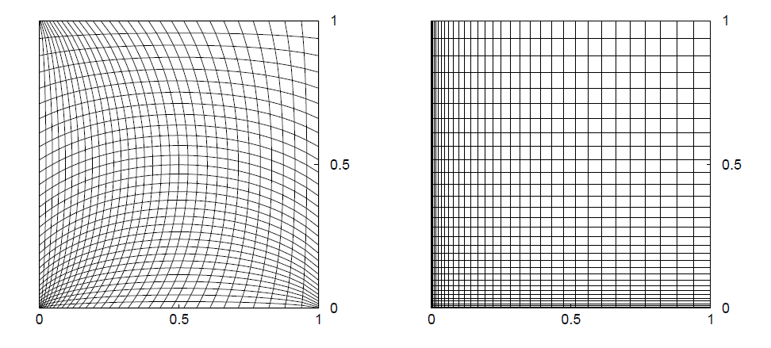
Effect of the source term
No Source Term
Source Term
Notes:
The source term however, can help very much in the orthogonality and spacing of the grid. Here for example, if we have a square domain and want to cluster points in one corner, no source term results in the mesh on the left, while correct tuning will give us the grid on the right, (which of course could just be done unevenly spacing the nodes of a simple rectangular grid, but that’s on fun).

Slide 9
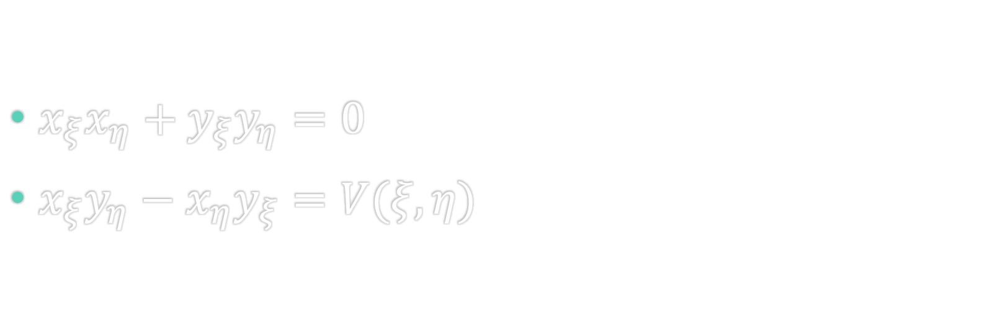
Hyperbolic System
$x_{ξ}x_{η}+y_{ξ}y_{η}=0$
$x_{ξ}y_{η}−x_{η}y_{ξ}=V(ξ,η)$
Notes:
The next type of PDE mesh generation is hyperbolic. Like elliptic we find ourselves again with this small system, however hyperbolic meshes march out from the boundary of an object, and don’t need an initial mesh. They have two key advantages over elliptic meshes in that they are orthogonal (as is the constraint in the first equation), the second equation constrains each cell to a certain volume, and they can be generated much faster, as the elliptic case is iterative. However, they are garbage for internal flows because, well…

Slide 10
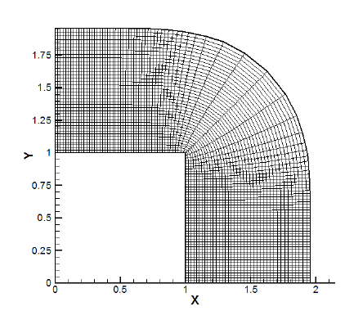
Hyperbolic Grid
Notes:
Here we can see a similar domain as before, except that we are now meshing the outside. While elliptic generators can be very useful for internal flows, such as turbomachinery [next]

Slide 11
Hyperbolic C-Grid
Notes:
Hyperbolic generators are much better at making grids like this C-grid around an airfoil or [next]

Slide 12
Hyperbolic O-Grid
Notes:
Or this O-grid. So next time you find yourself creating a mesh for CFD applications, instead of using a boring rectangular grid, or immediately going unstructured, think about using some of these options, your solver will thank you.

