Slide 1
Structured Mesh Generation
Elliptic and Hyperbolic Grids
Nick Earle
February 14th, 2019

Slide 2

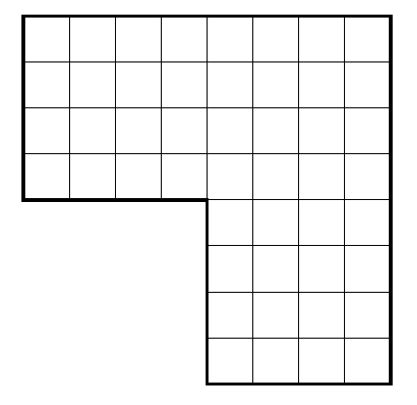
Standard Rectangular Grid

Slide 3
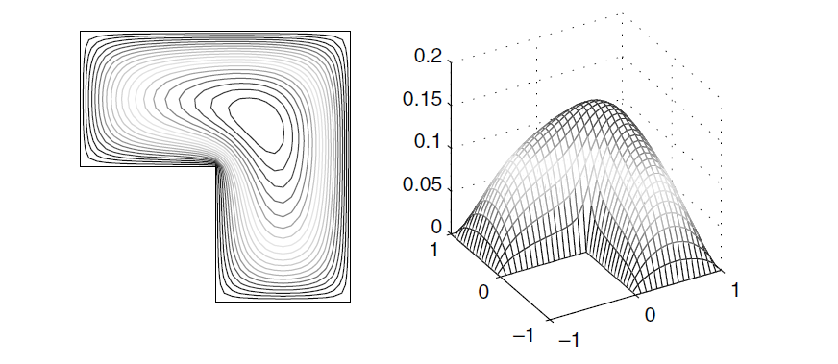
Poisson Solution with Zero BC

Slide 4
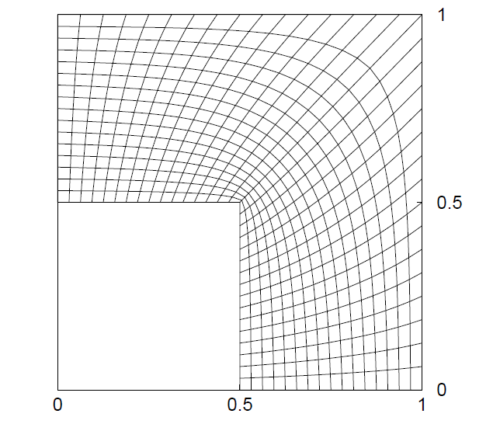
Elliptic Grid

