Slide 1



Accès Sécurisé
Transgerbeur
Campus St Félix-La Salle
Nantes
Nicolas CHANCEREL | Sébastien LEHUCHER | Edouard FORESTIER
Notes:
© Copyright Showeet.com – Free PowerPoint Templates

Slide 2
Sommaire
- OUTILS DE COLLABORATION
- PLANNIFICATION
- DIAGRAMME
- GANTT
- CAS D’UTILISATION
- CLASSE
- SÉQUENCE
- IHM
Notes:
© Copyright Showeet.com – Free PowerPoint Templates

Slide 3

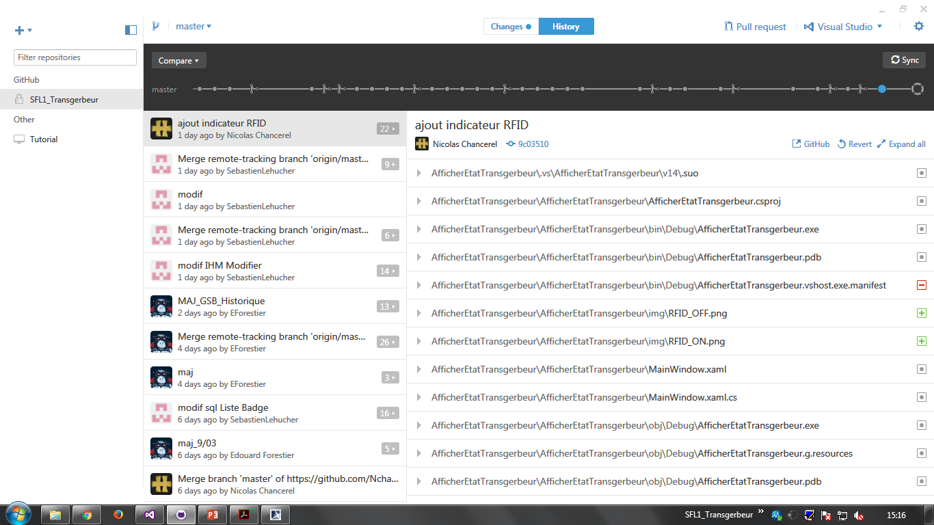

GITHUB
OUTILS DE COLLABORATION
PLANNIFICATION
. . .
Notes:
© Copyright Showeet.com – Free PowerPoint Templates

Slide 4

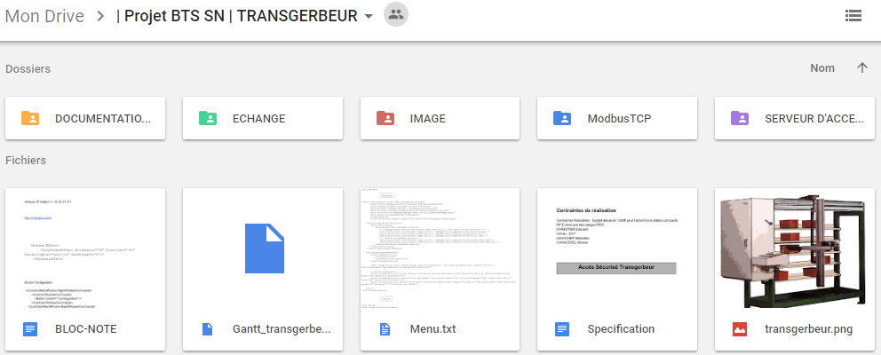
DRIVE
OUTILS DE COLLABORATION
PLANNIFICATION
Notes:
© Copyright Showeet.com – Free PowerPoint Templates

Slide 5

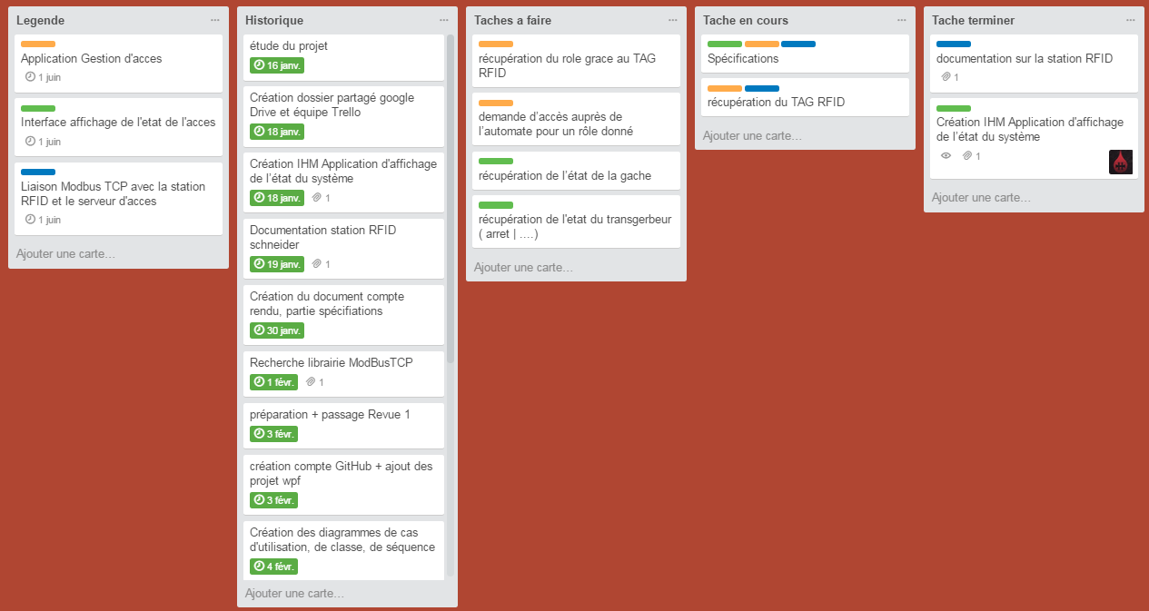
TRELLO
OUTILS DE COLLABORATION
PLANNIFICATION
Nom du tableau :
Etudiant 3 | Nicolas CHANCEREL
Notes:
© Copyright Showeet.com – Free PowerPoint Templates

Slide 6

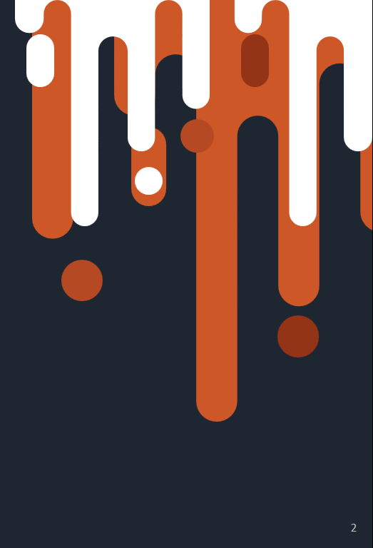

MS PROJECT
PLANNIFICATION
DIAGRAMME
Notes:
© Copyright Showeet.com – Free PowerPoint Templates

Slide 7


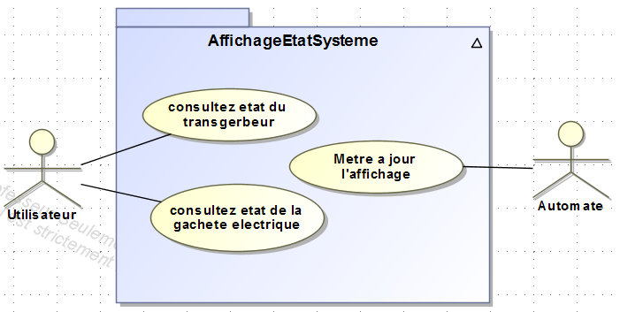
MAGICDRAW
Cas d’utilisation
DIAGRAMME
IHM
Notes:
© Copyright Showeet.com – Free PowerPoint Templates

Slide 8
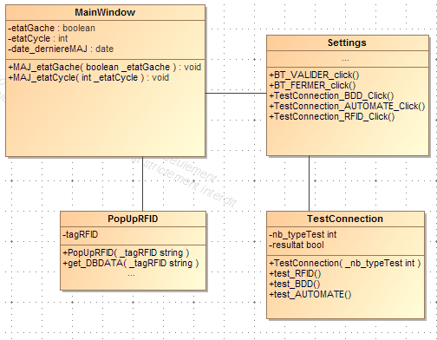
MAGICDRAW
Classe
DIAGRAMME
IHM
Notes:
© Copyright Showeet.com – Free PowerPoint Templates

Slide 9
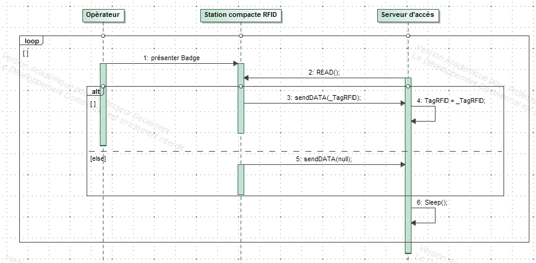
MAGICDRAW
Séquence
DIAGRAMME
IHM
Notes:
© Copyright Showeet.com – Free PowerPoint Templates

Slide 10
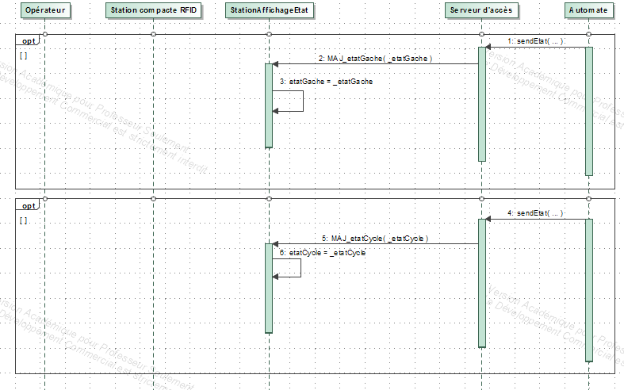
MAGICDRAW
Séquence
DIAGRAMME
IHM
Notes:
© Copyright Showeet.com – Free PowerPoint Templates

Slide 11
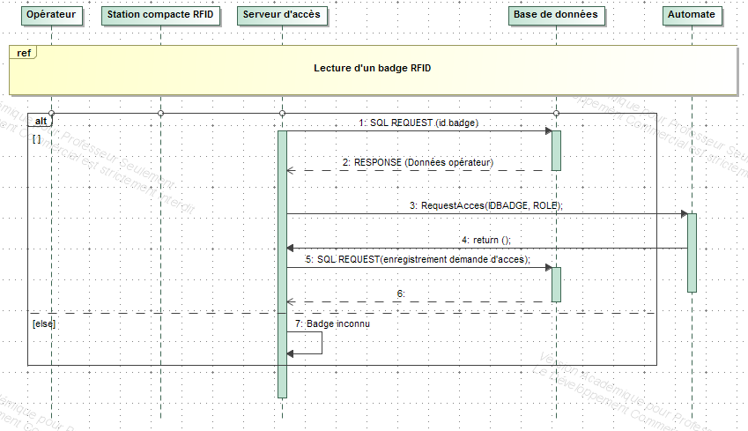
MAGICDRAW
Séquence
DIAGRAMME
IHM
Notes:
© Copyright Showeet.com – Free PowerPoint Templates

Slide 12

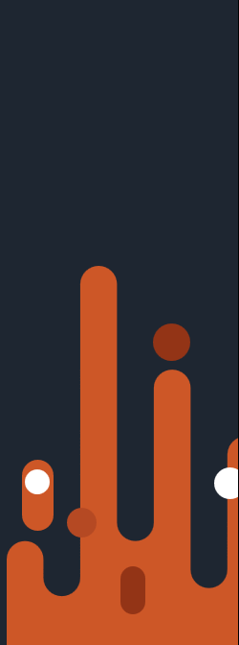


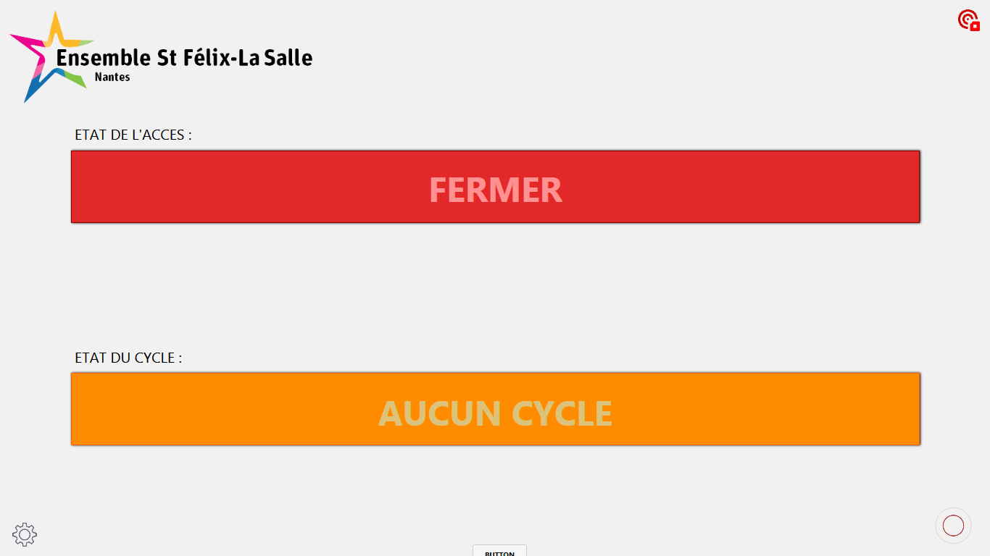
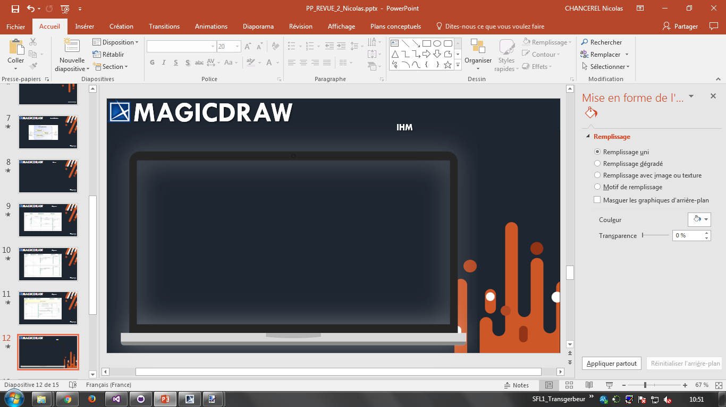
VISUAL STUDIO
IHM
Notes:
© Copyright Showeet.com – Free PowerPoint Templates

Slide 13
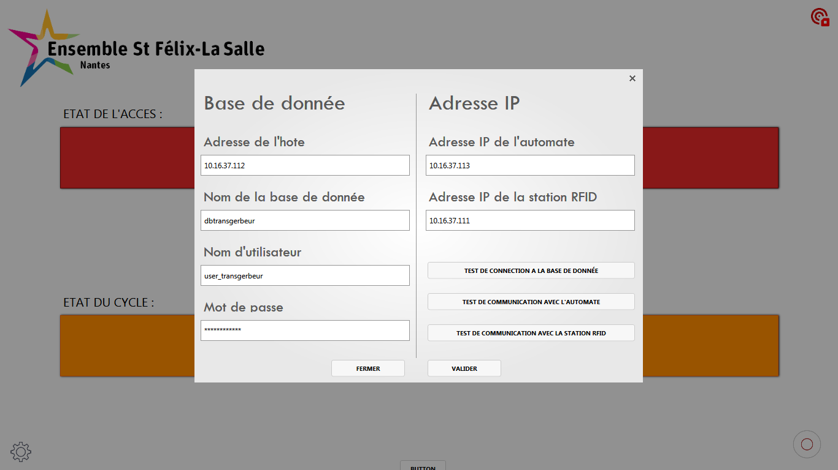
VISUAL STUDIO
IHM
Notes:
© Copyright Showeet.com – Free PowerPoint Templates

Slide 14
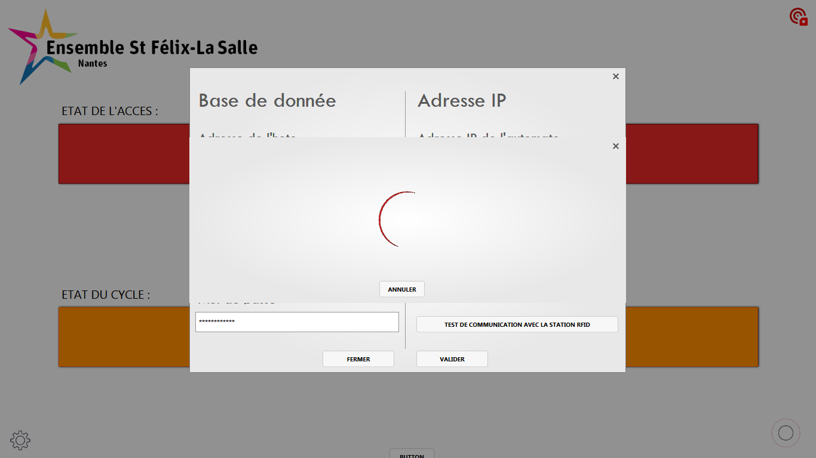
VISUAL STUDIO
IHM
Notes:
© Copyright Showeet.com – Free PowerPoint Templates

Slide 15
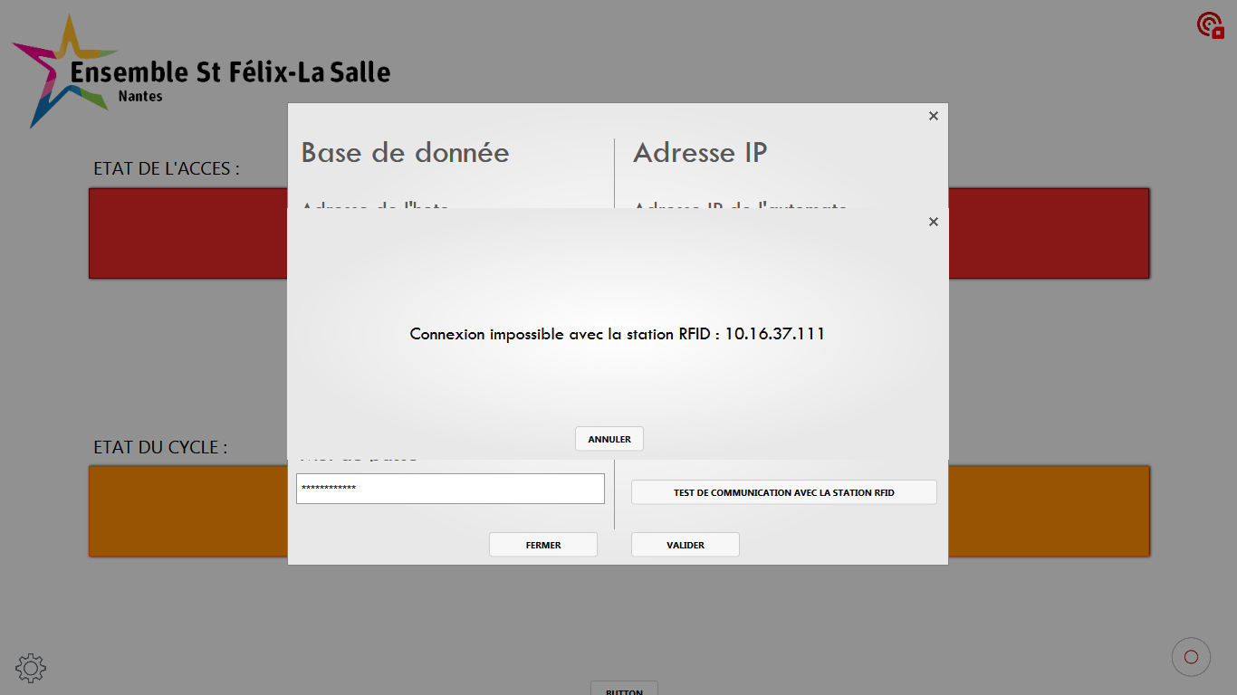
VISUAL STUDIO
IHM
Notes:
© Copyright Showeet.com – Free PowerPoint Templates

Slide 16
VISUAL STUDIO
IHM
Notes:
© Copyright Showeet.com – Free PowerPoint Templates

Slide 17
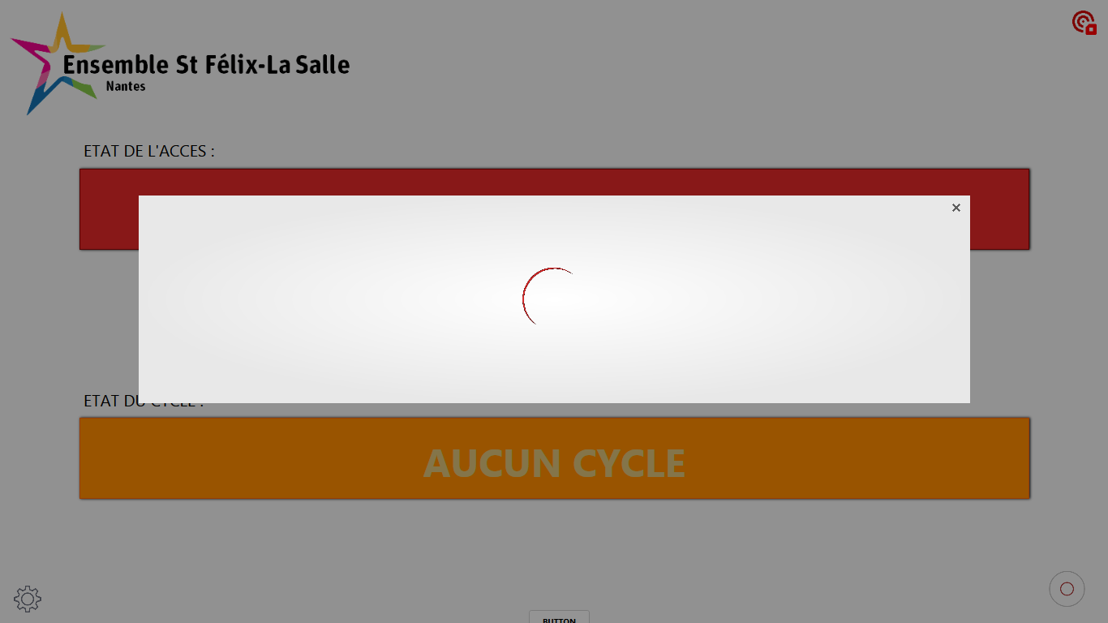
VISUAL STUDIO
IHM
Notes:
© Copyright Showeet.com – Free PowerPoint Templates

Slide 18
Accès Sécurisé
Transgerbeur
Campus St Félix-La Salle
Nantes
Notes:
© Copyright Showeet.com – Free PowerPoint Templates

