Slide 1

IS314 Project Group 11
Online Manuscript Submission System

Slide 2

Meet The Team

Slide 3

The Team
Anderson Kukutu
Divnesh Prasad
Joanna Latasi
Kristofferson Mala
Nickeel Chandra

Slide 4
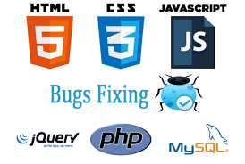
Description And Approach

Slide 5
Description
The System built was to be an Online Platform.
Functionalities: Major
Functionalities: Minor
Registration and Login
Uploading a Manuscript
Submission of Manuscript
Adding Reviewers
Assigning Reviewers
Submitting Feedback
Viewing Feedback
Email
Forget Password
. Edit Profile
Edit Manuscript

Slide 6

Approach
OOP Programming
Traditional Software Development Process
Deliverables
All Major Functionalities
Working System
Phases:
Requirements Gathering
Analysis And Design
Development
Requirement Change
Testing

Slide 7



Lessons Learnt
Teamwork
Meeting Deadlines
Building A System in a Real World Scenario
Meeting Client Expectations
Responsibility
Time Management

Slide 8

Interactions
Client Meetings in total:
10
Team Meeting In total:
8
2 – SAD
1 - Proposal
1 – SRS
Development

Slide 9
Project Success?
Experience
Built an entire online Platform.
Gained client meeting scenarios.
Made new Friends
Completed the System

Slide 10

Now Onto the Demo.

Slide 11




Thank You
+1 23 987 6554
april@www.proseware.com
www.proseware.com

