Slide 1
BDAT1001 FINAL PROJECT: PART1 :BUILD SECURE API
Submitted By: Neelanjna Chhabra
StudentID: 200460595

Slide 2

INTRODUCTION
Authentication and Authorization: In order to secure the Web API from unauthorized access, we will use Authentication and Authorization to control access to the Web API.
Final Project OBJECTIVES:
Explain how JWT is used in API security
Demonstrate your API
Acquire data from PostMan
Make a recommendation on which choice of Authentication method (OAuth, OpenId, or other) is best for API security.

Slide 3
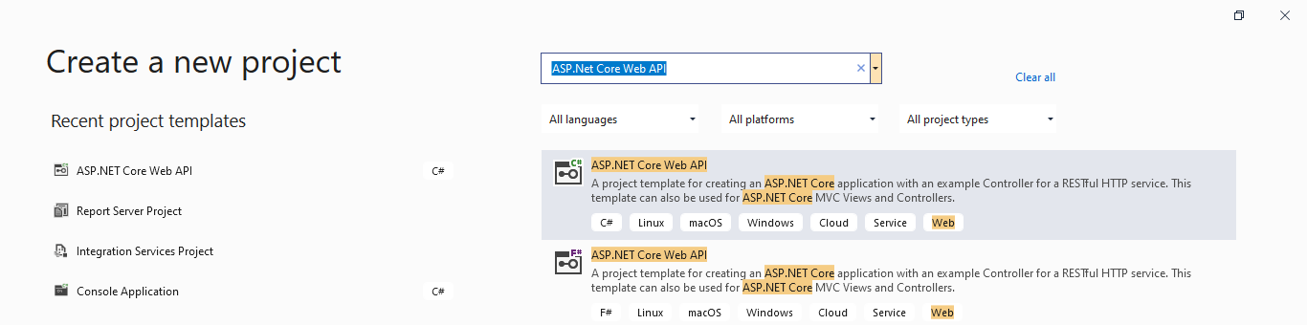
JWT is used in API security
Web Hosting uses HTTP Modules for its authentication. We will configure our project to use the authentication modules built in ASP.NET app.
1
First we create a project selecting type as ASP.Net Core Web App, uncheck HTTP in that. Name it as : Solution.

Slide 4
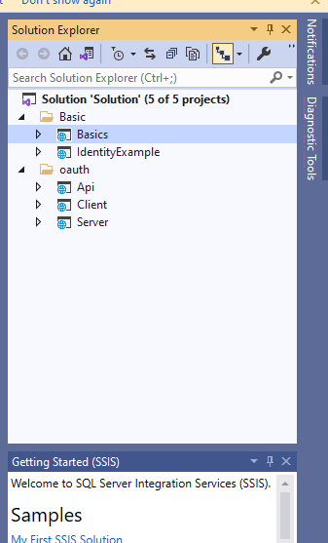
JWT is used in API security
FOLDER STRUCTURE:
“Solution” project folder will ultimately look like :

Slide 5
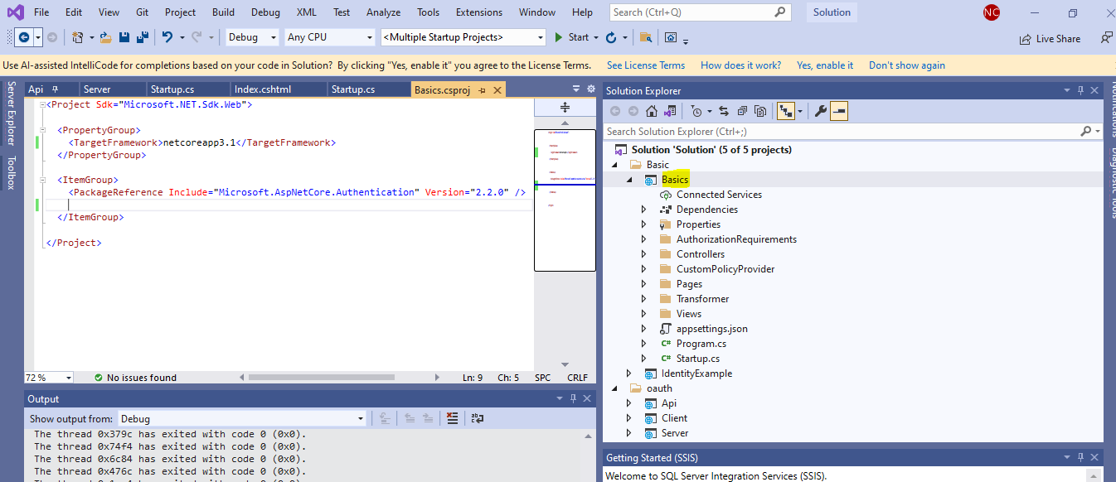
JWT Steps (Contd.)
2
Create a folder under the project and give it a name as Basic > create an ASP.Net Project named Basics in it:
3
Files under Basics folder: (i) Program.cs is a default file that is created with this. It is the starting point of our application.

Slide 6
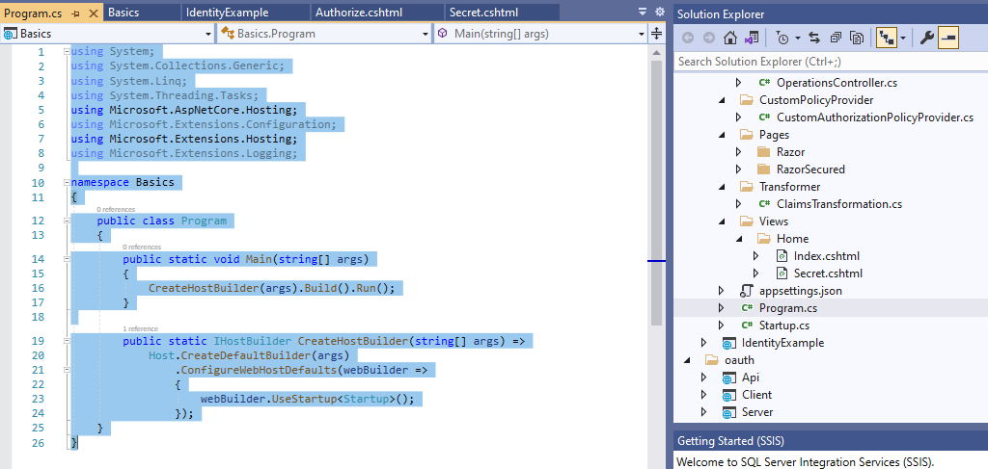
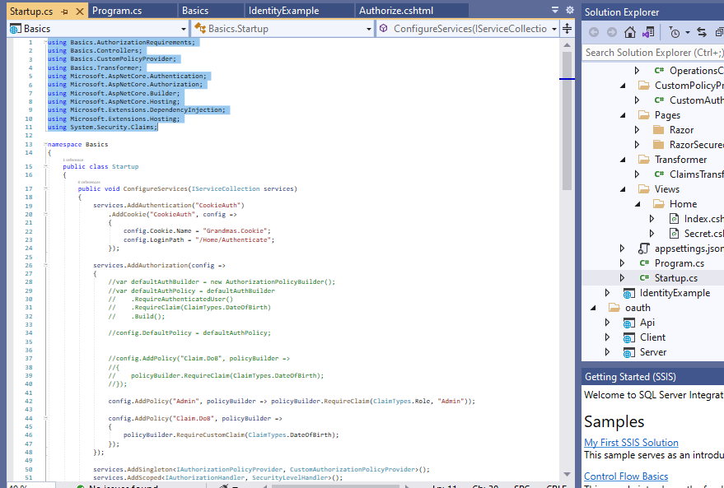
JWT Steps (Contd.)
Files under Basics folder: (ii) Startup.cs is a default file that sets up services for the current application. It allows you to register services through ConfigureServices() method and configure the HTTP request.
4

Slide 7
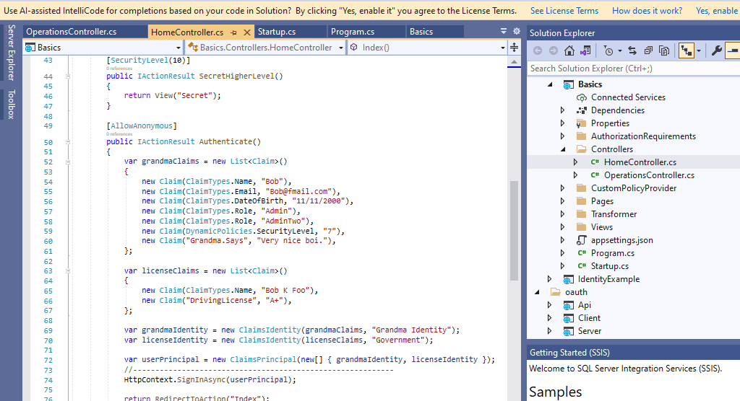
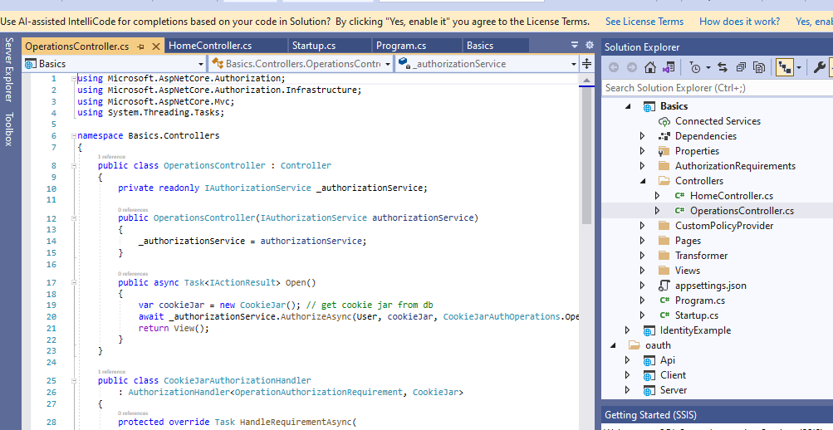
JWT Steps (Contd.)
Controller Setup: (i) Create folder Controllers under Basics, and add two classes (HomeController.cs and OperationsController.cs) (ii) The controller is added to handle HTTP requests..
5

Slide 8
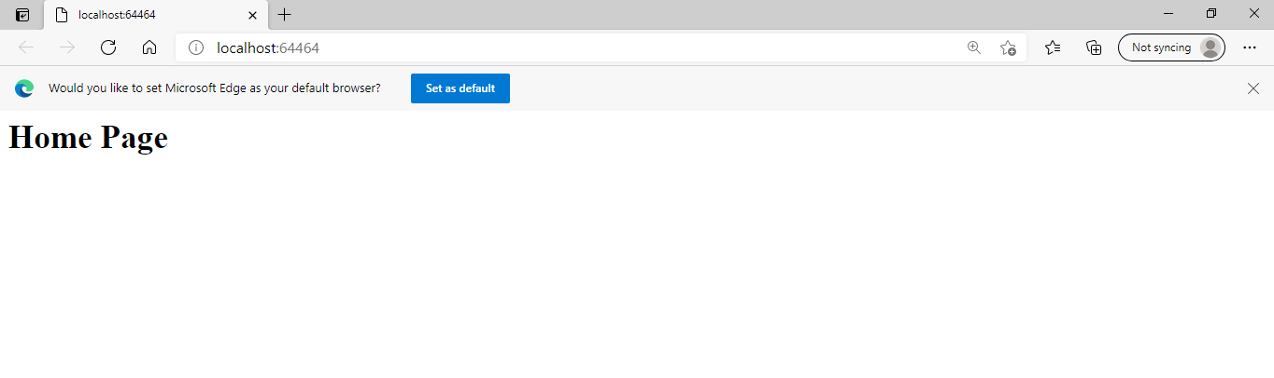
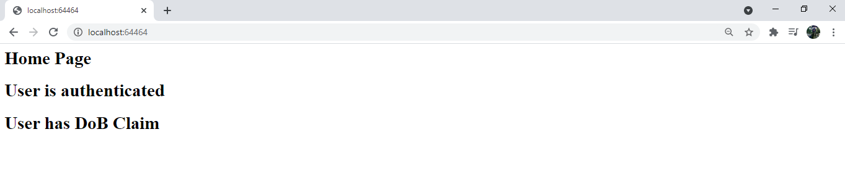
JWT Steps (Contd.)
Web API Configuration : (i) By default appsettings.json configuration file, check that "AllowedHosts": "*“. After adding all the required classes we launch Basics. Here we first check – Are you allowed - Authorization Who Are You ?- Authentication. The first launch takes us to the Homepage:
6

Slide 9
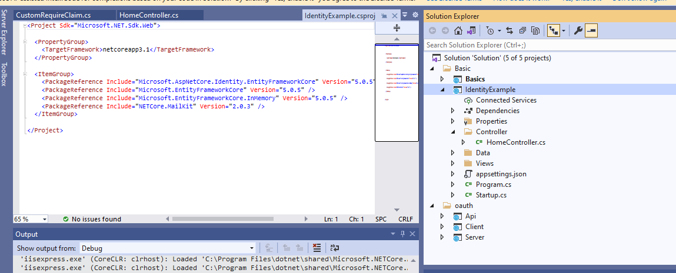
JWT Steps (Contd.)
1
Under project folder, add project > IndentityExample. Before we proceed further, we will first be installing the nugget packages: Microsoft.EntityFrameworkCore and Microsoft.EntityFrameworkCore.InMemory.

Slide 10
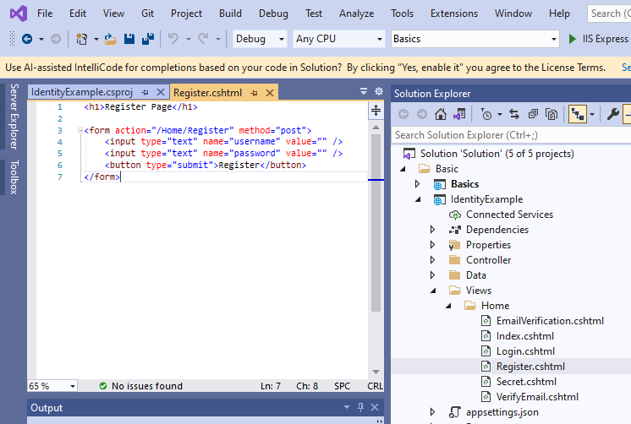
JWT Steps (Contd.)
2
Under Views folder > Login.cshtml file, Register.cshtml files are present.
The Register.cshtml contains the registration form which is used to register the user using the API service. The Login.cshtml allows user to enter their credentials. Launching this, first takes us to the homepage and then we type /Home/Register in the url to go to the registration page.

Slide 11
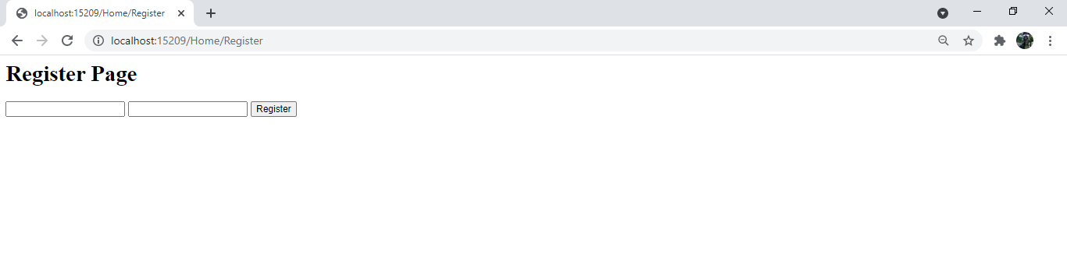
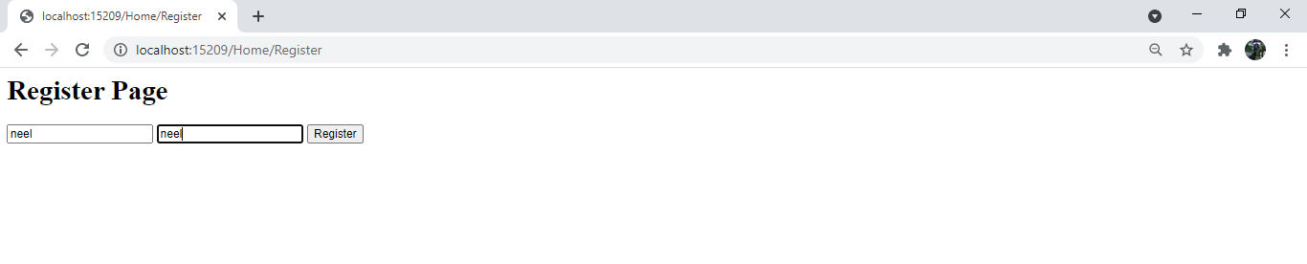
Registration Page:

Slide 12
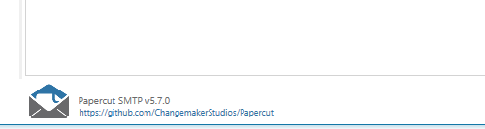
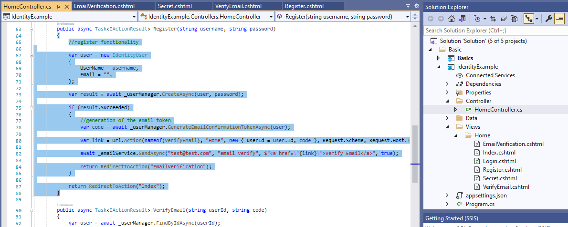
Email Verification:
1
We will be using the PaperCut Application for email verification Step.
2
Instead of signing in the users after registration, we want to verify their email to login to the site. The HomeController file contains the verify email code.

Slide 13
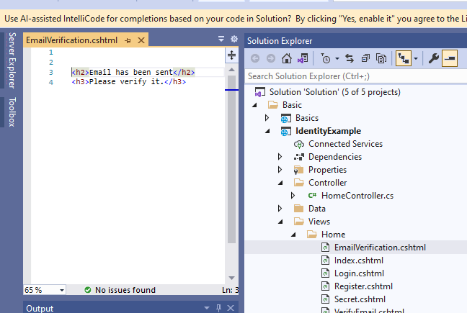
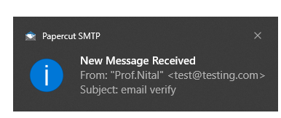
Email Verification:
4
Emailverification.cshtml contains the code of the message that gets displayed.
3
When we enter the credentials, it automatically sends and email using the PaperCut Tool and a pop comes that the email has been sent

Slide 14
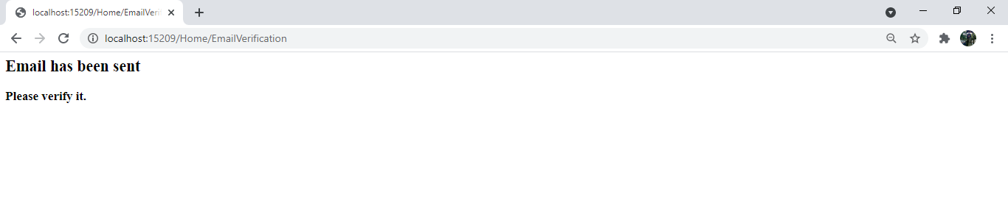
Email Verification:
6
Emailverification.cshtml contains the code of the message that gets displayed.
5
When we enter the credentials, it automatically sends and email using the PaperCut Tool and a pop comes that the email has been sent

Slide 15
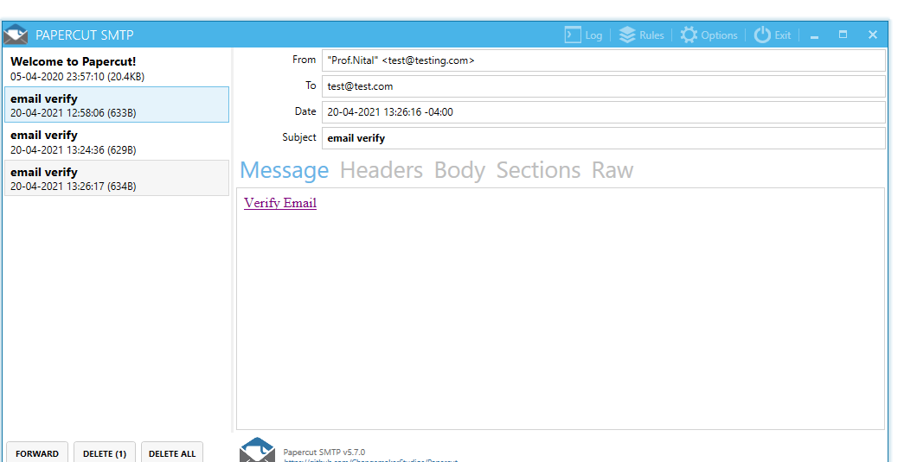
Email Verification:
8
Open the email in PaperCut SMTP tool, and click on verify Email:
7
Once the user enters the name and password, the message that the email has been sent gets displayed.

Slide 16
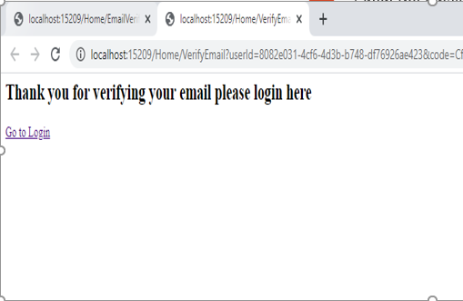
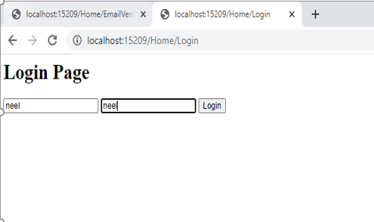
Email Verification:
When the email has been verified, it gives below message, asks to login back again
10
Login back window comes up:
9

Slide 17
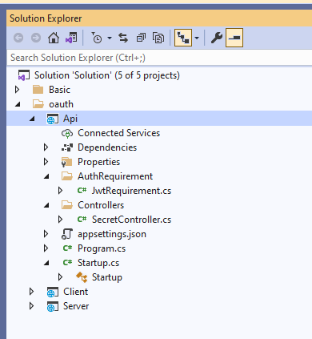
Oauth Implementation:
Create the Oauth folder under the Solutions project and add projects - Api, Client , Server.
1
API: This is used to verify the token that is generated by the server side.

Slide 18
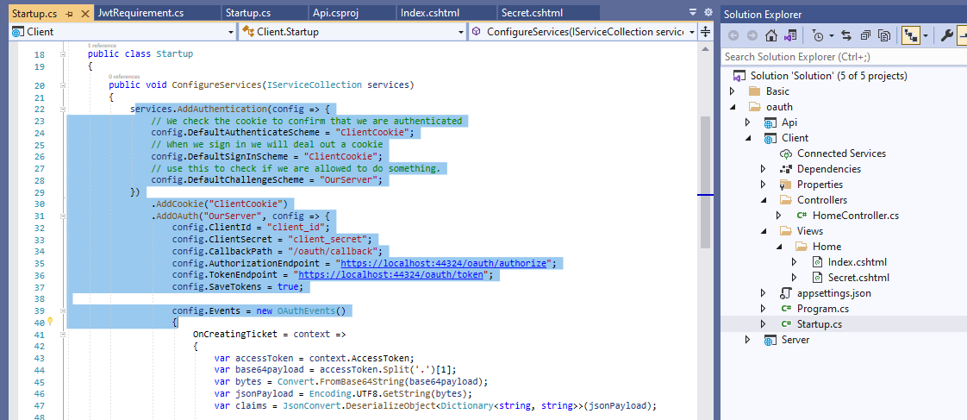
Oauth Implementation:
Client: This file contains the code about the access token and stores it.
In this we discuss how to create a client that can authenticate using the OAuth flow. Here we are authenticating the client and saving an access token which will then be used for authorization.
2

Slide 19
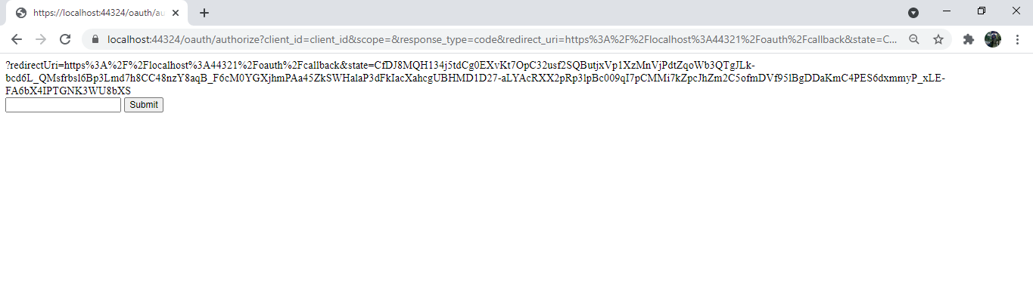
Oauth Implementation:
3
Server: This file contains the code about the token generation. Below is the output of the token generated, which will be used for authorisation.

Slide 20
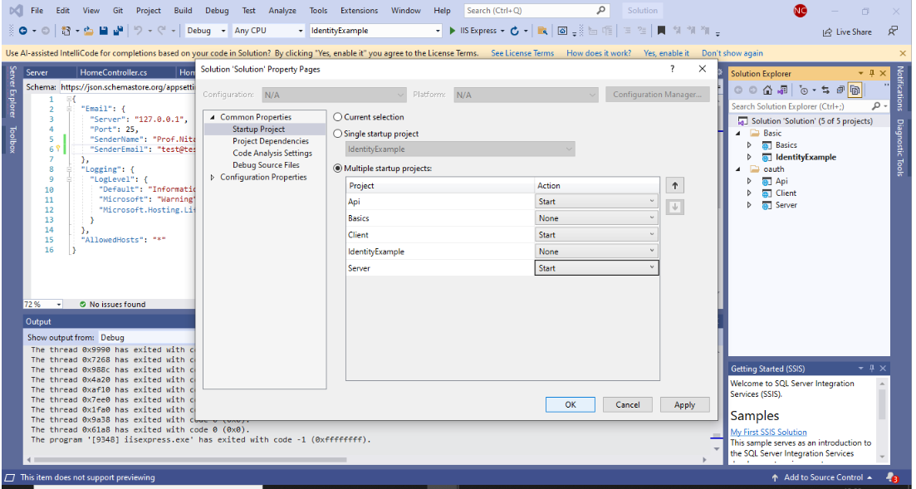
Oauth Implementation:
Once the Server, Client and API are setup we run the multiple startup project which opens up the 3 webpages respectively.

Slide 21
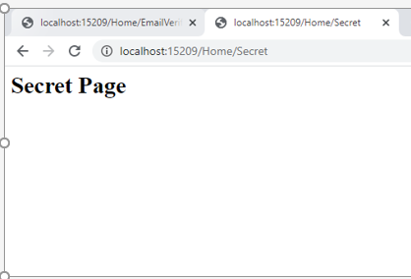
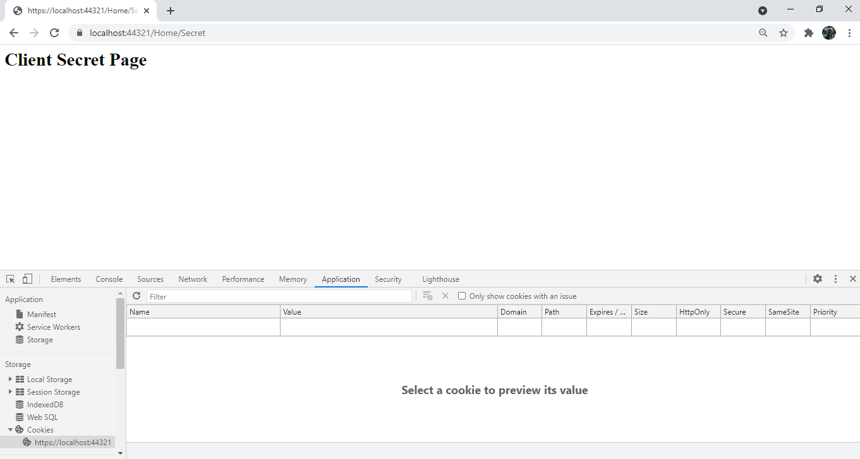
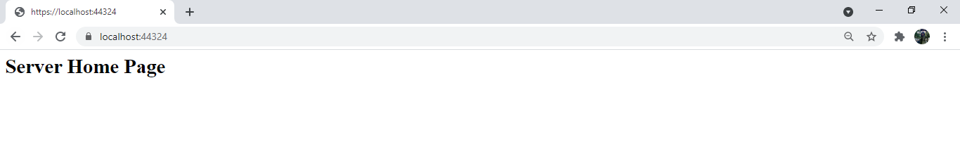
Oauth Implementation:

Slide 22
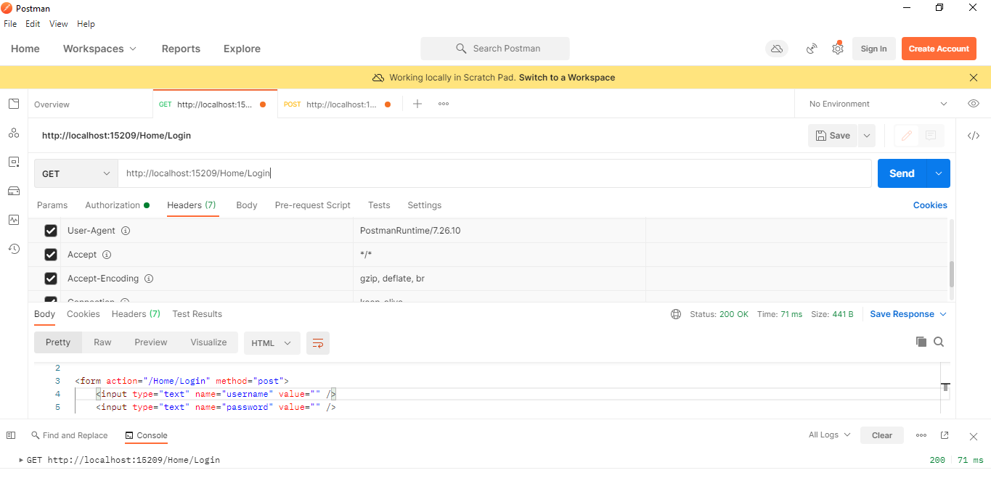
Acquire data from POSTMAN
Enter the URL of the local webpage in GET functionality, Then enter the JWT token for Authorization.If the user is not authorized, data is not displayed.
Here we get STATUS 200, OK.

Slide 23
Recommendations
OAuth can be considered as the best choice for authentication for API security because of the following reasons:
Less Time Consuming
Security: Since cryptography is used for token generation, there is less chance of security breach.

Slide 24
References:
https://github.com/T0shik/aspnetcore3-authentication
https://www.youtube.com/watch?v=Fhfvbl_KbWo&list=PLOeFnOV9YBa7dnrjpOG6lMpcyd7Wn7E8V&index=1

Slide 25

Git Repository and VIDEO Link:
My project has been uploaded at: https://github.com/Nchhabra-200460595/FinalProjectBDAT1001
I have created a small video to explain the process and walkthrough it practically.
The video will be uploaded on YouTube and below is the link: https://youtu.be/WV7VmhDiTSs

Slide 26
THANK YOU

