Slide 1

INSTACART DB
Capstone Project Report
Sales Performance & Operations Analysis | 2015 – 2023
Presented to Stakeholders · June 2026
PostgreSQL
Power BI
DAX
SQL

Slide 2
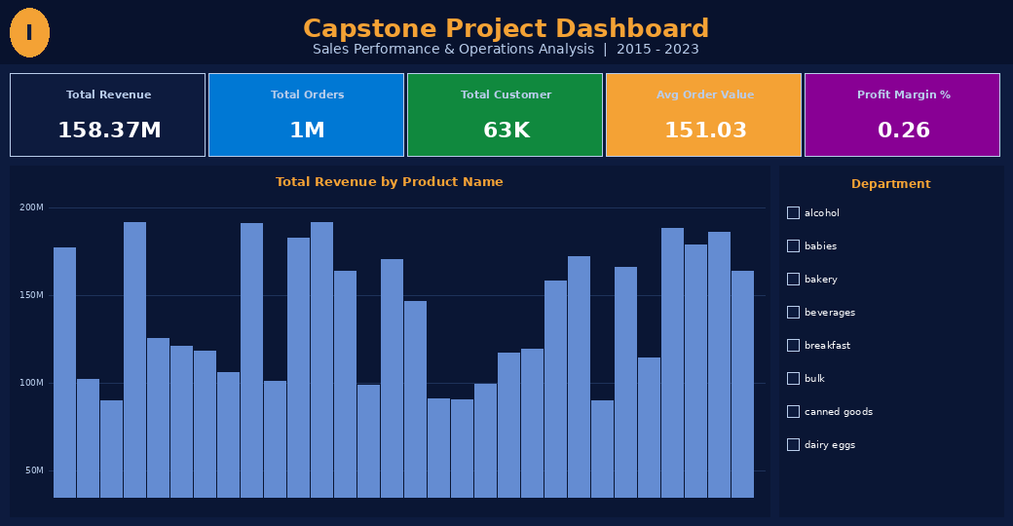
Power BI Dashboard
Instacart Capstone — Interactive Dashboard Overview
KPIs · Revenue by Product · Department Filter

Slide 3
Project Overview
About the Dataset
Business Objectives
Source: Instacart online grocery platform
Period: 2015 – 2023 (8 years of transactions)
Database: PostgreSQL (psql shell)
Tables: orders, products, aisle, departments
1,048,575 order records in total
63,100 unique customers
$158.37M gross revenue captured
Connected to Power BI via direct query
Identify profitable vs. underperforming aisles
Rank best & worst products by sales volume & revenue
Find peak order hours to optimize staff scheduling
Analyze revenue trends (2015–2022) for inventory planning
Deliver interactive Power BI KPI dashboard
Support data-driven stakeholder decisions

Slide 4
Data Architecture
PostgreSQL schema — 4 core tables
public.orders
public.products
public.aisle
public.departments
order_id (PK) user_id order_number order_dow order_hour_of_day days_since_prior quantity product_id (FK)
product_id (PK) product_name aisle_id (FK) department_id (FK) unit_price unit_cost
aisle_id (PK) aisle
department_id (PK) department
Relationships: orders → products (product_id) · products → aisle (aisle_id) · products → departments (department_id)

Slide 5
KPI Overview
All-time totals — filter context removed via DAX ALL()
Total Revenue
Total Orders
Total Customers
Avg Order Value
Profit Margin
$158.37M
1,048,575
63,100
$151.03
0.26%
Gross revenue all-time
Unique orders placed
Unique active customers
Revenue per order
Gross profit / Revenue
DAX: CALCULATE(SUMX / DISTINCTCOUNT / DIVIDE) with ALL('public orders') removes slicer filter context
INSIGHT: With 1M+ orders averaging $151 per basket across 63K customers, Instacart operates at significant scale. The 0.26% profit margin signals tight margins typical of grocery delivery — optimizing high-volume aisles is critical.

Slide 6
Business Problem 1
Profitable Aisles Analysis
Identifying High-Demand, Low-Margin Aisles
Key Findings
Yogurt & white wines lead all aisles by revenue
Top 5 aisles all exceed $148M combined revenue
~1M orders each in top aisles (near-equal demand)
High demand ≠ high profit — margin analysis needed
Recommendation
Negotiate better supplier pricing for top-volume aisles. Remove or reprice items in aisles with <0.5% margin. Bundle high-margin products with top-demand aisles.
SELECT a.aisle, SUM(o.quantity * p.unit_price) AS revenue FROM public.orders o JOIN public.products p ON o.product_id=p.product_id JOIN public.aisle a ON p.aisle_id=a.aisle_id GROUP BY a.aisle ORDER BY revenue DESC;

Slide 7
Business Problem 2
Best & Worst Selling Products
Top & Bottom Performers by Revenue Volume
TOP PERFORMERS: Promote fresh produce (Banana, Strawberries, Avocado) via targeted marketing campaigns. These items have high reorder rates and broad appeal.
LOW PERFORMERS: Evaluate bottom products for discontinuation or re-pricing. Specialty niche items have low turnover and tie up inventory capital.

Slide 8
Business Problem 3
Best Time of Day for Orders
Identifying Peak Hours to Optimise Staff Scheduling
PEAK WINDOW
10 AM – 2 PM
~80K orders / hour
QUIET WINDOW
Midnight – 5 AM (<1K/hr)
Peak: hours 10–14, topping 82K orders at noon
Second rise: 7–9 AM morning commute window
Saturday (DOW 6) is the busiest day overall
Activity drops sharply after 8 PM
Lowest point: 3–4 AM with ~350 orders
ACTION: Max staffing 10 AM–2 PM daily. Reduce shifts 12 AM–5 AM. Consider weekend surge pricing or Saturday-specific promotions to capitalise on peak DOW.

Slide 9
Business Problem 4
Sales Trend Analysis | 2015 – 2022
Revenue Growth & Seasonal Patterns
Key Observations
Steady growth 2015–2021 (+20.4% over 6 years)
Peak year: 2021 at $1.71M
2022 dip to $1.48M — post-pandemic normalisation
2020 shows resilience despite COVID disruption
Month slicer enables seasonal drill-down
Data subset: ~1.5M/yr of the $158M total
ACTION: Pre-stock high-demand items ahead of Q2–Q3 peaks. Investigate 2022 dip — supply chain, competition, or data gaps — and build contingency inventory buffers for future dips.

Slide 10
PostgreSQL Queries
Key SQL used to extract Instacart insights
KPIs — Revenue, Orders, Customers
Peak Hour Analysis
SELECT SUM(o.quantity * p.unit_price) AS total_revenue, COUNT(DISTINCT o.order_id) AS total_orders, COUNT(DISTINCT o.user_id) AS total_customers, SUM(o.quantity * p.unit_price) / COUNT(DISTINCT o.order_id) AS avg_order_value FROM public.orders o JOIN public.products p ON o.product_id = p.product_id;
SELECT order_hour_of_day, COUNT(*) AS order_count FROM public.orders GROUP BY order_hour_of_day ORDER BY order_count DESC;
Revenue by Aisle (Profitability)
SELECT a.aisle, SUM(o.quantity * p.unit_price) AS revenue, SUM(o.quantity * (p.unit_price - p.unit_cost)) AS gross_profit FROM public.orders o JOIN public.products p ON o.product_id = p.product_id JOIN public.aisle a ON p.aisle_id = a.aisle_id GROUP BY a.aisle ORDER BY revenue DESC LIMIT 20;

Slide 11
Power BI — DAX Measures
Calculated measures in the Calculated Measure table
Total Revenue (KPI card)
Total Orders (KPI card)
CALCULATE( SUMX('public orders', 'public orders'[quantity] * RELATED('public products'[unit_price]) ), ALL('public orders') )
CALCULATE( DISTINCTCOUNT('public orders'[order_id]), ALL('public orders') )
Removes ALL filter context → always shows $158.37M
All-time unique orders regardless of slicer
Total Customer (KPI card)
Order Count (chart measure)
CALCULATE( DISTINCTCOUNT('public orders'[user_id]), ALL('public orders') )
COUNTROWS('public orders')
All-time unique customers regardless of slicer
Responds to hour/day axis filters — used in Best Time of Day chart
Revenue Trend (chart measure)
Avg Order Value
SUMX( 'public orders', 'public orders'[quantity] * RELATED('public products'[unit_price]) )
DIVIDE([Total Revenue], [Total Orders])
Responds to Year axis — used in Sales Trend chart
Derived KPI — $151.03 per order

Slide 12
Recommendations
Strategic actions derived from data analysis
Aisle Profitability
Product Portfolio
01
Negotiate better supplier pricing for top-volume, low-margin aisles (vitamins, trash bags, water/seltzer). Remove or reprice items in aisles generating <0.3% gross margin.
02
Promote top fresh-produce items (Banana, Strawberries) through marketing campaigns. Discontinue or bundle worst performers. Focus restocking on top-20 products by reorder rate.
Staff Scheduling
Inventory Planning
03
Maximise staffing 10 AM–2 PM every day; double-staff on Saturdays. Cut late-night shifts (12 AM–5 AM). Estimated 15–20% labour cost saving from optimised scheduling.
04
Pre-stock ahead of Q2–Q3 demand spikes (peak: 2021 pattern). Build 10–15% safety stock for top-10 aisles. Monitor 2022-style dips and trigger contingency orders.

Slide 13
Conclusion & Next Steps
This capstone analysis of Instacart's PostgreSQL database reveals a high-volume grocery platform generating $158.37M in revenue across 1,048,575 orders from 63,100 customers. By combining Power BI's interactive dashboards with PostgreSQL's SQL analytics, the project delivers four evidence-based insights: aisle profitability mapping, product performance ranking, peak-hour identification, and multi-year revenue trend tracking — each translated into clear, actionable business recommendations.
Data-Driven Decisions
Operational Efficiency
Revenue Optimisation
Power BI + PostgreSQL pipeline enables real-time KPI monitoring without manual reporting.
Peak-hour insights can reduce labour costs ~15-20% through optimised shift scheduling.
Targeting top aisles and products guides marketing spend toward highest-ROI categories.
Next Steps: Integrate real-time PostgreSQL refresh · Add drill-through on aisle/product pages · Extend to customer cohort analysis
Thank You · Questions Welcome

