Slide 1
inter(mpc)
B tech
10th
Polytechnic
(diploma)
B tech
iti
Polytechnic
(diploma)
B tech

Slide 2
EAPCET
Colleges in that state
BITSAT, VITEEE, SRMJEEE
inter(mpc)
Jee advance
iit
Jee mains
Nit or iiit
paid

Slide 3
Mechanical Engineering
Robotics, Thermal Engineering, CAD/CAM, Mechatronics, Automobile Engineering, Aerospace, Manufacturing
Electronics & Communication Engineering (ECE)
VLSI design, Embedded Systems, IOT, Signal Processing, Microwave , Satellite Communication
Structural Engineering, Geotechnical Engineering, Construction mgmt, Transportational Engineering, Water resource Engineering
B tech
Civil engineering
Computer Science
AI&ML, Cyber Security, IT, AI & Data Science
Electrical Engineering
Power system, Control system, Power electronics, Renewable energy, Smart grids

Slide 4
COMMON CAREERS (BASED ON SUBJECTS WISE)
SCIENCE
ARTS & HUMANITIES
COMMERCE
VOCATIONAL
LAW
Business Management
ITI
Literature and languages
Accounting
Psychology

Slide 5
HUMANITIES
LAW
12th
graduation
3-year LLB
Register with bar council of India , clear all india bar exam (AIBE)
Judiciary Exams
5 year integrated law
Judge
Lawyer

Slide 6
Journalism
BJMC(Bachelor of Journalism & Mass Communication) 3yrs 12th any stream
Literature and languages
M.A Literature, Telugu , Hindi,English
Psychology
M.A Psychology

Slide 7
Constitutional
Fundamental Rights
Criminal
Murder ,theft …
LAW
Civil
Private disputes ( property , contract…etc.) . Focus on compensation not punishment
Administrative
Governs actions and decisions
Family
Adoption,divorce,inheritance

Slide 8
COMMERCE
Inter (Commerce)
B.com (from CUET)+CA
Accounting
12 th + CA 5yrs
BBA (3 yrs)(from CUET exam)
Business Management
CAT
MBA(2yrs)

Slide 9
Accounting
Recording and reporting of data
Accounting & Auditing
Auditing
Examination and verification of financial records and statements

Slide 10
Human Resource Management
(Recruitment , employee welfare.. etc.)
Business Management
Financial and Marketing Management
( budget ,branding and publicity )
Entrepreneurship ( startup building…)
Project Management ( planning , execution and risk analysis)

Slide 11
Vocational courses
Apply for jobs
ITI /Govt skill centre
(1-2 years)
10th class
Higher Education
Lateral entry into polytechnic diploma and Btech 2nd year

Slide 12
Some Famous Vocational Courses and job trainings
Electrician (ITI) 1-2yrs
Fashion Designing 1-2yrs
Beautician/Cosmetology
Mobile Repairing and Computer Hardware ( 3- 6 months )

Slide 13
Digital Marketing (3-6 months)
Hotel Management / Food Production (1 -3 yrs)
Medical Lab Technician ( 1-2 yrs)
Mechanic courses( 1-2 yrs)

Slide 14
MBBS
NEET, AIIMS, AFMC, JIPMER
Dental Science
NEET, KCET, EAPCET, KEAM
BiPC
Ayurvedic
NEET, OJEE, KEAM
B Pharmacy
EAPCET, JEE(MAINS), JELET
Bio Technology
MHT CET, KCET, WBJEE, MET

Slide 15

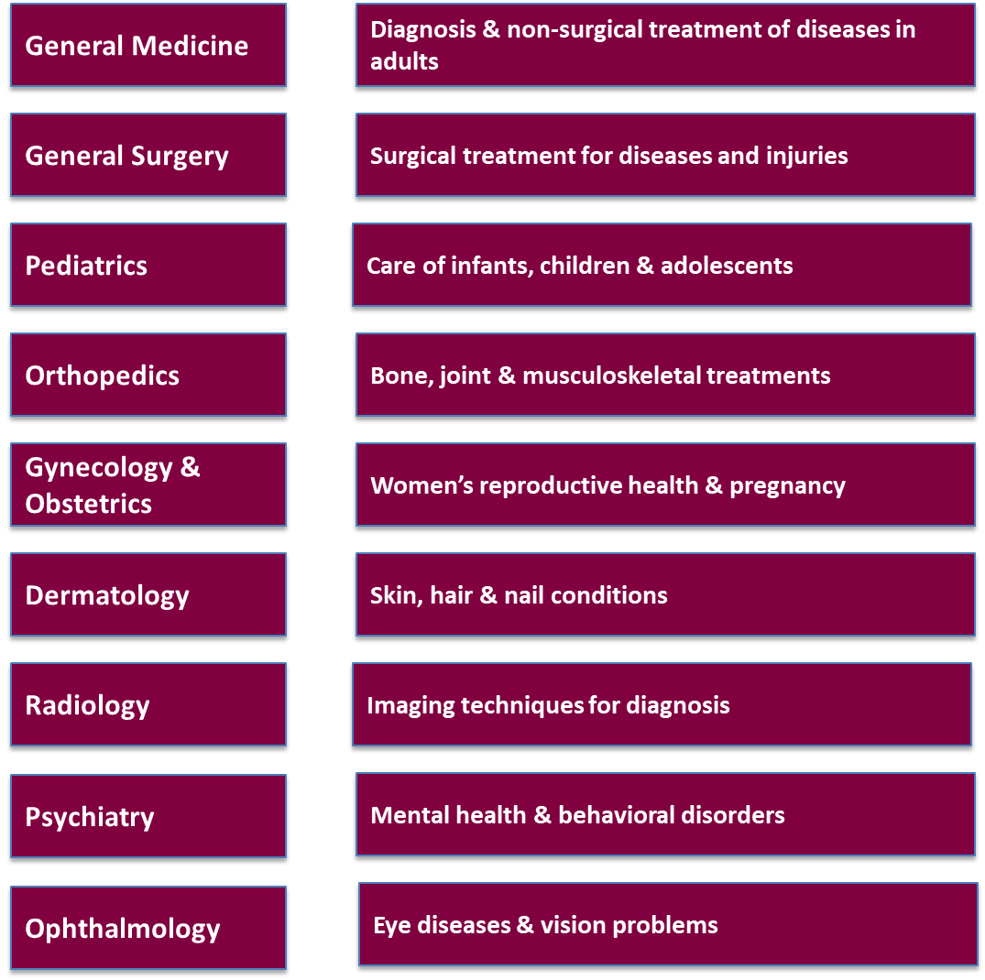

Slide 16
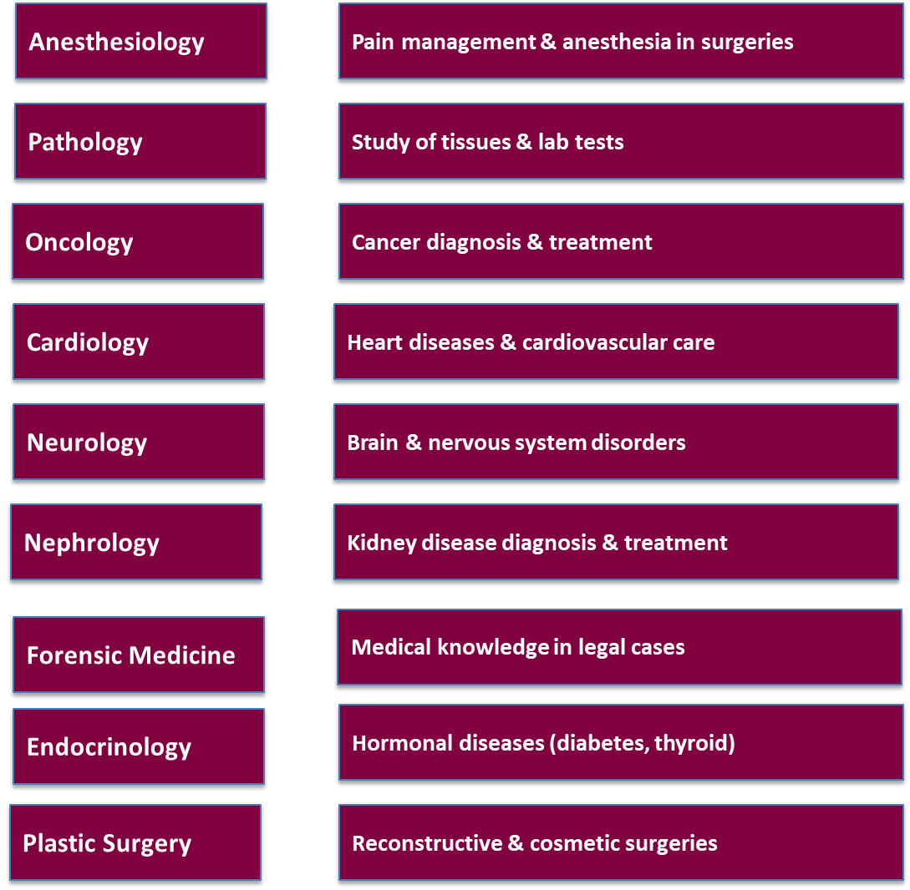

Slide 17

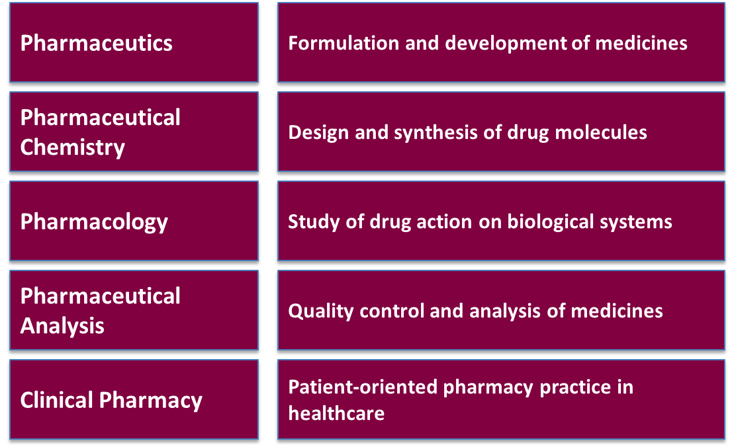

Slide 18
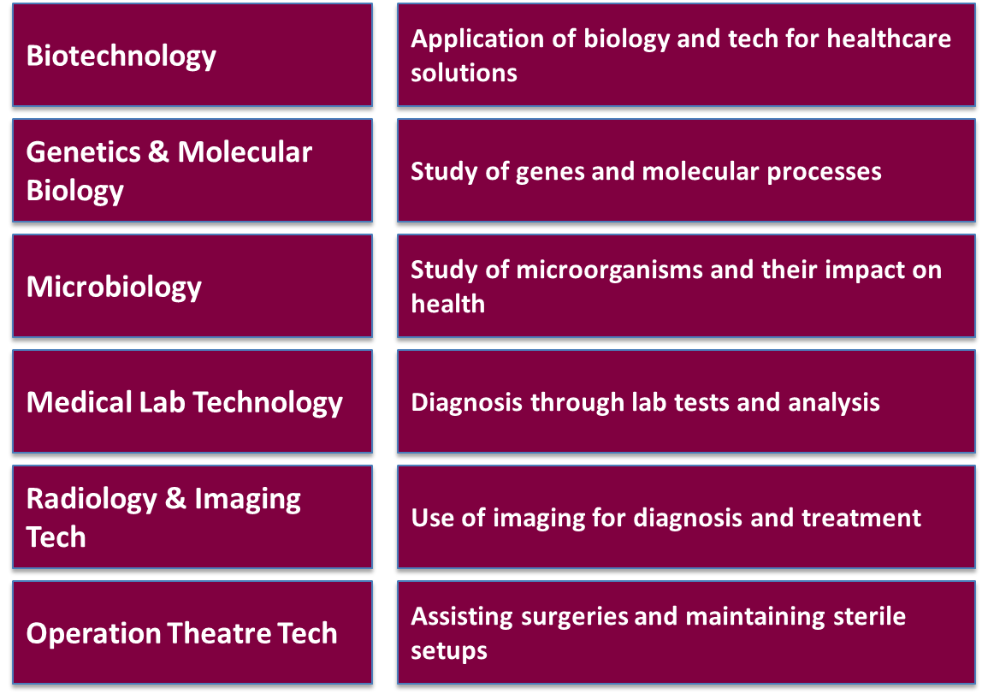


Slide 19
After 10th
Inter (MPC/Any Stream)
NDA Exam
SSB Interview & Training
Defence and Armed Forces
Army Officer (Indian Army), Navy Officer (Indian Navy), Air Force Pilot (Indian Air Force), Coast Guard Officer
Career Roles
Key Exams
NDA, CDS (later)

Slide 20
After 10th
Inter (Arts/Any Stream)
Design Entrance Exams
B.Des., BFA, Animation, FIlm Studios
Creative & Design Careers
Graphic Designer, Animator, Game Designer, Fashion Designer, Filmmaker, Photographer
Career Roles
Key Exams
NID, NIFT, FTII, UCEED

Slide 21
A
Sports Quota for Degree/B.P.Ed.
Inter (Any Stream)+Sports Participation
Specialized Coaching/
Training
After 10th
Professional Athlete, Sports Coach/PE Teacher, Sports Manager/Event Organizer, FItness Trainer
Sports & Physical Education
Career Roles
Key Points
Sports Scholarships, University Sports Quota

Slide 22
MPC / BiPC (Science)
B.Sc.
TET
CTET
Teacher
Bachelor’s Degree
B.Ed
Inter
State-Specific TET (APTET,..)
MEC / CEC / Humanities (Arts / Commerce)
B.A. / B.Com.
M.Ed.

Slide 23
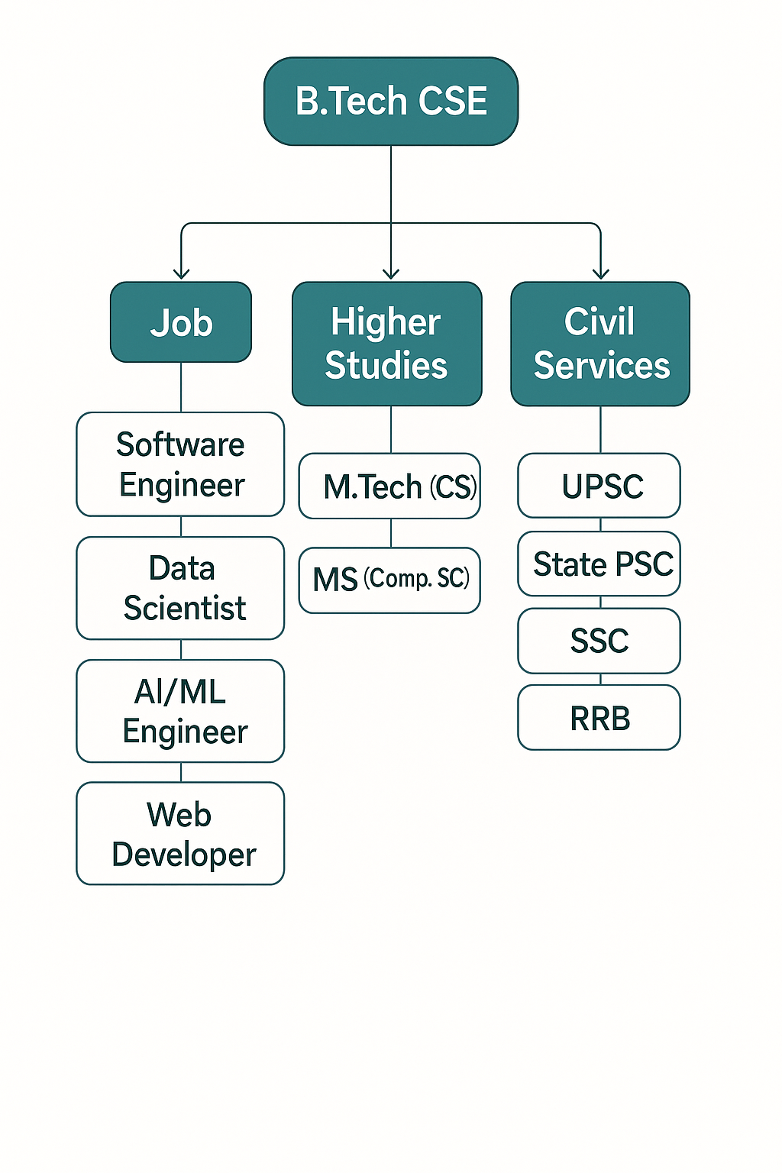

Slide 24
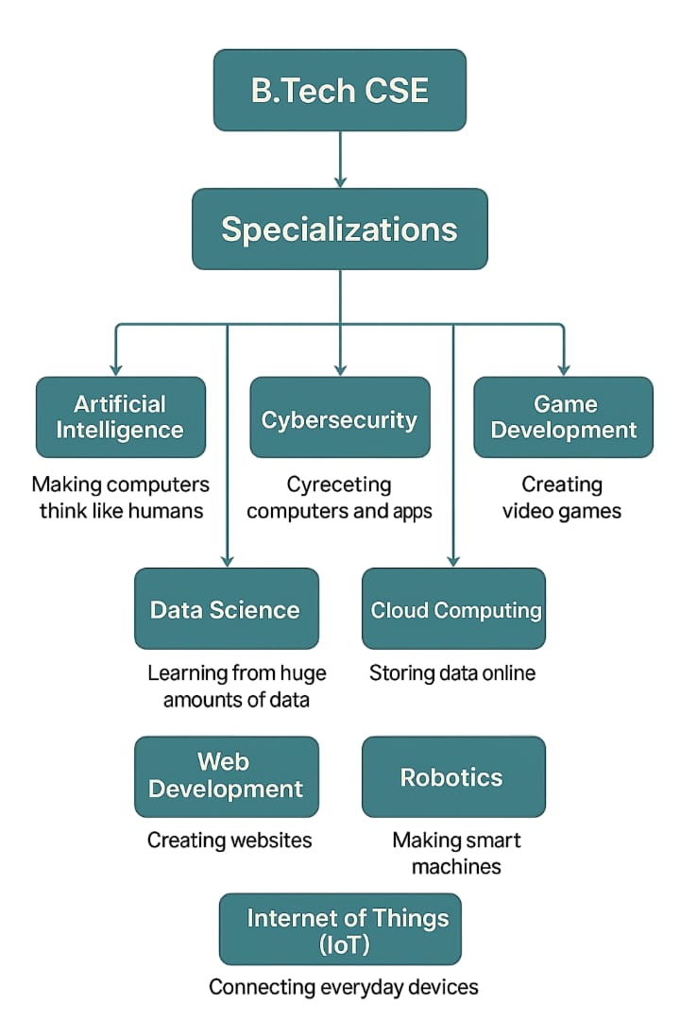

Slide 25
