Slide 1


Nishith Maity
2 November 2026

Slide 2

Outline
1 Methods
SpaceX API and Wikipedia collection, wrangling, SQL, mapping and modeling.
2 Results
Landing outcomes by site, orbit and year. Folium maps and Dash views put the patterns in context.
3 Prediction and conclusions
Four classifiers, an 18-flight test, and a check on how the models handle unsuccessful outcomes.

Slide 3
Executive summary
60 of 90 flights
Two thirds of the Falcon 9 records had a positive first-stage outcome, including five controlled ocean landings.
10 of 13 at Kennedy
KSC LC-39A had the highest within-site success rate in the 56-flight dashboard sample (76.9%).
15 of 18 test predictions
All four classifiers tied at 83.3%. In the verification run, every model missed three of the six class 0 outcomes.

Slide 4
Can launch records predict a first-stage landing?
The business question
Recovering a booster makes reuse possible. A competitor assessing a bid would want to know how reliably recovery can be anticipated.
The analytical question
How does the recorded outcome vary with payload, destination orbit, launch site and flight history?
What the data measure
The target is the course-defined first-stage outcome. Estimating refurbishment cost or actual savings would require additional data.

Slide 5

Section 1

Slide 6
Methodology
Collection and preparation
Retrieve historical launch records and parse Wikipedia tables. Use the course extracts to define a one-row-per-flight modeling table.
Exploration
Plot landing outcomes, query launch records in SQLite, and explore individual sites with Folium and Dash.
Evaluation
Tune four classifiers using cross-validation on the training set. Evaluate them on the same 18 held-out flights.

Slide 7
Three course extracts answer different questions
90 flights for EDA and prediction
The labeled Falcon 9 file has three launch-site labels. Its 80-column feature matrix supports the classification experiment.
101 records for SQL
The SQL file records mission and landing outcomes separately and distinguishes four site labels.
56 flights for interactive views
The map and dashboard sample uses four site labels. Percentages from this sample have a different denominator from the modeling data.

Slide 8
SpaceX API collection
Request
The live launches endpoint returned HTTP 522 in the saved run. The archived course response returned HTTP 200.
Parse and enrich
The notebook normalizes the JSON and defines lookups for rockets, payloads, cores and launchpads. Some live lookups returned empty results.
Recover a usable dataset
The wrangling notebook reads IBM’s prepared dataset_part_1.csv. The labeled snapshot provides the 90 records analyzed here.

Slide 9
Wikipedia web scraping
Retrieve the archived page
The saved request returned HTTP 200. BeautifulSoup found the launch tables on the Falcon 9 and Falcon Heavy launch list.
Parse the table rows
Extract flight number, date and time, booster, site, payload mass, orbit and customer. Read mission and booster outcomes separately.
Keep the sources distinct
The notebook includes a CSV export for the scraped table. The classification labels come from the course’s Falcon 9 dataset.

Slide 10
How the landing label was constructed
Class 1 • 60 flights
41 drone-ship landings, 14 returns to launch site and 5 controlled ocean landings.
Class 0 • 30 flights
Nine explicit failures and 21 records marked None. The negative class includes flights without a confirmed landing.
Predictors
One-hot encode orbit, site, landing pad and booster serial. The resulting matrix has 80 columns. The source table has 26 missing landing-pad entries.

Slide 11
Exploratory visualization
Compare individual flights
Scatter plots compare payload and flight sequence across sites and orbits. Color and marker shape identify the outcome class.
Compare grouped outcomes
For each orbit and year, divide the number of class 1 flights by all flights in the group.
Check the sample size
A 100% rate can represent a single flight. Show the count alongside each orbit rate.

Slide 12
SQL analysis
Select and aggregate
Use DISTINCT for site labels, LIKE for Cape Canaveral records, SUM and AVG for payload, and MIN for the first ground landing.
Filter and rank
Filter drone-ship outcomes by payload or calendar year. Use a maximum-payload subquery and rank counts over a specified interval.
Normalize outcome labels
Trim stray spaces from Mission_Outcome before counting. Retain the separate entry with unclear payload status.

Slide 13
Folium map construction
Locate the sites
Place a circle and label at each distinct coordinate. The nearby Florida labels merge at national scale.
Inspect individual flights
Group overlapping markers with MarkerCluster. Zoom in to distinguish green class 1 flights from red class 0 flights.
Measure a selected distance
Compute a great-circle distance between a launch coordinate and a selected comparison point. The result depends on both coordinates.

Slide 14
Plotly Dash dashboard
All sites
The pie chart groups class 1 flights by site and shows each site’s share of the 24 successful records.
One site
Selecting a site changes the pie chart to success versus other outcomes within that site.
Payload range
A slider filters the payload scatter plot. The vertical axis shows the outcome and color indicates booster version.

Slide 15
Predictive analysis methodology
Partition
Use the 80 encoded features and the binary landing label. Split 90 flights into 72 training flights and 18 test flights with random_state=2.
Tune
Run 10-fold GridSearchCV for logistic regression, SVM, decision tree and K-nearest neighbors. Compare their held-out accuracy.
Verify
Rerun the split with scaling inside each training fold, a fixed tree seed, and valid tree settings. Compare the rerun with the saved notebook.

Slide 16
Results
Flight patterns
The 90-flight snapshot spans June 2010 to November 2020. Later missions had a higher recorded landing rate than early missions.
Site-level exploration
The 56-flight interactive sample places 46 records in Florida and 10 in California.
Held-out prediction
All four classifiers returned the same test accuracy. Their errors matter when a positive prediction informs a reuse assumption.

Slide 17

Section 2

Slide 18
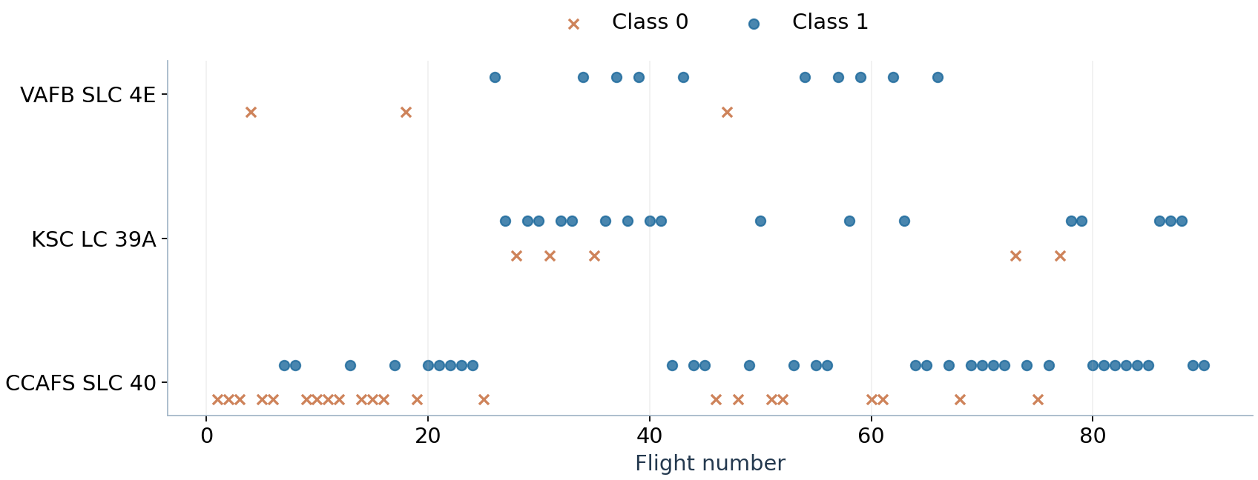
Later flights include more sites
Kennedy first appears at flight 27. Cape Canaveral spans flights 1–90, so raw site comparisons also reflect different operating periods.
Source: exploratory visualization notebook and IBM dataset_part_2.csv

Slide 19
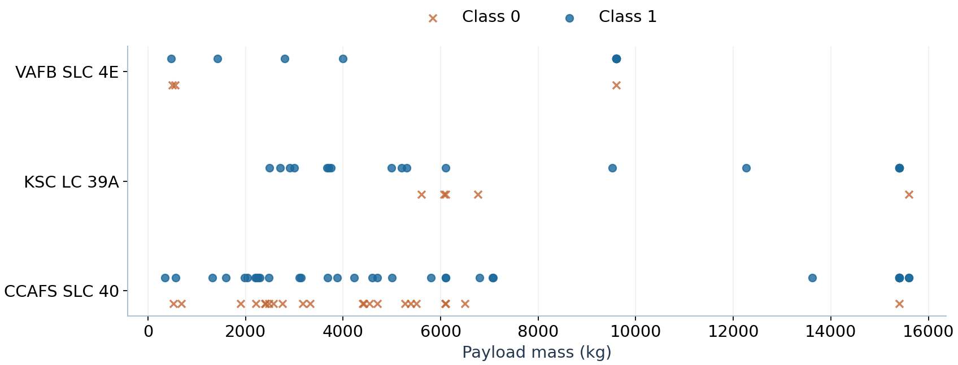
Payload ranges overlap across launch sites
Both Florida sites carried payloads up to 15,600 kg. Vandenberg’s largest payload in this sample was 9,600 kg.
Source: exploratory visualization notebook and IBM dataset_part_2.csv

Slide 20
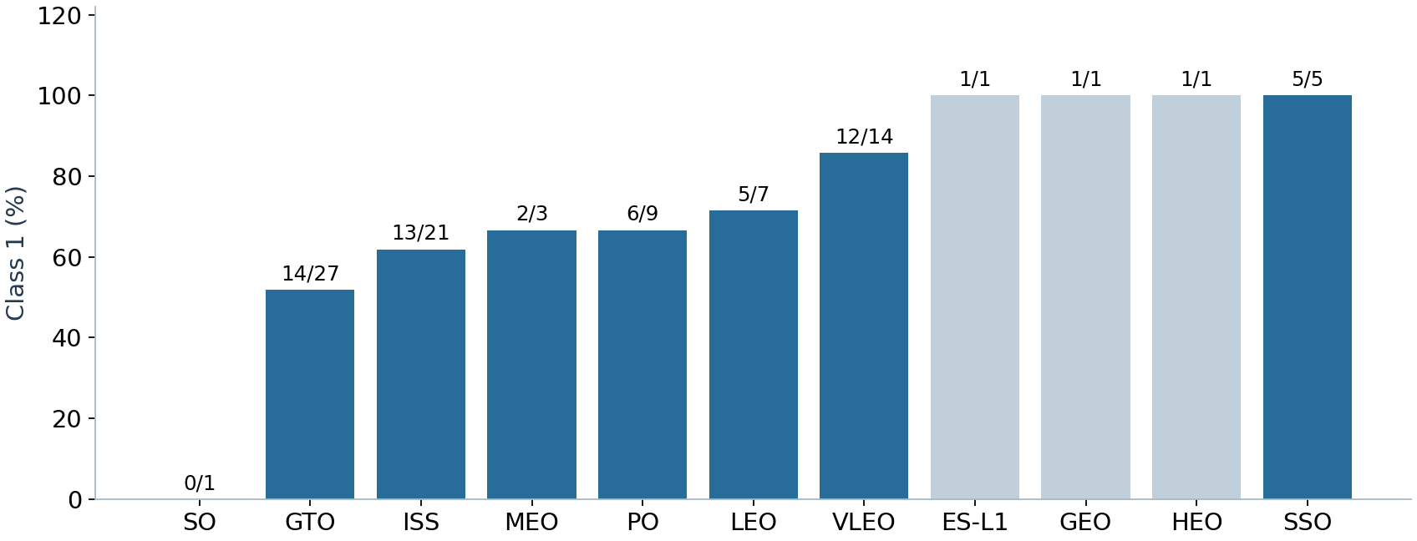
Orbit rates depend on the number of flights
SSO recorded 5/5 positive outcomes and VLEO 12/14. Three other orbits reached 100% on just one flight each. Labels show successes / flights.
Source: exploratory visualization notebook and IBM dataset_part_2.csv

Slide 21
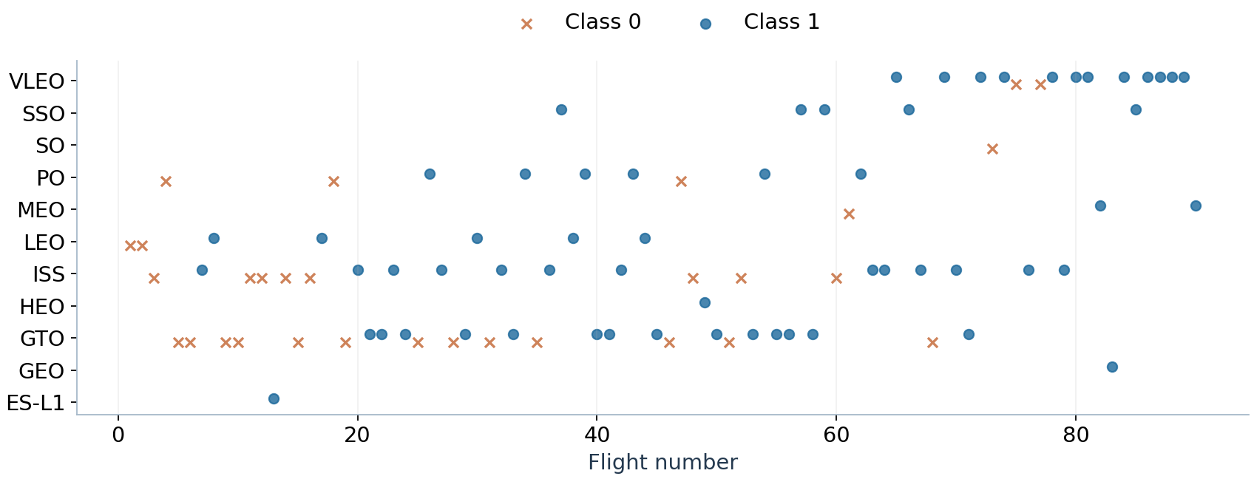
The mix of destination orbits changed over time
VLEO first appeared at flight 65. Comparing its landing rate with earlier orbits also compares different periods of booster operations.
Source: exploratory visualization notebook and IBM dataset_part_2.csv

Slide 22
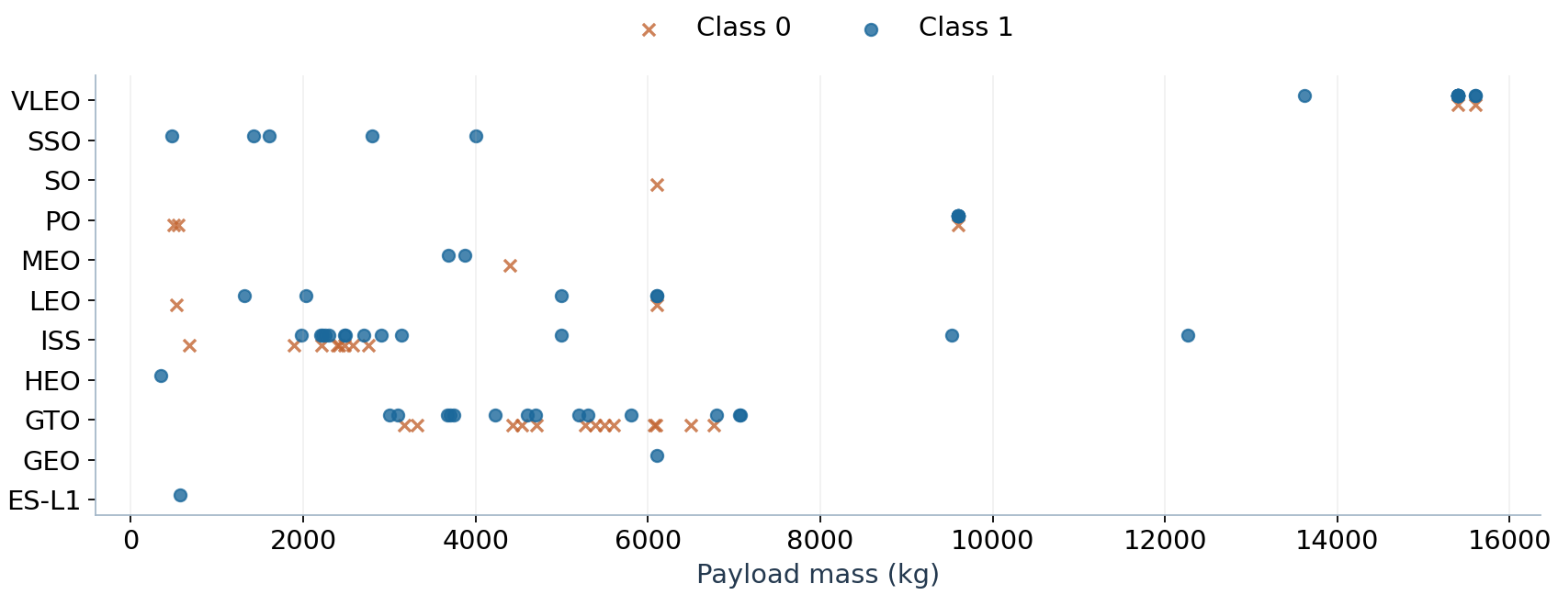
VLEO carried the heaviest payloads in this sample
VLEO payloads ranged from 13,620 to 15,600 kg. Large mass and orbit type overlap, making their separate effects difficult to isolate.
Source: exploratory visualization notebook and IBM dataset_part_2.csv

Slide 23
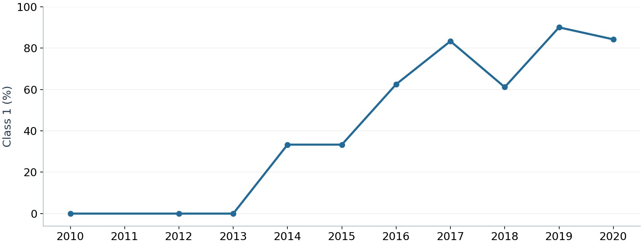
Annual landing rates rose unevenly
The first five flights across 2010, 2012 and 2013 had no positive outcomes. The rate reached 9/10 in 2019 and 16/19 in 2020. No 2011 flight appears in the sample.
Source: exploratory visualization notebook and IBM dataset_part_2.csv

Slide 24
SQL identified four site labels
Florida
CCAFS LC-40, CCAFS SLC-40 and KSC LC-39A.
California
VAFB SLC-4E.
Interpretation
The SQL extract lists the two Cape Canaveral labels separately. Keep those labels when reproducing its counts.

Slide 25
The first five CCA records came from LC-40
2010
4 June: qualification flight, B0003. 8 December: Dragon demo C1, B0004.
2012
22 May: Dragon demo C2, B0005. 8 October: CRS-1, B0006.
2013
1 March: CRS-2, B0007. A CCA prefix matches Cape Canaveral records. Sorting by date makes the five-row preview reproducible.

Slide 26
NASA CRS payload totaled 45,596 kg
45,596 kg
Total recorded payload mass for SQL rows whose customer is exactly NASA (CRS).
Query
SELECT SUM(PAYLOAD_MASS__KG_) FROM SPACEXTABLE WHERE Customer = 'NASA (CRS)'
Scope
Other NASA customer labels, including COTS, fall outside this filter.

Slide 27
F9 v1.1 payload averaged 2,534.7 kg
2,534.7 kg per flight
Mean payload for records whose booster-version field exactly matches F9 v1.1.
Query
SELECT AVG(PAYLOAD_MASS__KG_) FROM SPACEXTABLE WHERE Booster_Version = 'F9 v1.1'
Scope
Records with a serial number appended to the version string fall outside this exact-match query.

Slide 28
The first recorded ground-pad success was in 2015
22 December 2015
The earliest launch date in the SQL table with the landing outcome “Success (ground pad)”.
Query
SELECT MIN(Date) FROM SPACEXTABLE WHERE Landing_Outcome = 'Success (ground pad)'
Interpretation
The date refers specifically to a ground-pad landing in this extract.

Slide 29
Four boosters met the drone-ship payload filter
Payload window
Select successful drone-ship landings with payload strictly above 4,000 kg and below 6,000 kg.
Matching booster versions
F9 FT B1022, F9 FT B1026, F9 FT B1021.2 and F9 FT B1031.2.
Interpretation
Each of these four records combines a specified payload range with a confirmed drone-ship recovery.

Slide 30
Mission success and booster landing are separate outcomes
99 mission successes
Trimming the outcome field merges 98 “Success” records with one record containing a trailing space.
Two other mission records
One in-flight failure and one success with unclear payload status bring the SQL total to 101.
Why this matters
A mission can deliver its payload even when its booster fails to land. Classification uses the first-stage outcome.

Slide 31
Twelve booster records shared the maximum payload
15,600 kg
A subquery finds the maximum payload. The outer query returns all 12 flights tied at that mass.
F9 B5 booster records
B1048.4, B1049.4, B1051.3, B1056.4, B1048.5, B1051.4, B1049.5, B1060.2, B1058.3, B1051.6, B1060.3 and B1049.7.
Interpretation
The suffix identifies the flight of a core. Some core serials therefore appear more than once.

Slide 32
Two drone-ship landing failures occurred in 2015
January 2015
F9 v1.1 B1012 launched from CCAFS LC-40.
April 2015
F9 v1.1 B1015 launched from the same site.
Selection
Both SQL records have the exact landing outcome “Failure (drone ship)”.

Slide 33
Early flights often had no landing attempt
10 records
No attempt was recorded on 10 flights from 4 June 2010 through 20 March 2017, inclusive.
5 records each
Successful drone-ship landing and failed drone-ship landing tied for second.
Other outcomes
Ground success 3, controlled ocean 3, uncontrolled ocean 2, parachute failure 2, precluded drone ship 1. Total: 31 records.

Slide 34

Section 3

Slide 35
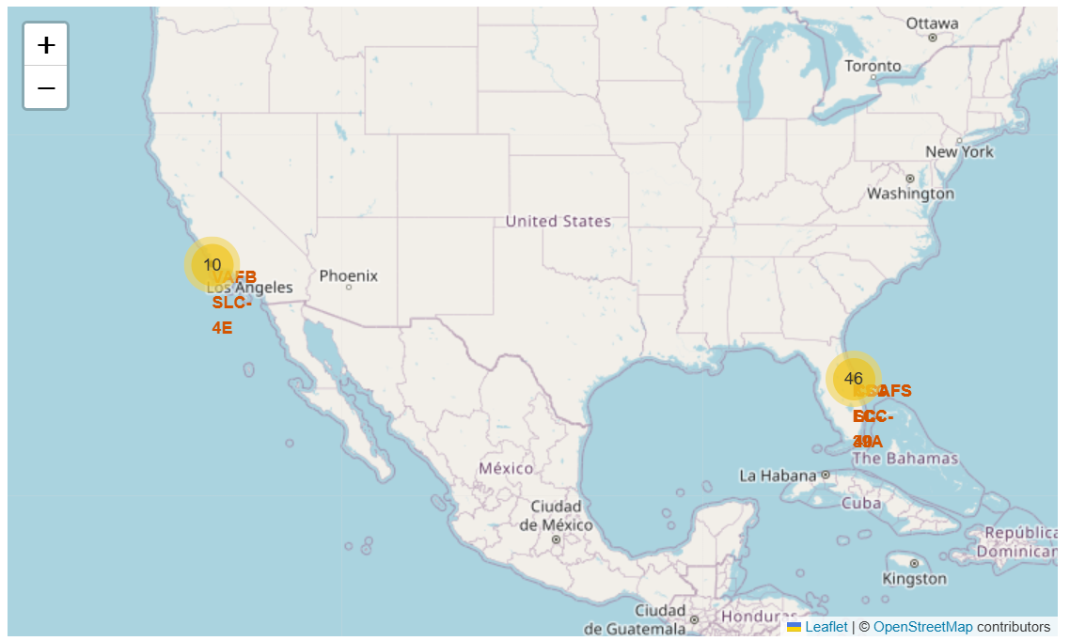
Launch records cluster on two US coasts
The markers represent 56 flights. Forty-six cluster in Florida and ten at Vandenberg in California. Zooming in separates the Florida site labels.
Source: Folium notebook and IBM geographic extract. Map © OpenStreetMap contributors.

Slide 36
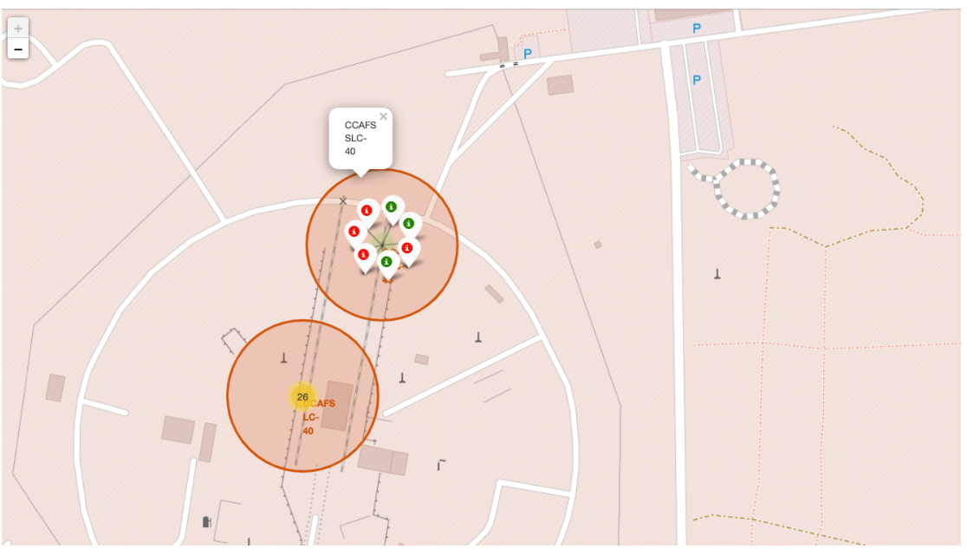
Zooming in reveals mixed outcomes at SLC-40
At CCAFS SLC-40, three of seven records have green markers (class 1) and four have red markers (class 0). The nearby LC-40 cluster contains 26 records.
Source: Folium notebook and IBM geographic extract. Map © OpenStreetMap contributors.

Slide 37
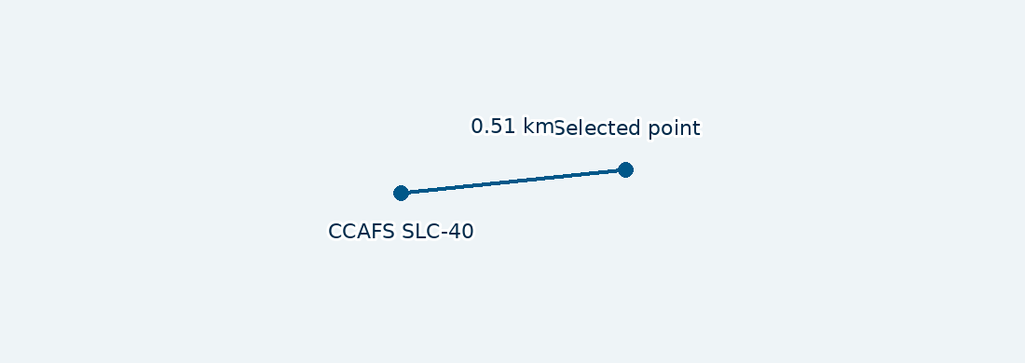
Distance to the selected coastline point was 0.51 km
The haversine calculation pairs CCAFS SLC-40 (28.563197°, −80.576820°) with the lab’s selected point (28.563670°, −80.571630°). This measures point-to-point distance.
Coordinate sketch from the Folium notebook. North is up. The chosen point determines the distance.

Slide 38

Section 4

Slide 39
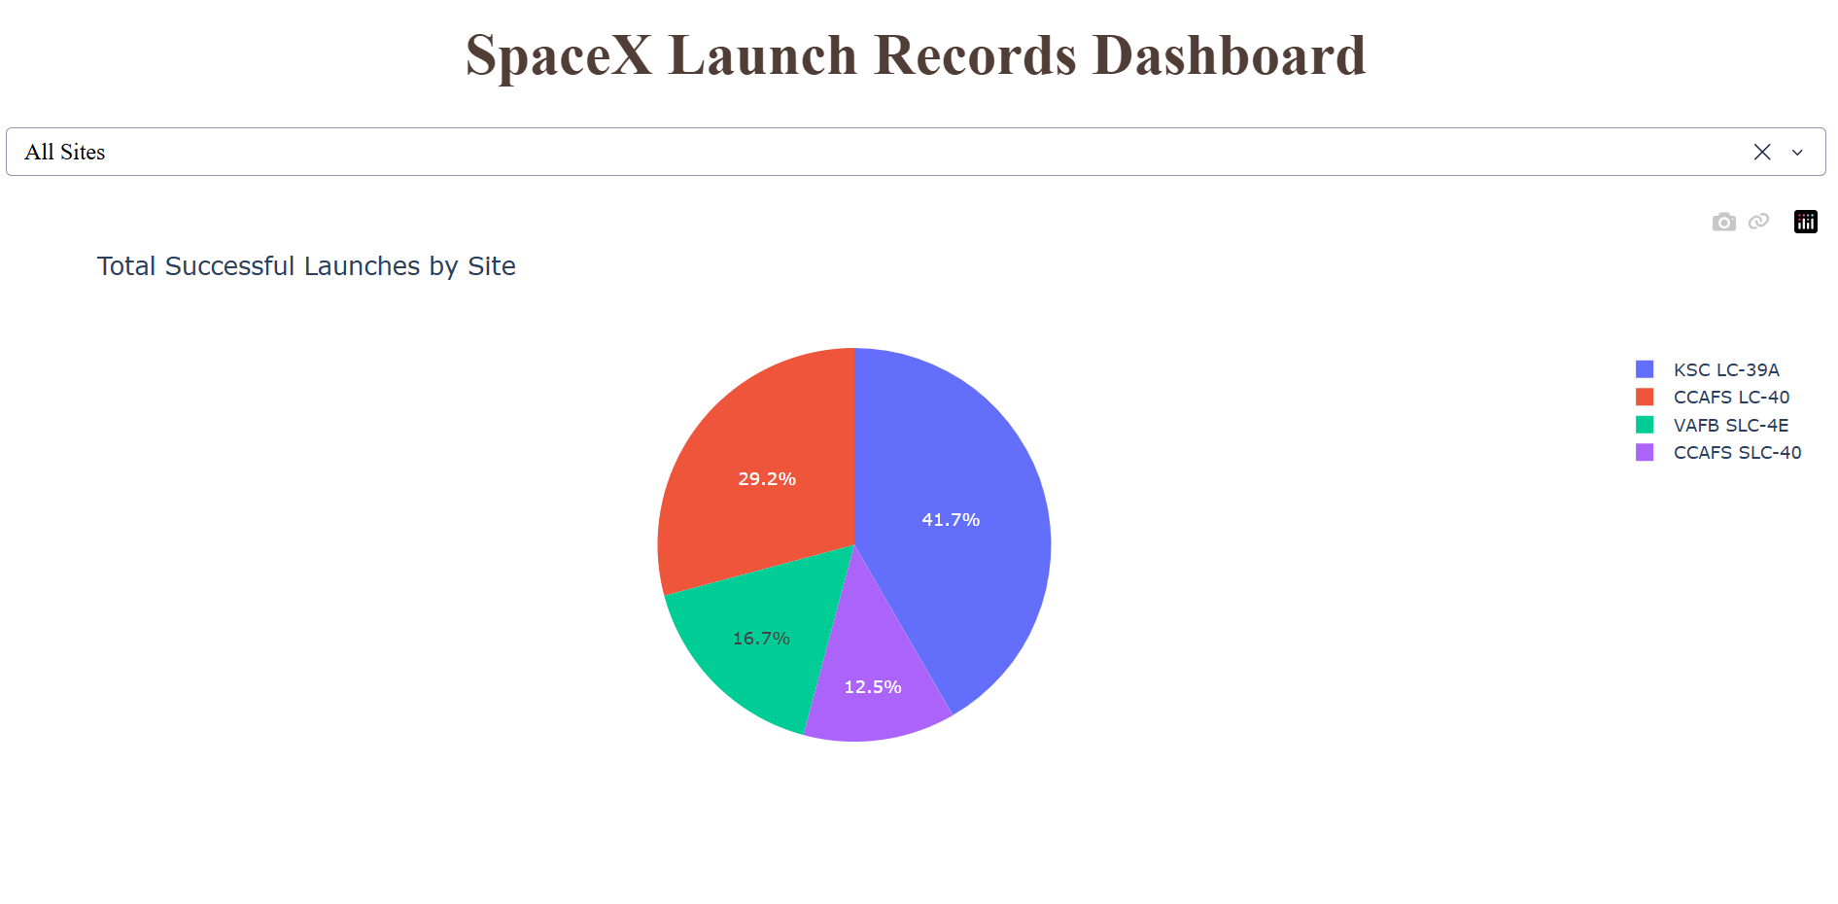
Kennedy accounted for 41.7% of successful flights
Ten of the sample’s 24 successful outcomes came from KSC LC-39A. The remaining 14 came from the three other site labels.
Source: original Plotly Dash output, All Sites view.

Slide 40
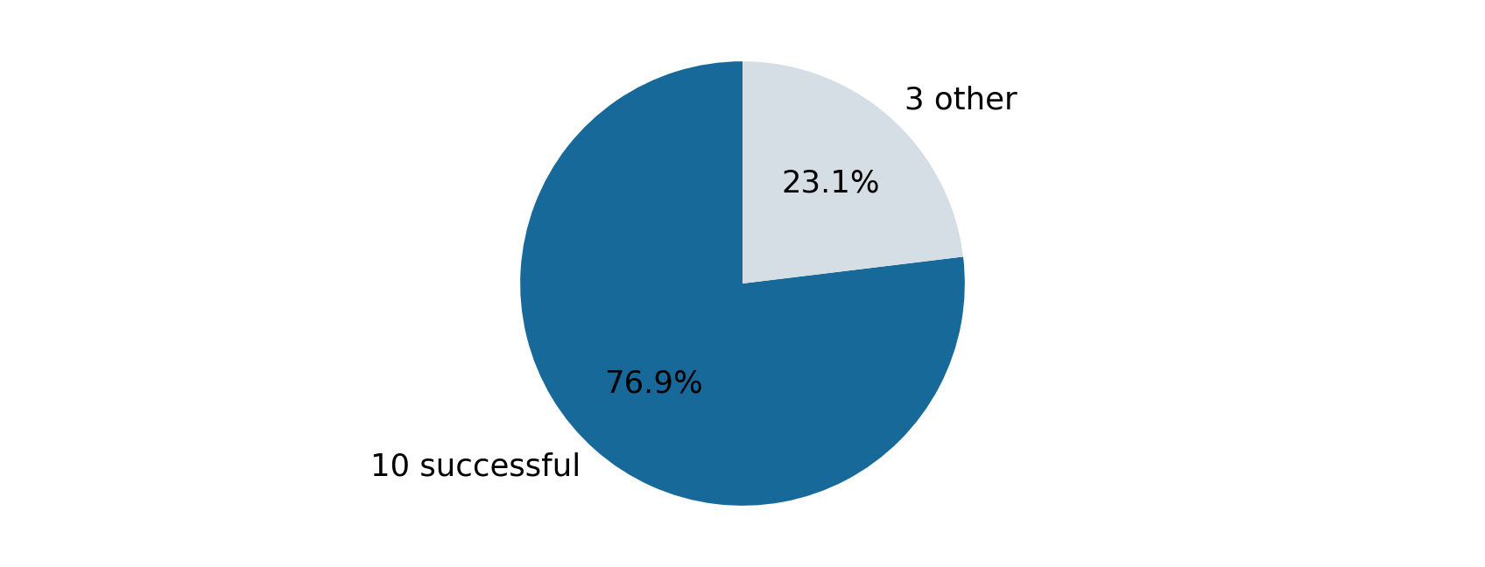
Kennedy had the highest within-site success rate
At KSC LC-39A, 10 of 13 flights succeeded (76.9%). The corresponding rates were 3/7 at CCAFS SLC-40, 4/10 at VAFB and 7/26 at CCAFS LC-40.
Single-site view reconstructed from the 56-flight geographic extract and checked against the all-sites dashboard.

Slide 41
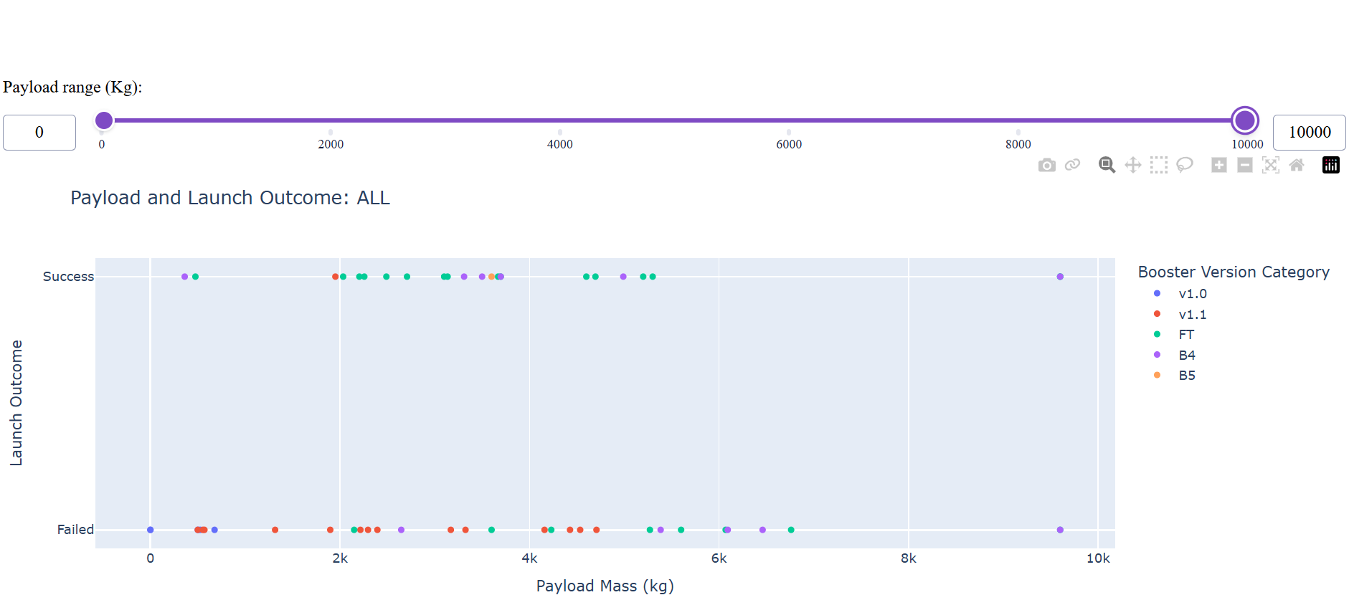
Similar payloads had different landing outcomes
Both outcomes occur around 3,000–4,000 kg and near 9,600 kg. In this 0–10,000 kg dashboard view, payload mass alone does not separate the classes.
Source: original Plotly Dash output, All Sites and full payload-slider range.

Slide 42

Section 5

Slide 43
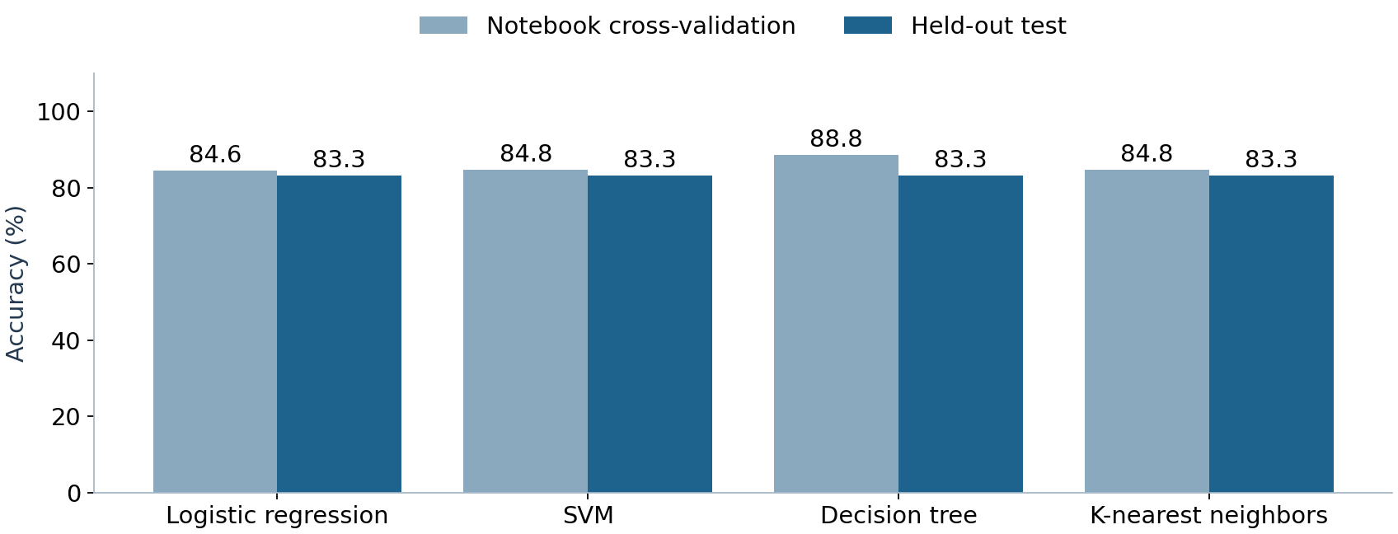
All four classifiers tied on the held-out flights
The tree led notebook cross-validation at 88.75%. On the same 18 test flights, each classifier scored 15/18 (83.3%). The fold-scaled rerun preserved the four-way tie.
Source: saved classification notebook scores. The appendix reports verification-run CV scores.

Slide 44
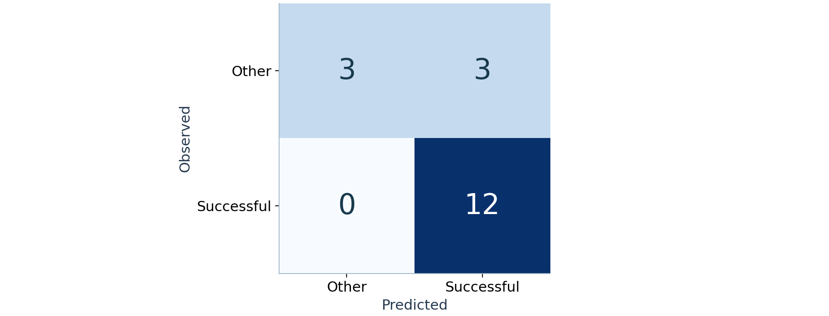
The models missed three class 0 outcomes
Logistic regression identified 12/12 class 1 flights and 3/6 class 0 flights. A positive prediction was correct 12/15 times (80%). All four verification-run matrices matched.
Source: verification run, 18 held-out flights. Rows are observed classes and columns are predictions.

Slide 45
Conclusions
Recovery became more common
The annual class 1 rate rose from zero in the earliest flights to 16/19 in 2020. Site and orbit comparisons also reflect changes in the mission mix.
The classifiers improve on a simple baseline
Always predicting class 1 gives 12/18 correct. The models give 15/18, but still predict a successful outcome for half the class 0 test flights.
A more realistic next test
Hold out later flights, restrict predictors to values known before launch, and evaluate how often a predicted recovery fails.

Slide 46
Appendix: model verification
Same data and split
Use dataset_part_2.csv for labels and dataset_part_3.csv for features. Use the same 72/18 split and 10-fold training-set grid search.
Changes in the rerun
Fit StandardScaler inside each training fold. Drop invalid max_features=auto, keep sqrt, and fix the tree seed at 2. The original tree grid rejected half its fits.
Verification-run accuracy
Mean CV: logistic regression 84.64%, SVM 82.14%, tree 87.68%, KNN 84.82%. Test: all four 83.33%.
Submission check: https://github.com/Ncontai14/Applied_Data_Science_Capstone_IBM_Coursera

Slide 47

Nishith Maity
2 November 2026

