Slide 1

MLB Attendance in accordance to weather
By Nathaniel Crumbaker, M00280781, CIS361 Spring 2021

Slide 2
Overview
Weather has always been seen as a factor affecting attendance to sports games.
In this project we decided to use Linear regression to test that hypothesis.
I will be using the Atlanta Braves as the team to take the attendance from

Slide 3
Introduction
Weather is seen as an important factor regarding sport events
This project is aiming to truly see if weather is a significant factor through statistical means
It is important for the MLB and its managers to know just how weather affects the events
With the knowledge of how weather affects attendance the MLB will be able to plan accordingly

Slide 4
Literature Review
The Major League Baseball or the MLB is a popular sports league in America that plays its games either in a dome or outside in a stadium or park
Some prior research was done regarding this subject by Q. Ge, and they concluded that weather could affect attendance however we will be expanding upon this by adding in more factors such as Wind Speed and Humidity.

Slide 5
Literature Review
Attendance to MLB is important for the MLB because it will help determine ticket prices to attend the games
This research question will also help provide data to help determine if it is economically viable for a team to build a dome stadium or an outdoor stadium.

Slide 6
Theory
The hypothesis that this study will be testing is that weather factors do have a significant effect in determining attendance at Atlanta Braves Games.

Slide 7
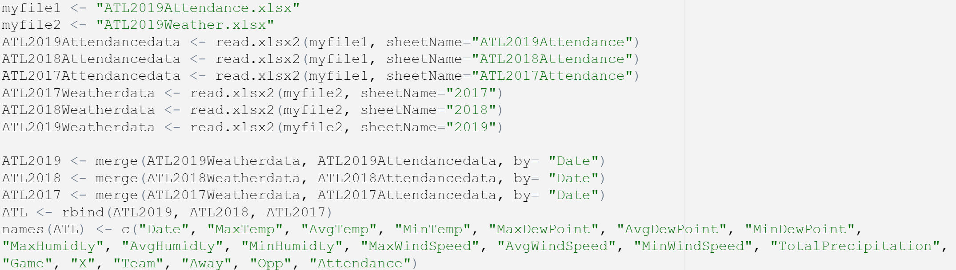
Data
Our first data set is the Attendance data taken from Baseball Reference.
This data set includes the Game-by-Game data necessary for conducting this analysis
Our second data is the Weather Data set taken from Wunderground
This data set includes the Weather Data needed to conduct Analysis
Next this data came as excel which were loaded into R and cleaned then merged inside R

Slide 8
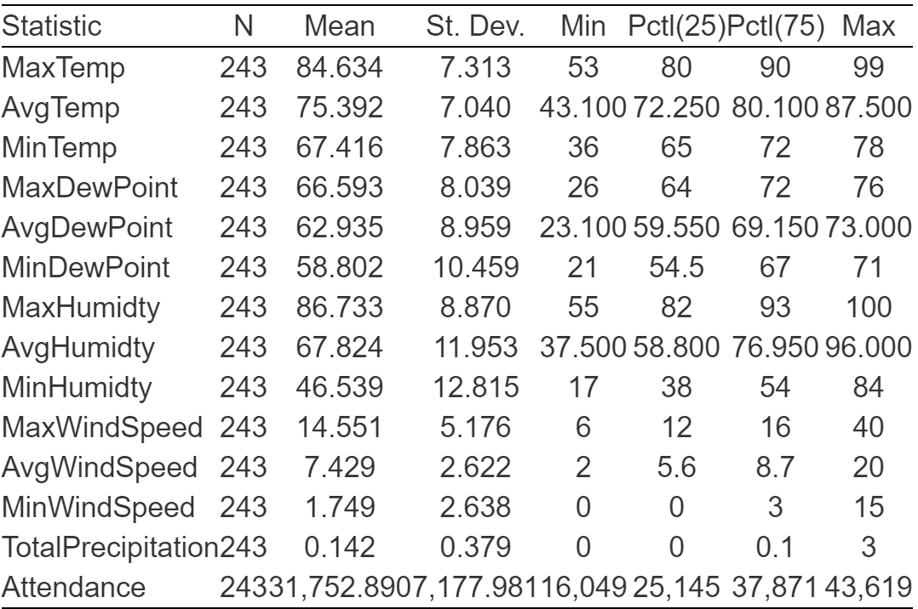
Data
This is the descriptive statistics of the data set after it has been cleaned.

Slide 9
Methodology
After the Data is Clean we first only get the home game data for our analysis and turn it into numeric
Then we will begin performing liner regression analysis on it

Slide 10
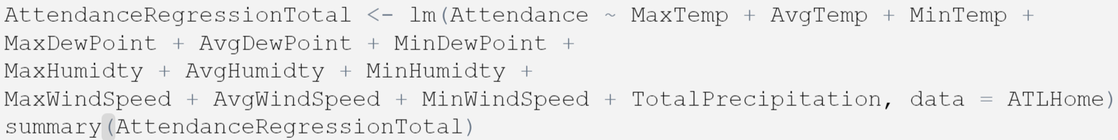
Methodology
We used the R function lm to perform the linear regression analysis
The lm function is a built-in r function
After gaining the results of the
function we then analyzed it.

Slide 11
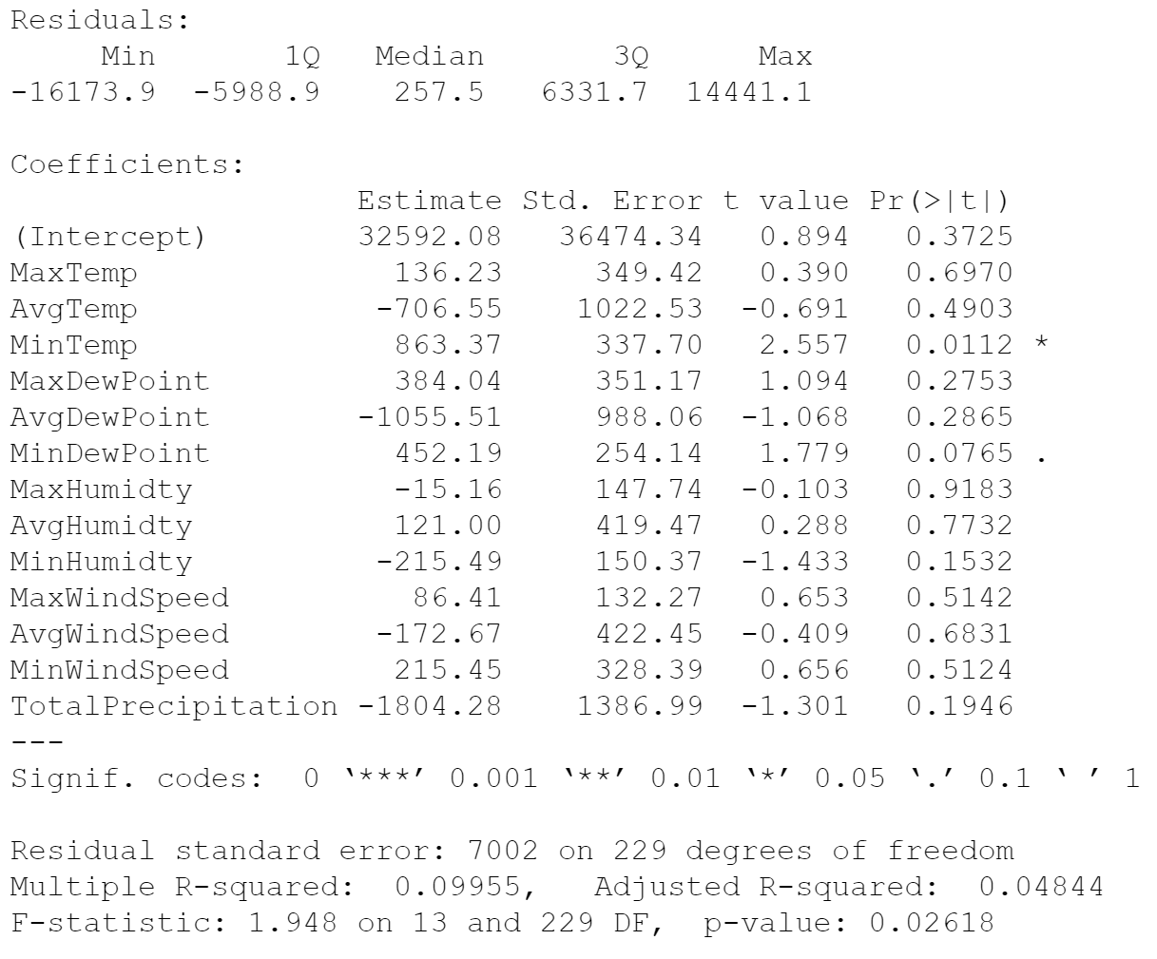
Results

Slide 12
Results
One important thing to remember about our results is about nonsignificant results
Nonsignificant results don’t disprove the hypothesis or prove it they simply state that the data could not prove the hypothesis

Slide 13
Implications
What the results show us is that more data and testing is needed.
Since the results are nonsignificant follow up research would be beneficial to the research project

Slide 14
Conclusion
The main conclusion from our study is that we are unable to prove or reject the null hypothesis of Weather affecting attendance for MLB games based on the analysis that we ran.

Slide 15
References
Atlanta, GA Weather History | Weather Underground. Wunderground.com. (2021). https://www.wunderground.com/history/monthly/KATL/date/2019-4.
2019 Atlanta Braves Schedule. Baseball Reference. (2021). https://www.baseball-reference.com/teams/ATL/2019-schedule-scores.shtml.
Ge, Q., Humphreys, B. R., & Zhou, K. (2020). Are fair weather fans affected by weather? Rainfall, habit formation, and live game attendance. Journal of Sports Economics, 21(3), 304-322.

