Slide 1



Summer Olympics 1936-2012
Cole, Anthony, Kabul

Slide 2

Summer Olympics through the years
More than 35,000 medals have been awarded at the Olympics since 1896.
Data was provided by the IOC Research and Reference Service and published by The Guardian's Datablog.
This dataset includes a row for every Olympic athlete that has won a medal since the first games.
Olympic Sports and Medals, 1896-2014 (kaggle.com)

Slide 3


Data Cleaning
This is how to clean data blah blah blah
Blah
blah
Blah
blah

Slide 4

Questions
Which country has the most total medals in our set. USA
Which country has the most Gold medals. USA
How many Gold, Silver, and Bronze medals were earned in the Summer Olympics. (Slide 6)
How many medals were won in aquatic events. (Slide 7)
Have women or men won more medals.

Slide 5
USA! USA! USA!
Most golds sorted by top 10 countries
SELECT `Country`, COUNT(*)
FROM `Summer Olympics`
GROUP BY `Country`
ORDER BY COUNT(*)
DESC LIMIT 10

Slide 6
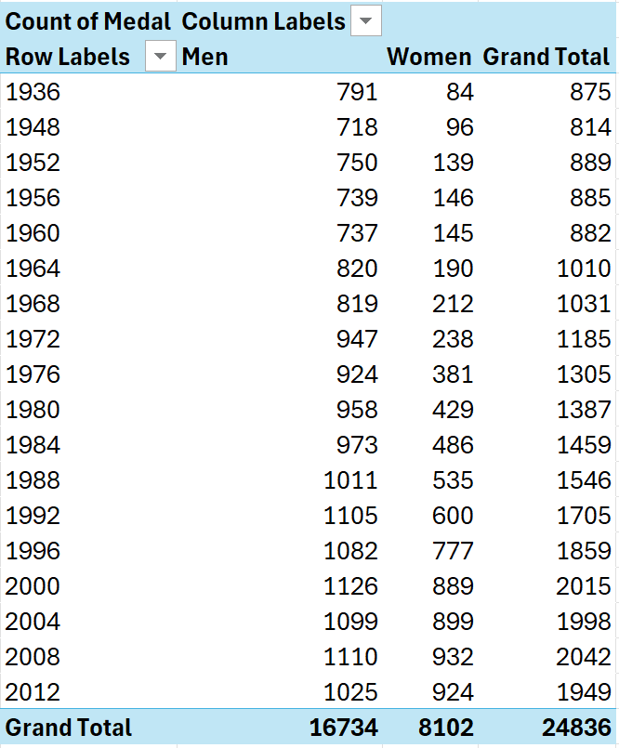
Men Vs Women in the Olympics
Have women or men won more medals:
SELECT `Medal`,`Gender`, COUNT(*)
FROM `Summer Olympics`
GROUP by `Medal`,`Gender`
ORDER BY Count(*)

Slide 7
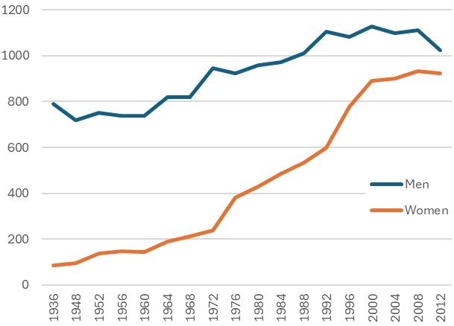
Battle of the Sexes
As time went on, more women’s events were introduced
Women began catching up to men in total medals won per olympics

Slide 8
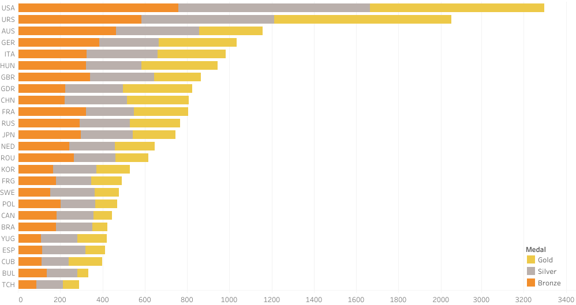
Top 25 Medal Counts by Countries
Total Medals by countries (Stacked Bar)

Slide 9
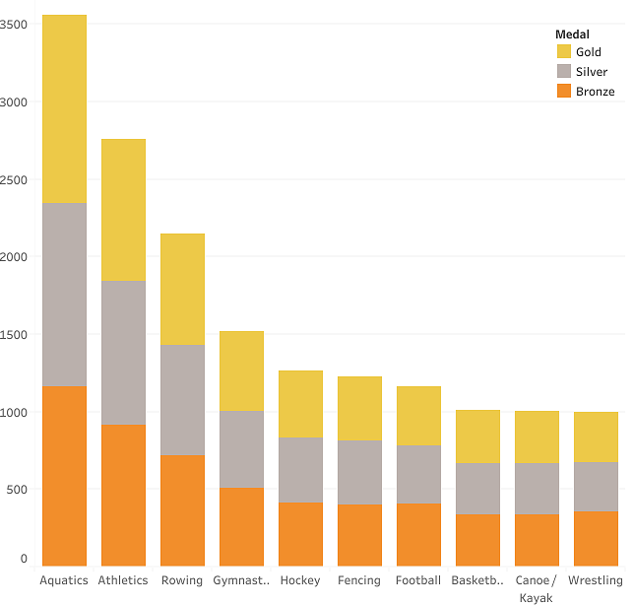
Most medals by Event
Top 10 Medal Producing Events
Looking at Summer Olympics 1936-2012
Events grouped into sports

Slide 10
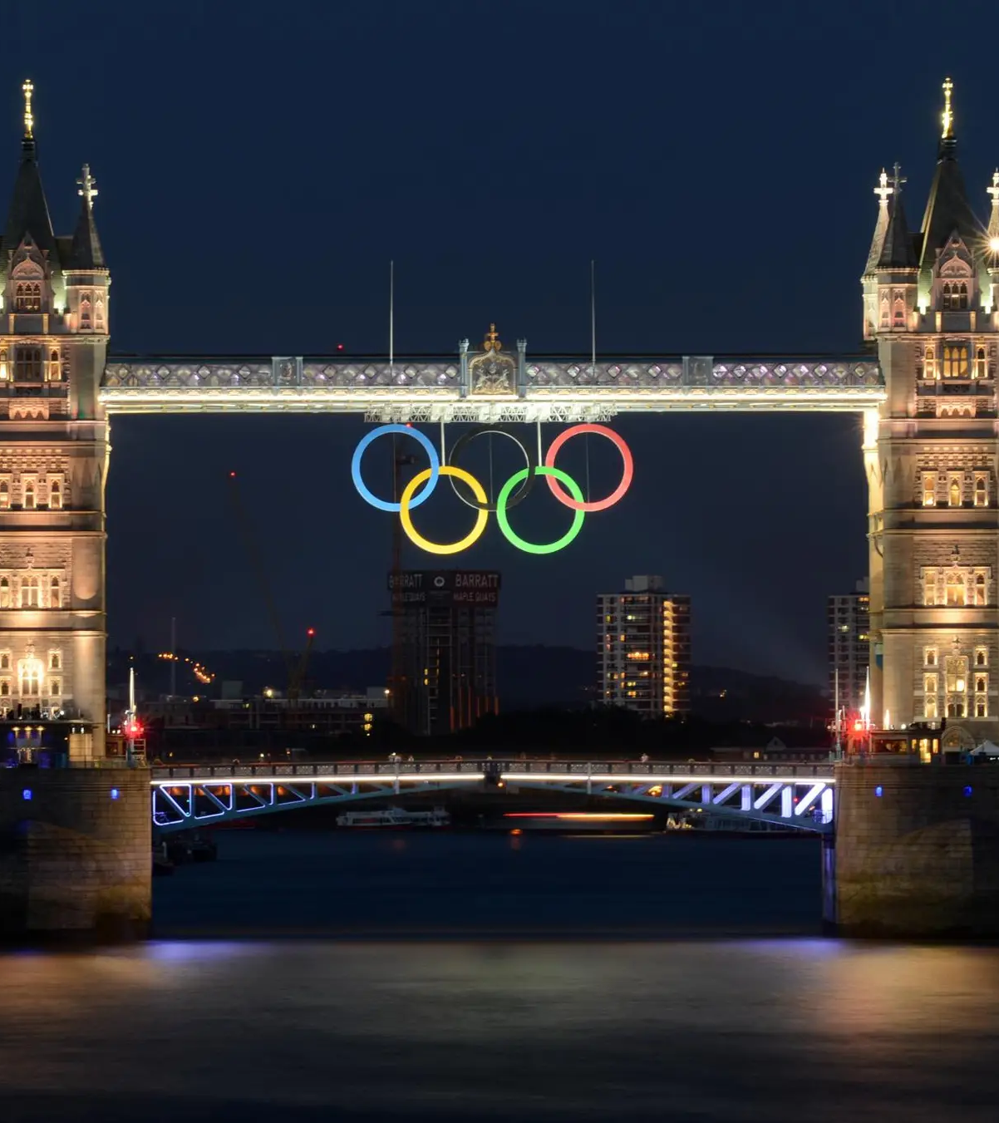
What we Learned
What did we learn:
Data is not always easy to display
Not all data is useful
How dominant the USA is in the Summer Olympics
Challenges:
Trying to get all of our Excel CSV file into SQL. We figure this out by just getting rid of some of our data so it could fit.
What question to ask and answer. We figure this out by putting down bad ones so we could get out the good one eventually.

Slide 11

References
Our Tableau Worksheets
Our Kaggle Dataset
SQL (whatever we used please insert)

