Slide 1
DIABETES PREDICTON
USING
MACHINE LEARNING TECHINQUES
Nimisha Agarwal

Slide 2
CONTENTS
Introduction
Purpose of this Project
What we are trying to accomplish in this project through our trained model
Methods and Models
What models we are using and methods used to train those models

Slide 3
PART ONE
INTRODUCTION

Slide 4
Diabetes is a very common metabolic disease. Usually onset of type 2 diabetes happens in middle age and sometimes in old age. But nowadays incidences of this disease are reported in children as well. There are several factors for developing diabetes like genetic susceptibility, body weight, food habit and sedentary lifestyle. Undiagnosed diabetes may result in very high blood sugar level referred as hyperglycemia which can lead to complication like diabetic retinopathy, nephropathy, neuropathy, cardiac stroke and foot ulcer. So, early detection of diabetes is very important to improve quality of life of patients and enhancement of their life expectancy.
The learning process starts with the gathering of data by different means, from various resources. Then the next step is to prepare the data, that is pre-process it in order to fix the data related issues and to reduce the dimensinality of the space by removing the irrelevant data. Next step is testing the model to calculate the accuracy and performance of the system. And finally optimization of the system, i.e. improvising the model by using new rules or data set. The techniques of machine learning are used for classification, prediction and pattern recognition.
My model is implemented using supervised machine learning techinques in Python for Pima Indian diabetes dataset to understand patterns for knowledge discovery process in diabetes. This dataset discusses the Pima Indian population’s medical record regarding the onset of diabetes. It includes several independent variables and one dependent variable i.e class value of diabetes in terms of 0 and 1.

Slide 5
PART TWO
PURPOSE

Slide 6
Diabetes is a disease that occurs when the blood glucose level becomes high, which ultimately leads to other health problems such as heart diseases, kidney disease, etc. Diabetes is caused mainly due to the consumption of highly processed food, bad consumption habits, etc.
According to WHO, the number of people with diabetes has been increased over the years.
Our purpose in this project to train a dataset to predict Diabetes at an early stage so that it can help a person to take the necessary precautions and change their lifestyle to either prevent the occurence of diabetes or control this disease.

Slide 7
PART THREE
METHODS AND MODELS

Slide 8
Methods
Data Preparation
Saving Model
Feature Engineering
We will be using
“Pima Indians Diabetes Database”
taken from Kaggle.
After selecting model, the only left is to save it for future use.
Feature engineering is the process of transforming the gathered data into features that better represent the problem that we are trying to solve to the model, to improve its performance and accuracy.
Data Exploration And Cleaning
Model Selection
This step is necessary to familiarize with the data, to gain some understanding of the potential features and to see if data cleaning is needed.
It is the phase where we select the model which performs best for the data set at hand.

Slide 9
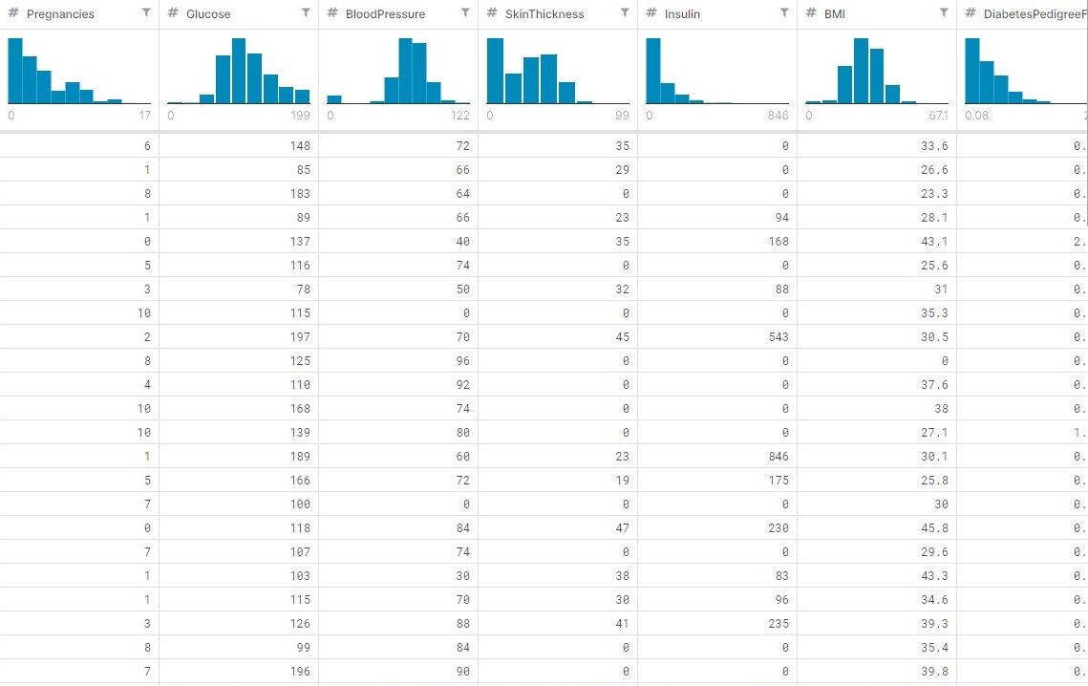
DATA
PREPARATION
As a Data Scientist, the most tedious task which we encounter is the acquiring and the preparation of a data set. Even though there is an abundance of data in this era, it is still hard to find a suitable data set that suits the problem you are trying to tackle. We will be using a data set called the “Pima Indians Diabetes Database”.

Slide 10
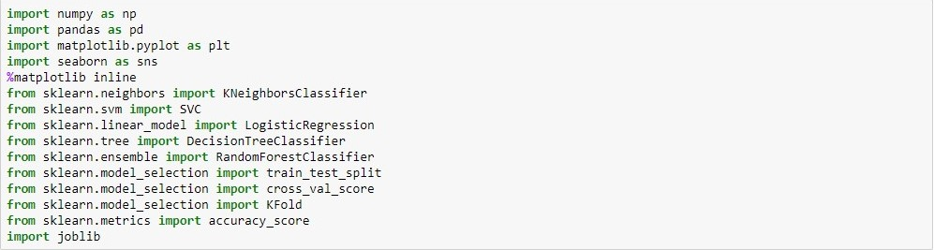
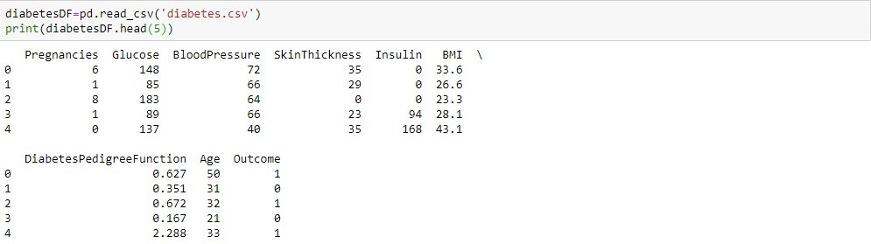
DATA EXPLORATION AND CLEANING
First, we will import the necessary libraries and import our data set to the Jupyter notebook.
After importing necessary libraries we will read our database csv file.
We can examine the data set using the pandas’ head() method.

Slide 11

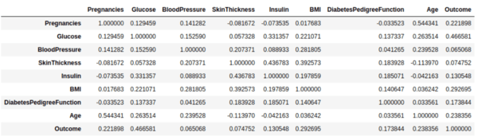
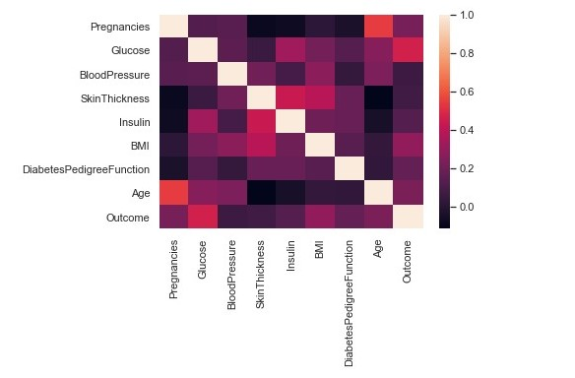
Visualization of data is an imperative aspect of data science. It helps to understand data and also to explain the data to another person.
We will use pandas’ visualization which is built on top of matplotlib, to find the data distribution of the features.
Let’s start by finding correlation of every pair of features (and the outcome variable), and visualize the correlations using a heatmap.

Slide 12
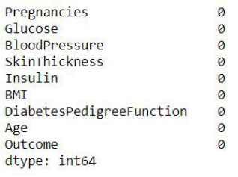
The next step is data cleaning, considered to be one of the crucial steps of the workflow because it can make or break the model.
There are several factors involved in data cleaning :
Missing or Null Data Points
Unexpected Outliers
Duplicate or irrelevant entries
Missing or Null Data Points
We will start by finding missing or null data points using pandas .isnull() and .sum() function.
OUTPUT :
From fig it is clear that database does not contain any null values.

Slide 13
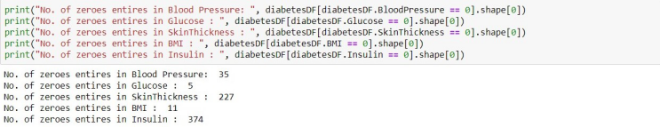
Unexpected Outliers
Now look for zeroes in dataset, if found then we will remove those rows.
We will remove the rows for which the “BloodPressure”, “BMI” and “Glucose” are zero. We will not alter values for SkinThickness and Insulin as they have a lot of invalid points.
(724, 9)

Slide 14
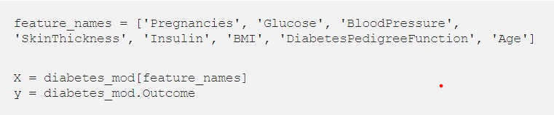
FEATURE ENGINEERING
Feature engineering creates more input features from the existing features and also combines several features to produce more intuitive features to feed the model. In the data set, features are - ‘Pregnancies’, ‘Glucose’, ‘Blood Pressure’, ‘Skin Thickness’, ‘Insulin’, ‘BMI’, ‘Diabetes Pedigree Function’, ‘Age’ By a crude observation, we can say that the ‘Skin Thickness’ is not an indicator of diabetes. But we can’t deny the fact that it is unusable at this point. Therefore we will use all the features available. We separate the data set into features and the response that we are going to predict. We will assign the features to the X variable and the response(outcome) to the y variable.

Slide 15
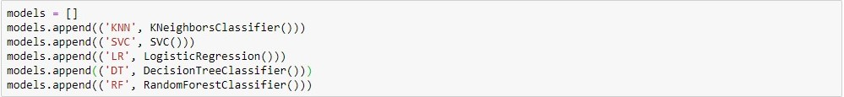
MODAL SELECTION,
NORMALIZATION,
TRAINING AND EVALUATING MODEL
In this step we select the model which performs best for the data set at hand. First, we will be calculating the “Classification Accuracy (Testing Accuracy)” of a given set of classification models with their default parameters to determine which model performs better with the diabetes data set. We will initialize the classifier models with their default parameters and add them to a model list.

Slide 16
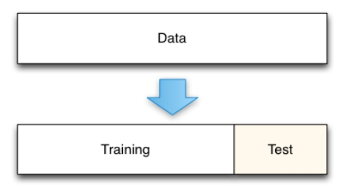
Now we will split out dataset in training and test set. It can be implemented in:- 1)Train/Test Split 2)K-Fold Cross-Validation
Train/Test Split
This method split the data set into two portions: a training set and a testing set. The training set is used to train the model. And the testing set is used to test the model, and evaluate the accuracy.

Slide 17

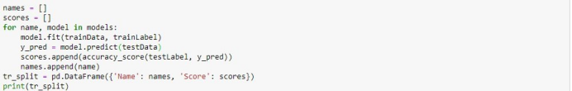
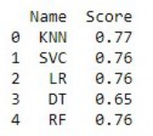
Normalization
Now we will normalize our training and test data set to change the values of numeric in data set to common scale, without distorting differences in the range of values.
Then we fit each model in a loop and calculate the accuracy of the respective model using the “accuracy_score”.
Train/Test Split Accuracy Scores

Slide 18
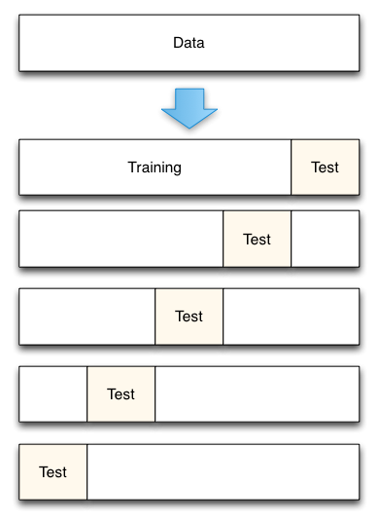
K-Fold Cross-Validation
This method splits the data set into K equal partitions (“folds”), then use 1 fold as the testing set and the union of the other folds as the training set. Then the model is tested for accuracy. The process will follow the above steps K times, using different folds as the testing set each time. The average testing accuracy of the process is the testing accuracy.

Slide 19
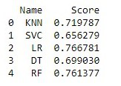
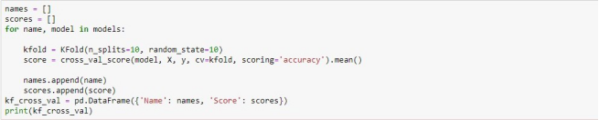
We will move forward with K-Fold cross validation as it is more accurate and use the data efficiently. We will train the models using 10 fold cross validation and calculate the mean accuracy of the models. “cross_val_score” provides its own training and accuracy calculation interface.
K-Fold Cross Validation Accuracy Scores
We can plot the accuracy scores using seaborn

Slide 20
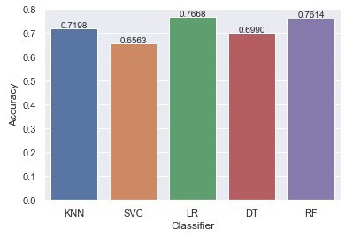
We can see the Logistic Regression, Gaussian Naive Bayes, Random Forest and Gradient Boosting have performed better than the rest. From the base level we can observe that the Logistic Regression performs better than the other algorithms. At the baseline Logistic Regression managed to achieve a classification accuracy of 76.68 %.

Slide 21
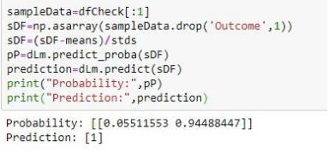
SAVING MODEL
As we saw that Logistic Regression model is more accurate so we will save it for future using joblib.
Now let us check whether our model is predicting correctly or not.
The prediction comes out to be true.

Slide 22
CONCLUSION
Diabetes is a heterogeneous group of diseases. It’s characterized by chronic elevation of glucose in the blood. To support the lives of the people all over the world, we are trying to detect and prevent the complications of diabetes at the early stage through predictive analysis by improving the classification techniques. My proposed work also performs the analysis of the features in the dataset and selects the optimal features based on the correlation values. Using Logistic Regression model which gives an accuracy of 76.68%.

Slide 23
THANK YOU

