Slide 1

Dept. of mechanical engineering ME 609: Programming Project Phase # 1
Presented By : Presented To :
Nikhil Dewangan (244103008) Dr. Deepak Sharma
Nikhil Patel (244103009) Assoc. Professor(M.E.)
Group No. 21

Slide 2
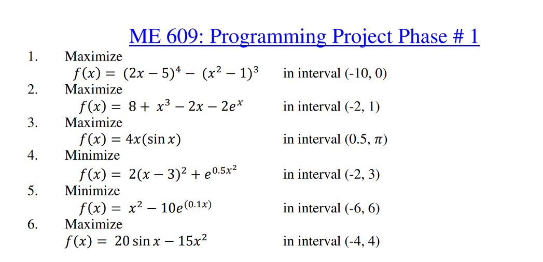
Questions
Interval Halving with Bounding Phase Method

Slide 3
Q. No. 1 Data
Initial Guess Value | Delta | New Interval | Iterations (B.P.) | No. of Function Evaluation | Optimum Point | Optimum Value | No. of Iterations | No. of Functions Evalution
-1 | 0.01 | (-11.23,-3.55) | 9 | 12 | -5.77492 | 41165.61421 | 13 | 26
-1.5 | 0.01 | (-11.73,-4.050) | 9 | 12 | -5.77477 | 41165.61354 | 13 | 26
-2 | 0.01 | (-7.110,-3.270) | 8 | 11 | -5.77477 | 41165.61354 | 12 | 24
-3 | 0.01 | (-8.110,-4.270) | 8 | 11 | -5.77492 | 41165.61421 | 12 | 24
-3.5 | 0.01 | (-8.610,-4.770) | 8 | 11 | -5.77477 | 41165.61354 | 12 | 24
-4 | 0.01 | (-6.550,-4.630) | 7 | 10 | -5.77492 | 41165.61421 | 11 | 22
-5 | 0.01 | (-6.270,-5.310) | 6 | 9 | -5.77477 | 41165.61354 | 10 | 20
-6 | 0.01 | (-5.930,-5.690) | 4 | 7 | -5.77461 | 41165.61241 | 8 | 16
-7 | 0.01 | (-6.370,-4.450) | 7 | 10 | -5.77492 | 41165.61421 | 11 | 22
-8 | 0.01 | (-6.730,-2.890) | 8 | 11 | -5.77492 | 41165.61421 | 12 | 24

Slide 4
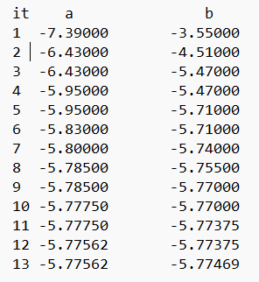
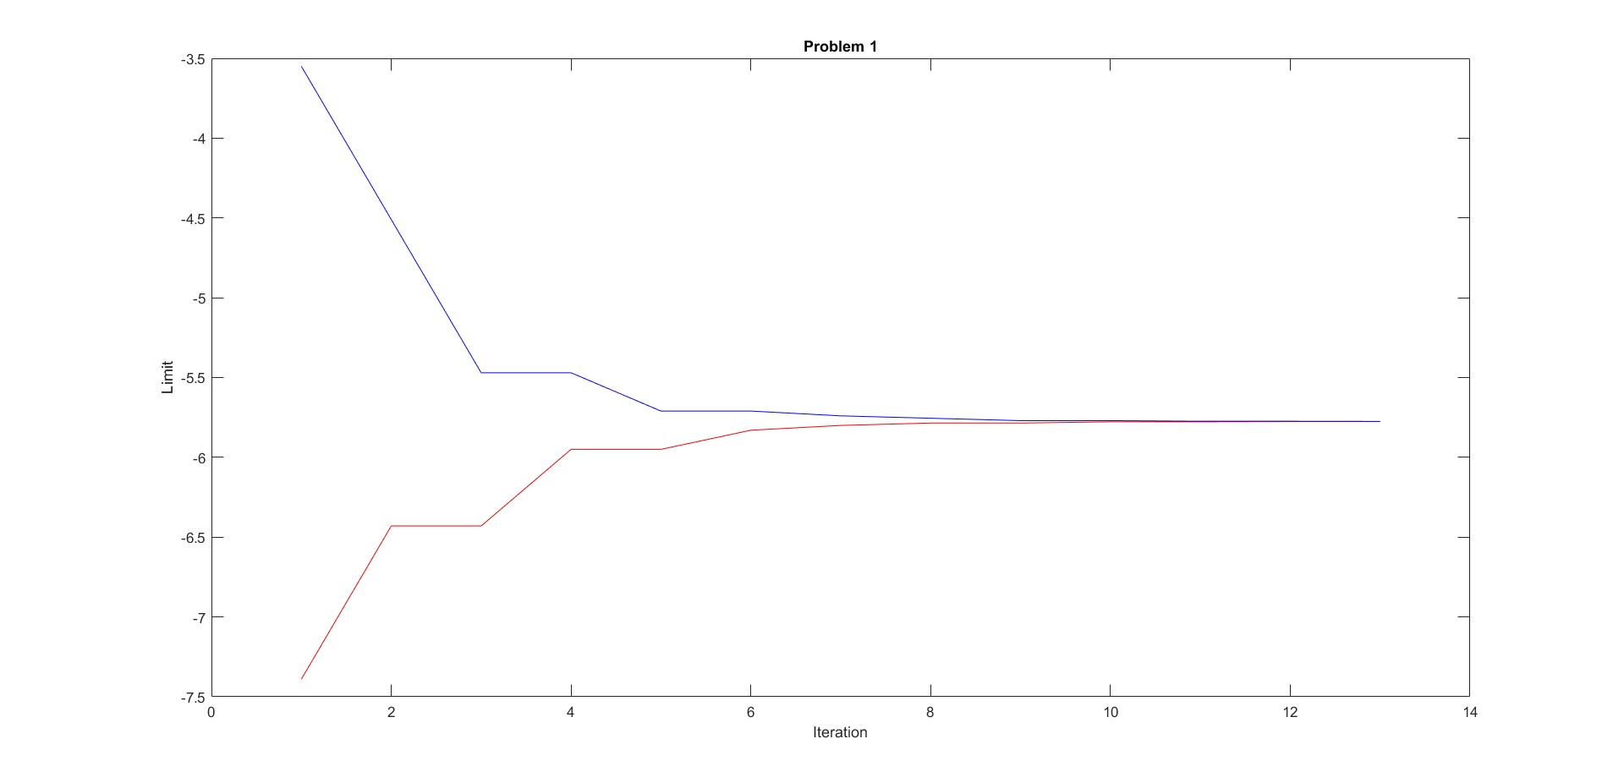
Convergence of Limits

Slide 5
Q. No. 2 Data
Initial Guess Value | Delta | New Interval | Iterations (B.P.) | No. of Function Evaluation | Optimum Point | Optimum Value | No. of Iterations | No. of Functions Evalution
-1 | 0.01 | (-0.990,-0.930) | 2 | 5 | -0.95977 | 8.26948 | 6 | 12
-0.8 | 0.01 | (-1.110,-0.870) | 4 | 7 | -0.95977 | 8.26948 | 8 | 16
-0.5 | 0.01 | (-1.130,-0.650) | 5 | 8 | -0.96008 | 8.26948 | 9 | 18
-0.1 | 0.01 | (-1.370,-0.410) | 6 | 9 | -0.96008 | 8.26948 | 10 | 20
0 | 0.01 | (-1.270,-0.310) | 6 | 9 | -0.95992 | 8.26948 | 10 | 20
0.15 | 0.01 | (-2.400,-0.480) | 7 | 10 | -0.95977 | 8.26948 | 11 | 22
0.3 | 0.01 | (-2.250,-0.330) | 7 | 10 | -0.95977 | 8.26948 | 11 | 22
0.5 | 0.01 | (-2.050,-0.130) | 7 | 10 | -0.95992 | 8.26948 | 11 | 22
0.7 | 0.01 | (-1.850,0.070) | 7 | 10 | -0.96008 | 8.26948 | 11 | 22
0.9 | 0.01 | (-1.650,0.270) | 7 | 10 | -0.95977 | 8.26948 | 11 | 22

Slide 6
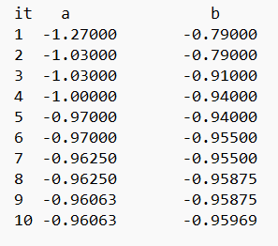
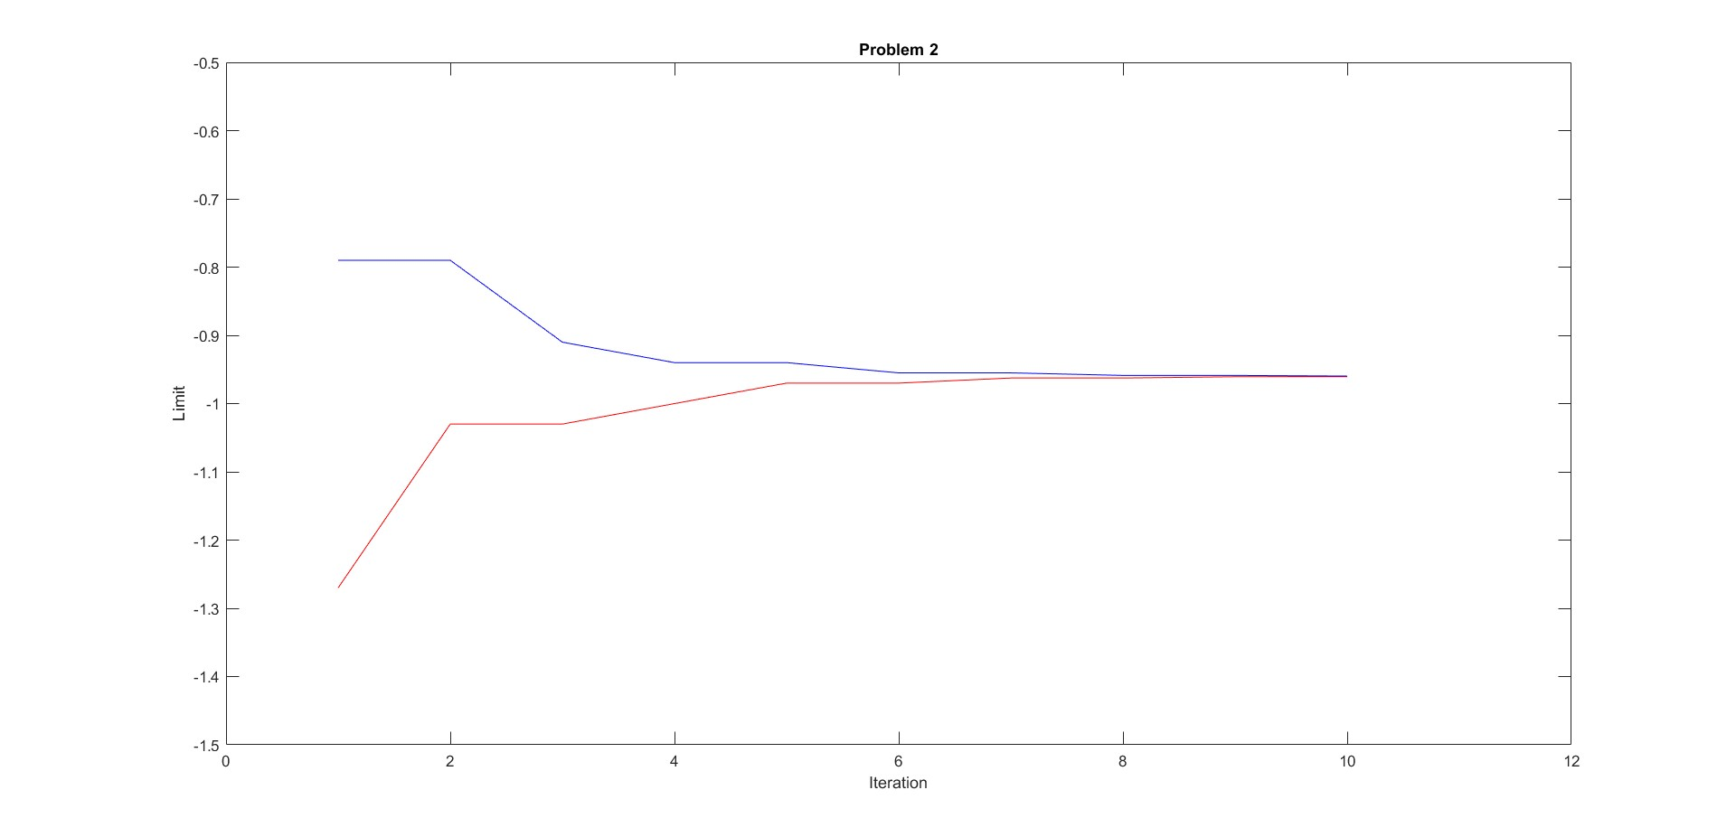
Convergence of Limits

Slide 7
Q. No. 3 Data
Initial Guess Value | Delta | New Interval | Iterations (B.P.) | No. of Function Evaluation | Optimum Point | Optimum Value | No. of Iterations | No. of Functions Evalution
0.7 | 0.01 | (1.330,3.250) | 7 | 10 | 2.02914 | 7.27882 | 11 | 22
0.95 | 0.01 | (1.580,3.500) | 7 | 10 | 2.02883 | 7.27882 | 11 | 22
1.1 | 0.01 | (1.410,2.370) | 6 | 9 | 2.02898 | 7.27882 | 10 | 20
1.7 | 0.01 | (1.850,2.330) | 5 | 8 | 2.02883 | 7.27882 | 9 | 18
2.3 | 0.01 | (1.670,2.150) | 5 | 8 | 2.02883 | 7.27882 | 9 | 18
3.01 | 0.01 | (0.550,2.470) | 7 | 10 | 2.02914 | 7.27882 | 11 | 22

Slide 8
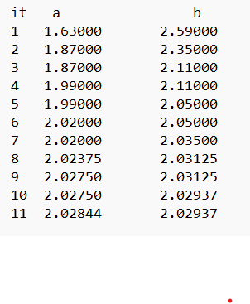
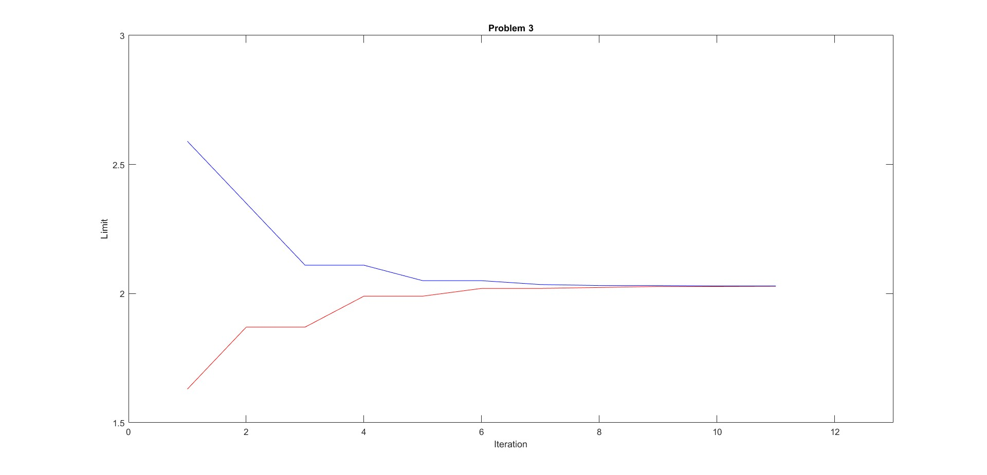
Convergence of Limits

Slide 9
Q. No. 4 Data
Initial Guess Value | Delta | New Interval | Iterations (B.P.) | No. of Function Evaluation | Optimum Point | Optimum Value | No. of Iterations | No. of Functions Evalution
-1.8 | 0.01 | (-0.530,3.310) | 8 | 11 | 1.59086 | 7.51592 | 12 | 24
-1.2 | 0.01 | (0.070,3.910) | 8 | 11 | 1.59086 | 7.51592 | 12 | 24
0.9 | 0.01 | (1.210,2.170) | 6 | 9 | 1.59086 | 7.51592 | 10 | 20
0.6 | 0.01 | (1.230,3.150) | 7 | 10 | 1.59117 | 7.51593 | 11 | 22
1.1 | 0.01 | (1.410,2.370) | 6 | 9 | 1.59117 | 7.51593 | 10 | 20
2.6 | 0.01 | (0.050,1.970) | 7 | 10 | 1.59102 | 7.51592 | 11 | 22

Slide 10
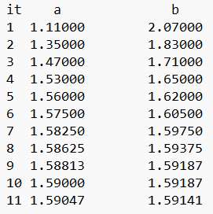
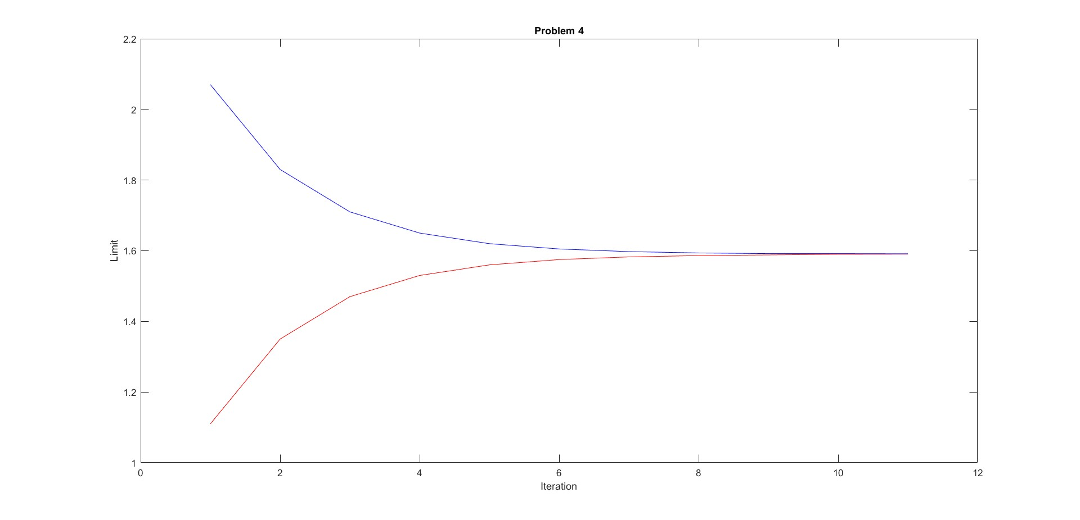
Convergence of Limits

Slide 11
Q. No. 5 Data
Initial Guess Value | Delta | New Interval | Iterations (B.P.) | No. of Function Evaluation | Optimum Point | Optimum Value | No. of Iterations | No. of Functions Evalution
-5 | 0.01 | (-2.450,5.230) | 9 | 12 | 0.52727 | -10.26340 | 13 | 26
-3.5 | 0.01 | (-0.950,6.730) | 9 | 12 | 0.52727 | -10.26340 | 13 | 26
-1.5 | 0.01 | (-0.230,3.610) | 8 | 11 | 0.52727 | -10.26340 | 12 | 24
0 | 0.01 | (0.310,1.270) | 6 | 9 | 0.52727 | -10.26340 | 10 | 20
1.8 | 0.01 | (-0.750,1.170) | 7 | 10 | 0.52711 | -10.26340 | 11 | 22
4 | 0.01 | (-1.110,2.730) | 8 | 11 | 0.52711 | -10.26340 | 12 | 24

Slide 12
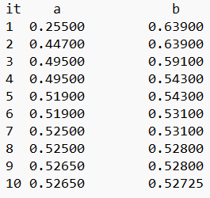
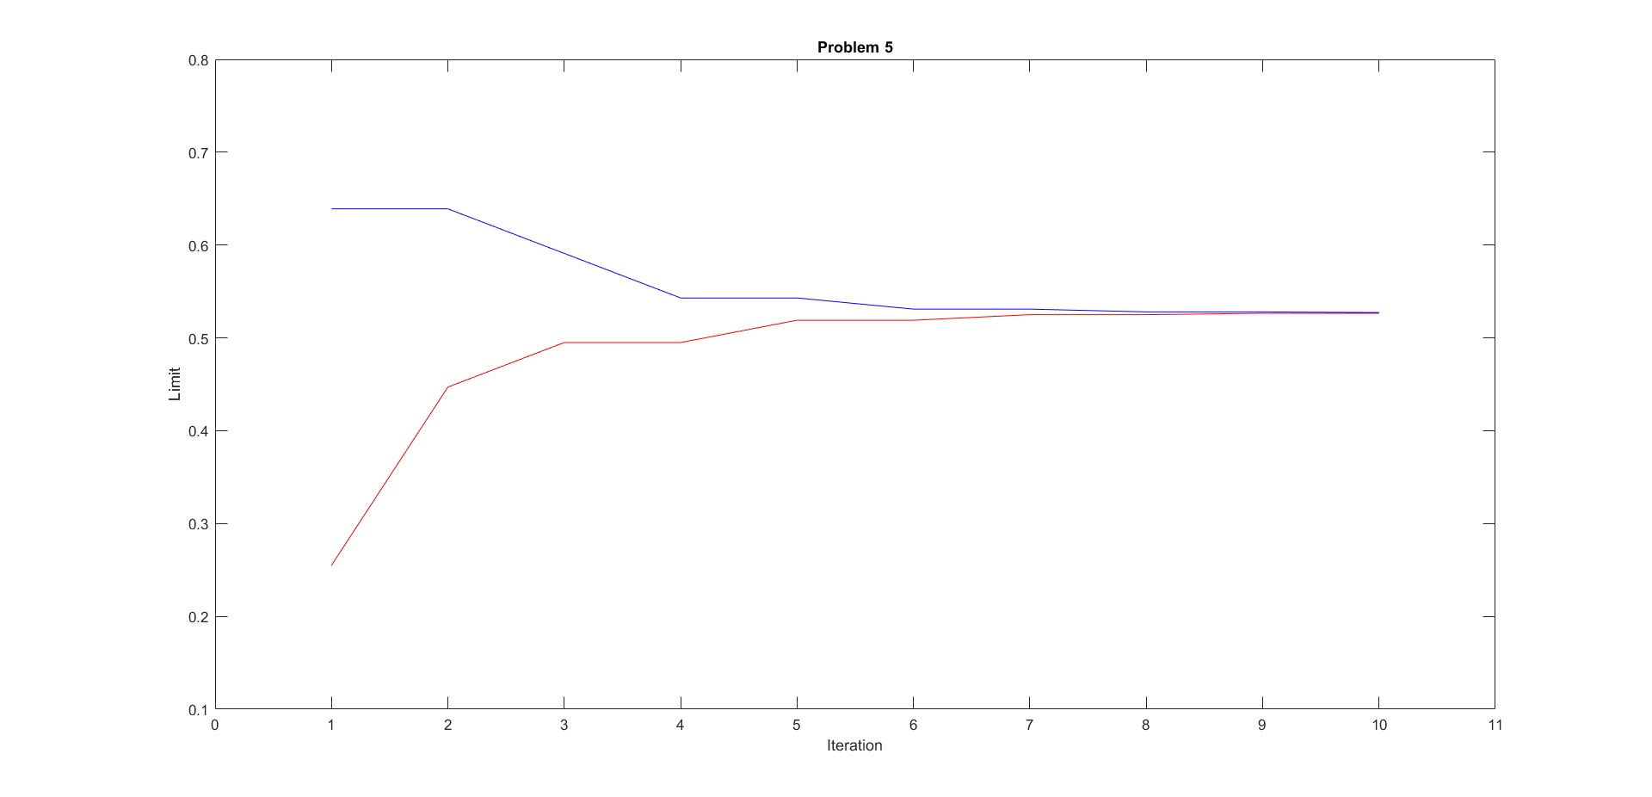
Convergence of Limits

Slide 13
Q. No. 6 Data
Initial Guess Value | Delta | New Interval | Iterations (B.P.) | No. of Function Evaluation | Optimum Point | Optimum Value | No. of Iterations | No. of Functions Evalution
-2.5 | 0.01 | (-1.230,2.610) | 8 | 11 | 0.56367 | 5.91998 | 12 | 24
-1 | 0.01 | (-0.370,1.550) | 7 | 10 | 0.56398 | 5.91998 | 11 | 22
0 | 0.01 | (0.310,1.270) | 6 | 9 | 0.56383 | 5.91998 | 10 | 20
0.9 | 0.01 | (0.270,0.750) | 5 | 8 | 0.56367 | 5.91998 | 9 | 18
2 | 0.01 | (-0.550,1.370) | 7 | 10 | 0.56398 | 5.91998 | 11 | 22
0.3 | 0.01 | (0.450,0.930) | 5 | 8 | 0.56367 | 5.91998 | 9 | 18

Slide 14
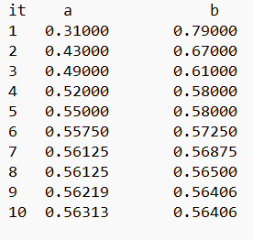
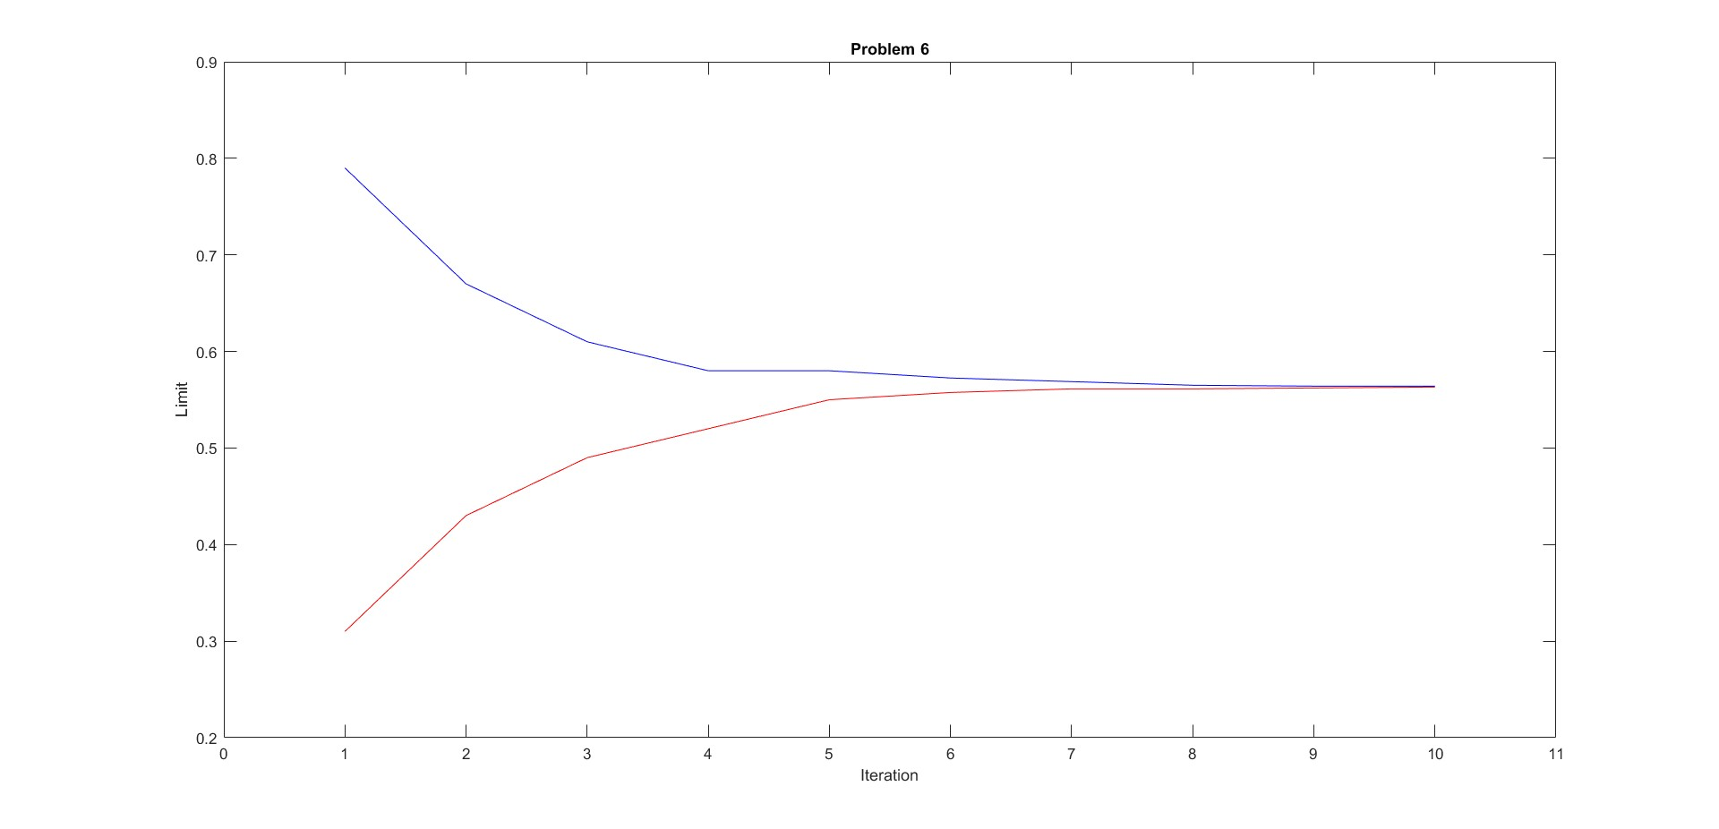
Convergence of Limits

Slide 15
Conclusion
If the initial guess value is near the optimum point then the no. of iterations and function evaluations are less.
Greater the value of delta choosen lesser the no. of iteration and function evaluations are performed.

