Slide 1

Dept. of mechanical engineering ME 609: Programming Project Phase # 3
Presented By : Presented To :
Nikhil Dewangan (244103008) Dr. Deepak Sharma
Nikhil Patel (244103009) Assoc. Professor(M.E.)
Group No. 21

Slide 2
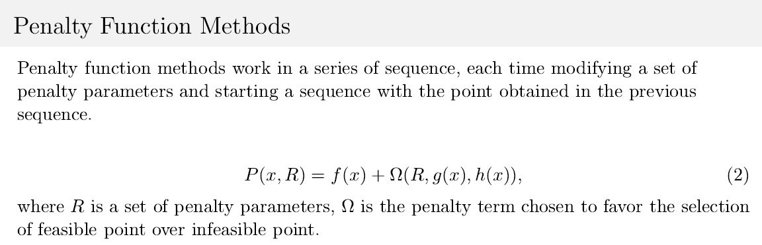
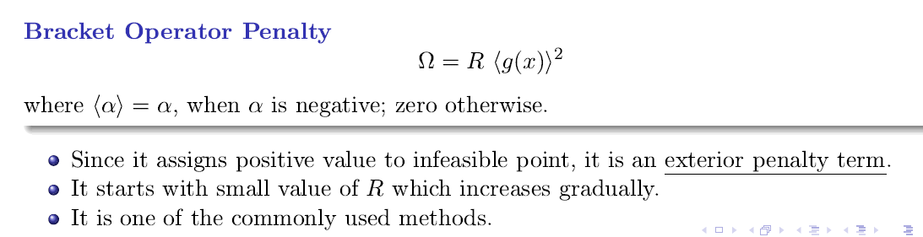

Slide 3
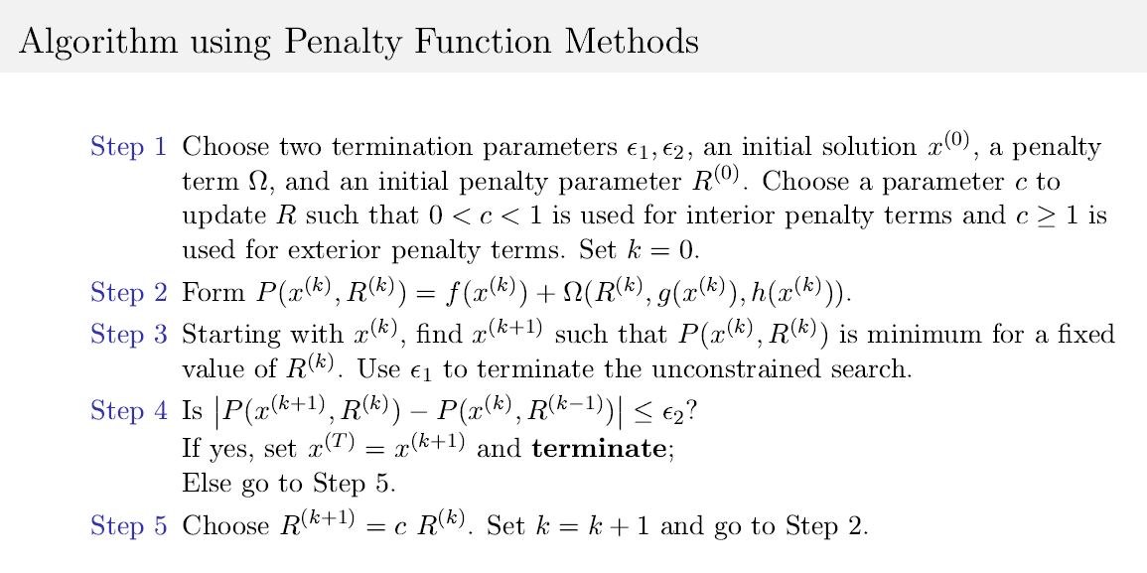

Slide 4
Flow Chart
Start
Initial guess as input
Forming Penalty function Implementation
Perform Conjugate Direction Method
Perform unidirectional search using interval halving method and bounding phase method
Condition Check
No
Yes
Optimum point
Print optimum point
End

Slide 5
Q1 Observations
Initial Guess | No. of Iteration | Function Evaluation | Optimal Point | Optimum Value
19.8141 0..4876 | 8 | 2715 | 14.0946 0.8641 | -6962.0481
17.6768 3.5427 | 10 | 4075 | 14.1181 0.8690 | -6958.9364
15.2354 2.2044 | 9 | 3759 | 14.1004 0.8414 | -6957.9374
15.1440 3.4012 | 9 | 3600 | 14.1140 0.8847 | -6914.1982
14.1238 1.6056 | 7 | 1548 | 14.0949 0.8428 | -6961.9168

Slide 6
Initial Guess | No. of Iteration | Function Evaluation | Optimal Point | Optimum Value
18.3403 3.1364 | 11 | 4158 | 14.0950 0.8431 | -6961.5641
19.5342 0.4284 | 8 | 3057 | 14.0948 0.8427 | -6962.0017
13.9740 3.1869 | 9 | 3876 | 14.0971 0.8473 | -6956.8441
19.1432 1.6253 | 58 | 7993 | 14.1202 0.8932 | -6905.3047
19.1685 1.4022 | Inf | —— | —— | ——

Slide 7
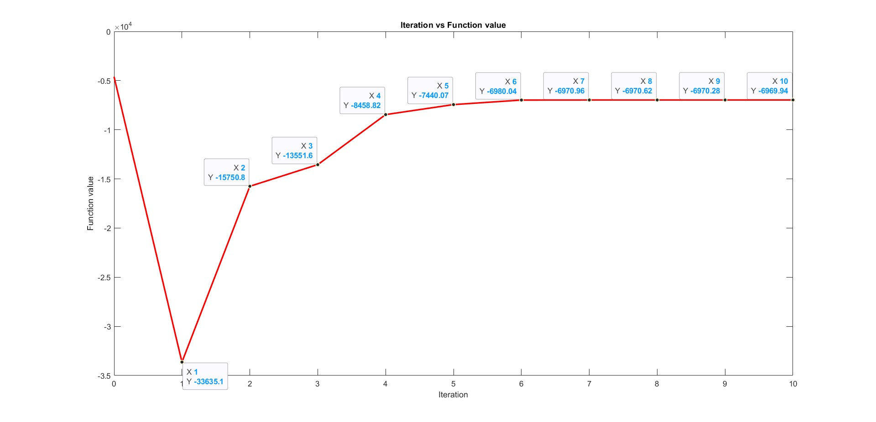
Iteration vs Function value
Function value
Iteration

Slide 8
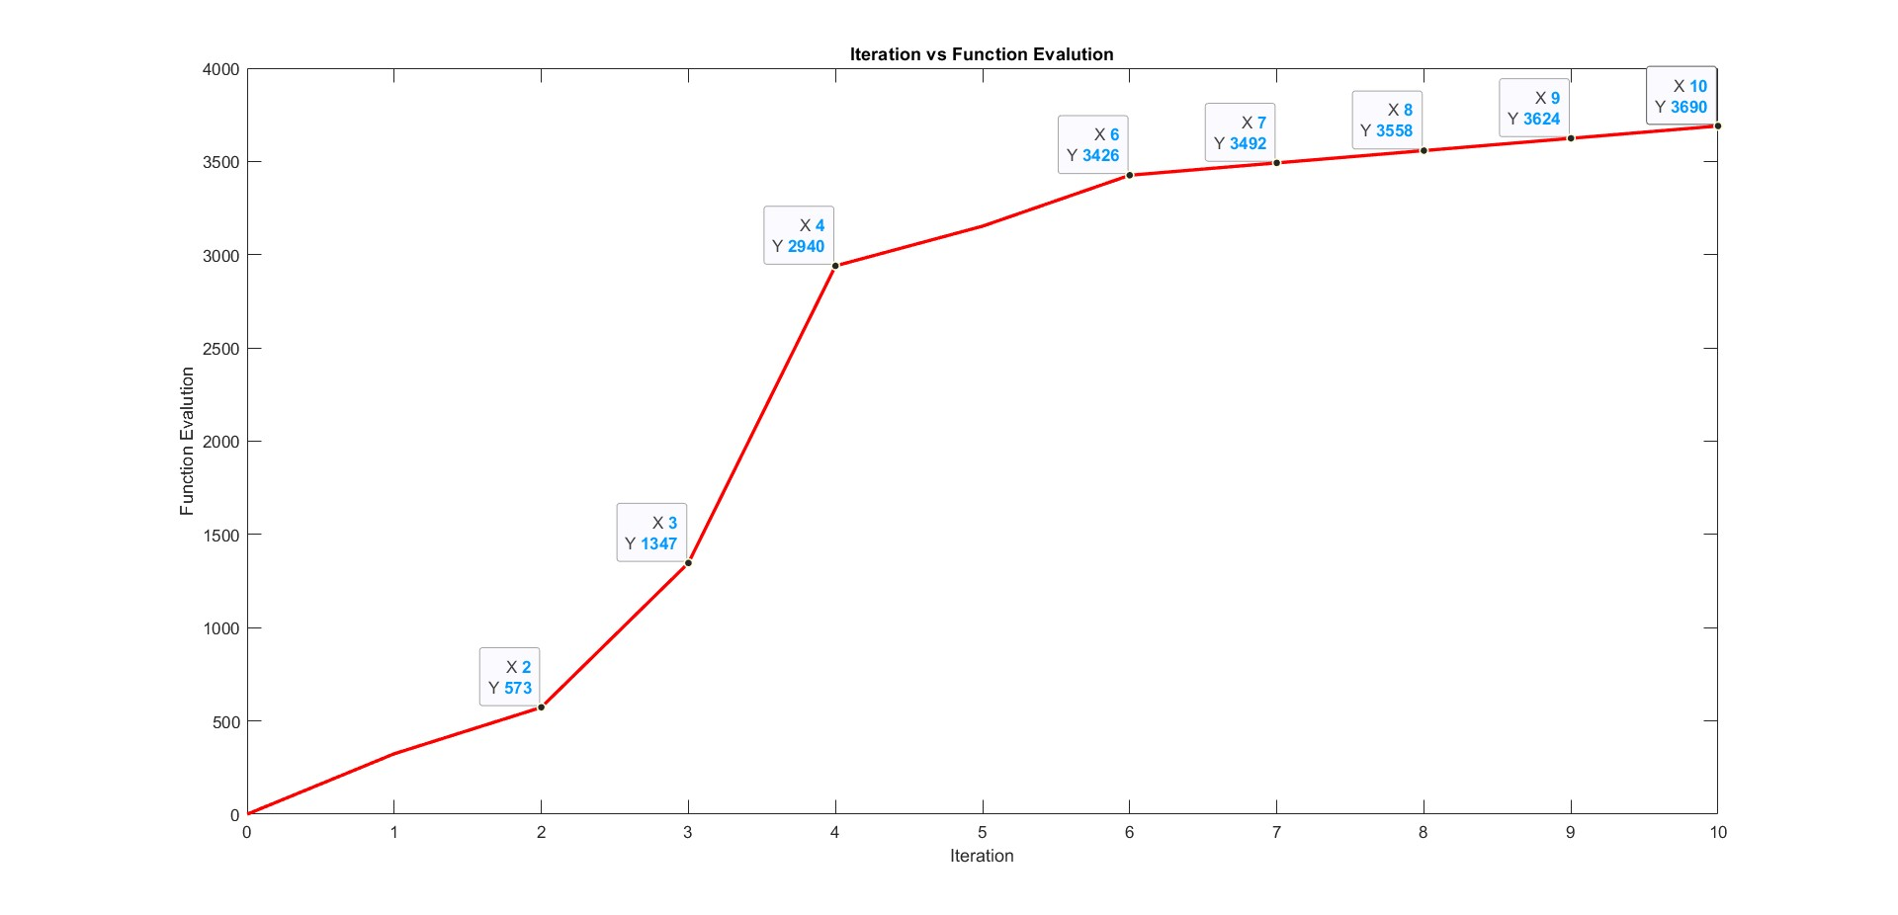
Iteration vs Function evaluations
Function evaluations
Iteration

Slide 9

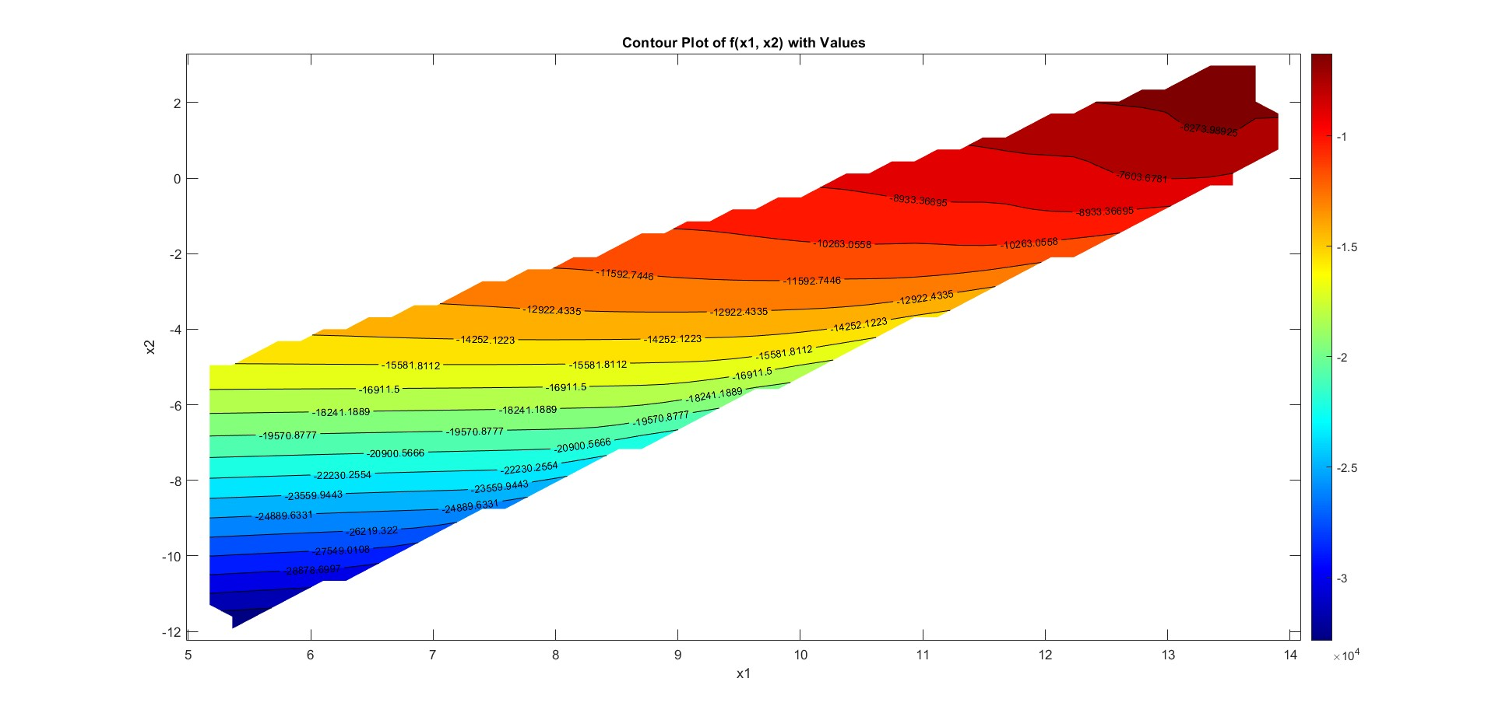

Slide 10
Q2 Observations
Initial Guess | No. of Iteration | Function Evaluation | Optimal Point | Optimum Value
0.9428 4.0546 | 3 | 1728 | 1.2269 4.2427 | 0.0958
6.3871 3.7815 | 4 | 2106 | 1.2245 4.2574 | 0.0957
5.4301 3.2211 | 2 | 711 | 1.2275 4.2452 | 0.0958
7.6332 1.0005 | 2 | 678 | 1.2279 4.2453 | 0.0958
4.7130 9.3732 | 2 | 1215 | 1.2259 4.2386 | 0.0957

Slide 11
Initial Guess | No. of Iteration | Function Evaluation | Optimal Point | Optimum Value
7.6372 5.1276 | 4 | 1806 | 1.2280 4.2455 | 0.0958
7.2670 4.1296 | 4 | 3771 | 1.2260 4.3252 | 0.0841
9.7116 5.7437 | 5 | 2643 | 1.6674 3.7801 | 0.0255
1.4042 4.8069 | 3 | 666 | 1.7340 4.7461 | 0.0292
9.2024 2.7509 | Inf | —— | —— | ——

Slide 12
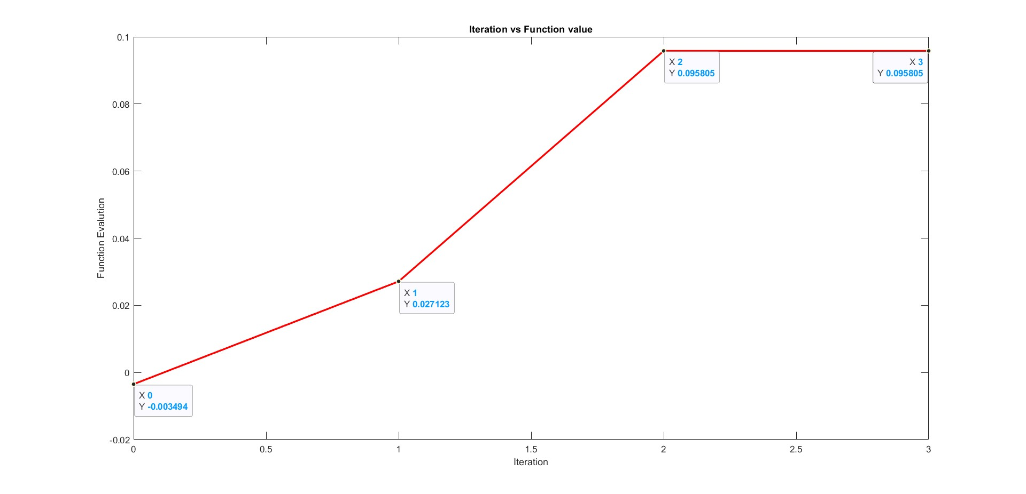
Iteration vs Function Value
Function Value
Iteration

Slide 13
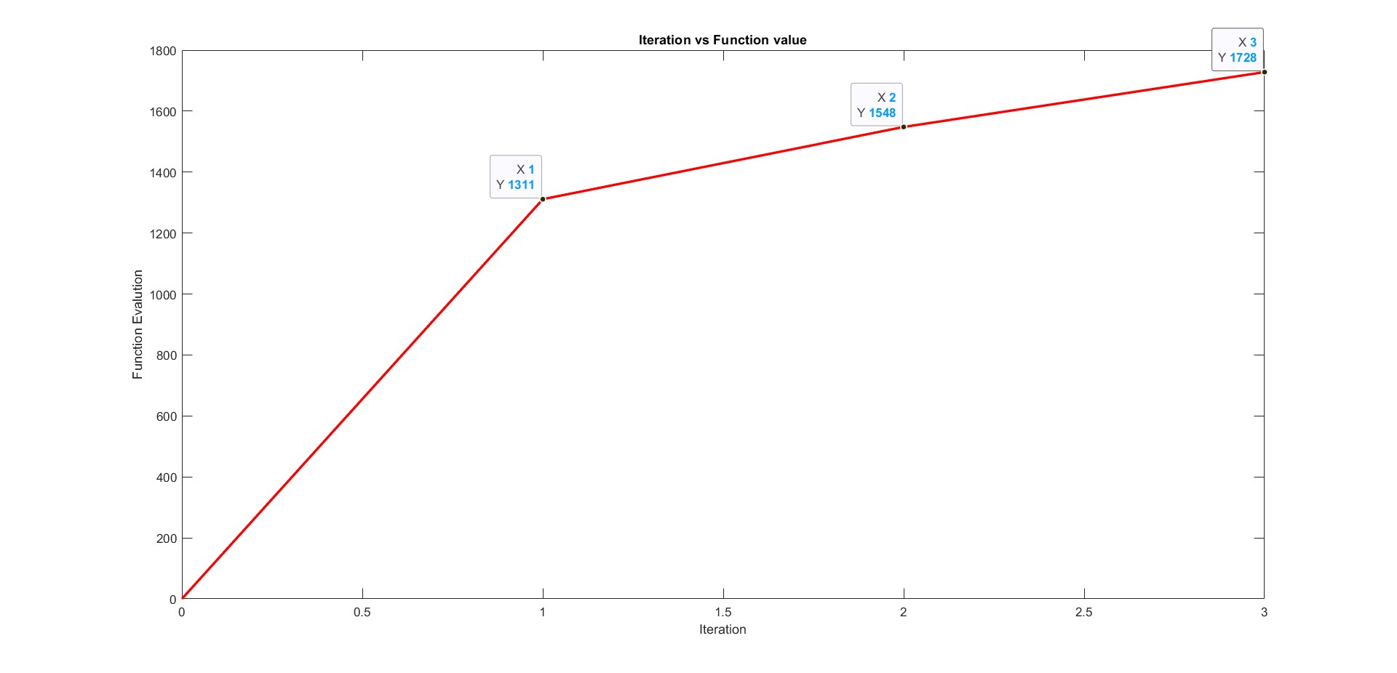
Iteration vs Function evaluations
Function evaluations
Iteration

Slide 14
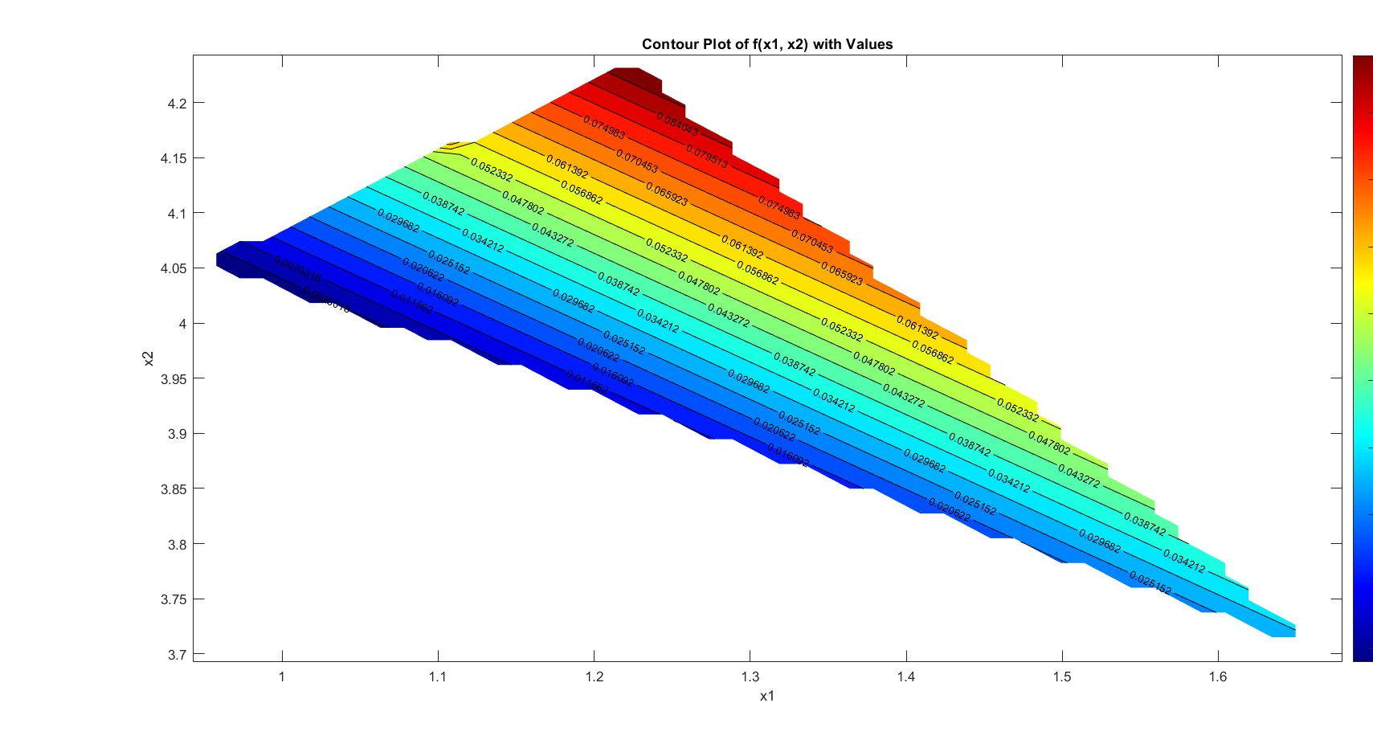

Slide 15
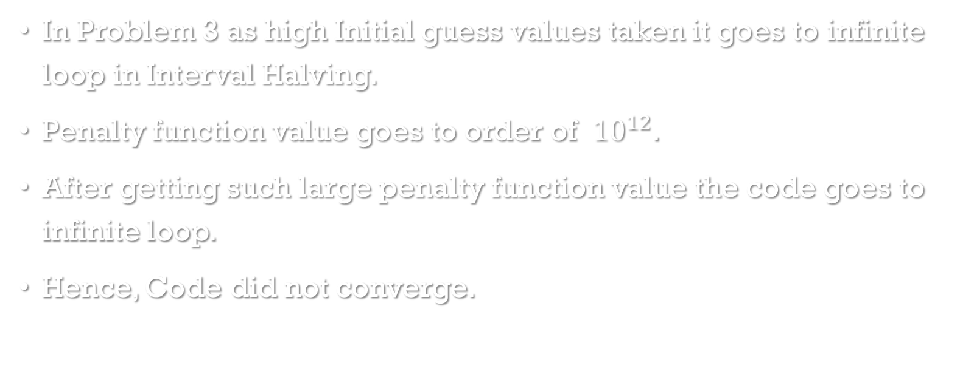
Q3 Observations
In Problem 3 as high Initial guess values taken it goes to infinite loop in Interval Halving.
Penalty function value goes to order of ${10}^{12}$.
After getting such large penalty function value the code goes to infinite loop.
Hence, Code did not converge.

Slide 16
Conclusion
If the initial guess value is near the optimum point then the no. of iterations for convergence are less.
For random initial guess and alpha no. of function evaluatios can vary.
Sometimes we got artificial optimas.
In some random points our method goes to infinite loop
it is due to greater value of R assign in lesser iterations.

Slide 17

Thank you

