Slide 1
Why Choose Complete Case Analysis?
Guarantees Data Integrity: in a risk prediction setting, our target population is the population with the complete set of features observed. It is the population in which eventually our model will be implemented.
Avoids Assumptions: Does not depend on assumptions about why data is missing.
Preserves True Variance: Imputed data mimics existing patterns without adding new variability, risking the reinforcement of trends.
Less than 5% of the data was missing.

Slide 2
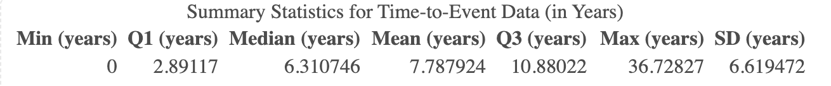
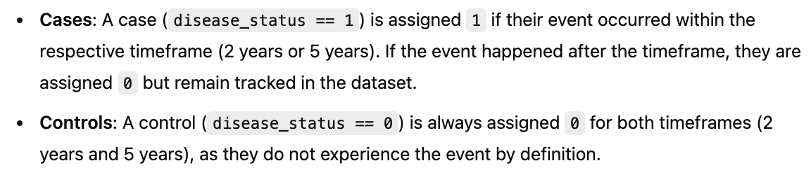
Right Censoring
Yes, the outcome is treated as a binary variable (Yes/No) for each time horizon, such as 2 years or 5 years.
If a participant's person-time is censored before reaching the 5-year mark (e.g., censored at 3 years), they are considered censored for the 5-year outcome. This means they contribute to the analysis up until the point of censoring (3 years), but their status after 3 years is unknown.
For the 5-year outcome, such a participant would be excluded from contributing either a "Yes" or "No" beyond their censoring point.
This ensures the integrity of the survival analysis by only including data up to the point where it is observed or can be validly interpreted.

Slide 3
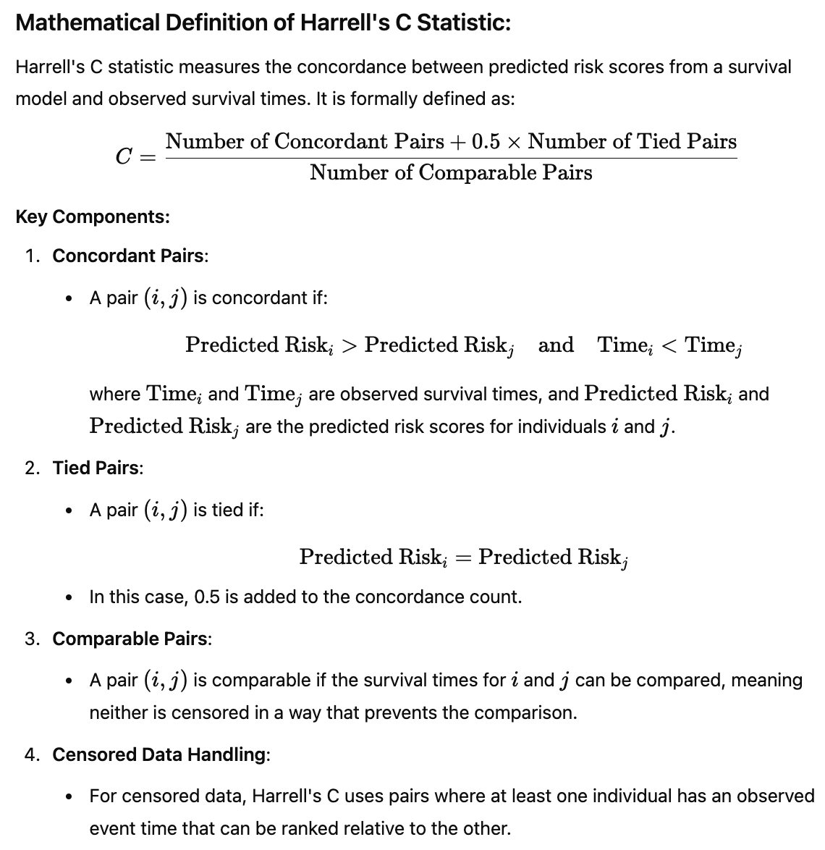
Harrell's C Statistic

Slide 4
PH Assumption
1. Schoenfeld Residuals Test: Tests whether the Schoenfeld residuals are independent of time.
How to Use:
After fitting a Cox model, check for a significant correlation between residuals and time.
Key Tool: cox.zph() function in R (from the survival package).
Interpretation:
p > 0.05: No evidence of a violation of the PH assumption.
p ≤ 0.05: Suggests the PH assumption may be violated for the corresponding covariate.
2. Graphical Methods: Schoenfeld Residual Plots:
Plot Schoenfeld residuals against time for each covariate.
If the residuals show no clear trend over time, the PH assumption holds.

Slide 5
Baseline Hazard Function
The Nelson-Aalen estimator was used to estimate the baseline hazard, as it aligns with the non-parametric nature of the Cox model and is the standard approach for deriving the baseline survival probability.
Alternative and difference:
Kaplan-Meier Estimator:
Estimates the survival function, which represents the probability of surviving past time t.
Focuses on the survival probability directly rather than the hazard.
Nelson-Aalen Estimator:
Estimates the cumulative hazard function H(t), which represents the accumulated risk of experiencing the event up to time t.
Focuses on modeling the cumulative hazard as a step function.

