Slide 1

MACHINE LEARNING MODEL DEPLOYMENT ON IBM CLOUD WATSON STUDIO
TEAM MEMBERS:
1.MATHAN.M
2.SENTHAMIL SELVAN.C
3.ARUN VISHVA.J.B
4.JAI PRAVEEN
5.DINESH.N
TITLE : Stock Market Prediction Using the Long Short-Term Memory Method

Slide 2
Stock Market Prediction Using the Long Short-Term Memory Method
We will use the Long Short-Term Memory(LSTM) method to create a Machine Learning model to forecast Microsoft Corporation stock values. They are used to make minor changes to the information by multiplying and adding. Long-term memory (LSTM) is a deep learning artificial recurrent neural network (RNN) architecture
Unlike traditional feed-forward neural networks, LSTM has feedback connections. It can handle single data points (such as pictures) as well as full data sequences (such as speech or video).
Learning Objectives
we will learn about the best ways possible to predict stock prices using a long-short-term memory (LSTM) for time series forecasting.
We will learn everything about stock market prediction using LSTM.

Slide 3
Program Implementation
We will now go to the section where we will utilize Machine Learning techniques in Python to estimate the stock value using the LSTM.
Step 1: Importing the Libraries :
As we all know, the first step is to import the libraries required to preprocess Microsoft Corporation stock data and the other libraries required for constructing and visualizing the LSTM model outputs.
We’ll be using the Keras library from the TensorFlow framework for this. All modules are imported from the Keras library.

Slide 4
#Importing the Libraries
import pandas as PD
import NumPy as np
%matplotlib inline
import matplotlib. pyplot as plt
import matplotlib
from sklearn. Preprocessing import MinMaxScaler
from Keras. layers import LSTM, Dense, Dropout
from sklearn.model_selection import TimeSeriesSplit
from sklearn.metrics import mean_squared_error, r2_score
import matplotlib. dates as mandates
from sklearn. Preprocessing import MinMaxScaler
from sklearn import linear_model
from Keras. Models import Sequential
from Keras. Layers import Dense
import Keras. Backend as K
from Keras. Callbacks import EarlyStopping
from Keras. Optimisers import Adam
from Keras. Models import load_model
from Keras. Layers import LSTM
from Keras. utils.vis_utils import plot_model

Slide 5
Step 2: Getting to Visualising the Stock Market Prediction Data
Using the Pandas Data Reader library, we will upload the stock data from the local system as a Comma Separated Value (.csv) file and save it to a pandas DataFrame. Finally, we will examine the data.
#Get the Dataset
df=pd.read_csv(“MicrosoftStockData.csv”,na_values=[‘null’],index_col=’Date’,parse_dates=True,infer_datetime_format=True)
Step 3: Checking for Null Values by Printing the DataFrame Shape
In this step, firstly, we will print the structure of the dataset. We’ll then check for null values in the data frame to ensure that there are none. The existence of null values in the dataset causes issues during training since they function as outliers, creating a wide variance in the training process.

Slide 6
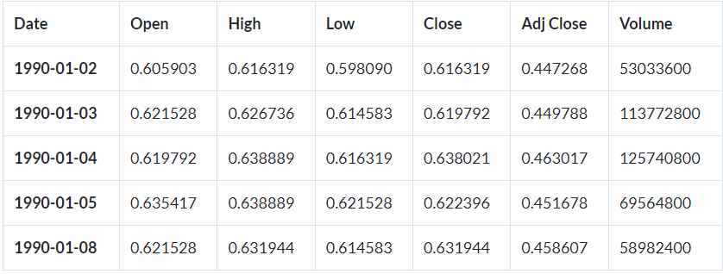
#Print the shape of Dataframe and Check for Null Values
print(“Dataframe Shape: “, df. shape)
print(“Null Value Present: “, df.IsNull().values.any())
Output:
>> Dataframe Shape: (7334, 6)
>>Null Value Present: False

Slide 7
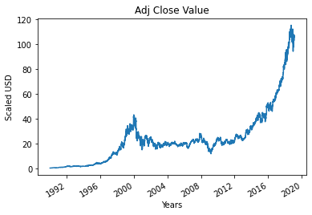
Step 4: Plotting the True Adjusted Close Value
The Adjusted Close Value is the final output value that will be forecasted using the Machine Learning model. This figure indicates the stock’s closing price on that particular day of stock market trading.
#Plot the True Adj Close Value
df[‘Adj Close’].plot()

Slide 8
Step 5: Setting the Target Variable and Selecting the Features
The output column is then assigned to the target variable in the following step. It is the adjusted relative value of Microsoft Stock in this situation. Furthermore, we pick the features that serve as the independent variable to the target variable (dependent variable). We choose four characteristics to account for training purposes:
Open
High
Low
Volume
#Set Target Variable
output_var = PD.DataFrame(df[‘Adj Close’])
#Selecting the Features
features = [‘Open’, ‘High’, ‘Low’, ‘Volume’]

Slide 9
Step 6: Scaling
To decrease the computational cost of the data in the table, we will scale the stock values to values between 0 and 1. As a result, all of the data in large numbers is reduced, and therefore memory consumption is decreased. Also, because the data is not spread out in huge values, we can achieve greater precision by scaling down. To perform this, we will be using the MinMaxScaler class of the sci-kit-learn library.
#Scaling
scaler = MinMaxScaler()
feature_transform = scaler.fit_transform(df[features])
feature_transform= pd.DataFrame(columns=features, data=feature_transform, index=df.index)
feature_transform.head()

Slide 10
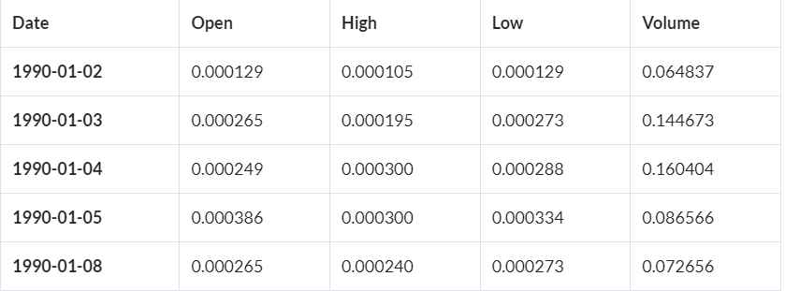
Step 7: Creating a Training Set and a Test Set for Stock Market Prediction
Before inputting the entire dataset into the training model, we need to partition it into training and test sets. The Machine Learning LSTM model will undergo training using the data in the training set, and its accuracy and backpropagation will be tested against the test set.

Slide 11
To accomplish this, we will employ the TimeSeriesSplit class from the sci-kit-learn library. We will configure the number of splits to be 10, indicating that 10% of the data will serve as the test set, while the remaining 90% will train the LSTM model.
timesplit= TimeSeriesSplit(n_splits=10)
#Splitting to Training set and Test set
for train_index, test_index in timesplit.split(feature_transform):
X_train, X_test = feature_transform[:len(train_index)], feature_transform[len(train_index): (len(train_index)+len(test_index))]
y_train, y_test = output_var[:len(train_index)].values.ravel(), output_var[len(train_index): (len(train_index)+len(test_index))].values.ravel()
Step 8: Data Processing For LSTM
Once the training and test sets are finalized, we will input the data into the LSTM model. Before we can do that, we must transform the training and test set data into a format that the LSTM model can interpret. As the LSTM needs that the data to be provided in the 3D form, we first transform the training and test data to NumPy arrays and then restructure them to match the format (Number of Samples, 1, Number of Features). Now, 6667 are the number of samples in the training set, which is 90% of 7334, and the number of features is 4. Therefore, the training set is reshaped to reflect this (6667, 1, 4). Likewise, the test set is reshaped.

Slide 12
#Process the data for LSTM
trainX =np.array(X_train)
testX =np.array(X_test)
X_train = trainX.reshape(X_train.shape[0], 1, X_train.shape[1])
X_test = testX.reshape(X_test.shape[0], 1, X_test.shape[1])
Step 9: Building the LSTM Model for Stock Market Prediction
Finally, we arrive at the point when we construct the LSTM Model. In this step, we’ll build a Sequential Keras model with one LSTM layer. The LSTM layer has 32 units and is followed by one Dense Layer of one neuron.
We compile the model using Adam Optimizer and the Mean Squared Error as the loss function. For an LSTM model, this is the most preferred combination. The model is plotted and presented below.

Slide 13
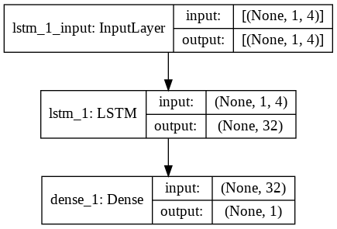
#Building the LSTM Model
lstm = Sequential()
lstm.add(LSTM(32, input_shape=(1, trainX.shape[1]), activation=’relu’, return_sequences=False))
lstm.add(Dense(1))
lstm.compile(loss=’mean_squared_error’, optimizer=’adam’)
plot_model(lstm, show_shapes=True, show_layer_names=True)

Slide 14
Step 10: Training the Stock Market Prediction Model
Finally, we use the fit function to train the LSTM model created above on the training data for 100 epochs with a batch size of 8.
#Model Training
history=lstm.fit(X_train, y_train, epochs=100, batch_size=8, verbose=1, shuffle=False)
Eросh 1/100
834/834 [==============================] – 3s 2ms/steр – lоss: 67.1211
Eросh 2/100
834/834 [==============================] – 1s 2ms/steр – lоss: 70.4911
Eросh 3/100
834/834 [==============================] – 1s 2ms/steр – lоss: 48.8155
Eросh 4/100

Slide 15
834/834 [==============================] – 1s 2ms/steр – lоss: 21.5447
Eросh 5/100
834/834 [==============================] – 1s 2ms/steр – lоss: 6.1709
Eросh 6/100
834/834 [==============================] – 1s 2ms/steр – lоss: 1.8726
Eросh 7/100
834/834 [==============================] – 1s 2ms/steр – lоss: 0.9380
Eросh 8/100
834/834 [==============================] – 2s 2ms/steр – lоss: 0.6566
Eросh 9/100
834/834 [==============================] – 1s 2ms/steр – lоss: 0.5369
Eросh 10/100
834/834 [==============================] – 2s 2ms/steр – lоss:

Slide 16
0.4761
.
.
.
.
Eросh 95/100
834/834 [==============================] – 1s 2ms/steр – lоss: 0.4542
Eросh 96/100
834/834 [==============================] – 2s 2ms/steр – lоss: 0.4553
Eросh 97/100
834/834 [==============================] – 1s 2ms/steр – lоss: 0.4565
Eросh 98/100
834/834 [==============================] – 1s 2ms/steр – lоss: 0.4576
Eросh 99/100
834/834 [==============================] – 1s 2ms/steр – lоss: 0.4588
Eросh 100/100
834/834 [==============================] – 1s 2ms/steр – lоss: 0.4599

Slide 17
Step 11: Making the LSTM Prediction
Now that we have our model ready, we can use it to forecast the Adjacent Close Value of the Microsoft stock by using a model trained using the LSTM network on the test set. We can accomplish this by employing simple prediction model on the LSTM model
#LSTM Prediction y_pred= lstm.predict(X_test)
Step 12: Comparing Predicted vs True Adjusted Close Value – LSTM
Finally, now that we’ve projected the values for the test set, we can display the graph to compare both Adj Close’s true values and Adj Close’s predicted value using the LSTM Machine Learning model.
#Predicted vs True Adj Close Value – LSTM
plt.plot(y_test, label=’True Value’)
plt.plot(y_pred, label=’LSTM Value’)
plt.title(“Prediction by LSTM”)
plt.xlabel(‘Time Scale’)
plt.ylabel(‘Scaled USD’)
plt.legend()
plt.show()

Slide 18
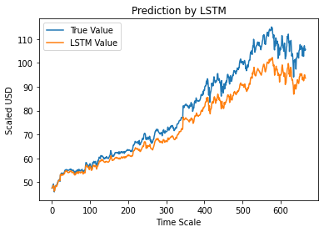
The graph above demonstrates that the extremely basic single LSTM network model created above detects some patterns. We may get a more accurate depiction of every specific company’s stock value by fine-tuning many parameters and adding more LSTM layers to the model.

Slide 19
Conclusion
However, with the introduction of Machine Learning and its strong algorithms, the most recent market research and Stock Price Prediction using machine learning advancements have begun to include such approaches in analyzing stock market data. The Opening Value of the stock, the Highest and Lowest values of that stock on the same day, as well as the Closing Value at the end of the day are all indicated for each date. Furthermore, the total volume of the stocks in the market is provided; with this information, it is up to the job of a Machine Learning Data Scientist to look at the data and develop different algorithms that may help in finding appropriate stocks values.
Predicting the stock market was a time-consuming and laborious procedure a few years or even a decade ago. However, with the application of machine learning for stock market forecasts, the procedure has become much simpler. Machine learning not only saves time and resources but also outperforms people in terms of performance. it will always prefer to use a trained computer algorithm since it will advise you based only on facts, numbers, and data and will not factor in emotions or prejudice. It would be interesting to incorporate sentiment analysis on news & social media regarding the stock market in general, as well as a given stock of interest.

