Slide 1
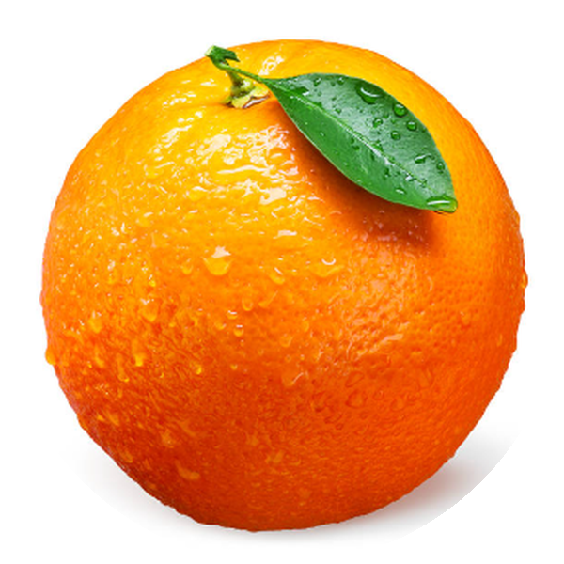
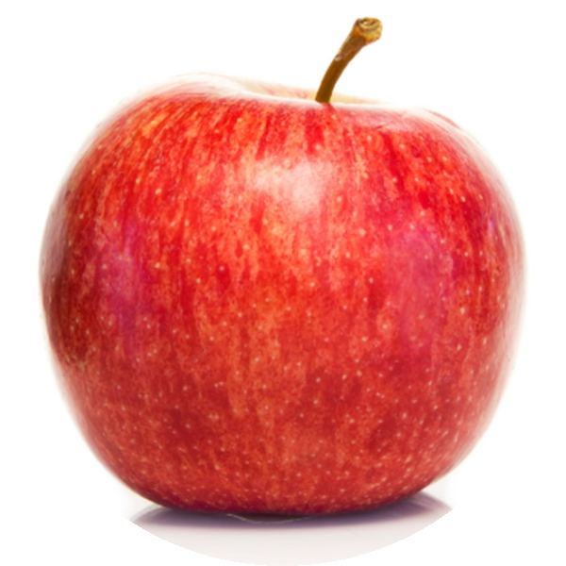
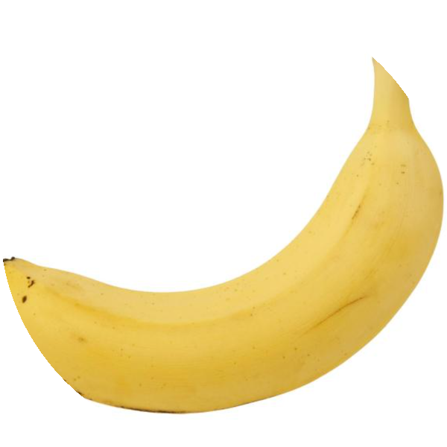
Fruit Classifier Web Application
ACADEMIC PROJECT REPORT
A deep learning model, a Streamlit web app and a PostgreSQL database, deployed online
Name: Ndongozi Chris Arsene
Reg Num: 26RP00610
Notes:
Introduce yourself and the project: a web application that recognises five fruits from a photo, with user accounts and a PostgreSQL database, deployed online with GitHub and Streamlit Community Cloud.

Slide 2



Project overview and objectives
Identifying fruit from a photo is a common task in sorting, retail and agriculture. This project turns a trained deep learning model into a complete web application that anyone can use from a browser, with user accounts and a database behind it.
Classify fruit photos
Upload a photo or use the camera and get the fruit name with a confidence score.
Store users and results
Accounts, predictions and admin actions are saved in PostgreSQL.
Fruits recognised
Apple
Banana
Mango
Manage everything as admin
Orange
Strawberry
A dashboard to view statistics, filter data and manage users.
Notes:
Identifying fruit from a photo is useful in retail, sorting and agriculture. The goal was to take a trained deep learning model and build a complete, usable product around it: accounts, a database and an admin dashboard.

Slide 3





System architecture
User (browser)
photo
Streamlit web app
save / read
PostgreSQL (Neon)
Signs in, uploads a photo
Python + YOLOv8s-cls model
Users, predictions, audit log
runs
GitHub repository
deploys
Streamlit Cloud
Secrets stay outside the code
Code and trained model
Hosts and runs the app
Database address and admin login are kept in Streamlit secrets
Notes:
The user works in a browser. The Streamlit app runs the model and talks to PostgreSQL hosted on Neon. The code lives on GitHub and Streamlit Community Cloud runs it. Secrets such as the database address are kept in Streamlit secrets, not in the code.

Slide 4


Dataset and model training
Dataset
Training setup
Kaggle fruit images, 5 classes: apple, banana, mango, orange, strawberry
1,500 training images (300 per fruit)
500 test images (100 per fruit)
One folder per fruit; varied photos: crates, bunches, cut fruit, plants, drawings
YOLOv8s-cls, pretrained, fine-tuned for 40 epochs
224 px images, batch size 32, AdamW optimizer (learning rate 0.001)
Augmentation: colour changes, rotation, scale, flips, random erasing
Google Colab, Tesla T4 GPU, about 6 minutes
Notes:
The model is a YOLOv8s classification network, pretrained and then fine-tuned on a Kaggle fruit image dataset with five classes. Training took about six minutes on a free Tesla T4 GPU in Google Colab.

Slide 5
Model results
93.8%
top-1 accuracy on 500 test images
1.5 ms
inference time per image on GPU
10 MB
size of the trained model file
Accuracy was measured on the same 500 images used to choose the best epoch, so accuracy on completely new photos may be slightly lower.
Notes:
The classifier reached 93.8 percent top-1 accuracy on the 500 test images. Accuracy rose quickly in the first few epochs and then levelled off around 93 percent. An important honesty point: the same 500 images were used to pick the best epoch, so accuracy on completely new photos may be a little lower.

Slide 6
Web application features
For users
For administrators
Create an account and sign in
Upload a photo or use the camera
See the fruit name, the confidence and all five probabilities
A "not sure" warning below 60% confidence
Personal history of past predictions
Statistics and charts: users, predictions, confidence
Browse, filter, export (CSV) and delete predictions
Manage users: roles, deactivate, reset password, delete
Read-only database browser
Audit log of every admin action
Notes:
There are two kinds of accounts. Users can classify photos and see their own history. Administrators additionally get a dashboard with statistics, data management and an audit log.

Slide 7
PostgreSQL database design
users
predictions
audit_logs
id
username
email
password_hash
role (user / admin)
is_active
failed_attempts
locked_until
created_at, last_login
id
user_id → users.id
filename
predicted_label
confidence
probabilities (JSON)
image_thumb
created_at
id
admin_id
admin_username
action
detail
created_at
One user has many predictions. Deleting a user also deletes their predictions.
Notes:
Three tables: users, predictions and audit_logs. Each prediction belongs to one user, and deleting a user also deletes their predictions. Passwords are stored only as bcrypt hashes.

Slide 8





Security and reliability
Hashed passwords
Account lockout
Role checks
bcrypt hashes only; plain passwords are never stored.
5 failed sign-ins lock the account for 15 minutes.
Roles are re-checked on every page load, so a deactivated user loses access at once.
Secrets outside the code
Read-only database browser
Audit log
Database address and admin login live in Streamlit secrets; .env is ignored by Git.
Admins can view tables but not password hashes or edit rows.
Deletions, role changes and password resets are recorded.
Notes:
Security was built in from the start: hashed passwords, account lockout, role checks on every page load, secrets outside the code, a read-only database browser that hides password hashes, and an audit log.

Slide 9
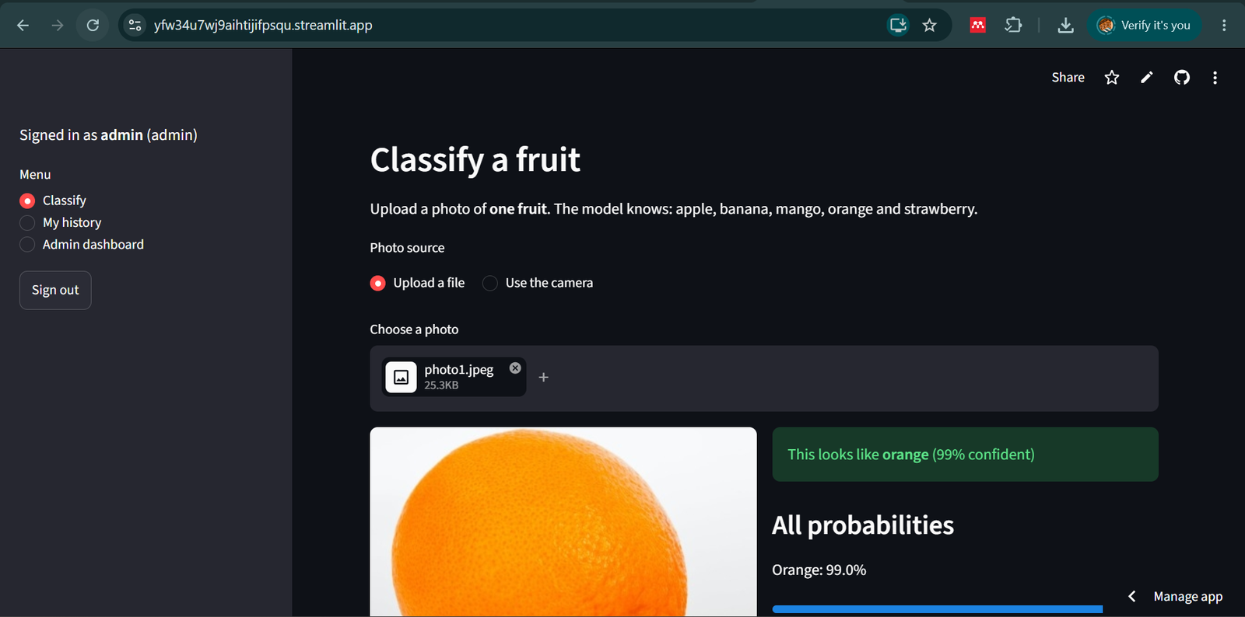
The deployed web interface
Figure 1. Classify page on Streamlit Community Cloud: signed in as admin, uploading photo1.jpeg
Notes:
This is the live application on Streamlit Community Cloud. The sidebar shows the signed-in user and the menu; admins also see the Admin dashboard. The user picks Upload a file or Use the camera, and the result appears next to the photo.

Slide 10
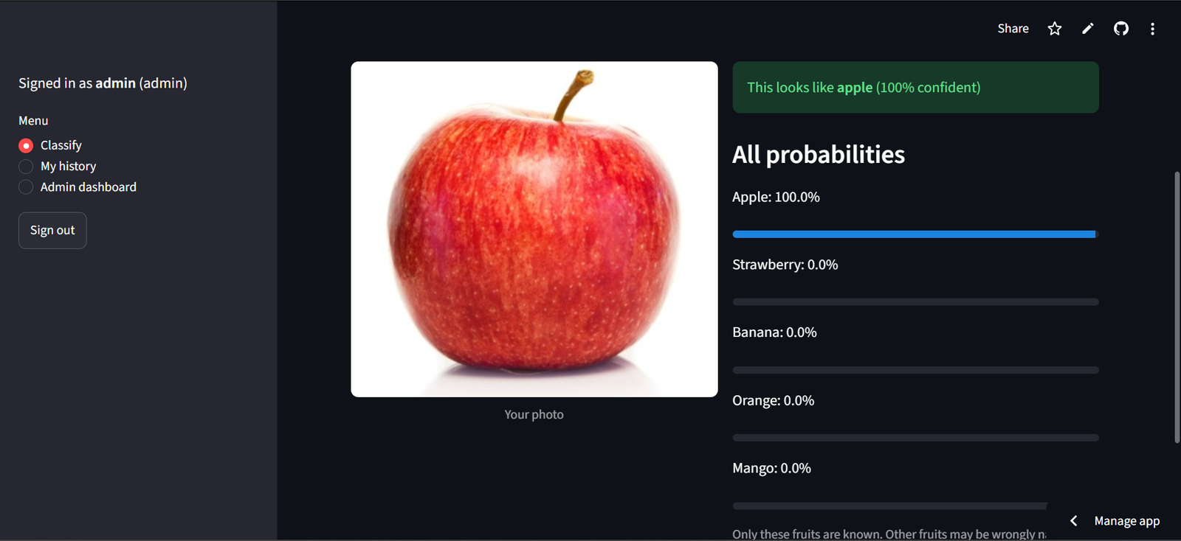

Prediction test: Apple
Predicted fruit
Apple
Confidence
100%
Next most likely
strawberry 0.0%
Correct
Figure 2. Apple photo classified as apple
The model gives a probability for each of the five fruits. The highest one is shown as the prediction.
Notes:
The apple photo was classified correctly with 100% confidence. The panel on the right lists the probability of every class; the second most likely fruit was strawberry 0.0%.

Slide 11
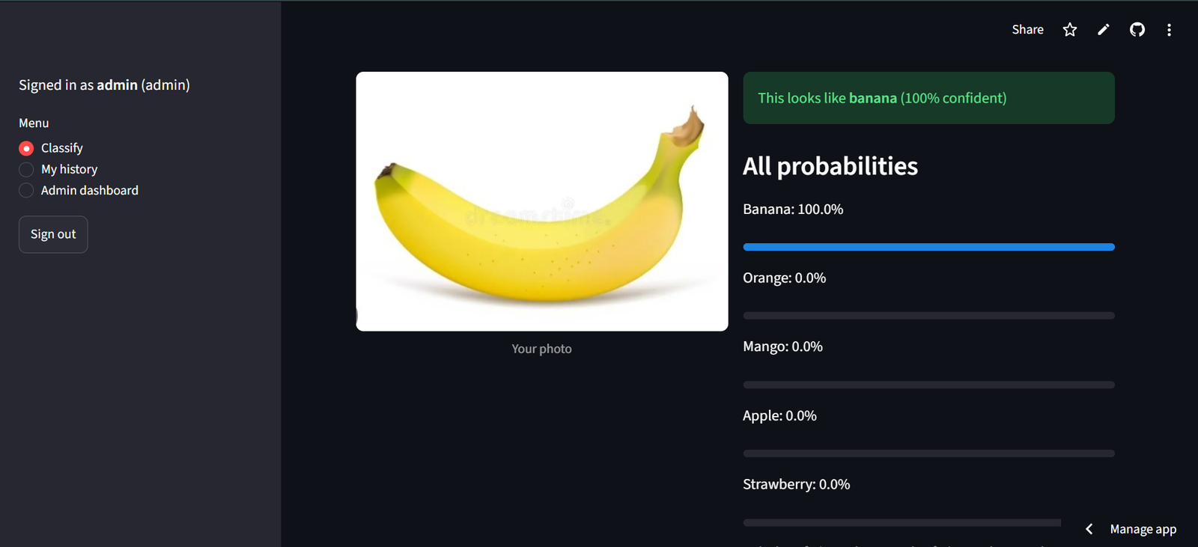
Prediction test: Banana
Predicted fruit
Banana
Confidence
100%
Next most likely
orange 0.0%
Correct
Figure 3. Banana photo classified as banana
The model gives a probability for each of the five fruits. The highest one is shown as the prediction.
Notes:
The banana photo was classified correctly with 100% confidence. The panel on the right lists the probability of every class; the second most likely fruit was orange 0.0%.

Slide 12
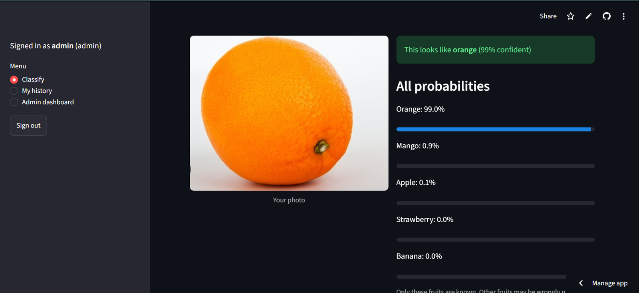
Prediction test: Orange
Predicted fruit
Orange
Confidence
99%
Next most likely
mango 0.9%
Correct
Figure 4. Orange photo classified as orange
The model gives a probability for each of the five fruits. The highest one is shown as the prediction.
Notes:
The orange photo was classified correctly with 99% confidence. The panel on the right lists the probability of every class; the second most likely fruit was mango 0.9%.

Slide 13
Deployment and challenges solved
Problem | Solution
The first Kaggle dataset had no box labels, so the detector could not be retrained | Switched from detection to classification and used a labelled 5-fruit dataset
Windows blocked port 5432 for the Docker database | Mapped the database to port 15432
App crashed on Streamlit Cloud while loading OpenCV | Added packages.txt with libgl1 and libglib2.0-0
Streamlit Cloud has no database of its own | Used a hosted Neon PostgreSQL and Streamlit secrets
Code on GitHub
1
App, model and settings pushed to the repository
Database on Neon
2
Free PostgreSQL, US East region
Streamlit Cloud
3
Builds and runs the app; secrets hold the database address
Notes:
The app is deployed from GitHub to Streamlit Community Cloud with a free Neon PostgreSQL database. Several real problems came up along the way and each was fixed: a dataset without box labels, a blocked Windows port, a missing system library on the cloud and the need for an external database.

Slide 14


Limitations and future work
Limitations
Future work
Only 5 fruits; other fruits are named as one of them
One fruit per photo; no boxes around several fruits
Accuracy measured on the same images used to choose the best epoch
Photos are stored in the database, so users must be told
More fruits and more varied photos, including an "unknown" class
Object detection to find several fruits in one photo
Test on fresh, unseen photos before claiming final accuracy
Mobile app (Android) and password reset by email
Notes:
Being honest about limits is part of good engineering. The model knows only five fruits and one fruit per photo, and its accuracy was measured on the same images used to choose the best epoch. Future work addresses each limit.

Slide 15



Conclusion
A working product
A public web app that names five fruits from a photo in about a second.
Good accuracy
93.8% top-1 accuracy on 500 test images, up from the 73.8% mAP@50 of the inherited detector (different metric).
A complete system
User accounts, PostgreSQL storage, an admin dashboard and online deployment.
Notes:
To conclude: the project delivered a working, public web application that classifies five fruits with 93.8 percent test accuracy, with accounts, a PostgreSQL database and an admin dashboard, deployed online.

Slide 16


Reflection: experience and skills gained
Experience gained
Skills gained
Turned a colleague's trained model into a complete product
Learned that the dataset format decides the method: labels without boxes cannot train a detector
Solved real deployment problems: blocked ports, missing libraries, secrets
Learned to keep passwords out of GitHub and screenshots
Deep learning: YOLOv8 classification, training and evaluation in Colab
Python web development with Streamlit
PostgreSQL, SQLAlchemy, authentication and role-based access
Git and GitHub, Docker, Streamlit Cloud and Neon
Troubleshooting from logs and error messages
Notes:
Reflection: the biggest lesson was that the data decides the method, and that most of the real work in a project like this is connecting and deploying the pieces, not training the model. I also learned to protect secrets and to troubleshoot from logs and error messages.

Slide 17

Project links
GitHub repository
https://github.com/NdongoziChrisArsene/-Fruit-webapp
Live web application (Streamlit)
Thank you
https://yfw34u7wj9aihtijifpsqu.streamlit.app/
Name: Ndongozi Chris Arsene
Reg Num: 26RP00610
Notes:
The source code is on GitHub and the application is live on Streamlit Community Cloud. Thank you.

