Slide 1

CAPSTONE DEFENSE · DATA ANALYTICS
Advancing Circular Economy Practices in Agricultural Waste Management
A Power BI decision-support analysis across eight African countries
Kenya
Cameroon
South Africa
Rwanda
Botswana
Ghana
Congo (Dem. Rep.)
SDG 2 · SDG 8 · SDG 12 · SDG 13

Slide 2




01 Problem Statement
Agricultural waste is a visible cost with no coordinated response
Fragmented data
No investment signal
Agricultural, socioeconomic, and environmental indicators sit in separate sources (FAOSTAT, World Bank, ILOSTAT, UNEP) with no shared view.
Policymakers and investors lack a way to see where waste, unemployment, and emissions overlap enough to justify capital.
Post-harvest blind spot
Insight locked in spreadsheets
Conversations focus on production volumes, while losses concentrated in storage, handling, and logistics go largely unmeasured.
Existing analysis is static and technical, inaccessible to non-technical decision-makers who need to act on it quickly.
Advancing Circular Economy Practices in Agricultural Waste Management
2

Slide 3




02 Project Objectives
What this capstone set out to do — and delivered
Quantify waste and food loss
Measure agricultural waste and post-harvest food loss by country and by crop across the full dataset.
Integrate socioeconomic indicators
Combine waste data with unemployment and emissions indicators to reveal where impact overlaps.
Identify priority regions
Pinpoint the regions where circular economy interventions can deliver the greatest impact.
Communicate through Power BI
Deliver insights via an interactive dashboard built for non-technical policymakers and investors.
Status: all four objectives from the original proposal were successfully implemented in the final build.
Advancing Circular Economy Practices in Agricultural Waste Management
3

Slide 4
03 Proposed Solution
A structured analytical pipeline, from raw data to decision-support dashboard
01
02
03
04
05
Data Preparation
Descriptive Analysis
Socioeconomic Correlation
Comparative Country Analysis
Power BI Dashboard
Standardize units, harmonize country codes, remove duplicates, handle missing values, align years
Baseline production volumes, food loss quantities, and crop-level waste contributions
Link waste indicators to unemployment and food-system emissions
Standardized cross-country metrics to prioritize interventions with evidence
Interactive, filterable decision-support tool for non-technical stakeholders
All four proposal objectives were carried through to completion in the final Power BI build.
Advancing Circular Economy Practices in Agricultural Waste Management
4

Slide 5


04 Technology Stack
Built on two complementary tools, each doing what it does best
Python
Power BI
Cleaning & wrangling
Modeling & visualization
Standardized units and country codes, removed duplicates, imputed or excluded missing values, and reshaped data for time-aligned comparisons.
Built the data model, DAX measures, and the interactive dashboard: KPI cards, comparative charts, and filter controls for country, crop, and indicator.
Advancing Circular Economy Practices in Agricultural Waste Management
5

Slide 6

05 AI Integration
AI accelerated the workflow; analyst judgment shaped every conclusion
Where AI assisted the analysis
Data cleaning scripts — Drafted and refined Python/SQL routines for unit standardization, country-name harmonization, and missing-value handling.
DAX & query generation — Assisted in writing Power BI DAX measures and M queries for KPI cards and cross-filtered visuals.
Pattern-to-narrative drafting — Helped translate visual patterns in the dashboard into first-draft written findings, later reviewed and edited by the team.
Documentation & QA — Supported report structuring, consistency checks, and this presentation's narrative and design.
Guardrail: every AI-assisted output — code, DAX, or narrative text — was reviewed and validated against the source data before inclusion.
Advancing Circular Economy Practices in Agricultural Waste Management
6

Slide 7
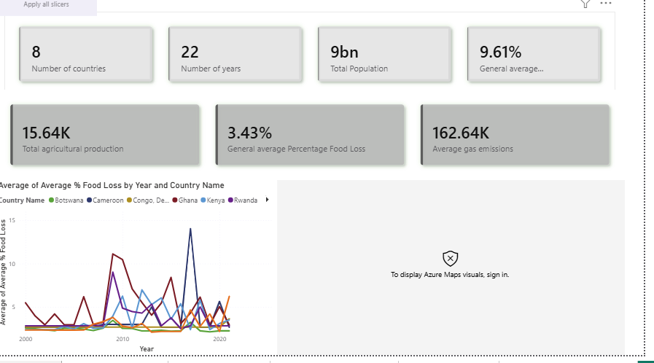
06 Project Demonstration
Insight 1 — Waste concentration is uneven across countries
Objective addressed: quantify agricultural waste and post-harvest food loss by country and crop
8
countries
3.43%
avg. food loss
15.64K
avg. production
What it shows
Countries with similar production volumes show very different average % food loss over the same 22 years — pointing to gaps in post-harvest handling and storage, not farming output, as the driver.
Dashboard: Country Overview Page
Advancing Circular Economy Practices in Agricultural Waste Management
7

Slide 8
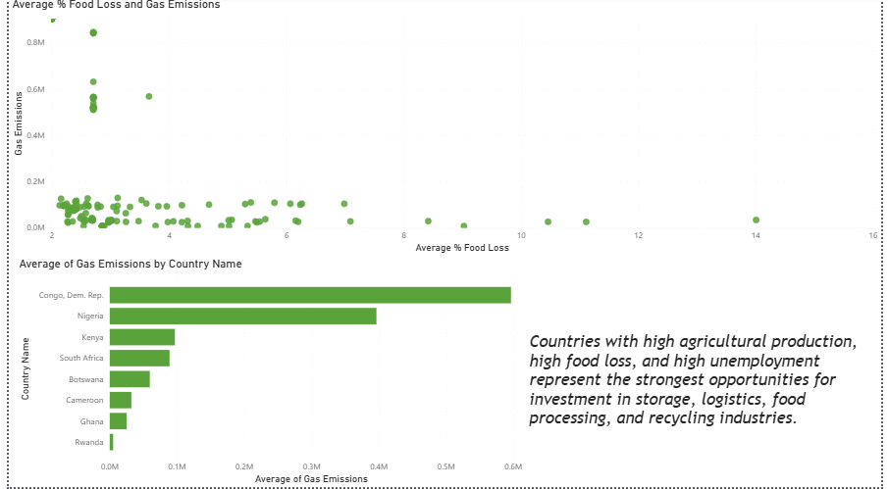

07 Project Demonstration
Insight 2 — Waste, emissions, and labor pressure overlap
Objective addressed: integrate socioeconomic indicators (unemployment, poverty, emissions) with waste data
What it shows
Congo (Dem. Rep.) and Nigeria dominate average gas emissions (~0.59M and ~0.39M), far above the rest of the cohort — and these same countries show elevated unemployment and poverty indicators.
Dashboard-generated insight
Countries with high agricultural production, high food loss, and high unemployment represent the strongest opportunities for investment in storage, logistics, food processing, and recycling industries.
Dashboard: Food Loss & Emissions Page
Advancing Circular Economy Practices in Agricultural Waste Management
8

Slide 9
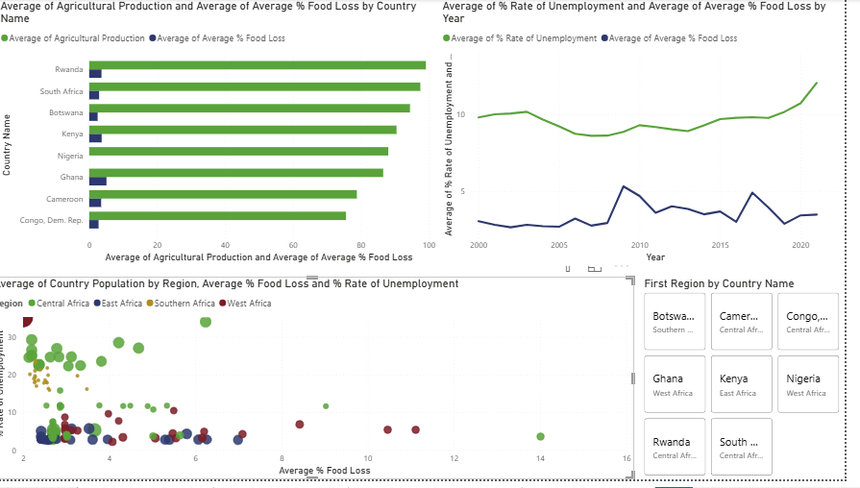
07 Project Demonstration
Insight 3 — Loss concentrates at post-harvest storage, in a few crops
Objective addressed: identify regions and supply-chain stages where interventions can deliver maximum impact
Post-harvest, the costliest stage
~26% average food loss — over 1.5× the next stage (retail, ~15%).
Storage tops the activity list
Highest cumulative loss (~3.8K), ahead of drying/harvest and transportation.
A handful of crops dominate losses
Papayas (~48%), watermelons, strawberries, and cattle sit far above grains and legumes.
Dashboard: Supply Chain Stage & Commodity Page
Advancing Circular Economy Practices in Agricultural Waste Management
9

Slide 10
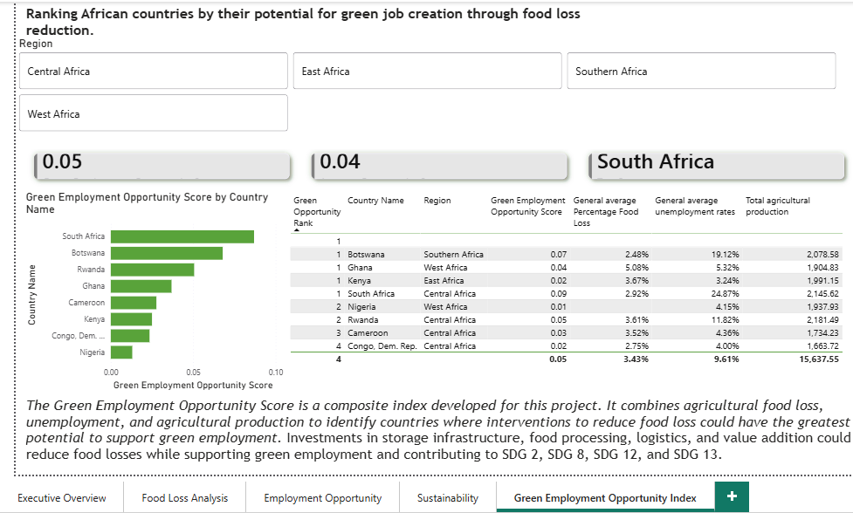
07 Project Demonstration
Insight 4 — A composite index ranks countries by green job potential
Objective addressed: synthesize waste, unemployment, and production data into a single, rankable investment-priority metric
What it shows
South Africa ranks highest on the Green Employment Opportunity Score (~0.09), followed by Botswana, Rwanda, and Ghana — countries combining relatively high food loss and unemployment with strong agricultural production.
Dashboard-generated insight
The Green Employment Opportunity Score is a composite index developed for this project. It combines agricultural food loss, unemployment, and agricultural production to identify countries where interventions to reduce food loss could have the greatest potential to support green employment. Investments in storage infrastructure, food processing, logistics, and value addition could reduce food losses while supporting green employment and contributing to SDG 2, SDG 8, SDG 12, and SDG 13.
Dashboard: Green Employment Opportunity Index Page
Advancing Circular Economy Practices in Agricultural Waste Management
10

Slide 11

08 Implications
What the findings mean for policy and investment
Target waste-to-value investment
Fix storage and post-harvest handling first
Prioritize capital toward high-waste, high-unemployment countries such as Congo (Dem. Rep.), Nigeria, and Ghana, where circular economy interventions can create jobs and reduce loss simultaneously.
Since post-harvest and storage activities account for the largest share of loss, storage infrastructure and cold-chain investment offer the highest-leverage intervention point.
Treat waste conversion as climate action
Operationalize the dashboard
Diverting organic waste into biogas, animal feed, or compost pathways directly reduces food-system emissions, linking circular economy work to SDG 13 commitments.
Use the Power BI dashboard as a living monitoring tool — updated as new FAOSTAT/World Bank data arrives — to track progress and re-prioritize interventions over time.
Advancing Circular Economy Practices in Agricultural Waste Management
11

Slide 12
09 Conclusion
A reproducible, evidence-based model for circular economy prioritization
This project shows that data analytics and visualization can turn scattered agricultural, employment, and emissions data into a single decision-support tool. The Power BI dashboard is the final analytical artifact: a scalable, reusable model for identifying where circular economy investment will do the most good — for people, for the climate, and for economic growth.
Final scope
8
countries
22
SDG 2
Zero Hunger
years
SDG 8
Decent Work & Economic Growth
4
SDG 12
Responsible Consumption & Production
SDGs aligned
SDG 13
Climate Action
1
live dashboard
Advancing Circular Economy Practices in Agricultural Waste Management
12

Slide 13
10 Team Contributions
The Women Techsters behind this capstone project (1 of 2)
S/N | Name | Women Techster ID | WT Course | Role during the Capstone Project
1 | Swiri Mercy Che | WTB/2026/5.1/2313 | Data Analysis | Group Coordinator; Data Cleaning; Power BI Dashboard Developer; Data Visualization Specialist; Prompt Engineering; Presentation Lead
2 | Gloria Ndiana Inyang | WTB/2026/5.1/0726 | Technical Project Management | Operations & Team Coordination; Data Collection; Project Publishing; Prompt Engineering
3 | Oga Flourish Oluwaseyi | WTB/2026/5.1/0122 | Technical Project Management | Report Writer
4 | Kellen Kavosa | WTB/2026/5.1/2185 | Data Analysis | Quality & Deliverables; Quality Assurance (QA) Reviewer; Data Collection; Data Cleaning Analyst; Exploratory Data Analysis (EDA) Analyst; Power BI Dashboard Developer; Data Visualization Specialist; Research; Presentation Lead
5 | Christianah Odunola Dada | WTB/2026/5.1/1323 | Data Analysis | Data Cleaning and Data collection
Advancing Circular Economy Practices in Agricultural Waste Management
13

Slide 14
11 Team Contributions
The Women Techsters behind this capstone project (2 of 2)
S/N | Name | Women Techster ID | WT Course | Role during the Capstone Project
6 | Joy Azwihangwisi Maimela | WTB/2026/5.1/1386 | Data Analysis | Data Collection; Data Cleaning; Research
7 | Onyinyechukwu Tenderly Oyeoka | WTB/2026/5.1/1863 | Data Analysis | Data Collection; Data Cleaning; Documentation Officer
8 | Oluwafikunayomi Oguntade | WTB/2026/5.1/1560 | Data Analysis | Data Collection; Data Cleaning; Research; Prompt Engineering
9 | Oguntoyinbo Esther Kanyinsola | WTB/2026/5.1/1440 | Data Analysis | Data Cleaning; Data Cleaning Analyst
10 | Namakau Nangomba | WTB/2026/5.1/1408 | Data Analysis | Data Collection; Data Cleaning; Research; Quality Assurance (QA) Reviewer
Advancing Circular Economy Practices in Agricultural Waste Management
14

Slide 15

Thank You
Questions & Discussion
Advancing Circular Economy Practices in Agricultural Waste Management
Across Selected African Countries

