Slide 1

Customer Connect Tel Churn Analysis
Presentation Analysis by Ndumbi Kimani.

Slide 2
About Connect Tel
Connect Tel is a global leader in telecommunications, providing reliable voice, data, and Internet services.
Offering mobile networks, broadband, and enterprise solutions, Connect Tel serves both individuals and businesses. Known for exceptional customer service and innovative technology, the company ensures seamless communication for millions worldwide. Through strategic partnerships and a customer-focused approach, Connect Tel drives progress in the telecom industry, helping people and businesses thrive in the digital age.
Problem Overview
ConnectTel faces a critical challenge with customer churn, threatening its growth and sustainability. The company's current retention strategies are ineffective, leading to customer losses to competitors. To address this, ConnectTel has enlisted you as a Data Scientist to develop a customer churn prediction system. By applying advanced analytics and machine learning to customer data, the goal is to accurately predict churn and implement focused retention strategies. This approach will help reduce attrition, improve customer loyalty, and maintain a competitive edge in the fast-paced telecommunications market.

Slide 4
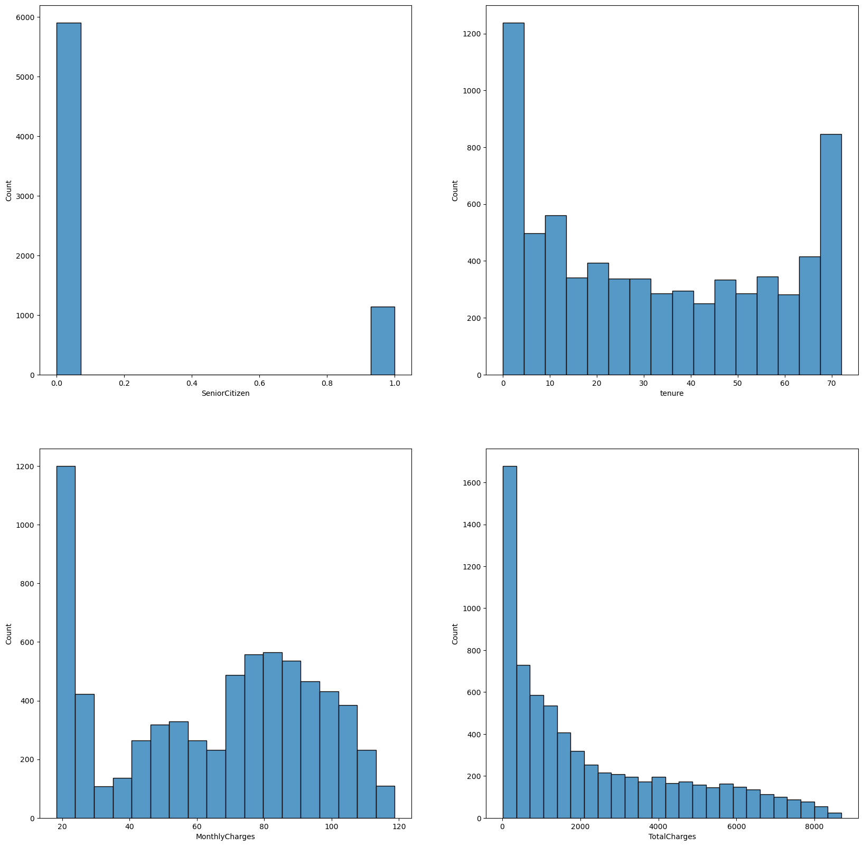
Univariate Analysis on Numerical Data
Skewed Distribution

Slide 5
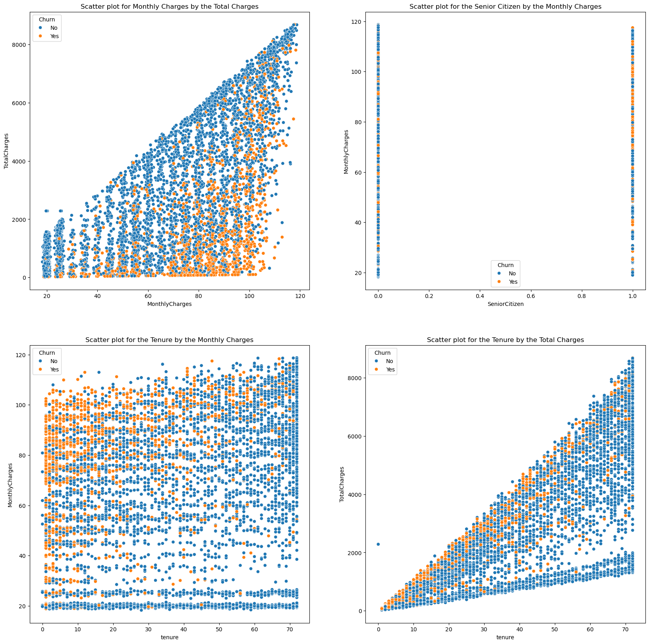
Bivariate Analysis on Numerical Data

Slide 6
Numerical EDA Analysis
Customer Demographics:
The majority of customers are non-senior citizens, with no significant difference in churn risk between senior and non-senior customers.
Tenure Patterns:
Customers tend to either leave early (low tenure) or stay long-term (high tenure), with fewer mid-tenure customers. This suggests churn happens early in customer relationships.
Customers with shorter tenure (under 20 months) and higher monthly charges are more likely to churn, indicating dissatisfaction with value early on.
Monthly Charges vs. Total Charges:
A strong linear relationship exists between Monthly Charges and Total Charges, with higher-paying customers accumulating higher total charges.
There is a higher concentration of churn among customers with higher monthly charges, suggesting dissatisfaction with the perceived value for money.
Churn Patterns:
Short-tenure customers with low Total Charges are at the highest churn risk.
Long-tenure, high-Total Charges customers are the most loyal and valuable to the company
Retention Strategies:
Target High-Paying, Short-Tenure Customers: Focus retention efforts on customers with high Monthly Charges but low tenure, who are most likely to churn.
Short-Tenure Retention: To reduce churn, implement initiatives such as improved customer service, early engagement offers, and discounts for newer customers.
Senior Citizens: Age is not a major factor in churn risk; focus strategies on more relevant churn predictors such as tenure and monthly charges rather than age.
These insights suggest a need for targeted retention plans focused on high-paying, short-tenure customers and improving early customer engagement.

Slide 7
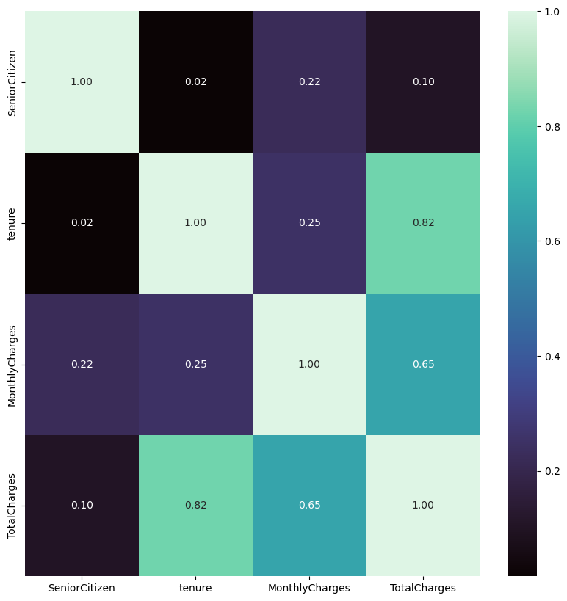
Numerical Data Coorelation
The heatmap shows a strong positive correlation between tenure and TotalCharges (0.82), indicating that long-term customers accumulate higher charges. MonthlyCharges also moderately correlate with TotalCharges (0.65), suggesting that high-paying customers contribute more over time. SeniorCitizen has minimal correlation with other variables, indicating that age has little impact on tenure or charges. This suggests age-specific retention strategies may not be necessary, while focusing on long-term and high-paying customers could be beneficial.

Slide 8
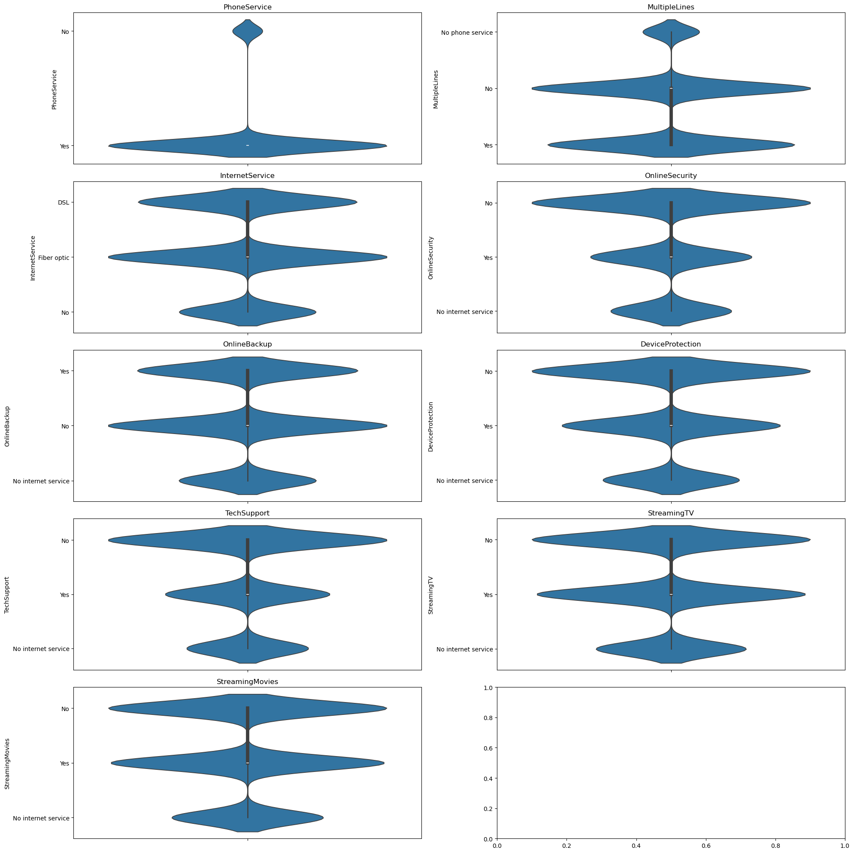
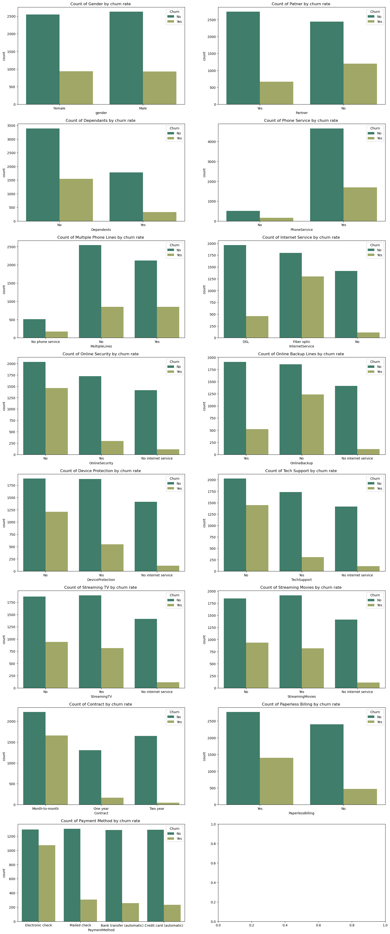
Univariate Analysis on Categorical Data

Slide 9
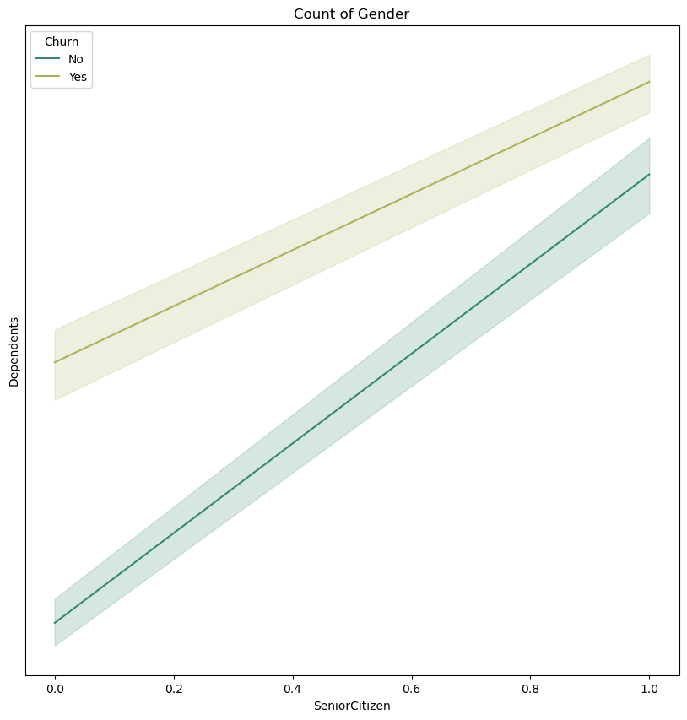
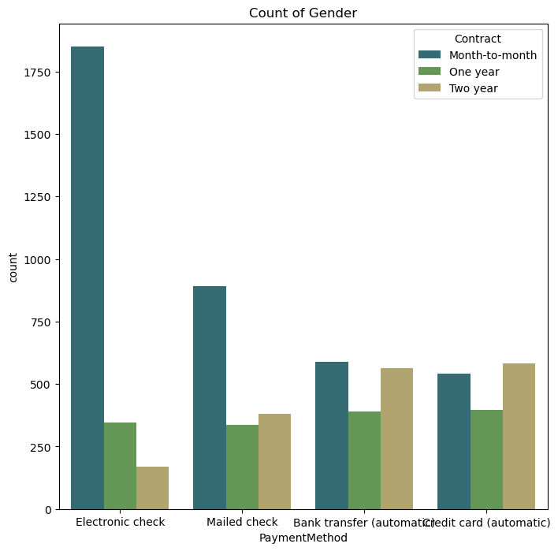
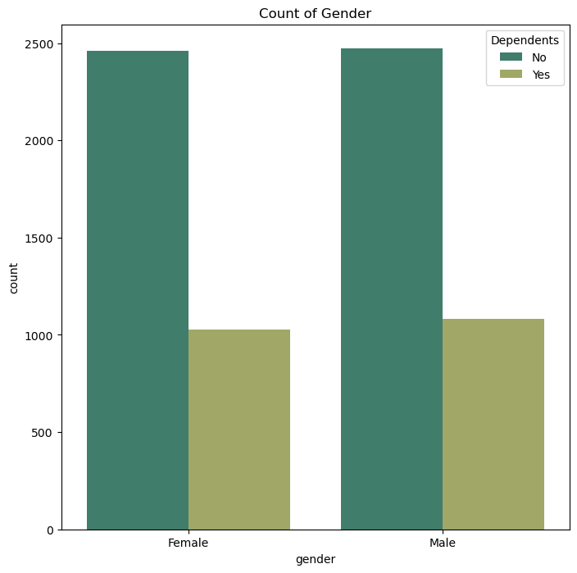
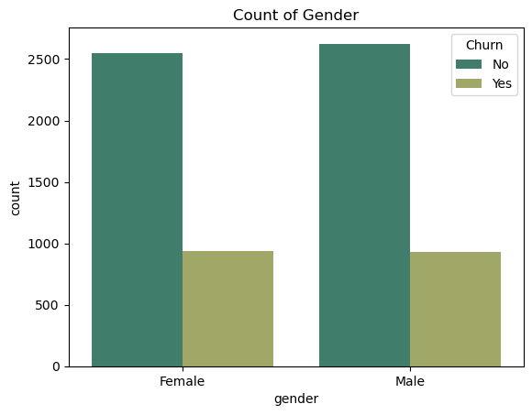
Bivariate Analysis on Categorical Data

Slide 10
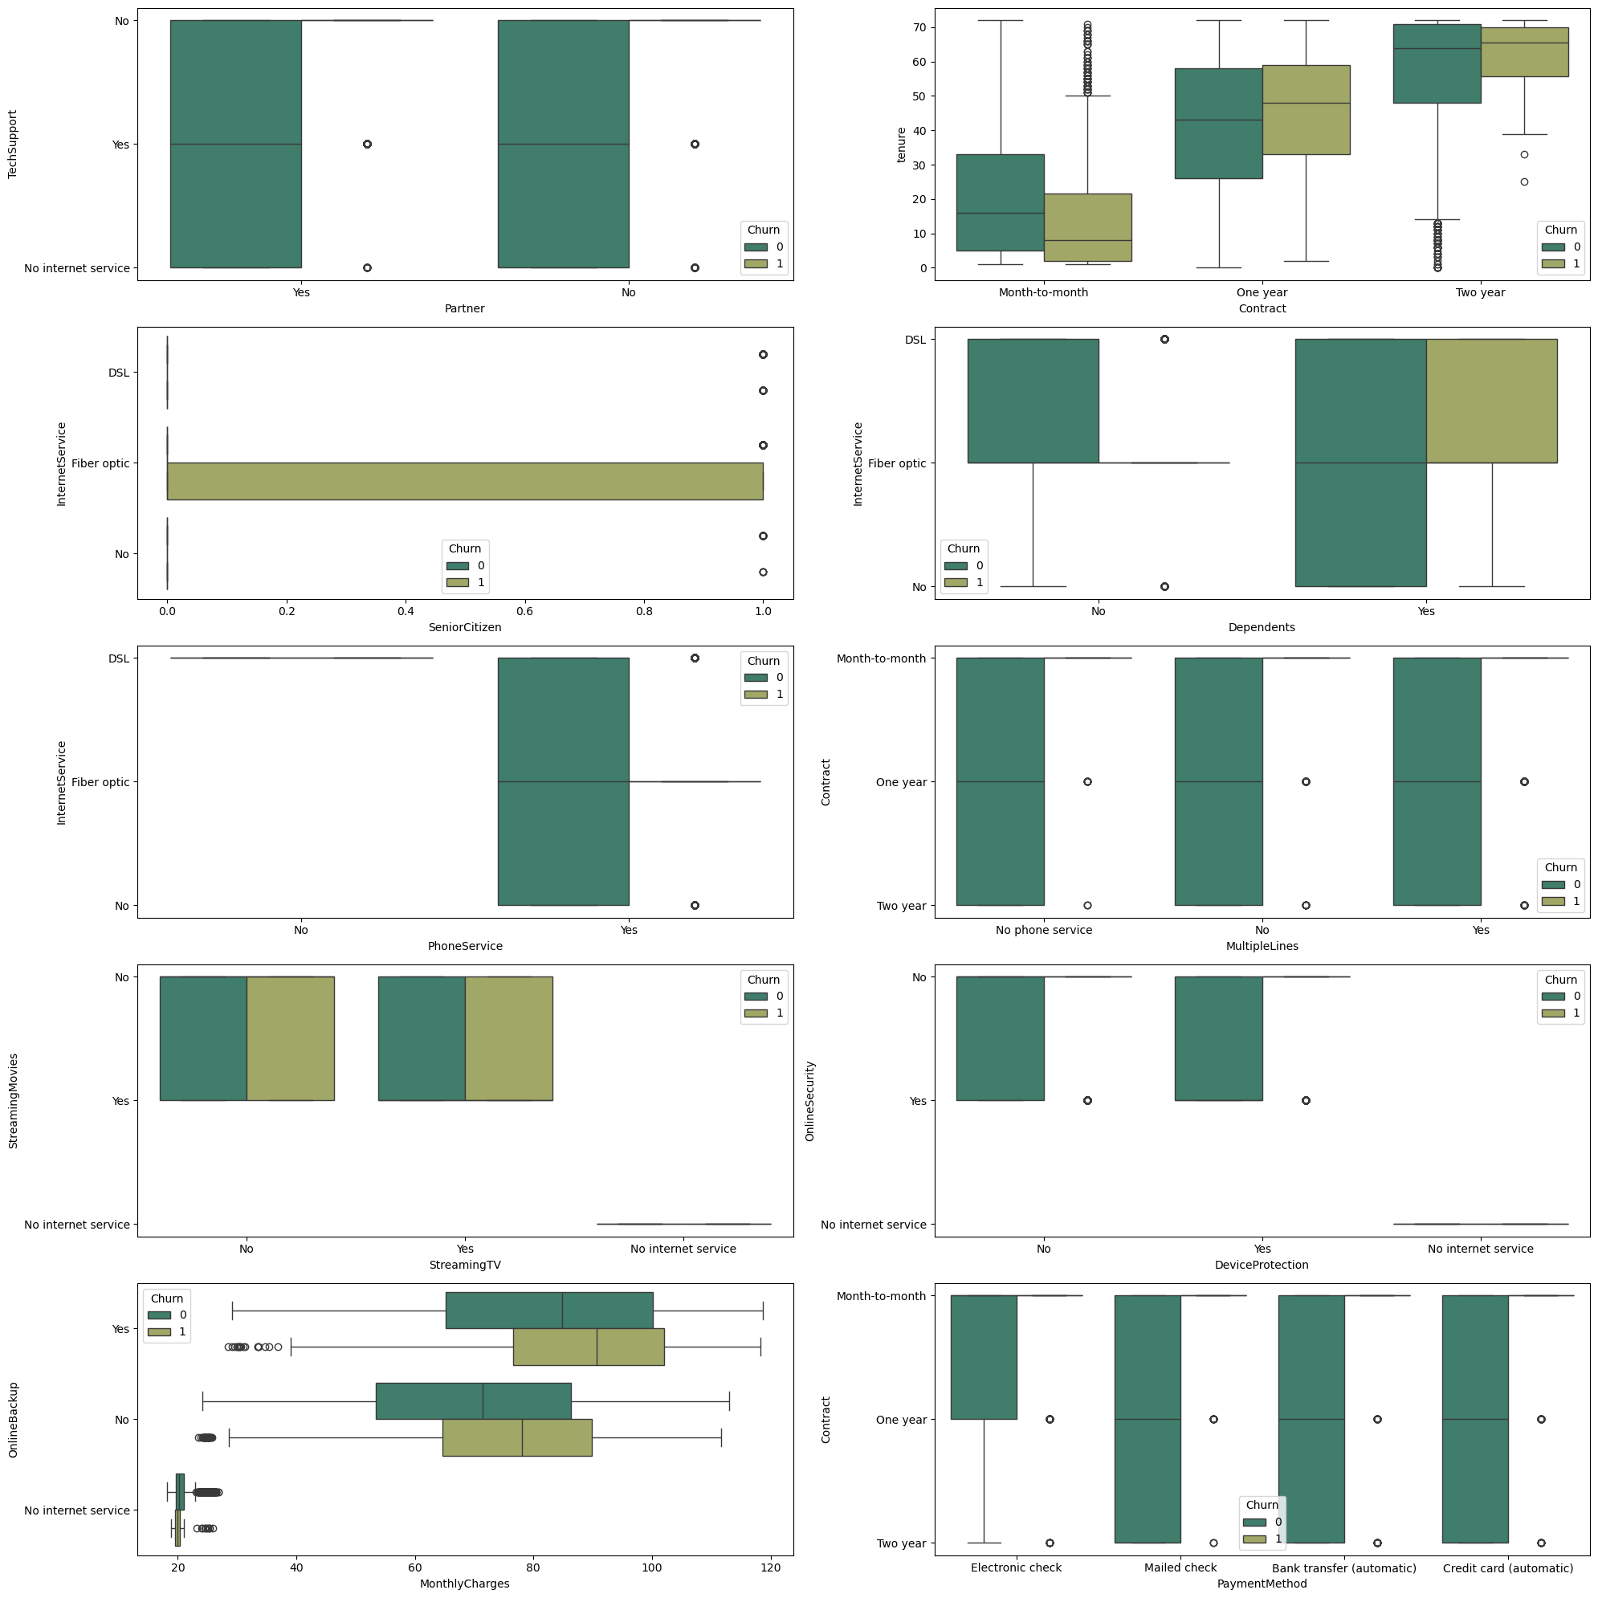
Multivariate Analysis on Categorical Data

Slide 11
Categorical EDA Analysis
Customer Demographics & Churn Patterns:
Gender: Churn rates are similar between male and female customers, so gender-specific strategies may not be necessary.
Partner & Dependents: Customers without a partner or dependents are more likely to churn, making them a key focus for retention efforts.
Service Subscription Insights:
Phone Service & Multiple Lines: Most customers have phone service, and those with multiple lines are less likely to churn. Offering discounts for adding multiple lines could increase retention.
Internet Service: Fiber optic customers show higher churn rates compared to DSL users. Retention strategies should focus on these high-value customers.
Online Services (Security, Backup, Device Protection): Customers without these services are more likely to churn. Cross-sell and upsell these services to increase retention.
Streaming Services: Customers without streaming TV or movie services are more likely to churn. Bundle these services with internet or phone plans.

Slide 12
Categorical EDA Analysis cont’d
Contract & Payment Methods:
Month-to-Month Contracts: Customers on month-to-month contracts have the highest churn rate. Focus on converting them to longer-term contracts with incentives or discounts.
Electronic Check Payments: These customers are more likely to churn compared to those using automatic payments. Promote automatic payment options (bank transfer or credit card) to reduce churn.
Cross-Selling & Bundling Opportunities:
Upsell Undersubscribed Services: Services like online security, tech support, and device protection correlate with lower churn. Bundling these services can increase customer stickiness.
Bundling Services for Single-Service Users: Customers who only use one service are more likely to churn. Offer bundled packages (phone, internet, and streaming) to increase satisfaction.
Senior Citizens:
Senior citizens, particularly on fiber optic plans, are more likely to churn. Offering simplified, affordable plans for this group can improve retention.

Slide 13
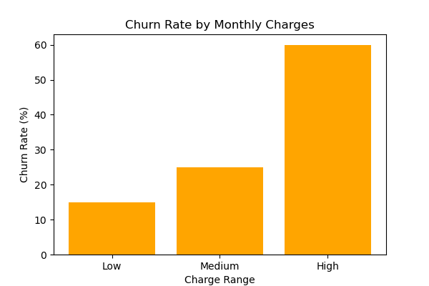
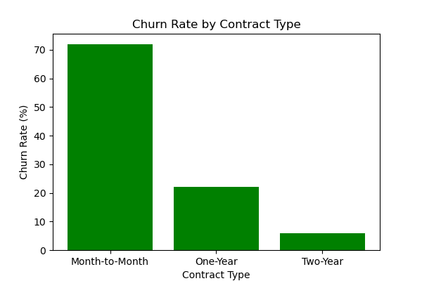
Customers with higher monthly charges are more likely to churn. Offering discounts or loyalty programs could reduce churn.
High Monthly Charges:
Customers with high monthly charges but fewer added services are more prone to churn. Offer tiered plans, discounts, or added services to retain these customers.
General Retention Strategy:
Focus on High-Risk Segments: High-paying, month-to-month customers and those on fiber optic plans or using electronic checks should be prioritized for retention efforts.
Encourage Long-Term Contracts: Offering incentives for customers to switch from month-to-month to longer-term contracts is key to reducing churn.
Customers on month-to-month contracts churn at significantly higher rates. Longer-term contracts (1-year, 2-year) show much lower churn.

Slide 14
EDA Conclusion/Recommendation
The exploratory data analysis (EDA) reveals several key factors influencing customer churn at Connect Tel. High churn rates are strongly associated with month-to-month contracts, electronic check payments, and customers without bundled services like online security, backup, or tech support. Additionally, fiber optic users and customers without partners or dependents show higher churn tendencies. Senior citizens, particularly on fiber plans, are also at higher risk.
To address these issues, Connect Tel should focus on converting month-to-month customers to longer-term contracts, upselling and cross-selling underutilized services, promoting automatic payment methods, and ohelp reduce churn, improve customer loyalty, and ensure sustained business growth.ffering targeted retention strategies for high-risk customer groups. Implementing these strategies will

Slide 15
Modelling/ML
In this analysis, we employed several machine learning classifiers to build predictive models, including:
XGB Classifier
Random Forest Classifier
K-Nearest Neighbors Classifier
Stochastic Gradient Descent (SGD) Classifier
Support Vector Classifier (SVC)
Naive Bayes (Gaussian NB)
Decision Tree Classifier
Logistic Regression
But first, we do feature engineering to split the data into features and labels then using a standard scaler we scale them to fit for best output and results .

Slide 16
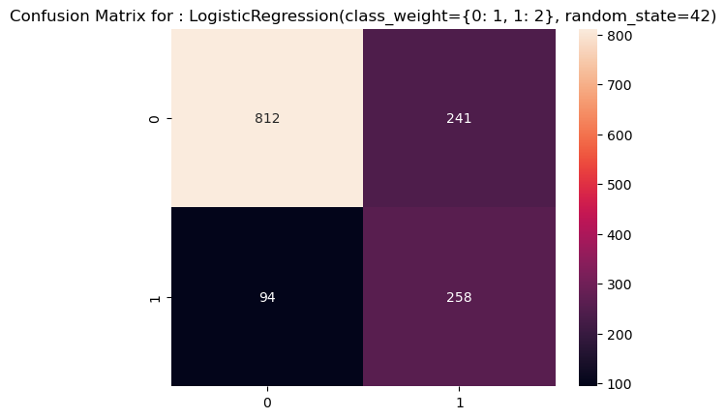
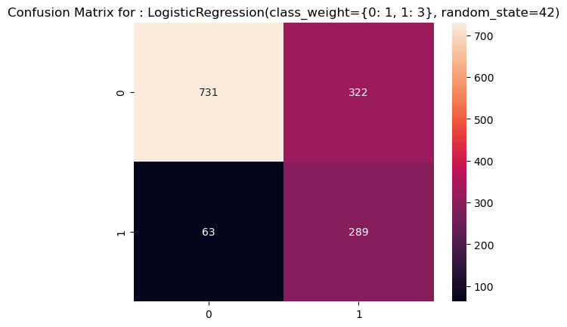
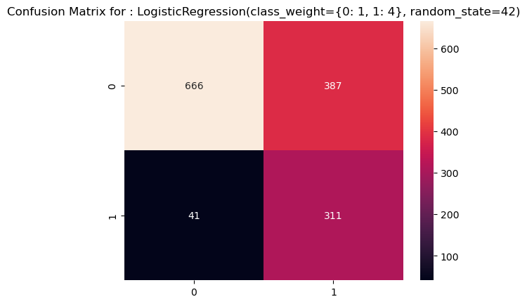
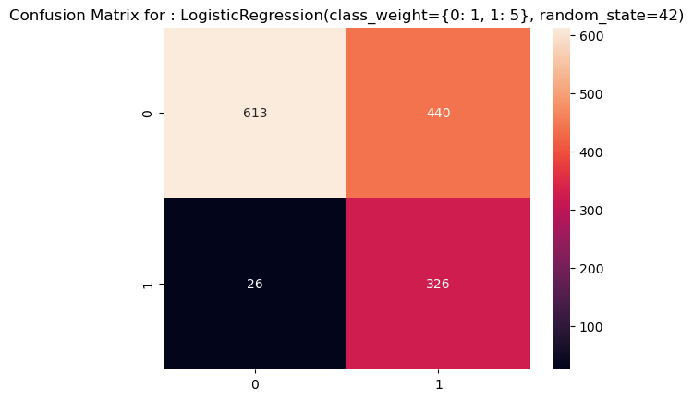
Results on Logistic Regression on different class weights . (0:1 , 1:3) Proves to be the best in balance between true positives and false positives

Slide 17
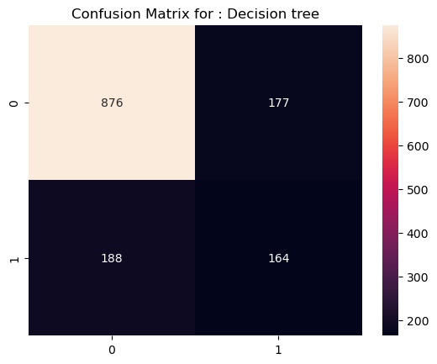

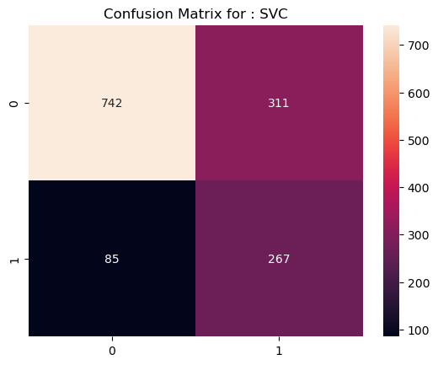
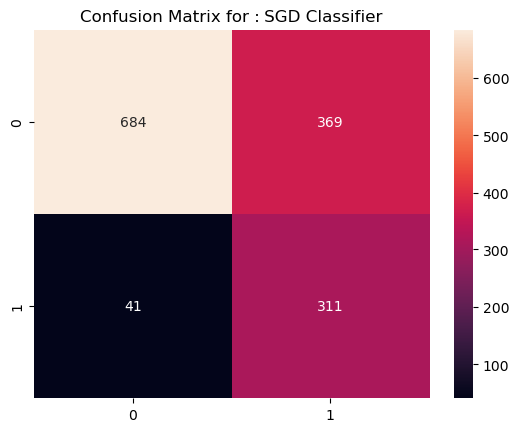
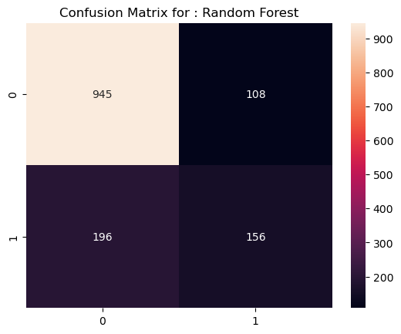
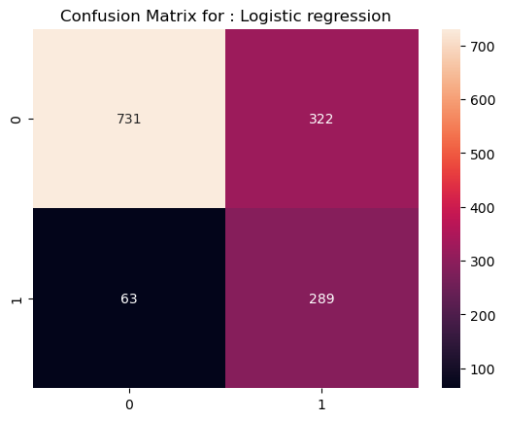
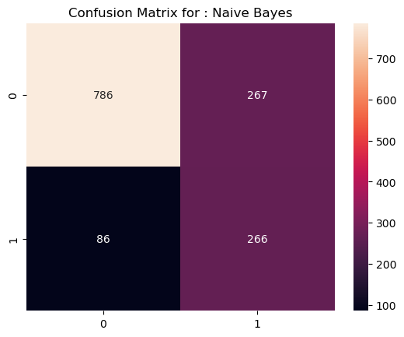

Other classifiers Fine-tuned with class weights (0:1 , 1:3)

Slide 18
Modelling Summary
Logistic Regression
Performance: By giving more weight to churners, this model becomes better at catching customers who are likely to leave. However, the downside is that it also predicts more loyal customers as churners, which means retention efforts could be wasted as we risk mistaking loyal customers as churners
XGBoost:
Performance: XGBoost has been a strong performer throughout. It’s highly accurate and misclassifies fewer customers, especially churners. The reason it works so well is that it learns from the imbalanced data, continuously improving its predictions.
Random Forest:
Performance: Random Forest is another solid performer, but it tends to miss more churners. While it’s robust, it could benefit from fine-tuning to improve its ability to identify customers at risk of churning.
K-Nearest Neighbors (KNN):
Performance: While KNN works moderately well, it misclassifies a significant number of loyal customers. This shows that KNN struggles with this particular dataset.

Slide 19
Modelling Summary cont’d
Stochastic Gradient Descent (SGD):
Performance: The model does well at identifying churners, but it comes with a cost—more false positives. In other words, it flags many loyal customers as churners, which means retention efforts could be directed at the wrong people.
Support Vector Machine (SVM):
Performance: SVM is very good at predicting when customers won’t churn, but it’s not as effective at catching everyone who will leave. It's excellent for precision, but we need more recall.
Naive Bayes:
Performance: Naive Bayes tends to be aggressive at identifying churners, but it also makes a lot of mistakes with loyal customers.
Decision Tree:
Performance: The Decision Tree provides a balanced recall but can sometimes overfit. This means it might work well in this particular dataset but may not generalize as well to new data.

Slide 20
Classifier | Precision | Recall | F1 - Score
Logistic regression | 47.30% | 82.10% | 60.02%
Stochastic Gradient Descent (SGD) Classifier | 45.73% | 88.35% | 60.27%
XGB Classifier | 53.65% | 48.01% | 50.67%
K-Nearest Neighbors Classifier | 52.26% | 52.55% | 52.40%
Support Vector Classifier (SVC) | 46.19% | 75.85% | 57.41%
Naive Bayes (Gaussian NB) | 49.90% | 75.56% | 60.11%
Decision Tree Classifier | 48.09% | 46.59% | 47.33%
Random Forest | 59.09% | 44.31% | 50.64%
Best Models: In this case ,SGD Classifier Logistic Regression with adjusted class weights are performing the best. They strike a good balance between catching churners and avoiding false alarms( Recall and Precision) with loyal customers

Slide 21
Thank you .

