Slide 1
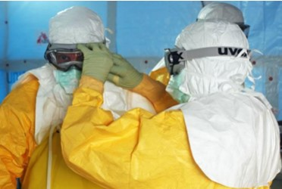
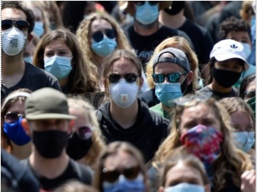
Keeping Safe & Sane in a Pandemic
Ndumiso Hlengwa 223452971

Slide 2
Did you know that Covid-19 is not the first?
Many epidemics (localised) and pandemics (world-wide)
Circa 3000 BC – an entire region of North China ravaged the population
From 430 BC to 541 AD various pandemics are recorded from Asia to Europe
The Black Death lasted from 1346 – 1353 is estimated to have wiped out over half of Europe’s population
The American plagues of the 16th century – smallpox, etc. – contributed to the collapse of the Inca & Aztec civilisations
1918-1920, the Spanish Flu pandemic rapidly spread from Russia all over the world, killing over 500 million people (did not originate in Spain!)

Slide 3
Current Pandemics
Diseases like smallpox and polio have largely been brought under control world wide, through vaccinations
The HIV/AIDS Pandemic, from 1981 to the present day, has claimed ±35 million lives, with an estimated 40 million living with HIV – 64% of these in sub-Saharan Africa – by early 2020, only 2 people cured
Ebola is still a huge threat – with the outbreak in West Africa only just under control – no cure, no vaccine
Covid-19 – still ravaging many parts of the world, with vaccines being deployed as rapidly as possible

Slide 4
Reactions to Living in a Pandemic World
Some societies have pulled together to alleviate suffering
Others are experiencing a spate of mental health issues
Foodbanks, making and distributing PPE
Causing citizens to lash out in high rates of crime & gun violence

Slide 5
World Wide Statistics
Statistics
Where | Cases | Recovered | Deaths
World | 178.2 million | 162.7 million | 3.6 million
South Africa | 1.786 million | 1.623 million | 58 323

Slide 6
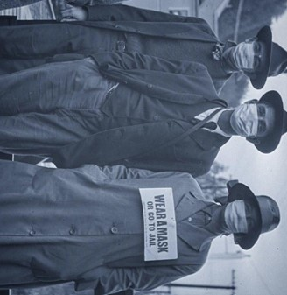
Keeping Safe …
Wearing a cloth mask or similar covering over the nose and mouth is mandatory when in public
Stay away from closed or crowded places
Keep distance of one and a half metres from others
Wash your hands regularly
Download the COVID alert SA mobile App
Register for the vaccine as soon as it becomes available to your age-group

Slide 7
WWW + V …
WEAR a mask
WASH your hands
WATCH your distance
Vax is key

Slide 8
What to do to Keep Sane
Create a schedule for work, play & rest
Developed self-discipline & stick to it
Do something that provides exercise, fresh air & happiness-e.g. gardening
Only have a small space-add planters & grow herbs for food
Have an outdoor space-grow vegetables & flowers
Notes:
Choose something you have always wanted to do from your bucket list

Slide 9
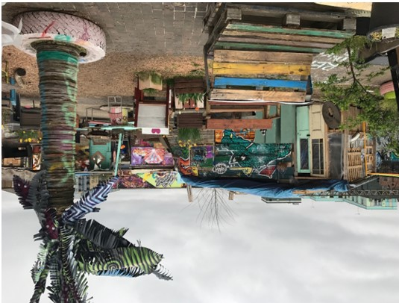
Contribute to …
Your dreams – what do you want to become?
Your family – how can you help make their lives better?
Your community – what is needed?
Your country – what can you do to make your country a better place to live in?

Slide 10
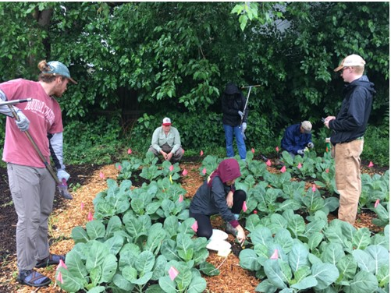
The End

Slide 11
Keeping Safe …
Wearing a cloth mask or similar covering over the nose and mouth is mandatory when in public
Stay away from closed or crowded places
Keep distance of one and a half metres from others
Wash your hands regularly
Download the COVID alert SA mobile App
Register for the vaccine as soon as it becomes available to your age-group

