Slide 1
T
Thabani
Danca
D

Slide 2



Slide 3
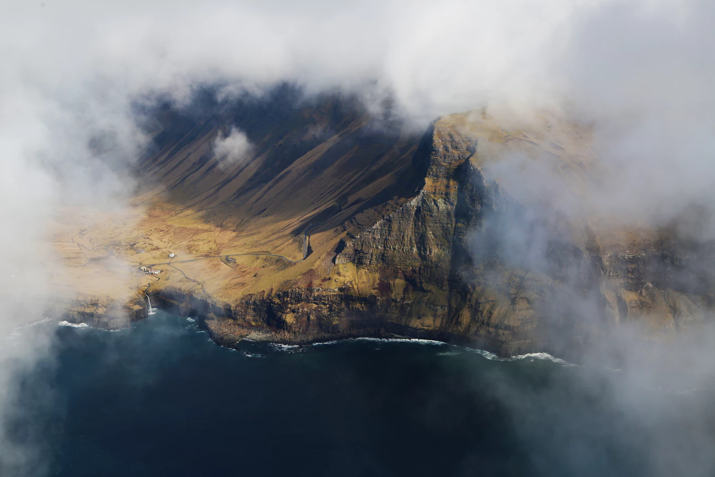
T
Thabani
Danca
D

Slide 4
Thabani
Danca

Slide 5
Thabani
Danca

Slide 6


Slide 7



