Slide 1
Assignment 1: Airline Satisfaction Analysis
By: Ezinne Ndumnwere

Slide 2
Business Problem
This project aims to identify factors that contribute to customer satisfaction and dissatisfaction and to make recommendations for improving customer satisfaction.

Slide 3
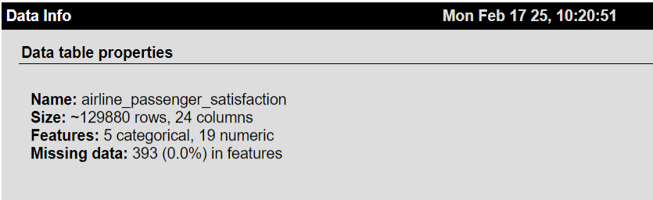
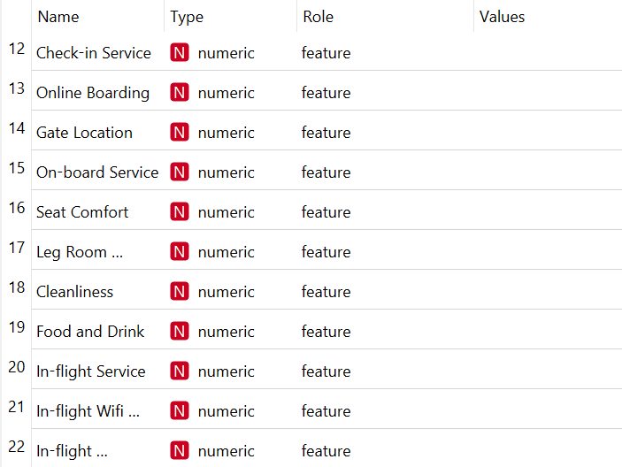
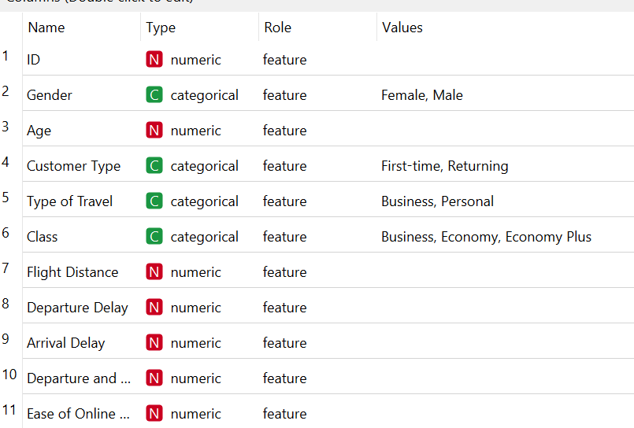

Data Information:

Slide 4
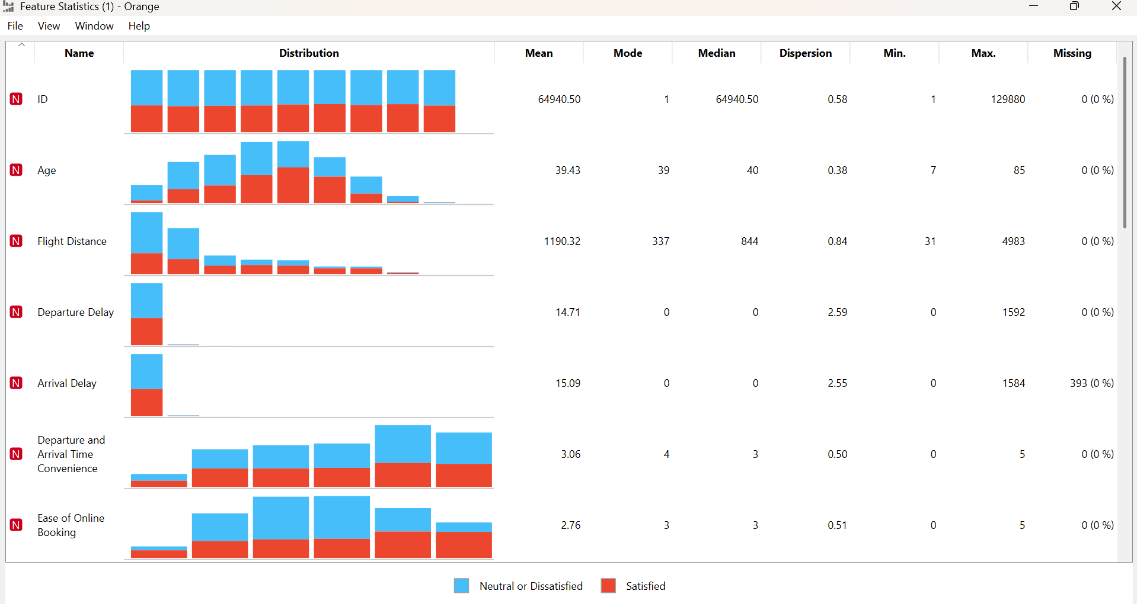
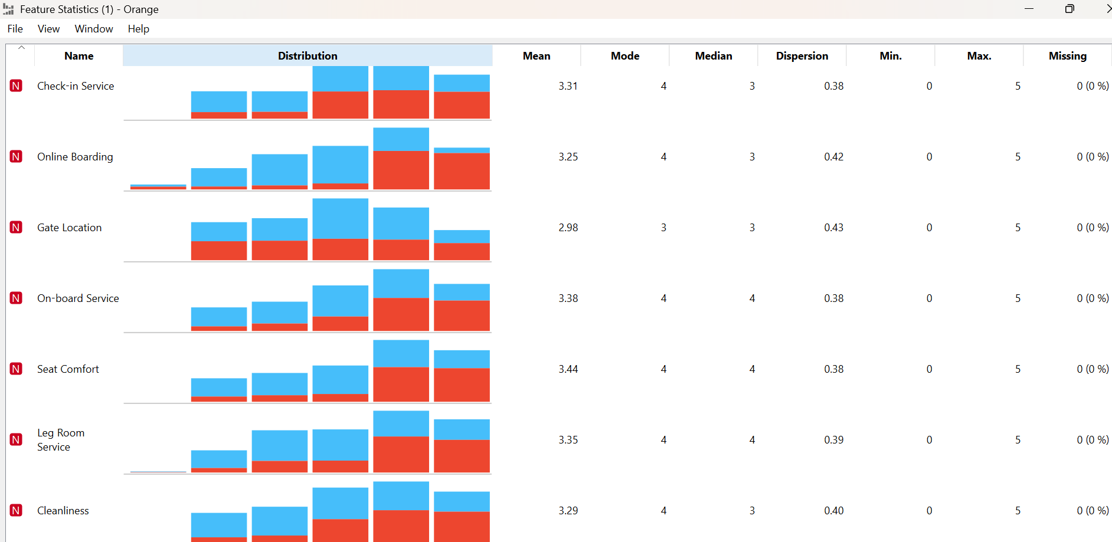
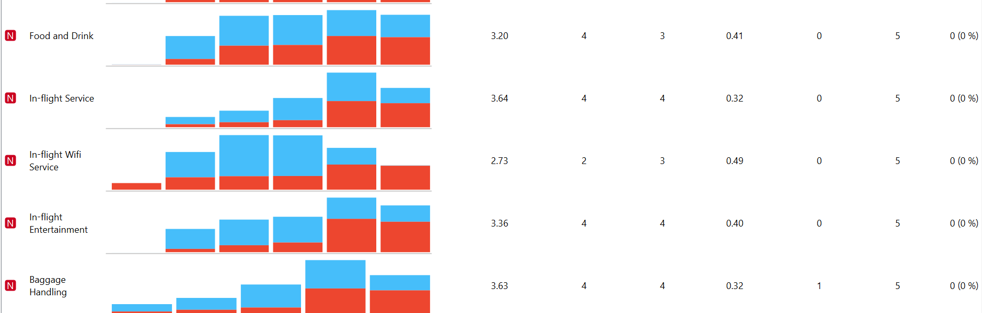
Feature Statistics Analysis- Observation for Numerical Variables
Key Observations:
Age Patterns:
Mean age is 39.43 years, so a typical passenger is around 40 years old
The low dispersion of 0.38 suggests a dominant middle age demographic.
Very few extremely young or elderly frequent flyers.
Flight Distance patterns:
The average flight distance is 1,190 miles
Many people take the shorter flights within 337miles
The longest flight distance flown by passengers is 5000miles
Flight Delays:
Most flights leave and arrive on time (0 delay)
In some extreme cases they had a delay of >24hours
Similar means for departure and arrival at (14.71,15.09) respectively
Service Ratings (on a scale of 0-5):
Highest rated: In-flight service (3.64) and baggage handling (3.63)
Lowest rated: In-flight Wifi (2.73) and ease of online booking at (2.76)
Technology based services get lower ratings than services that involve human interaction.
Most services ratings are good but not great
Delays are the most unpredictable aspect of flying.

Slide 5
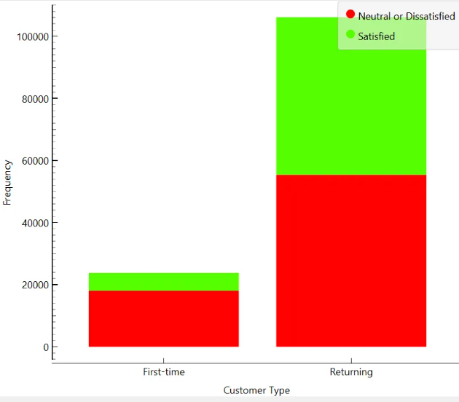
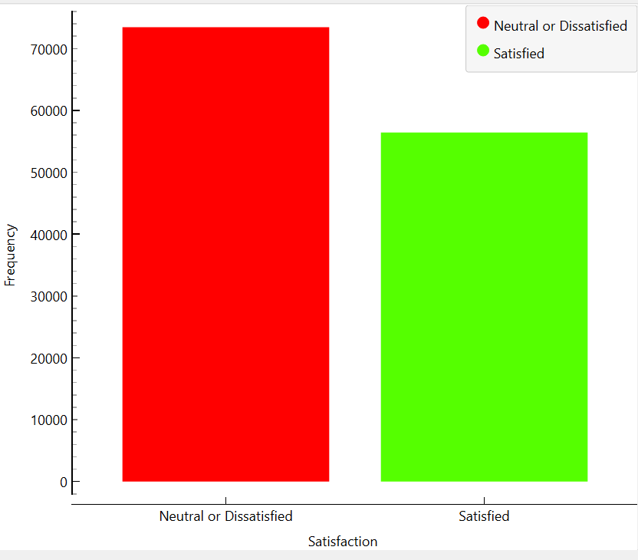
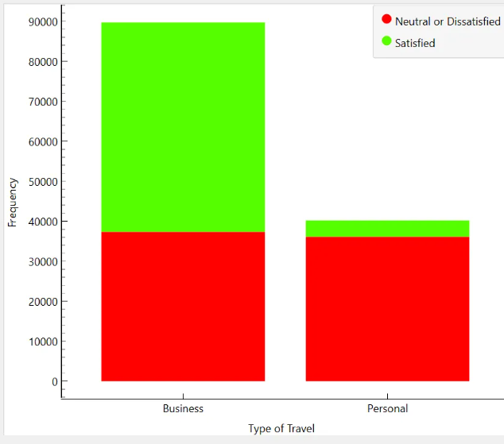
Which percentage of airline passengers are satisfied? Does it vary by customer type? What about the kind of travel?
Observations:
Business Travel passengers have a higher satisfaction rate between 55-60% satisfied
They also make up a large portion of the total travelers
They show a better satisfaction level compared to personal travel customers.
The lower satisfaction level seen in personal travelers approximately 35-40% while they are the smaller portion of the total travelers.
Clear opportunity to improve satisfaction among first-time customers and personal travelers.
Observations:
Most first-time customers have a lower satisfaction rate, around 20-25%
Returning customers have a higher satisfaction rate, between 45-50% and they make up the greater part of the airline customer base.
Observations:
The overall percentage of satisfied customers is between 43-45%
The older customers show more satisfaction levels, compared to their younger counterparts.
Both males and females show similar satisfaction patterns.

Slide 6
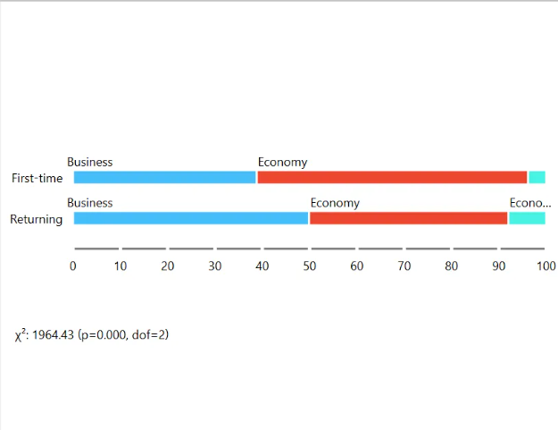
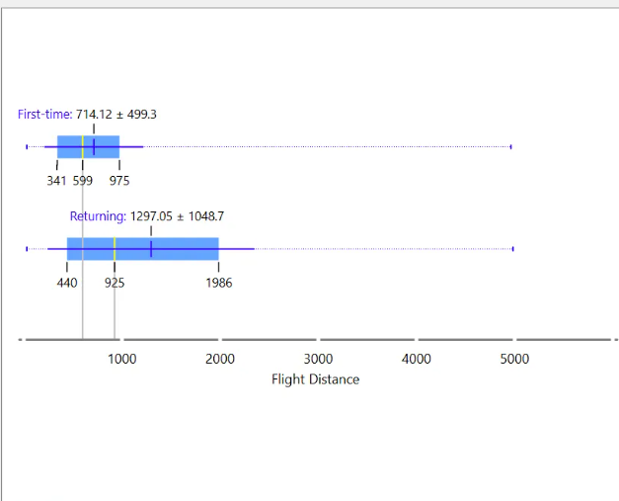
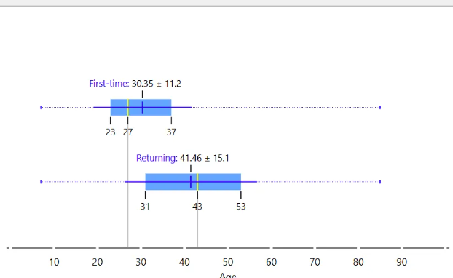
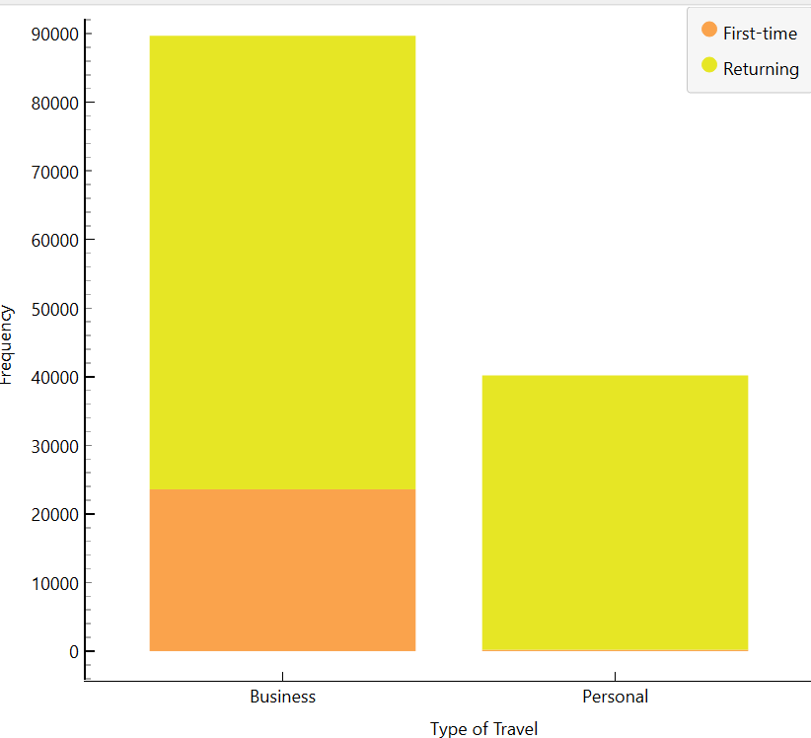
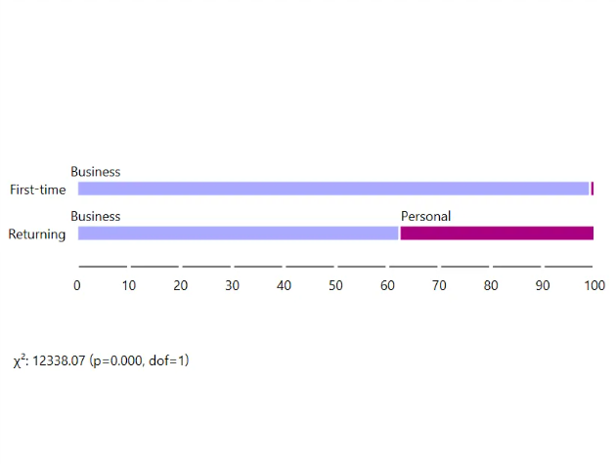
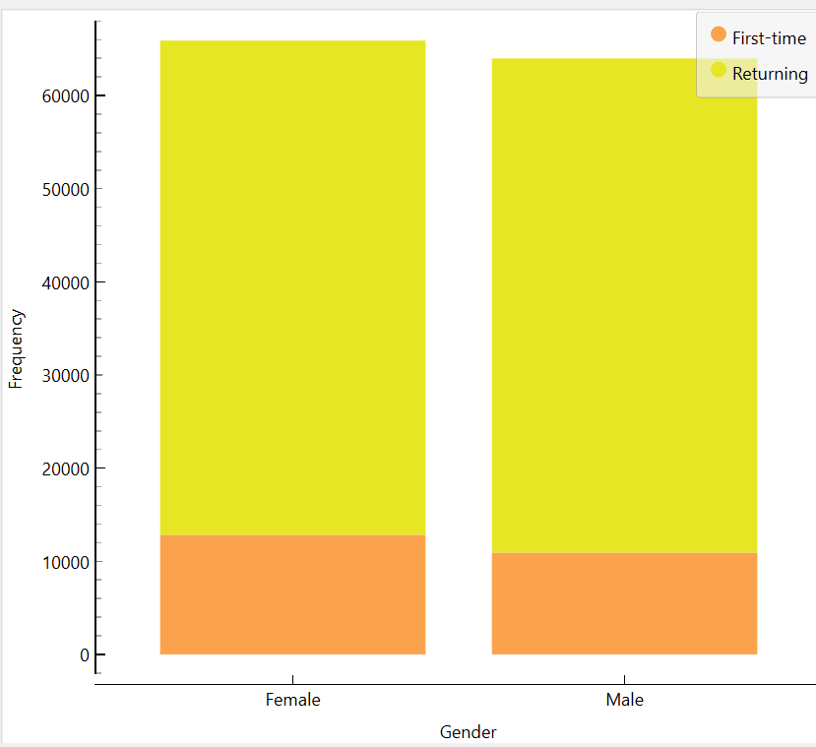
4. What is the customer profile for a repeating airline passenger?
Customer profile for most returning customers:
The repeating airline passenger is a middle-aged female, who is in her early 40s, she demonstrates strong loyalty to the airline, she flies both shorter and longer distances average being 1297.05 +- 1048.7 miles. Her travel purpose is between business and personal, but she has a stronger presence in business travels, she uses both business and Economy class depending on her immediate travel need. She is quite an experienced traveler who is very satisfied with the Services provided by the Airline.

Slide 7
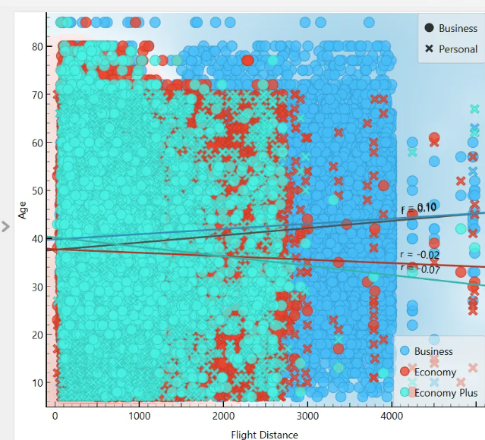
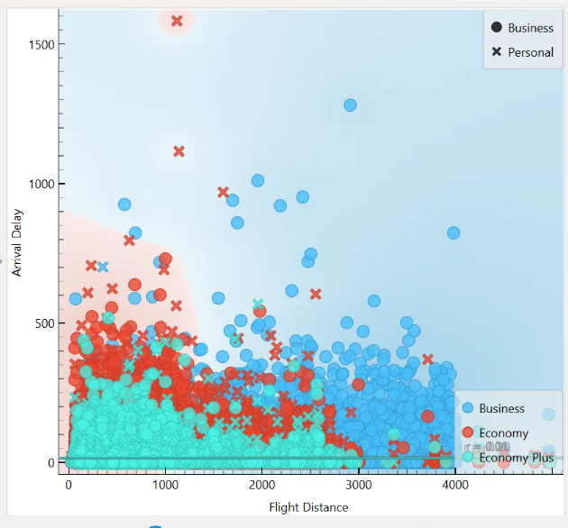
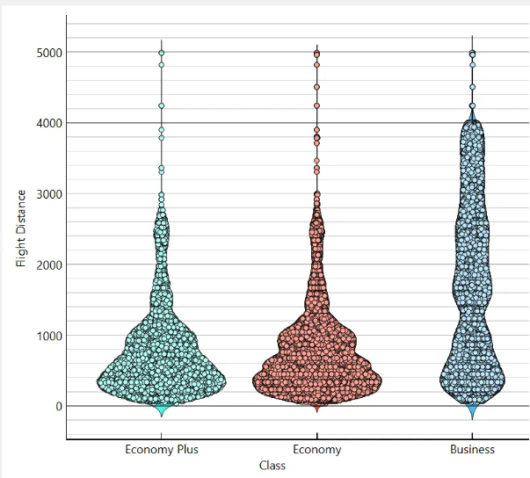
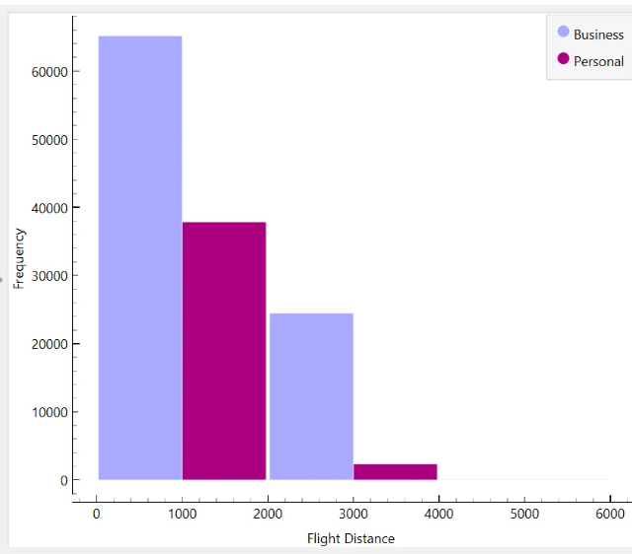
5. Does flight distance affect customer preferences or flight patterns?
1. Short-Distance Flights (0-1000 miles):
More popular with Economy and Economy Plus passengers
Higher concentration of younger travelers
mix of both business and personal travel
Medium-Distance Flights (1000-2000 miles):
Start seeing a shift toward Business class (blue dots)
balanced mix of different age groups
Strong presence of business travelers
Long-Distance Flights (2000+ miles):
Dominated by Business class travelers (blue section)
Attracts more experienced, middle-aged travelers
Mostly business travel rather than personal
Flight Distance vs Delays:
Short flights (0-1000 miles) tend to have fewer and shorter delays
Medium flights (1000-2500 miles) show moderate delays
Longer flights (2500+ miles) are more prone to delays
Most delays, regardless of distance, stay under 500 minutes
Both arrival and departure delays show similar patterns
Travel Class Preferences:
Economy class is most popular for shorter flights (under 2000 miles)
Economy Plus shows similar patterns to regular Economy
Business class dominates longer routes (2000-5000 miles)
People are more likely to upgrade to Business class for longer flights
Business vs Personal Travel
Business travelers frequently take both short and long-haul flights
Personal travelers predominantly choose shorter routes
Long-distance flights (3000+ miles) are significantly business-related
We see much less personal travel on longer routes

Slide 8
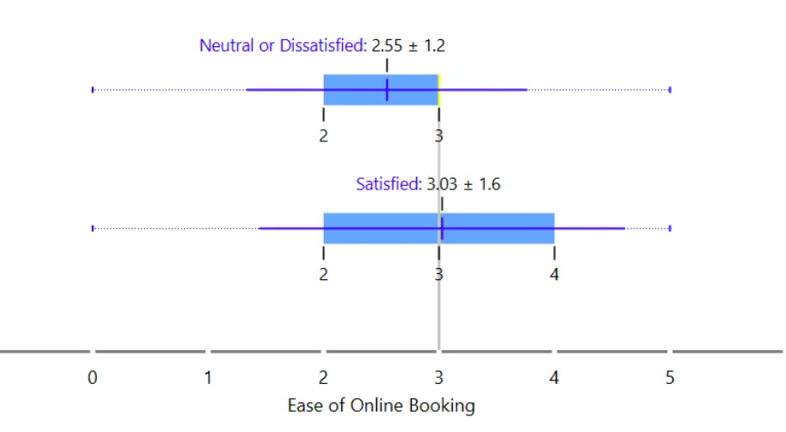
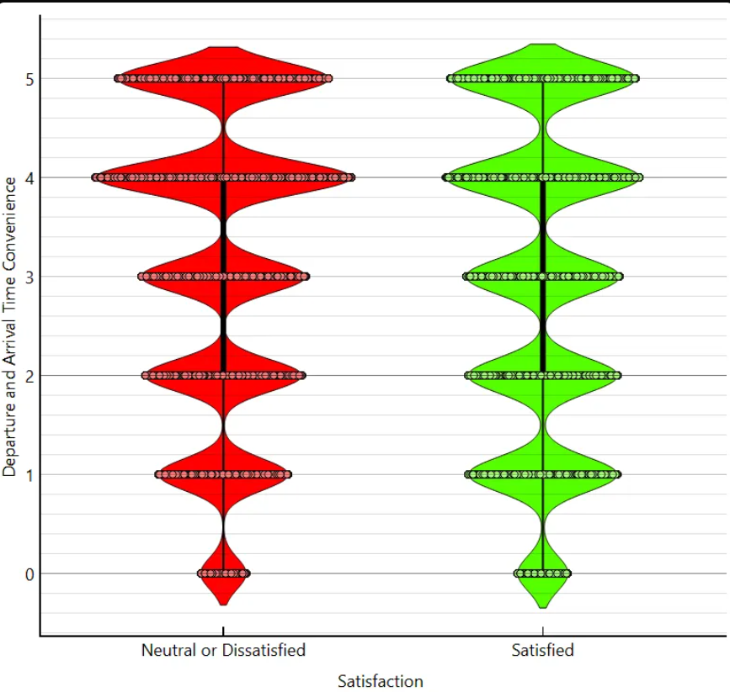
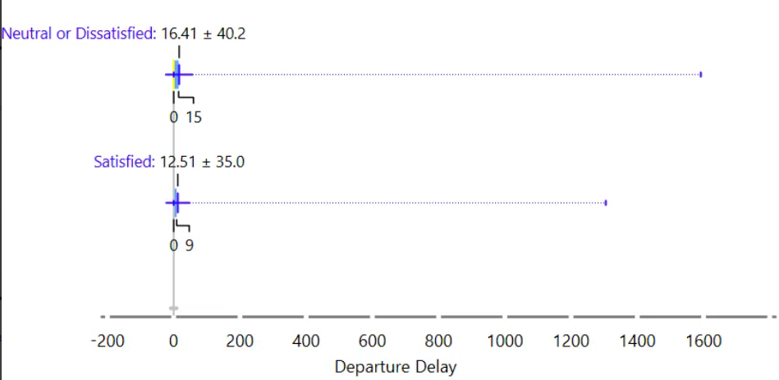
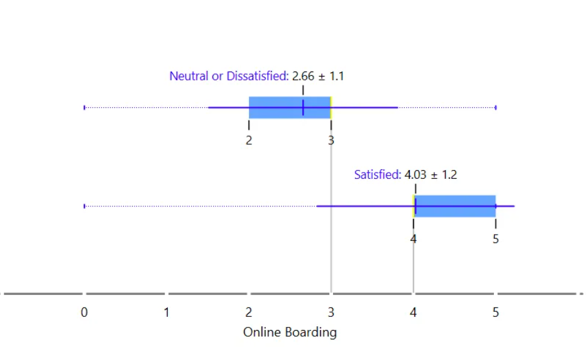
6. Which factors contribute to customer satisfaction the most? What about dissatisfaction?
In-flight Service (3.97 vs 3.39 = 0.58 difference)
High ratings from satisfied customers (nearly 4 out of 5)
Shows the impact of quality staff interactions
On-board Service (3.86 vs 3.02 = 0.84 difference)
Significant gap between satisfied and dissatisfied customers
Indicates importance of overall service quality
Major Dissatisfaction Triggers:
Flight delays (biggest pain point)
Poor booking experience
Inconvenient flight times
Online Boarding (4.03 vs 2.66 = 1.37 difference)
Satisfied customers rate it 4+ out of 5
Shows the importance of convenient, efficient boarding processes
Seat Comfort (3.97 vs 3.04 = 0.93 difference)
Satisfied customers consistently rate it nearly 4 out of 5
Physical comfort is a major driver of satisfaction

Slide 9
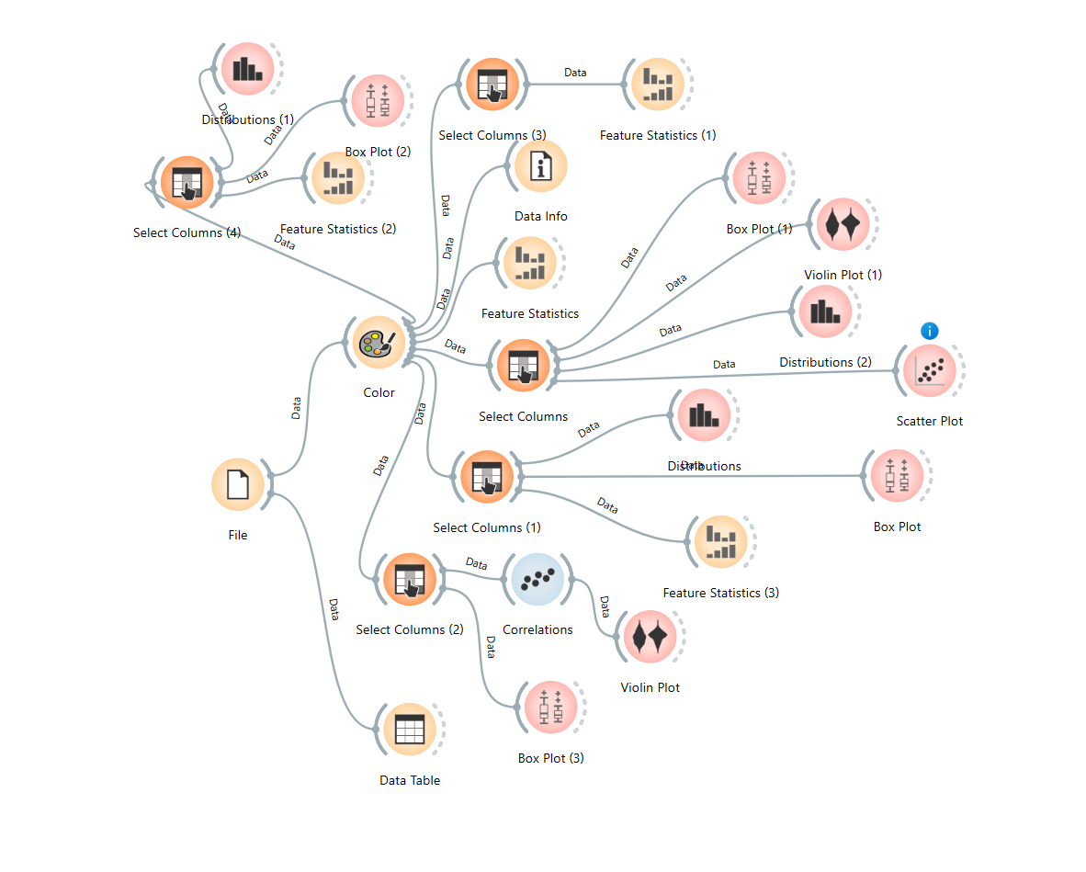
Orange workflow picture

Slide 10
Final Observations
Overall Satisfaction Levels:
Only about 43-45% of passengers are satisfied
More than half of passengers are neutral or dissatisfied
Clear opportunity for improvement in overall satisfaction
Customer Type Impact:
Returning customers (45-50% satisfied) show higher satisfaction than first-time customers (20-25% satisfied)
First-time customer experience needs significant improvement
Returning customers make up a larger portion of the customer base
Travel Purpose Influence:
Business travelers (55-60% satisfied) are more satisfied than personal travelers (35-40% satisfied)
Business travel makes up the majority of flights
. Personal travel experience needs enhancement
Age and Demographics:
Satisfied passengers tend to be older (mean age 41.74 years)
Dissatisfied passengers are younger (mean age 37.65 years)
Gender has minimal impact on satisfaction levels
Travel Distance and Service:
Satisfied customers tend to fly longer distances (mean 1529.54 units vs 929.72 for dissatisfied)
Flight delays have a significant negative impact on satisfaction
Convenience of departure/arrival times shows correlation with satisfaction
Service Quality Findings:
In-flight service (3.64/5) and baggage handling (3.63/5) receive highest ratings
WiFi service (2.73/5) and online booking (2.76/5) need most improvement
Human-interaction services generally rate higher than technical services
Recommendations:
Focus on improving first-time customer experience
Enhance personal travel services
Upgrade technical services (WiFi, online booking)
Target improvements for younger passenger demographics
Maintain strong performance in human-interaction services
Review and improve departure/arrival scheduling

