Slide 1
DS-520
ASSIGNMENT_2
Movie Worldwide Gross Prediction
Ndumnwere Ezinne

Slide 2
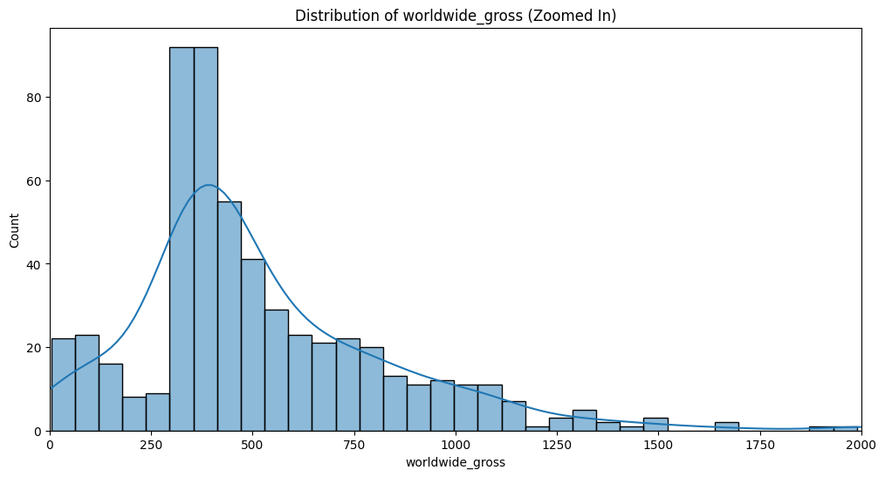
Question 1
Key Insights:
There is moderate to consistent frequency seen at $0-200M
From the graph, there’s a positive skew indicating higher grossing capacity with a long tail extending beyond $2000 with sparse yet very low count.
The highest counts occur around $300-400M where we see a significant peak, indicating a cluster of movies performing at that sweet spot for budget to return ratio.
As the gross earnings increase, movie count decreases indicating few outliers that surpass expectations.
The KDE line indicates a pattern in the earning trend which can be affected by some deciding factors that determine the earning potential of a movie.
Business Impacts:
On investment and strategy low range films-$0-250M proves to be a growing ground for innovations and emerging productions. The sweet spot range $300-400Mis guaranteed to hold reliable return on investment making a way for consistent flow of cash. High range production while risky can be a source of long-term revenue. Also, over reliance on low to midrange production can limit growth potential and stunt global market position.
Deep Learning with Python
Recommendation:
A balanced portfolio should be maintained for risk mitigation while providing stability and maintaining growth potential.
Utilize the opportunity the data provides to set exact budget targets, understand common earning levels and see where and why movies perform.
A deeper dive into the data to study the movies that surpass set targets should be encouraged to know why these movies perform highly globally and replicate such trends.

Slide 3
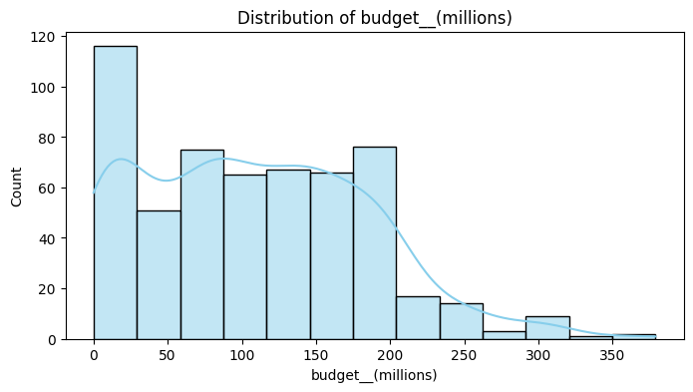
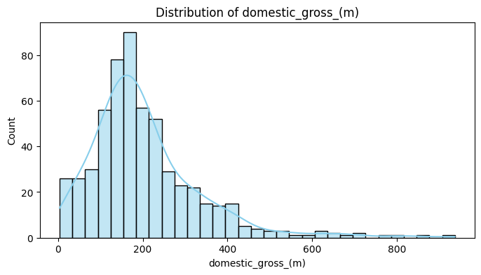
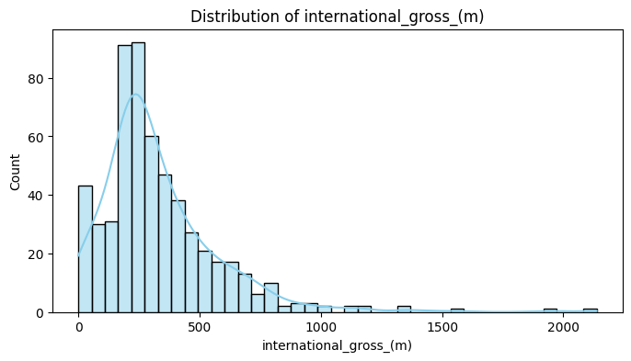
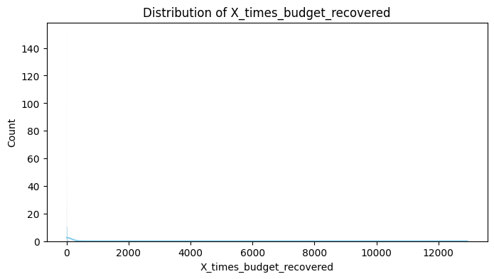
Question 2
Deep Learning with Python
Key Insights:
This graph gives us an in depth look at the structure surrounding distribution of budget in the movie industry.
With the peak distribution within $0-50M, the highest concentration of movies has their budgets set under $0-25M suggesting a cluster.
There is an average consistency of the frequency of movies within mid-range budget seen between $50 – 200M with a significant decrease of number of projects with higher budget declining after 200M.
Business Impact:
This indicates that there is a high occurrence of small to mid-budget movie projects compared to high budget projects which are quite rare.
Key Insights:
The International gross earnings chart has a highly right-skewed distribution with peak performance at $200-300M reaching approximately 85-90 films in this range. 75%-80% of films earn between 0-500M with extreme cases of successes recorded at 1500M – 2000M indicating a presence of outliers in the data as shown by the downwards trend after $700M.
The graph shows about 20-45 low performing movies record about $0-200M in earnings, Mid performing films with the highest concentration between $200-500M in earnings indicating a ceiling of target expected international gross earnings. High performing films make up about 15%-20% of the count recording a declining frequency of $500-1000M, As the gross earning increase the movie count decreases with about less than 5% of the movie count representing these rare cases of $1000M and more in earning.
Business Impact:
It indicates a heavy reliance on mid-range performing movies leading to market saturation in this range.
Key Insights:
The KDE line is flattened alongside the x-axis with a slight peak near zero which indicates extremely low probability density across all values.
This distribution is extremely skewed, successful cases are so rare they hardly register in the density projection.
The dense clustering near zero indicates that some movie projects barely break even or achieve minimal returns.
Key Insights:
Looking at the histogram, the bar with the highest count appears to be around $150-200M on the X-axis reaching 90 counts of movie on the Y-axis showing a significantly higher frequency in comparison to the rest of distribution.
The KDE line shows a peak between $150-175M on the x-axis suggesting a cluster of movies within this earning range. It also shows a mid-range distribution between $200M-400M, A positive skewness that indicates a decline after $400M with its long tail extending towards $800M suggesting that while rare there is a possibility of exceptional performance of domestic movie projects.
Business Impact:
The clustering of $0-400M suggests that this may be a realistic target earning for domestic projections. Hence, they need to be prepared for most films to perform within this range with a possibility of occasional breakout successes.

Slide 4
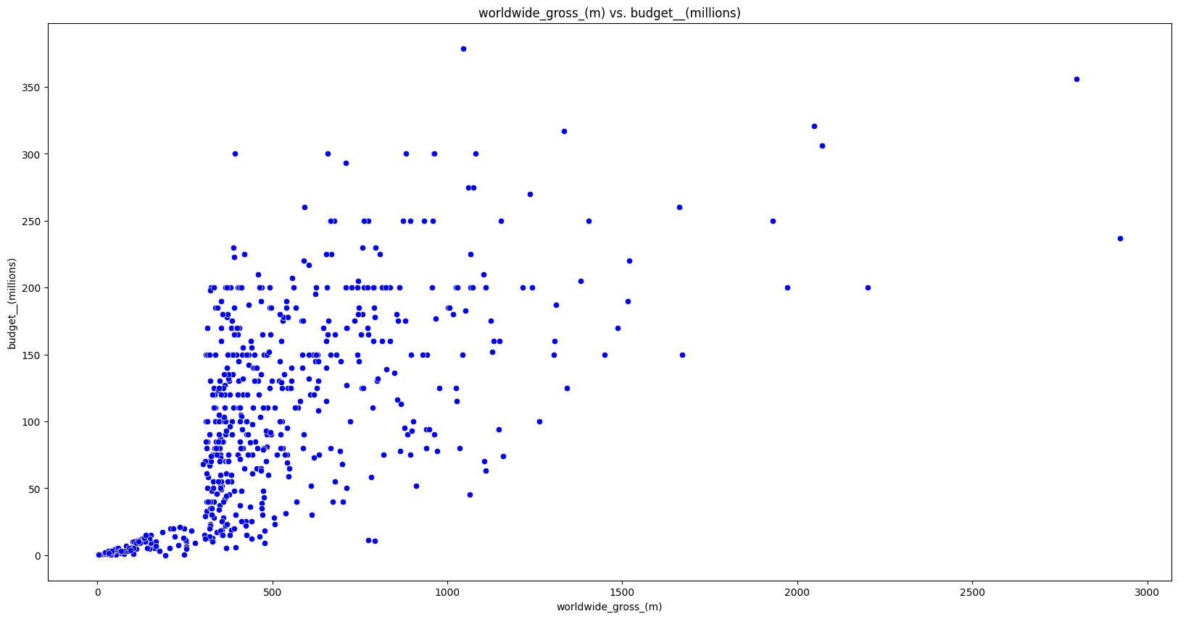
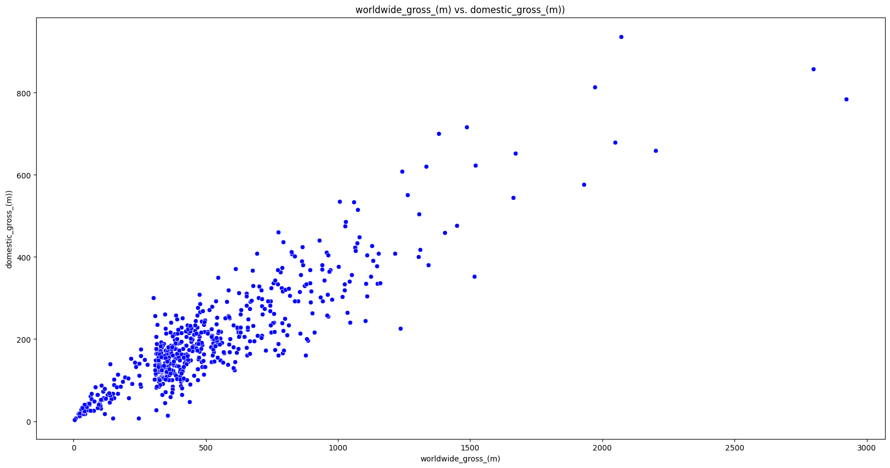
Question 3
Worldwide Gross vs. Budget (Millions)
On distribution and relationship there is a dense concentration of points towards the lower left indicating that movies with lower budget tend to yield lower earnings except for cases of outliers. The data points become sparser as both budget and gross increases; high budget movies are not a frequent occurrence. I observe that most movies under 200M budgets have a concentration of yields between 200M to 500M and in few cases 1000M.
There appears to be a positive correlation between worldwide gross and budget(M), As budget increases worldwide gross increases too. The slope in the plot suggests that higher budget movies may generate higher world gross earnings. So, the relationship can be said to be somewhat linear.
There is a presence of outliers where high budget movies perform exceptionally well yielding around 2500M-3000M. There are also interesting cases where low budget movies go on to yield high gross earnings.
Key Insights:
Whilst higher budgets correlate with higher earnings, there is no guaranteed relationship because of some significant variability in the data, because the spread suggests that high budget doesn’t necessarily guarantee high return. The presence of outliers and a few interesting turns out suggests that exceptional success can occur regardless of budget class.
Deep Learning with Python
Worldwide Gross vs Domestic Gross (both in millions):
The points form an upward trend from bottom left to the top right, the distribution are more together, and the density of the data points reduces as they both increase. There is a cluster below 200M domestic and 500M worldwide.
Though the slope suggests that worldwide earnings are typically higher than their domestic counterpart with little variance in between. There is an outlier presence suggesting exceptional success in both markets. Only very few movies deviate from this trend.
There is a very strong positive correlation between these two features, as the relationship appears to be consistently linear. This may suggest that if a movie does well domestically it will likely do well internationally.
Key Insights:
The international market clearly generates more income than the domestic.
When a movie is high performing it tends to do well in both spaces.
It can also be said that a movie doing well domestically is a good indicator that it will do well internationally.

Slide 5
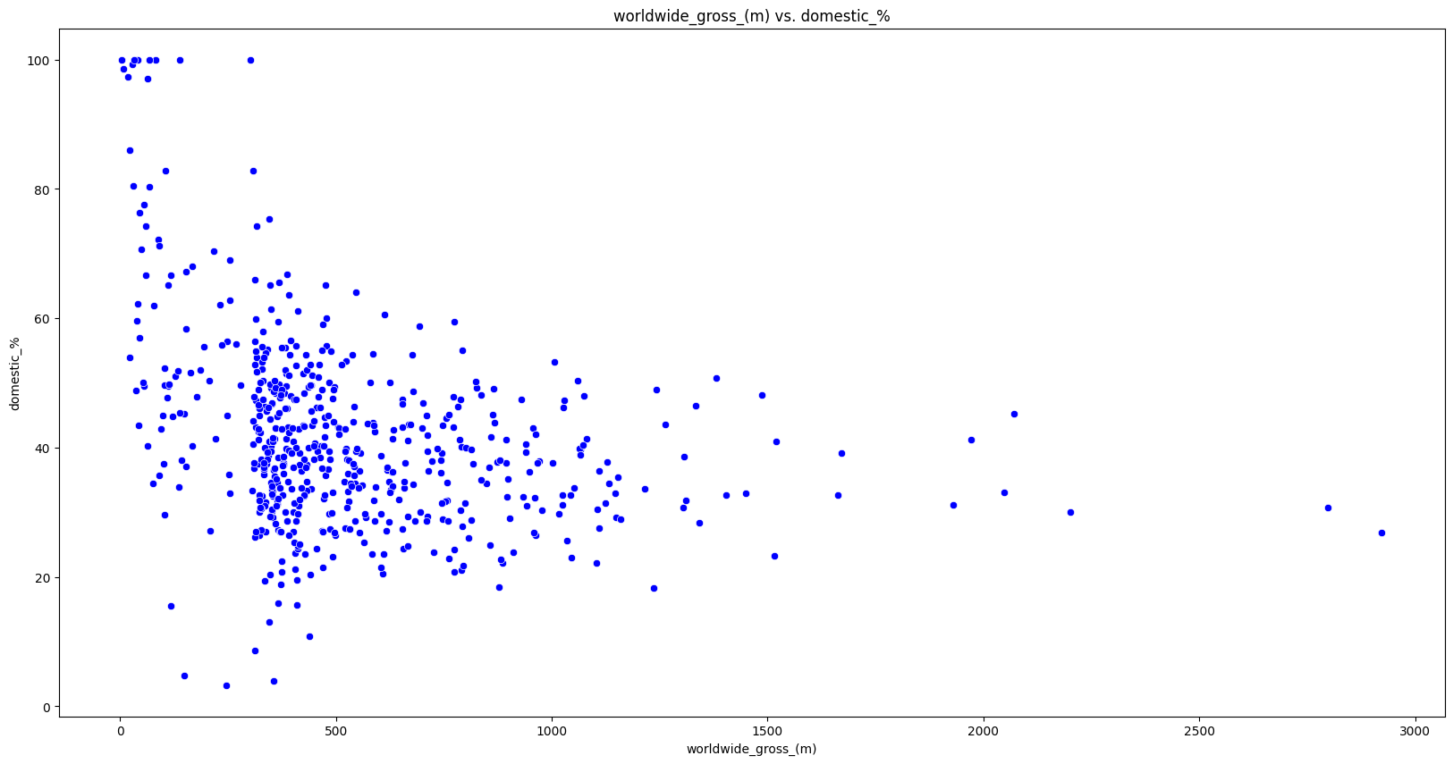
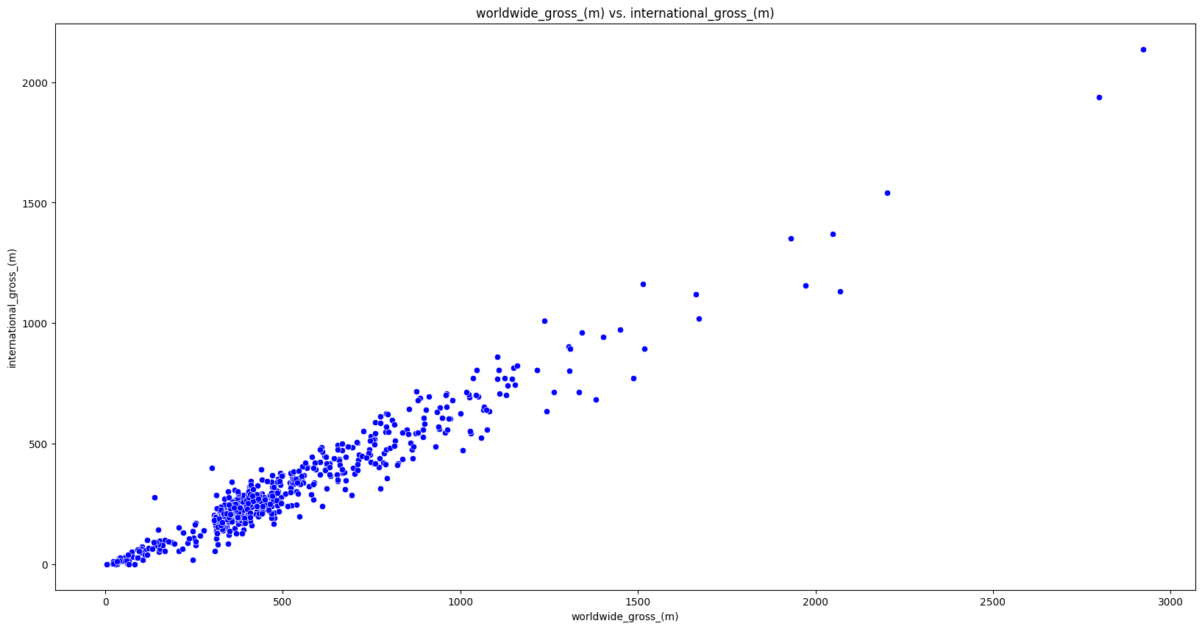
Question 3
Deep Learning with Python
Worldwide gross Vs international gross
There is a clear point formation depicting an upward diagonal trend, the data is more tightly clustered than domestic gross. While most films concentrate in the lower range <500M Intl gross) the density reduces as the earnings increase. Very few movies reach the > 1500M earnings mark.
There is few outliers compared to other graphs, the spread is quite lower in this trend line, and all the movies definitely hit above zero earnings in comparison to others
The data visualized suggests that there is a very strong positive linear relationship between these two even more than domestic gross correlation. It tells us that international gross may be the major driver of worldwide performance of movies.
Key Insights:
The relationship is exceptionally consistent across all earning levels,
The slope suggests that the international market in the film industry may contribute more than the domestic.
Higher grossing movies all had remarkable international performance which suggests the importance of having an international appeal in film making.
Worldwide gross Vs Domestic percentage
There is a negative correlation between these two, as worldwide gross increases domestic percentage reduces. The relationship is not exactly linear but shows a clear downward trend. Most points concentrate between 30%-50% domestic percentage while Highest density occurs between 400-600M Worldwide gross. On the right side is high grossing outlier presence with domestic at 20-40% and gross at >2000M. Several films show 100% domestic percentage with low gross, The upper right quadrant is noticeably empty.
Key Insights:
Pure domestic focus limited to lower grossing films.
Bigger budget movies seem to rely on international markets heavily.
Movies with lesser worldwide gross show more varying market performance.

Slide 6
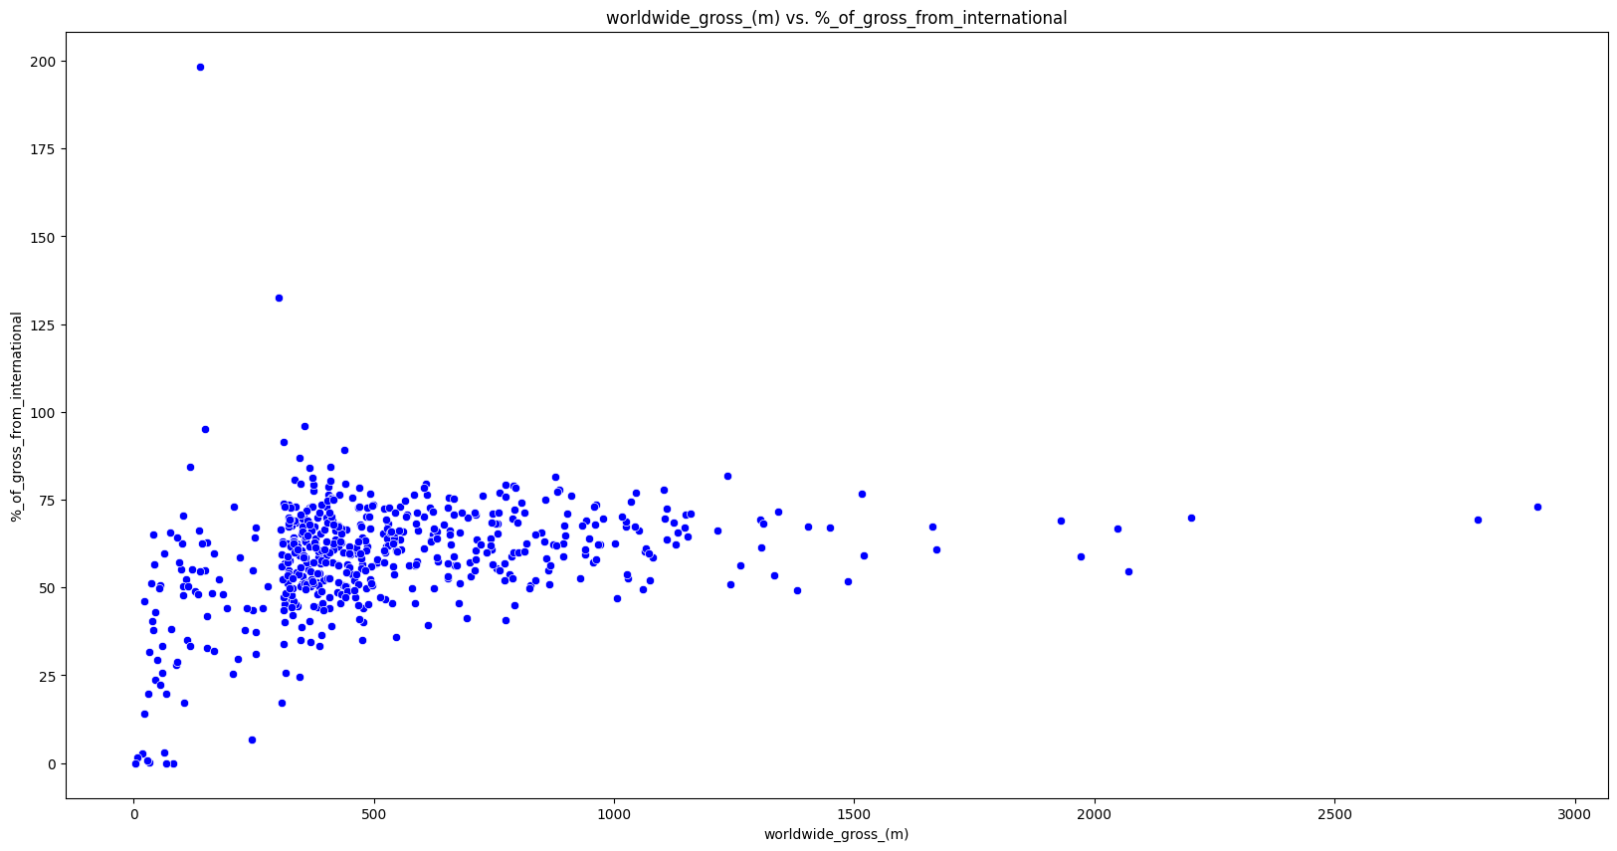
Question 3
Worldwide gross earnings (in millions Vs Percentage of gross from International
The data shows a considerable scatter spread, indicating a very weak positive relationship, the density of the data points tend to be concentrated the highest in the lower gross region. Most movies cluster in the 0-1000M world gross range with a concentration between 250M-500M while the international percentage typically ranges from 25% to 75% with a notable concentration between 40%-80%.
There’re a few outlier presences with high international percentages between 140-200%.
Key Insight
There doesn’t seem to be a strong established correlation between worldwide gross and international earnings percentage.
Even high grossing movies >1500M to some extent maintain some similar international percentages to lower grossing movies.
Lesser worldwide grossing movies show some variability in their international percentage range.
Deep Learning with Python

Slide 7
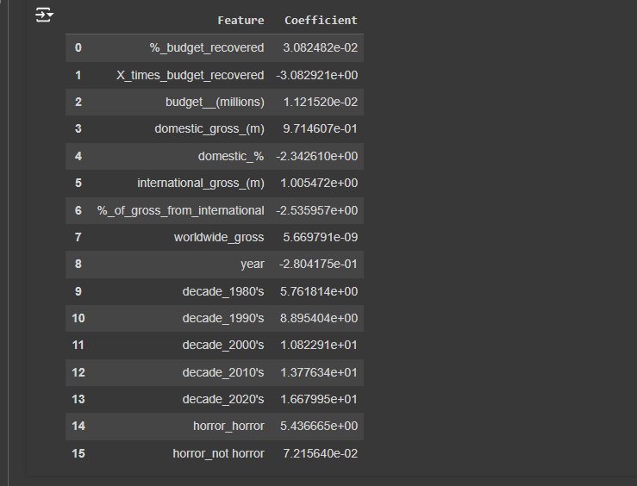
Question 4
Coefficient Analysis:
%_budget _recovered shows a little positive coefficient of 3.082482 presenting a positive contribution to worldwide gross while X_times_budget_recovered shows a strong negative coefficient of -3.082921e+00. This is interesting because they both impact the target variable to almost the same tune positively or negatively which implies that moderate budget recovery is better for worldwide gross than extreme multiples. It might also reflect that movies with high budget recovery values are often smaller production with lower worldwide gross numbers.
Budget in Millions shows a small positive coefficient of 0.0112, suggesting that if the budget of a movie was to be increased with impact moderately on worldwide gross.
International gross holds a positive coefficient of 1.005, indicating strong contribution to worldwide gross, while Domestic Gross (9.7146) though a bit lower than international gross impacts the target variable positively as well which is an indicator that both markets play a significant role but international gross even greater to the outcome of our target variable.
% of gross from international and domestic_%, (-2.342, -2.535) respectively both have a negative impact, which suggests that they both work hand in hand because an increase in one variable alone will detract from the target variable in general. If a movie does well internationally without doing well locally it would impact the worldwide gross negatively.
Worldwide gross has a rather small coefficient (5.669791e-09), the small magnitude suggests it has minimal direct predictive power on itself, which makes sense because its our target variable. The odds being that it may be redundant to the model since it’s the dependent variable.
Year shows a negative coefficient (-0.280), which might indicate that could be some negative fluctuations within decades. In contrast between negative yearly and positive decade coefficients, long term trends are more positive than short term variations.
Decade is the most influential variable , From the analysis decades present increasing magnitude of positive coefficients from the 1980s to the 2020s, (5.76, 16.67) respectively. Which shows that movies in this decade have a higher impact on worldwide gross compared to the 80s. Particularly, the 2020s (16.67) and 2010s (13.77) have the strongest positive impact which suggests that movies released in the later decade have a higher predicted outcome and contributes most positively to our target variable.
Horror_horror has a positive coefficient (5.436655) surprisingly indicating that horror movies tend to have greater impact on worldwide gross earnings. Horror_not_horror has a very small positive coefficient of 7.2156, having a minimal impact on target variable. looking at it from the budget coefficient analysis, Horror movies appear to be financially rewarding and given that it often operates with low budget.
Deep Learning with Python

Slide 8
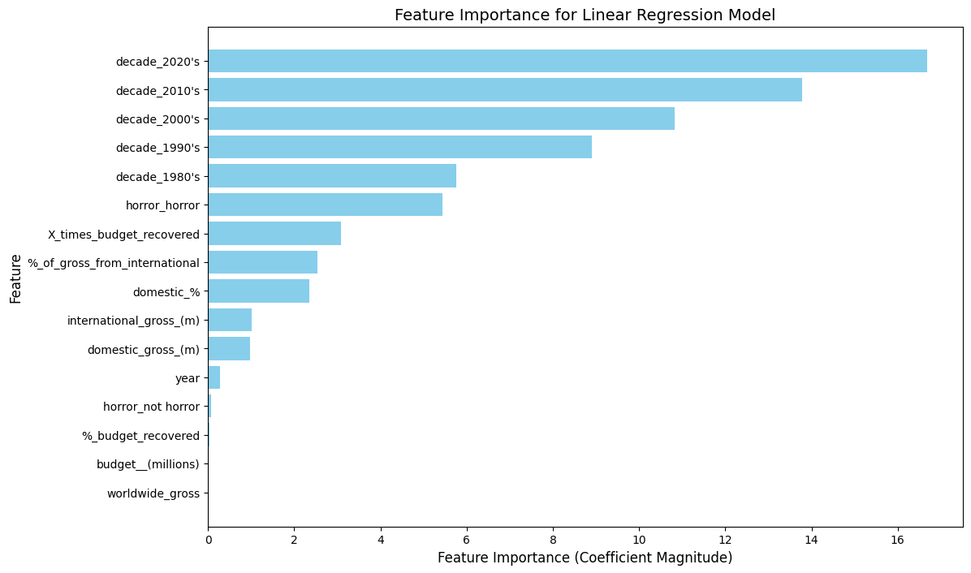
Question 5
Feature Importance Analysis:
Decade_2020s =16 seems to be the overwhelmingly most important feature, followed by decade_2010s =12 all belonging to the highest range. Decade_2000s and decade_1990s having 10 and 8 respectively coming in closely in the high range. For the medium impact range, we have decade_1980s =6 and horror_horror =5, lower impact range are having a feature importance magnitude between 2 and 4 are x_times_budget_recovered, %_of_gross_from_international, domestic_%. The minimal impact tier with less than 2 being the following international_gross_m, domestic_gross_(m), year, horror_not_horror, %_budget_recovered, budget_ (millions, worldwide gross.
Key Insights:
Visible progression of decade as the most important feature, with recent decades having a stronger impact on the target variable than the former.
The horror genre exhibits meaningful but not dominant influence on the target variable coming after decade, showing that horror as a genre performs exceptionally compared to non-horror genre.
Financial Metrics coming in low on the feature importance analysis shows that success of a movie may depend on timing and marketing strategy than raw investment.
Deep Learning with Python

Slide 9
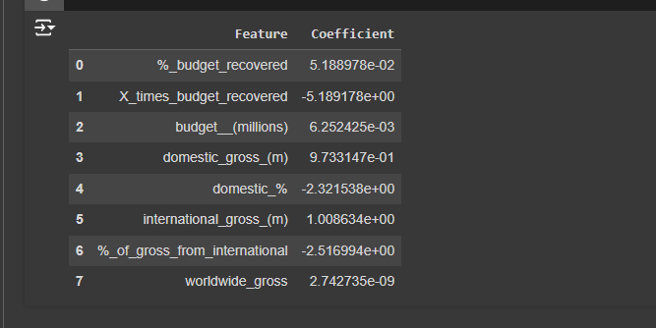
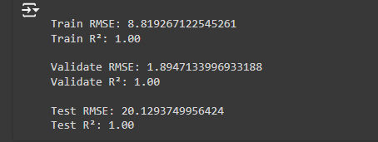
Question 6
Noticeable Changes in Coefficients:
domestic_gross_(m) went up slightly from 0.971 to 0.973
international_gross_(m) little increase from 1.005 to 1.008
domestic_% almost similar negative Influence (-2.342 to -2.321)
%_of_gross_from_international Slightly less negative (-2.535 to -2.516)
budget_(millions) went down from 0.0112 to 0.00625
%_budget_recovered went up from 0.0308 to 0.0518
X_times_budget_recovered more negative (-3.082 to -5.189)
worldwide_gross reduced from 5.669e-09 to 2.742e-09
Impact on model:
Model 2 shows slightly more consistent test performance
Perfect R² scores.
There is very little impact on training performance
Notable improvement in validation performance
Slight improvement in test performance
Perfect R² scores in both models which may signal Overfitting or Inclusion of target-related variables
Large validation-test RMSE gaps indicate that removing year, decade and genre variables didn't significantly harm performance
There is Slightly more consistent RMSE metrics in Model 2
Key Insights:
On training performance Model 1 RMSE: 8.700 vs Model 2 RMSE: 8.819, There is a Slight degradation in training RMSE (increase of 0.119) and both models show perfect R² scores.
On validation Performance Model 1 RMSE: 2.869 vs Model 2 RMSE: 1.894, visible Improvement in validation RMSE (decrease of 0.975) while both maintain perfect R² scores.
For Test Performance, Model 1 RMSE: 20.564 vs Model 2 RMSE: 20.129, Slight improvement in test RMSE (decrease of 0.435) while Both maintain perfect R² scores.
Deep Learning with Python

Slide 10
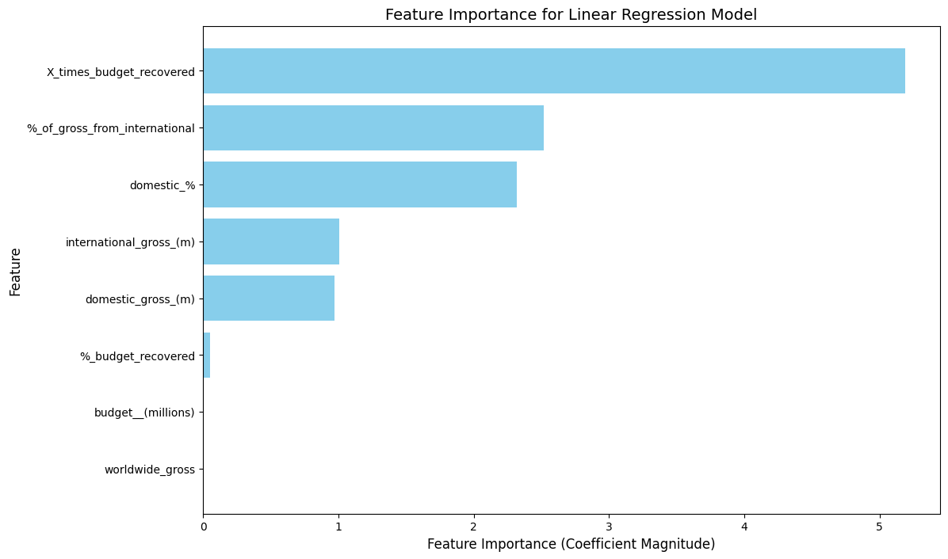
Question 7
Feature Importance Shift Analysis:
Previous model was dominated by decade variables (2020s ≈16, 2010s ≈14) and Horror genre was significant (≈5) while in model 2 X_times_budget_recovered (-5.189) is now most influential with %_of_gross_from_international (-2.516), domestic_% (-2.321), international_gross_(m) (1.008), domestic_gross_(m) (0.973).
International and domestic gross features became relatively more important in this model, and % of_gross_from_international, domestic% maintained similar importance levels.
X_times_budget_recovered became significantly more influential (from -3.082 to -5.189), %_budget_recovered increased in importance (0.0308 to 0.0518) while budget_(millions) decreased influence (0.0112 to 0.00625)
Key Insights:
Revenue components gaining importance makes sense after removing year and decade factors.
Focus on financial metrics aligns with business fundamentals.
Market distribution importance remains stable.
The extreme increase in X_times_budget_recovered might be overcompensation.
Concerns:
Loss of key variables like year and decade might limit predictive power
Extreme coefficient values might reduce practical applicability of the model
Perfect R² scores suggest potential reliability issues
The feature importance shifts partially makes sense but suggests the model might be overcompensating for removed variables, potentially reducing its practicality. The loss of year, decade variable seems to have pushed the model toward greater reliance on its financial variables, possibly to an extreme degree.
Deep Learning with Python

