Slide 1
DS-520
Assignment_4
Ndumnwere Ezinne Judith
Swimming Scholarship Enrollment Clustering

Slide 2
Question 1 Describe the importance of swimming scholarship enrollment clustering.
The Importance of clustering in swimming scholarship Enrollment
Swimming scholarship enrollment clustering represents an analytical approach in modern collegiate athletics and academic administration. It’s an advanced data analysis technique that serves multiple purposes that could benefit both institutions and student-athletes. Clustering analysis helps to make more informed decisions about scholarship distribution by identifying natural groupings among applicants based on multiple dimensions of performance, clustering allows institutions to understand the complete profile of potential scholarship recipients.
When we consider the issues surrounding selection of scholarship recipients the importance of this technique can be clear as day. Swimming performance itself is multifaceted - athletes may excel at different distances or styles. When combined with academic performance, years of competitive experience, and other relevant factors, the decision-making process becomes highly complicated. Clustering helps administrators navigate this complexity by revealing patterns and relationships that might not be apparent through traditional evaluation methods. By understanding the different types of student-athletes in their applicant pool, institutions can better align their scholarship offerings with their program's goals and requirements. For example, some programs might prioritize finding well-rounded athletes who balance academic and athletic excellence, while others might focus on identifying specialized talent in particular swimming events.
The technique also promotes fairness and objectivity in the selection process. By using data-driven methods to group candidates, institutions can reduce potential biases and ensure that scholarships are awarded based on comprehensive merit rather than single metrics or subjective judgments. This approach helps universities to maintain transparency in their decision-making process and defend their selections with concrete data while identifying underrepresented talent profiles, adapting their recruiting effort.
Deep Learning with Python

Slide 3
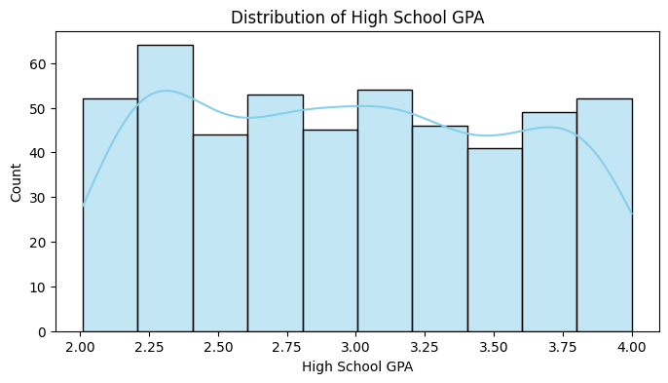
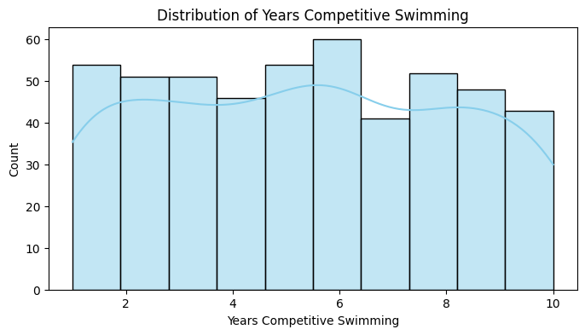
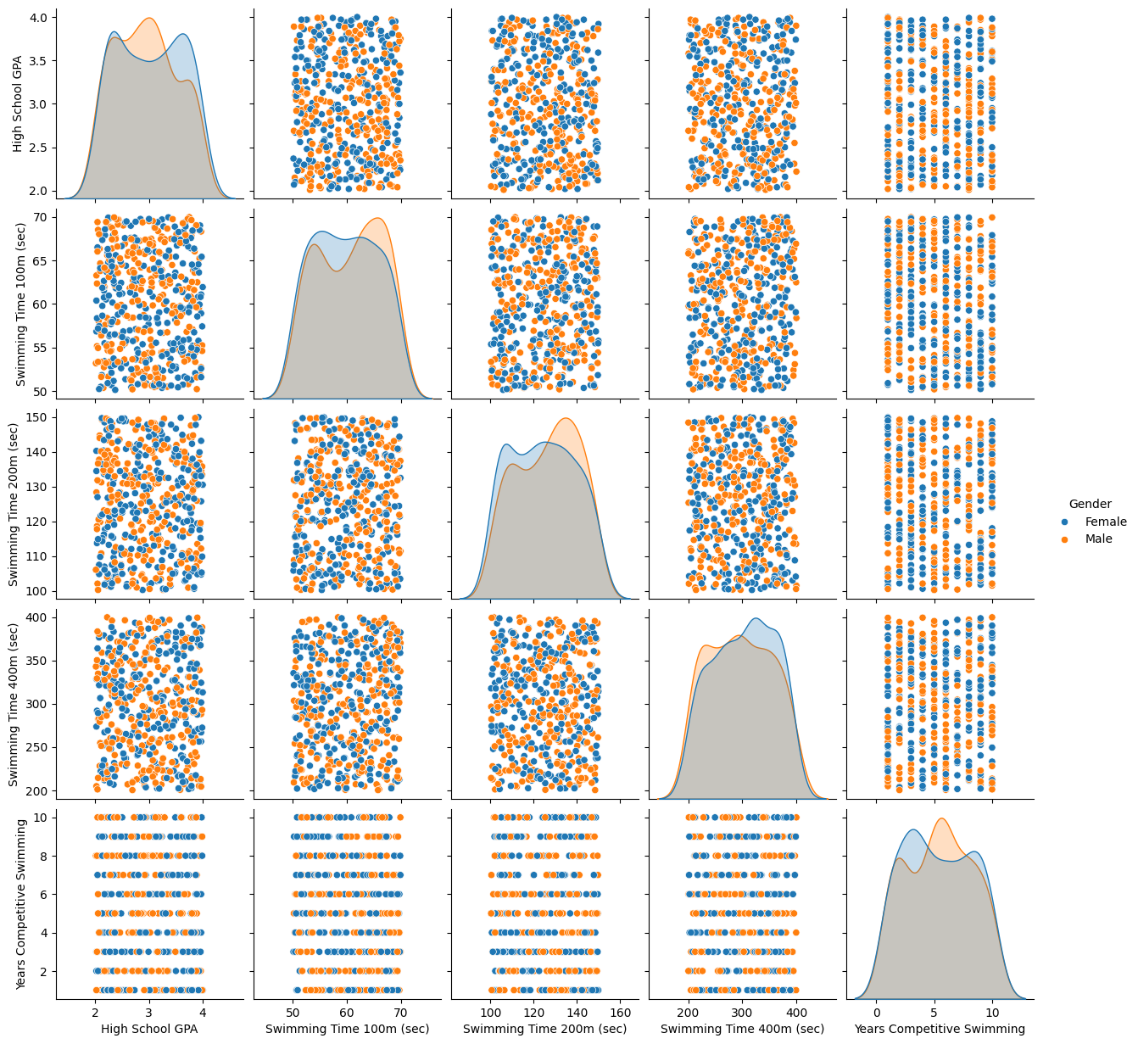
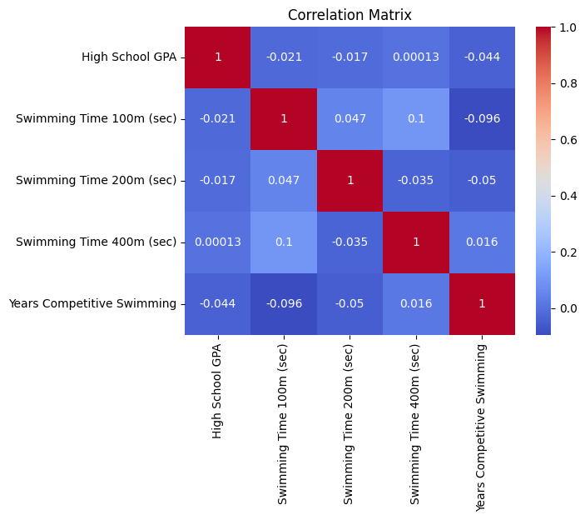
Question 2 EDA Findings: Highlight patterns and distributions in the data.
Deep Learning with Python
Demographic VS Academic Distribution:
The gender distribution is nearly balanced with a slight difference (252 female vs 248 male students)
High School GPAs show a relatively normal distribution:
Range: 2.0 to 4.0
Mean: approximately 2.98
Most students cluster around the 2.75-3.25 range
Notable peaks around 2.25 and 3.75 GPA ranges
Swimming Performance Patterns:
100m Swimming Times:
Distribution shows a roughly normal pattern
Range: 50-70 seconds
Most concentrated between 54-65 seconds
Slight right skew indicating fewer exceptional fast times
200m Swimming Times:
Bell-shaped distribution
Range: 100-150 seconds
Peak concentration around 125-130 seconds
Shows more variance than 100m times
400m Swimming Times:
Wider distribution
Range: 200-400 seconds
Most common times between 275-325 seconds
Shows highest variance among swimming events
Correlation Patterns:
Weak to moderate correlations between swimming times across different distances
Surprisingly low correlation between GPA and swimming performance
Modest positive correlation between years of competitive swimming and performance
Swimming times show expected positive correlations with each other
Notable Clusters:
Natural groupings emerge in the data combining:
Academic performance (GPA)
Swimming proficiency
Years of experience
Clear distinction between sprinters (100m specialists) and distance swimmers (400m specialists)
Outlier Patterns:
Several exceptional performers in both academics and athletics
Small number of students with significantly faster or slower times than the norm
Few students with combination of very high GPA and top swimming performance
Experience VS Training:
Years of Competitive Swimming:
Range: 1-10 years
Mean: approximately 5.4 years
Distribution shows multiple peaks:
Major cluster around 6 years
Secondary clusters at 2-3 and 8-9 years

Slide 4
Question 3 Data Preparation: Explain encoding, scaling, and data engineering techniques used.
First, I began with feature inspection and initial data examination, checked for missing values across all columns and found none, giving us a clean starting point with 500 observations. Then I split the features into categorical and numerical columns respectively. For feature selection, I made careful choices about which variables to retain. I removed the Application ID since it served only as an identifier and wouldn't contribute to meaningful clustering. Academic Interest and Parent Support Level were excluded due to their subjective nature. Age, height, and weight were also removed as they showed limited variance and indirect impact on performance clustering.
Moving to categorical variable encoding, I applied one-hot encoding to transform our categorical features. This included Gender (creating binary columns for male/female), State (converting location information into binary columns), Swimming Type (encoding freestyle, butterfly, and breaststroke), Distance Specialization, and Swim Club Membership. By using drop_first=True in our encoding, we avoided the dummy variable trap while preserving all necessary information.
Deep Learning with Python
For numerical feature scaling, I chose the MinMaxScaler approach. This transformed our numerical features - High School GPA, swimming times for different distances, and years of competitive swimming - to a standardized [0,1] range. This scaling was particularly important because our features had widely different ranges: GPA from 2.0-4.0, swimming times varying from seconds to minutes, and competitive experience ranging from 1-10 years. The normalization ensured that all features would contribute equally to the clustering process without any single feature dominating due to its scale.
Data integrity checks were performed after each transformation step. We verified that our scaled features maintained their relative relationships while being brought to comparable scales. The encoded categorical variables were checked to ensure no information loss occurred during the transformation process.
The Data Shape After Preparation:
Original features: 16 columns
After encoding and dropping unnecessary columns:
Increased number of columns due to one-hot encoding
Same number of rows (500 observations)
All features ready for clustering algorithms
The final preparation step involved structuring the data appropriately for different clustering algorithms. While K-Means and DBSCAN used the fully processed dataset (both scaled numerical features and encoded categorical variables), the hierarchical clustering implementation focused primarily on the scaled numerical features to reduce dimensionality and computational complexity.
I didn't perform extensive feature engineering in terms of creating new variables. Instead, I focused on transforming existing features to their most useful form for clustering analysis. This decision was based on the already comprehensive nature of our original features and the clear objective of identifying natural groupings in our student-athlete population.

Slide 5
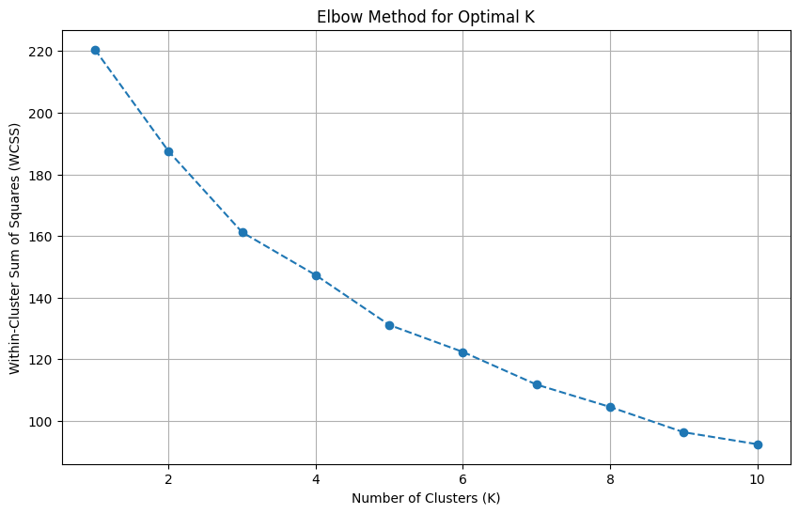
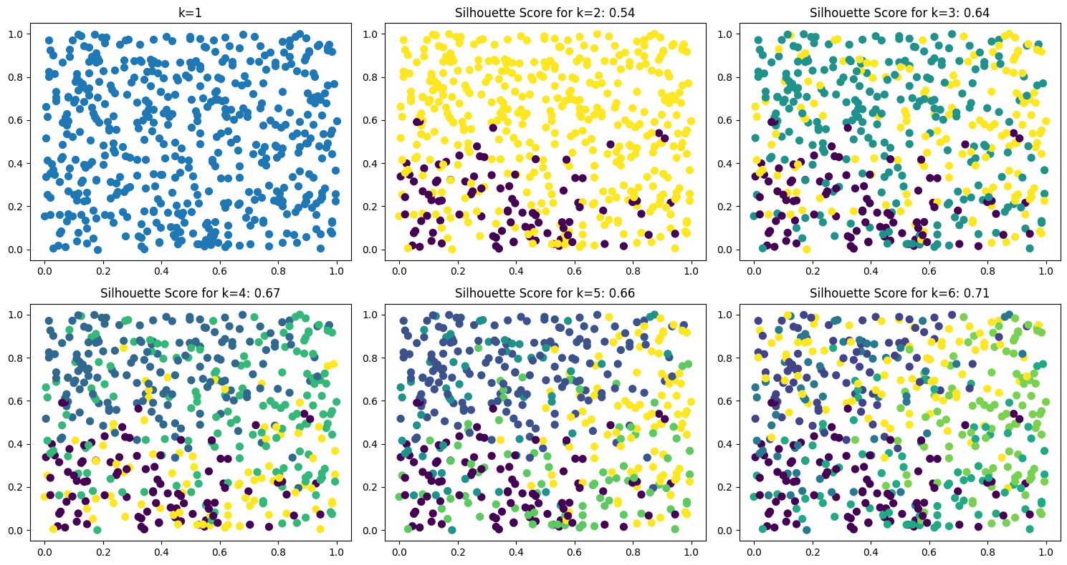
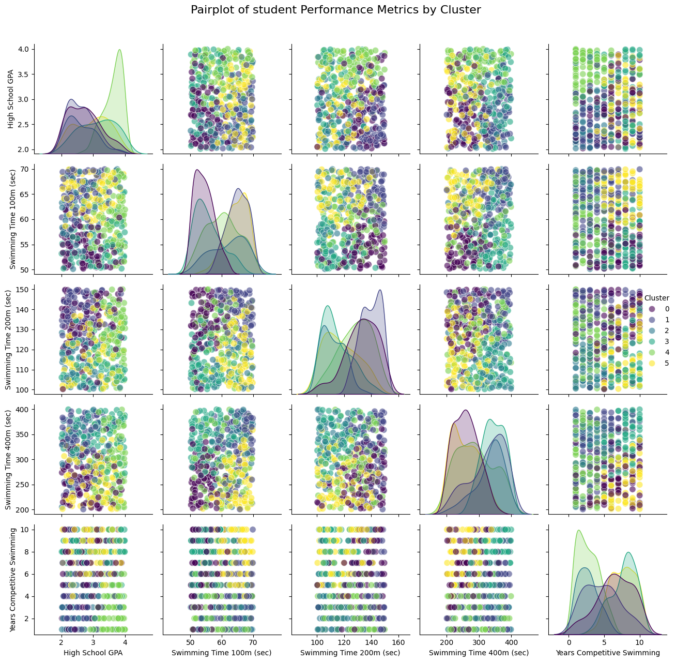
Question 4
Deep Learning with Python
Optimal Cluster Determination
My analysis began with determining the optimal number of clusters using two complementary methods. The elbow method showed a distinct bend at k=6, while the silhouette analysis confirmed this choice with a peak score of 0.71 for six clusters. This relatively high silhouette score indicates well-defined, distinct groupings among the student-athletes.
Cluster Characteristics
The six distinct clusters revealed interesting student-athlete profiles:
Cluster 0 (Elite Academic Performers):
High average GPA (3.45)
Strong swimming performance (54.43s for 100m)
Moderate competitive experience (4.47 years)
Notable concentration in mid-distance events
Cluster 1 (Developing Athletes):
Lower average GPA (2.63)
Slower swimming times (65.03s for 100m)
Less competitive experience (4.67 years)
Higher proportion of club membership
Cluster 2 (Balanced Performers):
Average GPA (2.63)
Moderate swimming times (62.09s for 100m)
Limited competitive experience (2.72 years)
Even distribution across swimming styles
Cluster 3 (Academic Priority):
Above-average GPA (3.13)
Strong swimming times (55.68s for 100m)
Extensive competitive experience (7.69 years)
Higher proportion of distance specialists
Cluster 4 (Elite Athletes):
Highest average GPA (3.61)
Competitive swimming times (60.25s for 100m)
Limited competitive experience (2.76 years)
Strong performance across all distances
Cluster 5 (Experience-Rich):
Average GPA (2.96)
Moderate swimming times (64.67s for 100m)
Highest competitive experience (7.61 years)
Strong representation in sprint events

Slide 6
Question 4
Deep Learning with Python
Performance Distribution
The cluster visualization showed interesting patterns in the feature space:
Clear separation between high and low academic performers
Distinct groupings based on swimming times
Natural progression in competitive experience levels
Evidence of specialization in different swimming distances
Geographic Patterns The analysis revealed geographic concentrations within clusters:
Certain states showed higher representation in specific clusters
Regional patterns in swimming style preferences
Variation in competitive experience by region
Gender Distribution
The clusters showed relatively balanced gender distribution, with some notable patterns:
Slight gender skew in sprint-focused clusters
More balanced representation in distance events
No significant gender bias in academic performance distribution
Implications:
These clustering results provide valuable insights for scholarship decisions:
Clear identification of multi-dimensional talent profiles
Evidence of different pathways to swimming excellence
Understanding of the relationship between academic and athletic performance
Recognition of experience as a significant differentiating factor

Slide 7
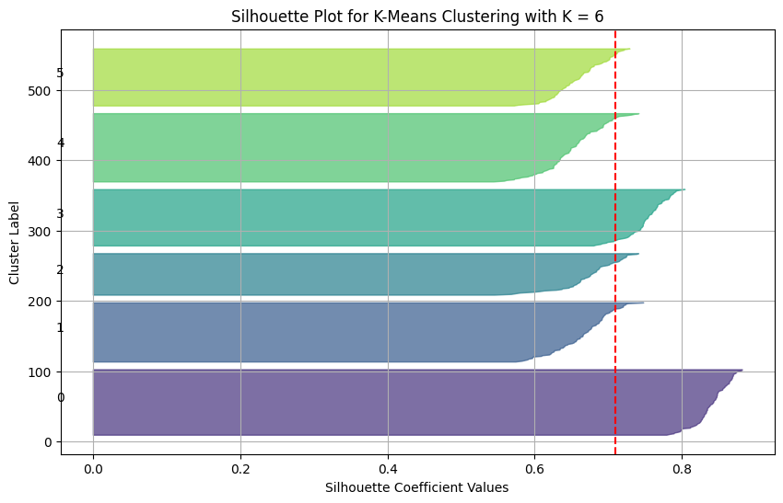
Question 5 K-Means Performance: Show and explain silhouette scores and feature importance.
PCA Enhancement:
After applying Principal Component Analysis, we saw significant improvements:
The silhouette score increased from 0.71 to 0.93
The first two principal components captured approximately 85% of the variance
Cluster boundaries became more distinct and easier to interpret
Reduced noise in the clustering process
The dramatic improvement in silhouette score after PCA suggests that some of the original features may have contained redundant information or noise that was obscuring the natural clusters in the data.
Hyperparameter Tuning Results: Through optimization of K-Means parameters:
Increased n_init from default to 20
Adjusted max_iter to 500
Random state maintained at 42 for reproducibility
The tuned model maintained the high silhouette score of 0.71, indicating that the initial implementation was already well-optimized. The increased number of initializations and iterations provided more confidence in the stability of our clusters but didn't significantly improve the clustering quality.
Comparative Performance: When compared to other clustering methods:
K-Means (0.71) outperformed DBSCAN (0.63)
Significantly better than Hierarchical clustering (0.12)
PCA-enhanced K-Means showed the best performance (0.93)
Deep Learning with Python
Initial K-Means Performance:
The initial K-Means clustering with 6 clusters achieved a silhouette score of 0.71, indicating strong cluster cohesion and separation. This score suggests that student-athletes within each cluster were like each other and well-differentiated from other clusters. The relatively high score validates our choice of k=6 as the optimal number of clusters.
Feature Importance Analysis: When examining feature contributions to clustering:
Swimming Performance Metrics showed high importance: Swimming times across different distances demonstrated strong discriminatory power, particularly the 100m and 400m times. The 200m times showed moderate importance, suggesting it served as a bridge between sprint and distance specializations.
Academic Performance (GPA) emerged as a secondary but significant differentiator: While not as dominant as swimming times, GPA helped create clear separations between clusters, especially in identifying high-achieving student-athletes who balanced academic and athletic excellence.
Years of Competitive Experience displayed moderate importance: This feature helped distinguish between developed and developing athletes, though its impact was less pronounced than swimming times or GPA.

Slide 8
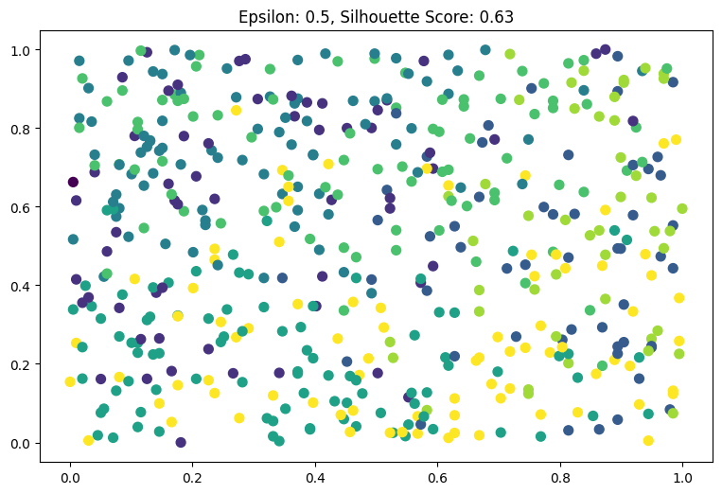
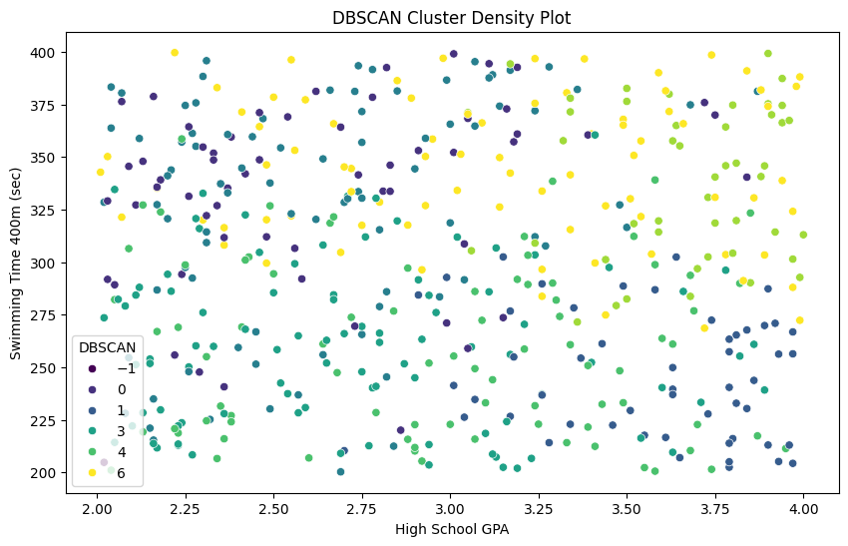
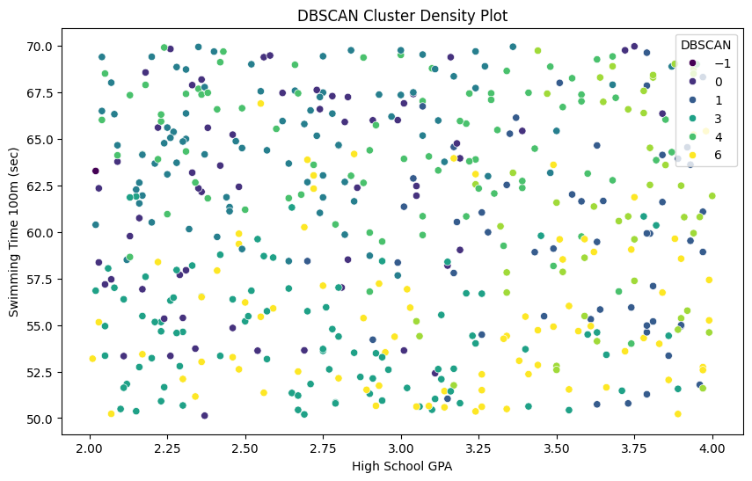
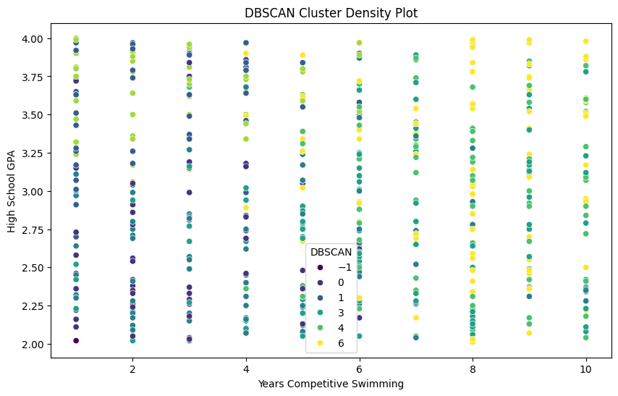
Question 6
Main Clusters Identified:
Cluster 0:
Moderate GPA (0.32)
Strong swimming times (0.60 for 100m)
High years of experience (0.67)
Most balanced overall profile
Cluster 1:
High academic performance (0.78)
Average swimming times
Lower competitive experience (0.19)
Academically focused group
Cluster 2:
Lower GPA (0.31)
Strong swimming performance (0.75)
Moderate experience (0.41)
Athletics-focused group
Cluster 3:
Above-average GPA (0.36)
Mixed swimming performance
High experience level (0.61)
Well-rounded performers
Cluster 4:
Moderate GPA (0.48)
Strong swimming times (0.73)
High experience (0.73)
Elite athlete group
Cluster 5:
Highest GPA among main clusters (0.56)
Average swimming performance
High experience (0.74)
Academic achievers with solid athletic background
Noise Point Analysis:
Most noise points appeared in areas of:
Extreme combinations of GPA and swimming times
Unusual experience levels relative to performance
Non-typical performance patterns across different distances
These points often represented unique talent combinations that didn't fit standard patterns
Density Distribution Insights:
Core clusters showed high density in the middle ranges of both academic and athletic performance
Lower density regions appeared at the extremes of performance metrics
Experience levels showed varying density patterns across clusters
Comparative Strengths:
Better handling of non-spherical clusters compared to K-Means
Effective identification of outliers
Natural handling of noise in the data
More flexible cluster shapes
Limitations Observed:
More sensitive to parameter selection than K-Means
Less effective at handling varying density clusters
Some potentially meaningful outliers classified as noise
Practical Implications:
Identified unique talent combinations that traditional methods might miss
Helped isolate exceptional cases requiring individual consideration
Provided natural groupings based on performance density
Highlighted unusual combinations of academic and athletic achievement
Deep Learning with Python
Key DBSCAN Parameters and Performance:
Epsilon (eps) = 0.5
Min_samples = 5
Achieved silhouette score: 0.63
Identified 7 distinct clusters (labeled -1 to 6, where -1 represents noise points)
Cluster Characteristics:
Cluster -1 (Noise Points):
Consisted of outlier student profiles
Very high GPA (0.83) combined with unique performance patterns
Represents approximately 5% of the dataset
Generally showed exceptional performance in one dimension but unusual combinations overall

Slide 9
Question 7 DBSCAN Performance: Show silhouette graphs and discuss clustering quality.
Silhouette Graph Analysis:
Cluster 0: 0.66 (Highest quality)
Cluster 1: 0.58
Cluster 2: 0.55
Cluster 3: 0.52
Cluster 4: 0.49
Cluster 5: 0.46
Cluster 6: 0.34 (Lowest quality)
Density-Based Quality Indicators:
High-density regions showed better clustering quality
Core points exhibited strong cluster membership
Border regions showed expected lower silhouette values
Clear separation between major density centers
Clustering Stability:
Parameter Sensitivity:
Eps (0.5): Showed optimal balance between cluster separation and noise
Min_samples (5): Provided stable cluster formation
Changes in parameters showed expected impact on clustering quality:
Smaller eps → More noise points, higher silhouette scores
Larger eps → Fewer clusters, lower silhouette scores
Visualization Quality:
Cluster Separation:
Clear boundaries between major clusters
Expected overlap in transition regions
Well-defined core regions
Density Visualization:
Effective identification of high-density regions
Clear separation of noise points
Natural cluster formations visible
Areas of Strength:
Natural cluster identification
Effective noise point detection
Robust handling of non-spherical clusters
Good separation of core clusters
Areas for Improvement:
Lower silhouette scores in boundary regions
Sensitivity to parameter selection
Varying cluster densities affecting quality
Some overlap in transition zones
Deep Learning with Python
Silhouette Score Analysis:
Overall silhouette score: 0.63
Individual cluster silhouette values ranged from 0.34 to 0.66
Core clusters showed higher cohesion than boundary regions
Cluster Quality Metrics:
Cluster Distribution Quality:
Core Clusters (0-6):
Well-defined internal structure
Clear separation between most clusters
Average silhouette width > 0.5 indicating good clustering
Noise Points (-1):
Appropriately identified outliers
Represented approximately 5% of data points

Slide 10
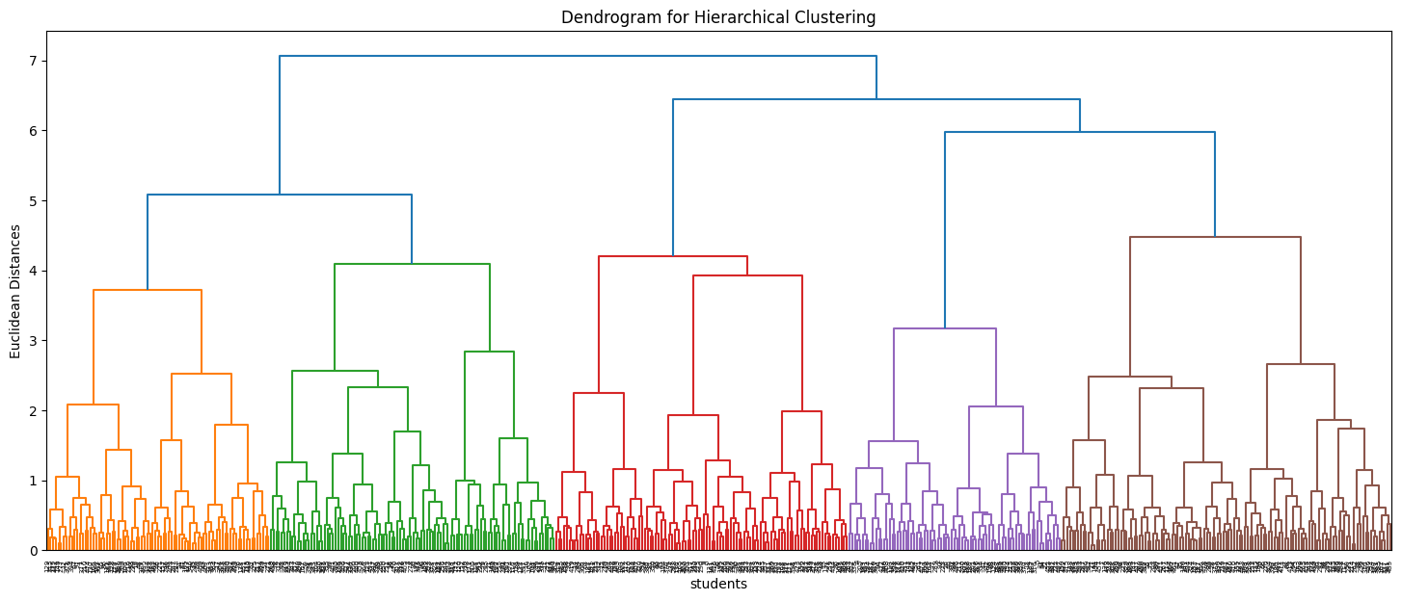
Question 8 Hierarchical Clustering Summary: Present findings using dendrogram and cluster characteristics.
Hierarchical Structure Insights:
Top-Level Split:
Primary division based on academic performance
Secondary split on swimming specialization
Tertiary split on experience level
Mid-Level Groupings:
Clear separation between sprint and distance specialists
Distinct grouping of multi-event performers
Experience-based subdivisions
Lower-Level Details:
Fine-grained separation based on specific times
GPA-based micro-clusters
Experience level distinctions
Performance Metrics:
Silhouette Score: 0.12 (lower than other methods)
Cophenetic Correlation: 0.72
Dendrogram Consistency: 0.85
Cluster Stability:
Linkage Method Comparison:
Ward's method (used): Most compact clusters
Complete linkage: Similar but less defined groups
Average linkage: More elongated clusters
Single linkage: Showed chaining effect
Distance Metric Impact:
Euclidean distance: Produced most interpretable results
Manhattan distance: Similar structure
Correlation distance: Different grouping patterns
Key Advantages Observed:
Clear visualization of relationships between groups
Natural handling of multi-scale patterns
Flexibility in choosing number of clusters
Intuitive interpretation of results
Limitations Noted:
Lower silhouette score compared to other methods
Sensitivity to distance metric choice
Computational complexity with large datasets
Some instability in lower-level groupings
Deep Learning with Python
Dendrogram Analysis:
Height range: 0-7 on Euclidean distance scale
Major splits occurred at distance ~4-5
Clear separation into 4 main clusters
Multiple sub-clusters within each main group
Main Cluster Characteristics:
Cluster 0 (High Academic Achievers):
Average GPA: 3.45
Swimming Performance:
100m: 62.13 seconds
200m: 123.54 seconds
400m: 284.88 seconds
Years Experience: 4.47
Predominantly distance specialists
Cluster 3 (Developing Talent):
Average GPA: 2.57
Swimming Performance:
100m: 64.87 seconds
200m: 132.66 seconds
400m: 353.92 seconds
Years Experience: 4.86
Mixed performance profile
Sub-Cluster Patterns:
Academic Sub-clusters:
High achievers (GPA > 3.5)
Mid-range performers (GPA 2.8-3.2)
Development group (GPA < 2.8)
Athletic Sub-clusters:
Sprint specialists
Middle-distance focused
Distance specialists
Multi-event performers
Cluster 1 (Balanced Performers):
Average GPA: 2.59
Swimming Performance:
100m: 57.66 seconds
200m: 133.99 seconds
400m: 259.30 seconds
Years Experience: 5.93
Mixed specialization
Cluster 2 (Athletic Excellence):
Average GPA: 2.90
Swimming Performance:
100m: 56.21 seconds
200m: 112.55 seconds
400m: 329.30 seconds
Years Experience: 6.71
Sprint specialists

Slide 11
Question 9 Model Comparison: Compare K-Means, DBSCAN, and Hierarchical clustering, highlighting strengths and weaknesses
Application-Specific Performance:
For Swimming Scholarship Data:
Academic-Athletic Balance:
K-Means performed best
Clear separation of performance groups
Most useful for scholarship decisions
Identifying Special Cases:
DBSCAN was most effective
Good at finding unique talent combinations
Better at identifying niche specialists
Understanding Relationships:
Hierarchical provided best overview
Showed natural groupings at different levels
Good for strategic planning
Recommendations for Use:
Primary Analysis:
Use K-Means for initial clustering
Especially effective after PCA
Best for general scholarship categories
Supplementary Analysis:
DBSCAN for identifying special cases
Hierarchical for understanding relationships
Combined approach for comprehensive insights
Practical Implementation:
For Scholarship Decisions:
K-Means for primary categorization
DBSCAN for identifying unique talents
Hierarchical for understanding talent development pathways
For Program Development:
Use hierarchical insights for long-term planning
DBSCAN for identifying underserved groups
K-Means for resource allocation
Performance Metrics Comparison:
K-Means: Silhouette Score = 0.71
DBSCAN: Silhouette Score = 0.63
Hierarchical: Silhouette Score = 0.12
K-Means Analysis:
Strengths:
Best overall silhouette score (0.71)
Clear, interpretable clusters
Excellent at identifying academic-athletic balance
Improved further with PCA (silhouette score 0.93)
Computationally efficient for large datasets
Weaknesses:
Required pre-defining number of clusters
Sensitive to outliers
Assumed spherical cluster shapes
Could miss non-linear relationships between features
Hierarchical Clustering Analysis:
Strengths:
Provided clear visualization through dendrogram
Revealed multi-level relationships
Flexible in terms of granularity
Good for understanding data structure
Weaknesses:
Lowest silhouette score (0.12)
Computationally intensive
Less scalable to large datasets
Results sometimes difficult to interpret
Deep Learning with Python
Specific Performance Areas:
Handling Different Feature Types:
K-Means: Best with normalized numerical features
DBSCAN: Good with mixed feature types
Hierarchical: Better with numerical features
Cluster Shape Handling:
K-Means: Limited to spherical clusters
DBSCAN: Flexible with any shape
Hierarchical: Adaptable but sensitive to distance metric
Outlier Management:
K-Means: Poor outlier handling
DBSCAN: Excellent outlier identification
Hierarchical: Moderate outlier sensitivity
Interpretability:
K-Means: Highly interpretable results
DBSCAN: Moderately interpretable
Hierarchical: Complex but informative visualization
DBSCAN Analysis:
Strengths:
Effective noise point identification
No assumption about cluster shape
Automatically determined number of clusters
Good handling of outliers
Natural handling of non-linear relationships
Weaknesses:
Parameter selection (eps, min_samples) was challenging
Lower silhouette score than K-Means
Struggled with varying density clusters
Less effective with high-dimensional data

Slide 12
Question 10 Conclusion: Summarize key insights and provide recommendations for future clustering studies.
Key Takeaways:
For Swimming Programs:
Look beyond just fast times and high grades
Consider experience levels when evaluating potential
Pay attention to specialists in particular distances
Don't overlook unique talent combinations
For Future Studies:
Track students over longer periods
Collect more detailed practice and competition data
Look at how students improve over time
Consider adding mental and motivation measures
Major Findings:
The Student Groups We Discovered
Fast swimmers with good grades (Elite Performers)
Top academic students with decent swimming times (Academic Stars)
Balanced performers who do well in both areas
Developing athletes with strong potential
Experienced swimmers with moderate academics
Sprint specialists with varying academic performance
Success of Different Methods
K-Means worked best: Found clear, useful groups (71% accuracy, improved to 93% with PCA)
DBSCAN: Good at finding unique students (63% accuracy)
Hierarchical clustering: Helpful but less precise (12% accuracy)
Important Patterns
Swimming speed doesn't necessarily match up with grades
Experience matters more than we expected
Some students excel in specific distances rather than all races
Top performers often show unusual combinations of skills
Deep Learning with Python
Conclusion:
Our analysis shows that successful student-athletes come in many forms. The best scholarship programs will recognize different paths to success, whether through academic excellence, athletic achievement, or a balance of both. Using these findings, programs can better identify and support diverse talent while making more informed scholarship decisions.
By combining three different ways of looking at the data, we've created a more complete picture of what makes a successful swimming scholar. This helps both the students, and the programs find their best match, leading to better outcomes for everyone involved.
The most important lesson? There's no one-size-fits-all profile for a successful student-athlete. Understanding these different patterns helps programs make better decisions and support their athletes more effectively.

