Slide 1
NeCTAR Training
Module 3
Common use cases

Slide 2
Common use cases
“The data tsunami is changing everything in science. Every discipline is now confronted with it—a vast exploration of data that comes from instruments, from online sources, from the web, from social media. Analyzing this data can’t be done on a PC.”
— Dennis Gannon, director of Cloud Research Strategy for Microsoft Research Connections
Notes:
Say something about how some problems require more than a Desktop PC to be solved. Special infrastructure is required, which the research organisation may not be able to provide you with easily.

Slide 3
In this module
Common use cases for the NeCTAR Research Cloud and the research outcomes they can enable.
8 fast ways to make the cloud work for your research.

Slide 4
The NeCTAR Research Cloud
Provides Infrastructure-as-a-Service (IaaS)
Provides processing power and storage required for computationally and storage intensive projects.
Empowers researchers with new self-service abilities to
publish research data,
share knowledge and
rapidly deploy and access software applications.
Notes:
Before starting with the common use cases, a brief recap: What is the Research Cloud?
IaaS: : Researchers can run their own virtual machines and manage their storage.

Slide 5
Case 1: Embarrassingly Parallel Problems
Embarrassingly parallel problems (EPP)
Characterized by being trivially parallelizable.
When parallel computations are finished, results from all computations are summarized.
Notes:
Characterized by being trivially parallelizable: no complex methods have to be applied to solve the problem by means of parallel methods.

Slide 6
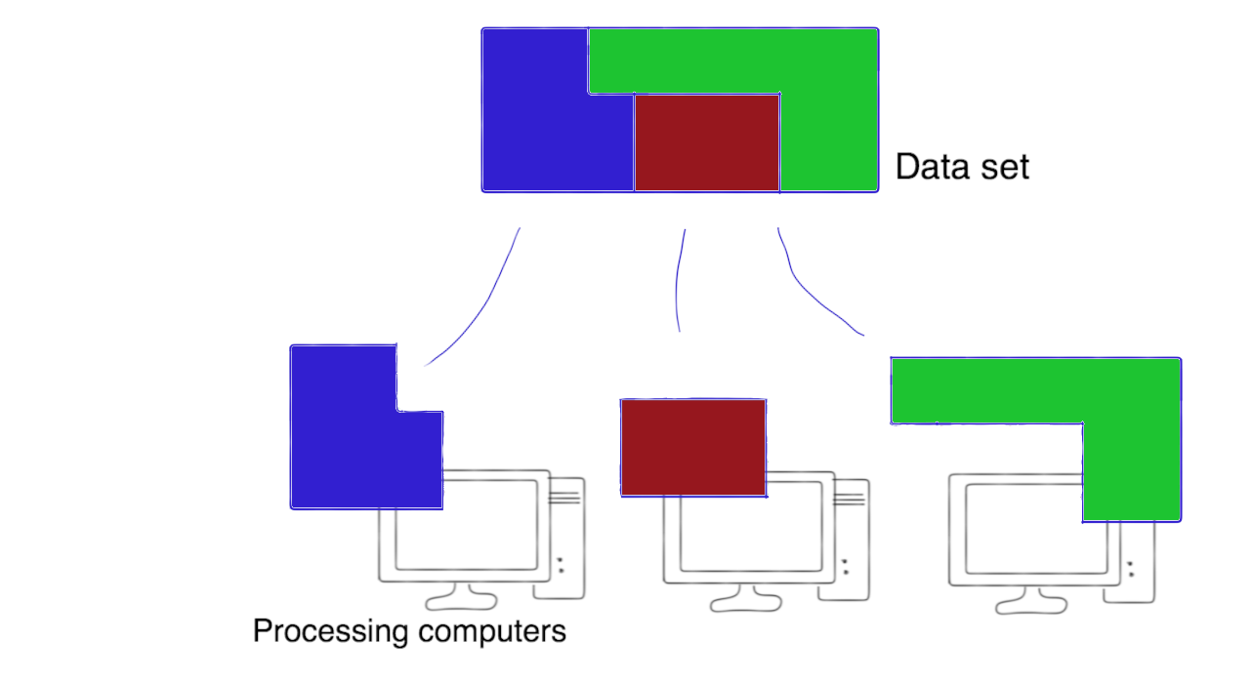
Case 1: Embarrassingly Parallel Problems
Example 1:
A very large data set can be chopped into pieces which are then dispatched to various computers for processing.

Slide 7
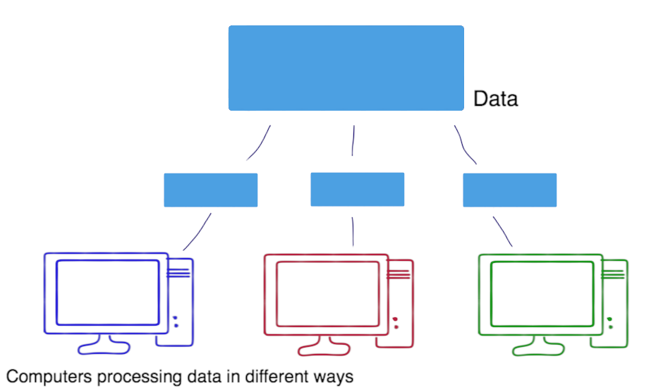
Case 1: Embarrassingly Parallel Problems
Example 2:
Copies of a smaller data set are distributed across computers to perform different computations on it.

Slide 8
Case 1: Embarrassingly Parallel Problems
The individual processing computers don’t have to be super fast
Instead the power lies in having a huge number of computers solving the problem simultaneously.
Outlook on related topics:
Module 4 will get back to EPPs.
Module 6 will also discuss the use of several VMs.
Module 7 will show you how to set up a VM.
Notes:
EPP’s will be re-visited in Module 4 – more details on how this can be made to work in the cloud.
Module 7 will discuss how to set up and access VM – which can be used as one processing node for an EPP.

Slide 9
Case 2: Data Sharing
Shared access to data to collaborate.
You may request the amount of storage you require and give collaborators access to the on-line storage.
The different types of storage available to you are discussed in Module 6.

Slide 10
Case 3: On-Demand Computing
You need compute power only at a certain time (on-demand).
Easily access the required amount of computing power and storage in the cloud.
You don’t need to worry about maintenance and re-investment in new, faster computers.
Notes:
Example of time that resources are needed: when results for a paper need to be processed quickly.
You can hold resources for only the time you need to run the experiments, and then release them again.

Slide 11
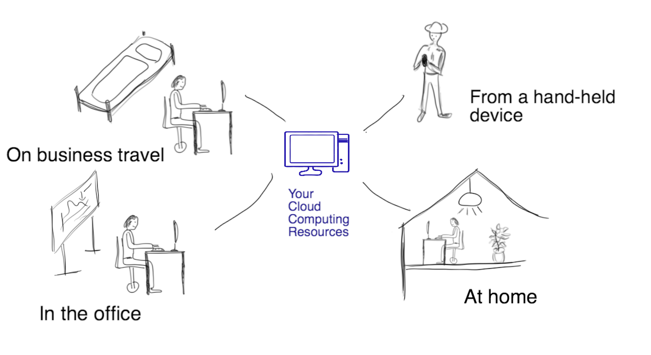
Case 4: Remote Access
Access to large-scale computing resources, data and tools from any platform, and any location.

Slide 12
Case 5: Research App
Develop your own research app that can be accessed from a variety of devices and from anywhere.
For example, you want to undertake a field study.
Your students and collaborators venture out to collect data and
They upload their results and materials directly to your app on the Research Cloud.

Slide 13
Case 6: Reproducible Research
Provide a Snapshot of your virtual machine:
Including all tools, data and documentation required to reproduce the results.
You can cite this Snapshot in a paper, for other researchers to reproduce your results easily.
Module 9 will cover how to create Snapshots.

Slide 14
Case 7: Training
Provide a platform for course attendees to flexibly get access to materials from anywhere.
No investment in expensive laboratory facilities and staff.
Create templates of your virtual machines for repeated use in classes.

Slide 15
Case 8: Big Data
Your research requires large amounts of storage to which you need easy access.
The application that processes the data needs to be “close to the data”!
The app should run on a VM in the same data center.

Slide 16
Closing note
You should now have a better idea of what uses and benefits the Research Cloud can have.
You may have identified one or a few use cases that apply to your research.
There are a lot more use cases, as the Research Cloud offers great flexibility and scalability.

