Slide 1
NeCTAR Training
Module 4
From PC To Cloud or HPC

Slide 2
In this module
Differences between Cloud Computing and High Performance Computing (HPC).
Overview of pros and cons of moving from traditional desktop computing (PC) to Cloud or HPC infrastructure.
Notes:
You may have heard of High Performance Computing (HPC), or you may already be using it.

Slide 3
Cloud vs HPC
High Performance Computing (short: HPC) is not the same as cloud computing.
Both technologies differ in a number of ways, and have some similarities as well.
We may refer to both types as “large scale computing”.
Both systems target computing scalability differently.

Slide 4
High Performance Computing (HPC)
HCP targets extremely large sets of data and crunching the information in parallel, while sharing the data between compute nodes.
The data connection between the nodes has to be very fast.
The entire grid of nodes is turned into a single “supercomputer”.
One application can be run across a variable number of nodes. We call this vertical scalability.
Notes:
Metnion that specialised hardware is required to achieve this “single supercomputer” – e.g. Inifitec.

Slide 5
Cloud Computing
Cloud computing targets “embarrassingly parallel problems” (EPP).
The individual computers don’t have to be super fast.
The power lies in having a huge number of computers.
Several applications run on a several nodes. We call this horizontal scalability.
Notes:
EPPs discussed in Module 3.

Slide 6
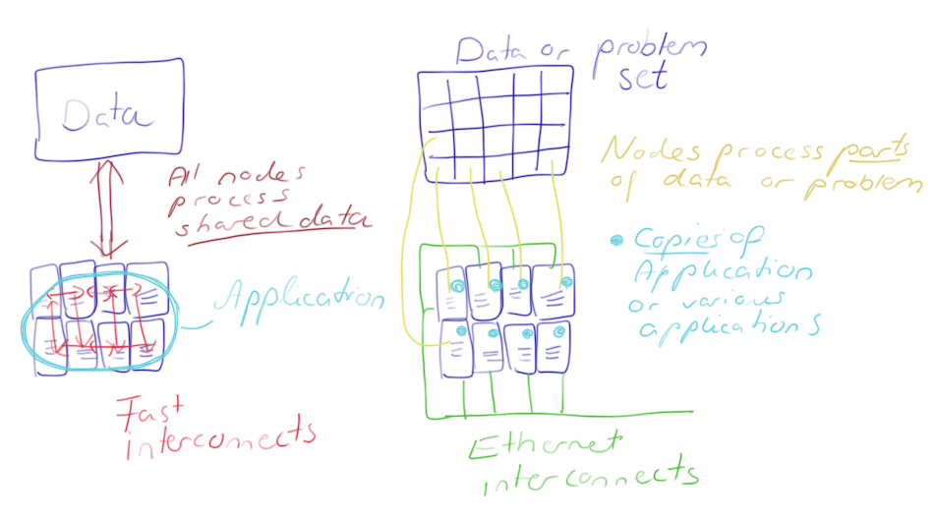
Cloud vs. HPC

Slide 7
Cloud vs HPC
HPC and Cloud Computing try to achieve a different type of scalability.
To achieve their aim, both techniques use their own optimized hardware.
Depending on the requirements of your research application, one or the other may be the better solution.

Slide 8
When to use HPC
Your application pushes on all levels of performance:
computing
fast interconnects, and
high-performance storage
Optimized HPC libraries—the result of years of research—may be required for your application.
Notes:
Optimized HPC libraries work closely with the hardware and are therefore specialised to HPC

Slide 9
When to use HPC
Some applications rely on a technology called MPI (Message Passing Interface)
Such applications may not run efficiently in the Cloud because inter-node communication is slower.
Some applications require very fast interconnects.
Requires communication that bypasses the OS kernel.
Most virtualization schemes do not support this “kernel bypass”.
Notes:
Because virtualization schemes are central to cloud computing, it is very difficult to use such kernel-bypassing communication in the cloud.

Slide 10
When to use HPC
Other specialised hardware which your application may benefit from are performance accelerators.
Not found on typical Cloud infrastructure.
Some HPC solutions offer a set of pre-installed software packages.
Notes:
Performance accelerators or SIMD units (Single-Instruction Multiple Data processors).
The pre-installed software packages sometimes also include the license already.

Slide 11
When to use the Cloud
The cloud is great for EPPs
Process one data set with a variety of parameters, or split it in several pieces for parallel processing.
The application does not rely on fast shared memory or storage.
e.g. digital rendering
Notes:
The application does not rely on fast shared memory or storage, so it can be distributed into many independent processing units
Digital rendering: As an example, in 3D animation, creating an image of a 3D scene takes time --- for example, lighting, reflections, colours have to be caluclated for the scene. Thousands upon thousands of images have to be produces from the 3D modelling software. But each image captures one tiny state of the animation… it can be independently processed from the other images.

Slide 12
When to use the Cloud
You want instant availability of large-scale computing resources.
Possibility of software choice: design virtual machines to suit your need, incl. choice of OS.
The simple case: you need easy access to computing infrastructure.
Notes:
To the instant availability: In HPC, we may need to wait for the resources to become available (i.e. submit job, and wait for a while until the execution starts on some node).
In the Cloud, they are typically instantly available.
Software choice incl. OS and installed applications can be problematic in HPC.
Easy access: IT infrastructure (already connected to the Internet) may not be as easily accessible through your research organisation.
The ready connection to the internet is also a plus. It may be a bit more work on local infrastructure to set up firewall, get a static IP, open up access to outside, etc.
In the cloud, computers (VMs) are accessible by default, and firewall is easy to configure.

Slide 13
The Cloud: Drawbacks
Requires Internet to access—if it drops out, you lose access.
Indirect access control: The ISPs and telecommunication companies control your Internet access.
Service outage at the cloud service provider can take out your resources.
Concerns about ownership: Who owns the data you store online?
Service charge is based upon usage.
Notes:
ISPs may even charge for higher bandwidth demands.
Ownership: Who owns the data, you, or the company storing it? Policies among Cloud providers vary. NeCTAR never lays any claims on your data!
Service charge: However NeCTAR services are free to researchers across Australia.

Slide 14
The Cloud: Advantages
Cost savings: NeCTAR resources are free; building and maintaining on-premises infrastructure is expensive.
Individual setup: Users can set up their own server.
Access independence: Via the Internet from anywhere.
Large computing capacity access quickly and easily.

Slide 15
The Cloud: Advantages
“Elasticity” (Flexibility and Scalability): users can scale up or down resources as required at the time.
Resource sharing: Multiple users can work on the same data.
Security of professionally run data centers is often as good as, or better than maintaining local infrastructure.

Slide 16
Closing note
You should now have a good idea about the difference between Cloud and HPC.
If you have found that the Research Cloud is great for your purposes—graet, enjoy the rest of the course!
Notes:
You may have found that HPC is the right choice for you
Contact your local IT department to enquire about your options.
You will still benefit from attending the rest of this course to extend your knowledge for possible future uses of the Cloud in other research projects.

