Slide 1
NeCTAR Training
Module 5
The Research Cloud Lifecycle

Slide 2
In this module
This module provides a high-level overview of the processes involved when using the Research Cloud.
Topics will include:
How to get onto the Research Cloud.
Necessary housekeeping (e.g. updates, backups).
How to keep a VM secure.
Terminating services without losing anything.
How to get support.
Notes:
This mdoule is only an overview, with the purpose to get a rough idea of what tasks await the users.
Say that if it seems like a lot of things to watch out for and obsever, it’s actually all not very hard to achieve, and there’s step-by-step instructions in the later modules.

Slide 3
NeCTAR Project Trial
Australian researchers have access to a Project Trial:
2 instances and 2 cores for 3 months.
To obtain a larger allocation, file an allocation request.
You can run VMs of various sizes in the Research Cloud
From 1—16 cores, and
up to hundreds of VMs.
Notes:
Any researcher who logs on to the web Dashboard can immediately have access to the project trial.
E.g. with the project trial You can run
a medium (two core) VM, or
two small (single core) VMs.

Slide 4
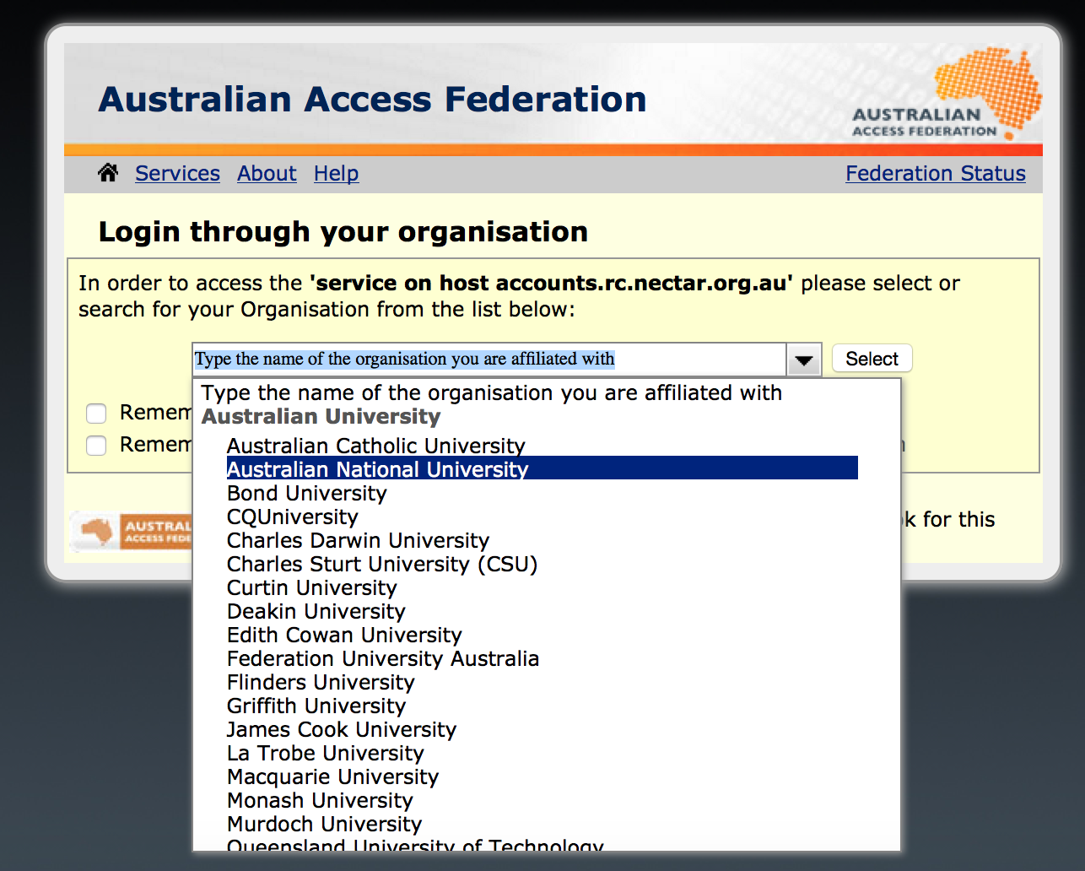
Connecting
You can easily get onto the Research Cloud via the web Dashboard.
You can use your institutional login to connect.

Slide 5
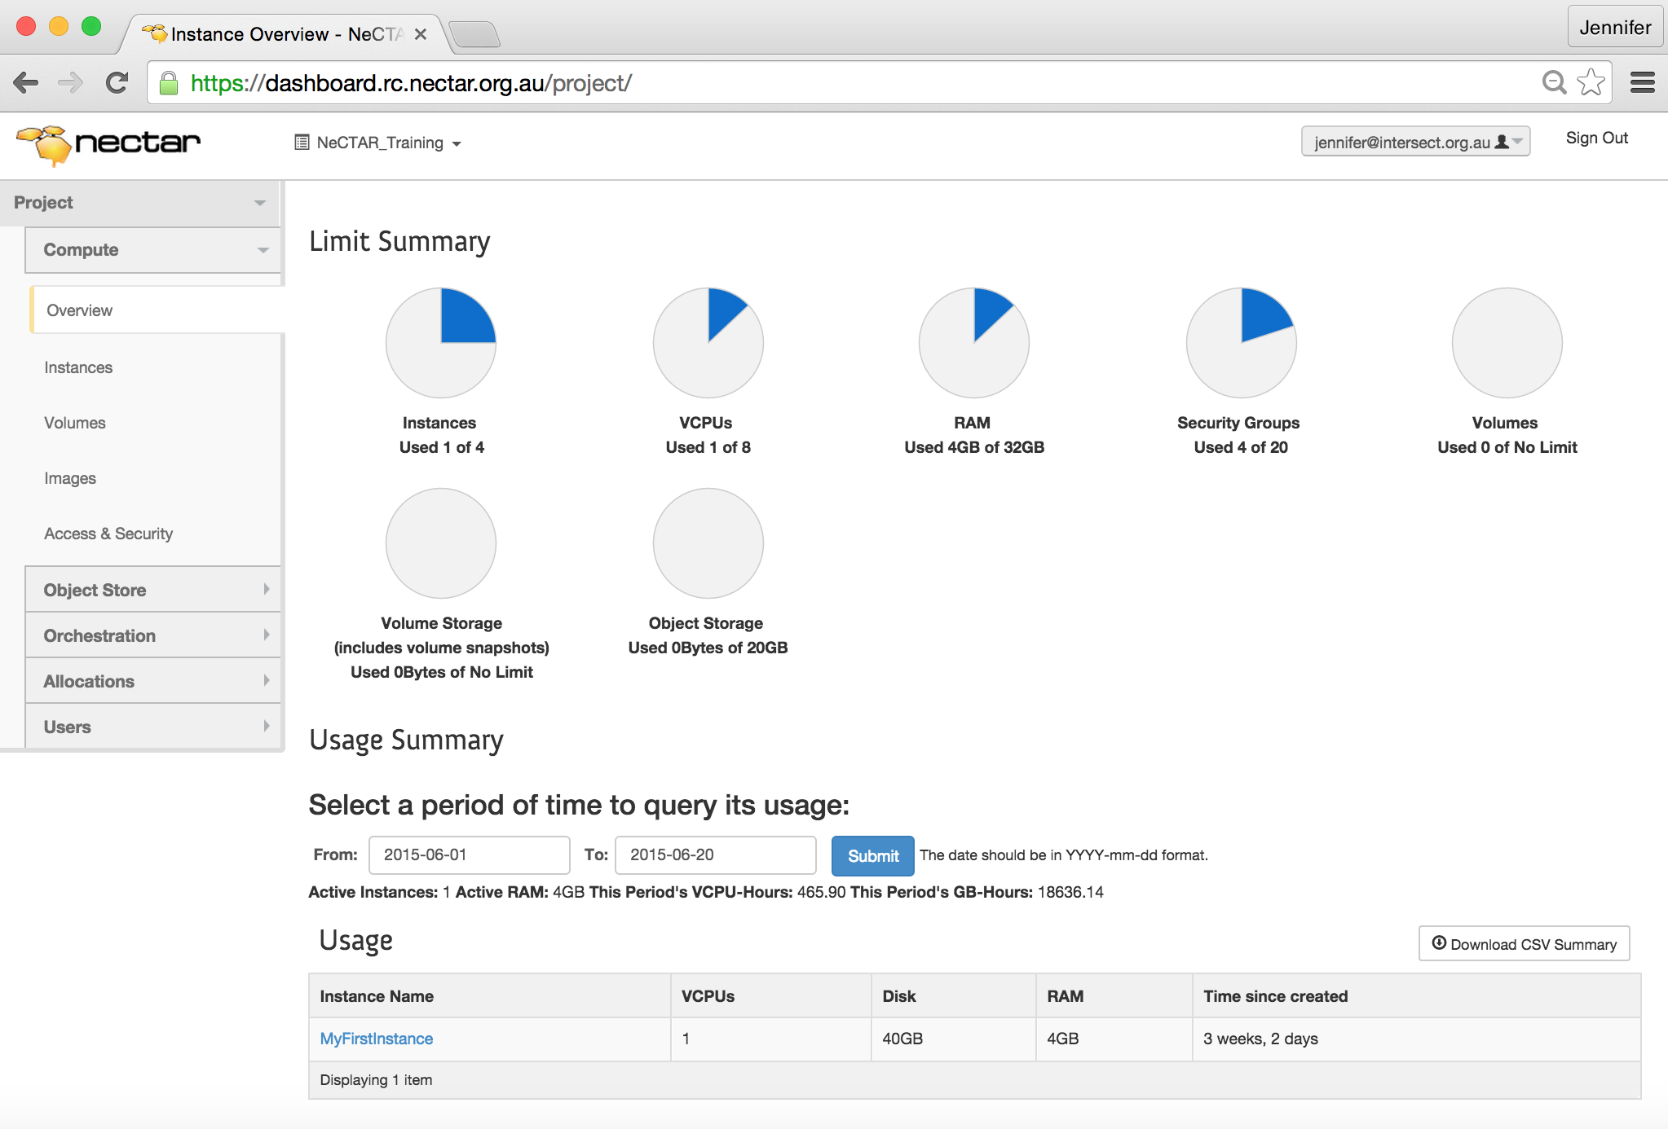
Connecting

Slide 6
Connecting
The Project Trial will be activated upon first logon to the Dashboard.
Project Trials have names like pt-12345.
You may launch virtual machines on the Dashboard.
You can then connect to the VMs and use them just like regular servers.
Notes:
Not only you can connect, but also and anyone else you allow access to the VM

Slide 7
Connecting
We will refer to a Virtual Machine as an Instance:
An instance is a running virtual machine (VM) on the NeCTAR Research Cloud. Instances running inside the Research Cloud are just like real-life computers, but in a remote location.
Notes:
Note: An instance is sometimes also one physical computer, but in the NeCTAR Cloud, all instances are virtual machines.

Slide 8
Connecting
Instances originate from Images.
Images of VMs are files which capture the configuration of a computer system.
To create your VM, you will have to select an Image.
NeCTAR has a few pre-configured Images that can make the set-up of a new instance much easier.
Notes:
An Image which can be used to launch instances captures the configuration of a computer system, including the Operating System, and stores it in an Image file.
Mention that the NeCTAR images can be used as a starting base, upon which individual configurations can be made.

Slide 9
Connecting
To suit your purposes, the instance may need some tweaking, configuration and installing of software.
Tipp: You may save the state of your virtual machine in a Snapshot after you have configured it (see Module 9).
Share the Snapshot with others, or
Re-launch instances from the Snapshot.

Slide 10
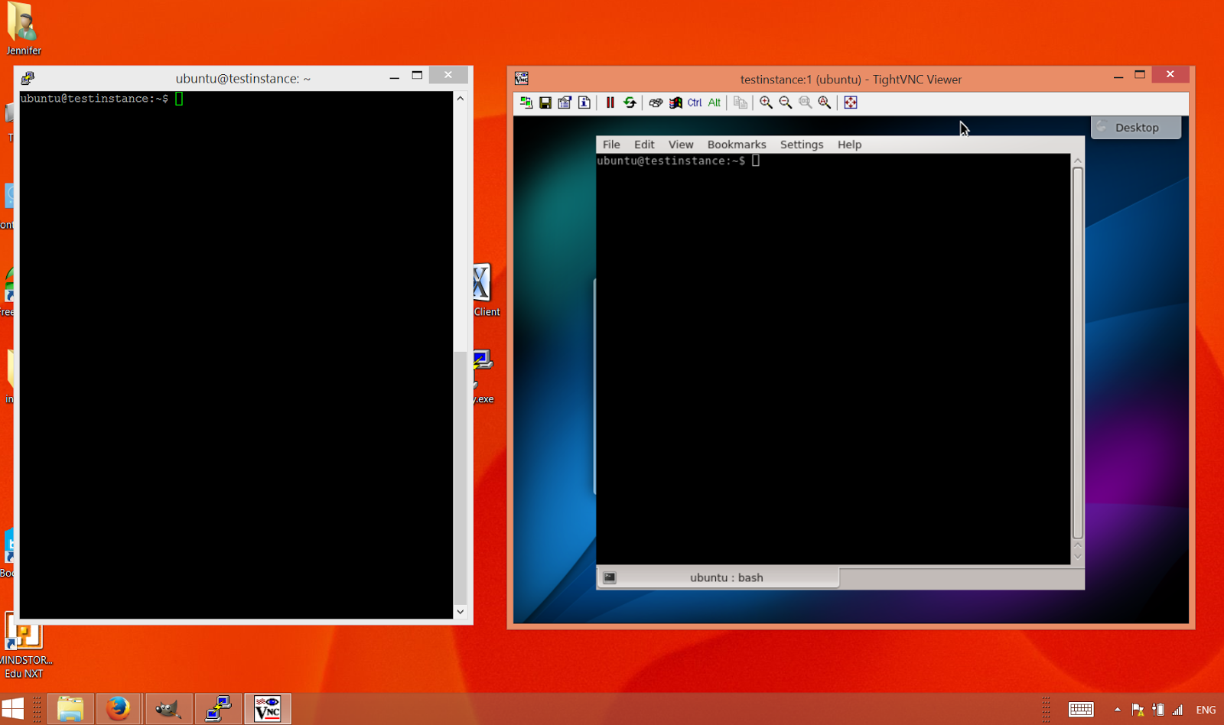
Connecting
Virtual machines can be accessed via
the command line terminal (left), or
using a remote desktop (right).
In Module 7 we will take a closer look at these two methods.

Slide 11
Mitigating risks: Housekeeping
Updates
Always ensure the newest security updates are installed on your virtual machine (see Module 7).
Backups
The NeCTAR cloud does not backup your data or your instance automatically. See Module 9 for data backup tools and methods.

Slide 12
Mitigating risks: Passphrases
You will need to choose passphrases at several occasions.
For example, you will have to create keys which are generated with a password and which encrypt the connection to the VM.
Always choose secure passphrases!
Never share your password with anyone!
Notes:
Secure passphrases:
Combinations of alphanumeric and characters.
It should be at least 10 characters long, and it should be hard to guess.
You should be able to remember it, or save it in a secure place!

Slide 13
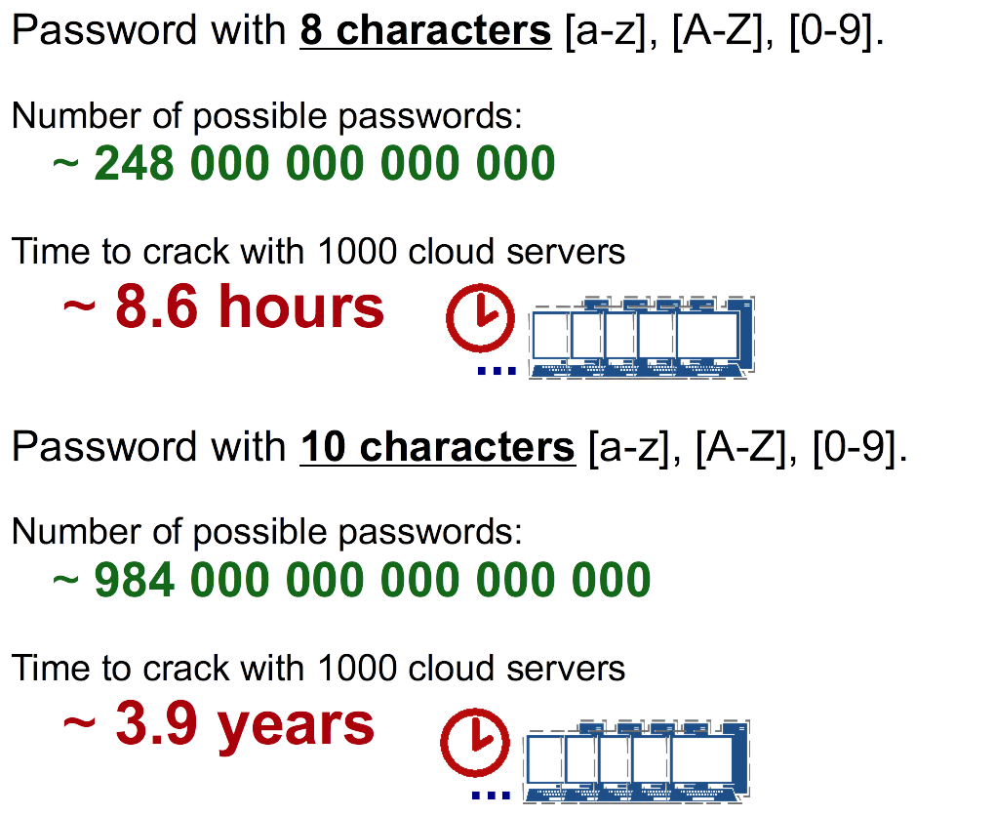
Mitigating risks: Passphrases
Notes:
Explain how passwords can be cracked by using a large amount of computers required to achieve the task.
The numbers in the figure show what a dramatic difference secure passphrases do when it comes to time required to crack them.

Slide 14
Mitigating risks: Firewall
Firewall protection: The NeCTAR instances come with a firewall protection already in place.
When you launch and manage your virtual machine, you will have to specify the firewall rules for it.
Manage “Security Groups” on the Dashboard.
Free up “Ports” to access your VM.
Notes:
A security group is a collection of firewall rules.
By default, the firewall allows no access, but you will have to free up Ports to be able to connect.

Slide 15
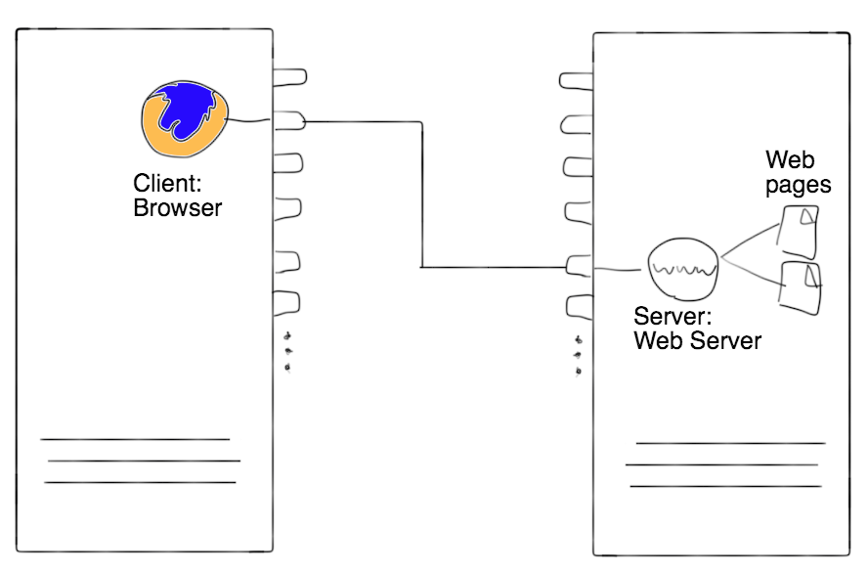
Mitigating risks: Firewall
Think of a Port like a plug: a network connection between two applications is established when two plugs are connected.
The two applications communicating are the server application and the client application.

Slide 16
Mitigating risks: Firewall
A firewall blocks all ports, unless they are explicitly opened.
Each free Port is also a potential entry point to the instance!
Connections to a Port are only possible if a server application is “listening” on that Port.
Make sure your server application is secure!

Slide 17
Mitigating risks: Secure access
When you connect to your virtual machine to control it, always use an encrypted connection.
In Module 7, we will learn how to establish a secure connection via SSH.
Many applications use SSH to secure a connection.
Notes:
It is possible to set up insecure connections if you allow this on your firewall rules of your virtual machine—don’t do this!

Slide 18
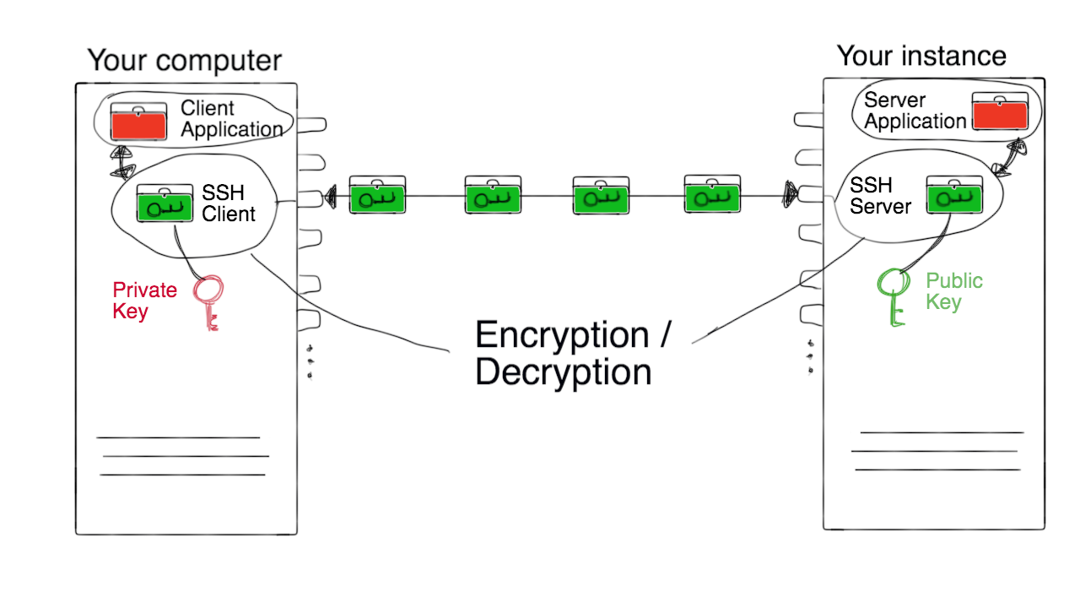
Mitigating risks: Secure access
SSH (“Secure Shell”) encrypts connections.
Two keys are required: The private and the public key.
Notes:
Explain with the graphic how the ssh client (on the local computer) uses the private key (it’s private because it’s not meant to be shared!) to encrypt/decrypt data packages to and from the client application. The public key is on the server and does the same – however the encrypted connection can only be established with both keys (i.e. having only the public key is useless).
By default, SSH uses Port 22. On the remote machine (the instance), a ssh server is running which accepts connections from ssh clients.
A simple client/server application is the ssh shell, which we will use in Module 7 to communicate with the instance.

Slide 19
Mitigating risks: SSH Tunneling
Some applications are not designed for a secure connection.
Unencrypted connections can be secured through the use of ssh tunneling.
This technique operates through the ssh client and server.
The application does not need to know that encryption is used—this is handled by ssh client and server.
Notes:
Explain how the unencrypted packages arrive at the application’s usual port. Use graphic on next slide to explain.

Slide 20
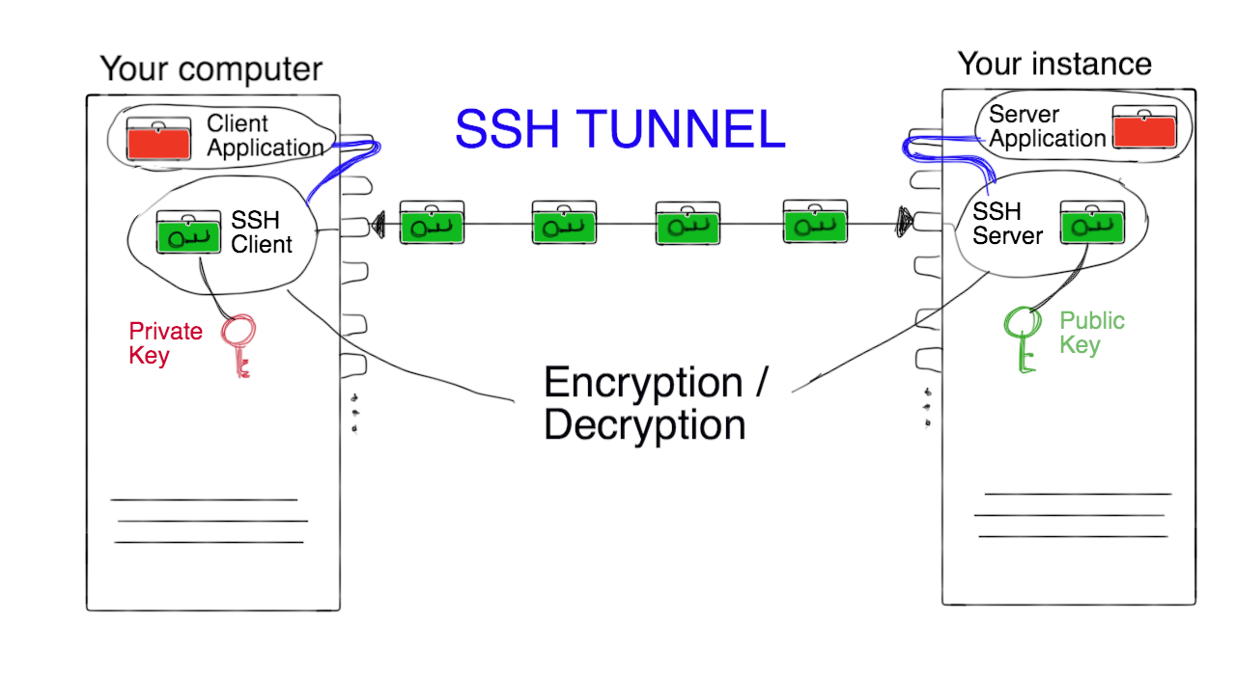
Mitigating risks: SSH Tunneling
Notes:
The data packages are forwarded to ssh client/server from the application end points. The applications “think” they are using their designated port, when in fact the connection is deviated via the ssh encryption on port 22. This way we can have lots of applications operating on various ports, but the firewall only needs to have port 22 open, as all connections are deviated via this ssh tunnel.
This is a good way to keep your VM safe!

Slide 21
Mitigating risks: Limiting access
Only grant access to your VM to people you trust!
Each user of the instance should ideally
Have their own user account and password, and
Use their own ssh keys—Module 7 will show how to do this.

Slide 22
Mitigating risks: Protection Software
Linux, Unix and other Unix-like OS are generally regarded as very well-protected against viruses
But they are not immune!
Your VM is already protected by a firewall, but you may also want to install an Anti-Virus protection.

Slide 23
Mitigating risks: Keep things tidy
Know your virtual machine!
You can then recognize when something abnormal happens.
Many types of attacks specifically target Web servers.
Use separate virtual machines for them!

Slide 24
Mitigating risks: Keep things tidy
Securely erase data from your storage (Module 9).
Prevent untidy machines: Don’t re-provision virtual machines constantly—
Rather keep optimizing one and then make Snapshots of it.
Notes:
See Module 9 which will cover all this.
Explain how re-provisioning is dangerous if you repeat the same set-up process many times. At some stage you’ll forget one step, e.g. installing anti-virus.
Rather set up a good basic VM first, take a snapshot, then modify more, take anohter snapshot, and so on. Then you can start up VMs not from the raw image, but from an already safer state.

Slide 25
Mitigating risks: Data encryption
Transfer sensitive data securely to/from your instance:
Use an encrypted connection (e.g. scp or sftp).
Encrypt files before you upload/download (see Module 8).
Risk added with file encryption!
If you lose the encryption key or forget the passphrase, you will lose the data forever!

Slide 26
Mitigating risks: Summary
In summary, things to watch out for to mitigate risks:
OS Upgrades, Data Backups
Secure passphrases.
Carefully configured firewall.
Secure methods of access (e.g. ssh).
Access limited only to trusted users.
Keeping things tidy.
Encrypting sensitive data.

Slide 27
Cleaning up
When you are finished with your work and don’t need the virtual machine any more, you should terminate it, so
it does not take up any more of your allocated resources.
resources become available to other researchers.
You can easily terminate an instance on the Dashboard.
Don’t forget: back up your instance and data before you terminate it (see Module 9).

Slide 28
Cleaning up
If you don’t need your NeCTAR data storage any more, you should delete it.
This can be done on the Dashboard.
Don’t forget: Before you delete your storage, back up your data and securely erase the drives (Module 9).

Slide 29
Getting support
There are several ways to get support:
For general advise, first contact your local eResearch office or IT services.
The NeCTAR project also offers online user guides and technical support through the support site
support.nectar.org.au
Notes:
POINT OUT: Please read the information given on the support website.
First read the known issues and FAQ, and search the support website and the community forum for a solution.

Slide 30
Allocation request
Request more resources on the Research Cloud by submitting an allocation request via the Dashboard.
Your association to a local cloud node may provide you with default allocations easily!
Notes:
After you have used the Project Trial to gain experience, you may want to request more.
Users should find out whether they have an association with a local cloud node, so they can specify this in the allocation request and get allocated in that node, where they’d have access to the resources (or more resources) easily.

Slide 31
Allocation request
Submit a request via the Dashboard—it may take up to 4 weeks for your resources to be available.
Refer to the On-Line Documentation of this course for details on how to submit an allocation request.
You may also request an increase of your existing allocation later.
Notes:
One note: “Core hours” you request is the amount of hours you estimate your instance will be in existence—the time between you launch and terminate it.

Slide 32
Closing note
In this module you have learned about processes to:
Get onto the Research Cloud.
Launch an instance and connect to it.
Do housekeeping and take other measures to mitigate risks.
Clean up after you by terminating VMs and deleting storage.
Get support.
File an allocation request.
Notes:
Note again that this was only an overview, and point out the modules in which the topics are treated in more detail later.
This module was only to get a rough idea of what tasks await the users.
Say that it may seem more scary as it actually may seem at this point --- it is actually all not very hard to achieve, and there’s step-by-step instructions in the later modules.

