Slide 1
NeCTAR Training
Module 9
Backing up & Packing up

Slide 2
Backing up & packing up
How to back up your VM and your data
Taking Snapshots of your VM
Backing up data
How to “pack up” and release resources
Terminating an instance
Securely erasing storage
Releasing storage

Slide 3
Why is it important to release resources?
Two reasons:
Running VMs and existing volumes block the resources to other researchers! Play fair.
Your running VMs will use up your allocated CPU hours!
It is easy! You can restore the state of your resources with the Snapshots and backups.
Notes:
“release resources” = Terminating instances and deleting volumes
NeCTAR experiences resource shortage problems from time to time, which is largely due to that most NeCTAR instances are seriously underutilized (they are idle). It has been observed that the average CPU utilization rate across the NeCTAR federation is less that 5%, and many large instances sit idle for days, weeks or months at a time.
Save your instance and volumes, release the resources, and re-launch your instance and volumes in exactly the same state when you need it again at a later time.

Slide 4
Instance Snapshots
Copy the state of your instance, and reboot it later in the same state:
Snapshots of an instance can be used like other Images to start new instances.
Snapshots only include data on your primary ephemeral drive.
Notes:
Mention that while “live snapshots” can be done, possible issues can be avoided by shutting down the instance first (see documentation online)

Slide 5
Volume Snapshots
A Volume Snapshot creates a copy of a Volume.
Is stored on the Research Cloud.
Uses up storage allocation quota.
A Snapshot can be used to create new Volumes.
Snapshots depend on the original Volume: it must still exist!
To delete a volume, you have to delete all snapshots of it first.
“Backups” — discussed later — offer a different functionality.
Notes:
Snapshots of Volumes
A Volume Snapshot creates a 1:1 copy of the state of a Volume.
A Snapshot creates an Image which can be used to create new Volumes – NOT restore existing Volumes!
Takes up significant disk quota the same size of your Volume.
The original Volume on which the Snapshot was based must still exist, or the Snapshots of it become useless.
If you want to delete a volume, you have to delete all snapshots of it first!
You may prefer other forms of backup discussed later.

Slide 6
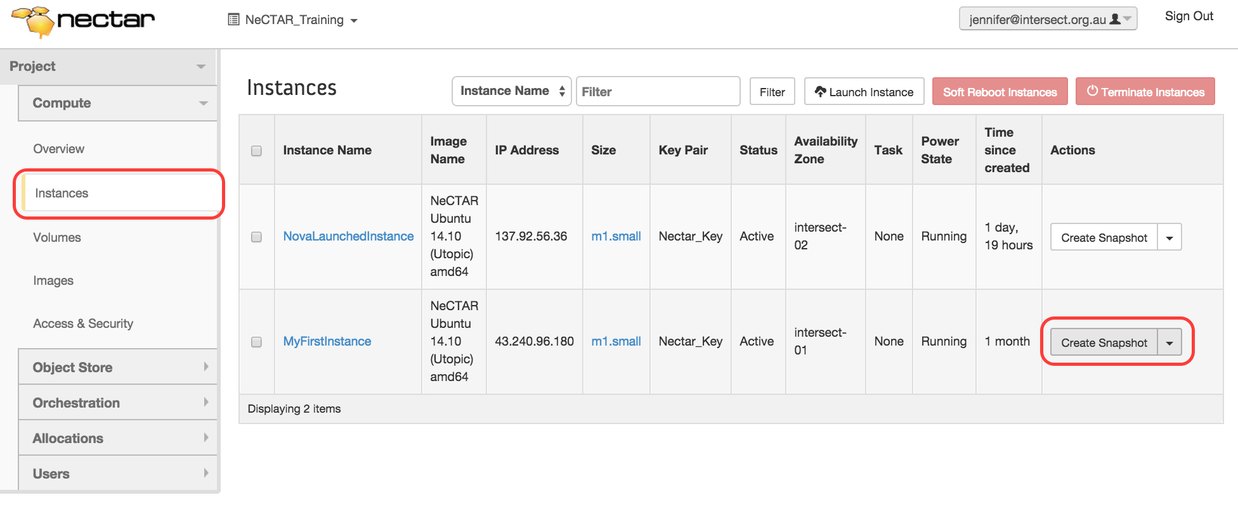
Instance Snapshots
Exercise 1
Take a snapshot of an instance on the Dashboard

Slide 7
Instance Snapshots
Exercise 2
Launch a new instance from the snapshot
Go to Dashboard > Compute > Images
Find the Snapshot image you would like to launch a new instance from, and click Launch
This brings up the familiar launch dialogue.
Notes:
Select the Project filter on the top of the list, and you will get an overview of all your own Images.
Explain how you have to select availability zone, ssh key etc. Keep the flavor or choose a larger one.

Slide 8
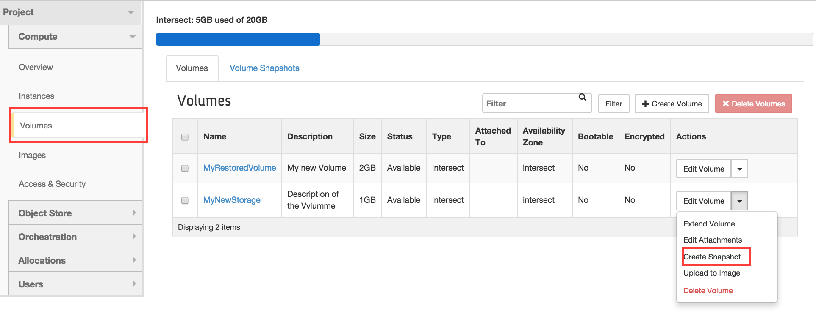
Volume Snapshots
Exercise 3: Create a Volume Snapshot
First, make sure the Volume is detached and in Status available.

Slide 9
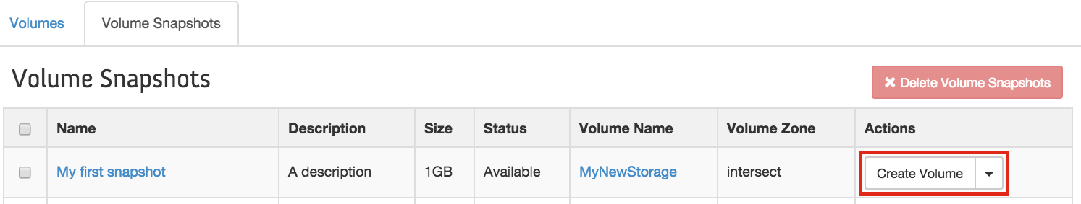
Volume Snapshots
Exercise 4: Create a new Volume from a Snapshot
Go to Dashboard > Compute > Volumes and click on “Create Volume”
Notes:
Point out that the size of the new volume should be at least the size of the original snapshotted volume. The original size can be looked up in the “Volume Snapshots” details by clicking on the name. But the dialogue should pre-fill the correct size already.

Slide 10
Backing up
Notes:
Generally speaking, NeCTAR does take measures against data loss
While mostly RAID backed storage systems are used to secure the data, there’s no guarantee this is the case.
The guideline is “all care taken, no guarantees given” — part of ensuring your data won’t be lost is your responsibility: Back it up!

Slide 11
Backing up
You may back up your data
On-line (in the cloud)
Off-line (on your premises)
Notes:
Generally speaking, NeCTAR does take measures against data loss
While mostly RAID backed storage systems are used to secure the data, there’s no guarantee this is the case.
The guideline is “all care taken, no guarantees given” — part of ensuring your data won’t be lost is your responsibility: Back it up!

Slide 12
On-line backups

Slide 13
On-line backups
Object store
Already maintains redundant copies.
Scripts can be written to automate backups.
Volumes
Snapshots & Backups
On-Instance storage
Primary drive: Instance Snapshots
Secondary drive: Only manual backups, e.g. onto a Volume.

Slide 14
Backing up Object Storage on-line
Object storage is quite robust against data loss.
To backup the data on-line:
Use clients like CyberDuck or FTP clients like FileZilla to copy your files across manually (see Module 7).
Write scripts for automated backups with OpenStack command line tools discussed in Module 10.
Notes:
Mention again that data replication contributes to data safety.
Describe the listed tools as in the On-Line documentation to give an overview.

Slide 15
On-line Volume “Backups”
“Backups” can be made with the OpenStack command line client.
This will be explained in Module 10.
It is planned to integrate Backups in the Dashboard as well.
This will be similar to taking Snapshots.

Slide 16
Volume Snapshot vs. Backup
Snapshot
Backup
1:1 copy of entire volume.
Stored as Image on the NeCTAR Image Server.
Create a new volume.
Depend on the existing original volume.
Backup used data on volume.
Stored in Object Storage.
Create a new volume or restore an existing volume.
Independent of original volumes existence.

Slide 17
Off-line backups

Slide 18
Off-line backups
Object storage
Copy files with clients like Cyberduck.
Scripts can be written to automate backups with the openstack command.
Volumes and On-Instance Storage
Manual backups
Incremental backup tools
RSync command line utility
Automated services like BackupPC
… and more which support backup of remote directories.
Notes:
Manual backups: Using clients like e.g. FTP, or creating zip files and then copying them over.
Problem with manual backups: Copying the whole file across every time.

Slide 19
RSync command line utility
Rsync is a Unix command line tool
Maintains a copy of a local directory on a (typically) remote system, in a traditional “mirror” fashion.
The contents of the two folders, which we call source and destination folders, are synchronized.
Notes:
Source and destination folders can be on the same computer, or on separate computers that are accessible over a network.
In the most typical backup scenario, the source would be the disk which is mounted on your NeCTAR instance, and the destination would be a server at your research organization onto which the data will be backed up. The destination folder can also be on your local computer, though this is not a robust backup location, so it is recommended to use a dedicated backup server.

Slide 20
Rsync command line utility
Creates incremental backups: only what has changed in the directory since the last backup will be copied to the backup folder.
Can compress and encrypt data streams during the backup process.
Notes:
Rsync creates incremental backups, which means only what has changed in the directory since the last backup will be copied to the backup folder, so not every time a backup is performed all files have to be transferred again. This speeds up the backup process, especially with slow network connections.
Rsync can also compress and encrypt data streams during the backup process, which is important if the data being backed up has to travel through the internet to reach the server which maintains the backup copy.

Slide 21
Rsync command line utility
A good choice if:
You want to create a backup of the most recent state of your volume or secondary ephemeral drive.
And save the backup on your local computer, or another computer onto which you can log on to with a terminal.

Slide 22
Rsync command line utility
Advantages:
Incremental per-file copies enable a generally fast backup.
Easy to access (and edit) files off-line and then synchronize.
Uses ssh for a secure connection.
Drawbacks:
Difficult to maintain backups of multiple time points.
Aborted rsync process leaves a mix of old and new files.
It is s a bit more complicated to set up automated backups.
Notes:
Drawbacks:
- Difficult to maintain multiple copies: Rsync is more suitable to keep a backup of the most recent state.
- If something goes wrong while the rsync process in ongoing, the backup will contain a mix of old and new files.
Automated backups: you can do this using cronjobs; But the easiest is if you do the backups manually each time you want to back up your data.

Slide 23
Rsync command line utility
Installation of Rsync on your local computer:
Linux: On many distributions, rsync is already installed. If it is not, install for example on Ubuntu/Debian: $ sudo apt-get install rsync
On Mac OS X, rsync is available by default.
Under Windows, rsync can be installed as part of the cygwin package and used from the command line.
Notes:
Windows: This is a bit more complicated, so if you are using a Windows system, rsync is maybe not the right choice.

Slide 24
Backing up
Exercise 5 (Linux and Mac users)
Reference: Usage of rsync, automatically using your ssh keys: $ rsync -av <source directory> <destination directory> (Manually specify ssh key with option -e '-i <path-to-private-key>’)
Step 1. Create a test file with some text in your ssh terminal, e.g. in the /data folder. Then, synchronize in your local terminal: $ rsync -av ubuntu@NNN.NNN.NNN.NNN:/data/ dataCopy/ $ ls dataCopy
Step 2. Create a test file with some text in your local dataCopy folder. In your local terminal: $ rsync -av dataCopy/ ubuntu@NNN.NNN.NNN.NNN:/data/ In your ssh terminal: $ ls /data
Notes:
Windows users can grab a coffee ;)
Or they can read online instructions for other backup tools in the meantime.

Slide 25
Packing up

Slide 26
Cleaning up
Be responsible and have your instance and volume storage up and running only when you really need it.
Or your resources will sit idle, and you will be using up your CPU hours and block the resources to other researchers.
We will now learn how to
Terminate instances
Securely erase data
Delete volumes

Slide 27
Securely erasing data
Just removing all files from your secondary ephemeral drive or your Volumes won’t do the job.
To securely erase the data, you have to overwrite all bits with other (random) bits.
Notes:
Only removing files just removes the index of the files (think of it like a table of contents), but the actual bits of the files will still be on the harddrive, so it is possible to restore them when using special tools.
Overwriting data: You even have to repeat the overwriting several times to be sure nothing can be recovered. Some people even argue the only way to really, really ensure the data is erased is to burn up the hard drive — an option we don’t have in this case, so we will have to be satisfied with overwriting the data several times.

Slide 28

Notes:
This is a block of storage

Slide 29
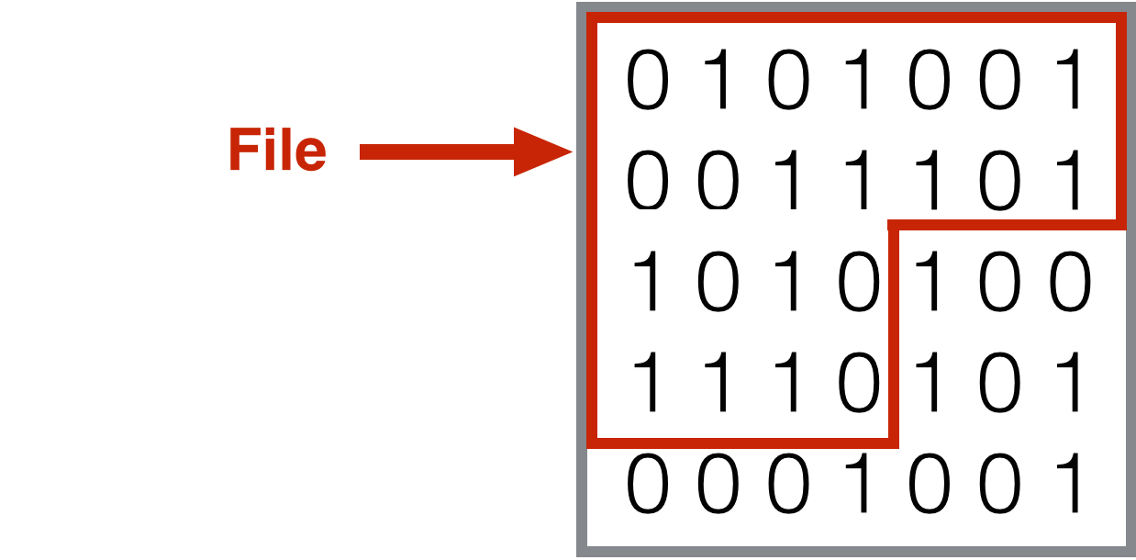
Notes:
A file boundary in the block of storage

Slide 30

Notes:
File removed: 0es and 1s still there, only boundary removed

Slide 31
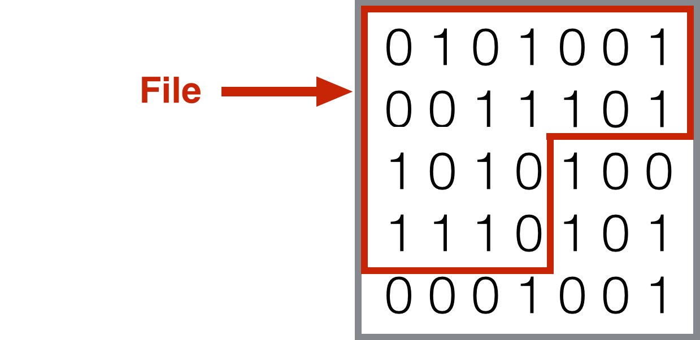
Notes:
File was restored by a smart scanning software.
Clicking up arrow key twice, then down arrow key twice, and repeat, to create a shuffle effect in the next slides to show how the bits are overwritten.

Slide 32
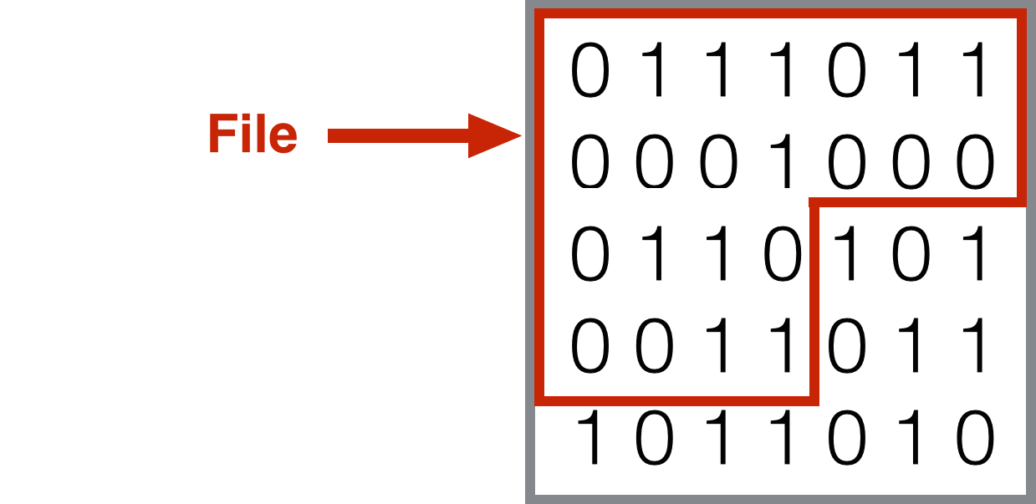

Slide 33
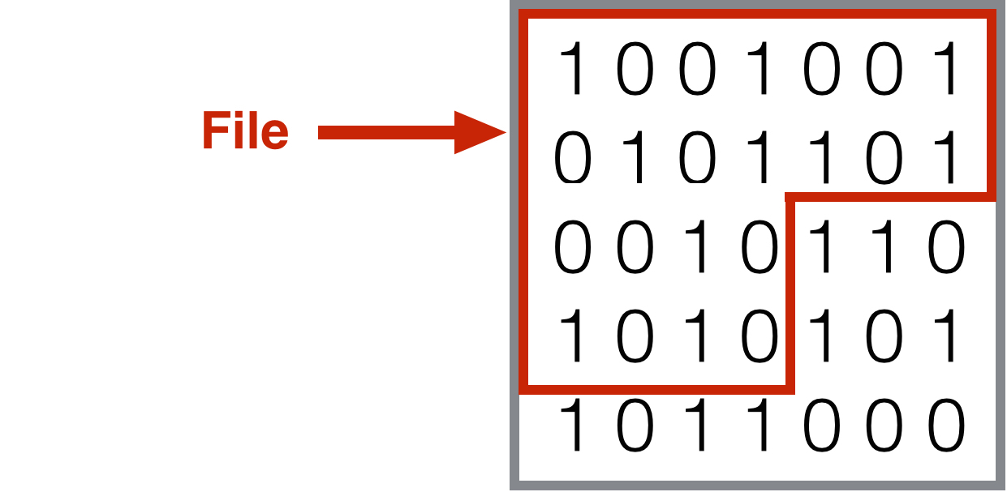

Slide 34
Securely erasing data
This is good, but: To make absolutely sure nobody ever gets access to your data, you should encrypt it!
After securely erasing data, you can release the storage.
Terminate instance to release 2ndary drive.
Delete volume storage.

Slide 35
Securely erasing data
A number of tools can be used to securely erase data:
The dd command line utility
$ sudo dd if=/dev/urandom of=<device file> bs=4K
The shred command line utility
$ sudo shred -v <device file>
.. and more.
See On-Line Documentation for more details.

Slide 36
Securely erasing data
Exercise 6:
Use dd to erase a volume or 2ndary ephemeral drive.
Find out your device file name. In your ssh terminal:
$ sudo lsblk –l
Unmount your device, e.g.
$ sudo umount /dev/vdc
Erase the drive:
$ sudo dd if=/dev/urandom of=/dev/vdc bs=4K
This is finished when dd reports the error “No space left on device”

Slide 37
Packing up
Terminating instances on the Dashboard
First make sure you have securely erased the data on the secondary ephemeral disk.
Go to Dashboard > Compute > Instances and find the instance you want to terminate in the list.
In the right-hand side drop-box next to the instance, select Terminate instance.

Slide 38
Packing up
Deleting Volumes on the Dashboard
First, make sure you have securely erased all data.
Detach the Volume from any instance.
go to Dashboard > Compute > Volumes and find the volume you want to delete in the list.
In the right-hand side drop-down menu, select Delete Volume.

Slide 39
Closing note
You have now learned how to
back up your instances and your data.
release resources securely for other researchers.
recover your resources after you have terminated or deleted them.
You are now ready to apply your knowledge about the Research Cloud to your research!
Notes:
Outlook on Module 10: If you like using the command line to get things done, you will love the extra information given in the last Module.

