Slide 1
Flutter Layout
Author: Yung-Hsun Chen

Slide 2
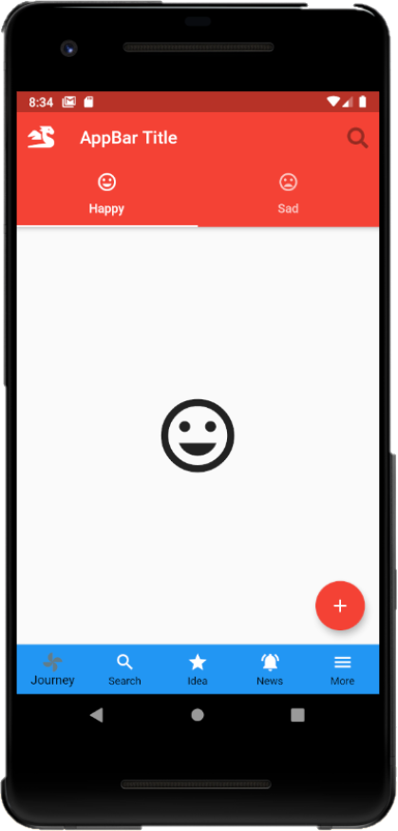
Menu
1.AppBar
2.Drawer
3.NavigationBar
4. FloatingActionButton

Slide 3

AppBar
Leading
Title
Actions
Bottom

Slide 4
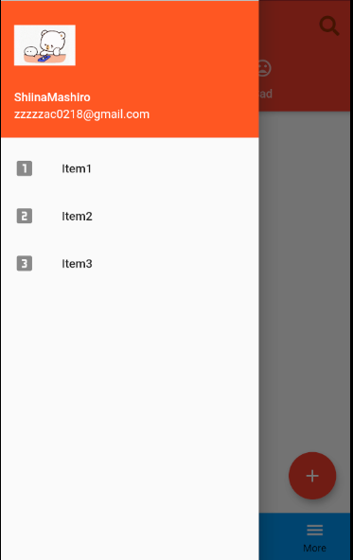
Drawer

Slide 5
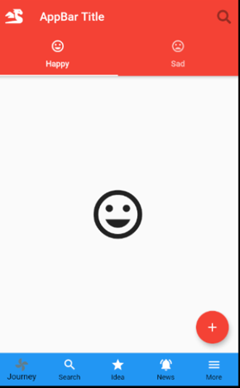
NavigationBar
NavigationBar

Slide 6
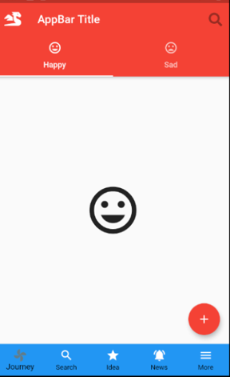
FloatingActionButton
FloatingActionButton

