Slide 1
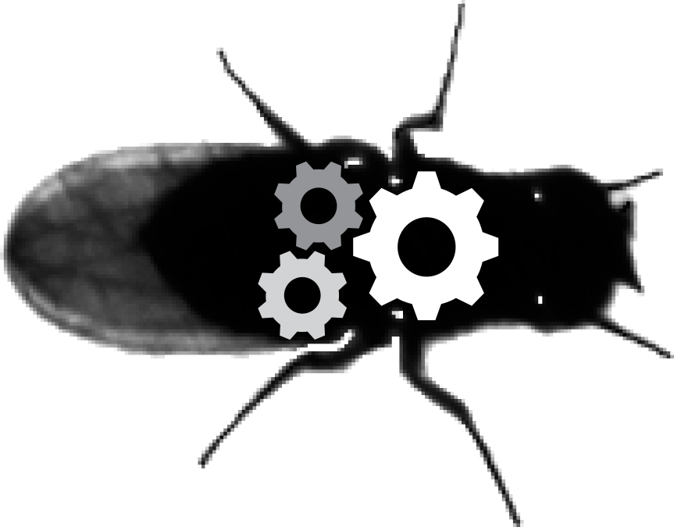
Introduction to central pattern generators (CPG)
Neuroengineering Laboratory

Slide 2
Decentralised or centralised?
Last week:

Slide 3
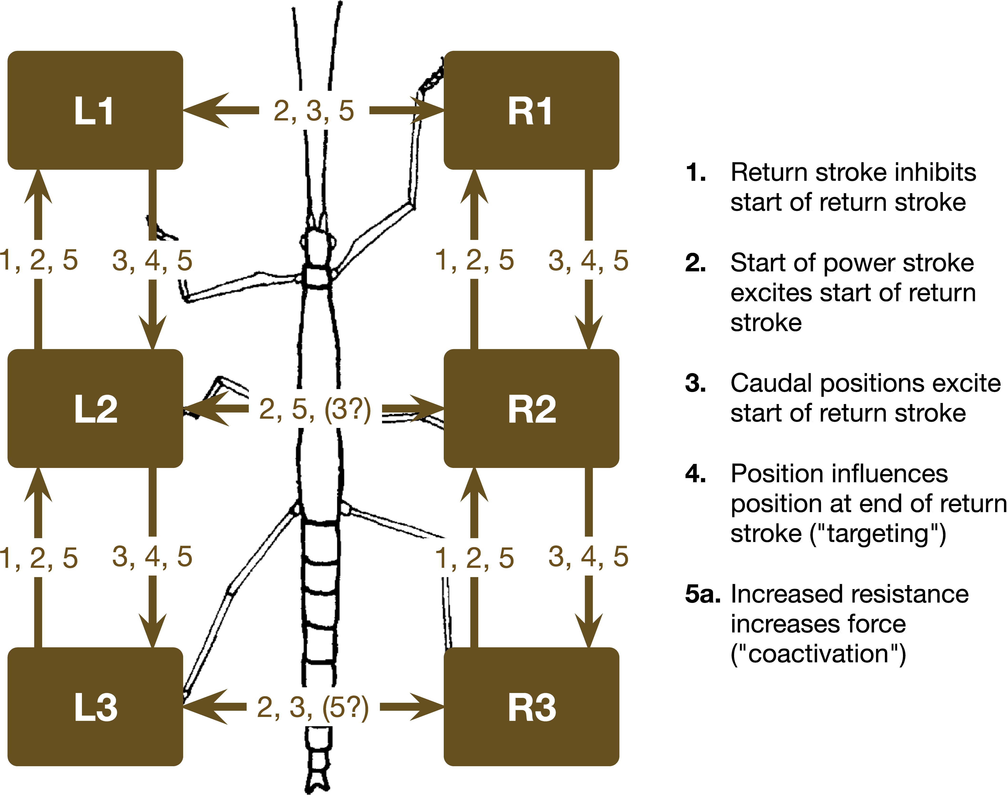
Decentralised or centralised?
Last week:
M. Schiling et al. PLOS computational biology (2020)

Slide 4
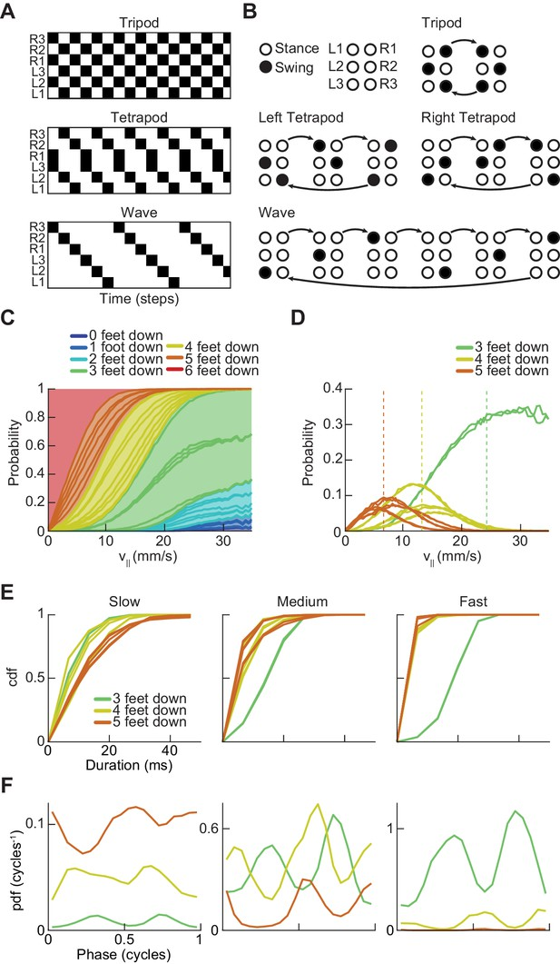
Diversity of walking gaits
This week:
There exists more diversity than possible by following rigid rules only
3 main gaits, but a continuum might exist
DeAngelis et al., eLife 2019

Slide 5
Diversity of walking gaits
Common features: rhythm and regularity
Classical description: oscillators
DeAngelis et al., eLife 2019

Slide 6
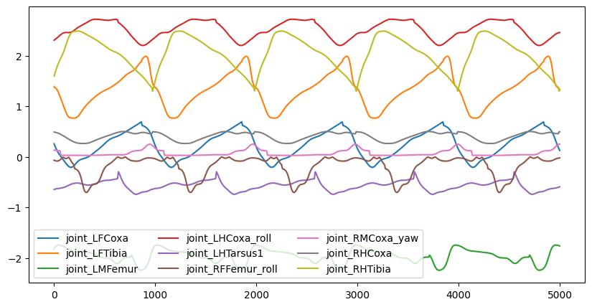
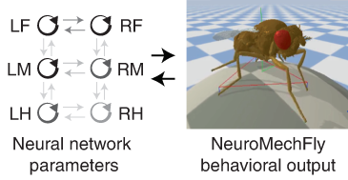
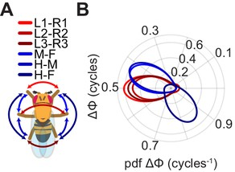
Diversity of walking gaits
One possible description:
Each leg is described by an oscillator
The phase of the oscillator is matched to the phase of the leg swing
Possible to tune the coupling between the oscillators to match phase difference between limbs
DeAngelis et al., eLife 2019 & Lobato-Rios et al., Nature Methods 2022

Slide 7
Where does the rhythm come from?
Wiki: Central-Pattern-Generators
Central Pattern Generators (CPGs) are neural circuits that generate rhythmic output without receiving rhythmic input.
CPG
Model used to explain rhythmic activity in animals

Slide 8
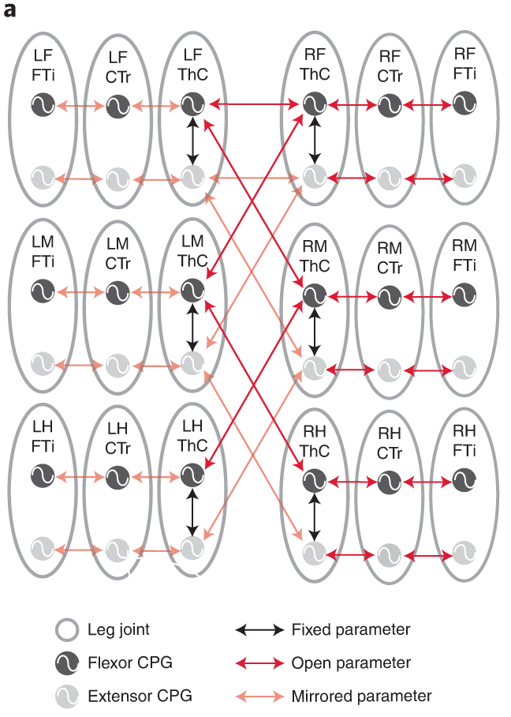
Where does the rhythm come from?
Wiki: Central-Pattern-Generators
Central Pattern Generators (CPGs) are neural circuits that generate rhythmic output without receiving rhythmic input.
Model used at many levels:
Entire legs
Single joints
Single muscles
…
Lobato-Rios et al., Nature Methods 2022

Slide 9
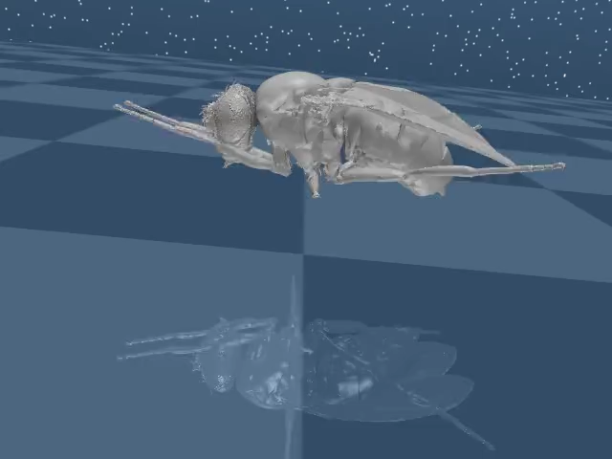
Today: implement CPG-driven walking
Parameters of the CPGs:
Input
Frequency
Coupling
Tripod gait

