Slide 1
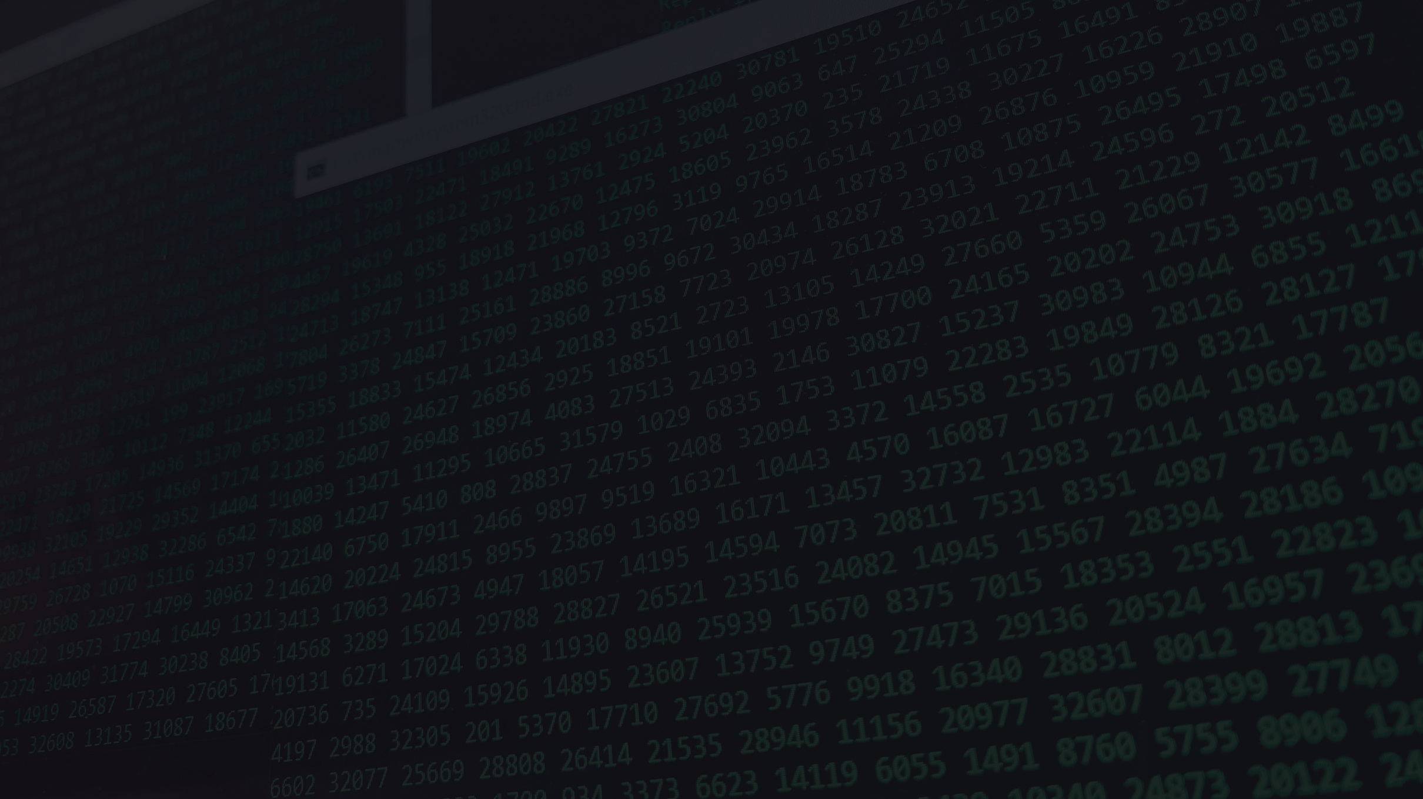
USER BEHAVIOR ANALYTICS
FOR
INSIDER THREATS
Monitor employee activity and flag unusual behavior
PROJECT: SilentFlag
Team: BlackWater

Slide 2
PROBLEM STATEMENT
Insider threats are one of the most difficult to detect in any organization.
Unusual behaviors like late-night access, large file downloads, and unauthorized actions need to be flagged.
We aim to develop an automated system that tracks and analyzes user activity to identify and alert for suspicious behavior.

Slide 3
SOLUTION OVERVIEW
A system that monitors and analyzes user activity in real-time.
Flagging abnormal behavior using a combination of rule-based and machine learning techniques.
Real-time alerts to administrators on detected anomalies.

Slide 4
TECHNOLOGY STACK
Backend: Python / Node.js
ML: Scikit-learn / TensorFlow / Custom Logic
Database: MongoDB / PostgreSQL
Frontend: React / HTML-CSS
Deployment: AWS / Firebase / Localhost
Optional: Logging Tools (ElasticSearch, Kibana, etc.)

Slide 5
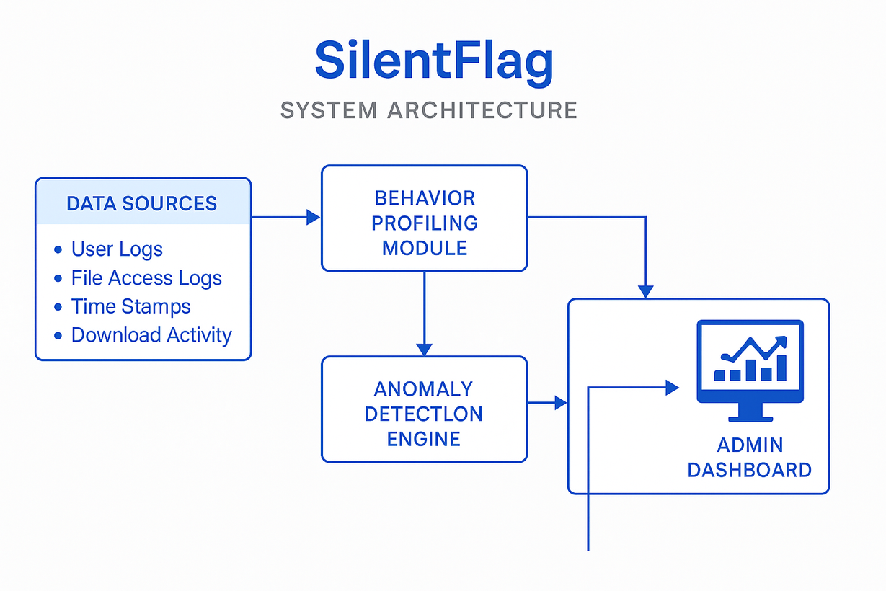
ARCHITECTURE/WORKING BLOCK DIAGRAM

Slide 6
KEY FEATURES
Behavior Tracking (logins, file downloads, work hours)
Anomaly Detection (ML models or statistical rules)
Real-time Alerts
Admin Dashboard
Privacy-respecting Logging

Slide 7

THANK YOU

