Slide 1
The Implementation of a Communication Deadlock Analysis Based on the Theory of
Deadlock Analysis for the Actor Model
Harris, Johnny, Jack

Slide 2
Introduction
Actor: Isolated concurrent entities that do not share states.
Communicate though asynchronous messages
Respond to a message by:
  generating a finite set of messages
  changing its state
  creating a finite set of new actors

Slide 3
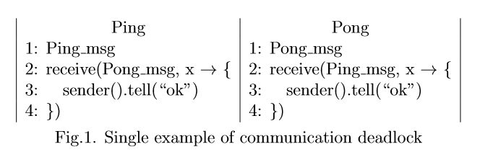
Special Situation

Slide 4
Communication Deadlock
A communication deadlock is a condition in a system where two or more actors are blocked forever waiting for each other to do something.
Restricted Communication Deadlock
In our research, two or more actors don’t sent messages that are required by another actor and only possessed by themselves, so that the actor system reaches a state that each actor in the actor system is waiting for another actor to send its message.

Slide 5
Derivation from Dependency Graph
GS is actually built upon nodes like objects and task identifiers and whose edges are defined between objects and tasks

Slide 6

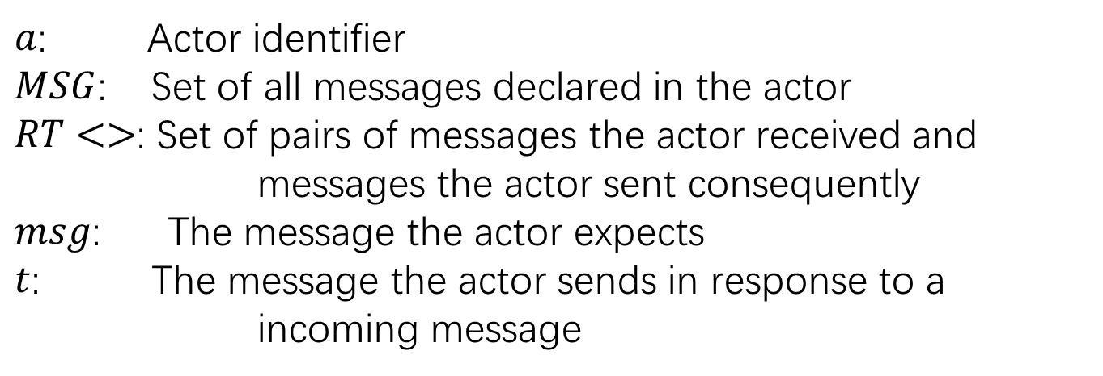
Semantics
$a$: Actor identifier
$MSG$: Set of all messages declared in the actor
$RT<>$: Set of pairs of messages the actor received and messages the actor sent consequently
$msg$: The message the actor expects
$t$: The message the actor sends in response to a incoming message

Slide 7
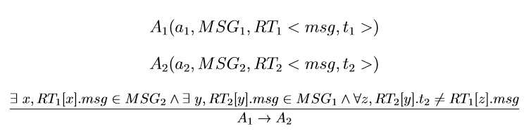
Slave Dependency Relationship

Slide 8
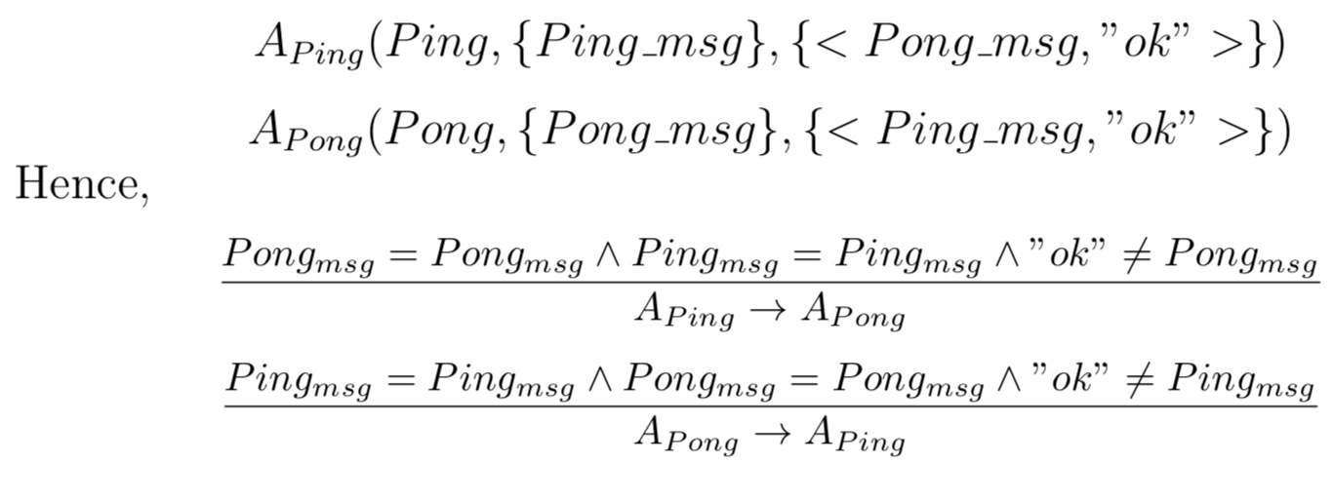


Example
$$Ping→Pong$$
$$Pong→Ping$$

Slide 9
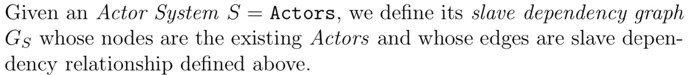
Restricted Communication Deadlock Detection
Slave Dependency Graph

Slide 10
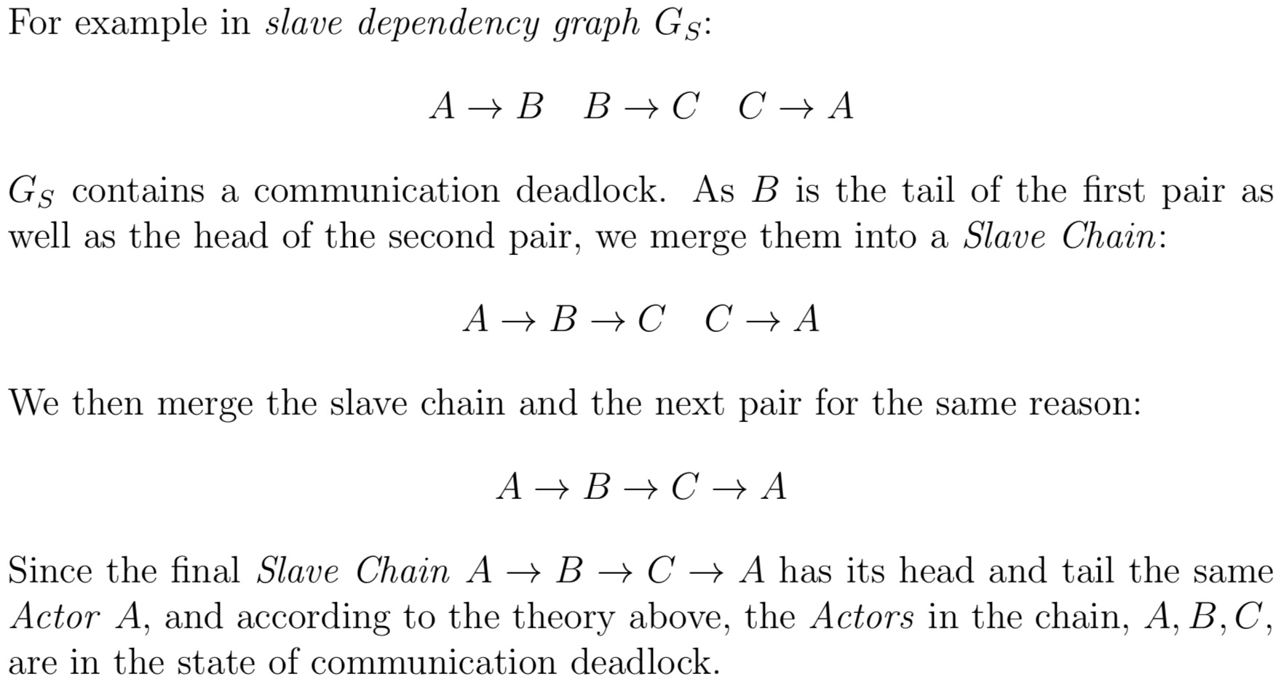
Slave Chain
The way to find circles in the slave dependency graph.

Slide 11
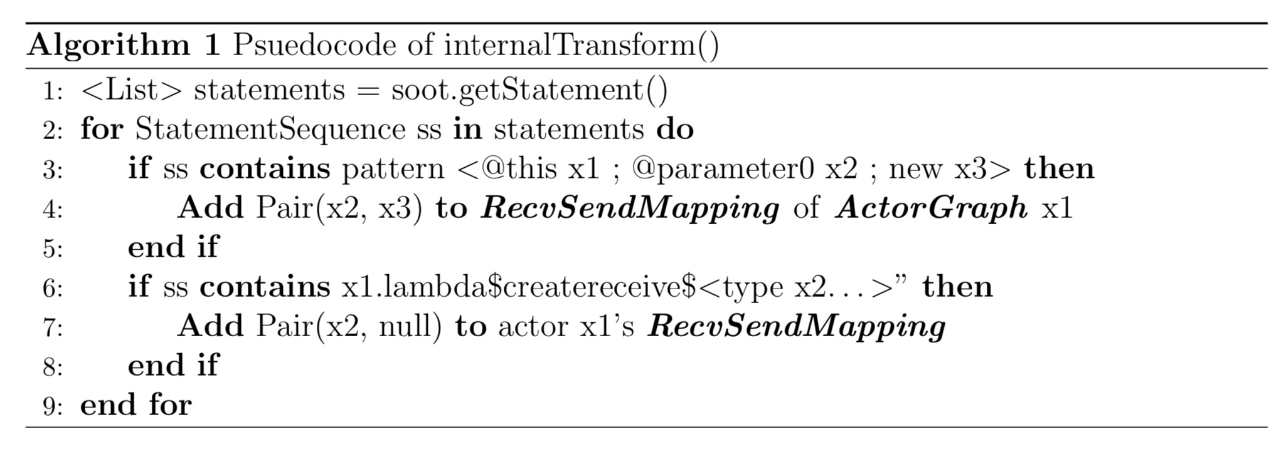

Implementation

Slide 12
Restrictions
The message must be sent by the Actor that it is belonged to.
In in each method match() of an Actor class, there is only one tell() function, which sends back the message declared in the Actor.

Slide 13
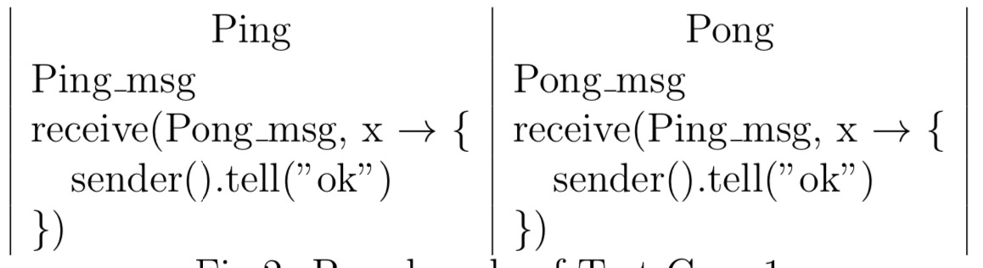
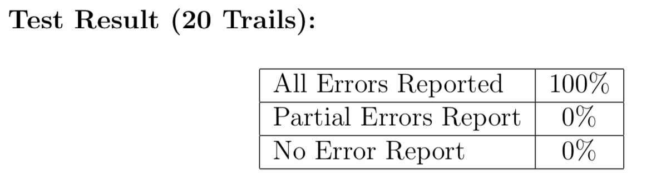
Test Cases

Slide 14
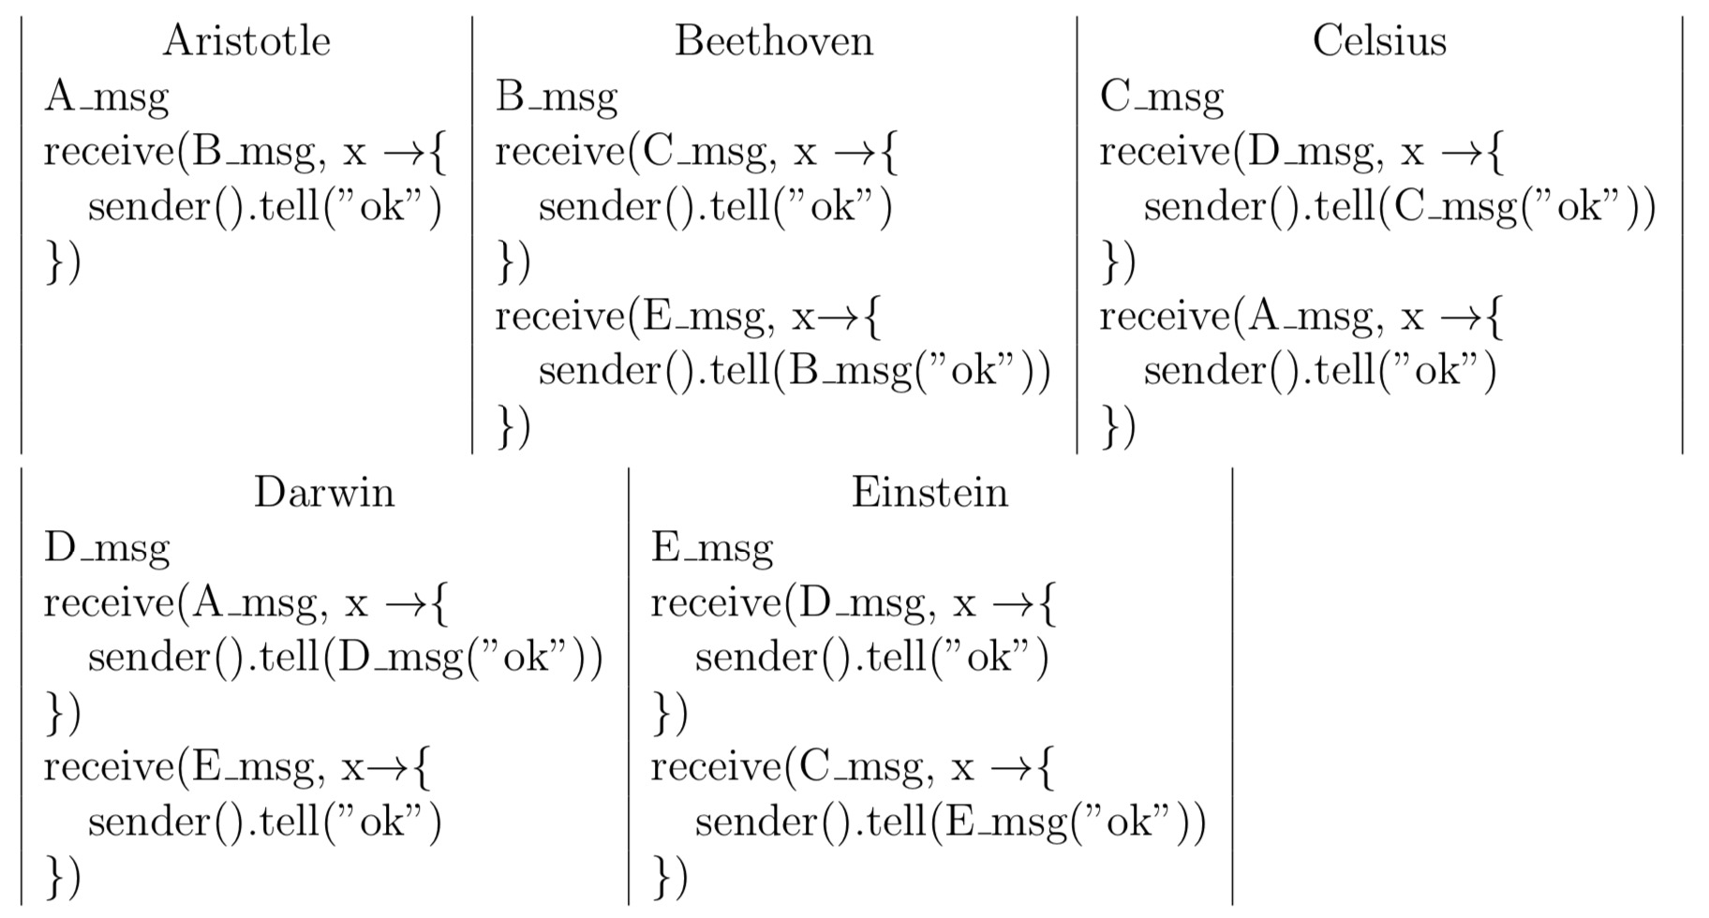
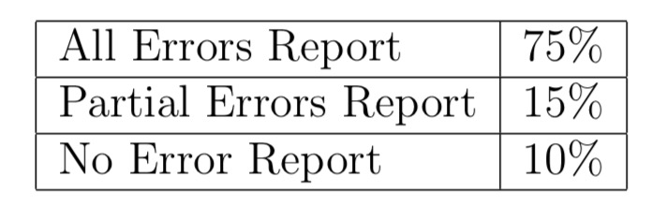
Test Cases

Slide 15
Related works
Flores-Montoya et al.
  Dependency Graph
  Find deadlocks by finding circles in Dependency graph
  Focus on thread based concurrency
Maria Christakis and Konstantinos Sagonas
  Control Flow Graph
  Deadlock when CFG not closed
  Implemented on open-sourced libraries

Slide 16
Conclusion
We develop a novel dependency graph, slave dependency graph, in which we can find communication deadlocks of an actor-based program, and demonstrate the algorithm’s feasibility by the implementation of building an analysis program. The analysis program can detect a specific kind of communication deadlock in an actor- based Java program with Akka toolkit

Slide 17
Limitations
imperfect precision of our analysis program
a narrow definition of communication deadlock

