Slide 1

Software Code
Bug-Fixing using Unsupervised Learning
‘BREAK-IT-FIX-IT: UNSUPERVISED LEARNING FOR PROGRAM REPAIR’
MICHIHIRO YASUNAGA PERCY LIANG

Slide 2
TEAM DATA PIRATES
Aayush Patel (202101452)
Pranav Patel (202103040)
Kalp Shah (202103003)
Vatsal Shah (202103022)

Slide 3

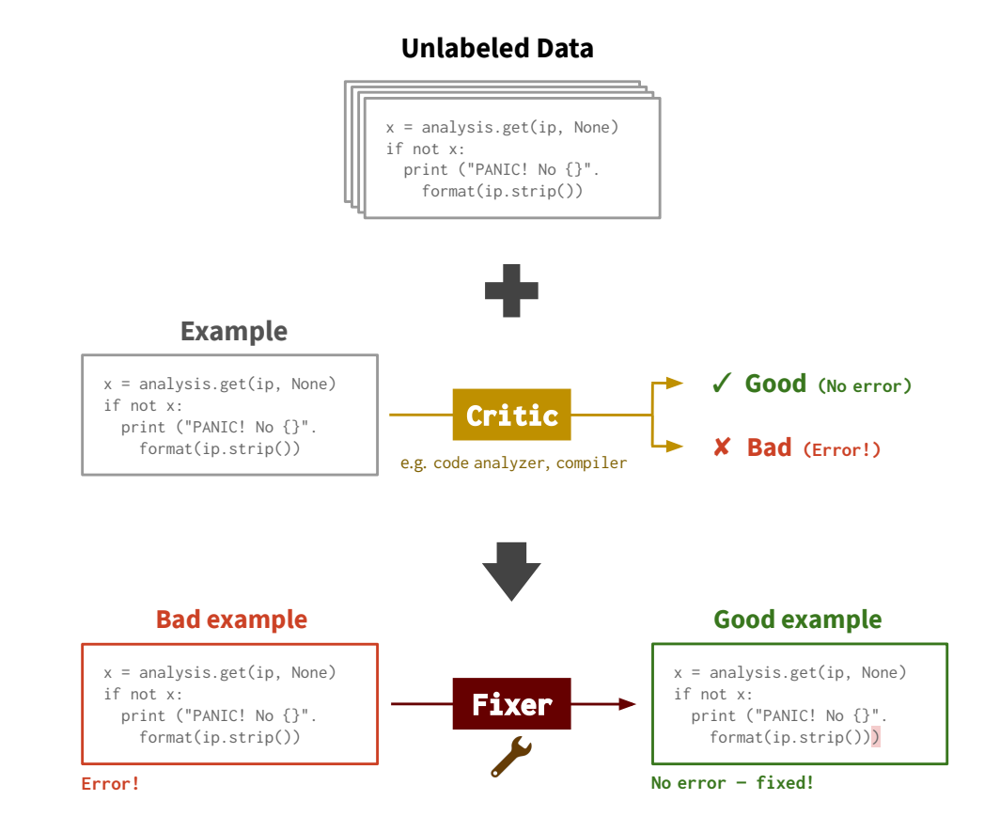
PROBLEM SETUP
We are given a CRITIC that assesses the quality of an input. The code is bad if there is at least one error and it is good if there are no errors.
Our goal is to train a FIXER that repairs bad code into good code that satisfies the critic, i.e using unlabeled data and critic to learn a fixer.

Slide 4
THE DATASET
GitHub-Python
Dataset of 3M Python code snippets from github.com.
Unpaired set of good code and bad code.
38K snippets of bad code and ~3M snippets of good code.
Consists of following columns- code_string, code_toks_joined, anonymize_dict, err_obj.

Slide 5
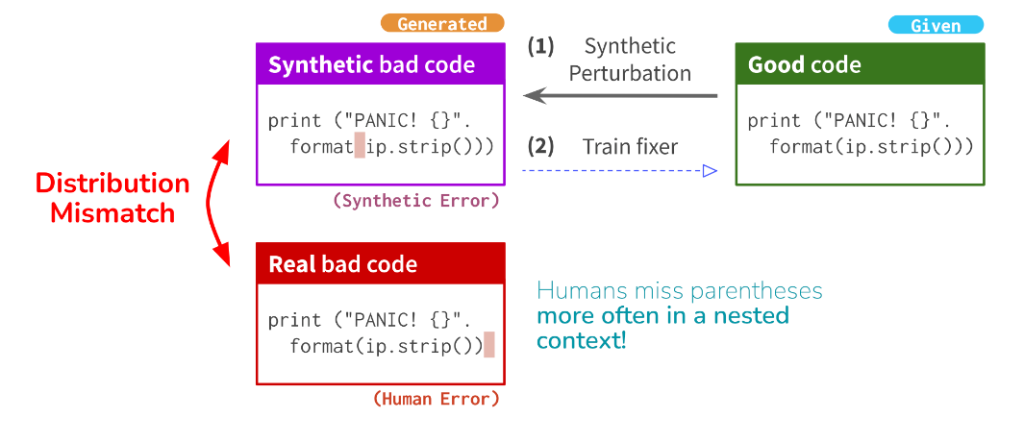
CHALLENGES FACED
Unaligned Data Challenge: Manual labeling of paired data, (broken code, fixed code) is costly. Hence we learn from unlabeled data.
Synthetic Data Issue: Perturbations (e.g., dropping tokens) create synthetic bad code that doesn't reflect real-world errors.
Distribution Mismatch: Synthetic errors often differ from actual human errors, especially in nested contexts.
Hence, BIFI was proposed to deal with this major problem.

Slide 6
SOLUTION: BREAK-IT-FIX-IT (BIFI)
The basic idea of BIFI is to introduce a ML-based BREAKER that learns to corrupt good code into realistic bad code, and iteratively train both the fixer and the breaker while using them in conjunction to generate more realistic paired data.
Concretely, BIFI takes as inputs:
Critic.
Unaligned set of good and bad code.
Initial fixer, which potentially is trained on synthetic data.

Slide 7
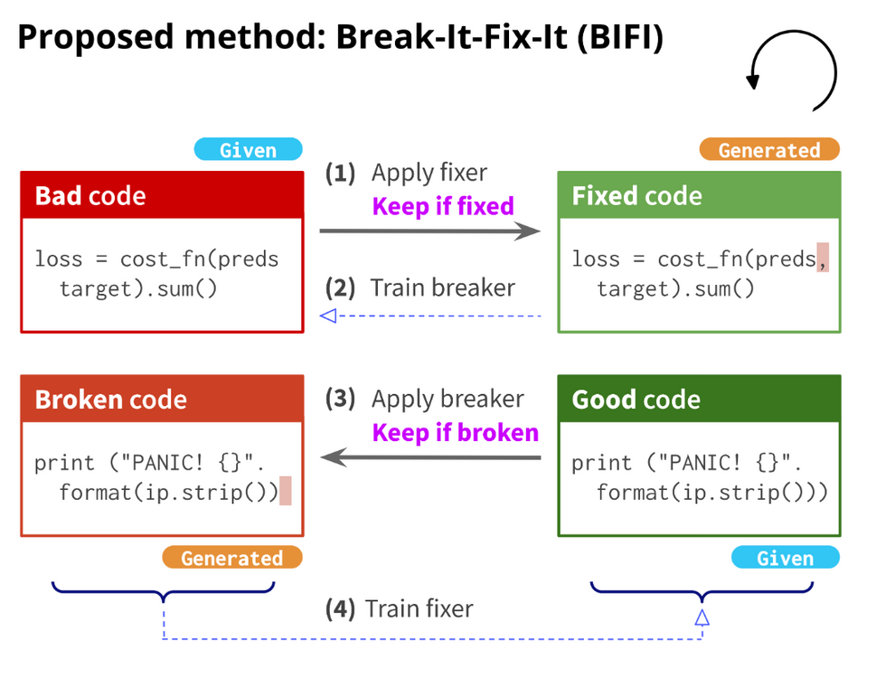
THE BIFI MODEL
0. Initialization
1. Initial Fixing:
Apply the initial fixer trained on synthetic paired data to real bad examples. Use the critic to assess the output(Round-0); keep the pairs where the output is good and correct.
2. Training the Breaker:
Train a breaker using the paired data generated in the first step. The breaker learns to generate realistic code errors based on the real bad examples.

Slide 8
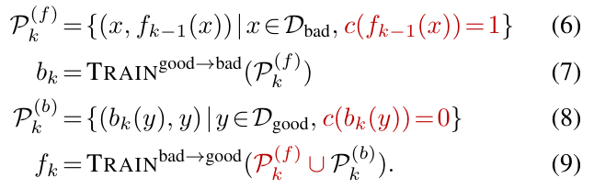
THE BIFI MODEL
3. Generating New Bad Examples:
Apply the trained breaker to good examples to create new bad examples. This step enhances the variety of errors the fixer will learn to handle.
4. Retraining the Fixer:
Train the fixer on the newly generated paired data from both the initial fixing and the breaker outputs. Improves both performances.

Slide 9
IMPLEMENTATION

Slide 10
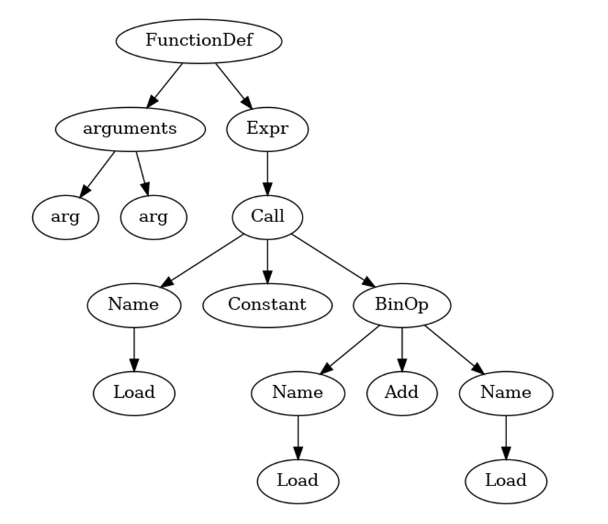
CRITIC
Error Detection: The code detects unbalanced parentheses, braces, and brackets by tracking their counts while iterating through tokens.
AST Utilization: It uses Python's ast module to parse the code into an Abstract Syntax Tree (AST), which helps identify invalid structures in the code.

Slide 11
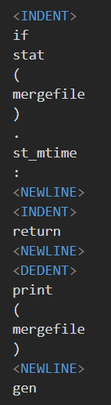
TOKENIZATION
Token Matching: Uses regular expressions to match patterns for Python syntax like keywords, identifiers, operators, and literals.
Line-by-Line Processing: Reads the Python source code line by line, skipping over comments and whitespace while generating tokens.
Encoding Detection: Reads the first two lines to determine the file's encoding as per PEP-0263.
Token Output: Produces tokens as instances of TokenInfo, each containing the token type, value, and positional information in the source.

Slide 12
FIXER AND BREAKER
Implementation: Both the fixer and breaker are trained using sequence-to-sequence models in Fairseq. The fixer corrects broken code, while the breaker generates erroneous code from correct versions.
Training Data: Both models use paired datasets, where the breaker learns from good-to-bad code pairs, and the fixer learns from bad-to-good code pairs.
Text Augmentation: Both models augment their datasets to improve robustness. The breaker creates varied "bad" code examples from "good" code, and the fixer is trained on diverse instances of "bad" code to enhance its correction capabilities.

Slide 13
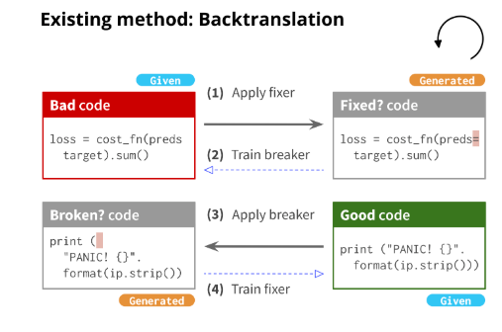
BASELINE MODEL - BACKTRANSLATION
Use of Critic: BIFI uses a critic to ensure high-quality data, while backtranslation may include noisy examples.
Training on Real Data: While backtranslation trains the fixer only on examples predicted by the breaker, BIFI trains the fixer on the real bad examples in addition to examples generated by the breaker. Improves the correctness and distributional match of training data.

Slide 14
RESULTS
Method | Our Accuracy | Paper’s Accuracy
Initial Fixer(R0) | 54.2% | 62.0%
Backtranslation (R2) | 68.3 % | 80.1 %
BIFI (R2) | 74.8% | 90.5 %
our evaluation metric
REPAIR ACCURACY
Repair Accuracy measures how effectively the fixer repairs bad code examples by calculating the ratio of successfully fixed bad examples to the total number of bad examples in the test set.
WE ACHIEVED 74.8% ACCURACY AFTER RUNNING BIFI FOR 2 ROUNDS.

Slide 15
THANK
YOU

