Slide 1
Enhancing Information Retrieval Using Topic Modelling
By-
Kavisha Madani(202318007)
Vishaka Nair(202318041)
Srushti Bhagchandani(202318047)
Shubham Gupta(202318052)

Slide 2
Problem Statement & Objective:
Problem:
The increasing volume of unstructured text data necessitates efficient retrieval methods.
Traditional text-matching techniques often overlook deeper context and topic relevance.
Objective:
The project aims to enhance information retrieval by integrating CUR decomposition for dimensionality reduction and Latent Dirichlet Allocation (LDA) for topic modeling.
Combine this with traditional information retrieval systems to offer results that are contextually aligned with the query topics.

Slide 3
Dataset:
MS Marco Dataset
(https://microsoft.github.io/msmarco/)
Reuters-21578 Dataset
(https://www.kaggle.com/datasets/thedevastator/uncovering-financial-insights-with-the-reuters-2?select=ModHayes_test.csv)
BD News Dataset

Slide 4
Flowchart
Documents
Document Preprocessing
Dimension Reduction Using CUR
Document Topic Distribution
Queries
Query Preprocessing
Topic Modelling using LDA
Topic Word Distribution
Evaluation
Document Retrieval
Vocabulary

Slide 5
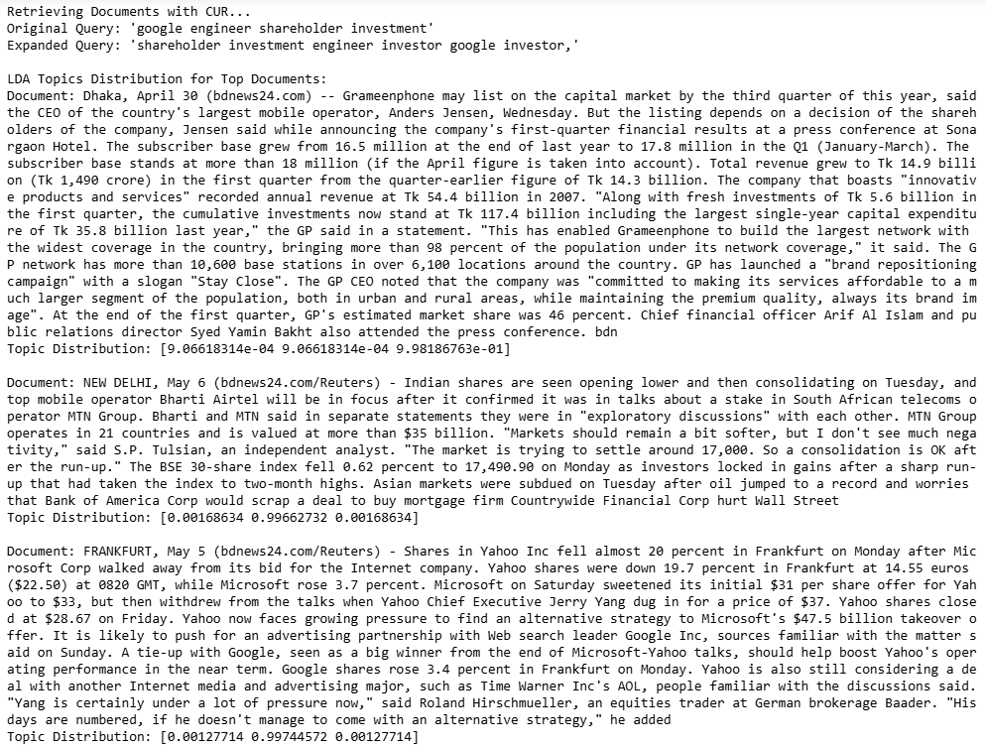
Document Retrieval Instance:

Slide 6
Evaluation:
Reuters Dataset & BD News Dataset:
Perplexity
Coherence Score
Comparison with gensim model
MS Marco Dataset:
Coherence Score
Perplexity
Precision@k
Recall@k

Slide 7
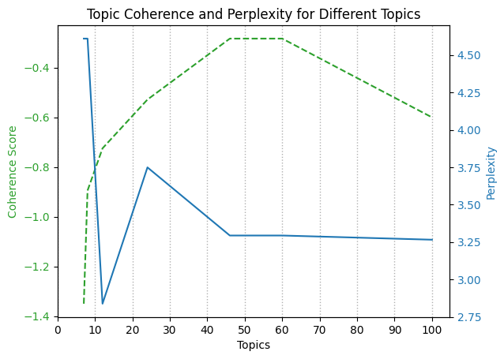
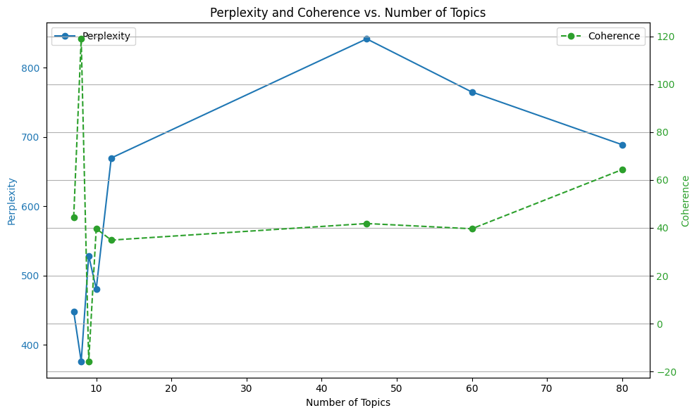
Hyper parameter tuning:
Reuters Dataset:
BD News Dataset:

Slide 8
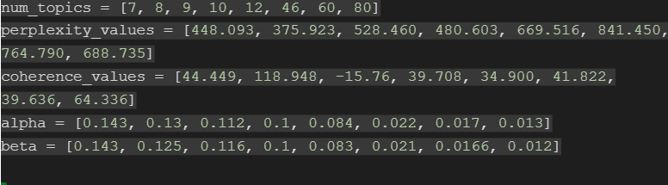
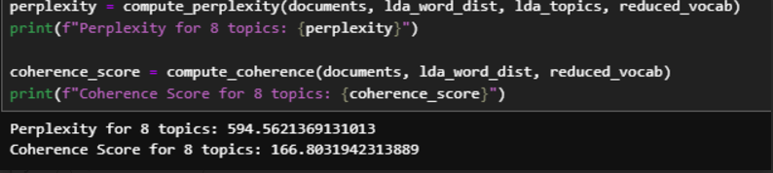
Results:
BD News Dataset:

Slide 9
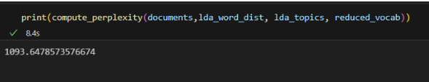
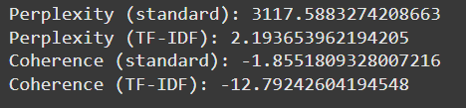
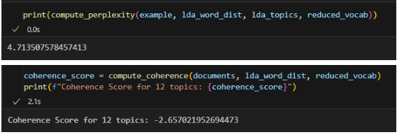
Results
Reuters Dataset:
Using LDA with CUR:
Using Gensim Library:

Slide 10
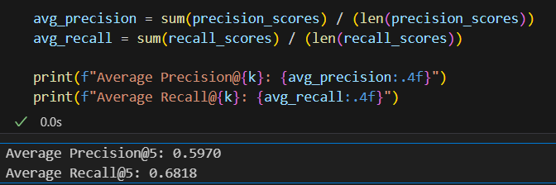
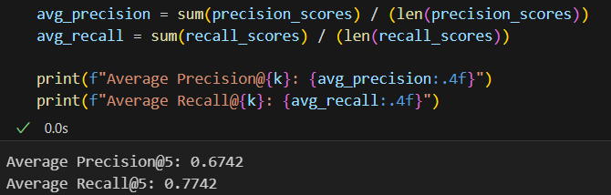
Results:
MS Marco Dataset:

Slide 11
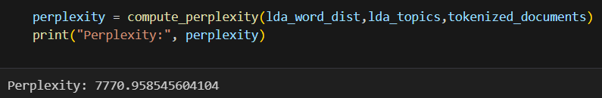
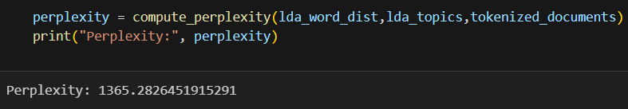
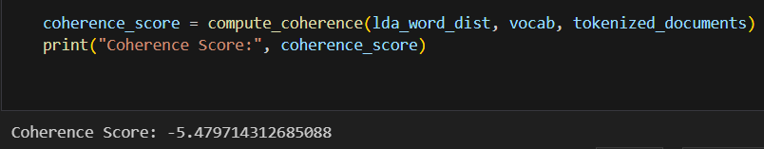
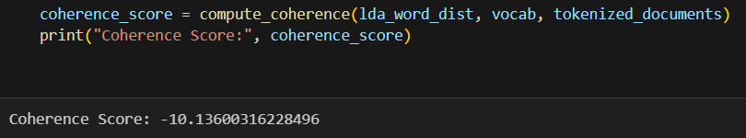
Results:
MS Marco Dataset:

Slide 12
Thank You!

